Slide 1
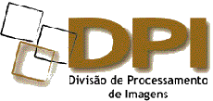
Geotecnologias livres de licença e sem restrição de uso
DPI is part of INPE’s General-Coordination on Earth Observation - OBT
40 employees: 29 doctors, 10 masters
16 fellowships
Research and development in digital image processing and geoinformatics aiming at assuring the technological domain of this segment, that is fundamental to best use of remote sensing data
http://www.dpi.inpe.br/
http://www.dpi.inpe.br/menu/Pessoal/funcionarios.php

Slide 2
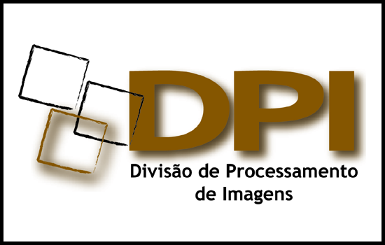
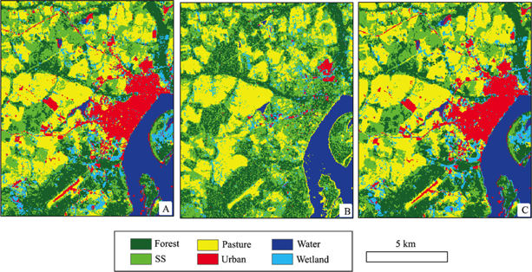
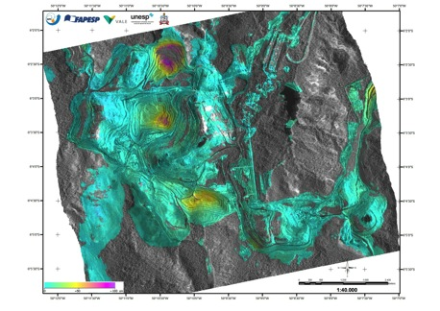
SAR Image Processing
 | SAR Radiometry and Geometry SAR Interferometry Pattern Recognition Mainly for environmental applications
 | People Fabio Gama José Claudio Mura Leonardo Bins Luciano Dutra Sidnei Sant’Anna
Polarimetry for land use / land cover studies
SAR interferometry to estimate land subsidence

Slide 3
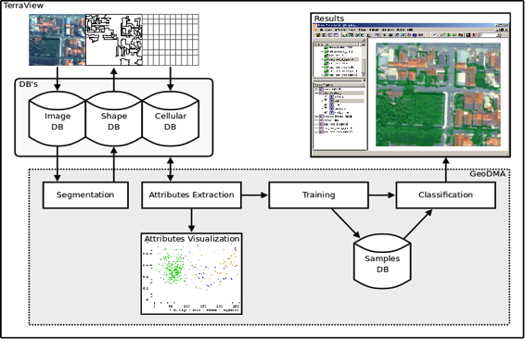
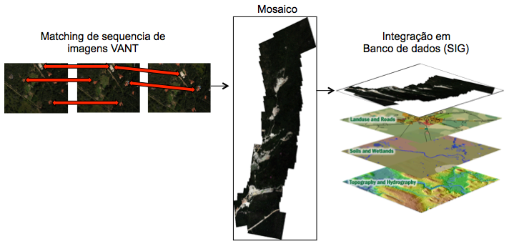
Optical Image Processing
 | Geographic object-based image analysis Image data mining Multitemporal processing
 | People Me. Emiliano Castejon Me. Guaraci Erthal Dra. Leila Fonseca Dr. Thales Korting
Geographic object-based image analysis
UAV image processing

Slide 4
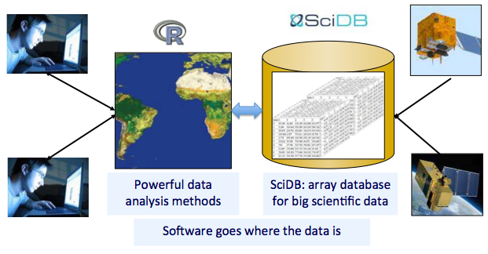
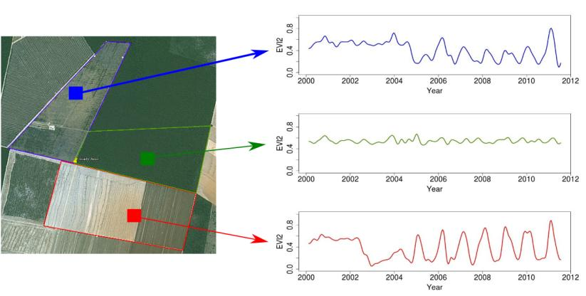
Geoinformatics – Databases
 | Geographical information systems Big Earth observation data Image time series analysis
 | People Gilberto Câmara Gilberto Queiroz Karine Ferreira Lúbia Vinhas Ricardo Cartaxo
Big data for Earth observation
Time series analysis

Slide 5
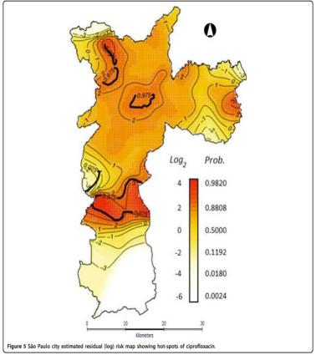
Geoinformatics – Interdisciplinary studies
 | Geographical applications in: Public health Epidemiology Hydrology Demography
 | People Antônio Miguel Monteiro Carlos Felgueiras Eduardo Camargo Jussara Ortiz
Modeling the dynamic transmission of Dengue fever
Antibiotics resistance in São Paulo city

Slide 6
Free and Open Source Software for Geo
People Carlos Felgueiras João Pedro Cordeiro Juan Garrido Lauro Hara Marisa da Motta
For detailed information search the projects pages at http://www.dpi.inpe.br/

Slide 7
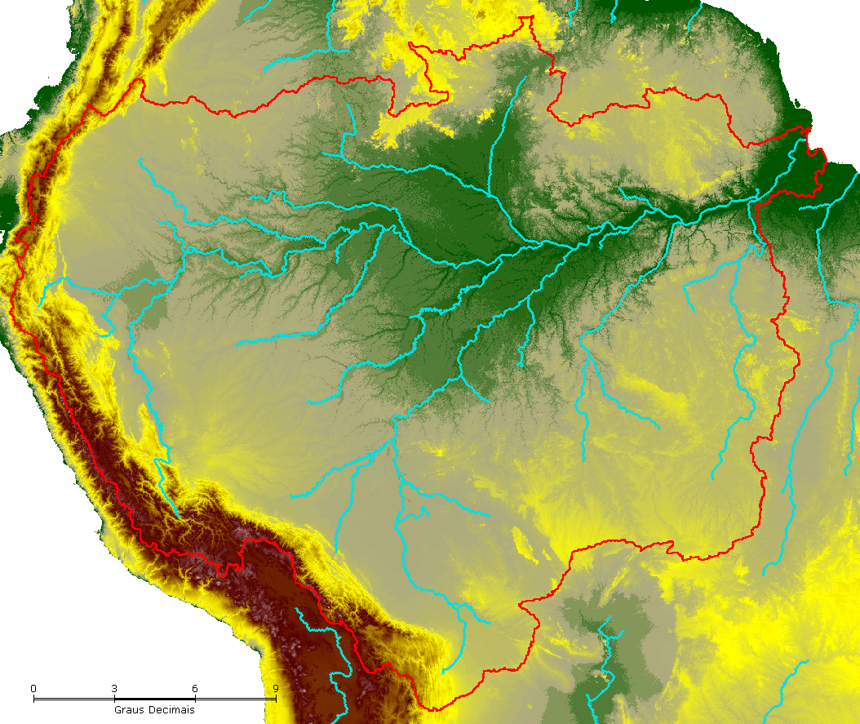
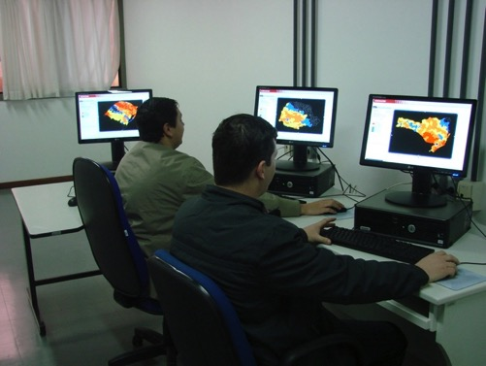
Environmental modeling
 | Hydrological monitoring Modeling of ecosystems Dynamics of wetlands Geo applications to environmental risk assessment
 | People Camilo Rennó Claudio Barbosa Eymar Lopes João Ricardo Oliveira Laércio Namikawa Sérgio Rosim Silvia Leonardi
Drainage network in Amazônia
Monitoring room using TerraMA²

Slide 8
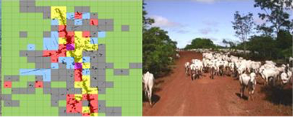
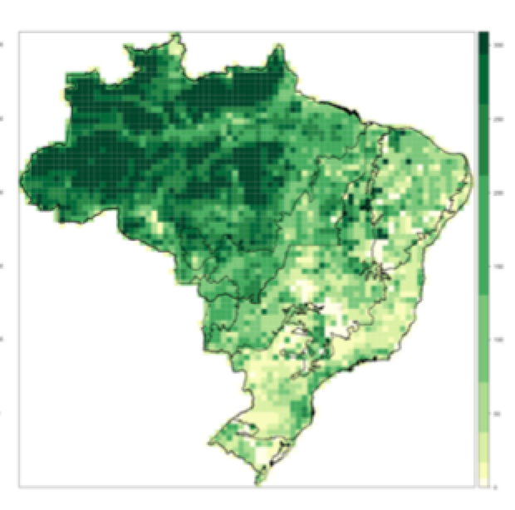
Land Use / Land Cover Change
 | Human-nature interaction Patterns and process in land use and land cover Human occupation in Amazônia Land use scenarios
 | People Antônio Miguel Monteiro Diógenes Alves Gilberto Câmara Isabel Escada Luis Maurano Silvana Amaral
Padrões de uso e cobertura na Amazônia
Projeção de florestas no Brasil para 2050

Slide 9
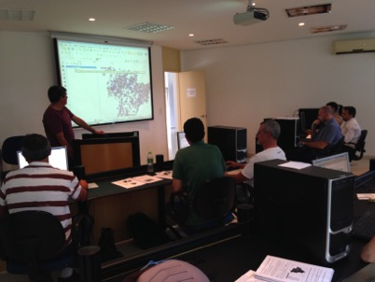
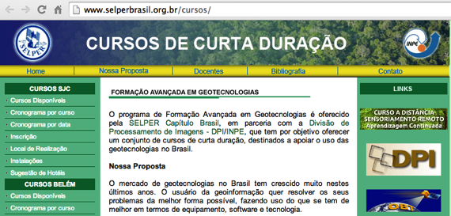
Capacity building
 | Extension courses: Geographical databases Spatial analysis SPRING TerraView TerraMA² Fundamentals of geoprocessing Digital image processing Remote sensing (distance learning)
 | People Janete Cunha Hilcea Ferreira José Carlos Moreira
TerraView training at INPE

Slide 10
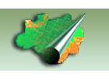
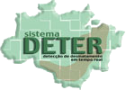
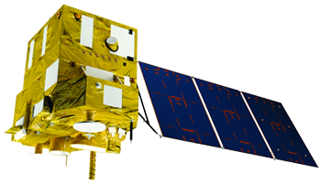
Support to INPE’s transversal programs
 | Operational activies of Amazonia Program Validation and verification User support | People Camilo Rennó Isabel Escada Luis Maurano Silvana Amaral
 | Reception Commissioning phase Mission planning Data cataloguing and dissemination | People Julio D’Alge José Bacellar Leila Fonseca Ricardo Cartaxo
 | Representing INPE in working groups and projects | People Hilcea Ferreira Leila Fonseca Lubia Vinhas
DPI Webmaster: Sueli Castellari DPI TI manager: João Diehl Adminisitrative: Regina Bruno
Amazônia Program
CBERS-4

Slide 11
Pós-graduação
49 students in co-supervision/supervision: 27 PhDs and 22 Masters
Remote Sensing
Applied Computing
Earth System Science
http://www.inpe.br/pos_graduacao/

Slide 12
Some projects
Title | Funding Duration | Contact
e-Sensing: Big Earth observation data analytics for land use and land cover change information | FAPESP 2015-2018 | Gilberto Camara
Desenvolvimento de rotinas para a extração automática de APPs – EXAPP | FINEP 2013-2015 | Sergio Rosim
TerraClass Cerrado: mapeamento do uso e cobertura da terra nas áreas já desmatadas no Bioma Cerrado para o ano de 2013 | GEF 2015 | Luis Maurano
Integration of multi-sensor and multi-scale remote sensing data for examining land use/cover disturbance at a regional scale in the Brazilian Amazon | CNPq 2012-2015 | Luciano Dutra
Energy crop management platform based on remote sensing technologies | Boeing 2014-2015 | Karine Ferreira
Avaliação de técnicas de interferometria diferencial avançada utilizando dados SAR orbitais para a detecção de instabilidade em minas de ferro a céu aberto no Quadrilátero Ferrífero (MG) | ITV Vale 2015-2017 | Fabio Furlan
URBISAmazônia: qual a natureza do urbano na Amazônia contemporânea? | ITV Vale 2012-2015 | Antonio M. Monteiro
Monitoramento ambiental por satélites no Bioma Amazônia | Amazônia Fund 2015-2018 | Leila Fonseca
These and other projects are in cooperation with OBT, other areas of INPE as CRA and CCST, and corporations and institutions in Brazil and abroad

