Slide 1
Geotecnologias livres de licença e sem restrição de uso
DPI is part of INPE’s General-Coordination on Earth Observation - OBT
40 employees: 29 PhD, 10 MSc
16 fellowships
R&D in digital image processing and geoinformatics
http://www.dpi.inpe.br/
http://www.dpi.inpe.br/menu/Pessoal/funcionarios.php

Slide 2
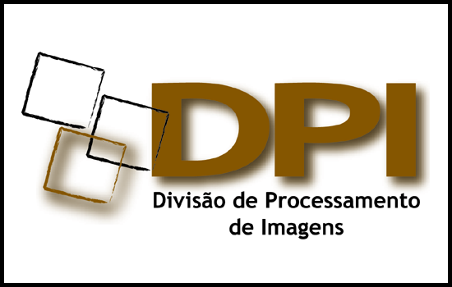
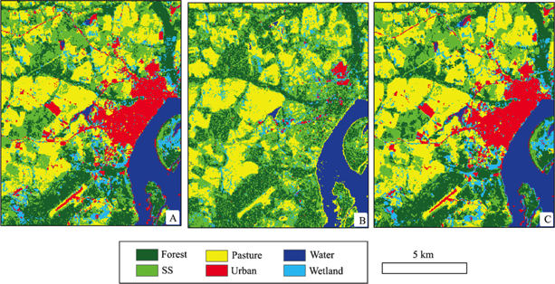
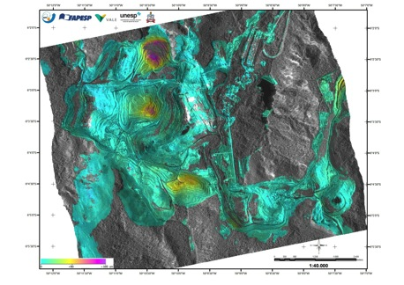
SAR Image Processing
 | SAR Radiometry and Geometry SAR Interferometry Pattern Recognition Mainly for environmental applications
 | Team Fabio Gama José Claudio Mura Leonardo Bins Luciano Dutra Sidnei Sant’Anna
Polarimetry for land use / land cover studies
SAR interferometry to estimate land subsidence

Slide 3
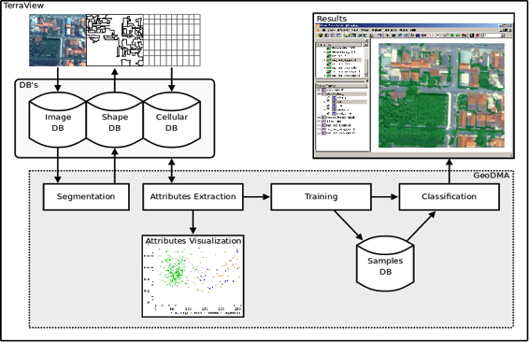
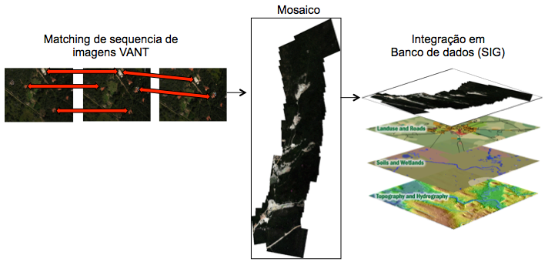
Optical Image Processing
 | Geographic object-based image analysis Image data mining Multitemporal analysis
 | Team Me. Emiliano Castejon Me. Guaraci Erthal Dra. Leila Fonseca Dr. Thales Korting
Geographic object-based image analysis
UAV image processing

Slide 4
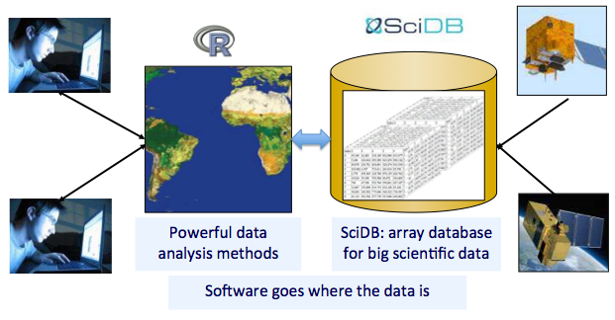
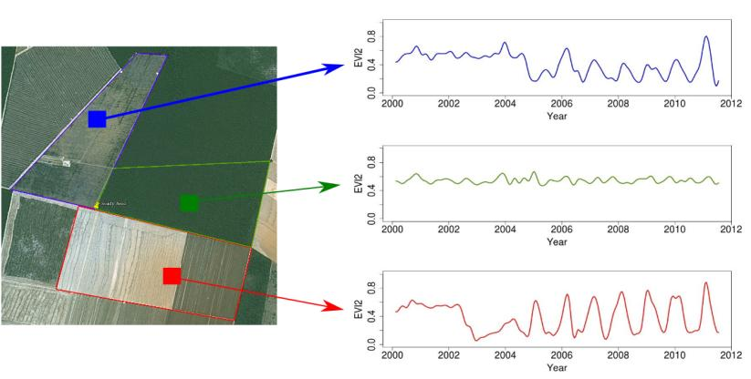
Geoinformatics – Databases
 | Geographical information systems Big Earth observation data Image time series analysis
 | Team Gilberto Câmara Gilberto Queiroz Karine Ferreira Lúbia Vinhas Ricardo Cartaxo
Big data for Earth observation
Time series analysis

Slide 5
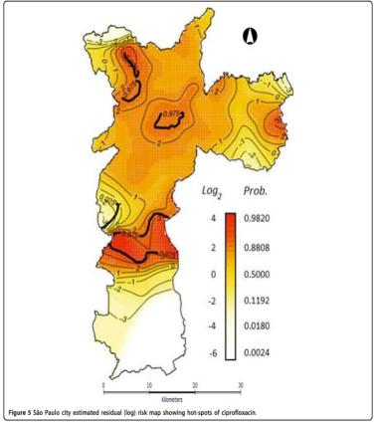
Geoinformatics – Interdisciplinary studies
 | Geoinformatics applications in: Public health Epidemiology Hydrology Spatial Demography Urban Studies
 | Team Antônio Miguel Vieira Monteiro Carlos Felgueiras Eduardo Camargo Jussara Ortiz
Modeling the dynamic transmission of Dengue fever
Antibiotics resistance in São Paulo city

Slide 6
Free and Open Source Software for Geo
Team Carlos Felgueiras João Pedro Cordeiro Juan Garrido Lauro Hara Marisa da Motta
For detailed information search the projects pages at http://www.dpi.inpe.br/

Slide 7
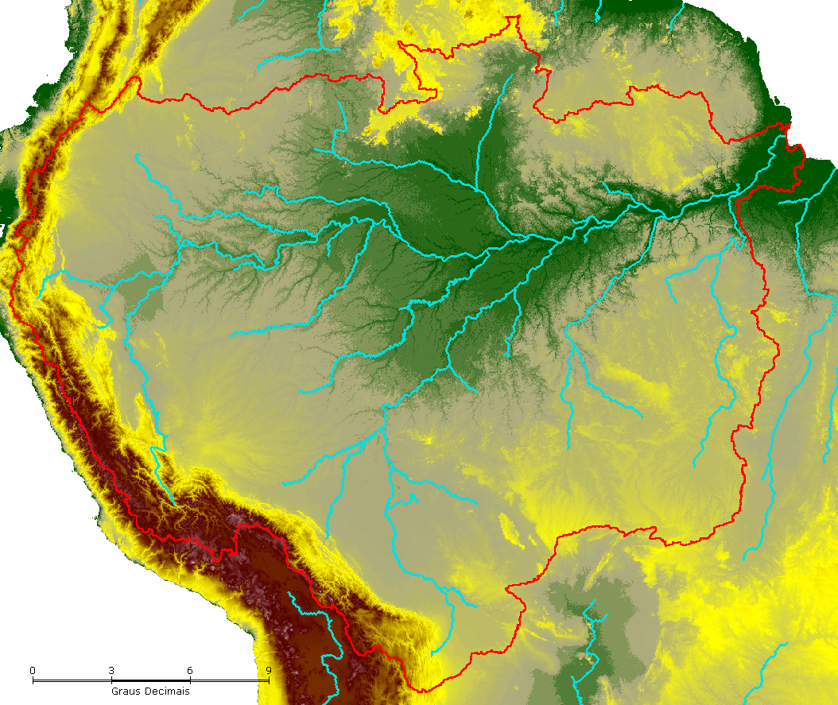
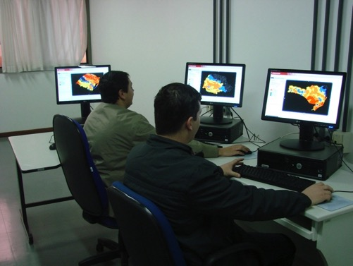
Environmental modelling
 | Hydrological monitoring Ecosystems modelling Wetlands dynamics Geoinformatics to environmental risk assessment
 | Team Camilo Rennó Claudio Barbosa Eymar Lopes João Ricardo Oliveira Laércio Namikawa Sérgio Rosim Silvia Leonardi
Drainage network in Amazônia
Monitoring room using TerraMA²

Slide 8
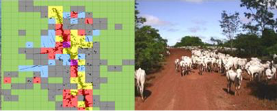
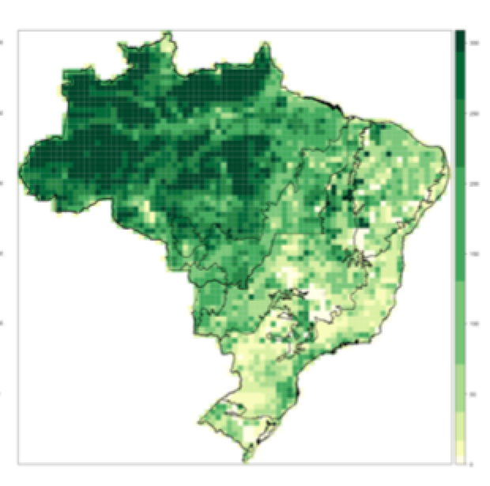
Land Use / Land Cover Change
 | Human-environment interaction Land use and land cover patterns and processes Human occupation in Amazonia Land use scenarios
 | Team Antônio Miguel Vieira Monteiro Diógenes Alves Gilberto Câmara Isabel Escada Luis Maurano Silvana Amaral
Land use and land cover patterns in Amazônia
Forest in Brazil in 2050

Slide 9
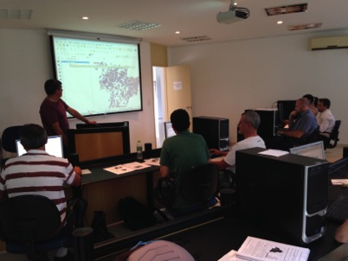
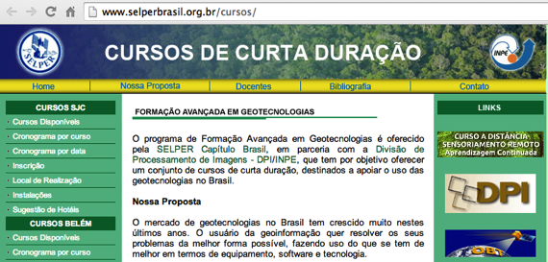
Capacity building
 | Extension courses: Geographical databases Spatial analysis SPRING TerraView TerraMA² Fundamentals of geoinformatics Digital image processing Remote sensing (distance learning)
 | Team Janete Cunha Hilcea Ferreira José Carlos Moreira
TerraView training at INPE

Slide 10
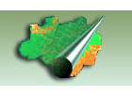
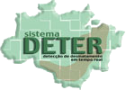
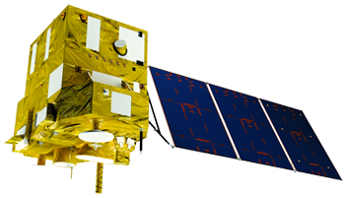
Support to INPE’s transversal programs
 | Operational activities of Amazonia Program Validation and verification User support | Team Camilo Rennó Isabel Escada Luis Maurano Silvana Amaral
 | Reception Commissioning phase Mission planning Data cataloguing and dissemination | Team Julio D’Alge José Bacellar Leila Fonseca Ricardo Cartaxo
 | Representing INPE in working groups and projects | Team Hilcea Ferreira Leila Fonseca Lubia Vinhas
DPI Webmaster: Sueli Castellari DPI TI manager: João Diehl Administrative: Regina Bruno
Amazônia Program
CBERS-4

Slide 11
Graduate studies
49 students in co-supervision/supervision: 27 PhDs and 22 Masters
Remote Sensing
Applied Computing
Earth System Science
http://www.inpe.br/pos_graduacao/

Slide 12
Some projects
Title | Funding Duration | Contact
e-Sensing: Big Earth observation data analytics for land use and land cover change information | FAPESP 2015-2018 | Gilberto Camara
Desenvolvimento de rotinas para a extração automática de APPs – EXAPP | FINEP 2013-2015 | Sergio Rosim
TerraClass Cerrado: mapeamento do uso e cobertura da terra nas áreas já desmatadas no Bioma Cerrado para o ano de 2013 | GEF 2015 | Luis Maurano
Integration of multi-sensor and multi-scale remote sensing data for examining land use/cover disturbance at a regional scale in the Brazilian Amazon | CNPq 2012-2015 | Luciano Dutra
Energy crop management platform based on remote sensing technologies | Boeing 2014-2015 | Karine Ferreira
Avaliação de técnicas de interferometria diferencial avançada utilizando dados SAR orbitais para a detecção de instabilidade em minas de ferro a céu aberto no Quadrilátero Ferrífero (MG) | ITV Vale 2015-2017 | Fabio Furlan
URBISAmazônia: qual a natureza do urbano na Amazônia contemporânea? | ITV Vale 2012-2015 | Antonio M. Monteiro
Monitoramento ambiental por satélites no Bioma Amazônia | Amazônia Fund 2015-2018 | Leila Fonseca
These and other projects are in cooperation with OBT, other areas of INPE as CRA and CCST, and corporations and institutions in Brazil and abroad

