Slide 1


Slide Template for
Scientific Presentations
Michael Alley
College of Engineering
Penn State
March 16, 2007
Notes:
This file is a template for making effective slides for scientific presentations.* Although much about the layout and typography contrasts sharply with the defaults of PowerPoint, these changes are done so to make the slides more effective at communicating technical information. The design advocated by this template arises from pages 113-152 of The Craft of Scientific Presentations (Springer, 2003). The homepage for this and other similar templates exist at the following web site:
http://writing.eng.vt.edu/slides.html
Right now you are viewing the notes pages. To work on the slides, click on “Slide” under “View.”
Reference slide: Katrina Aspmo, Torunn Berg, and Grethe Wibetoe, “Atmospheric Mercury Depletion Events (AMDEs) in Polar Regions During Arctic Spring,” presentation (Oslo, Norway: University of Oslo, 16 June 2004).
___________________________________________
*You are more than welcome to use this template for your presentation slides. You may not, though, distribute this template for profit or distribute this template without giving credit to the source.

Slide 2
Title of Presentation:
32 or 36 Points, Calibri Bold
Key image for introducing talk’s scope, importance, or background
Name
Name
Name
Department
Institution
Date
Logo
Notes:
This slide template is for the title slide of a presentation. Consider repeating a key image from one of the slides later in the presentation. The image helps orient the audience to the key words in the title. This image also gives you the opportunity to say a few things about your work—perhaps addressing the work’s importance or providing key background information. Forcing yourself to spend more time with this slide is good because a common mistake in presentations is not to leave the title slide on long enough. Because of this mistake, many in the audience do not have the chance to comprehend the key details of the title. See pages 66, 69-71, and 177 of The Craft of Scientific Presentations (CSP).
This template shows one layout for the slide. You might want to rearrange the placement of the body’s wording to accommodate a different sized image.

Slide 3
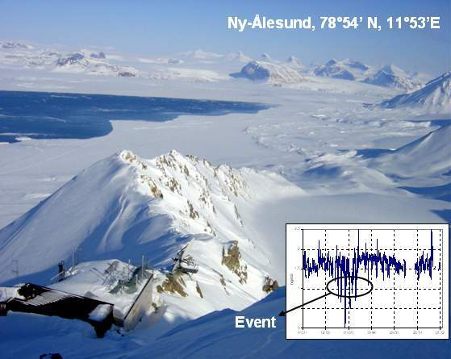


Atmospheric Mercury Depletion Events in Polar Regions During Arctic Spring
Ny-Ålesund, 78°54’ N, 11°53’E
Katrine Aspmo
Torunn Berg
Norwegian Institute for
Air Research
Grethe Wibetoe
University of Oslo,
Dept. of Chemistry
June 16, 2004
Event
Notes:
Sample title slide.
Reference:
Katrina Aspmo, Torunn Berg, and Grethe Wibetoe, “Atmospheric Mercury Depletion Events (AMDEs) in Polar Regions During Arctic Spring,” presentation (Oslo, Norway: University of Oslo, 16 June 2004).

Slide 4
This presentation focuses on… (complete sentence, but go no more than two lines)
Image for
Topic 1
Topic 1
Image for
Topic 2
Topic 2
Image for
Topic 3
Topic 3
Logo
Notes:
Mapping slide for the presentation (note that a background slide or a slide justifying the importance might precede this slide). A common mistake with mapping slides is to give the audience simply a boring and unmemorable vertical list of topics (including the names “Introduction” and “Conclusion” and “Questions”). Such a list is quickly forgotten after the slide is removed.
On a mapping slide, take the opportunity to show a key image or perhaps a representative image for each major section of the presentation. In the second case, each image would be repeated on the first visual of the corresponding section and would remind the audience that they have arrived to a major section of the presentation’s middle.
In regards to the names “Introduction” and “Conclusion,” every talk has those sections, and the names are ignored by audiences. So why state them? Also, for the divisions that you do have, find a logical and parallel grouping. Note that groups of two’s, three’s, and four’s are much easier to remember and are not so nearly intimidating as groups of five’s, six’s, and seven’s. See the example mapping slide in the textbook. (CSP, pages 55-56, 74-75, 86, 143, 147, and 148)

Slide 5
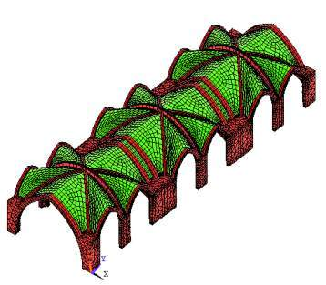
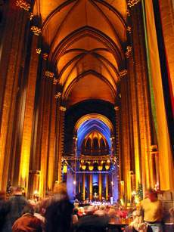
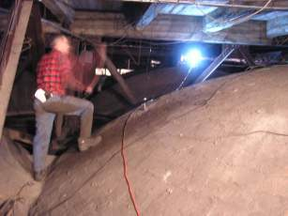
This talk shows the validation of numerical models with experimental data
Numerical
Tools
Importance of Research
Experimental
Tools
Cathedral of Saint John
the Divine in New York
Photo Credit: http://peterkaminski.com
Photo Credit: S. Atamturktur
Notes:
Sample mapping slide that maps three sections of presentation. Notice that the presenters wrote a sentence headline that restates the presentation’s scope. Notice also that the presenters have shown the connections among the three sections of the talk—connections that bullets cannot make.
Reference:
Sezer Atamturkur and Thomas E. Boothby, “When Can a Historic Masonry Monument Be Left Without Repair?” presentation (State College, PA: Pennsylvania State University, 27 November 2006).

Slide 6
This sentence headline makes an assertion on the first topic: 28 points, no more than two lines
Image(s)
supporting
above assertion
If necessary, identify key assumption or background for audience—keep to two lines (18–24 point type)
Logo
Notes:
Sample body slide from the first section of the presentation’s middle. Consider having the first-topic image from the mapping slide repeated here. Use the headline (no more than two lines) to make an assertion about this topic. In the body of the slide, support that headline with images and with words, if necessary. See CSP, pages 116-117 and 147-151.
This slide shows one orientation for the image and text in the body of the slide. Other orientations appear in this template. Choose the one that best supports your headline assertion.

Slide 7
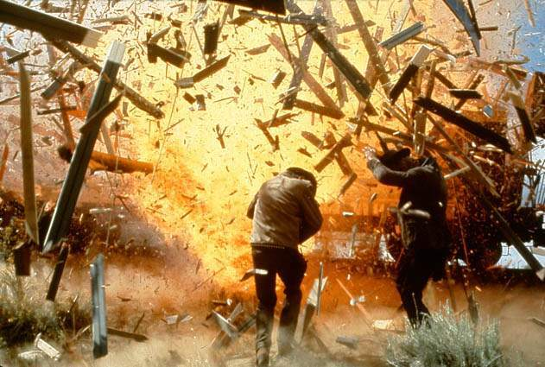
Fragments quickly outpace the blast wave, and become the primary hazard to personnel/materiel
5
Notes:
Sample slide from second section of the presentation’s middle. The image was such that there was no need for subordinate descriptions.
Reference:
Reference slide: Jared Rochester, “Three Primary Products of an Explosive,” presentation (Aberdeen, MD: US Army Research Laboratory, 5 December 2005).

Slide 8
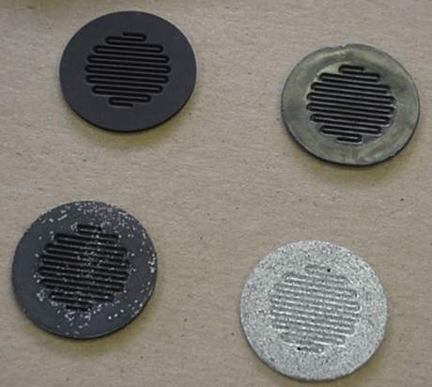
Composite materials are ideal for bipolar plates
Advantages
  Easy to shape
  Light in weight
  Resistant to corrosion
Disadvantages
  Low conductivity
  High cost (at present)
Notes:
Sample slide from the presentation’s middle. The photograph from the lower right hand corner is from the mapping slide and indicates the section of the middle in which the presenter is in. It just so happens that the image on this slide is the same.
Reference:
Kevin Desrosiers, “Evaluation of Novel and Low Cost Materials for Bipolar Plates in PEM Fuel Cells,” master’s thesis presentation (Blacksburg, VA Mechanical Engineering Department, August 2002).

Slide 9
This sentence headline makes an assertion on the second topic: 28 points, no more than two lines
Call-out, if necessary: keep to one or two lines
Call-out, if necessary: keep to one or two lines
Image or equations supporting
the headline assertion
Call-out, if necessary: keep to one or two lines
Logo
Notes:
Sample body slide from the second section of the presentation’s middle. For the first body slide of this second section, consider repeating the corresponding image (or equation) from the mapping slide. Use the headline to make an assertion about this topic. In the body of the slide, support that headline assertion with images and with words, if necessary. See CSP, pages 116-117 and 147-151.
This slide shows one orientation for the image and text in the body of the slide. Other orientations appear in this template. Choose the orientation that best supports your headline assertion.

Slide 10
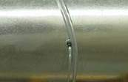
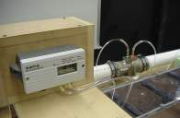

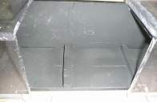

Normalized friction factors and Nusselt numbers correlated our data with the data of others
Pressure Taps
Venturi Meter
Voltmeter
Thermocouples
Pressure Drop
Reynolds Number
Heat Flux, q˝
T_{inlet}
T_{wall}
T_{bulk}
h
Friction Factor, f
Nu_{o}, f_{o}
Nu
Notes:
Sample slide from the middle of a presentation. Notice how animation works to allow the speaker to present fairly complex connections in a way that the audience can digest. Notice how the arrows show connections—something that bullets could not achieve.
Reference
This slide is a composite slide from a number of mechanical engineering seniors in ME 4006, a laboratory course at Virginia Tech. These presentations occurred during the Fall 2004 semester.

Slide 11
In pseudospectral methods some operations are carried out in Fourier space
Physical space
Fourier space
Change of variable to eliminate linear terms
FFT (spatial)
Apply filters to specific wavelengths
Compute m’th spatial derivative by multiplying with (ik)^{m}
IFFT
March one time step with Runge Kutta
Reverse change of variable
Notes:
Sample slide from the middle of a presentation. Notice how animation works to allow the speaker to present fairly complex connections in a way that the audience can digest. Notice how the arrows show connections—something that bullets could not achieve.
Reference
Håvard Holmås, “Pseudospectral Numerical Methods for Modelling of Waves in Pipe Flow,” presentation (Kjeller, Norway: Institute for Energy Technology, 27 September 2006).

Slide 12
This sentence headline makes an assertion on the third topic: 28 points, no more than two lines
Image supporting above assertion
Supporting point, if needed
Supporting point, if needed: parallel to first point
Logo
Notes:
Sample body slide from the third section of the presentation’s middle. For the first body slide of this third section, consider repeating the corresponding image from the mapping slide. Use the headline to say state an assertion about this topic. In the body of the slide, support that headline with images and with words, if necessary. See CSP, pages 116-117 and 147-151.
This slide shows one orientation for the image and text in the body of the slide. Other orientations appear in this template. Choose the orientation that best supports your headline assertion.

Slide 13
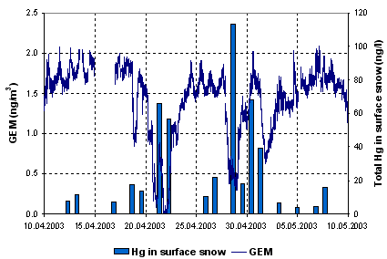
Our work shows that atmospheric mercury depletion events lead to increased mercury in surface snow
Notes:
Sample slide from second section of the presentation’s middle. The image was such that there was no need for supporting text.
Reference:
Katrina Aspmo, Torunn Berg, and Grethe Wibetoe, “Atmospheric Mercury Depletion Events (AMDEs) in Polar Regions During Arctic Spring,” presentation (Oslo, Norway: University of Oslo, 16 June 2004).

Slide 14
In summary, this sentence headline states the most important assertion of the presentation
Image that supports conclusion
Supporting point (no more than two lines)
Another supporting point (parallel to the first)
Questions?
Logo
Notes:
Conclusion slide. Use the headline (no more than two lines) to state your most important conclusion. Begin the headline with In summary or In conclusion to ensure that the audience knows they have come to the presentation’s end. Support that headline with an image and parallel points.
This slide should be your last slide. Audiences lose patience when they believe that they have come to the end, but other slides follow.
Notice that the word Questions appears at the bottom of this slide. That strategy is much more effective than burning a slide with just the word Questions. This slide allows the audience to look at the most important slide of the presentation during the question period. See CSP, pages 65, 150, 151-152.

Slide 15

In summary, the unit failed because of a short-circuit created by abrasion of wire insulation
Wires not harnessed to prevent contact with housing
Wire abraded against housing, exposing conductor
Short circuit to ground created where wire contacted housing
Questions?
Notes:
Conclusion slide. Use the headline (no more than two lines) to state your most important conclusion. Begin the headline with In summary or In conclusion to ensure that the audience knows they have come to the presentation’s end. Support that headline with an image and with words, if necessary.
This slide should be your last slide. Audiences lose patience when they believe that they have come to the end, but other slides follow.
Notice that the word Questions animates in at the bottom of this slide. That strategy is much more effective than burning a slide with just the word Questions. This slide allows the audience to look at the most important slide of the presentation during the question period. See CSP, pages 65, 150, 151-152.
Notice how the presenter showed the connections between words blocks on this slide—a strategy that is much more effective than a bullet list, which hides the connections between details.
Reference:
Manning Seltzer, “Failure Analysis of the Ice Detector in the Austria 13 Helicopter,” presentation (Hartford, CT: Sikorsky Helicopter, 30 April 2004).

