Slide 1
Introduction to Geoinformatics: Geographical Fields
Gilberto Camara

Slide 2
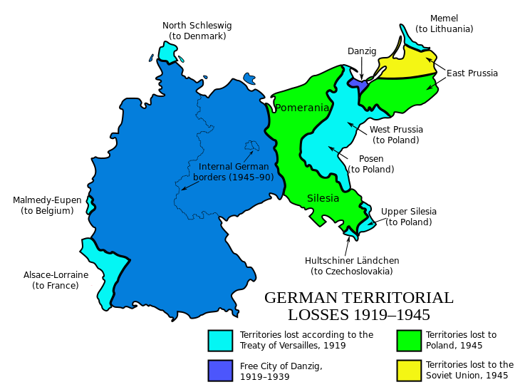
Social objects

Slide 3
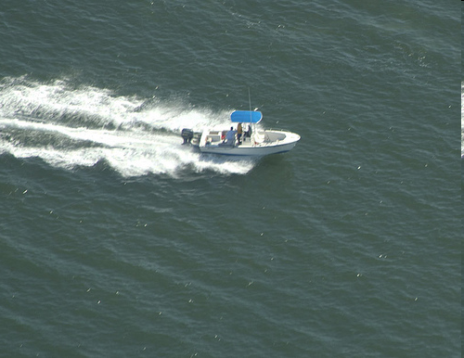
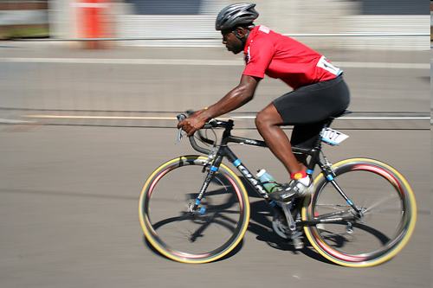
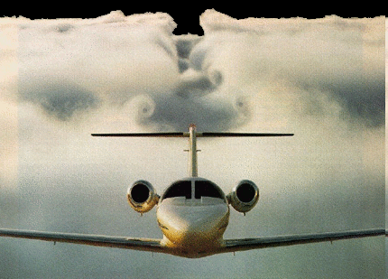
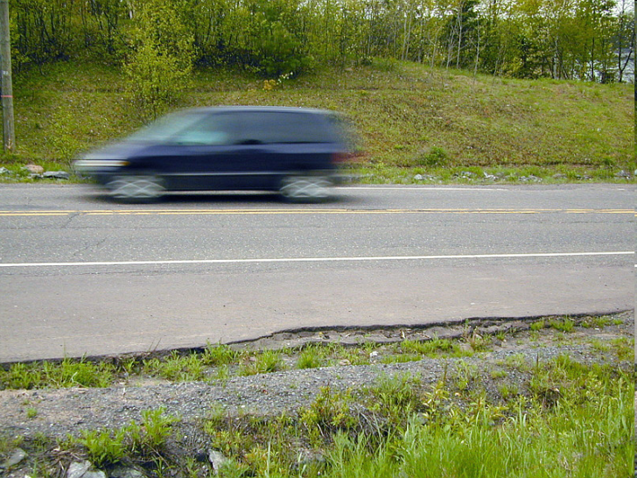
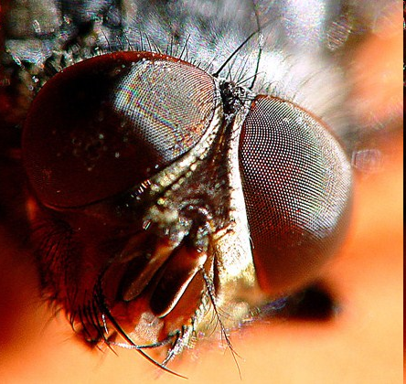
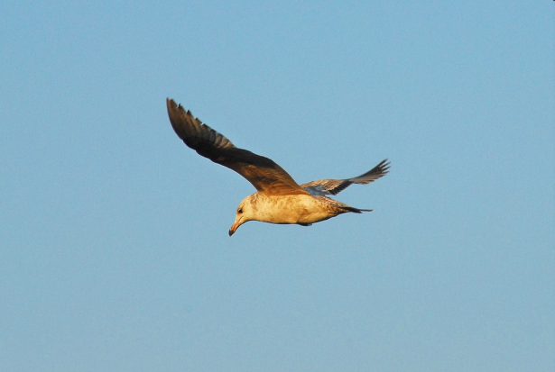
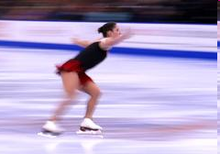
Moving objects
MOVING OBJECTS
Objects whose position and extent change continuously

Slide 4
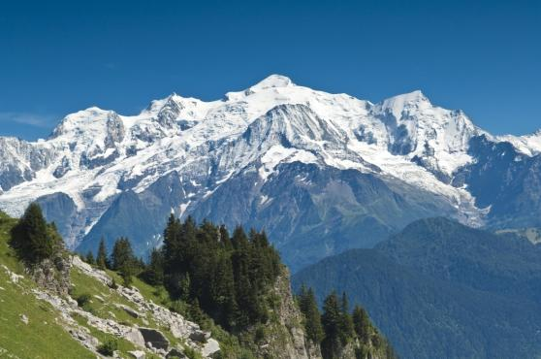
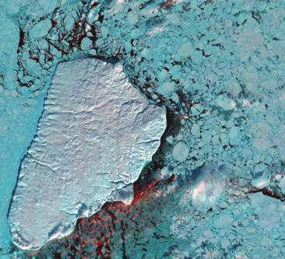
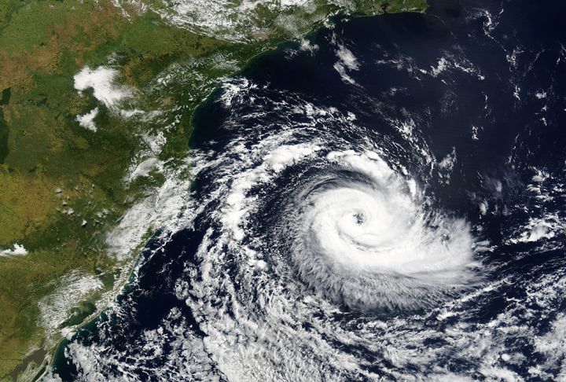
Natural objects
Humans identify natural objects by convention

Slide 5
A catch-all concept in geospatial ontologies
”Amazon
forest”
”Barack
Obama”
”Linux”
Object
”Mont Blanc”
”hurricane
Katrina”
”Germany”
”Artic ice”
”Adige
river”

Slide 6
What’s in an geospatial object?
Object
Spatiotemporal
support
Observable
properties
Inferred
properties

Slide 7
What’s in an geospatial object?
Object
Spatiotemporal
support
Observable
properties
Inferred
properties
ObsFunction
EstimFunction

Slide 8
What’s in an geospatial object?
 | ST support | Property
”Amazon forest” | XIX Century Amazon biome | Existence of a tree coverage
”Linux” | Physical boundaries of the dog | Current location of the dog
”Germany” | Boundaries of FDR | Sovereignty over a territory
”Pacific Ocean” | Agreed limits by convention | Sea surface temperature

Slide 9
What’s in an geospatial object?
Object
Spatiotemporal
position
Observed
values
Inferred
values
ObsFunction
EstimFunction

Slide 10
What’s in an geospatial object?
Object
properties

Slide 11
What’s in an geospatial object?
Object
properties
Fields

Slide 12
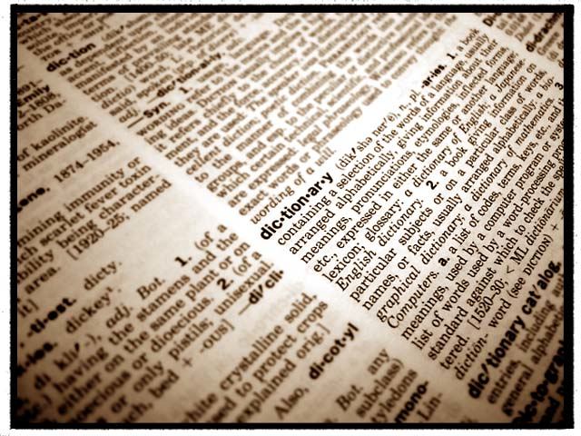
It all begins with observations…
What’s out there?
We use words in our language to describe the world

Slide 13
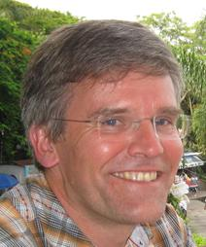
Everything starts with measurements (Kuhn)
“All information ultimately rests on observations, whose semantics is physically grounded in processes and mathematically well understood. Exploiting this foundation to understand the semantics of information derived from observations would produce more powerful semantic models”.

Slide 14
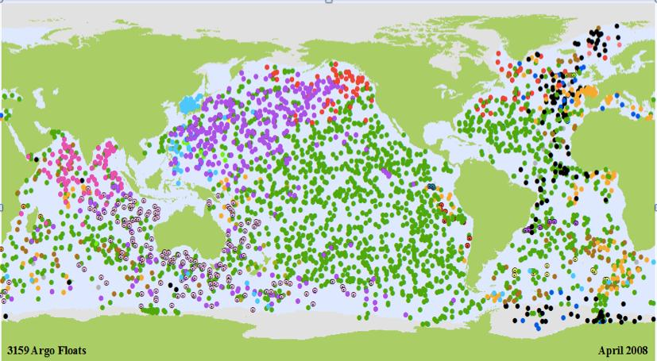
We measure properties of the world
Observations allow us to sense external reality

Slide 15
An observation is a measure of a value in a location in space and a position in time

Slide 16
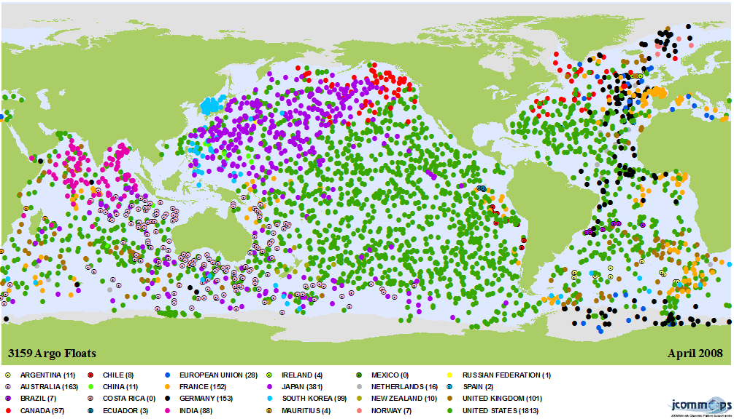
Observations
Observation : (S,T,V)
A triple (space, time, value)

Slide 17
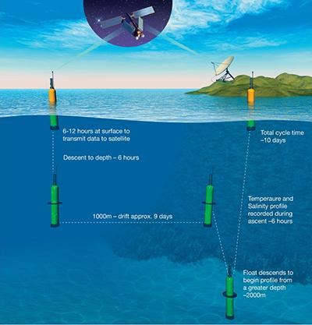
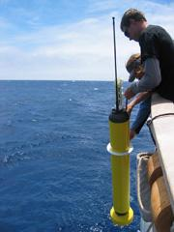
ARGO buoys: innovative technology
Sensors measure down to 2,000 m, 10-Day Cycle
images source: NOAA
Floating buoys measuring properties of the oceans

Slide 18
Premise 1: Reality exists independently of human representations and changes continuously

Slide 19
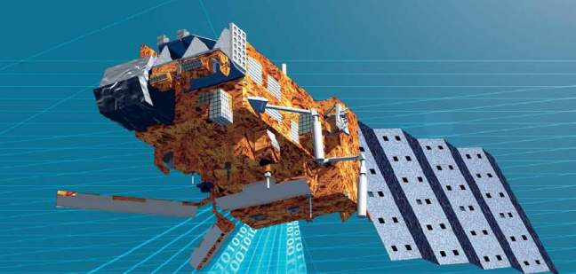
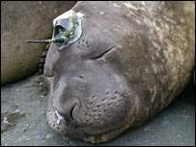
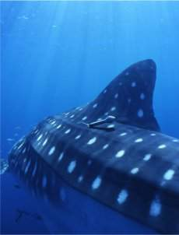
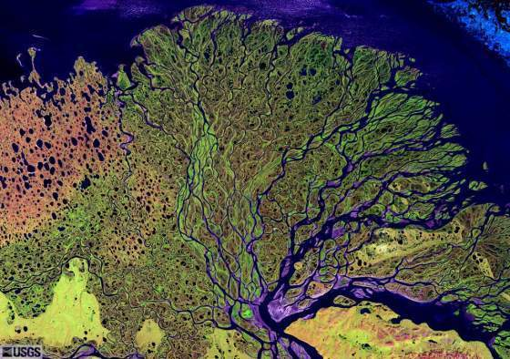
Premise 2: We have access to the world through our observations

Slide 20
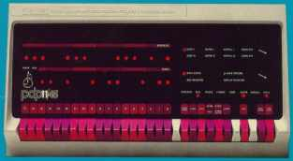
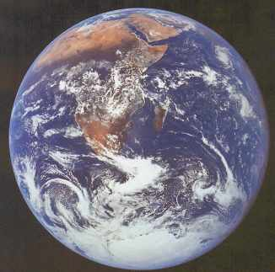
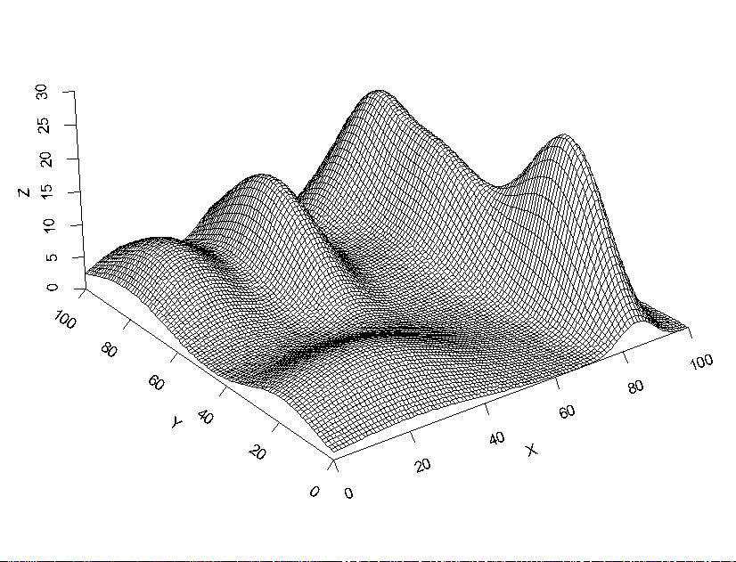
Premise 3: Computer representations of space and time should approximate the continuity of external reality

Slide 21
Natural world has continuous spatial variation
Temperature, Water ph, soil acidity...

Slide 22
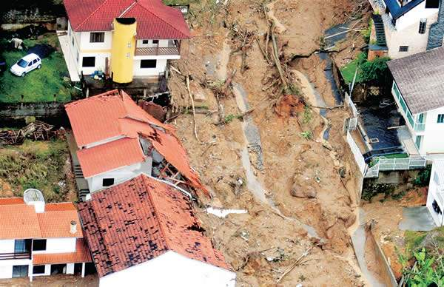
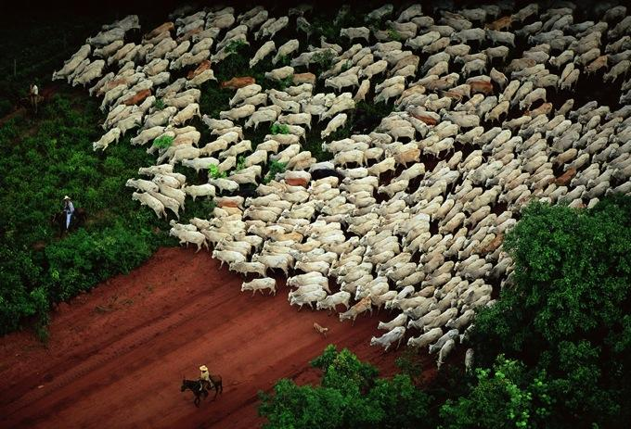
Conjecture 1: Ontologies for space-time data should be as generic as possible
Geo-objects have spatio-temporal properties

Slide 23
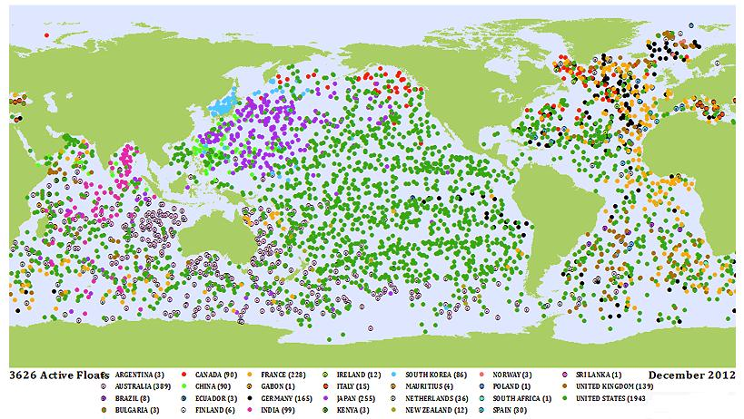
Conjecture 2: Spacetime ontologies need observations as their building blocks
An observation is a measure of a property in space-time

Slide 24
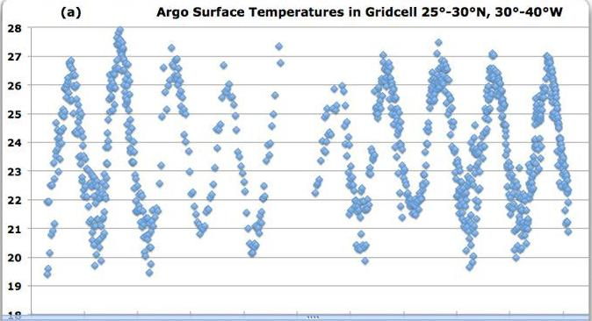
Conjecture 3. Sensors only provide samples of the external reality
Willis Eschenbach
To represent the continuity of world, we need more!

Slide 25
Conjecture 4: Approximating external reality needs space-time data samples and estimators
Willis Eschenbach
temp = (2 + sin(2 π* (julianday + lag)/365.25)) ˆ1.4

Slide 26
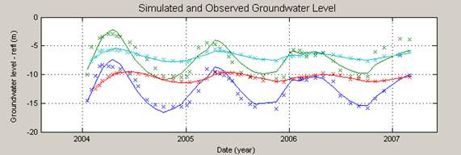
Conjecture 5: Fields = Sensor data + Estimators
A field estimates values of a property for all positions inside its extent
(fields simulate the continuity of external reality)

Slide 27
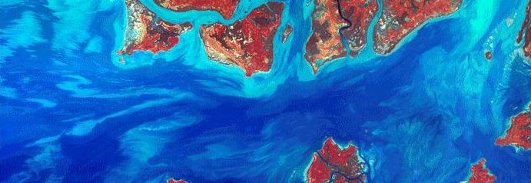
Fields as a Generic Data Type
estimate: Position → Value
Positions at which estimations are made
Values that are estimated for each position

Slide 28
Fields as a Generic Data Type
estimate: Position → Value
Positions are generic locations is space-time
Values are generic estimates for each position

Slide 29
Fields as a Generic Data Type
estimate: Position → Value
Instances of Position: space, time, and space-time
Instances of Value: numbers, strings, space-time

Slide 30
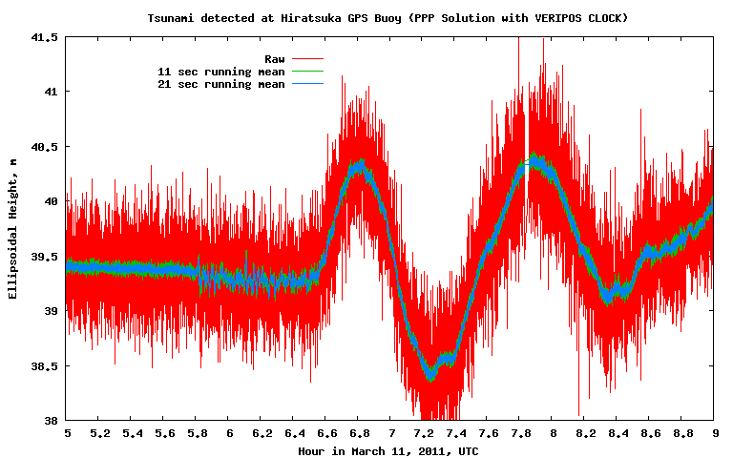
A time series field (tsunami buoy)
image: Buoy near the coast of Japan
positions: time values: wave height
An Australian Geoscience Data Cube

Slide 31
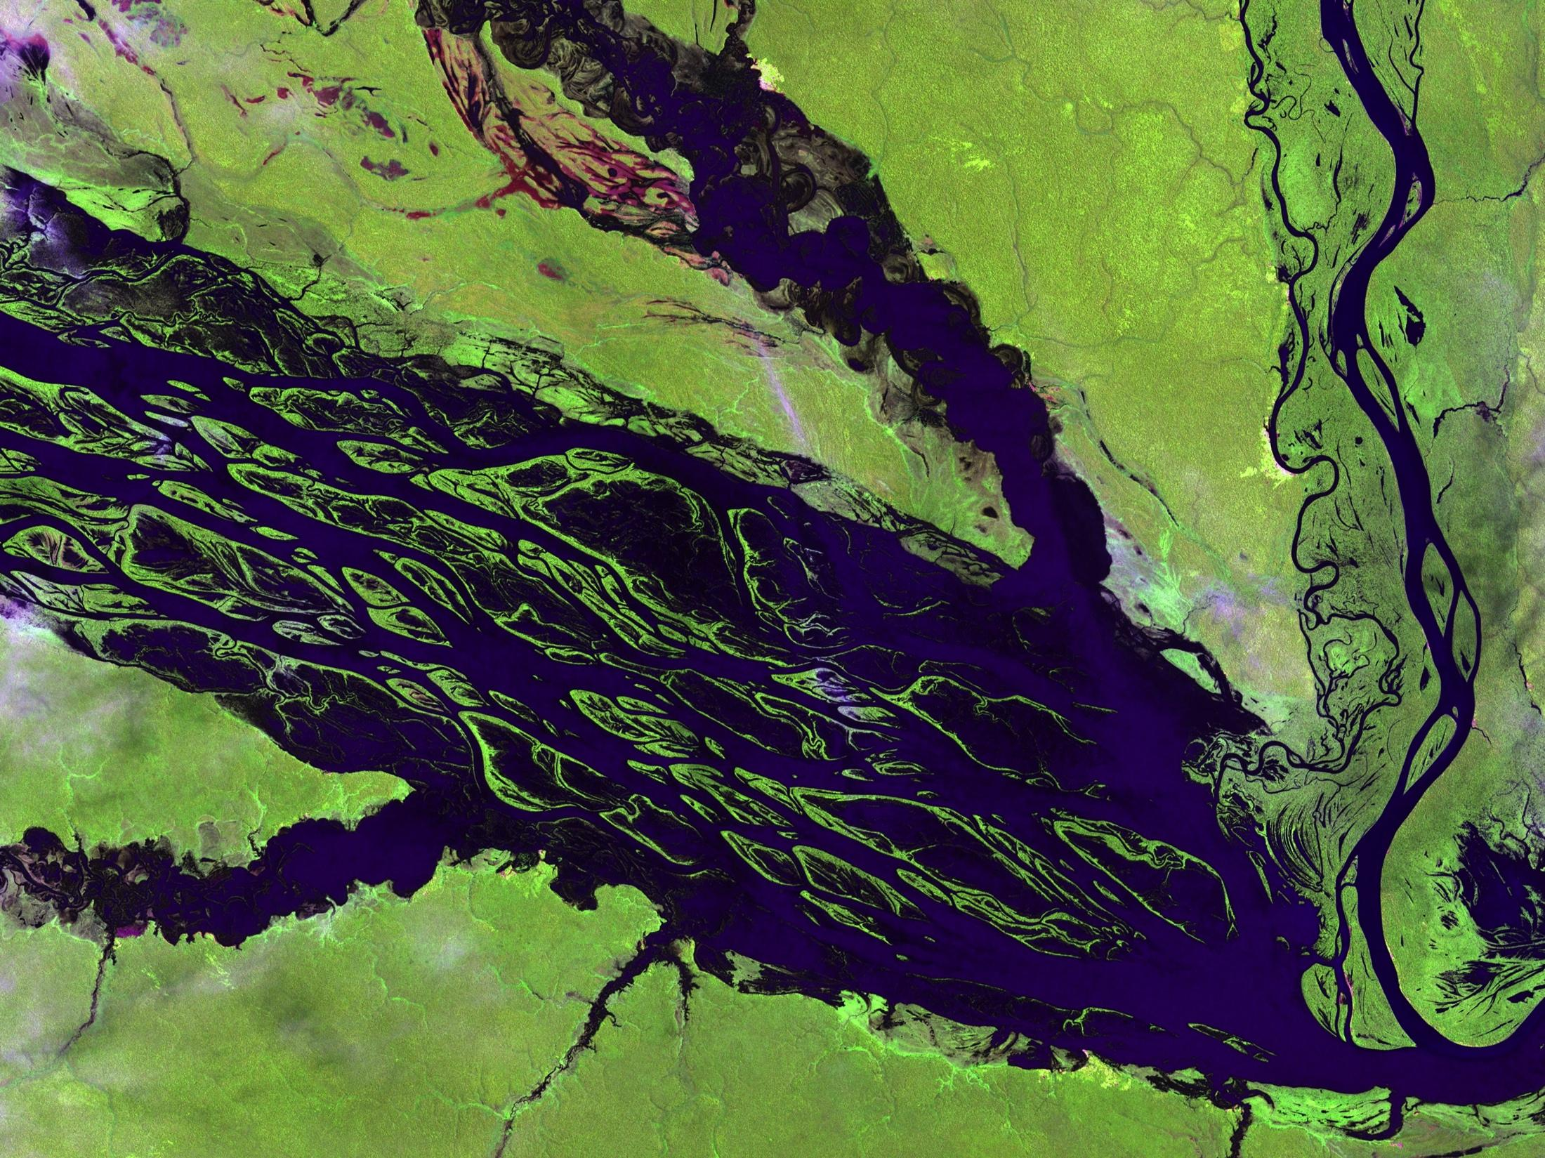
A coverage field (remote sensing image)
image: USGS
positions: 2Dspace values: soil reflectance
An Australian Geoscience Data Cube

Slide 32
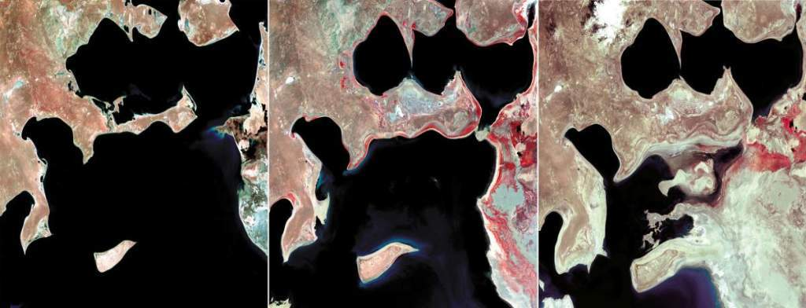
A field of fields
images: USGS
positions: time values: coverages (2DSpace number)
coverage set
An Australian Geoscience Data Cube

Slide 33
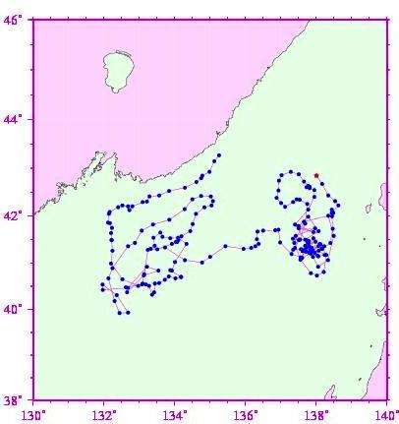
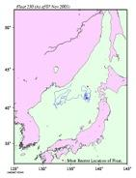
A trajectory field
Russia
• 8/8/99
Argo float UW 230
deployed 02.08.1999
10-day interval data
until 07.11.2003
• 11/7/03
Japan/East Sea
source: Stephen Riser
University of Washington
Japan
positions: time values: space

Slide 34
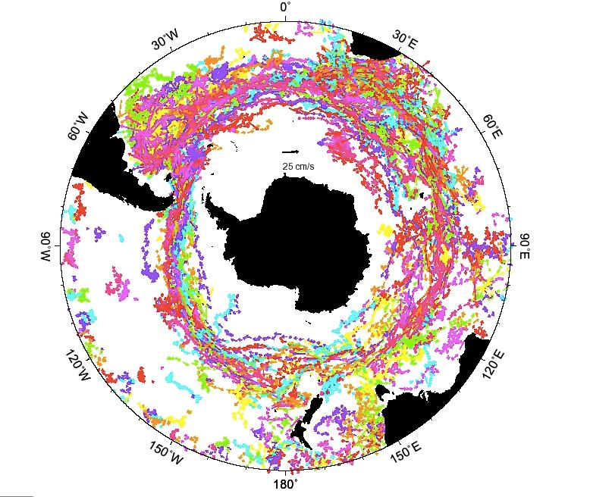
A field of fields (Argo floats in Southern Ocean)
Positions: space Values: trajectories (time  space)

Slide 35
A space-time field extracted from float data
Positions: space-time Values: water temperature

Slide 36
Different choices for spatial estimators: same data source, different fields
Observations
of soil profiles
Geostatistics
Gravitational
Voronoi
Notes:
Parte 1: definições, conceitos, os quatro universos de representação, modelagem de dados;
Parte 2: estrutura dual, bancos de dados relacionais, consulta espacial;
Parte 3: aspectos interdisciplinares, modelagem matemática, integração de dados, generalização;
Parte 4: principais operadores, álgebra de mapas, LEGAL, menus e formulários x linguagem de alto nível;
Parte 5: apresentação dos detalhes de alguns projetos tipicamente ambientais e cadastrais.

Slide 37
Field data model
Field F [P:Position, V:Value, E:Extent, G:Estimator]
extent
A
F₁
domain(f₁) = {p₁,p₂,p₃}
estimate (f₁, p_{new}) = g(f₁, p_{new})
extent (f₁) = δ(A)
p₂
p₃
p₁
p_{new}
Domain defines granularity
Estimator provides value on all positions inside the extent

Slide 38
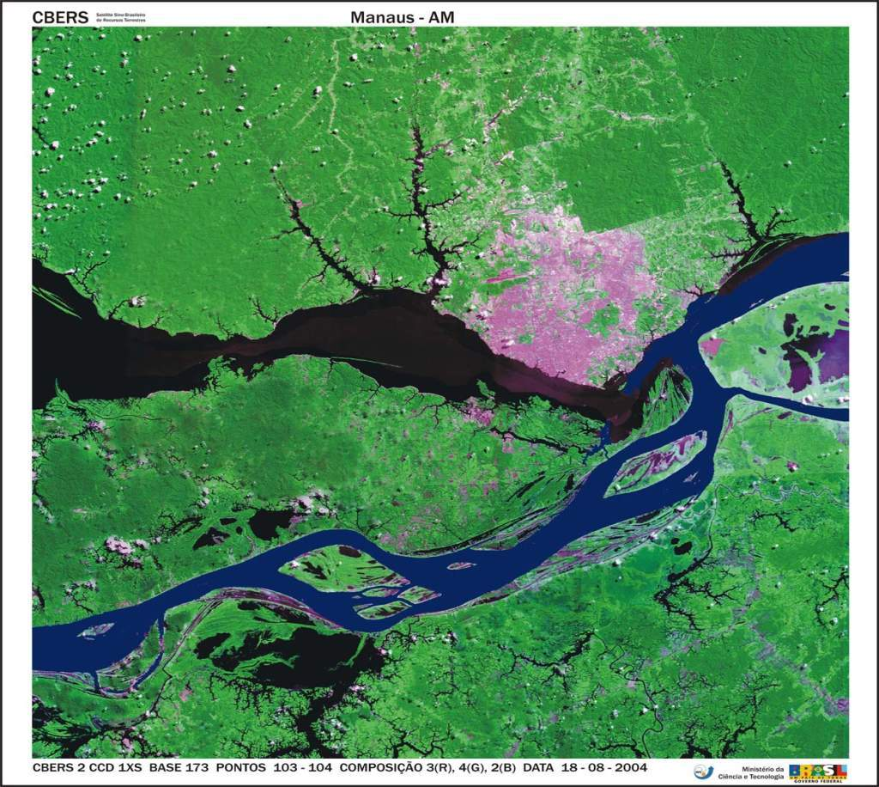
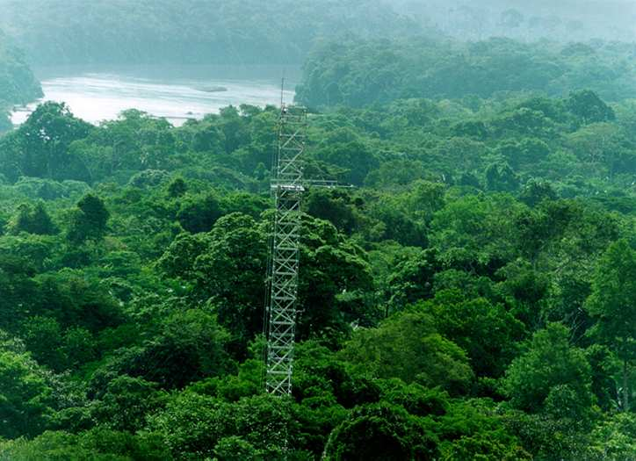
What is a geo-sensor?
What is a geo-sensor?
Field [E, P, V, G] uses E:Extent, P:Position, V:Value, G:Estimator
new: E x G → Field
add: Field x (P, V) → Field
obs: Field → {(P, V)}
domain: Field → {P}
extent: Field → E
estimate: Field x P → V
subfield: Field x E → Field
filter: Field x (V → Bool) → Field
map: Field x (V → V) → Field
combine: Field x Field x (V x V → V) → Field
reduce: Field x (V x V → V) → V
neigh: Field x P x (P x P → Bool) → Field
measure (s,t) = v
s ⋲ S - set of locations in space
t ⋲ T - is the set of times.
v ⋲ V - set of values

Slide 39
Operations on fields
Three fields, same extent,
different granularities, different estimators
•
•
•
•
•
•
•
•
•
•
•
•
•
•
f1
f2
f3
How do we express the operation
f3 = max (f1,f2)?

Slide 40
Operations on fields
Three fields, same extent,
different granularities, different estimators
•
•
•
•
•
•
•
•
•
•
•
•
•
•
f1
f2
f3

Slide 41
Conjecture 6: Properties of objects and events of reality can be expressed as fields
Objects
External Reality
Observ.
Fields
Events

