Slide 1
Introduction to Geoinformatics: Geographical Objects
Gilberto Camara
National Institute for Space Research, Brazil

Slide 2
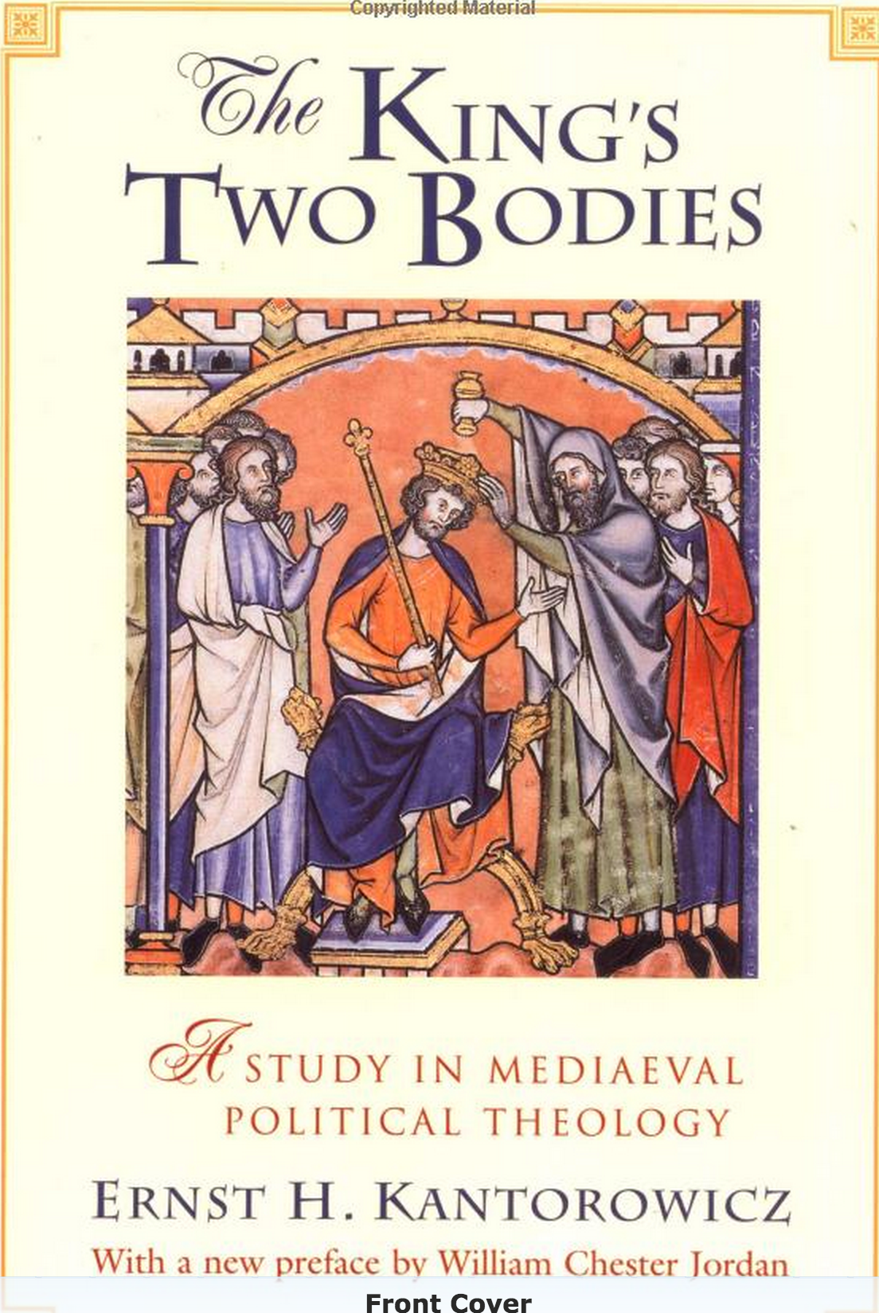
Representation
The Medieval King has in him two Bodies: a Body natural, and a Body politic.
Representations of the King fulfill a key political function

Slide 3
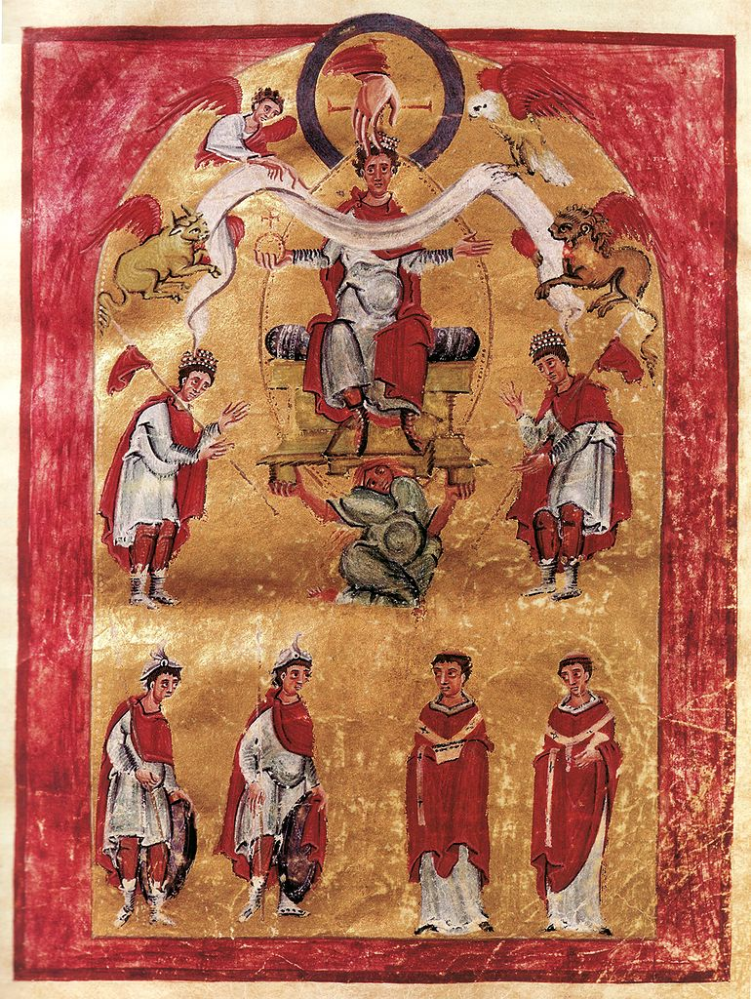
Representation
The King had two bodies:
Otho III, holding a royal orb, inside a mandorla.
Vivet et non vivit

Slide 4
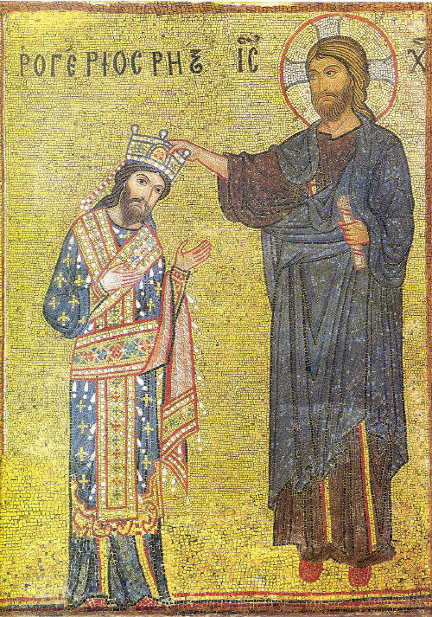
Representation
"Mosaic in the Martorana at Palermo, representing the coronation of King Roger II at the hands of Christ, where the desired effect of making the God manifest in the king was achieved by a striking facial resemblance between Roger and Christ." Ernst H. Kantorowicz, The King's Two Bodies: A Study in Mediaeval Political Theology (Princeton: 1957) 65

Slide 5
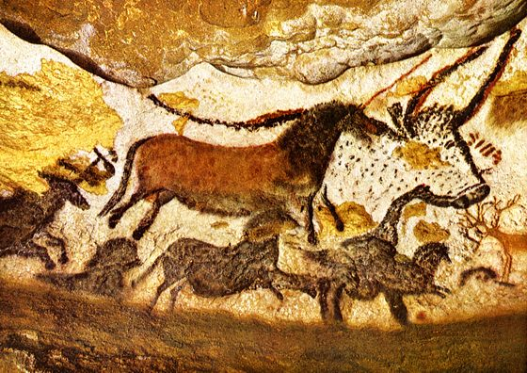
Humans before language: cave paintings
17,000 BCE, Lascaux, France

Slide 6
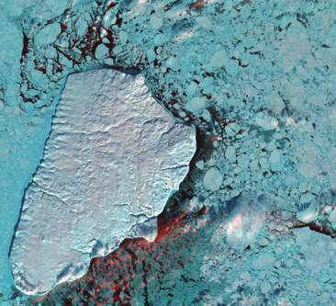
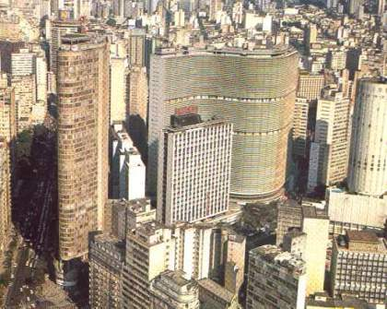
Geoinformatics enables crucial links between nature and society
Nature: Physical equations
describe processes
Society: Decisions on how to
use Earth´s resources

Slide 7
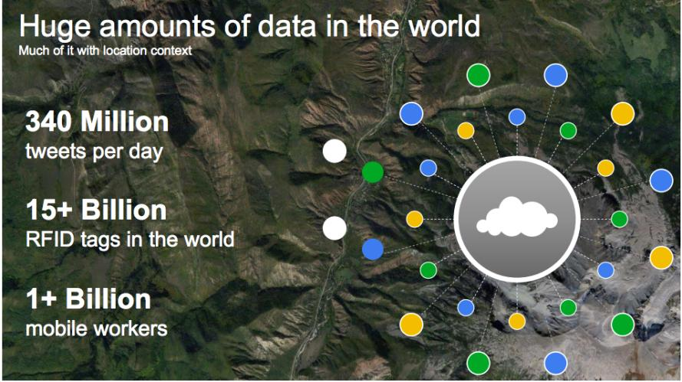
The motivation for “big data”
source: Louis Perrochon (Google)

Slide 8
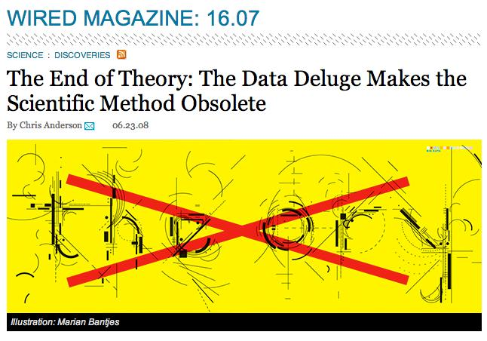
Is the scientific method obsolete?

Slide 9
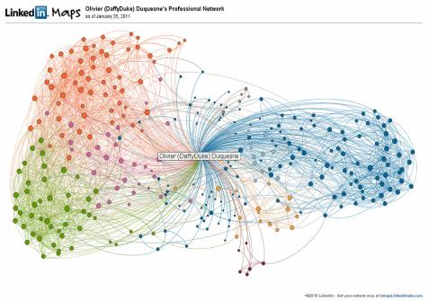
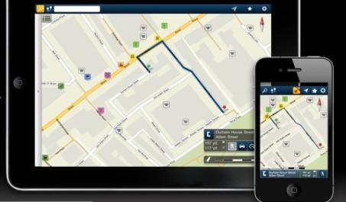
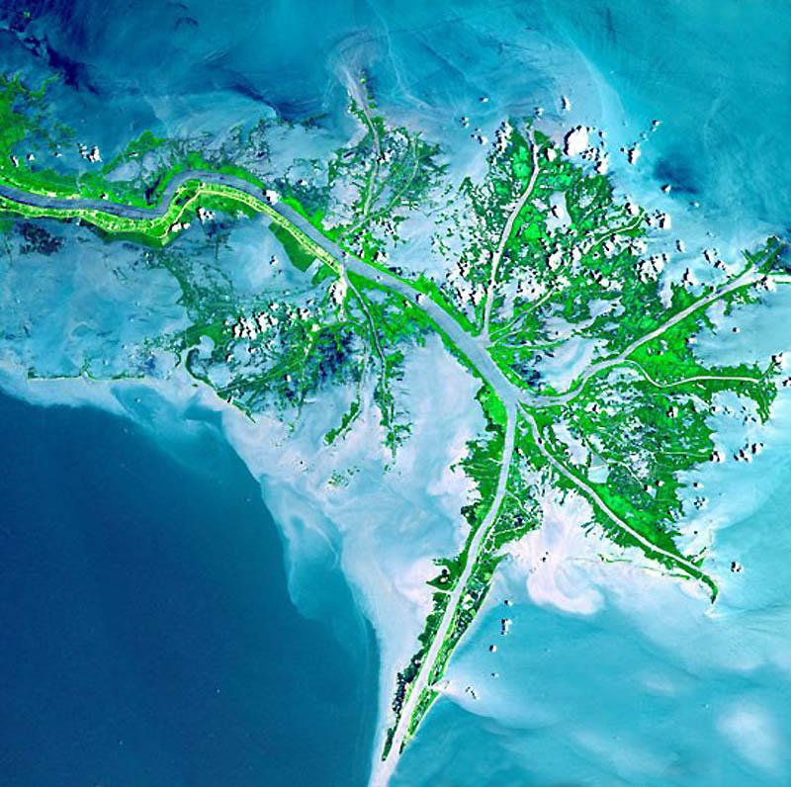
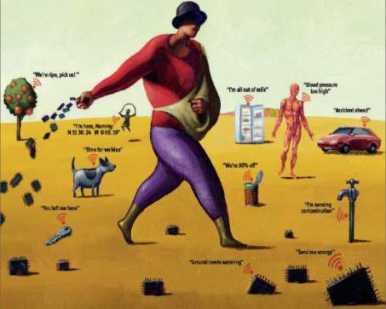
mobile devices
social networks
Mobile devices, crowdsourcing, massive Earth observation sets: new technologies, new challenges
sensors everywhere
ubiquitous imagery

Slide 10
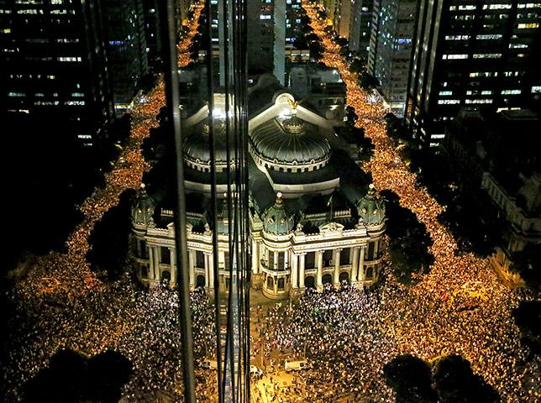
Semantics of big data
Records of interaction on human societies
primary aim: communication

Slide 11
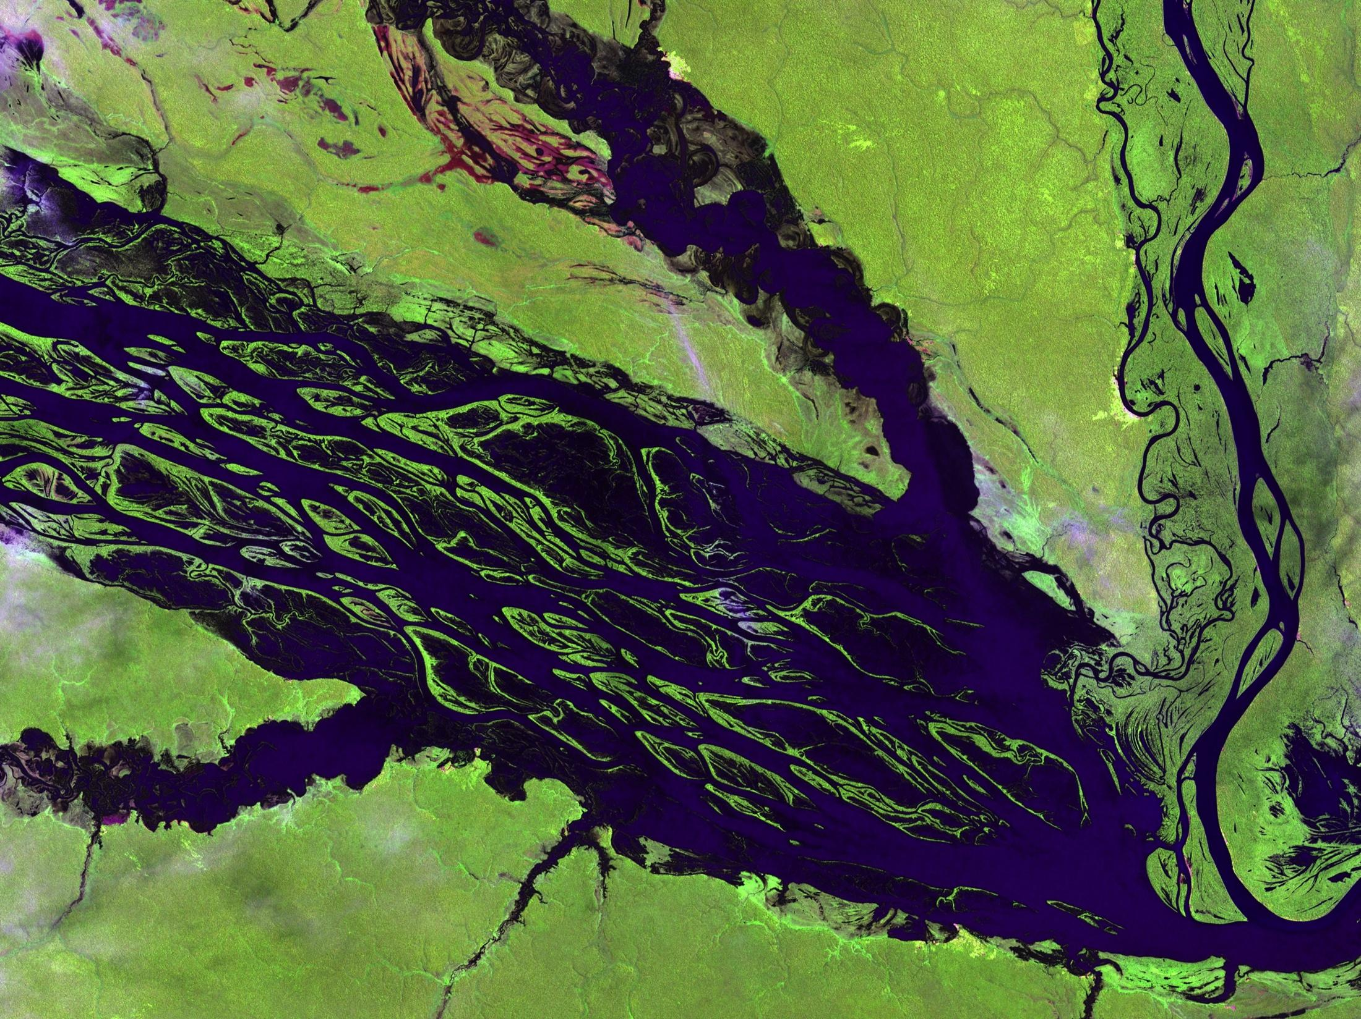
Semantics of big data
Observations of nature
primary aim: description

Slide 12
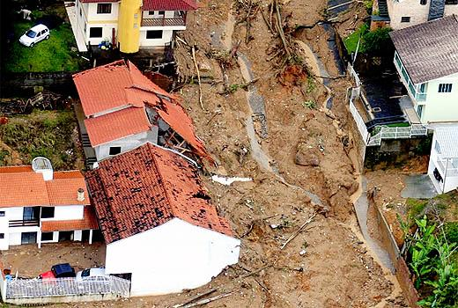
Measurements of nature-society interaction
Semantics of big data
primary aim: sustainability

Slide 13
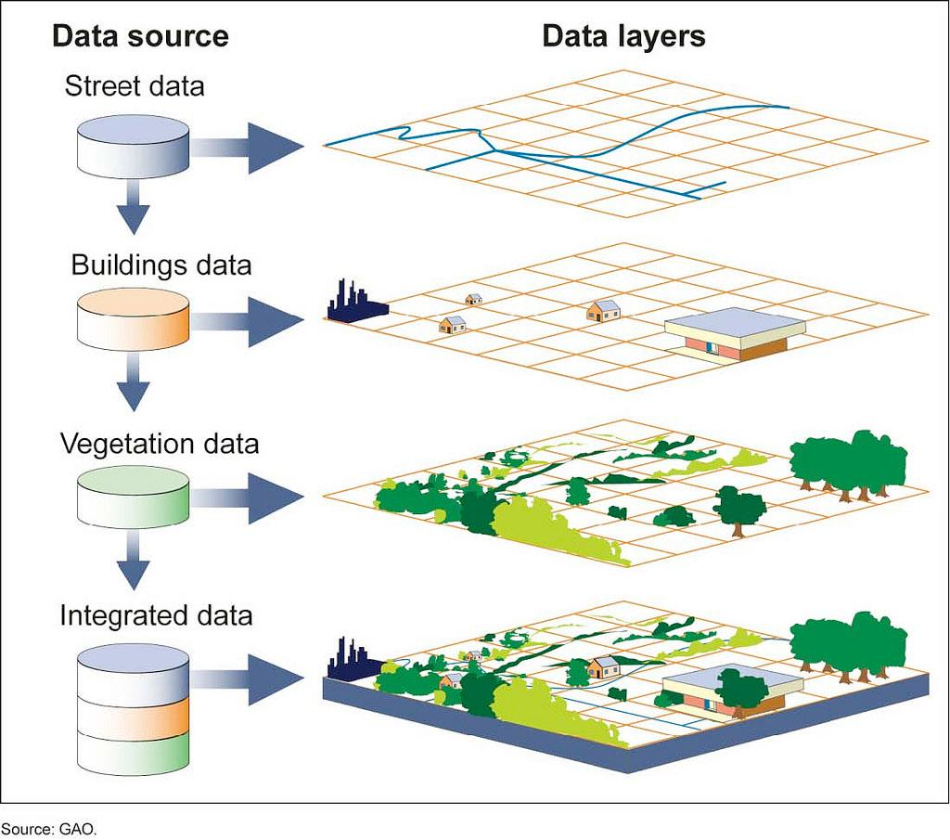
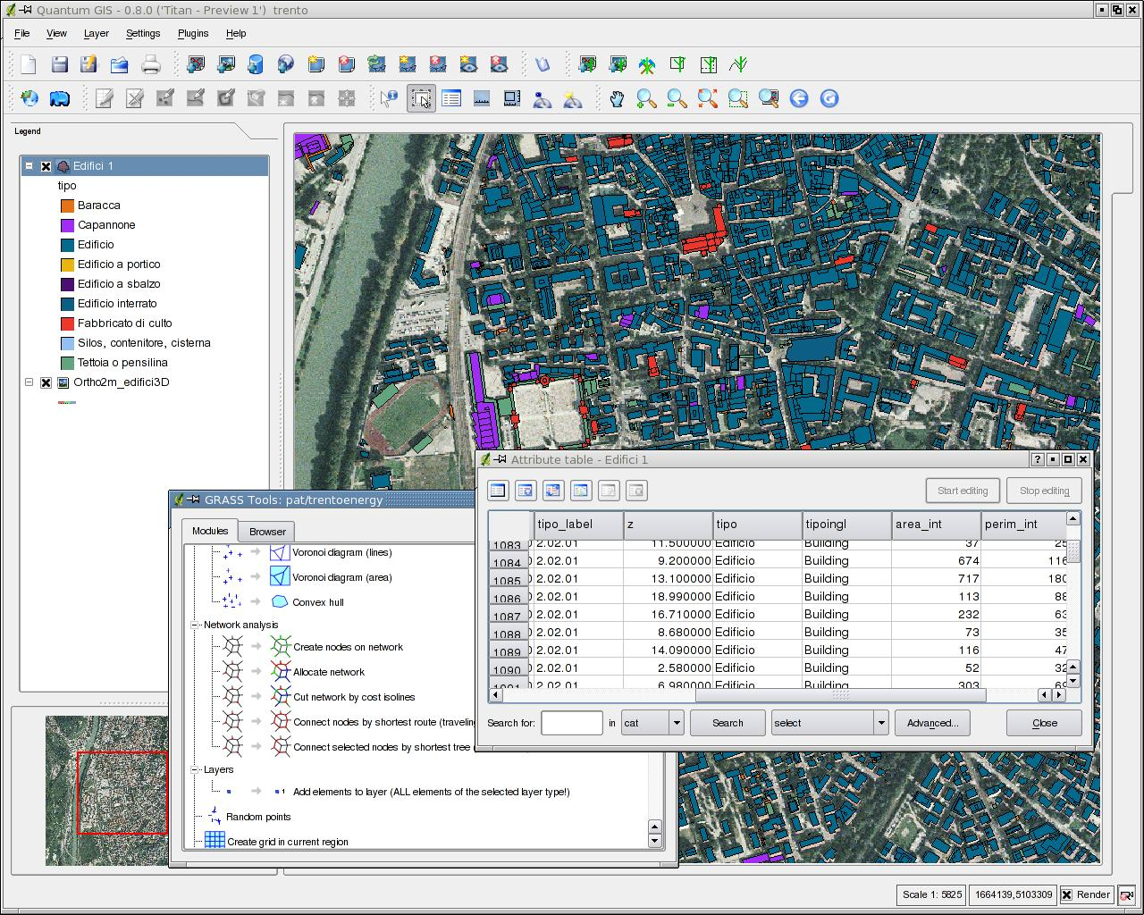
Current GIS is map-based
Big data does not fit in the “map as set of layers” model

Slide 14
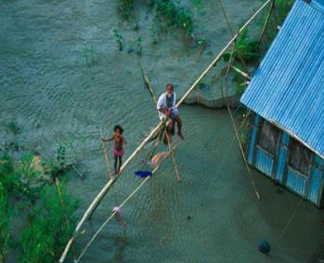
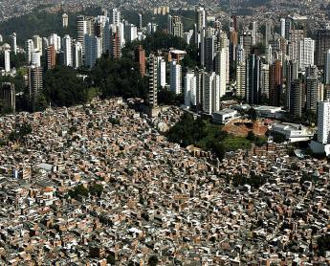
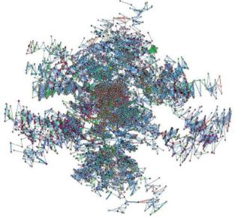
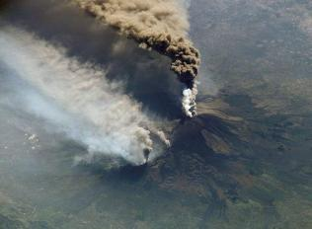
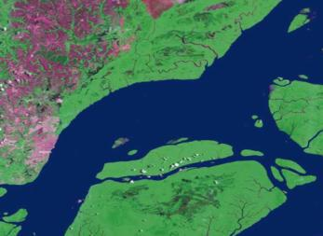
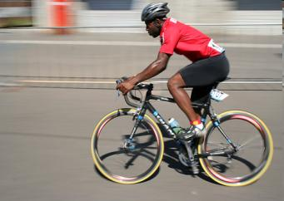
Core concepts of spatial information (Kuhn, IJGIS, 2012)
network
neighborhood
location
field
object
event
Notes:
Na TerraLib partimos do principio que existem core concepts compartilhados na area de geoinformatica e uma idéia interessante que vem crescendo em aceitacao na comunidade\

Slide 15
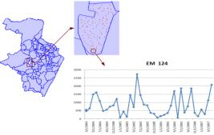
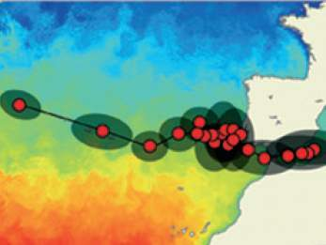
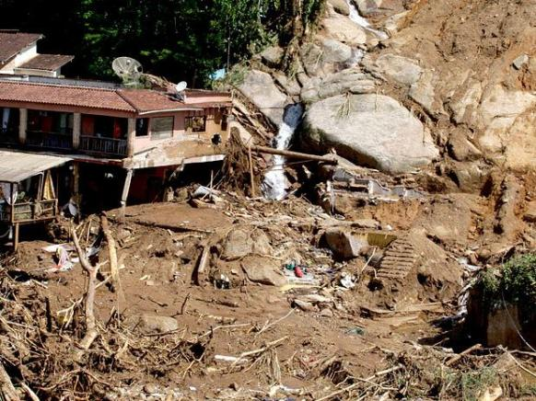
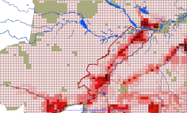
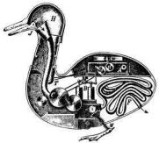
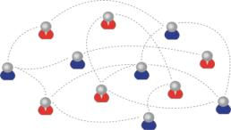
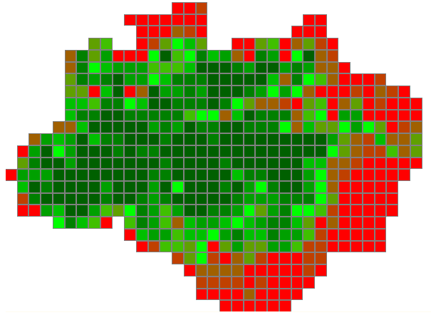
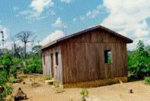
Core concepts as abstract data types
Time Series
Trajectory
Event
2014
Cellular Space
Social Network
Agent
2010
Object
Geometry
2002
Coverage

Slide 16
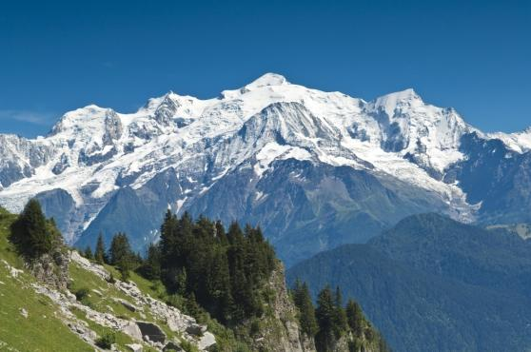
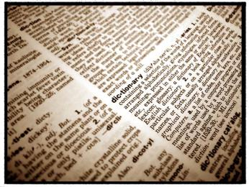
It all begins with observations…
What’s out there?
We use words in our language to describe the world

Slide 17
What about objects?
Mont Blanc
Objects are language constructs, built upon observations
They require both an external reality and a conscious act to identify their existence

Slide 18
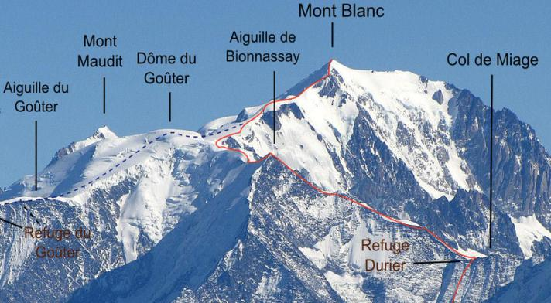
Objects as mental constructions derived from physical reality
Mont Blanc
“Mont Blanc” is a socially-accepted name for a specific topographic feature
Where does “Mont Blanc” start and “Dôme du Goûter” end?

Slide 19
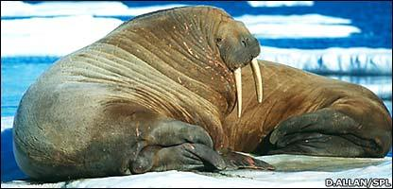
Objects as mental constructions derived from physical reality
Walrus W1
To understand animal behaviour, we tag them and assign them an identity

Slide 20
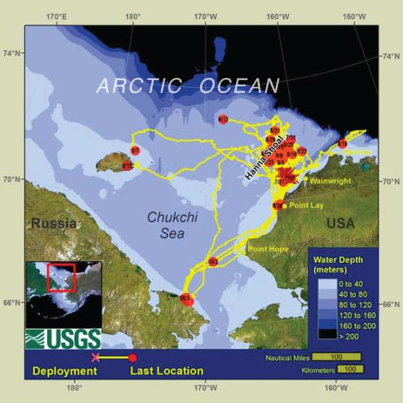
Objects as mental constructions derived from physical reality
Walrus W1
To understand animal behaviour, we tag them, assign them an identity and track their movements

Slide 21
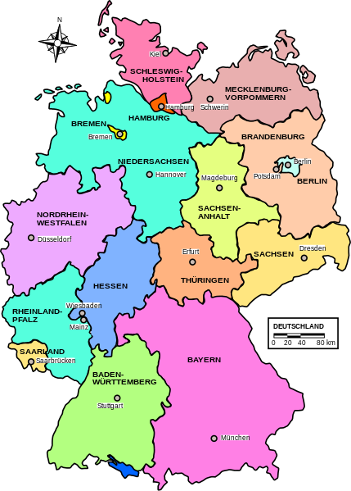
Boundaries: a key concept

Slide 22
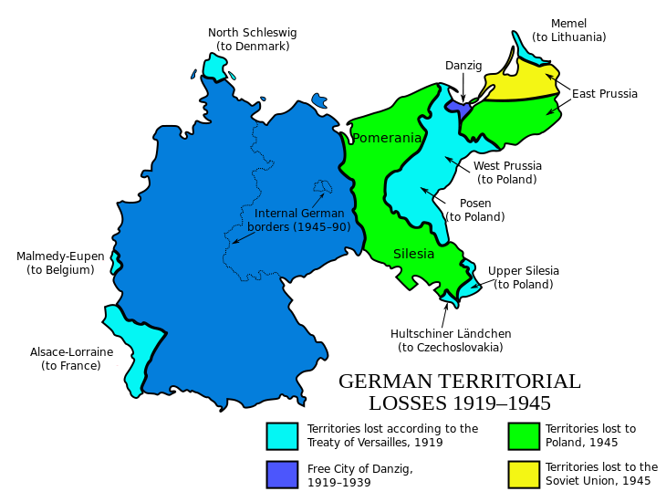
Social objects

Slide 23
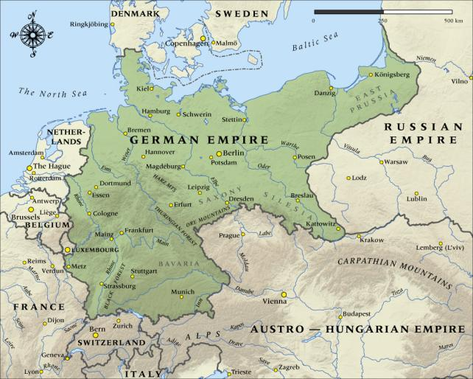
Objects as mental constructs derived from social reality
“Germany (1871)” is a geographical object whose existence is defined by laws and treaties
Die Proklamation des Deutschen Kaiserreiches 1871

Slide 24
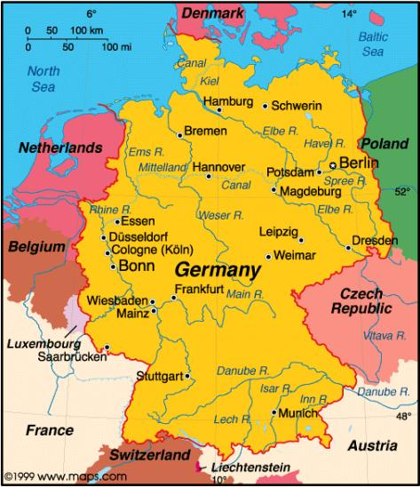
Objects as mental constructs derived from social reality
“Germany (2013)” is a geographical object whose existence is defined by laws and treaties
Einigunsvertrag 1990
Two-plus-Four Agreement 1990

Slide 25
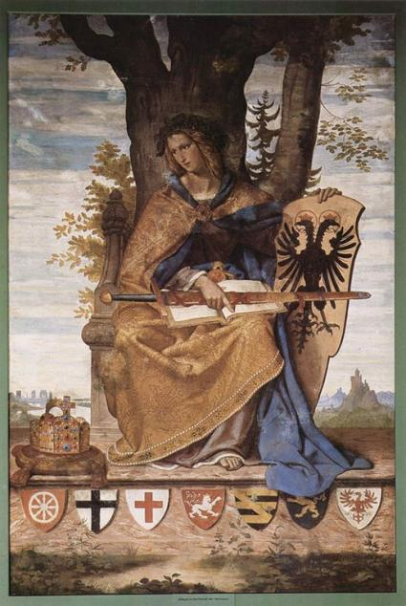
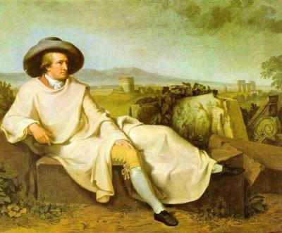
Was Germany a nation before it were a state?
Germania, in a 1834 fresco.
When did Germany start to exist?
What were the boundaries of Germany when Goethe lived?

Slide 26
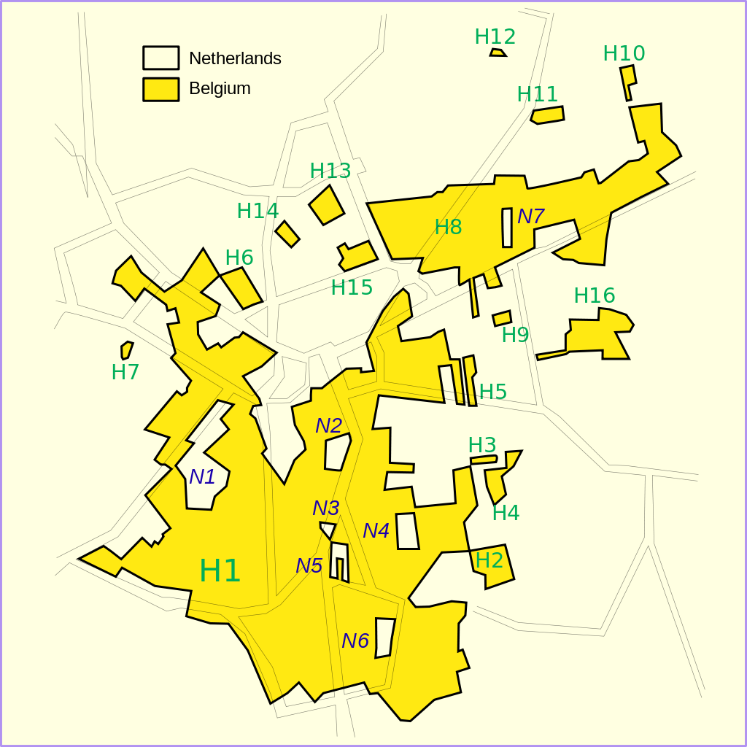
The enclaves of Baale-Hartog

Slide 27
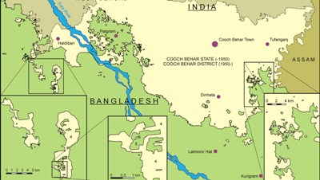
India-Bangladesh enclaves

Slide 28
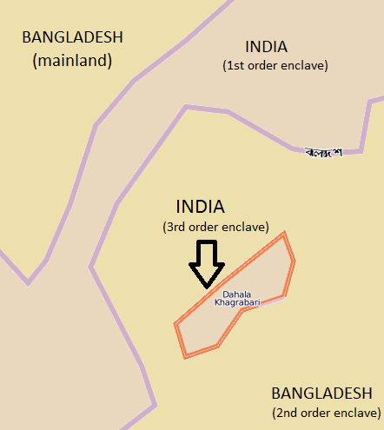
Dahala Khagrabari: a 3rd order enclave

Slide 29
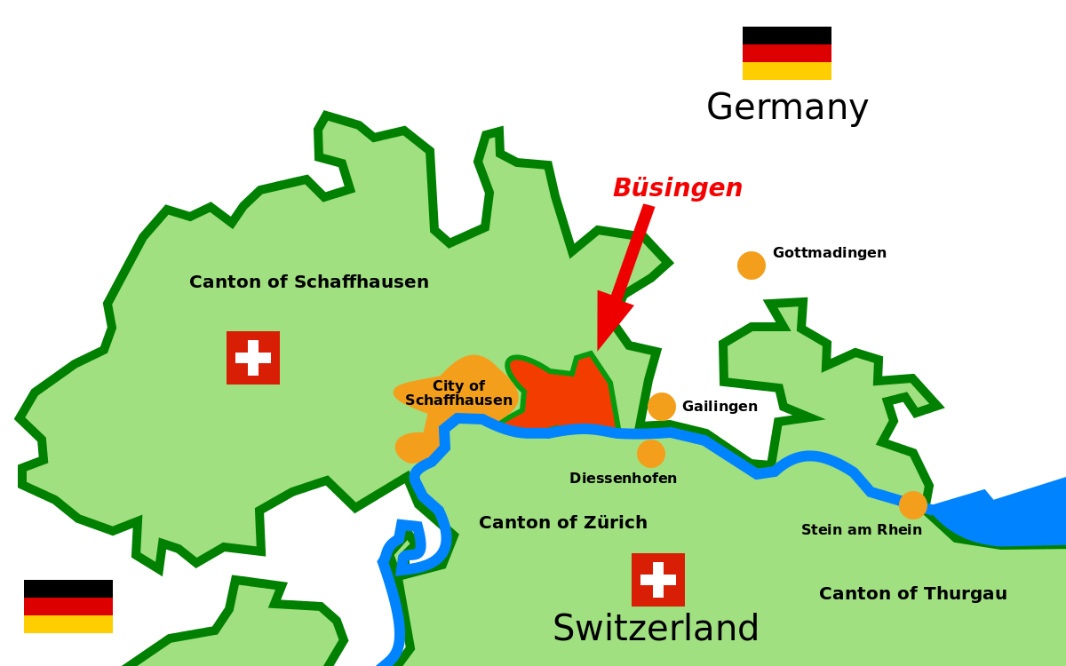
Büsingen in Germany

Slide 30
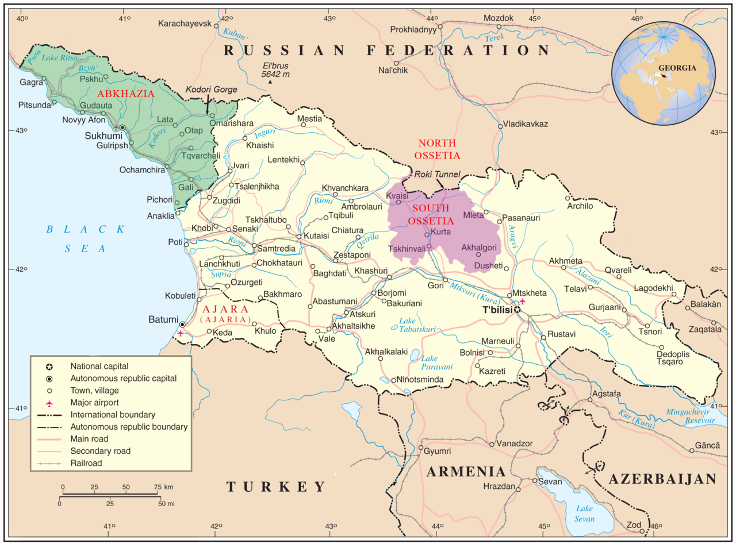
What makes a sovereign state?

Slide 31
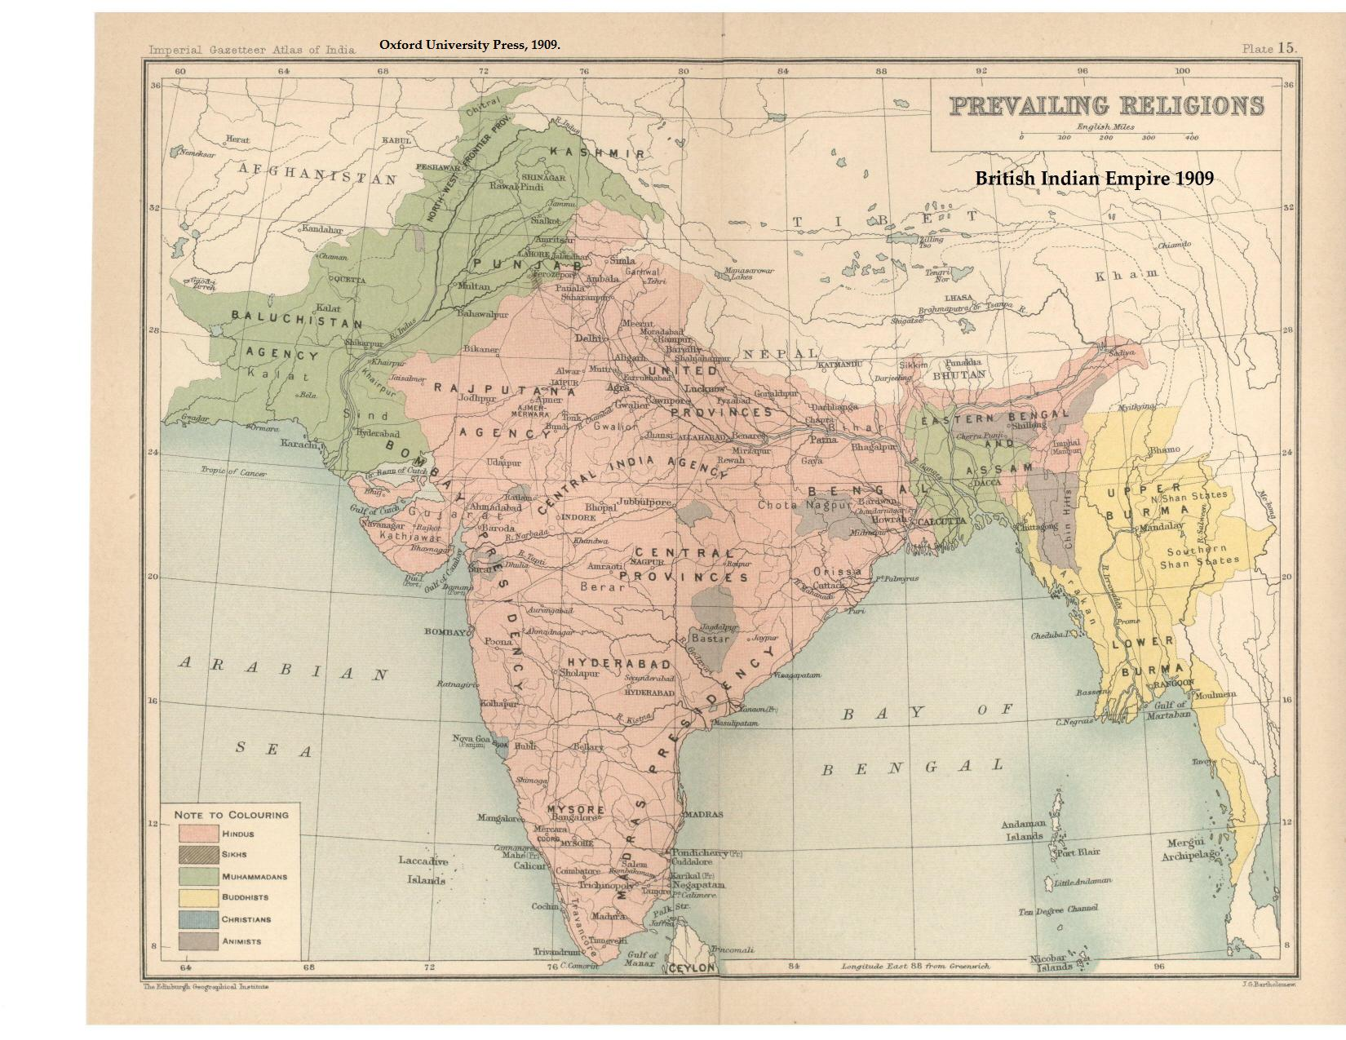
British Raj (1909)

Slide 32
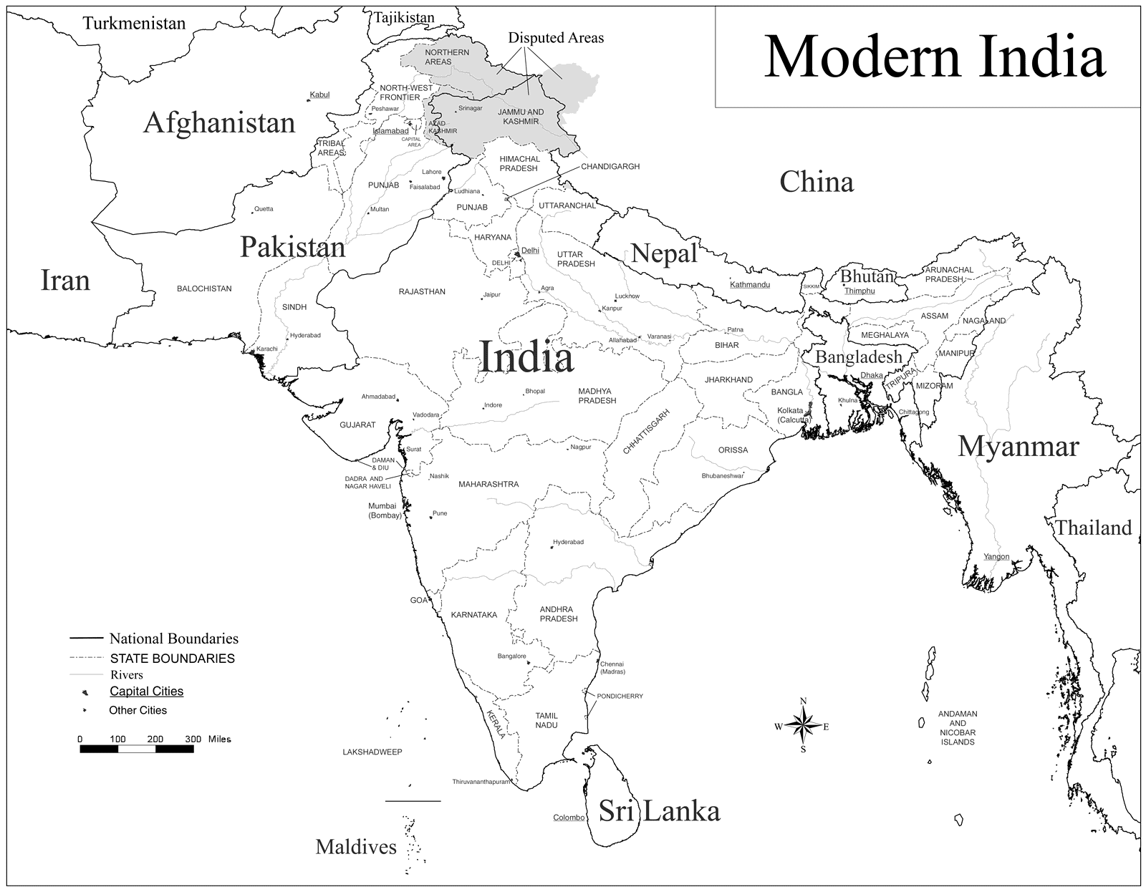

Slide 33
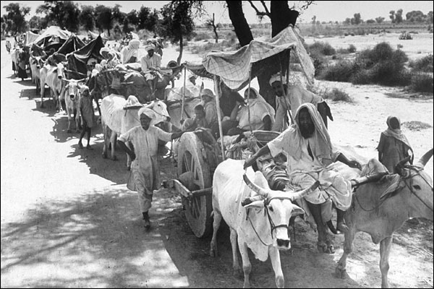
The human cost of boundaries…

Slide 34
Not all entities have fiat boundaries…
Ciclone Catarina

Slide 35
Moving objects
MOVING OBJECTS
Objects whose position and extent change continuously

Slide 36
Natural objects
Humans identify natural objects by convention

Slide 37
Boundaries of natural and social objects may coincide (but are not the same)
The boundaries of the Republic of Cuba are not the boundaries of the island of Cuba (think of Guantánamo)

Slide 38
We observe nature, and describe it
One river?
Social conventions

Slide 39
Approaches to spatial ontology: (1) Searle
X acts as Y in context C
These 23 states act as the European Union in the context of the Treaty of Lisbon

Slide 40
Searle (“The Construction of Social Reality”)
Institutional fact= physical fact + social function
(e.g., paper or money)

Slide 41
When does paper turns into money?

Slide 42
Approaches to spatial ontology: (2) Smith
Fiat and bona fide objects
A bona fide object
(the Moon)
A fiat object
(Germany)

Slide 43
Fiat and bona fide boundaries
Approximations of reality (bona fide)
ex. Coastline
Social conventions (fiat)
ex. Country boundaries

Slide 44
Approaches to spatial ontology: (3) Galton
Physical and institutional boundaries

Slide 45
A catch-all concept in geospatial ontologies
”Amazon
forest”
”Barack
Obama”
”Linux”
Object
”Mont Blanc”
”hurricane
Katrina”
”Germany”
”Artic ice”
”Adige
river”

Slide 46
What’s in an geospatial object?
Object
Spatiotemporal
support
Observable
properties
Inferred
properties

Slide 47
What’s in an geospatial object?
Object
Spatiotemporal
support
Observable
properties
Inferred
properties
ObsFunction
EstimFunction

Slide 48
What’s in an geospatial object?
 | ST support | Property
”Amazon forest” | XIX Century Amazon biome | Existence of a tree coverage
”Linux” | Physical boundaries of the dog | Current location of the dog
”Germany” | Boundaries of FDR | Sovereignty over a territory
”Pacific Ocean” | Agreed limits by convention | Sea surface temperature

