Slide 1
Daisyworld

Slide 2

Daisy World

Slide 3
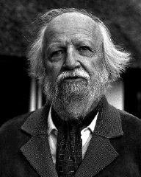
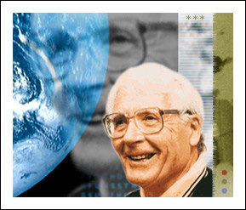
Gaia Theory: the world is a strongly interacting system
William Golding – Nobel laureate
Oxford physics undergraduate
James Lovelock – inventor
of electron capture detector
and daisyworld

Slide 4
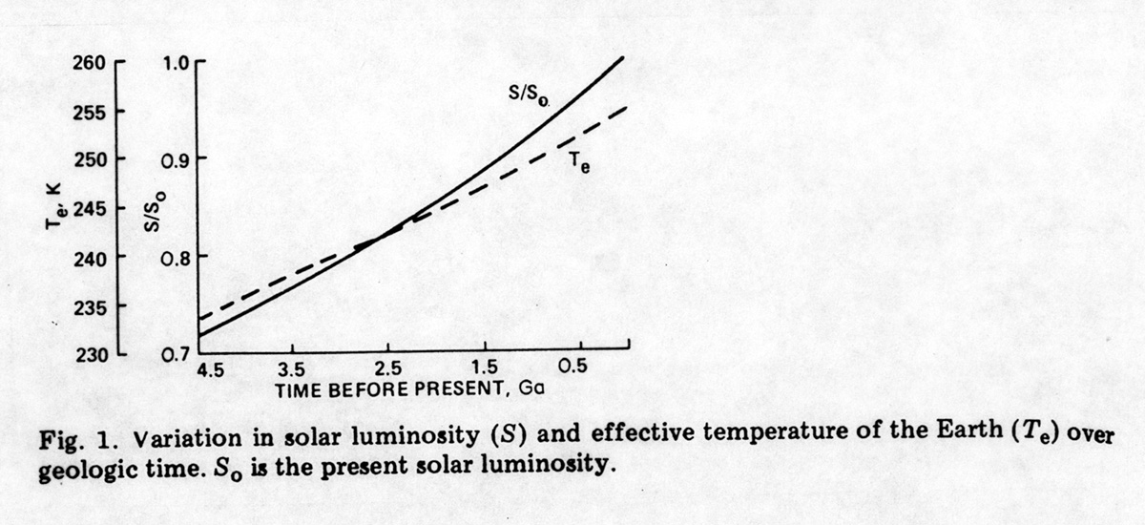
Lovelock’s Questions
James Lovelock: NASA atmospheric chemist analyzing distant Martian atmosphere.
Why has temp of Earth’s surface remained in narrow range for last 3.6 billion years when heat of sun has increased by 25%?

Slide 5
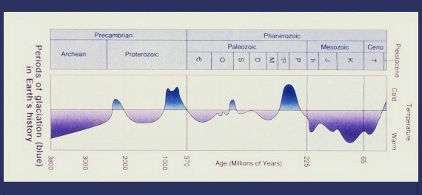
Lovelock’s Questions
James Lovelock: NASA atmospheric chemist analyzing distant Martian atmosphere.
Why has temp of Earth’s surface remained in narrow range for last 3.6 billion years when heat of sun has increased by 25%?

Slide 6
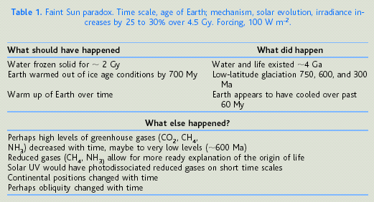
Faint sun paradox

Slide 7
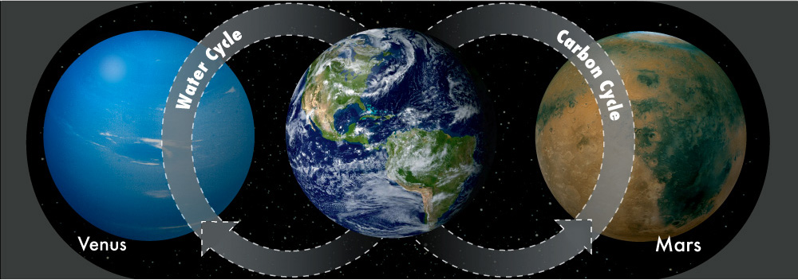
Our Earth is a Unique Planet in the Solar System
source: Guy Brasseur (CSC/Germany)
Runaway greenhouse ::
No water cycle to remove carbon from atmosphere
Earth
Harbor of Life
Loss of carbon ::
No lithosphere motion on Mars to release carbon
Look again at that pale blue dot. That’s here. That’s home. That’s us.(Carl Sagan)

Slide 8
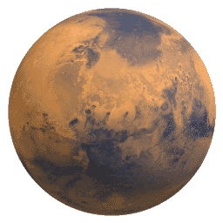
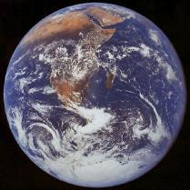
Lovelock’s Questions
  Why has oxygen remained near 21%?
  Martian atmosphere in chemical equilibrium, whereas Earth’s atmosphere in unnatural low-entropy state.

Slide 9
Main idea
Lovelock began to think that such an unlikely combination of gases such as the Earth had, indicated a homeostatic control of the Earth biosphere to maintain environmental conditions conducive for life, in a sort of cybernetic feedback loop, an active (but non-teleological) control system.

Slide 10
The athmosphere as a dynamic system
A lifeless planet would have an atmospheric composition determined by physics and chemistry alone, and be close to an equilibrium state.
The atmosphere of a planet with life would depart from a purely chemical and physical equilibrium as life would use the atmosphere as a ready source, depository and transporter of raw materials and waste products

Slide 11
Mars and Venus
Both planets, based on spectroscopic methods, have atmospheres dominated by CO2 and are close to chemical equilibrium.
Differences in temperature and their atmospheres are related to distances from sun.
No evidence of atmospheric imbalances on these planets to indicate the presence of life.

Slide 12
Lovelock´s answers
Earth can’t be understood without considering the role of life
Abiotic factors
determine biological possibilities
Biotic factors feed back to control abiotic factors
Increased Planetary
Temperature
Sparser Vegetation,
More Desertification
Increased Planetary Albedo
Reduced
Planetary
Temperature

Slide 13
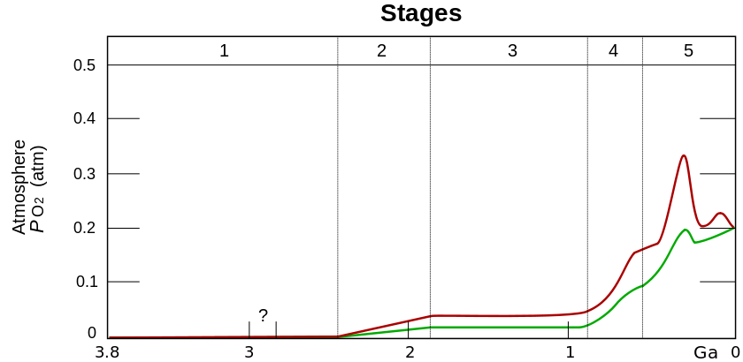
Great oxidation
Stage 1 (3.85–2.45 Ga): Practically no O2 in the atmosphere.
Stage 2 (2.45–1.85 Ga): O2 produced, but absorbed in oceans & seabed rock.
Stage 3 (1.85–0.85 Ga): O2 starts to gas out of the oceans, but is absorbed by land surfaces.
Stages 4 & 5 (0.85–present): O2 sinks filled and the gas accumulates.

Slide 14
Gaia Hypothesis
Organisms have a significant influence on their environment
Species of organisms that affect environment in a way to optimize their fitness leave more of the same – compare with natural selection.
Life and environment evolve as a single system – not only the species evolve, but the environment that favors the dominant species is sustained

Slide 15
Gaia Hypothesis
Influential Gaia
Life collectively has a significant
effect on earth’s environment
Homeostatic Gaia
Atmosphere-Biosphere interactions are
Dominated by negative feedback
Goes beyond simple interactions amongst biotic and abiotic factors
Coevolutionary Gaia
Evolution of life and Evolution of
its environment are intertwined
Optimizing Gaia
Life optimizes the abiotic environment
to best meet biosphere’s needs
Geophysiological Gaia
Biosphere can be modeled as a
single giant organism

Slide 16
Example: ATMOSPHERE
"Life, or the biosphere, regulates or maintains the climate and the atmospheric composition at an optimum for itself.“
Loveland states that our atmosphere can be considered to be “like the fur of a cat and shell of a snail, not living but made by living cells so as to protect them against the environment”.

Slide 17
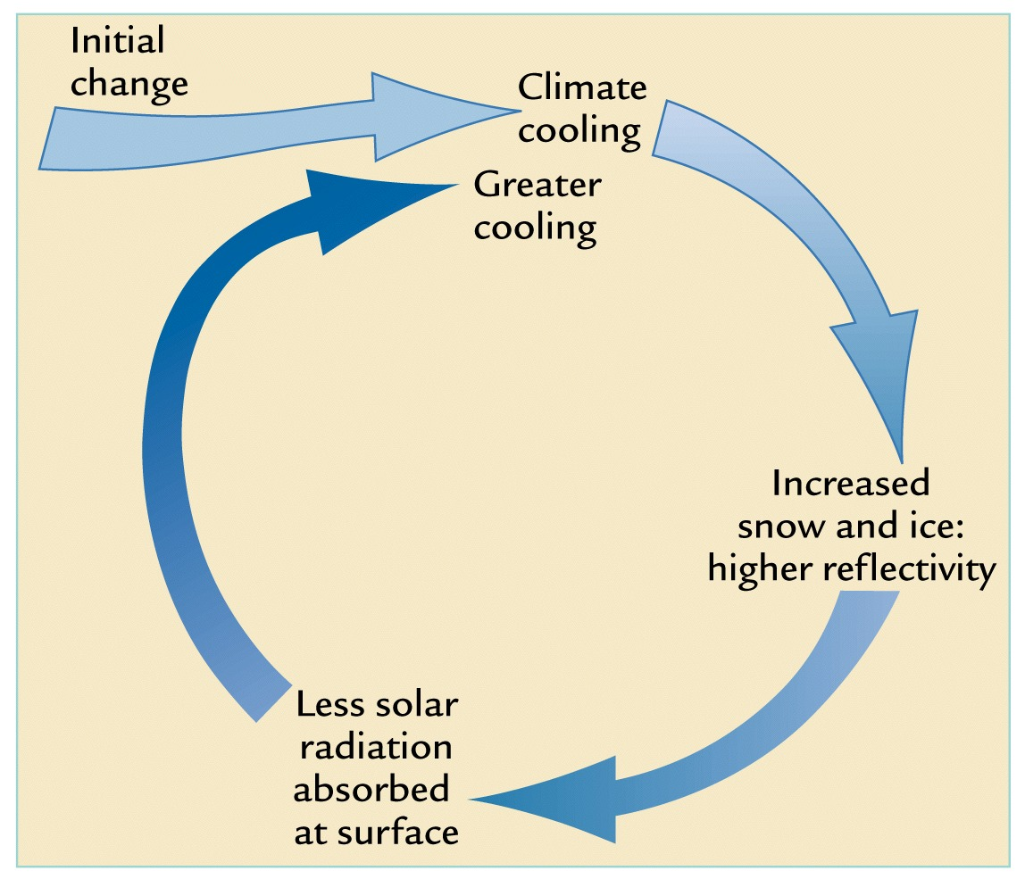

Slide 18
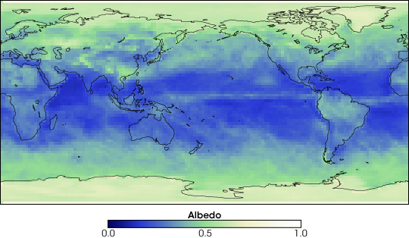

What is Albedo?
The fraction of sunlight that is reflected back out to space.
Earth’s average albedo for March 2005
NASA image http://visibleearth.nasa.gov/view_rec.php?id=17177
Notes:
measured by the Clouds and Earth’s Radiant Energy System (CERES) instrument aboard NASA’s Terra satellite

Slide 19
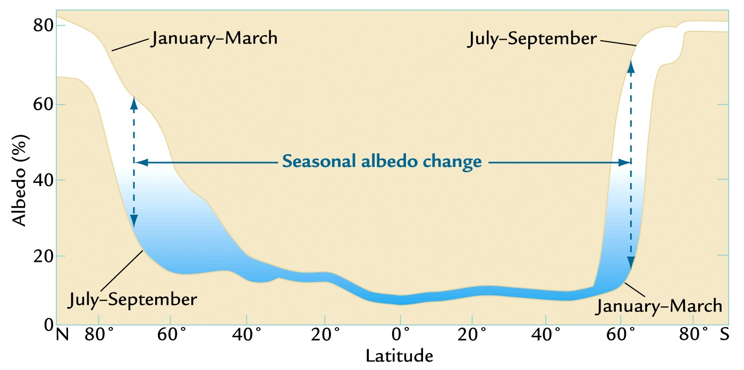

Slide 20
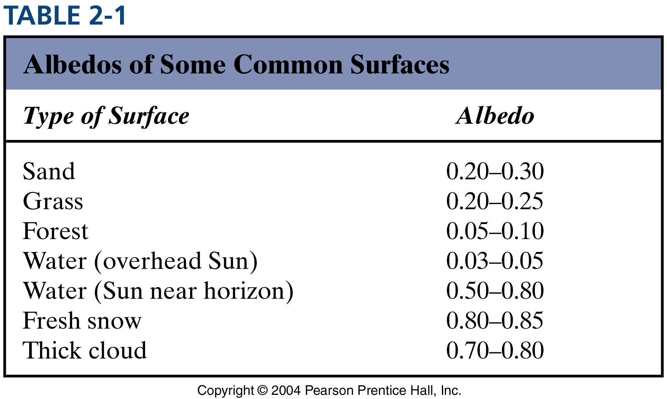
source: Youmin Tang (UNBC)

Slide 21
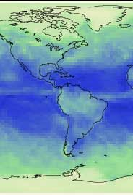
Why is albedo higher at the poles and lower at the equator?
Choose the correct answer:
  Because more sunlight hits at the equator than the poles.
  Because snow and ice at the poles reflects more sunlight.
  Because higher temperatures at the equator allow the atmosphere to hold energy.
High
Low
High

Slide 22
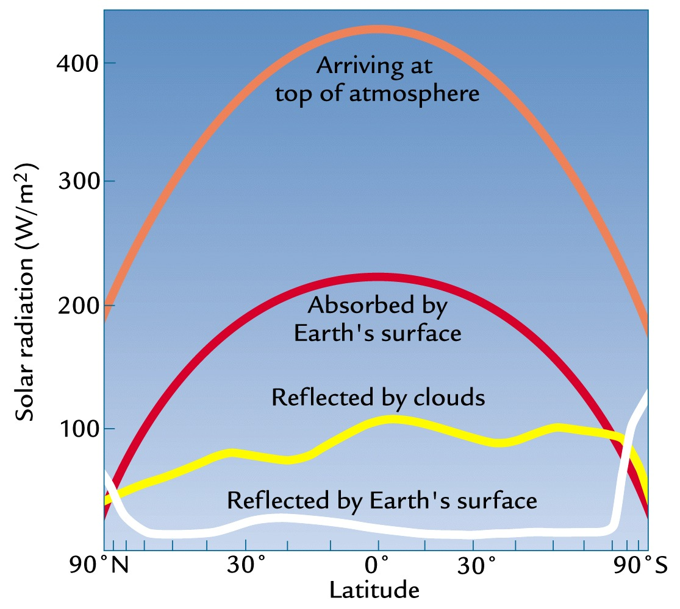

Slide 23
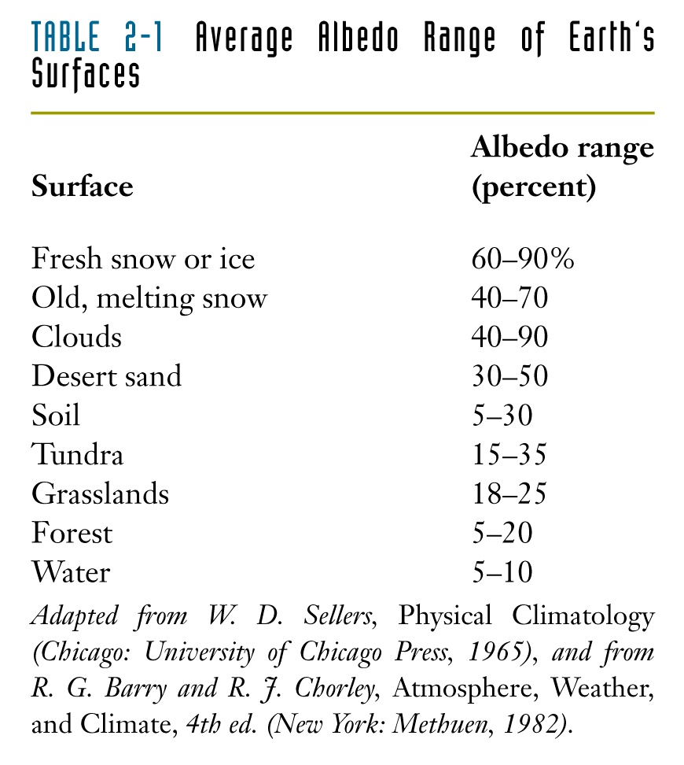

Slide 24


Daisyworld
A planet with dark soil, white daisies, and a sun shining on it.
The dark soil has low albedo – it absorbs solar energy, warming the planet.
The white daisies have high albedo – they reflect solar energy, cooling the planet.
Notes:
There’s a simple flash animation of daisyworld concept out there too.
http://library.thinkquest.org/C003763/flash/gaia1.htm

Slide 25



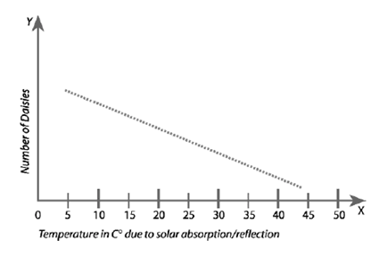
The number of daisies affects temperature
  The number of daisies influences temperature of Daisyworld.
  More white daisies means a cooler planet.

Slide 26
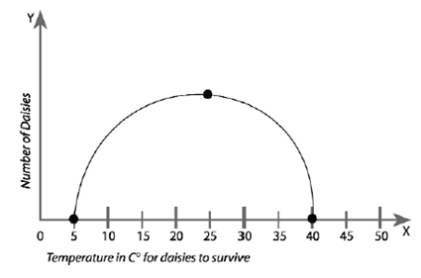
Temperature affects the number of daisies
At 25° C many daisies cover the planet.
Daisies can’t survive below 5° C or above 40° C.

Slide 27
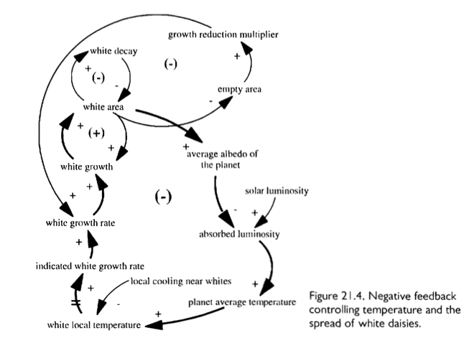

Slide 28
Intersection of 2 curves means the 2 effects are balanced => equilibrium points P₁ & P₂.
daisy
coverage
daisy
coverage
T
T
Effects of daisy coverage on T
P₁
Effects of T on
daisy coverage
Daisy coverage
P₂
T
source: Youmin Tang (UNBC)

Slide 29
Perturb daisy coverage at P₁ => system returns to P₁ (stable equilibrium point)
P₁
A large perturbation
=> daisies all die
from extreme T
Daisy coverage
P₂
T
source: Youmin Tang (UNBC)

Slide 30
Large increase in daisy cover => very low T =>
decrease in daisy cover => very high T => lifeless.
Daisy coverage
P₁
P₂
T
source: Youmin Tang (UNBC)

Slide 31
From P₂, increase daisy coverage => decrease T =>
further increase in daisy coverage => converge to P₁
daisy
coverage
T
Daisy coverage
P₁
unstable
equilibrium point
P₂
T
source: Youmin Tang (UNBC)

Slide 32
Gradual increase in solar luminosity
For all values
of daisy coverage, T increases
The effect of T on
Daisy unchanged
P₁′
P₁
Daisy coverage
P₂′
ΔT_{o}
ΔT_{f}
ΔT_{eq}
P₂
T
source: Youmin Tang (UNBC)

Slide 33
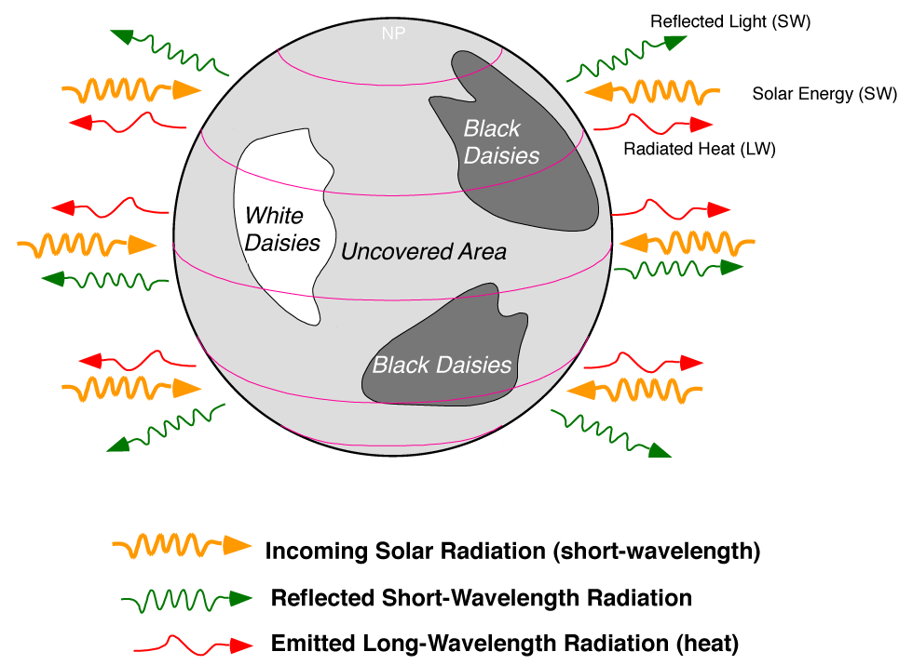
Daisy World – two species

Slide 34
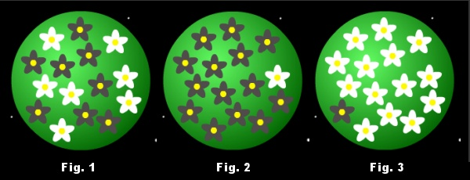
Daisyworld with two species of daisies
Figure 1: Equal numbers of white and black daisies. Temperature is 'normal'.
Figure 2: Mostly black daisies - temperature is consequently high.
Figure 3: Mostly white daisies - temperature is low.
Source: Jeffrey Smith (UGA)

Slide 35
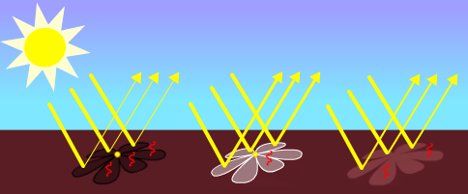
Daisyworld Experiment
Seed the planet with a mix of light and dark daisies, and then slowly increase the luminosity (light reaching the planet). This is not unlike the case for Earth, since the sun's luminosity has increased gradually about 30% over 4.6 Ga.

Slide 36
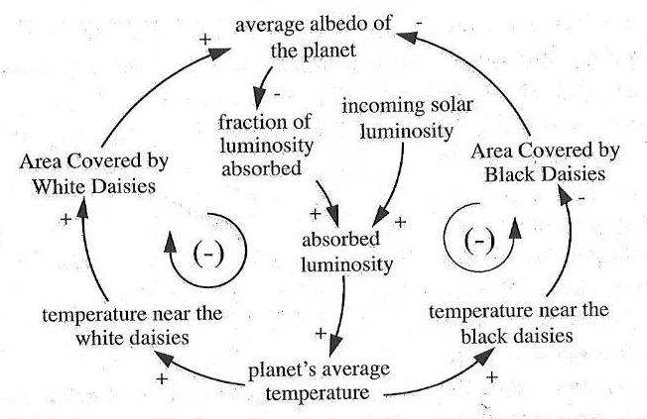
Daisyworld as a feedback system
+
source: Andrew Ford

Slide 37
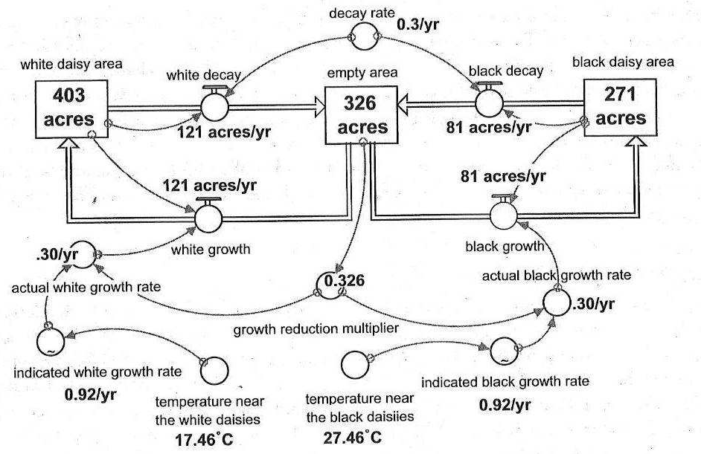
Daisyworld equilibrium conditions
source: Andrew Ford

Slide 38
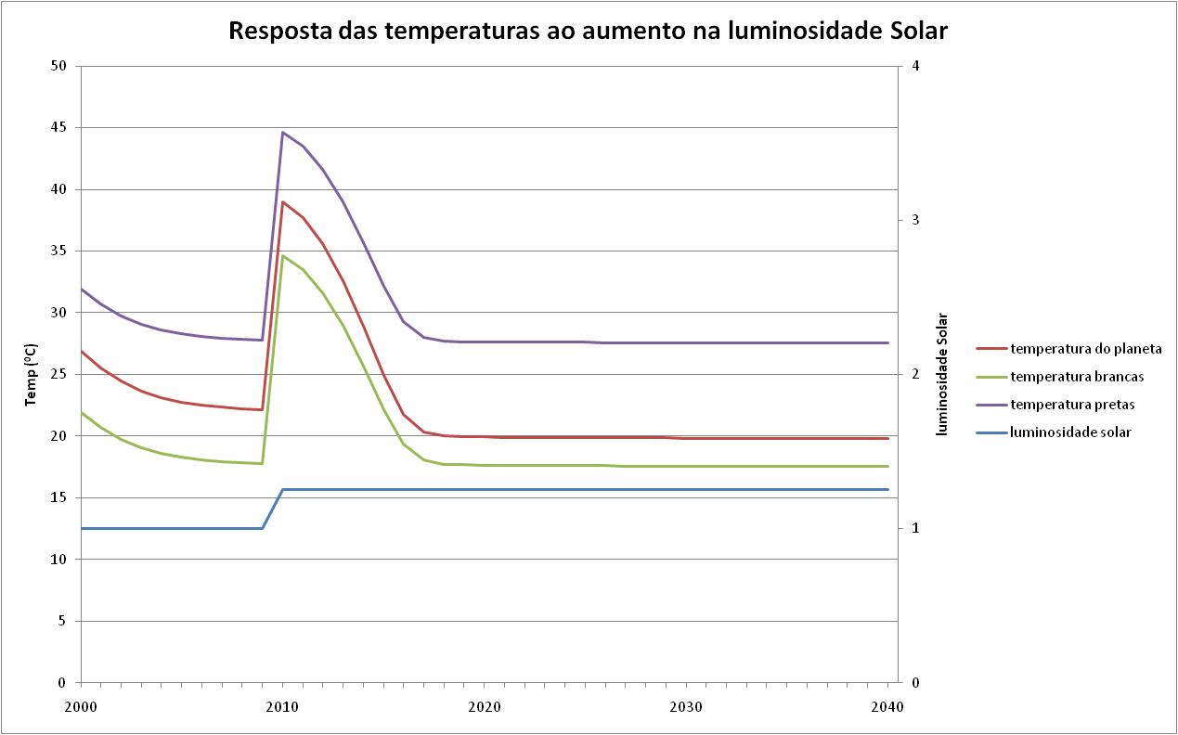
Temperature Control on Daisyworld

Slide 39
Daisyworld simulation
First, run the model long enough for Daisyworld temperature to reach equilibrium
Then, apply a sudden change in solar input
Observe how Daisyworld reacts to restore its temperature
Source: Jeffrey Smith (UGA)

Slide 40
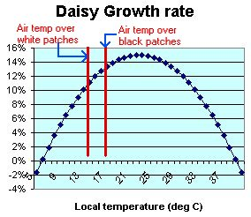
When Daisyworld is cool…
Air temperature over the black patches is higher
Black patches grow more
Overall planet color becomes darker
Planet albedo decreases
Source: Jeffrey Smith (UGA)

Slide 41
When Daisyworld is cool…
Planet absorbs more sunlight and gets warmer
Daisies have altered the climate!
Daisyworld temperature is closer to optimal temperature for daisies!

Slide 42
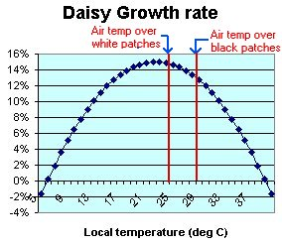
When Daisyworld is warm…
Air temperature over the black patches is higher
White patches grow more
Overall planet color becomes lighter
Planet albedo increases

Slide 43
The key variables
Notes:
Later, we’ll see that we also need T, the “effective temperature”, but that isn’t obvious until we get a bit further on in the modelling.

Slide 44
Equation for the black daisies
α_{b}
( 1 – α_{b} – α_{w})
β(T_{b})
dα_{b}/dt =
- γα_{b}
= α_{b} (α_{g} β(T_{b}) – γ)
β(T) is a function that is zero at 5⁰ C, rises to a maximum of
one at 22.5⁰ C and then falls to zero again at 40⁰ C
A convenient choice is

Slide 45
Equation for the white daisies
We use a similar equation for the white daisies:
dα_{w}/dt = α_{w} (α_{g} β(T_{w}) – γ)
We don’t have to use the same b(T) and g but it
keeps things simple. We can use different ones
later if we want to.
Notes:
Another reason for using a different growth function and death rate later on is to check that the result doesn’t depend on using the same for both. But we have only two equations for four unknowns, so we have to think about what else is going on that we haven’t included so far.

Slide 46
Energy balance
Energy arrives on Daisyworld at a rate SL(1-A) where L is the solar luminosity, S is a constant and A is the mean reflectivity
Daisyworld radiates energy into space at a rate
s: Stephan’s constant T: the ‘effective’ temperature.
Energy in must equal energy out, and so we have
Notes:
This is all standard physics. By “effective temperature” we mean the T such that if all the planet were at that temperature, the rate of energy radiation would be as indicated

Slide 47
Heat Flow
Because different regions of Daisyworld are at different
temperatures, there will be heat flow. We include this in
the model using the equations
Note that if q=0 the whole planet is at the same temperature,
i.e., the heat flow is very rapid indeed. As q increases, so do
the temperature differences.
Notes:
T is now properly defined. Note that if q=0, then heat flow is so rapid that the whole planet is at the same temperature.

Slide 48
The Daisyworld Equations

Slide 49
The Daisyworld Equations

Slide 50
Daisyworld Model (3)
Area of daisies is modified according to the following equations

Slide 51
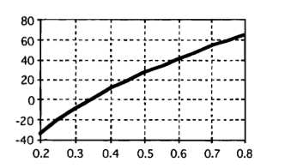
Temperature as a function of luminosity
Notes:
On a dead planet, as the solar luminosity steadily increases, so does the temperature.

Slide 52
Daisyworld results: planet temperature x solar luminosity

Slide 53
Daisyworld results: daisy percentage x average solar luminosity

Slide 54








Effects of Solar Luminosity on 2D Daisyworld
Phillipa Sessini (Toronto)
0.7
0.8
0.9
1.0
1.1
1.2
1.3
1.4

