Slide 1
Cities and Complexity
Gilberto Câmara
Based on the book “Cities and Complexity” by Mike Batty
Reuses on-line material on Batty’s website www.spatialcomplexity.info

Slide 2
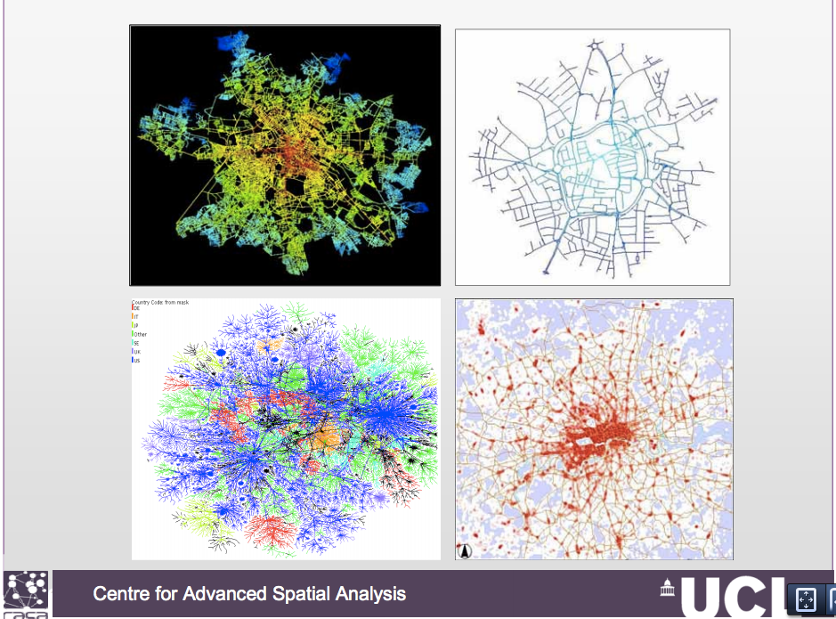

Slide 3
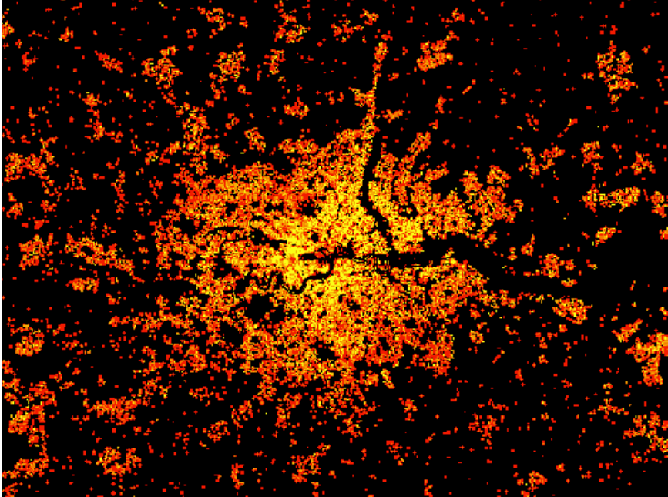

Slide 4
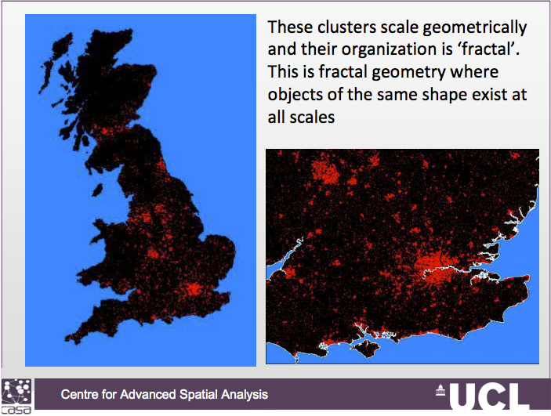

Slide 5
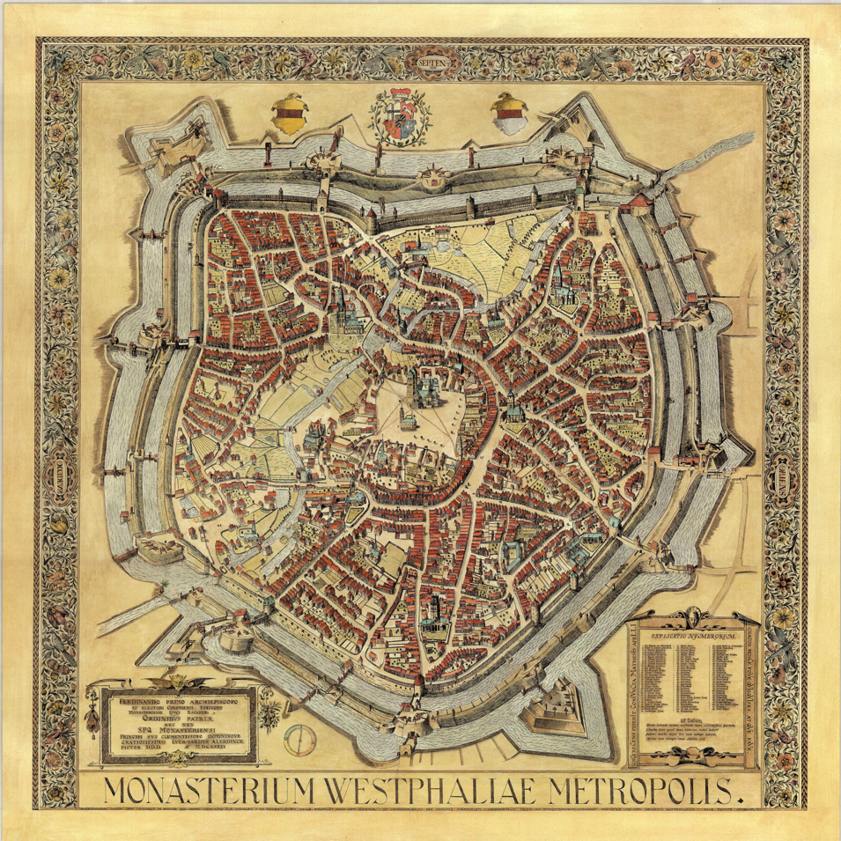
Münster (1636)

Slide 6
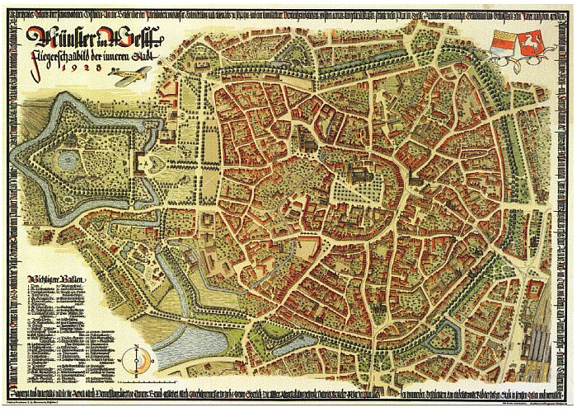
Münster (1926)

Slide 7
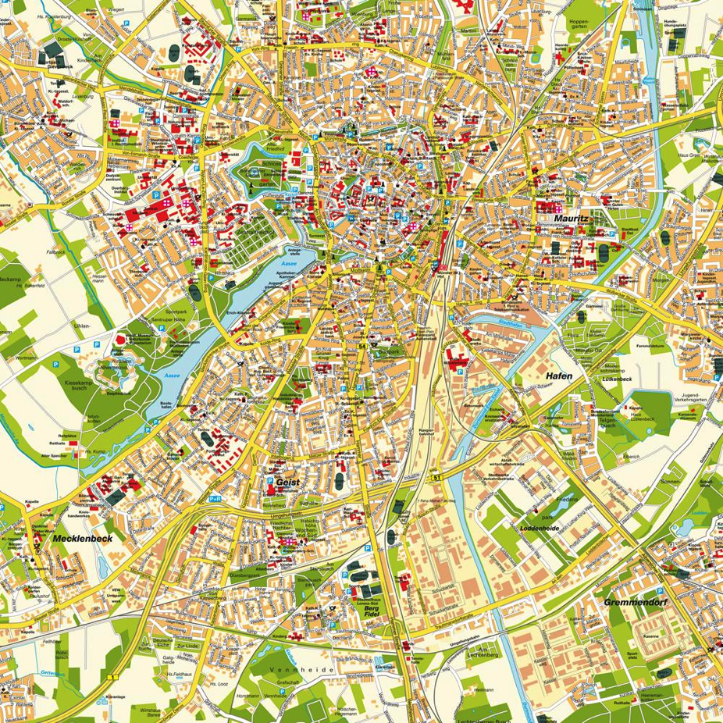
Münster (2010)

Slide 8
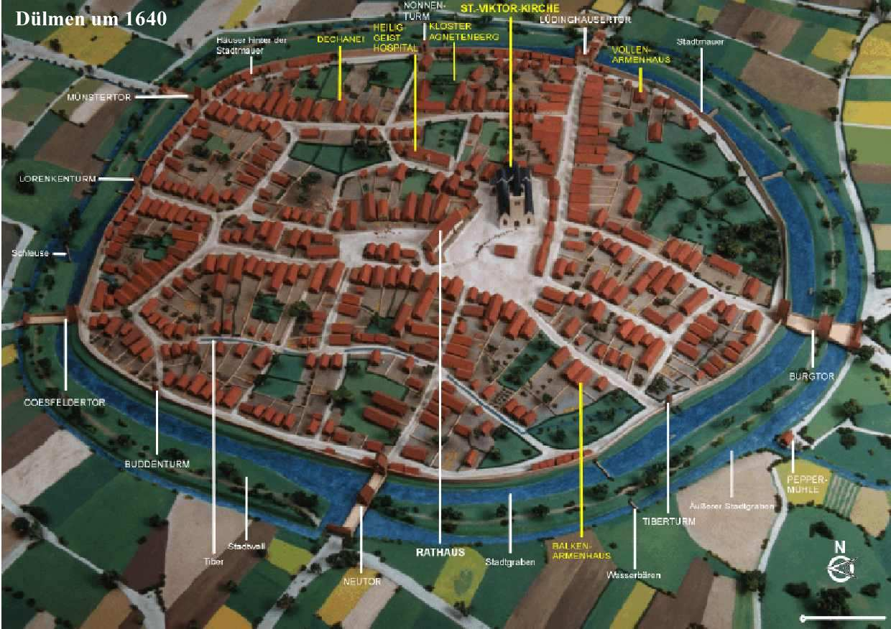
Time future is contained in time past

Slide 9
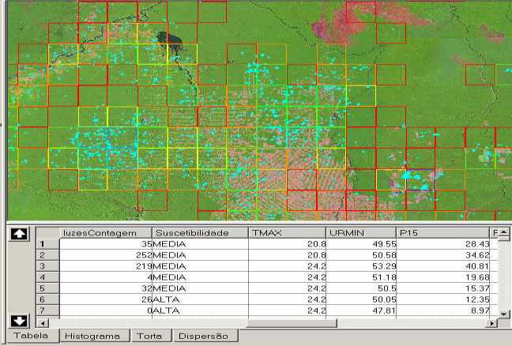
Key property of cellular spaces: potential
POTENTIAL

Slide 10
What is the potential of a cell?
Potential refers to the capacity for change
Higher potential means higher chance of change
How can we compute potential?
People
Potential
Nature

Slide 11
Different models for calculating potential
Brian Arthur’s model of increasing returns
Vicsek-Salay model: structure from randomness
Schelling’’s model: segregation as self-organization

Slide 12
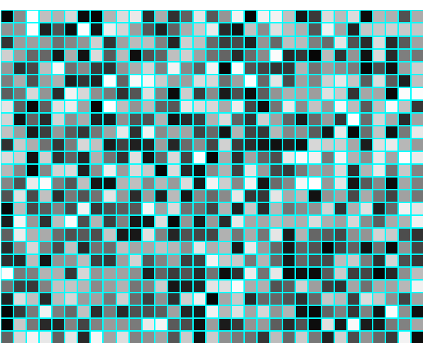
The Brian Arthur model of increasing returns
Create a cell space and fill it with random values
For example, take a 30 x 30 cell space and populate with random values (1..1000)

Slide 13
The Brian Arthur model of increasing returns
Think of this cellular space as the starting point for a population
What happens if the rich get richer?
This model is called “increasing returns”
  This effect is well-known in the software industry
  Customer may become dependent on proprietary data formats
  High switching costs might prevent the change to another product
  Examples: QWERTY keyboard, and Microsoft Windows
Arthur, B. (1994). “Increasing Returns and Path Dependence in the Economy”. Ann Arbor, MI: The University of Michigan Press.

Slide 14
The Brian Arthur model of increasing returns
Consider a situation where the potential grows with a return factor α (μ is a scale factor)
O < α < 1 - decreasing returns (increased competition)
α = 1 – linear growth
α > 1 – increasing returns (rich get richer)

Slide 15
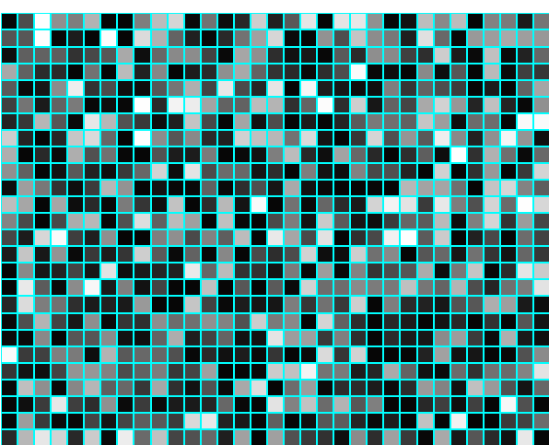
The Brian Arthur model of increasing returns
Take the random 30 x 30 cell space and apply the increasing returns model α = 2 – What happens?

Slide 16
The Vicsek-Szaly Model: Structure from Randomness
Consider a CA with a 4 x 4 neighbourhood
Establish a random initial distribution
  Historical accident that set the process in motion
Pure averaging model

Slide 17
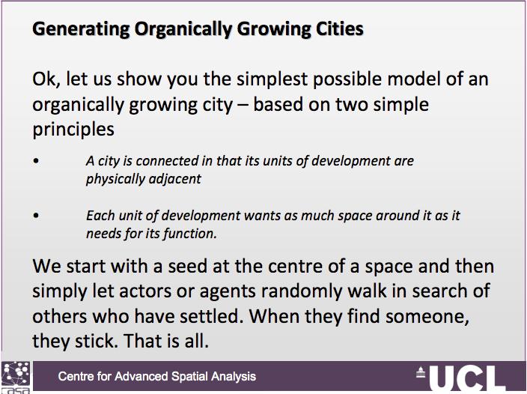

Slide 18
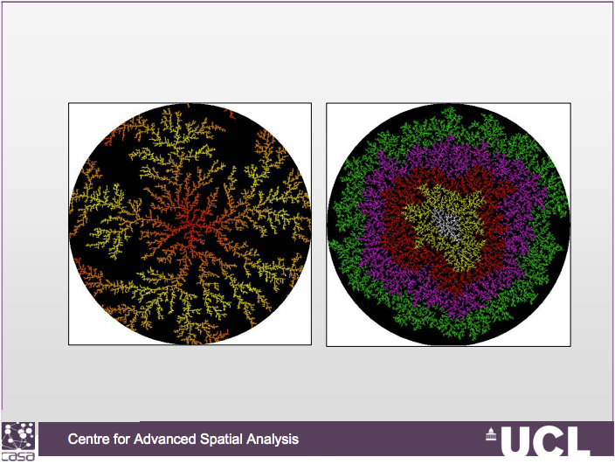

Slide 19
Schelling segregation model

Slide 20
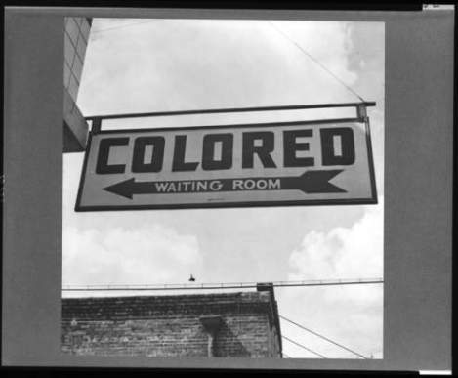
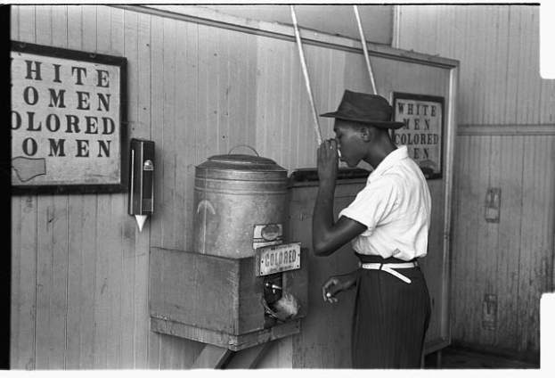
Segregation
Some studies show that most people prefer
to live in a non-segregated society.
Why there is so much segregation?

Slide 21
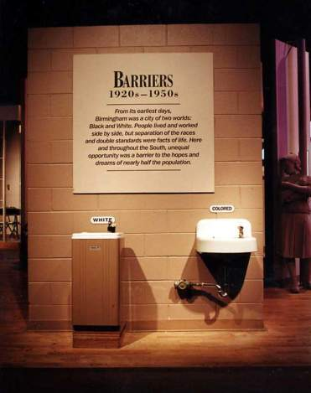
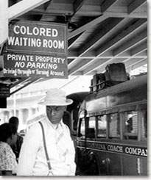
Segregation
Segregation is an outcome of individual choices
But high levels of segregation indicate mean that people are prejudiced?

Slide 22


Schelling’s Model of Segregation
Micro-level rules of the game
Stay if at least a third of neighbors are “kin”
< 1/3
Move to random location otherwise

Slide 23
Schelling’s Model of Segregation
Schelling (1971) demonstrates a theory to explain the persistence of racial segregation in an environment of growing tolerance
If individuals will tolerate racial diversity, but will not tolerate being in a minority in their locality, segregation will still be the equilibrium situation

Slide 24
Schelling Model for Segregation
Start with a CA with “white” and “black” cells (random)
The new cell state is the state of the majority of the cell’s Moore neighbours
  White cells change to black if there are X or more black neighbours
  Black cells change to white if there are X or more white neighbours
How long will it take for a stable state to occur?

Slide 25
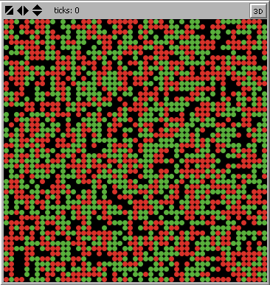
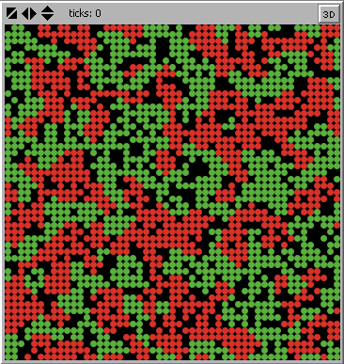
Schelling’s Model of Segregation
Tolerance values above 30%: formation of ghettos

Slide 26


Urban Growth in Latin American cities: exploring urban dynamics through agent-based simulation
Joana Xavier Barros
2004

Slide 27
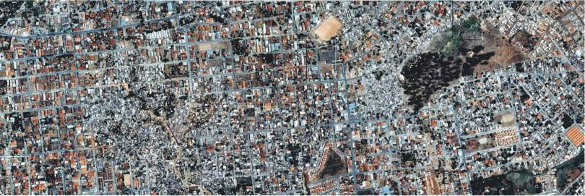
Latin American cities
High rates of urban growth (rapid urbanization)
Poverty + spontaneous settlements (slums)
Poor control of public policies on urban development
Fragmented urban fabric with different and disconnected morphological patterns that evolve and transform over time.
Notes:
Latin American cities + dynamics → lead to urban modelling and simulation
I believe each research is motivated by a scientific curiosity, and to some extend to a faith that that is a topic worth being explored.
In my case, I had worked with research
When I first came to CASA I had

Slide 28
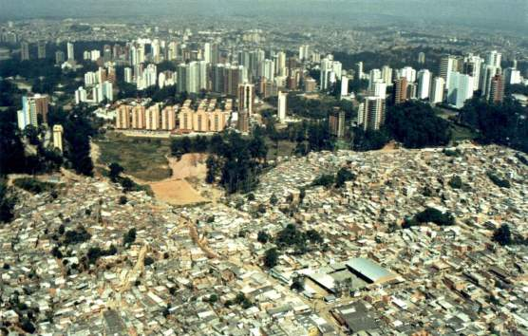
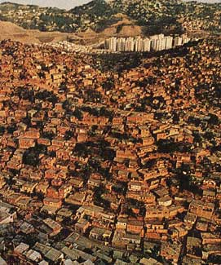
Peripherization
Process in which the city grows by the addition of low‐income residential areas in the peripheral ring.
These areas are slowly incorporated to the city by spatial expansion, occupied by a higher economic group while new low‐income settlements keep emerging on the periphery..
São Paulo - Brasil
Caracas - Venezuela
Notes:
Latin American cities + dynamics → lead to urban modelling and simulation
I believe each research is motivated by a scientific curiosity, and to some extend to a faith that that is a topic worth being explored.
In my case, I had worked with research
When I first came to CASA I had

Slide 29
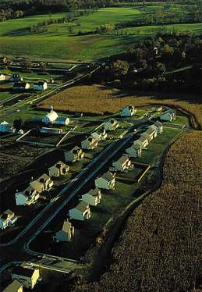
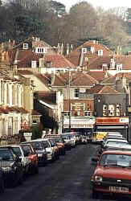
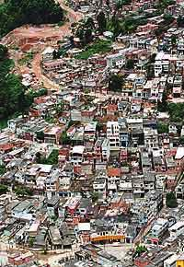
Urban growth
“Urban sprawl” in United States
“Urban sprawl”in Europe (UK)
Peripherization in Latin America (Brazil)

Slide 30
Research question
How does this process happen in space and time?
How space is shaped by individual decisions? ⇒ Complexity approach
Time + Space ⇒ automata model
Social issues ⇒ agent‐based simulation)

Slide 31
Model: Growth of Latin American cities
Peripherisation module
Spontaneous settlements module
Inner city processes module
Spatial constraints module

Slide 32
Peripherization module
reproduces the process of expulsion and expansion by simulating the residential locational processes of 3 distinct economic groups.
assumes that despite the economic differences all agents have the same locational preferences. They all want to locate close to the best areas in the city which in Latin America means to be close to high‐income areas
all agents have the same preferences but different restrictions

Slide 33
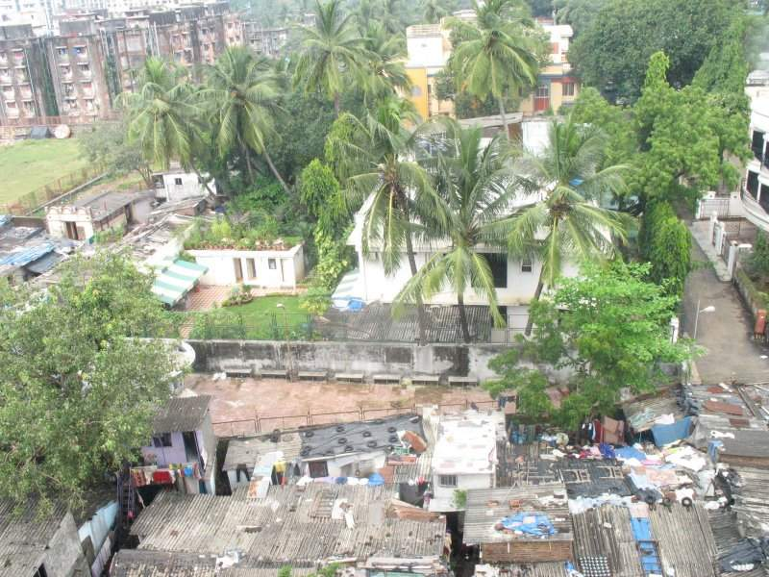
Peripherization module: rules
1. proportion of agents per group is defined as a parameter
2. high‐income agent –can locate anywhere
3. medium‐income agent –can locate anywhere except on high‐income places
4. low‐income agent –can locate only in the vacant space
5. agents can occupy another agent’s cell: then the latter is evicted and must find another

Slide 34
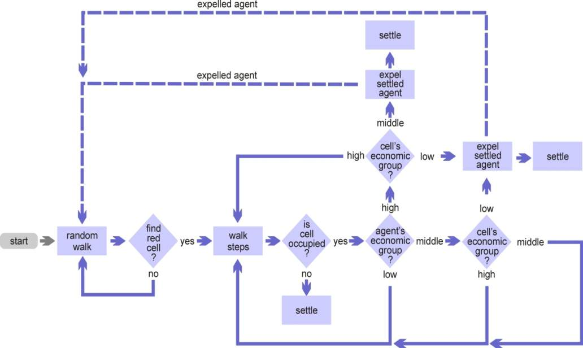
Peripherization module: rules

Slide 35
Peripherization module: rules
Spatial pattern:
the rules do not suggests that the spatial outcome of the model would be a segregated pattern
Approximates the spatial structure found in the residential locational pattern of Latin American cities
multiple initial seeds ‐resembles certain characteristics of metropolitan areas

Slide 36
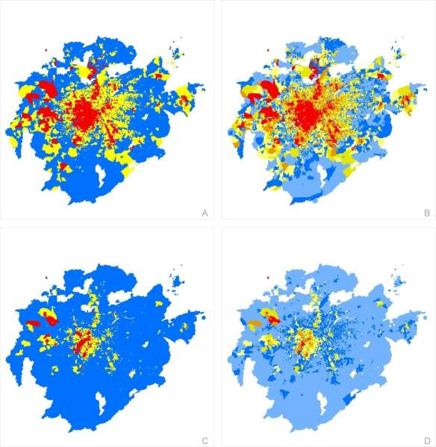
Comparison with reality
Maps of income distribution for São Paulo, Brazil (census 2000)
Maps A and B: quantile breaks (3 and 6 ranges)
Maps C and D: natural breaks (3 and 6 ranges)
No definition of economic groups or social classes

