Slide 1



Introdução a Linguagem de Modelagem TerraML
Dr. Tiago Garcia de Senna Carneiro
TerraLAB - Laboratório INPE/UFOP para Simulação e Modelagem dos Sistemas Terrestres
Fevereiro de 2010

Slide 2

Lua
Roberto Ierusalimschy
PUC-Rio, Brazil
QUASE TODA ESSA APRESENTAÇÃO ESTAVA PRONTA NA WEB!!!
Notes:
PUC-Rio is the Catholic University of Rio de Janeiro. Our Computer Science Department ("Departamento de Informatica") is considered the best one in Brazil.
I am an associate professor there.
Lua is the work of Waldemar Celes, Luiz H. Figueiredo and me, in no particular order.
CGILua is the work of Renato Borges, Anna Hester and me; Anna and Renato are graduate students of mine...

Slide 3
What is Lua?
Yet Another Scripting Language
an “extension” language
implemented as a library in ANSI C
-- a Lua script
color = RED
b = button {
label = ‘OK’,
x = 10,
y = 20}
Host
Program
Lua
Interpreter
Notes:
Lua lives in a niche close to Tcl, Perl and Python. From its kind of use, Tcl is the closer; both Tcl and Lua were created as an embedded language (in opposition to Perl and Python). Both are small and "slim".
Lua seems to be more appropriate than Tcl for real programs, and then gets as an alternative to Python and Perl. (In fact, I don't know whether Python is really a scripting language; it seems a very nice language, but a little "heavy" for real "quick-and-dirty" programming.) Lua is much smaller than Perl, on the other hand it has a much smaller library. I would say Perl is more appropriate for systems administration (standard Lua has no Posix facilities, only ANSI C), but is really for hackers.

Slide 4
Why Lua?
Simple and flexible
“Simple things simple, complex things possible”
Small
Efficient
Portable
Whole library written in ANSI C, compiles the same source code in all platforms
Typical uses: MS-DOS, Windows (3.1, 95, NT), Unix (Linux, Solaris, IRIX, AIX, ULTRIX), Next, OS/2, Mac
Notes:
Lua is smaller, faster and more portable than Tcl, Perl and Python. Simplicity and flexibility are more arguable qualities...

Slide 5

Where is Lua?
Inside Brazil
Petrobras, the Brazilian Oil Company
Embratel (the main telecommunication company in Brazil)
many other companies
Outside Brazil
Lua is used in hundreds of projects, both commercial and academic
CGILua still in restricted use
until recently all documentation was in Portuguese
Notes:
CGILua is also spread, but mainly in Brazil. CGILua has got a commercial impact much bigger than Lua, and that created some pressure for documentation in Portuguese. Only recently we found the time to translate it to English...

Slide 6
How is Lua?
Pascal-like Syntax.
Interpreter executes sequence of statements.
function definitions are also statements (see later)
Six types:
numbers, tables, functions, strings, userdata, nil
function fat (n)
if n == 0 then
return 1
else
return n*fat(n-1)
end
end

Slide 7
My first Lua program
C = 2; -- rain/t
K = 0.4; -- flow coefficient
q = 0;
-- RULES
for time = 0, 20, 1 do
-- soil water
q = q + C - K*q;
end
print(“q = "..q);

Slide 8
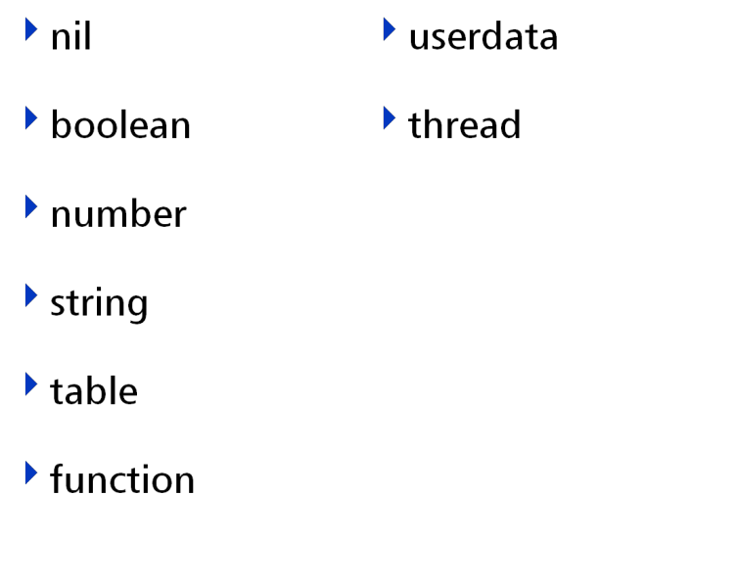
Types

Slide 9
Type nil
Different from everything else
Default variable type
Also acts as false (boolean)

Slide 10
Type boolean
Comparison value
if (rain == true) then ....

Slide 11
Type number
Unique native type for numbers
double (by default)
a = 3
b = 3.5
c = 4.5e-8

Slide 12
Type string
Immutable
No size limit (read large files as strings)
No termination value (‘\0’)
Powerful Pattern-matching in standard library
myname = “Ciclano da Silva Sauro”;

Slide 13
Tables
Implement associative arrays:
any value (including functions and other tables) can be used both for indices and values
t = {} -- creates an empty table
t[1] = "hello"
t.x = print -- t.x is sugar for t[‘x’]
t.x(t[1]) -- prints ‘hello’
t.next = t -- circular list
Notes:
The first line creates an empty table, and stores a reference to it in “t”. Then the string “hello” is associated with index 1, and the function print is associated with index “x”.

Slide 14
Constructors
Expressions to create and initialize tables
Record style
point={x=10,y=20}
print(point.y) --> 20
List style
days={"Sun","Mon","Tue","Wed","Thu","Fri","Sat"}
print(days[3]) --> Tue
Mixed style
points={{x=0,y=0}, point, n=2}
print(points[points.n].y) --> 20
Notes:
Constructors were inspired by some “declarative” languages, such as BibTex and IDL (a language for describing interfaces in Motif).
Note in the last example a use of nested constructors: because a constructor is an expression, it can be used wherever a value is expected.

Slide 15
Table
loc = {
cover = "forest",
distRoad = 0.3,
distUrban = 2 };
loc.cover = “cerrado”;
loc[“cover”] = “soja”;
if (loc.distUrban > 1.5) then

Slide 16
Tables in Lua
loc = { cover = "forest", distRoad = 0.3, distUrban = 2 };
loc.desfPot = loc.distRoad + loc.distUrban;

Slide 17
Tables em Lua : functions
loc = { cover = "forest", distRoad = 0.3, distUrban = 2 };
...
loc.reset = function( self )
self.cover = "";
self.distRoad = 0.0;
self.distUrban = 0.0;
end

Slide 18
Constructors
calls function “article”
article( { author =…, tilte = …, year = ….} )
article{
author="F.P.Brooks",
title="The Mythical Man-Month",
year=1975,
}
Notes:
The syntax “foo{...}” is only syntactic sugar for “foo({...})”, that is, a table is created by the constructor and then passed as argument to the function “foo”. Typically, such a function can check if the fields are correct, supply default values to some fields, and register the table in same global place.
Many people write those kind of declarations in an application (a typical example is for describing a GU interface), and don’t even know they are “programming” in Lua...

Slide 19
Functions in Lua
function fat (n)
if n == 0 then
return 1
else
return n*fat(n-1)
end
end

Slide 20
Functions in Lua
First class values
function inc (x)
return x+1
end
inc = function (x)
return x+1
end
sugar
Example: cloning a table t
clone = {}
ForEachCell(t, function (i,e)
clone[i]=e
end)
Notes:
In the last example, “foreach” is a predefined function that applies a given function over all elements of a given table. For each element, the function is called with two arguments, the index and the value.
Functions as first class values is a key mechanism in Lua; albeit few people do functional programming in Lua, this facility is used for Object-oriented programming in Lua, for redefining functions, and many other goods things. We will see some of them later.

Slide 21
Upvalues
Mechanism to allow functions to access non-local variables
An upvalue is a variable expression whose value is computed when the enclosing function is instantiated (and not when the function is executed)
function add (x)
return function (y)
return y+%x
end
end
add1 = add(1)
print(add1(10)) --> 11
upvalue
Notes:
Upvalues give to Lua the full power of Lambda-Calculus. For programmers that do functional programming, this is a must.
Like functions as first-class values, this is the kind of mechanism that most people do not understand how useful it can be. Nevertheless, even those people take great advantage of upvalues. The next slides show a somewhat unexpected use of upvalues that plays a key role in CGILua architecture.

Slide 22
Functions and Tables
w = {
redraw = function () ... end,
pick = function (x,y) ... end,
}
if w.pick(x,y) then
w.redraw()
end
Notes:
In the last example, “foreach” is a predefined function that applies a given function over all elements of a given table. For each element, the function is called with two arguments, the index and the value.
Functions as first class values is a key mechanism in Lua; albeit few people do functional programming in Lua, this facility is used for Object-oriented programming in Lua, for redefining functions, and many other goods things. We will see some of them later.

Slide 23
Tables x Objects
Tables are dynamically created objects.
in the sense of Hoare
list = {value=v, next=list}
list
old list
...
value - v
next -
Notes:
This is a big difference between tables in Lua and associative arrays in other languages, such as AWK and Tcl. Tables in Lua are “objects”, in the sense of Hoare, that is, dynamically allocated “things” manipulated through pointers to them.
Tables in Lua can directly represent dynamic structures such as trees and graphs, even cyclic structures.
Moreover, tables allow an Object-Oriented style of programming in Lua; see later.

Slide 24
Objects
First-class functions+ tables = almost OO
Tables can have functions as fields
Sugar for method definition and call
Implicit parameter self
function a:foo (x)
...
end
sugar
a.foo = function (self,x)
...
end
sugar
a:foo(x)
a.foo(a,x)
Notes:
This is only to illustrate how OO can be done in Lua. There is much more to say about that, but CGILua does not use those facilities, so this is not our focus here.
Specifically, in the above scheme we miss inheritance. Lua does not provide inheritance, but it is very easy to implement delegation. With delegation, we can do a “prototype-base” OO programming.

Slide 25
My second Lua program
C = 2; -- rain/t
K = 0.4; -- flow coefficient
q = 0; --
function rain (t)
if (t < 10) then
return 4 – 4*math.cos(math.pi*t/10);
else
return 4 – 4*math.cos(math.pi*(t-10)/10);
end
end
--
for time = 0, 20, 1 do
-- soil water
q = q + rain(time) - K*q;
end
-- report
print(“q = "..q);

Slide 26
Standard libraries
Basic
String
Table
Math
IO
OS
Debug
Coroutine

Slide 27
Basic
Basic functions
print
type
setmetatable
pairs

Slide 28
String
String manipulation
pattern matching
string.find
string.gsub

Slide 29
Table
Function for table manipulation
table.insert
table.remove
table.sort

Slide 30
Obrigado…
Perguntas?
Mais informações em:
www.terralab.ufop.br
www.terrame.org

