Slide 1
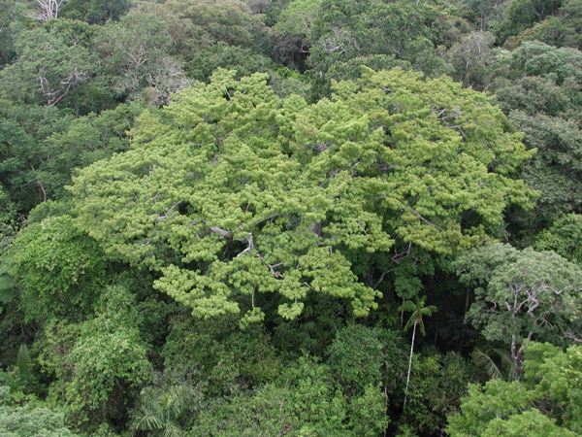

Data mining of remote sensing time series for land use change classification
Gilberto Câmara
www.esensing.org
Creative Commons License: By Attribution ̶̶̶̶ Non Commercial ̶̶̶̶ Share Alike

Slide 2





With many thanks to the esensing team…
Victor Maus
Lúbia Vinhas
Ieda Sanches
Isabel Escada
Karine Ferreira
Gilberto Ribeiro
Luiz F. Assis
Alber Sanchez
Ricardo Cartaxo
Eduardo Llapa

Slide 3
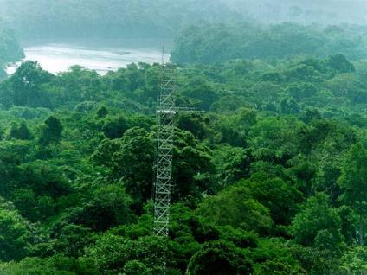
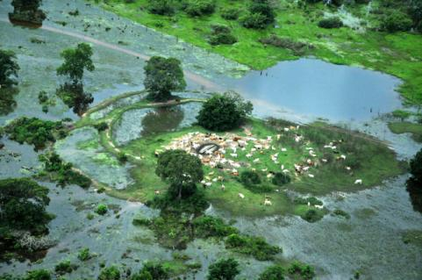
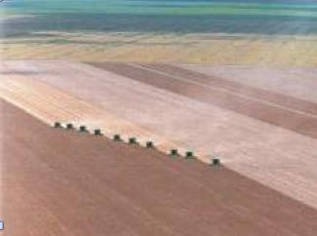
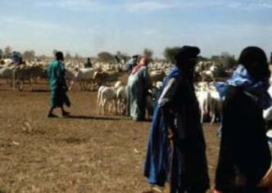
Land cover
  tropical forest
  wetlands
“the observed biophysical cover on the Earth’s surface"
  Non-natural vegetation
  shrublands

Slide 4
Land use
  unmanaged forest
  cattle production
“the arrangements, activities and inputs people undertake in a certain land cover type to produce, change or maintain it”
  Temporary agriculture
  shifting cultivation

Slide 5
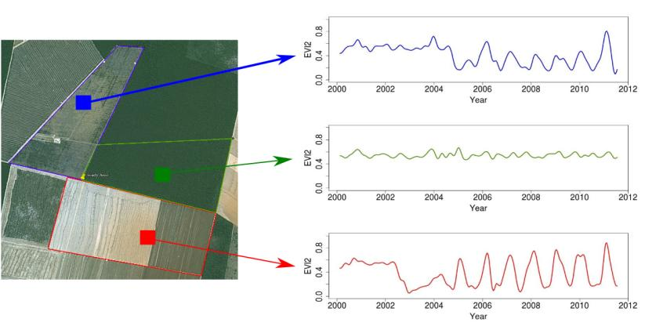
Land trajectories
Forest
Pasture
Agric
Área 1
Forest
Área 2
Forest
Agriculture
Área 3
“The transformations of land cover due to actions of land use”
graphics: Victor Maus (INPE, IFGI)

Slide 6
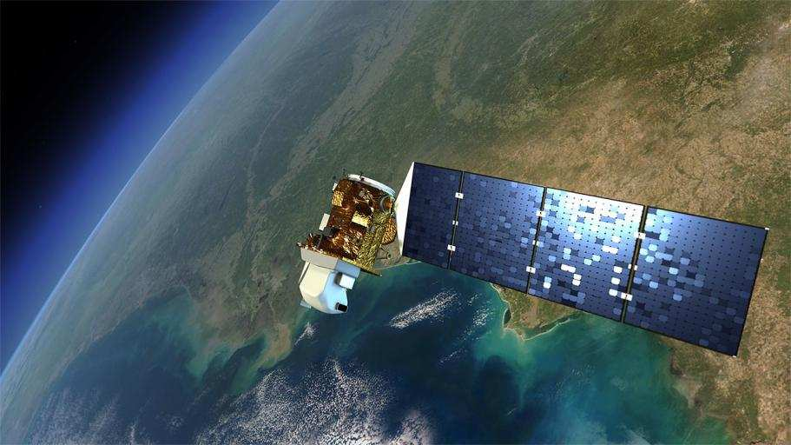
Earth Observation data is now free…and big
graphics: NASA
Sentinels + CBERS + LANDSAT + …: > 10Tb/day

Slide 7
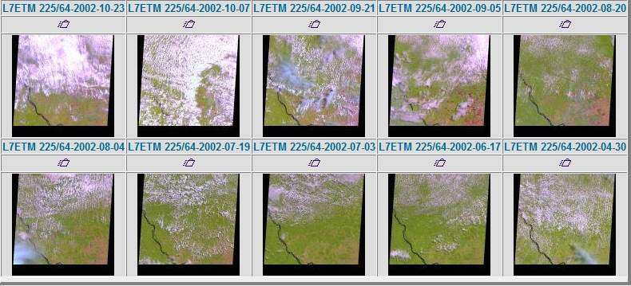
Is free data download our answer?
Users download one snapshot at a time
Notes:
Este slide mostra o impacto da cobertura de nuvens sobre a analise de imagens. Esta é uma região do Pará, onde todas as imagens durante o ano de 2002 tem cobertura de nuvens. Para reduzir este impacto, o INPE analisa varias imagens para uma mesma regiao.

Slide 8

Data Access Hitting a Wall
How do you download a petabyte?
You don’t! Move the software to the archive

Slide 9



Where we want to get to
Remote visualization and
method development
Big data EO management and analysis
40 years of Earth Observation data of land change accessible for analysis and modelling.

Slide 10
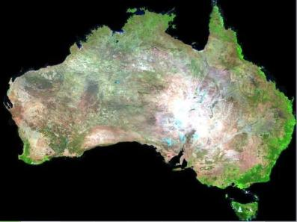


What changes with big EO data?
graphics: Geoscience Australia
Searching for changes instead of searching for objects

Slide 11
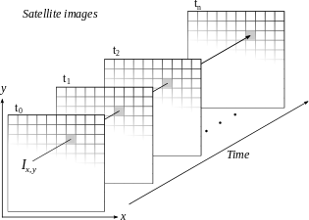
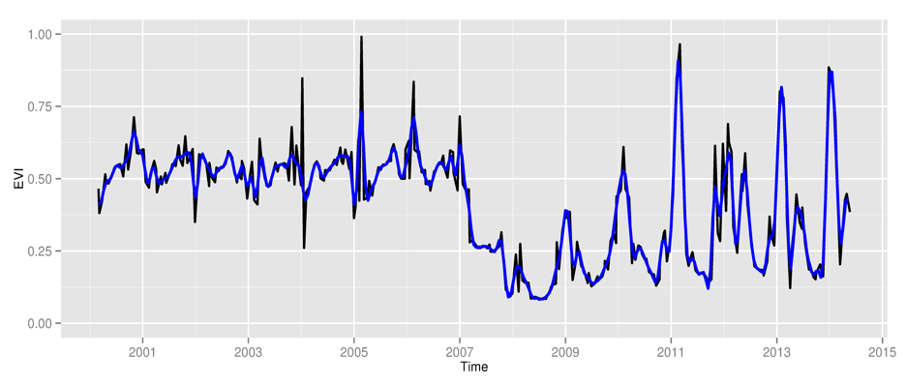
Space first, time later or time first, space later?
Space first: classify
images separately
Compare results in time
Time first: classify
time series separately
Join results to get maps

Slide 12
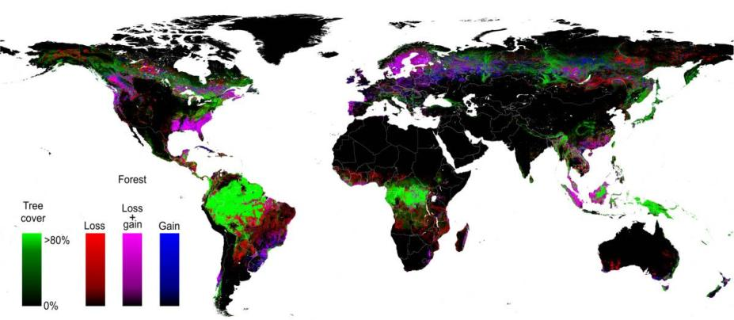
Space first, time later
High spatial resolution, low temporal resolution
Hansen et al. (2013)

Slide 13
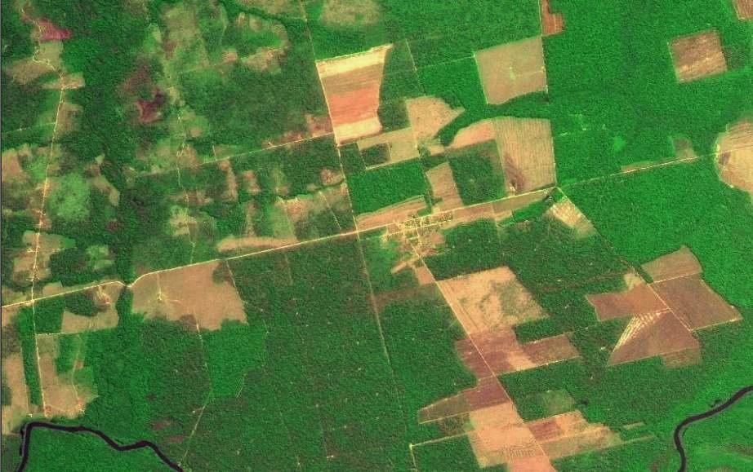
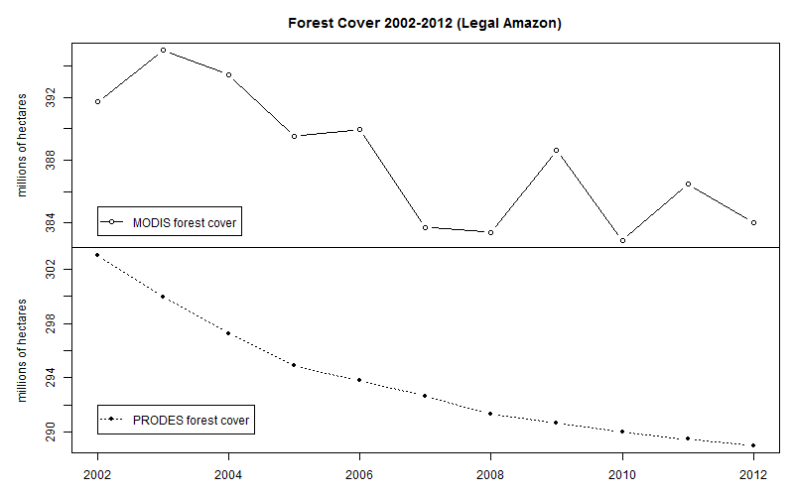
Space first can lead to inconsistent land trajectories
MODIS land cover: unrealistic forest gains and losses
Data sources: INPE, NASA. Analysis by M. Buurman

Slide 14
Hansen 2000 - Forest
Space first can lead to inconsistencies
MODIS 2000 - Forest
Disagreement in the Cerrado and Caatinga:
Image season, spatial resolution?

Slide 15
MODIS and HANSEN: forest in Brazil in 2000
Forest/Biomes | MODIS 2000 (Mha) | HANSEN 2000 (Mha)
Amazon | 350.289 | 355.888
Caatinga | 14.401 | 13.162
Cerrado | 43.782 | 52.556
Mata Atlântica | 33.630 | 37.318
Pantanal | 5.363 | 4.905
Pampa | 2.571 | 2.835
TOTAL | 450.036 | 466.663
Legal Amazon | 371.536 | 383.716
Strong total and spatial disagreement in the Cerrado, spatial disagreement in the Caatinga

Slide 16
Time first, space later
Forest
Pasture
Agric
Área 1
Forest
Área 2
Forest
Agriculture
Área 3
Remote sensing time series with good resolution provide data for describing landscape dynamics

Slide 17



How does our brain represent time?
…by means of events: relevant moments of change
photos: Reginald Gooledge

Slide 18
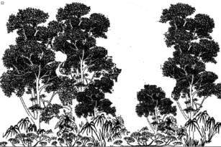
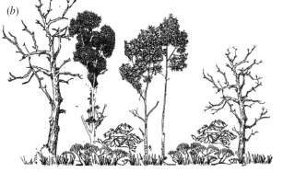
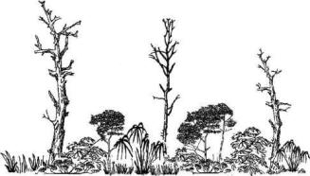

Land trajectories in forests
Exploração intensiva
80%
Event 1
Perda >50% do dossel
Event 2
50%
Perda >90% do dossel
Event 3
10%
Event 4
Corte raso
Floresta
0%
Floresta
Events of forest cover loss

Slide 19
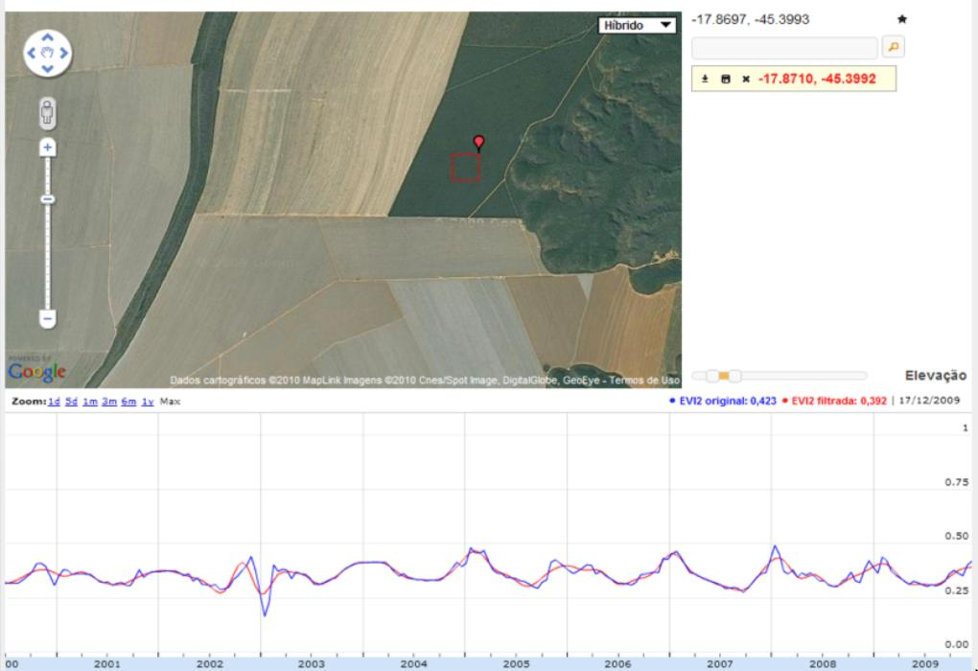
Tropical forest: stable signal + low seasonal change
One sample per year (PRODES)
graphics: LAF/INPE
source: INPE

Slide 20
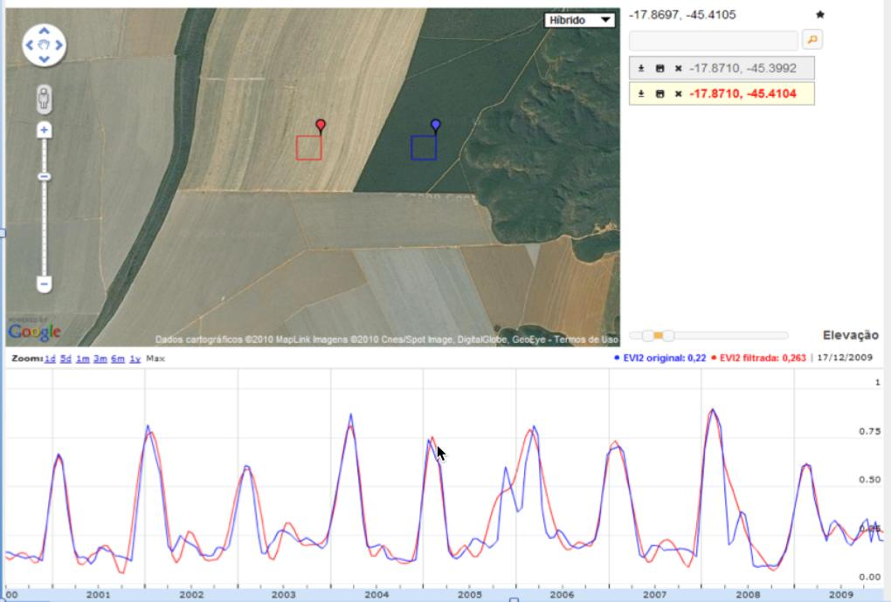
Single-crop grain production (60-120 days)
One sample per month (?)
graphics: LAF/INPE
source: INPE

Slide 21
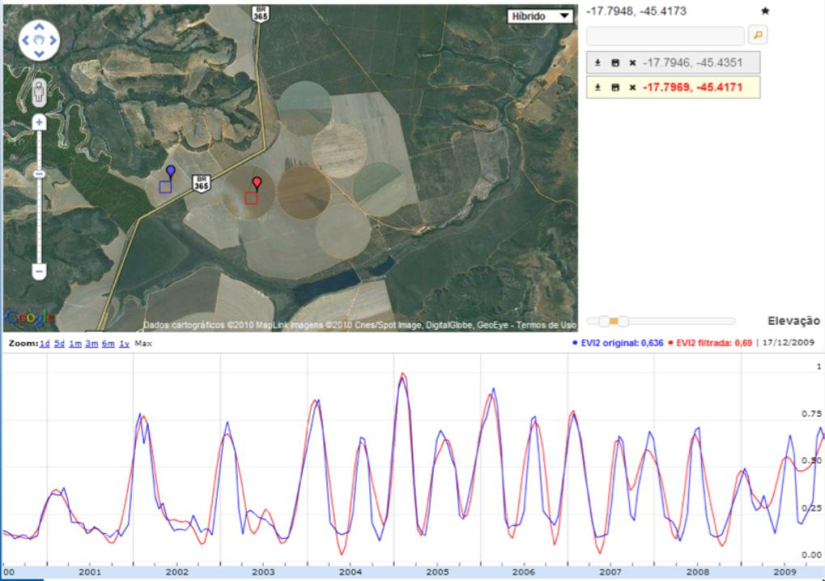
Double-cropping: soybeans + corn
Two samples per month (?)
graphics: LAF/INPE
source: INPE

Slide 22
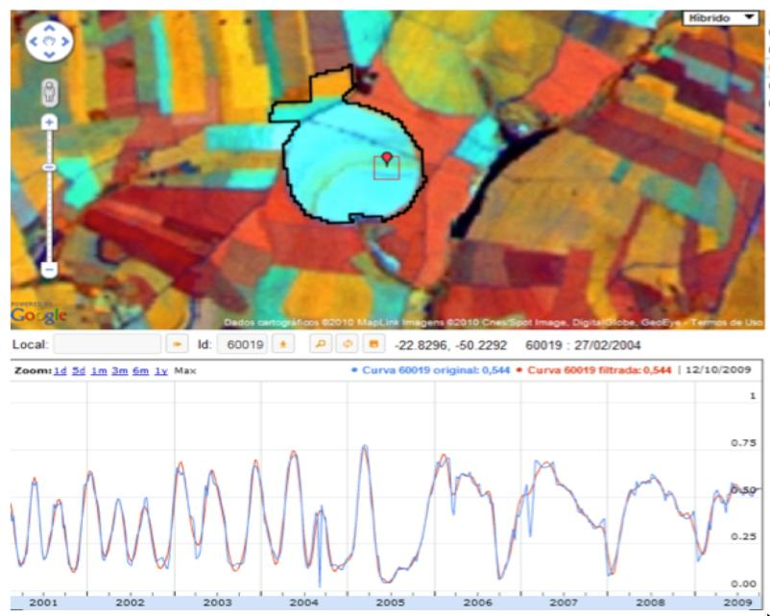
Crop conversion: from soy-corn to sugarcane
graphics: LAF/INPE

Slide 23
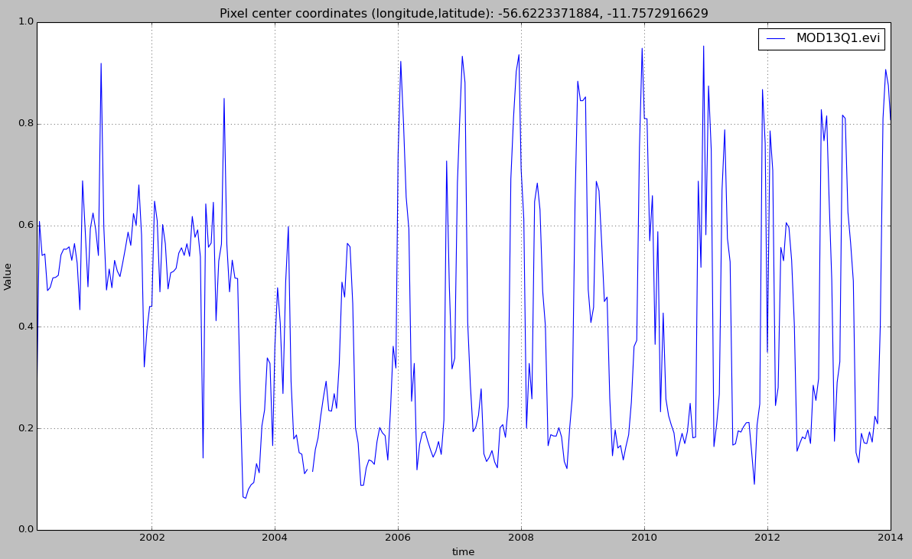

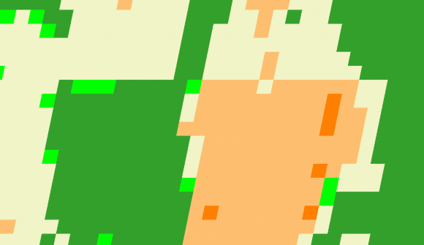
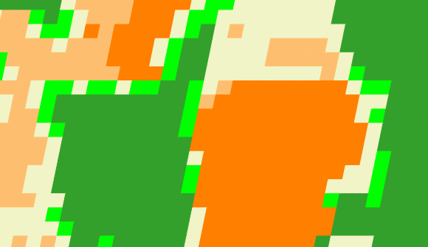
Land trajectories
Forest
Single cropping
Double cropping
2001
2006
2013

Slide 24
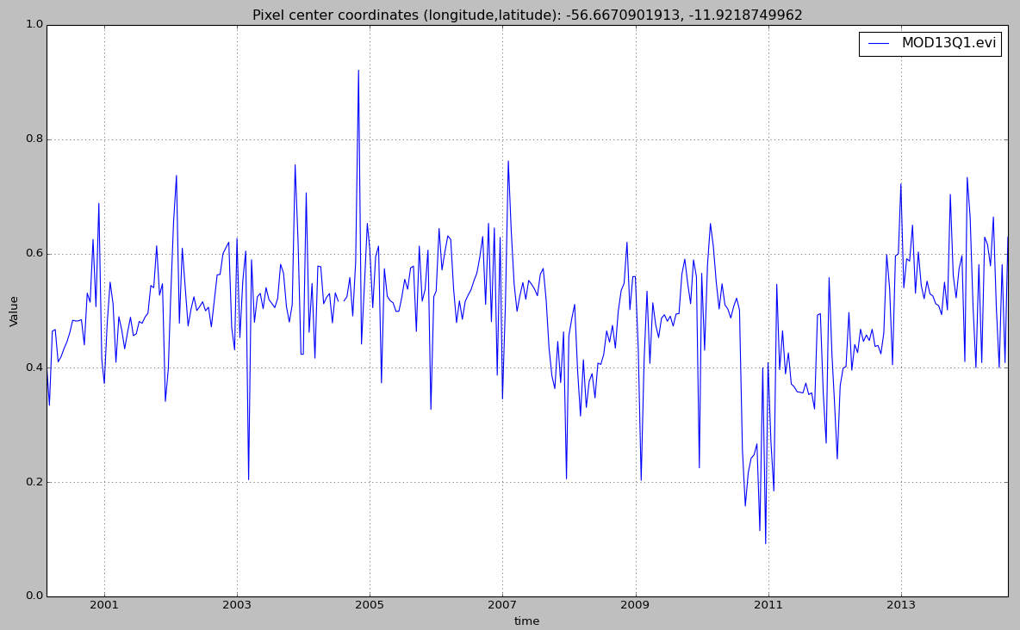
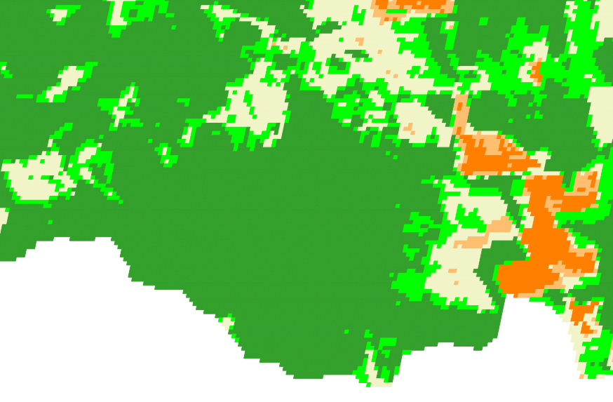
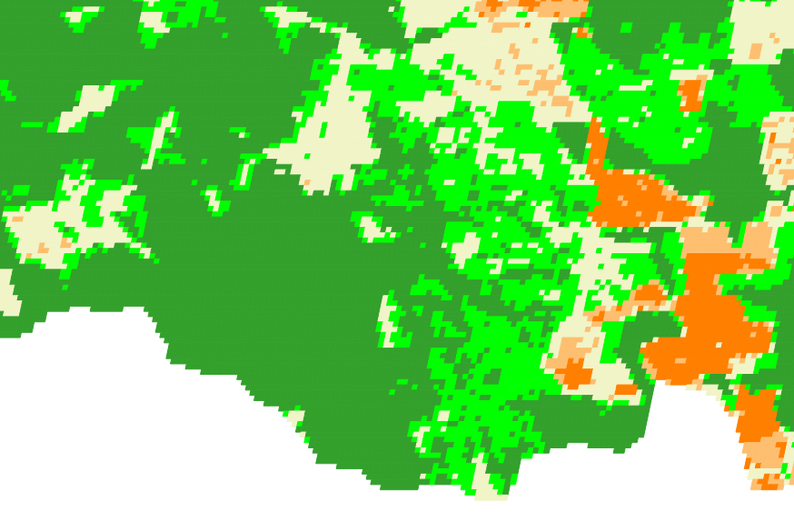
Land trajectories: forest degradation
EVI Time Series
2007
2009
2007
2009

Slide 25
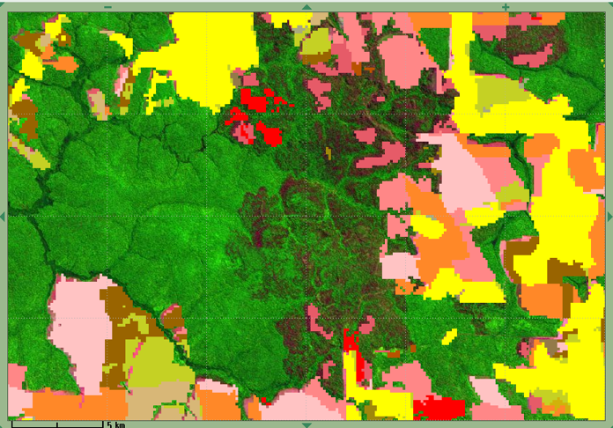
Land trajectories: forest degradation
EVI Time Series
2007
2009
PRODES
2007
2008

Slide 26
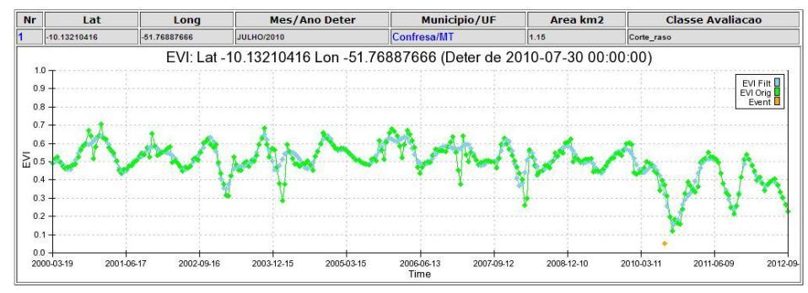
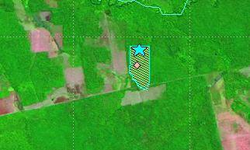
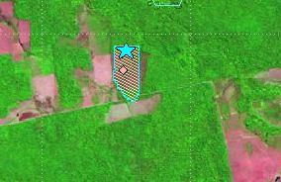
Land trajectories: deforestation events
images: INPE
2010
2011

Slide 27
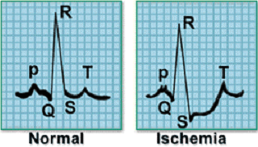
What do we want to do with time series?
Clustering
Classification
Pattern Matching
Novelty Detection
Keogh (2006)

Slide 28
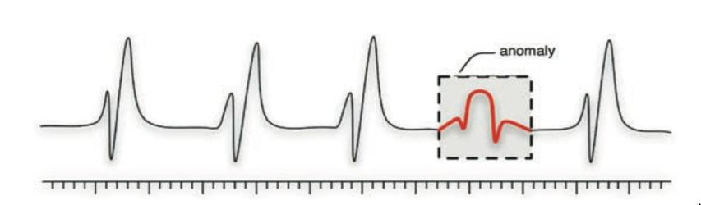
Data mining in time series: event detection
Deviation from standard behaviour:
find subsequences that do not follow the model
Esling & Agon (2012)

Slide 29
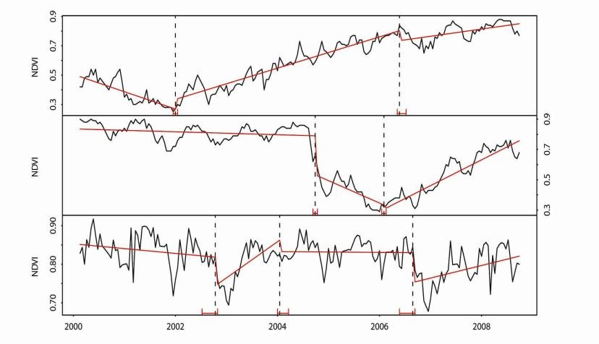
Time series mining: event detection
BFAST: changes in a pine plantation (trend breaks)
Verbesselt et al. (2010)

Slide 30
Deforestation alert detection: progress needed
True positive
True positive
False negative
BFAST in Amazonia: high user’s accuracy (90%), low producer’s accuracy (15%): Deforestation is not always related to abruptly decreasing EVI values.
Stephan (2015)

Slide 31
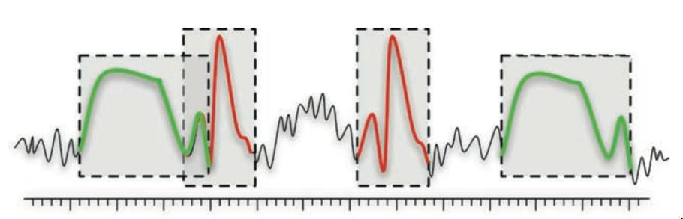
Data mining in time series: pattern matching
Finding subsequences in a time series
High computational complexity
Patterns are idealized, data is noisy
Esling & Agon (2012)

Slide 32
Hypotesis: land patterns have distinct shapes
Forest
Pasture
Agric
Área 1
Forest
Área 2
Forest
Agriculture
Área 3
source: Victor Maus (INPE, IFGI)

Slide 33
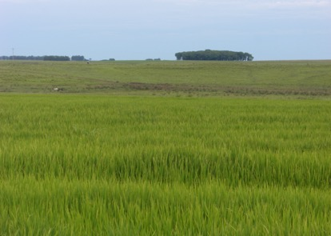
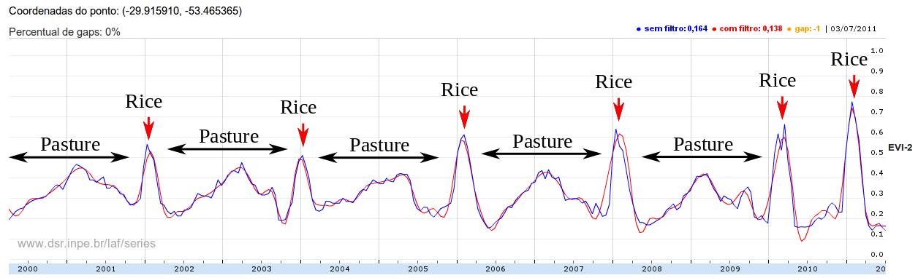
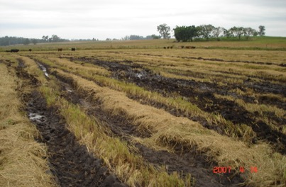
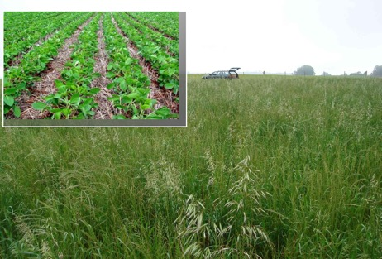
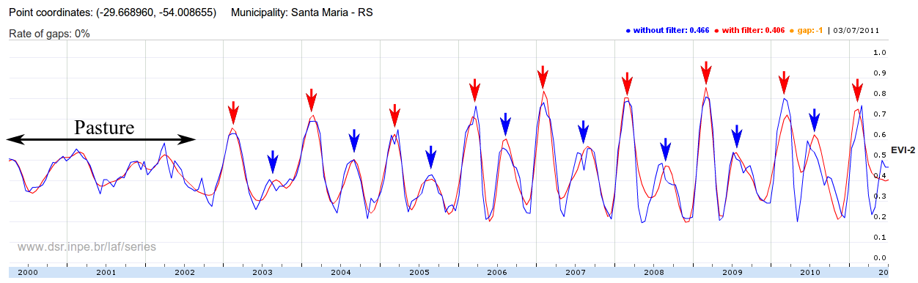
Assumption: shape recognition is key problem
Fallow
Fallow
Fallow
Fallow
Fallow
Soybean
Ryegrass
Victor Maus

Slide 34
Land use patterns derive from phenological cycles
Temporal patterns of EVI modis 16 days
Arvor et al. (2011)

Slide 35
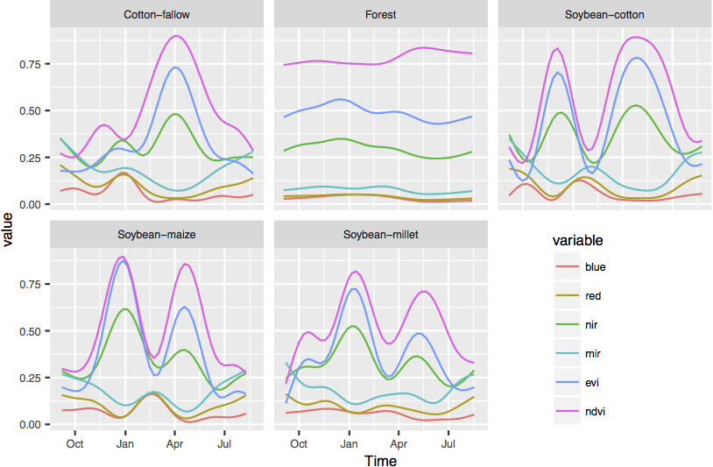
Temporal patterns of different classes
Maus (2016)

Slide 36
How to match land use patterns in a remote sensing time series?
A good match needs shape similarity and temporal coherence

Slide 37
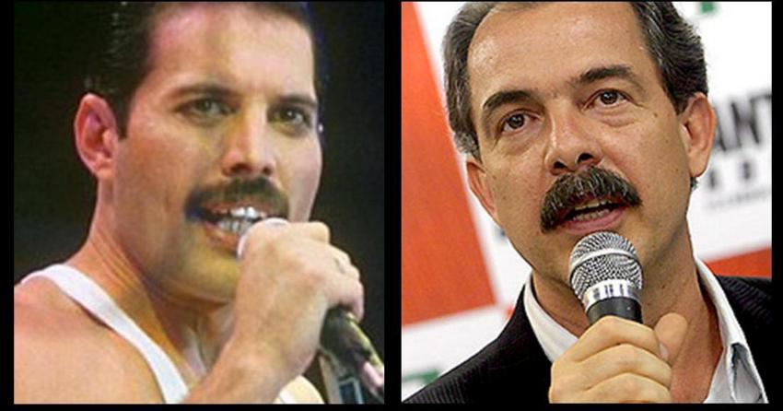
What is similarity?
resemblance, likeness, sameness, comparability, correspondence, analogy, parallel, equivalence;
adapted from Keogh (2006)

Slide 38
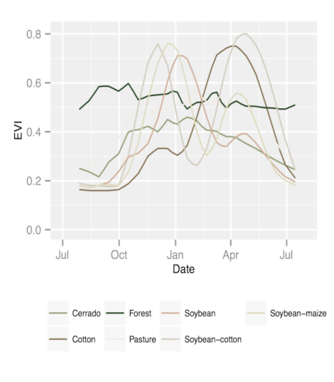
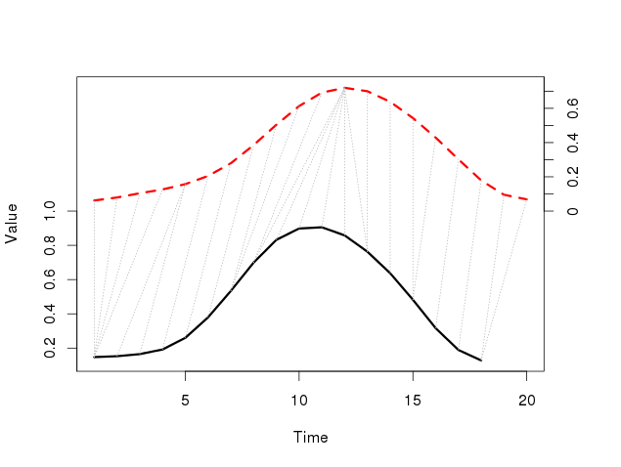
Dynamic Time Warping: pattern matching by similarity
Arvor et al (2012), Keogh (2006)
DTW “warps” the time axis: nonlinear matching

Slide 39
How is DTW calculated?
Q
C
C
Q
We create a matrix the size of
|Q| by |C|, then fill it in with the distance between every pair of point in our two time series.
Keogh (2006)
Notes:
Time Warps, String Edits, and Macromolecules: The Theory and Practice of Sequence Comparison. By David Sankoff and Joseph Kruskal
is a classic reference for this

Slide 40
How is DTW calculated?
Every possible warping between two time series, is a path though the matrix. We want the best one…
C
Q
Warping path w
Keogh (2006)

Slide 41
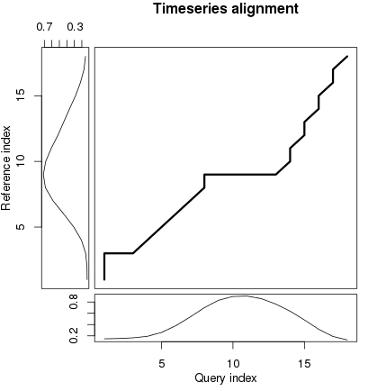
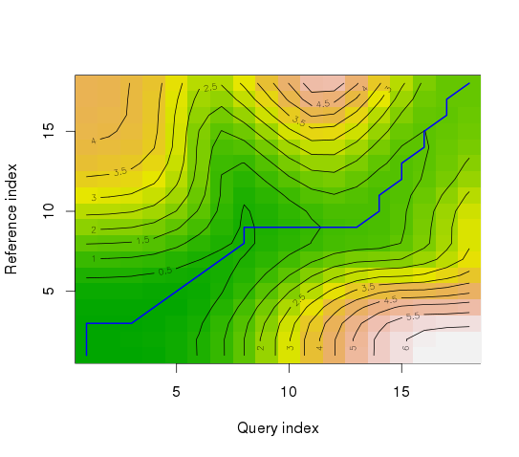
Dynamic Time Warping (DTW)
Density
DTW finds the lowest cost path

Slide 42
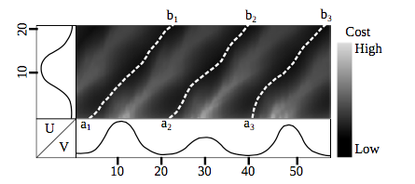
Accumulated cost matrix
Three possible alignments of the pattern U within the long-term time series V
Maus et al. (2015)

Slide 43
Land use patterns should also match agricultural calendar
Balance between shape matching and temporal alignment
(matches distant in time are penalised)

Slide 44
Time-weighted dynamic time warping (TWDTW) for remote sensing time series
TWDTW finds alignments of short templates in a long time series
considering the agricultural calendar

Slide 45
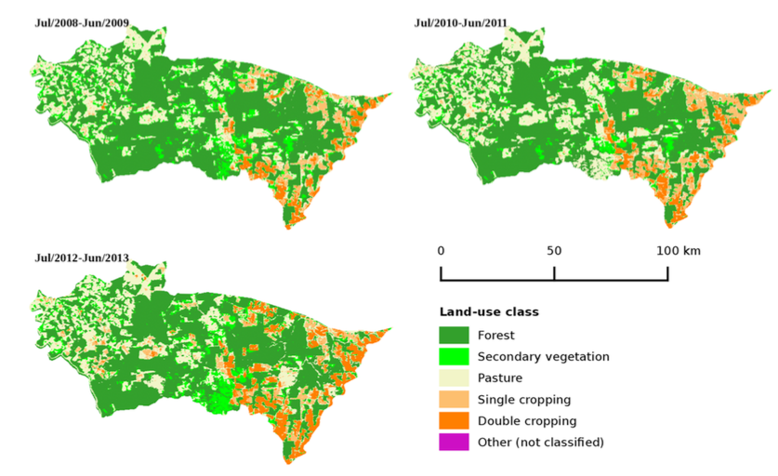
Porto dos Gaúchos, MT
Maus et al. (2016)

Slide 46
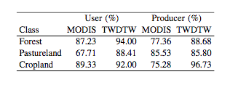
MODIS x Time-weighted DTW
Producer's accuracy: fraction of correctly classified pixels compared to all pixels of that ground truth class
User's accuracy (reliability): fraction of correctly classified pixels of a class compared to all pixels classified as being that class

Slide 47
Reproducibilty: R package

Slide 48
dtwSat: classifying image time series

Slide 49
dtwSat: classifying spacetime images

Slide 50
dtwSat: classifying spacetime images
Percentage of land cover class from 2008 to 2013

Slide 51
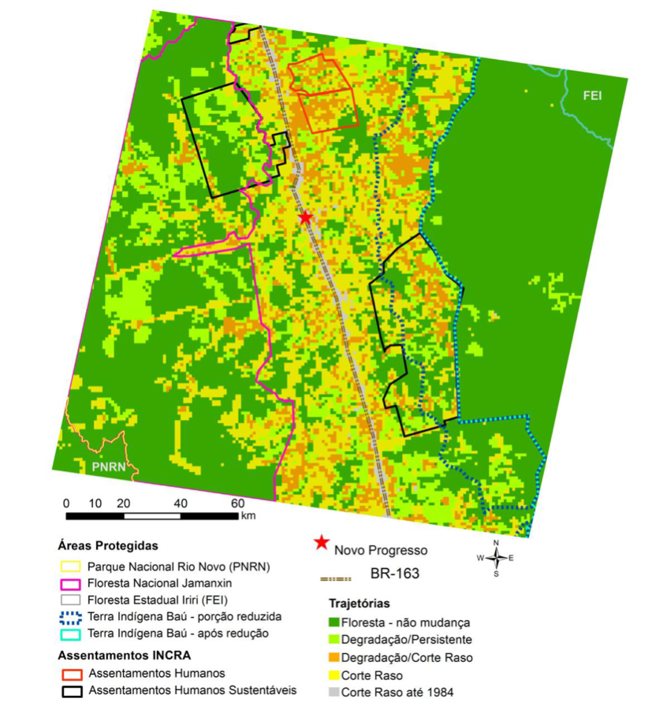
Data mining applications to big EO data
Deforestation and degradation trajectories in Amazonia
Pinheiro (2015)

Slide 52
Data mining applications to big EO data
Crop trajectories in Brazilian agriculture
Sanches et al. (2015)

Slide 53
Land use change trajectories in the Amazonian biome of Mato Grosso state (2001-2014)
7.8 million time series

Slide 54
Mato Grosso – Amazonia biome (2001)

Slide 55
Mato Grosso – Amazonia biome (2002)

Slide 56
Mato Grosso – Amazonia biome (2003)

Slide 57
Mato Grosso – Amazonia biome (2004)

Slide 58
Mato Grosso – Amazonia biome (2005)

Slide 59
Mato Grosso – Amazonia biome (2006)

Slide 60
Mato Grosso – Amazonia biome (2007)

Slide 61
Mato Grosso – Amazonia biome (2008)

Slide 62
Mato Grosso – Amazonia biome (2009)

Slide 63
Mato Grosso – Amazonia biome (2010)

Slide 64
Mato Grosso – Amazonia biome (2011)

Slide 65
Mato Grosso – Amazonia biome (2012)

Slide 66
Mato Grosso – Amazonia biome (2013)

Slide 67
Mato Grosso – Amazonia biome (2014)

Slide 69




How do we handle big EO data?

Slide 70

Scientific data: multidimensional arrays
y
t
X
g = f (<x,y,z> [a₁, ….a_{n}])

Slide 71

Array databases: all data from a sensor put together in a single array
t
y
y
X
result = analysis_function (points in space-time )

Slide 72
WTSS: web time series service

Slide 73







Open source and open data = knowledge sharing
New insights into land use change
Free satellite
imagery
R: New data analysis methods
SciDB: array database for big scientific data
www.esensing.org
Big data analytics: the new frontier on Earth observation

Slide 74

Global Land Observatory: describing change in a connected world
Methods for land change for forestry and agriculture uses
40 years of LANDSAT + 12 years of MODIS + SENTINELs + CBERS
Unique repository of knowledge and data about global land change

Slide 75
Where we want to get to
Remote visualization and
method development
Big data EO management and analysis
40 years of Earth Observation data of land change accessible for analysis and modelling.

Slide 76
References from e-sensing project
MAUS, V.; CAMARA, G.; CARTAXO, R.; SANCHEZ, A.; RAMOS, F. M.; QUEIROZ, G. R. A time-weighted dynamic time warping method for land- use and land-cover mapping. IEEE Journal of Selected Topics in Applied Earth Observations and Remote Sensing, online, 2016.
Maus, V.; Camara, G.; Cartaxo, R.; Sanchez, A.; Ramos, F. M.; Queiroz, G. R. Land use and land cover monitoring using remote sensing image time series. Doctoral dissertation in Earth System Science, INPE.
Taíse Pinheiro. Padrões e trajetórias de degradação florestal em fronteiras madeireiras da amazônia (Patterns and trajectories of forest degradation in the logging frontiers in Amazonia). Doctoral dissertation in Earth System Science, INPE. Viva: 17.12.2015. Advisor: Isabel Escada.

