Slide 1
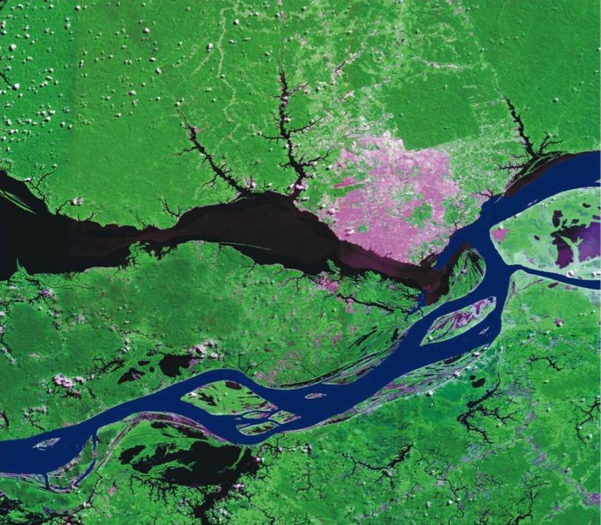
Fields as a Generic Data Type for Big Spatial Data
Gilberto Camara, Max J. Egenhofer, Karine Ferreira, Pedro Andrade, Gilberto Queiroz, Alber Sanchez, Jim Jones, and Lubia Vinhas
image: INPE

Slide 2
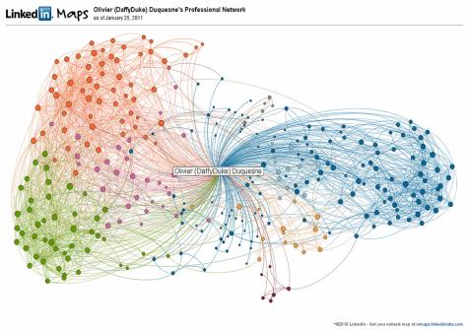
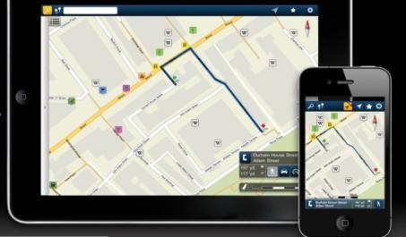
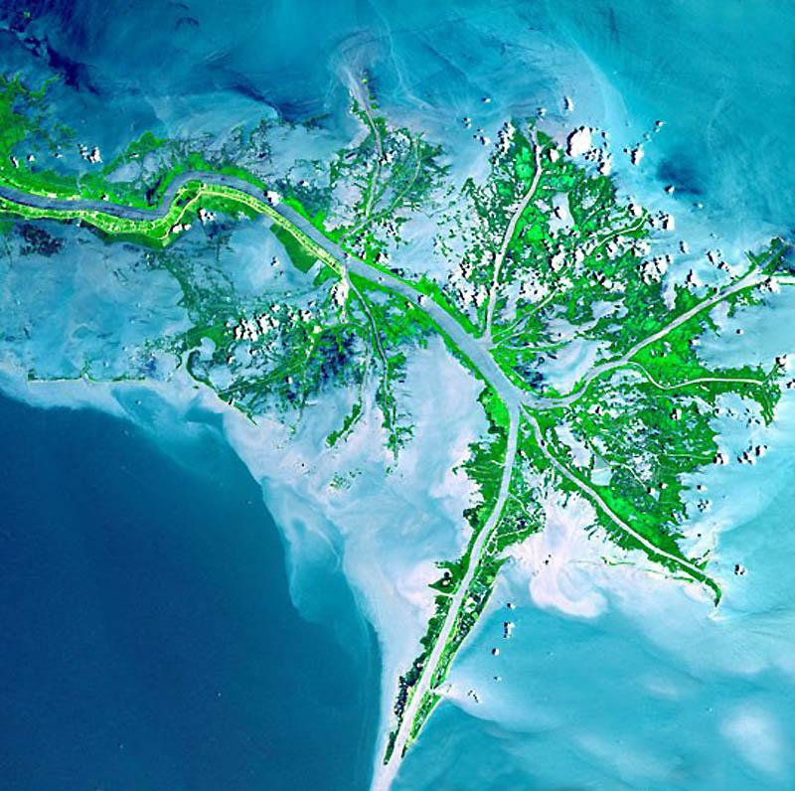
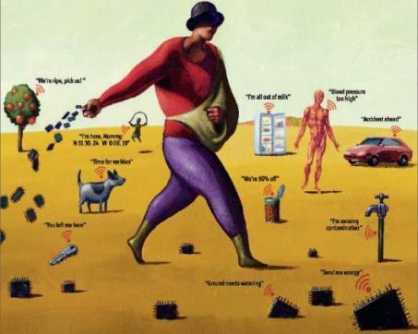
mobile devices
social networks
Earth observation and navigation satellites, mobile devices, social networks, and smart sensors: Big geospatial data.
sensors everywhere
ubiquitous imagery

Slide 3
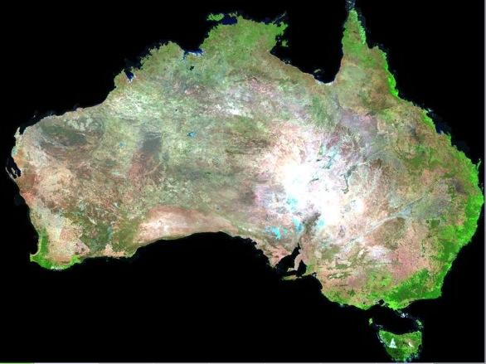
Big data requires new conceptual views
How can we best use the information provided by big data sources?
Image source: Geoscience Australia

Slide 4
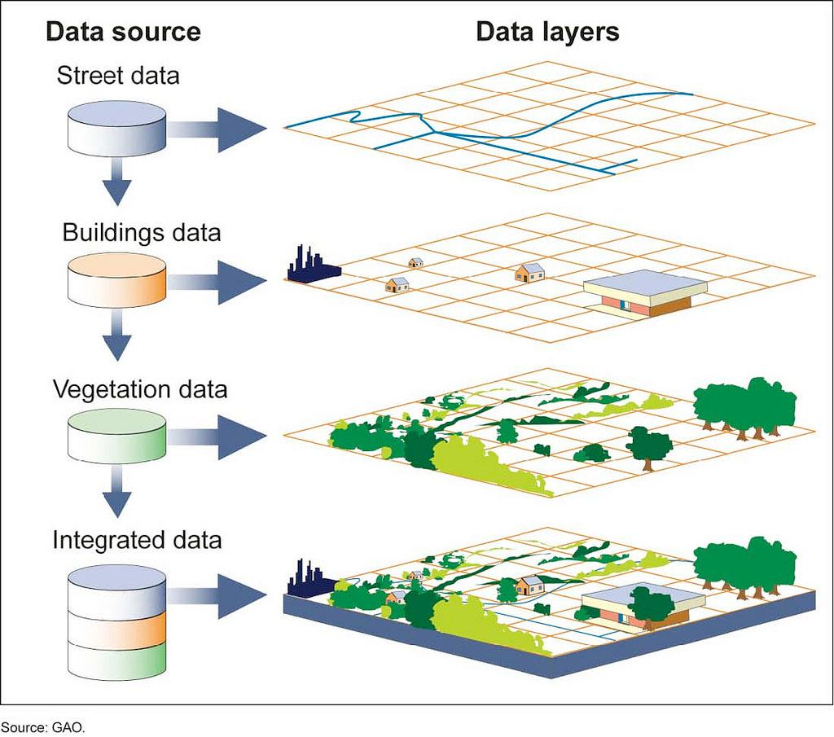
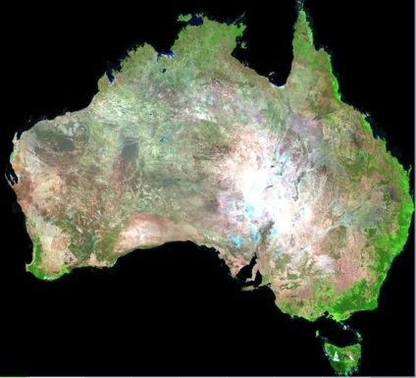
Layer-Based GIS: Few and different data sources Big Data GIS: Lots of similar data sources
Big data does not fit into the “map as set of layers” model
Image sources: GAO, Geoscience Australia

Slide 5
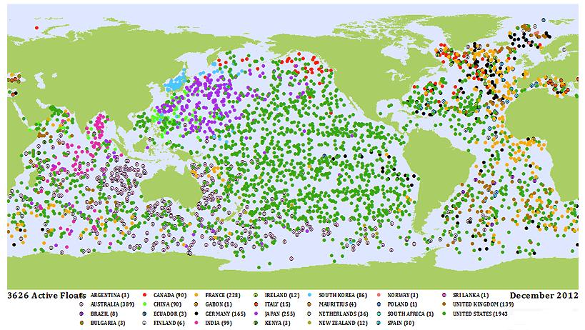
An example of big geospatial data
image source: NOAA
ARGO buoys - 3,500 floats
120,000 temp, salinity, depth profiles/year

Slide 6
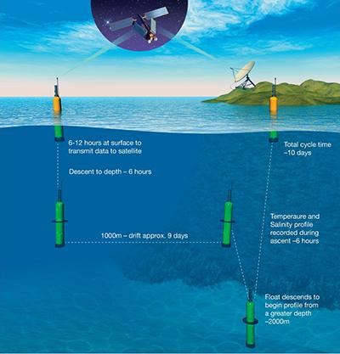
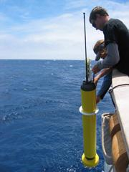
ARGO buoys: innovative technology
Sensors measure down to 2,000 m, 10-Day Cycle
images source: NOAA
Floating buoys measuring properties of the oceans

Slide 7
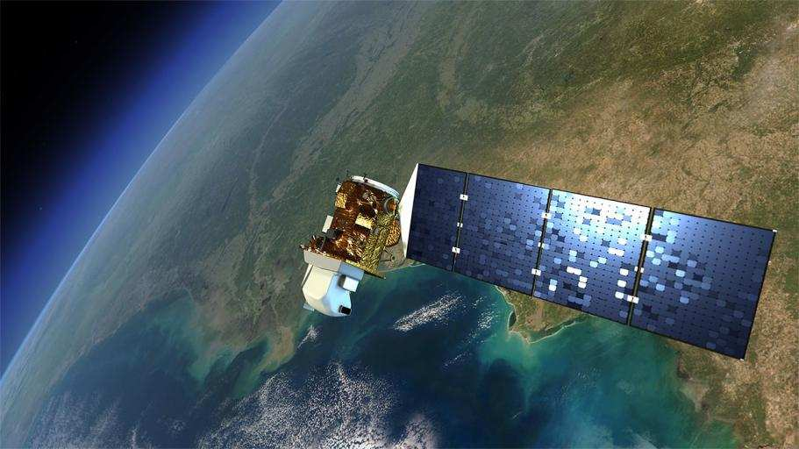
Another example: Free and big Earth Observation data
Open access data (US, EC, BR, CH): 5Tb/day
Image source: NASA

Slide 8
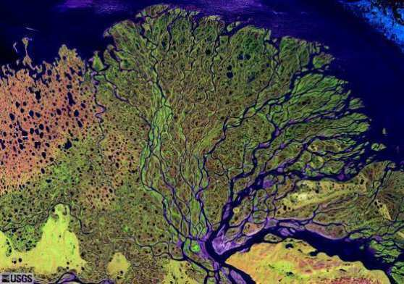
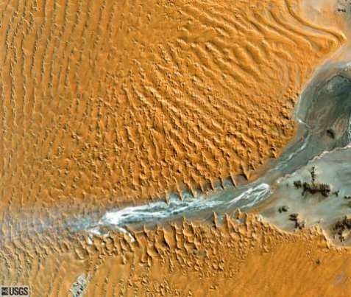
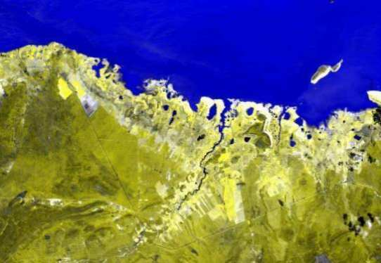
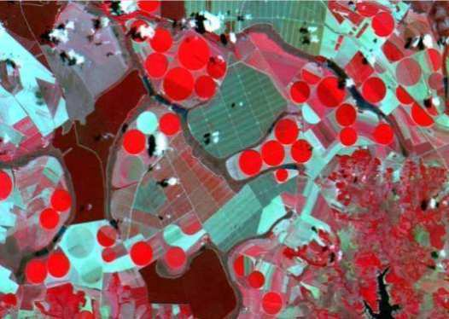
Earth observation satellites provide key information about global change …
… but that information needs to be modeled and extracted

Slide 9
To deal with big geospatial data, we need to reassess the core concepts of Geoinformatics

Slide 10
Premise 1: Reality exists independently of human representations and changes continuously

Slide 11
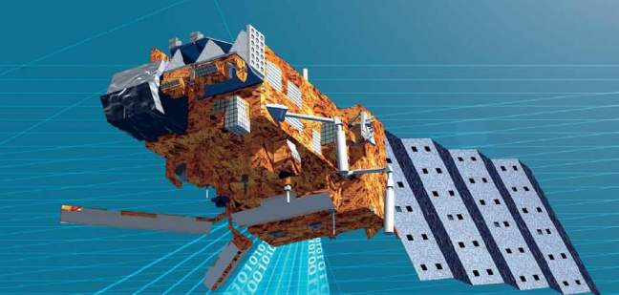
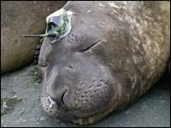
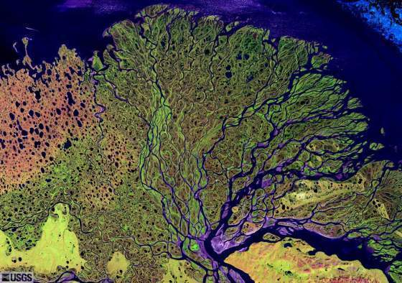
Premise 2: We have access to the world through our observations

Slide 12
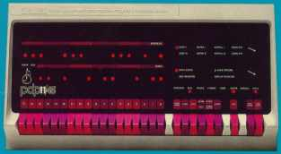
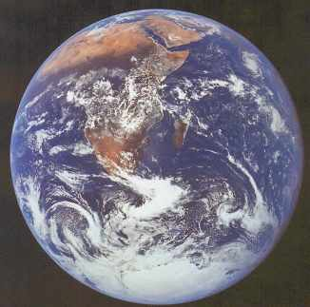
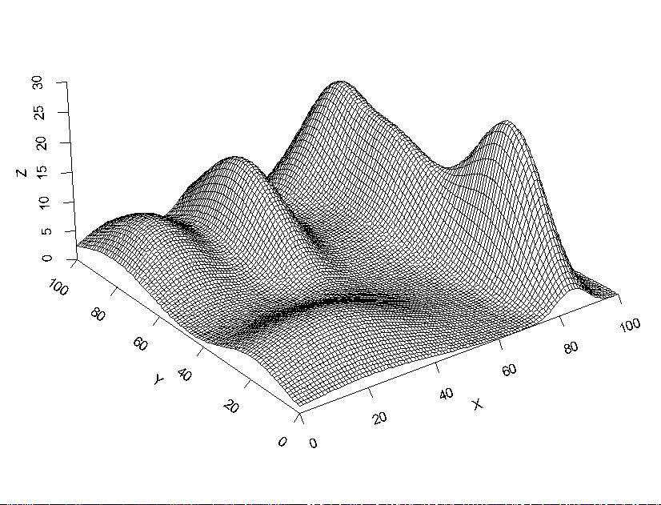
Premise 3: Computer representations of space and time should approximate the continuity of external reality

Slide 13
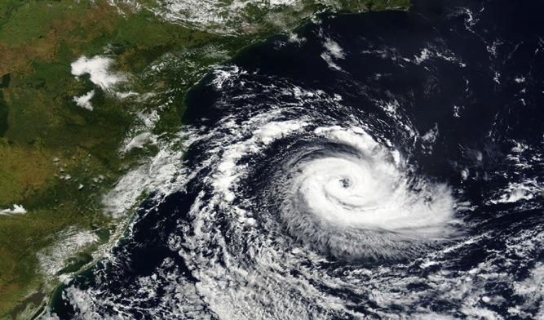
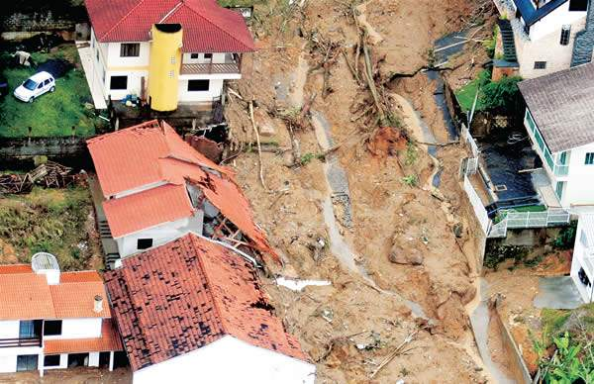
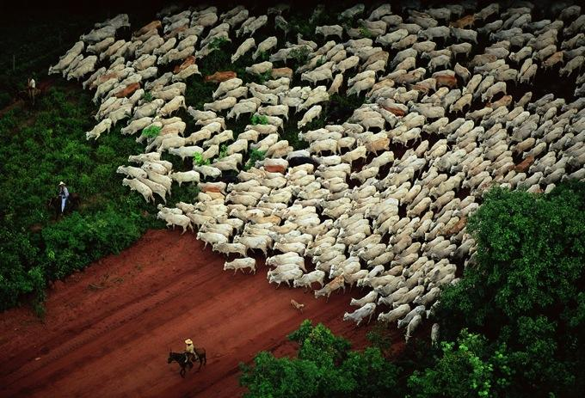
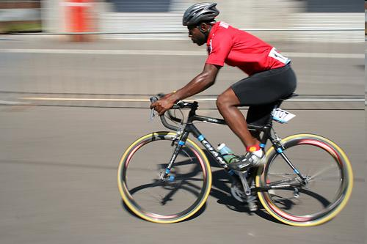
Conjecture 1: Data models for space-time data should be as generic as possible
We need to represent volume, variety, velocity

Slide 14
Conjecture 2: Space-time data models need observations as their building blocks
An observation is a measure of a property in space-time

Slide 15
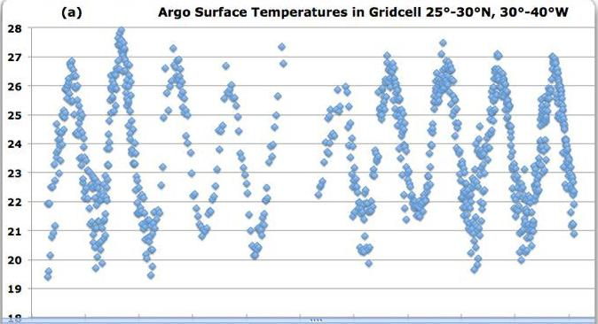
Conjecture 3. Sensors only provide samples of the external reality
Willis Eschenbach
To represent the continuity of world, we need more!

Slide 16
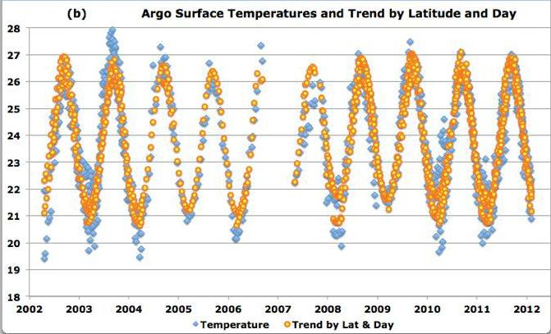
Conjecture 4: Approximating external reality needs space-time data samples and estimators
Willis Eschenbach
temp = (2 + sin(2 π* (julianday + lag)/365.25)) ˆ1.4

Slide 17
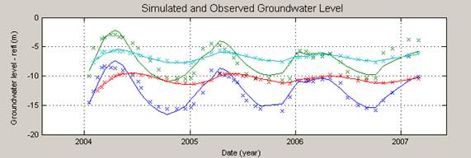
Conjecture 5: Fields = Sensor data + Estimators
A field estimates values of a property for all positions inside its extent
(fields simulate the continuity of external reality)

Slide 18
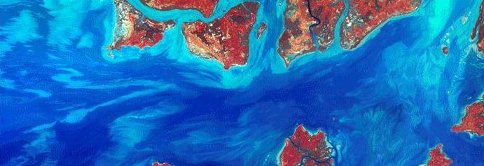
Fields as a Generic Data Type
estimate: Position → Value
Positions at which estimations are made
Values that are estimated for each position

Slide 19
Fields as a Generic Data Type
estimate: Position → Value
Positions are generic locations is space-time
Values are generic estimates for each position

Slide 20
Fields as a Generic Data Type
estimate: Position → Value
Instances of Position: space, time, and space-time
Instances of Value: numbers, strings, space-time

Slide 21
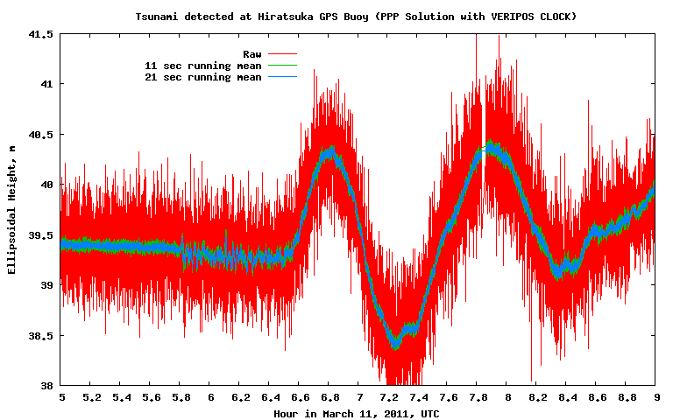
A time series field (tsunami buoy)
image: Buoy near the coast of Japan
positions: time values: wave height
An Australian Geoscience Data Cube

Slide 22
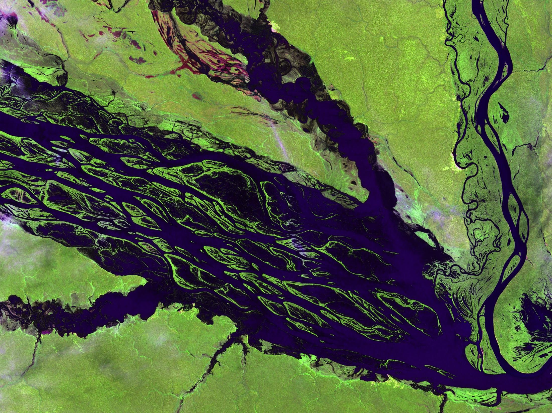
A coverage field (remote sensing image)
image: USGS
positions: 2Dspace values: soil reflectance
An Australian Geoscience Data Cube

Slide 23
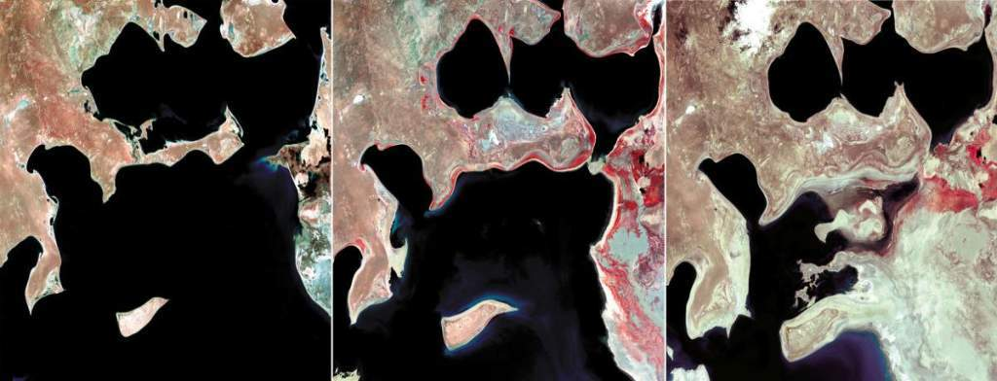
A field of fields
images: USGS
positions: time values: coverages (2DSpace number)
coverage set
An Australian Geoscience Data Cube

Slide 24
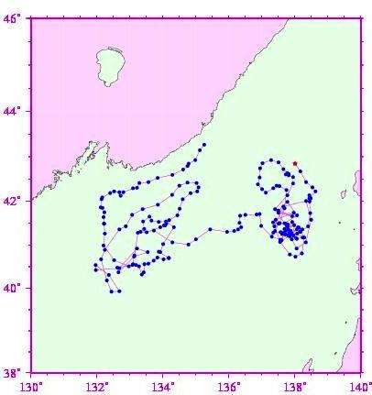
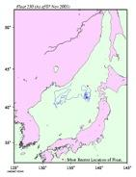
A trajectory field
Russia
• 8/8/99
Argo float UW 230
deployed 02.08.1999
10-day interval data
until 07.11.2003
• 11/7/03
Japan/East Sea
source: Stephen Riser
University of Washington
Japan
positions: time values: space

Slide 25
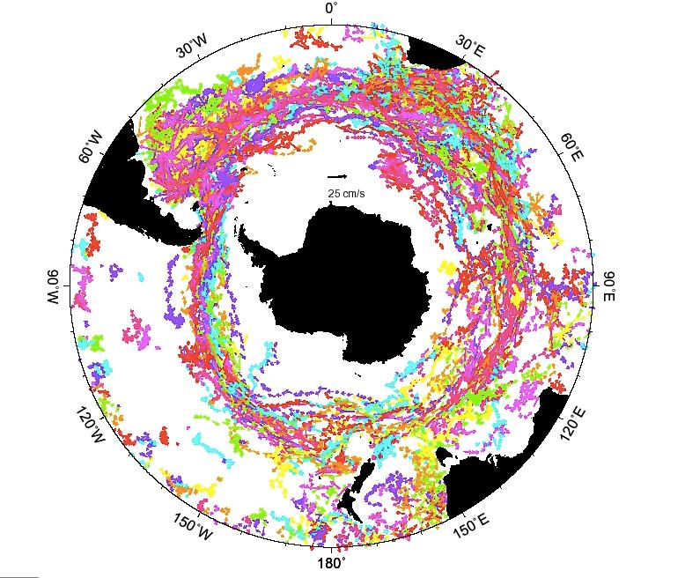
A field of fields (Argo floats in Southern Ocean)
Positions: space Values: trajectories (time  space)

Slide 26
A space-time field extracted from float data
Positions: space-time Values: water temperature

Slide 27
Different choices for spatial estimators: same data source, different fields
Observations
of soil profiles
Geostatistics
Gravitational
Voronoi
Notes:
Parte 1: definições, conceitos, os quatro universos de representação, modelagem de dados;
Parte 2: estrutura dual, bancos de dados relacionais, consulta espacial;
Parte 3: aspectos interdisciplinares, modelagem matemática, integração de dados, generalização;
Parte 4: principais operadores, álgebra de mapas, LEGAL, menus e formulários x linguagem de alto nível;
Parte 5: apresentação dos detalhes de alguns projetos tipicamente ambientais e cadastrais.

Slide 28
Field data model
Field F [P:Position, V:Value, E:Extent, G:Estimator]
extent
A
F₁
domain(f₁) = {p₁,p₂,p₃}
estimate (f₁, p_{new}) = g(f₁, p_{new})
extent (f₁) = δ(A)
p₂
p₃
p₁
p_{new}
Domain defines granularity
Estimator provides value on all positions inside the extent

Slide 29
Conjecture 6: To identify objects and events in our descriptions of reality, we need first to define fields
Objects
External Reality
Observ.
Fields
Events

Slide 30
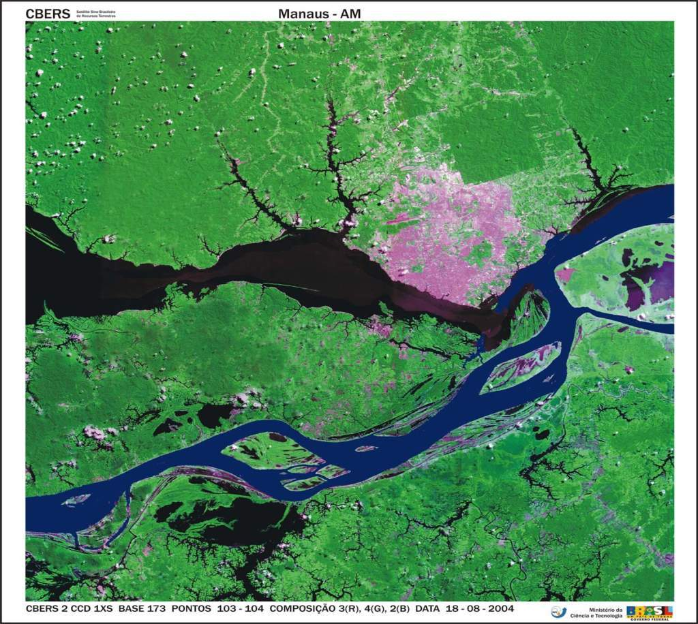
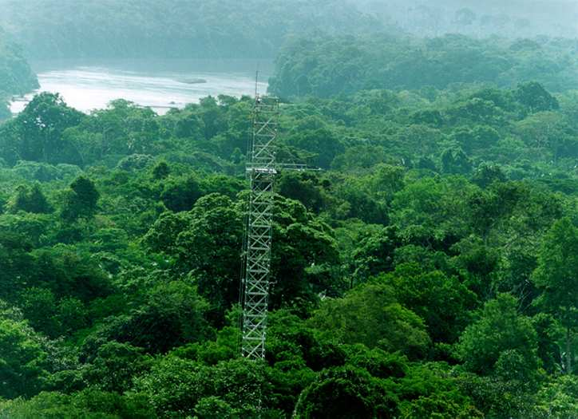
What is a geo-sensor?
What is a geo-sensor?
Field [E, P, V, G] uses E:Extent, P:Position, V:Value, G:Estimator
new: E x G → Field
add: Field x (P, V) → Field
obs: Field → {(P, V)}
domain: Field → {P}
extent: Field → E
estimate: Field x P → V
subfield: Field x E → Field
filter: Field x (V → Bool) → Field
map: Field x (V → V) → Field
combine: Field x Field x (V x V → V) → Field
reduce: Field x (V x V → V) → V
neigh: Field x P x (P x P → Bool) → Field
measure (s,t) = v
s ⋲ S - set of locations in space
t ⋲ T - is the set of times.
v ⋲ V - set of values

Slide 31
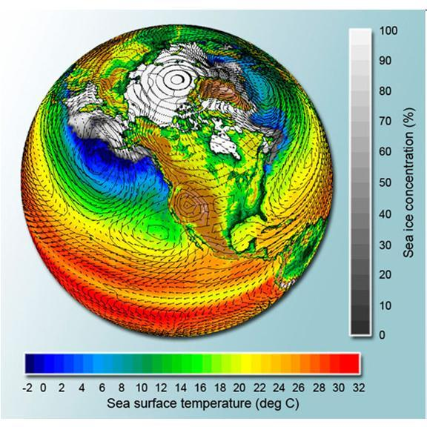
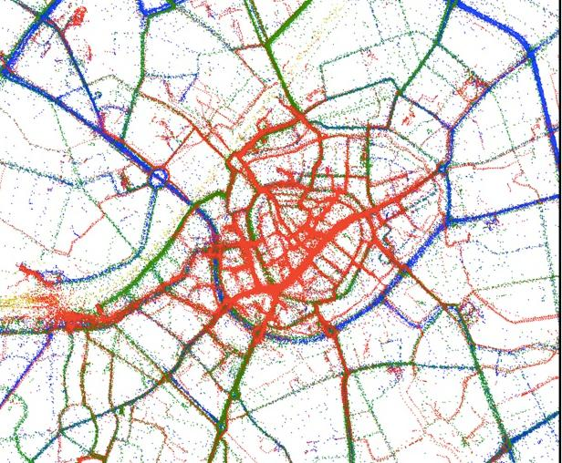
How can we make the Fields model work in practice?
Image sources: INPE, Filip Biljecki, UNAVCO

Slide 32
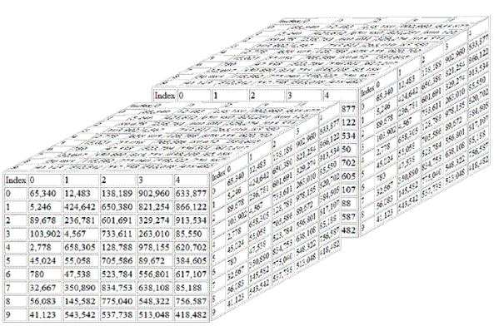
Scientific data: multidimensional arrays
y
t
X
g = f(<x,y,t> [a₁, ….a_{n}])

Slide 33
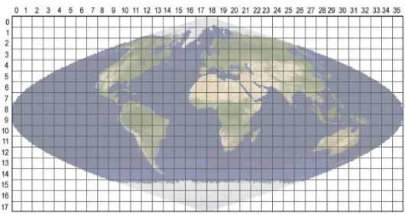
Array databases: all data from a sensor put together into a single array
y
t
X
Field operations on positions in space-time

Slide 34
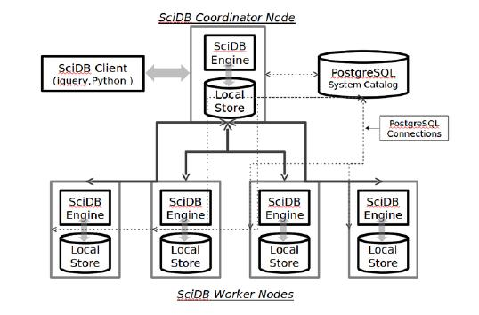
SciDB architecture: “Shared nothing”
image: Paul Brown (Paradigm 4)
Large data is broken into chunks
Distributed server process data in parallel

Slide 35
Mapping the Fields data model to SciDB
What we have in SciDB
Array management
Array analysis (linear algebra)
Scalability, distributed proc
What we need
Spatial, temporal, spectral, and semantic reference systems
Operations in space-time data

Slide 36
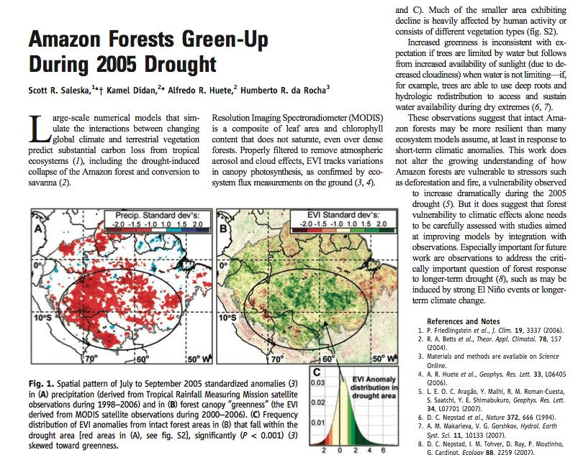
An experiment on reproducible science using the Fields data model and SciDB

Slide 37
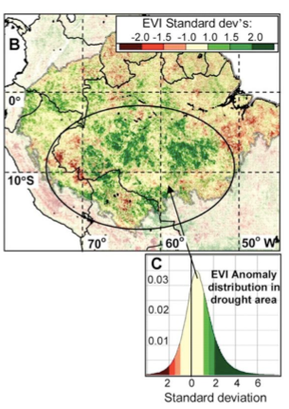
Did Amazon forests green up during 2005 drought?
An experiment on reproducible science
Forest canopy “greenness” JAS 2005
Significantly greater than average “greeness” JAS 2000-2006
“Greeness” measured by EVI (enhanced vegetation index)
S R Saleska et al., Science 2007;318:612
Notes:
Spatial pattern of July to September 2005 standardized anomalies (3) in (A) precipitation (derived from Tropical Rainfall Measuring Mission satellite observations during 1998–2006) and in (B) forest canopy “greenness” (the EVI derived from MODIS satellite observations during 2000–2006). (C) Frequency distribution of EVI anomalies from intact forest areas in (B) that fall within the drought area [red areas in (A), see fig. S2], significantly (P < 0.001) (3) skewed toward greenness.

Slide 38
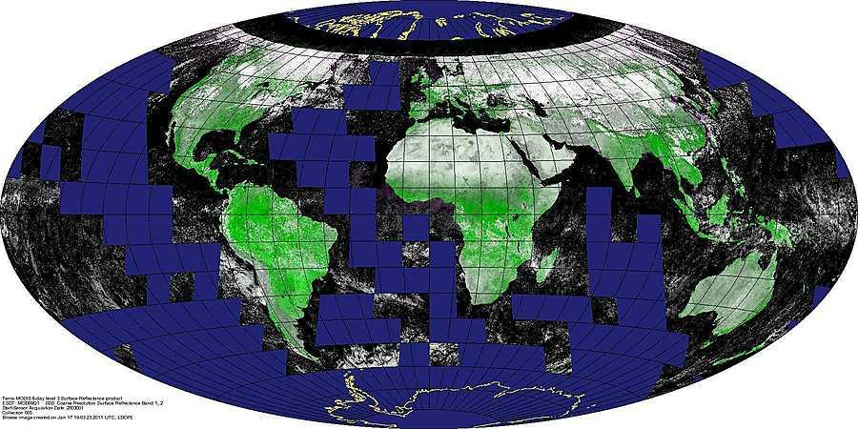
Data: MODIS MOD9Q1 product
250 mts spatial resolution, 8 days temporal resolution
4800 x 4800 pixels, 3 bands (red, nir, qc)
13 years of data (since 2000)
image: NASA
Notes:
38

Slide 39
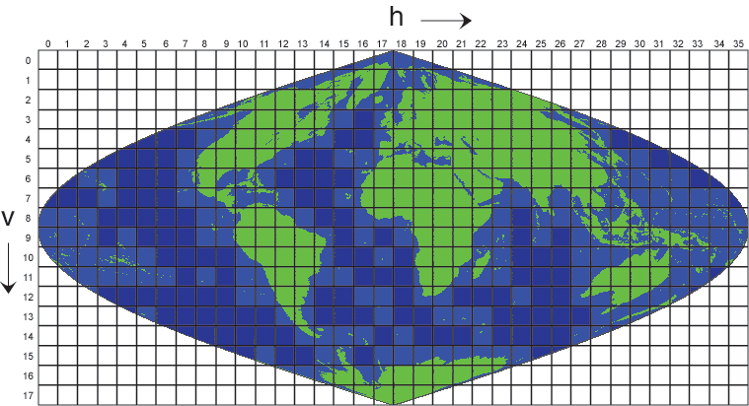
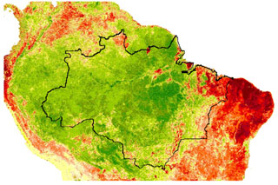
Reproducing big data science with SciDB and the Field data model
Extract the subarray covering Amazonia (filter)
EVI for each cell in all time steps (map)
EVI mean and stdev for JAS 2000-2006 for each cell (filter + map)
EVI mean for JAS 2005 for each cell (filter + map)
Compare EVI mean (JAS 2005) to the JAS 2000-2006 mean (combine)
4,000 MODIS tiles (92 billion cells), 7 field functions,
4.6 hours processing

Slide 40
Our goal for the Fields data model
Field
operations
Remote visualization and
method development
Big data EO management and analysis
40 years of Earth Observation data of land change accessible for analysis and modelling.

Slide 41
Conclusion 1:
The Fields data type is a generic model for
different kinds of big space-time data
image: INPE

Slide 42
Conclusion 2: The Fields data type enables a better description of
of big space-time data than the layer view
image: INPE

Slide 43
Conclusion 3: The Fields data type may foster a new generation of GISs that deal with big space-time data
image: INPE

