Slide 1
Modelling Land Use Change in Brazil : 2000-2050
São Paulo, 06.07.2015
Gilberto Câmara
FAPESP Programme on Global Change Research
National Institute for Space Research, INPE

Slide 2
REDD-PAC project team (www.redd-pac.org)
Alexandre Ywata (IPEA)
Aline Soterroni (INPE)
Fernando Ramos (INPE)
Gilberto Câmara (INPE)
Pedro Andrade (INPE)
Ricardo Cartaxo (INPE)
Aline Mosnier (IIASA)
Florian Kraxner (IIASA)
Johannes Pirker (IIASA)
Michael Obersteiner (IIASA)
Rebecca Mant (WCMC)
Valerie Kapos (WCMC)

Slide 3
REDD+ Policy Assessment Center
www.red-pac.org.br
Partner
Institutions:
Duration: November 2011 – March 2016

Slide 4
What are the likely trajectories on Brazilian emissions?
?
Redução de 75% em florestas, crescimento em energia e agricultura
Notes:
4

Slide 5
Brazil’s dilemma: deep-sea oil or renewables?

Slide 6
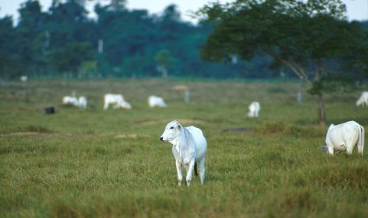
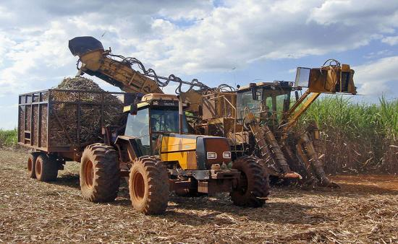
Brazil: Do biofuels cause indirect land change?

Slide 7
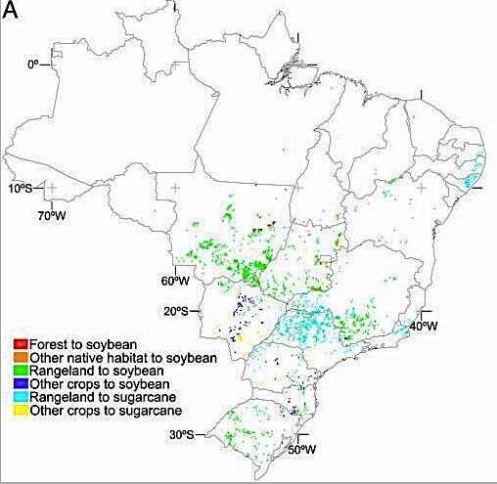
Brazil: Projected direct land change from biofuels (2020)
source: Lapola et al (PNAS, 2010)

Slide 8
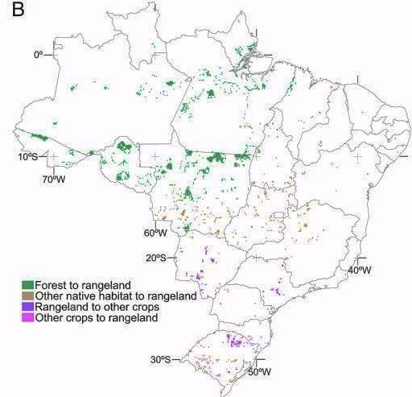
Brazil: Projected indirect land change from biofuels (2020)
source: Lapola et al (PNAS, 2010)
source: Lapola et al (PNAS, 2010)

Slide 9
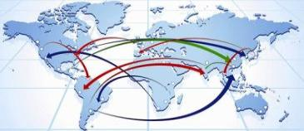
GLOBIOM: Global Biosphere Management Model
Partial equilibrium model: Agriculture, Forestry and Bioenergy sectors
Population & Economic Growth & Exogenous Demand Shocks
REGION
Commodity
Prices and Quantities
DEMAND
MARKETS
Wood
Crops
Livestock
Land Use
SUPPLY
SPATIAL RESOLUTION
Forest Cropland Pasture Other
Environmental effects
LAND
source: IIASA

Slide 10
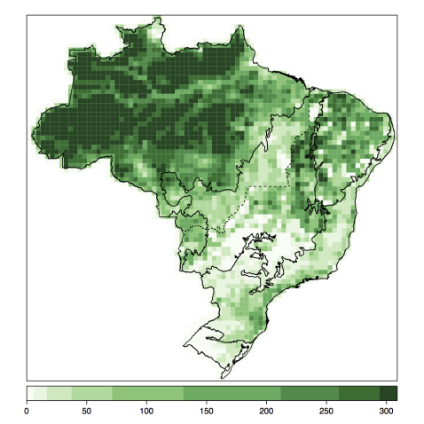
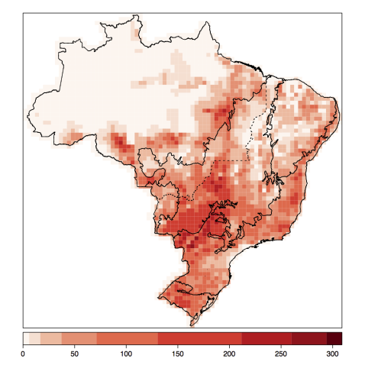
Base maps for GLOBIOM-Brazil
Forest 2000
Livestock 2000

Slide 11
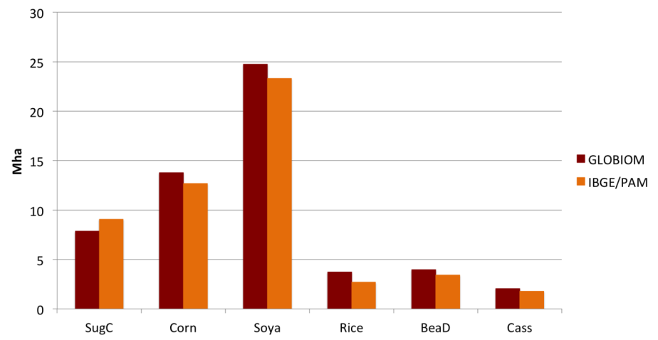
Validation: GLOBIOM x IBGE for 2010

Slide 12
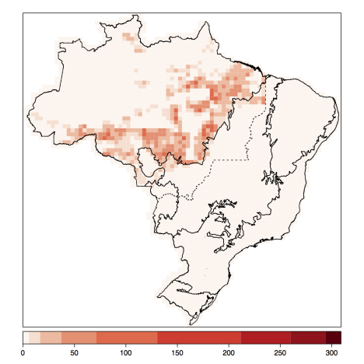
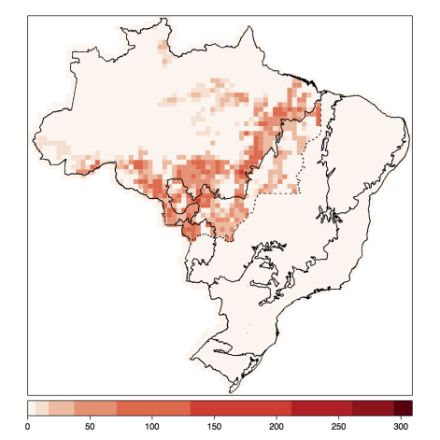
Validation: deforestation in Amazonia 2000-2010
PRODES (16.5 Mha)
GLOBIOM (16.9 Mha)

Slide 13
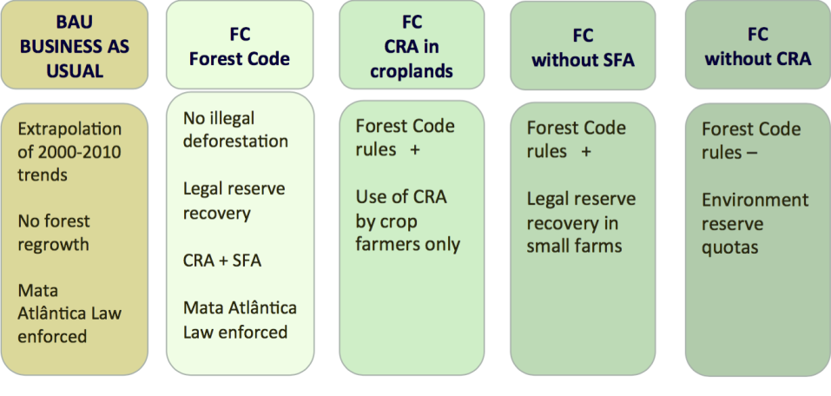
Scenarios for land use policies

Slide 14
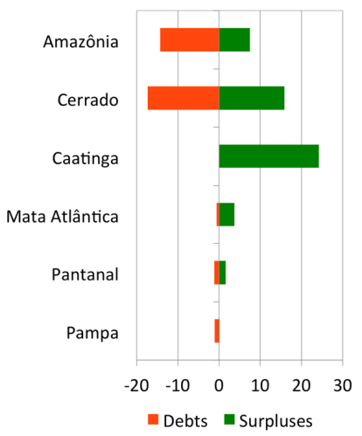
Environmental Debts and Surpluses (2010)
Debts
Surpluses

Slide 15
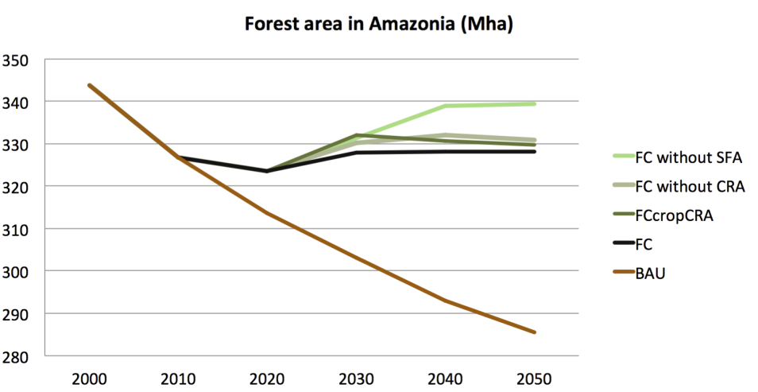
Projections for total forest in Amazonia

Slide 16
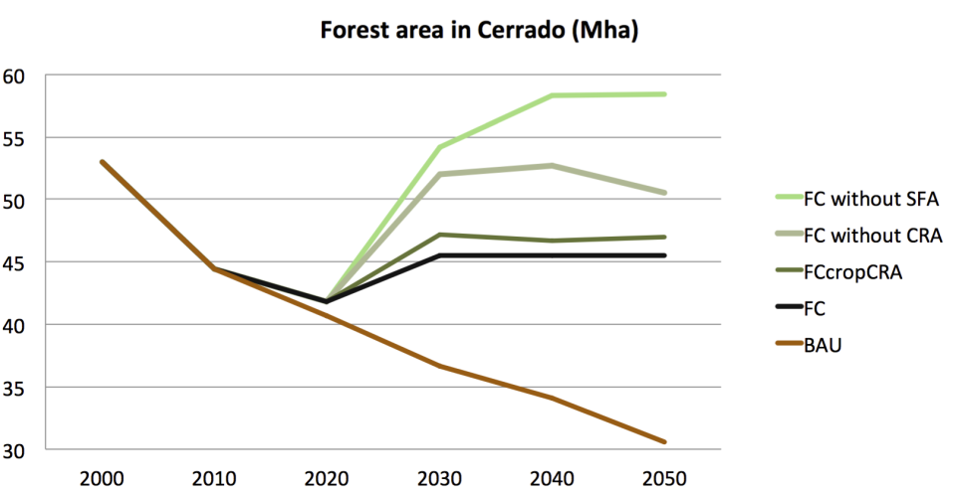
Projections for total forest in Cerrado

Slide 17
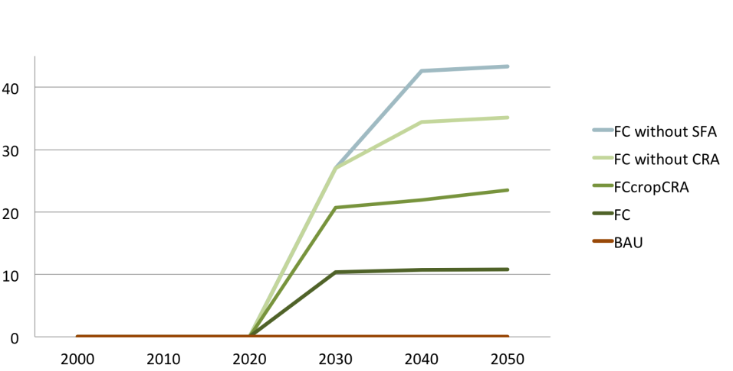
Projections for forest regrowth

Slide 18
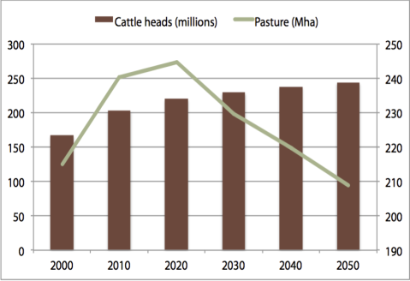
Crop production grows, grassland decreases
Croplands (Mha)
Cattle and pasture (heads and Mha)
Projections of GLOBIOM-Brasil model

Slide 19
Relative change in bovine productivity

Slide 20
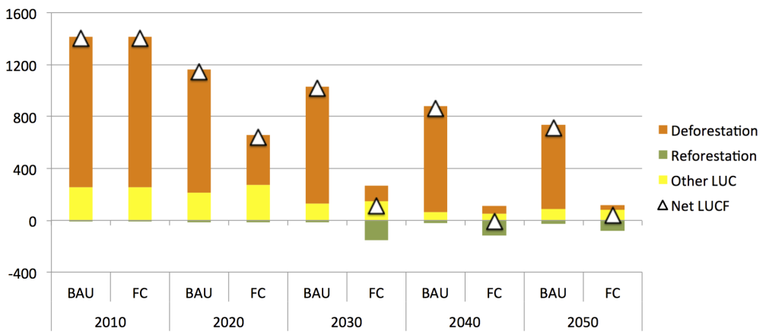
Brazil’s new Forest Code: zero net emissions from deforestation after 2030
Projections of GLOBIOM-Brasil model
(BAU = “business as usual”, FC = Forest Code)

Slide 21
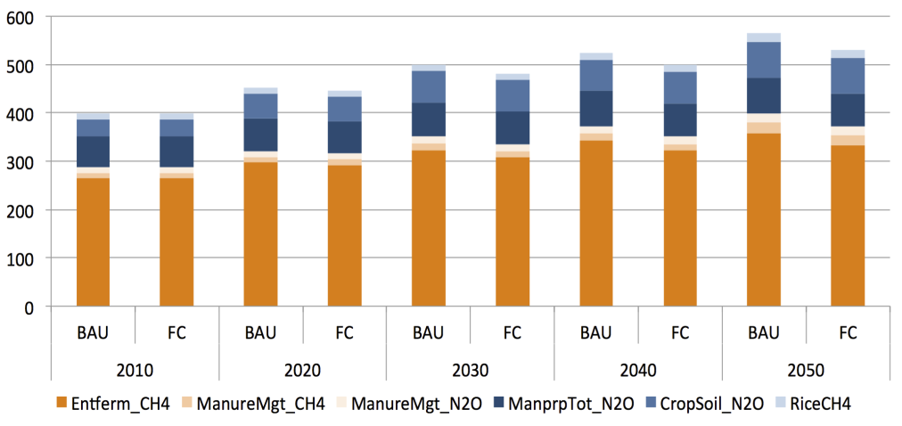
Brazil’s emissions from crops and cattle

Slide 22
Energy policy is crucial for our future emissions

Slide 23
Innovation + policies = low carbon economy
With the right carbon tax, biofuels can be 30% of energy matrix

