Slide 1
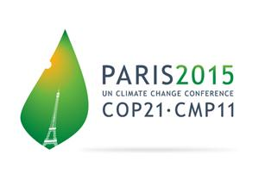
The road to Paris: Brazilian emissions and the rôle of Geoinformatics
Gilberto Câmara (INPE/IFGI)

Slide 2
REDD-PAC project team (www.redd-pac.org)
Alexandre Ywata (IPEA)
Aline Soterroni (INPE)
Fernando Ramos (INPE)
Gilberto Câmara (INPE)
Pedro Andrade (INPE)
Ricardo Cartaxo (INPE)
Aline Mosnier (IIASA)
Florian Kraxner (IIASA)
Johannes Pirker (IIASA)
Michael Obersteiner (IIASA)
Rebecca Mant (WCMC)
Valerie Kapos (WCMC)

Slide 3
REDD+ Policy Assessment Center
www.red-pac.org.br
Partner
Institutions:
Duration: November 2011 – March 2016

Slide 4
Global Carbon Cycle
Data: CDIAC/NOAA-ESRL/GCP
GHG emissions and sinks for 2004–2013 (GtCO₂/yr)

Slide 5
Global Carbon Budget

Slide 6
Global fossil fuel and cement emissions for 2014
37 GtCO₂, growth of 2.5% per year

Slide 7
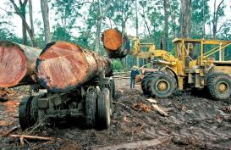
Land-Use Change Emissions
Indonesian peat fires
CO₂ emissions: 3.3 ± 1.8 GtCO₂ during 2004–2013 Decrease in emissions since 1990

Slide 8
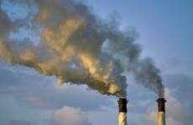
Total Global Emissions
Total global emissions: 39.4 ± 3.4 GtCO₂ in 2013, 42% over 1990 Land-use change: 36% in 1960, 19% in 1990, 8% in 2013

Slide 9
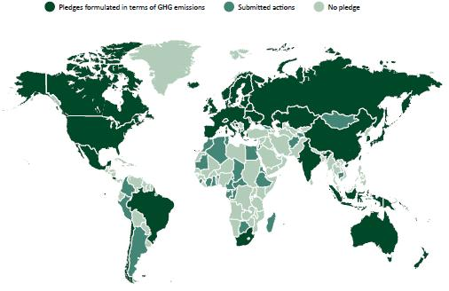
Preparing for Paris: Broadening global climate action well beyond Kyoto
Global agreement on staying below 2°Celsius
Countries need to make concrete pledges in Paris COP-21
source: EC DG Climate Action

Slide 10
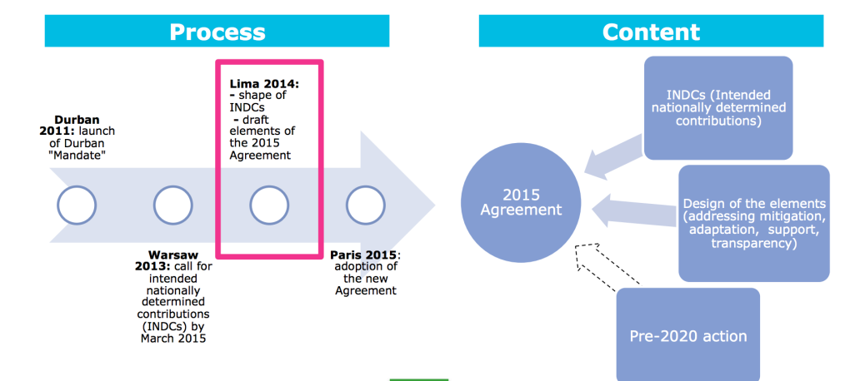
UNFCCC roadmap: Durban, Warsaw, Lima, Paris
A new international agreement with contributions from all countries to keep global warming less than 2⁰ C
source: EC DG Climate Action

Slide 11
What does 1ºC more means?

Slide 12
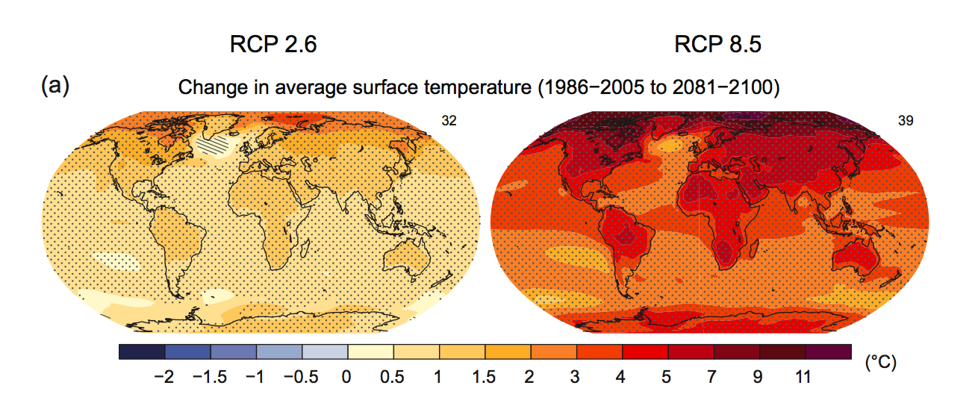
What world are we heading to?

Slide 13
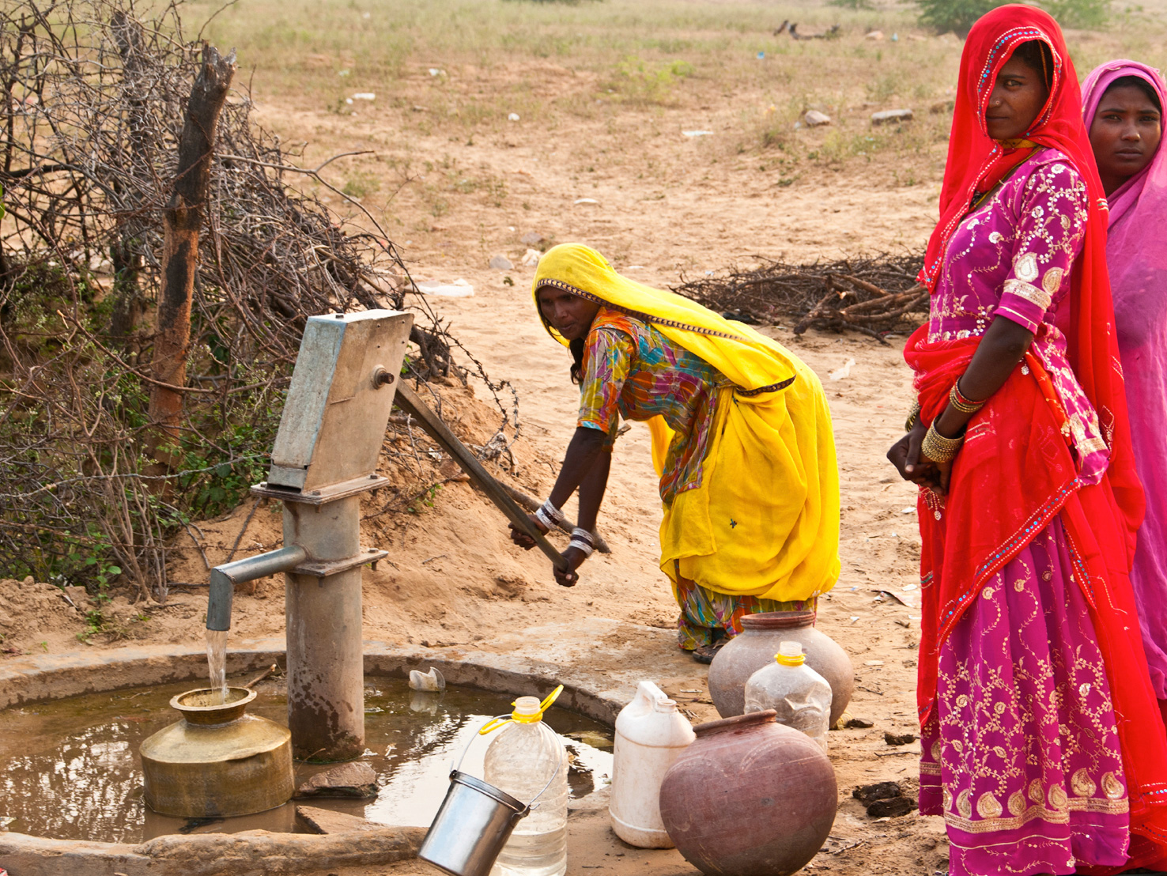
Water availability: a fundamental issue
Notes:
Hilarie -- First show pic and then have map come in --- need to include legend for map – I think you have this from a GC mag issue
Figure 1. Areas of greatest threat to water security and biodiversity
Biodiversity threat: Low High Low High
Human water scarcity threat: Low Low High High
Source: Vörösmarty et al., 2011

Slide 14
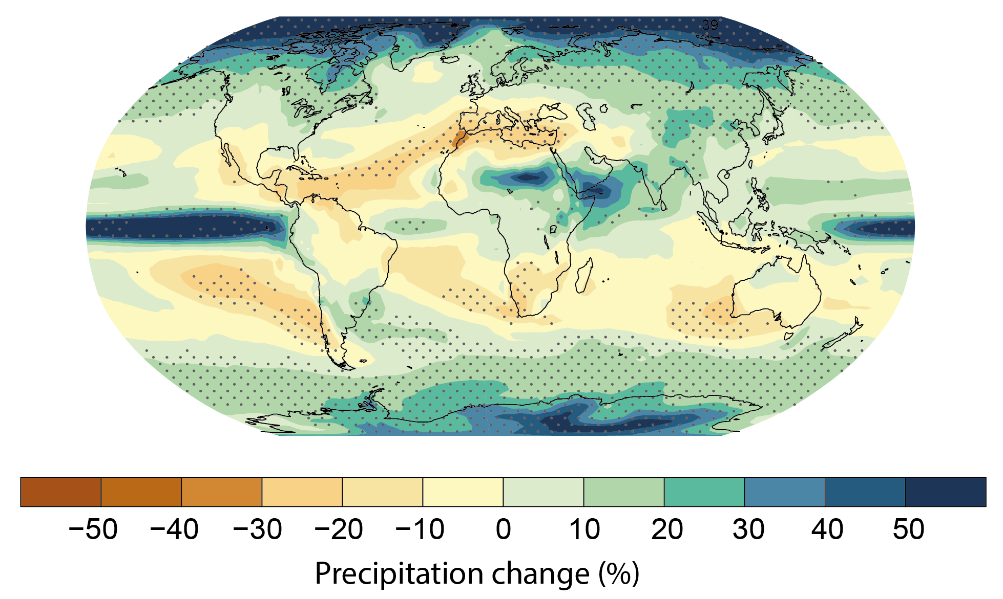
Projected precipitation changes: 2000 - 2100
RCP8.5

Slide 15
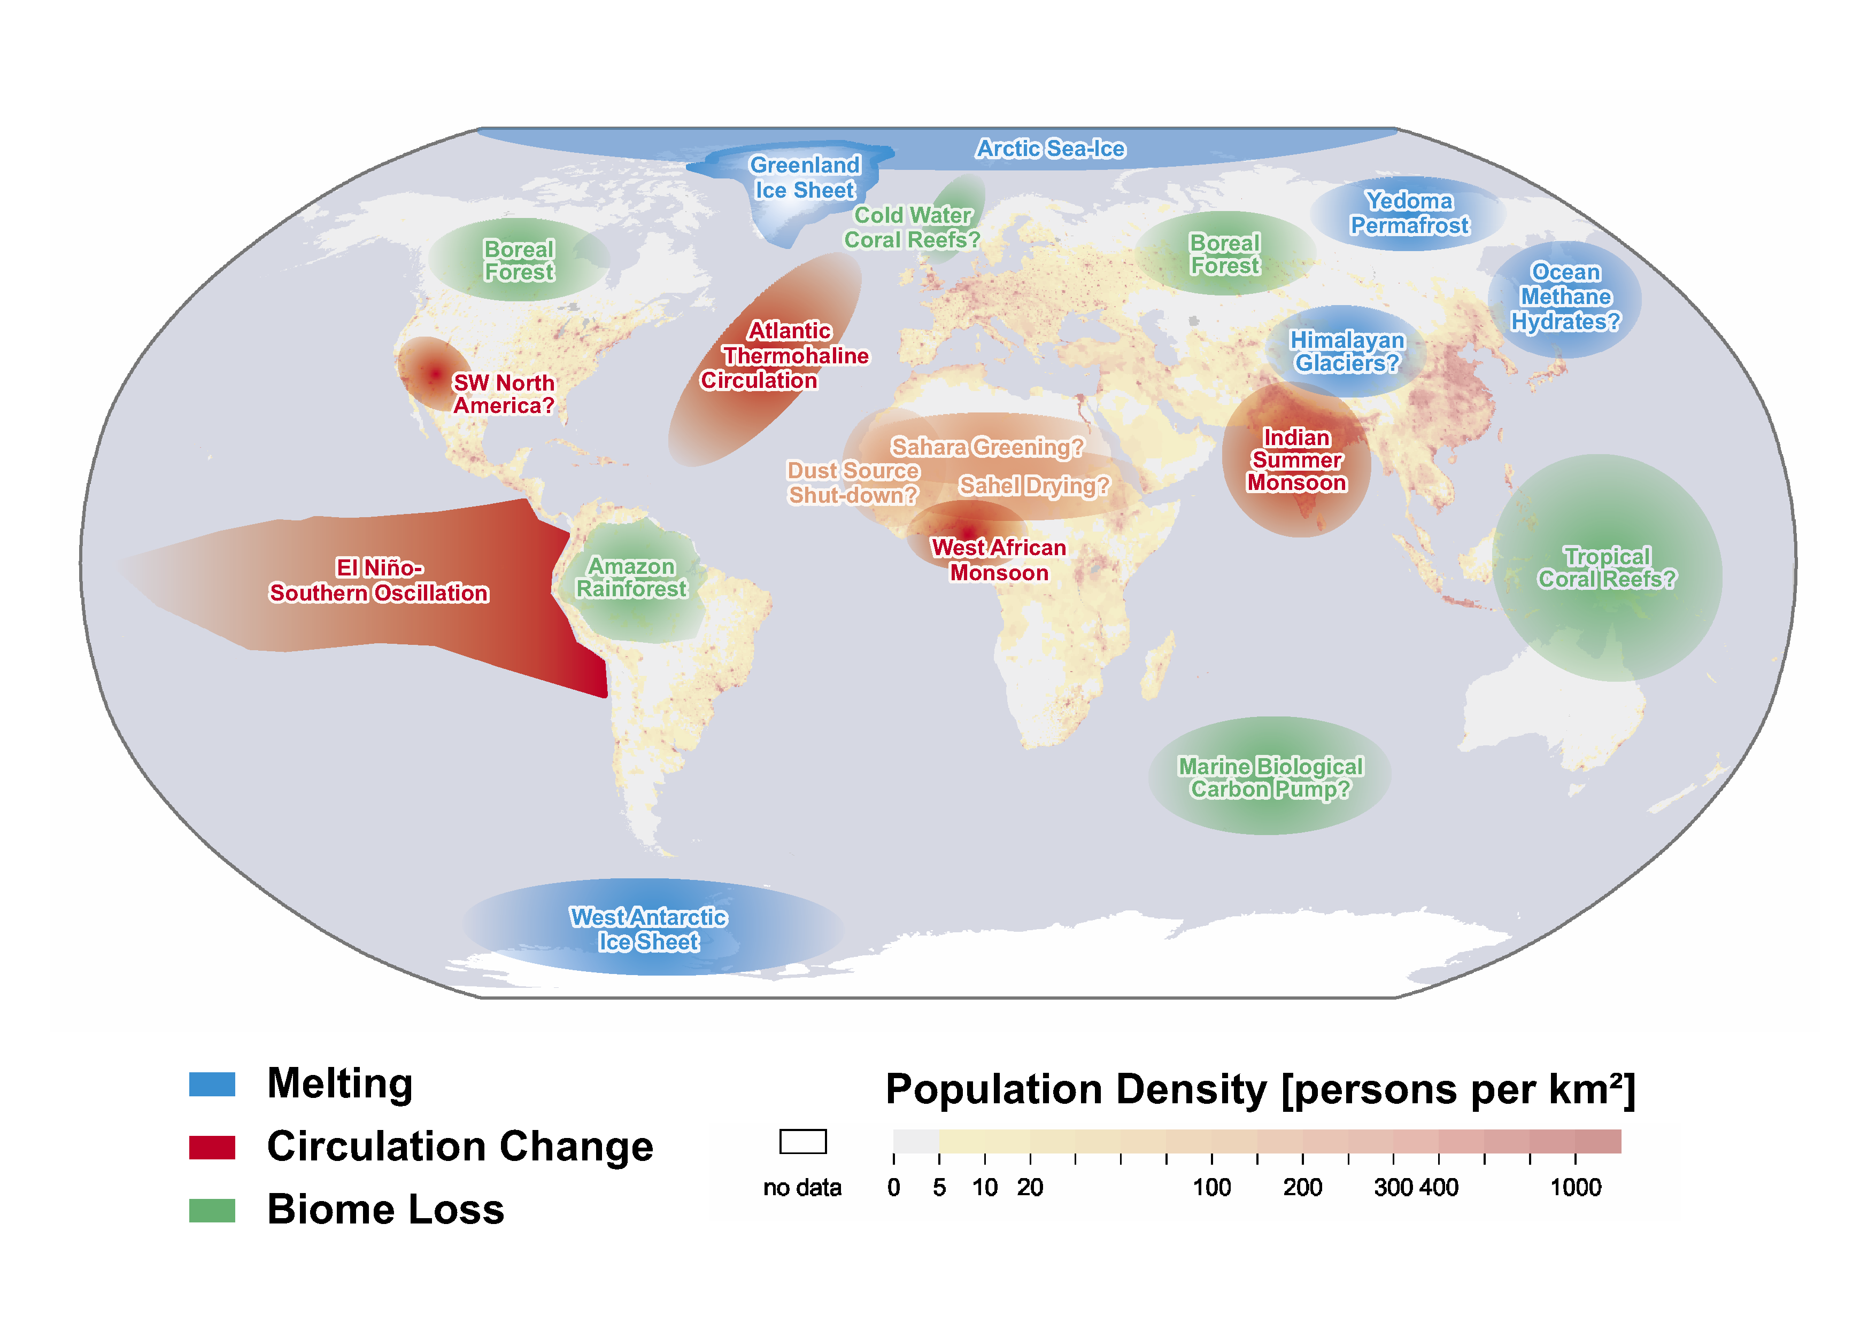
Tipping Elements in the Earth System
(Source: after Lenton et al. 2008)
Notes:
OK, so we hav eestablished humanity is the prime driver of change at the planetary scale now and we have profoundly affected the biogeochemical cycles. What do we know about thresholds and tipping points in the Earth system

Slide 16
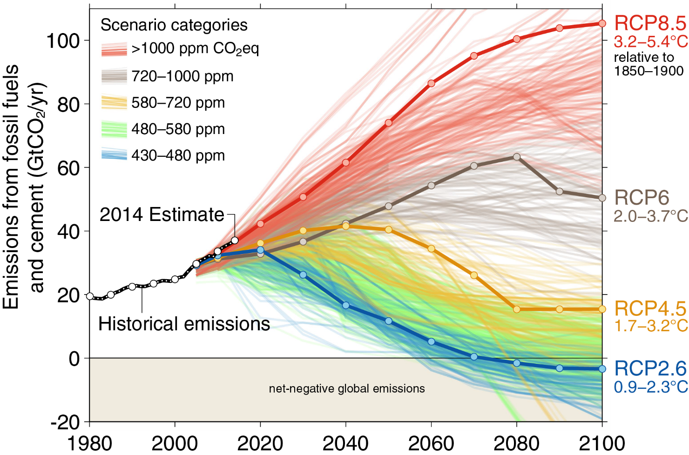
What are the current trends?

Slide 17
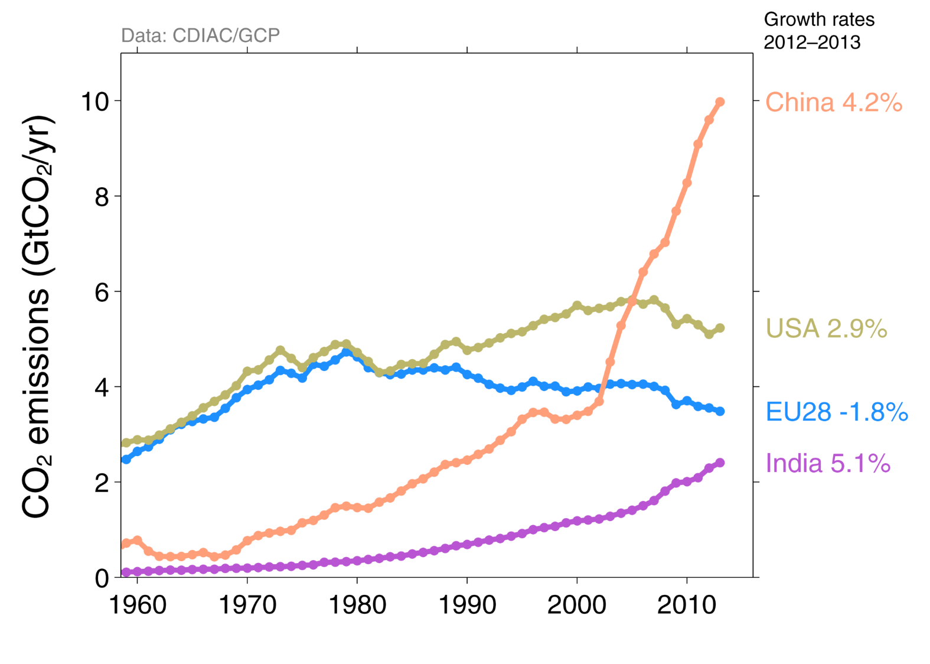
Which countries emit most GHG?

Slide 18
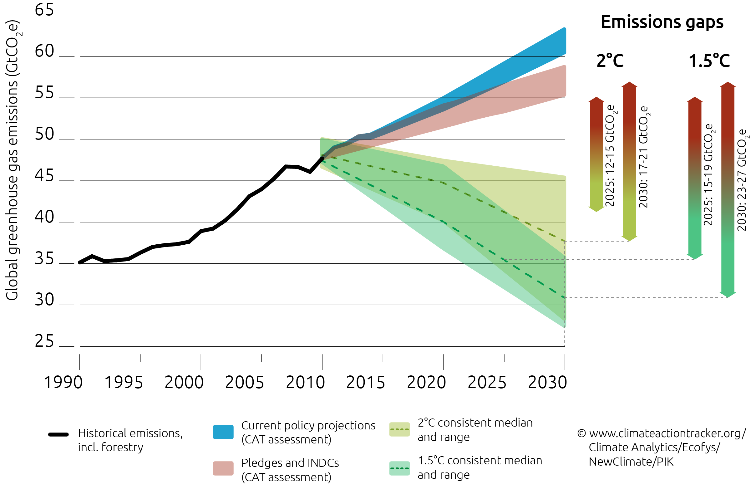
What is the effect of pledges made for COP-21?

Slide 19
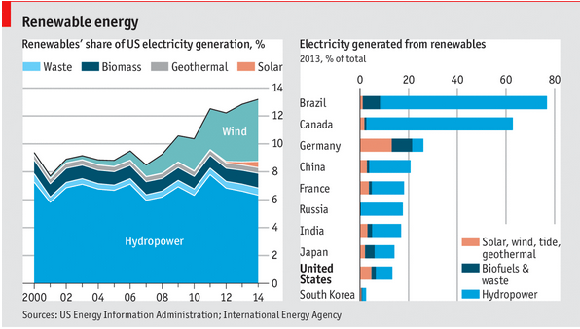
Trends in Emissions: Renewables in USA

Slide 20
What is being proposed for Paris?

Slide 21
What are the likely trajectories on Brazilian emissions?
?
Notes:
21

Slide 22
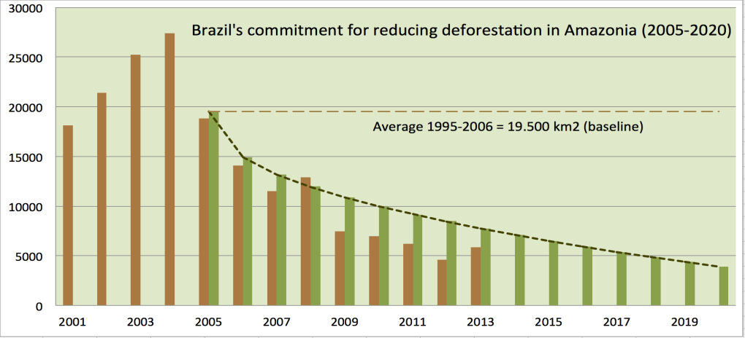
Brazil’s pledge to COP-15: reducing deforestation
Brazil has a policy for Amazon deforestation until 2020
Brazil needs sound guidance for land use policies beyond 2020

Slide 23
Brazil’s dilemma: deep-sea oil or renewables?

Slide 24
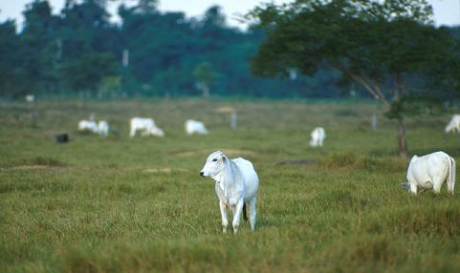
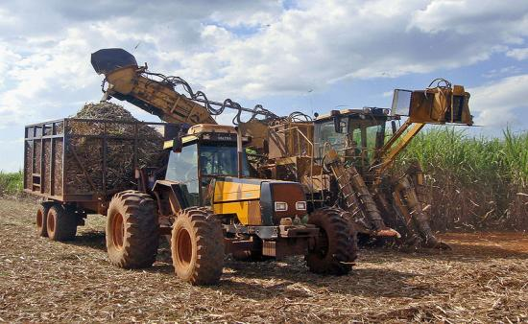
Brazil: Do biofuels cause indirect land change?

Slide 25
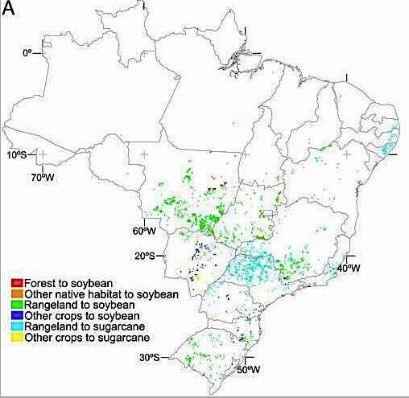
Brazil: Projected direct land change from biofuels (2020)
source: Lapola et al (PNAS, 2010)

Slide 26
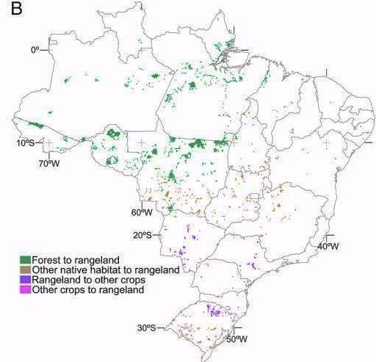
Brazil: Projected indirect land change from biofuels (2020)
source: Lapola et al (PNAS, 2010)
source: Lapola et al (PNAS, 2010)

Slide 27
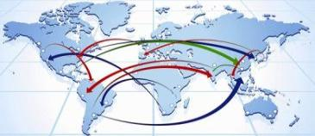
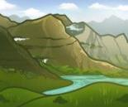
GLOBIOM: Global Biosphere Management Model
Partial equilibrium model: Agriculture, Forestry and Bioenergy sectors
Population & Economic Growth & Exogenous Demand Shocks
REGION
Commodity
Prices and Quantities
DEMAND
MARKETS
Wood
Crops
Livestock
Land Use
SUPPLY
SPATIAL RESOLUTION
Forest Cropland Pasture Other
Environmental effects
LAND
source: IIASA

Slide 28
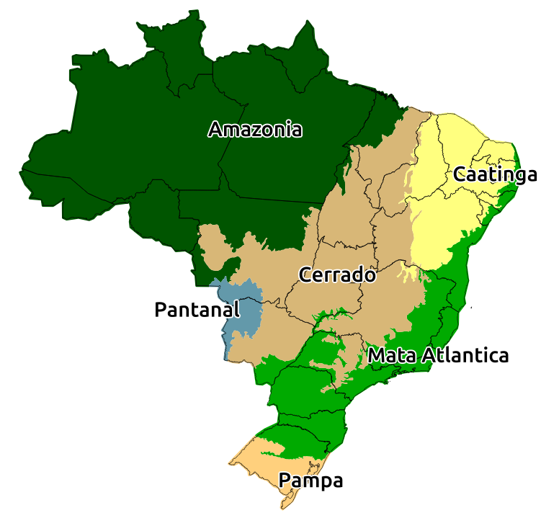
What are the “known unknowns”?

Slide 29
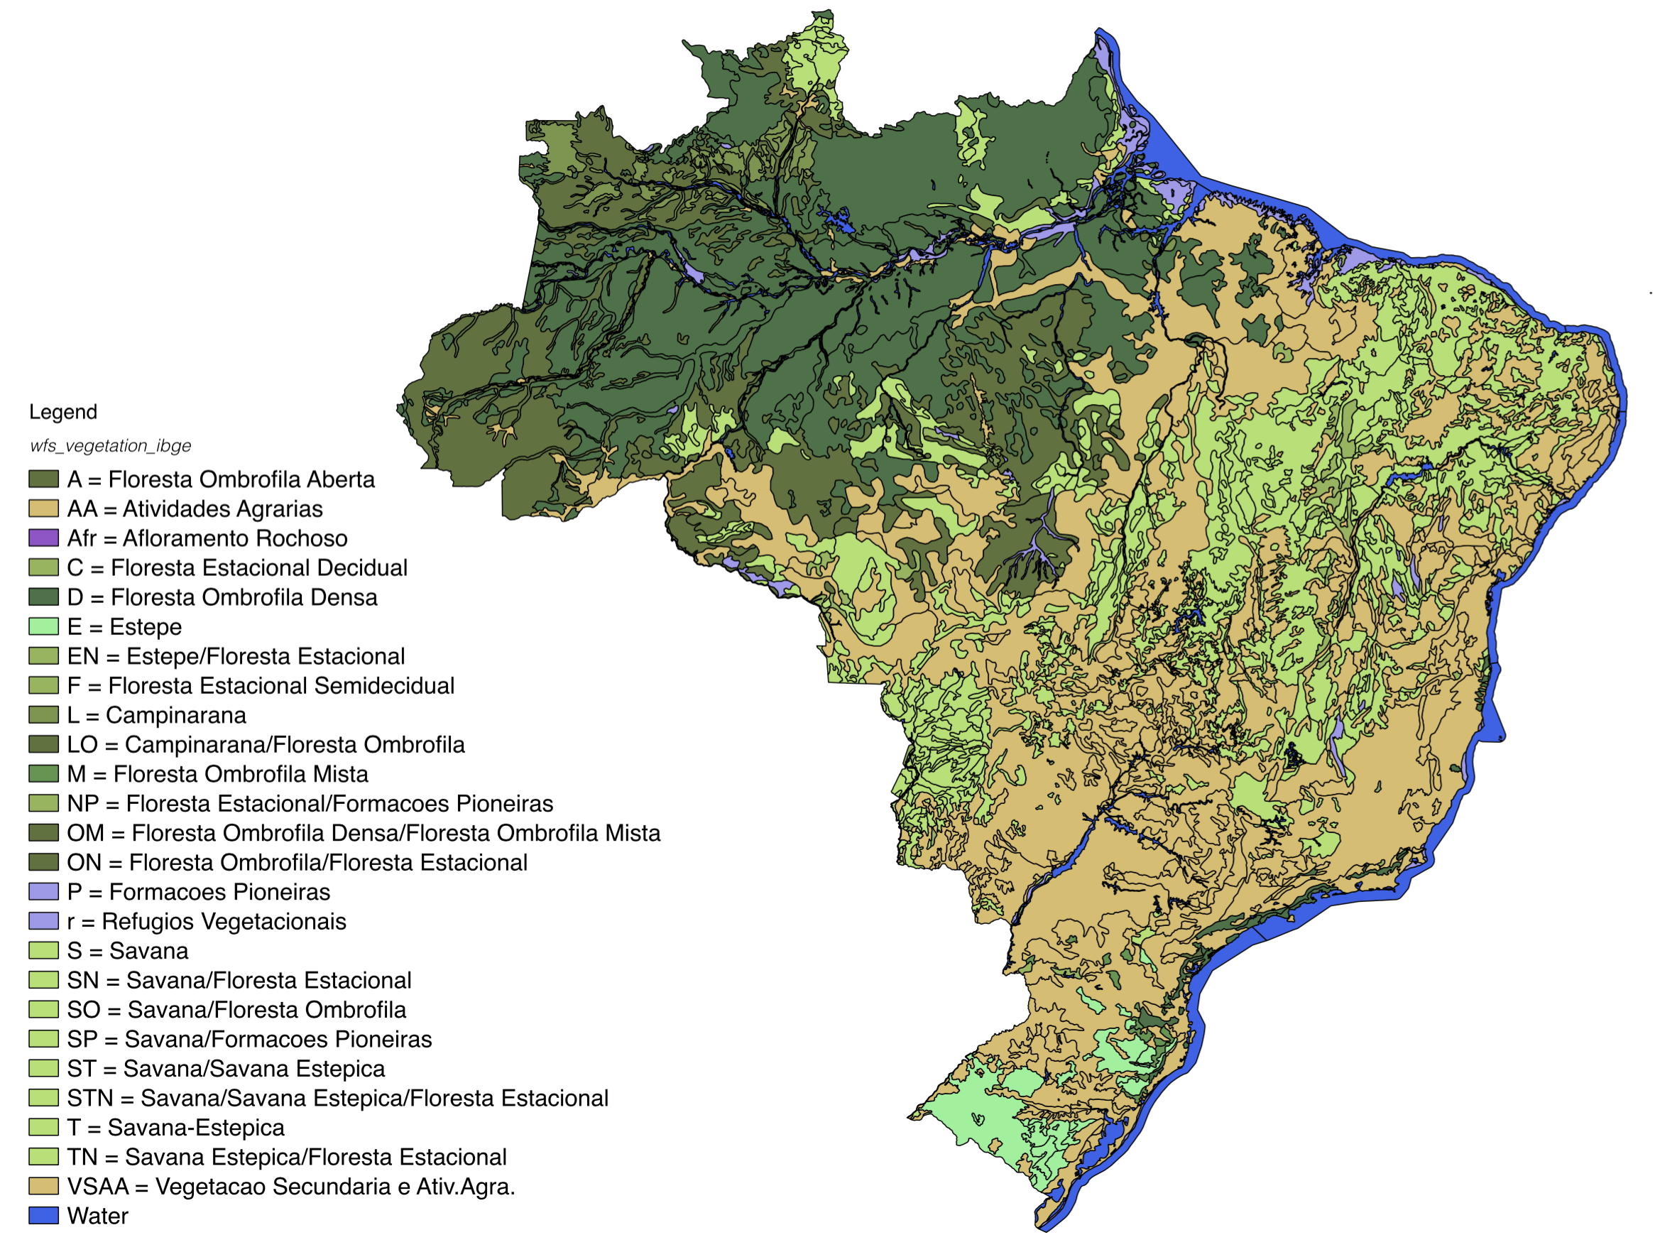
Brazil’s vegetation map (IBGE)

Slide 30
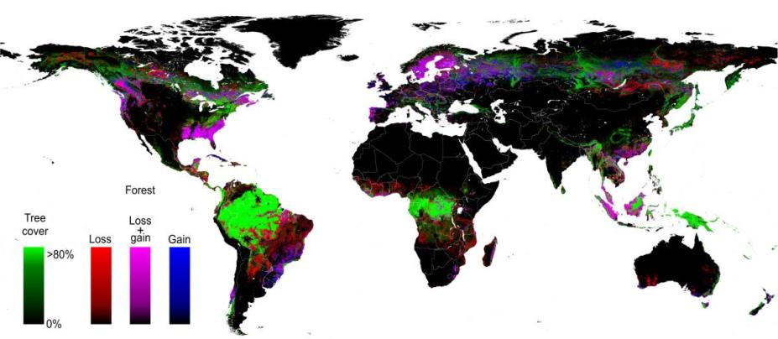
Space first, time later
Spatial data resolution is better than temporal resolution
Hansen et al. (2013)

Slide 31
Hansen 2000 - Forest
MODIS 2000 - Forest

Slide 32
MODIS and HANSEN
Forest/Biomes | MODIS 2000 | MODIS 2010 | HANSEN
Amazon | 350.289 | 340.696 | 355.888
Caatinga | 14.401 | 14.743 | 13.162
Cerrado | 43.782 | 42.859 | 52.556
Mata Atlântica | 33.630 | 34.896 | 37.318
Pantanal | 5.363 | 6.476 | 4.905
Pampa | 2.571 | 2.133 | 2.835
TOTAL | 450.036 | 441.803 | 466.663
Legal Amazon | 371.536 | 362.022 | 383.716

Slide 33
Cerrado: a tropical savanna with forests

Slide 34
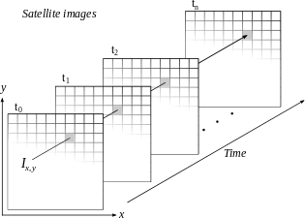
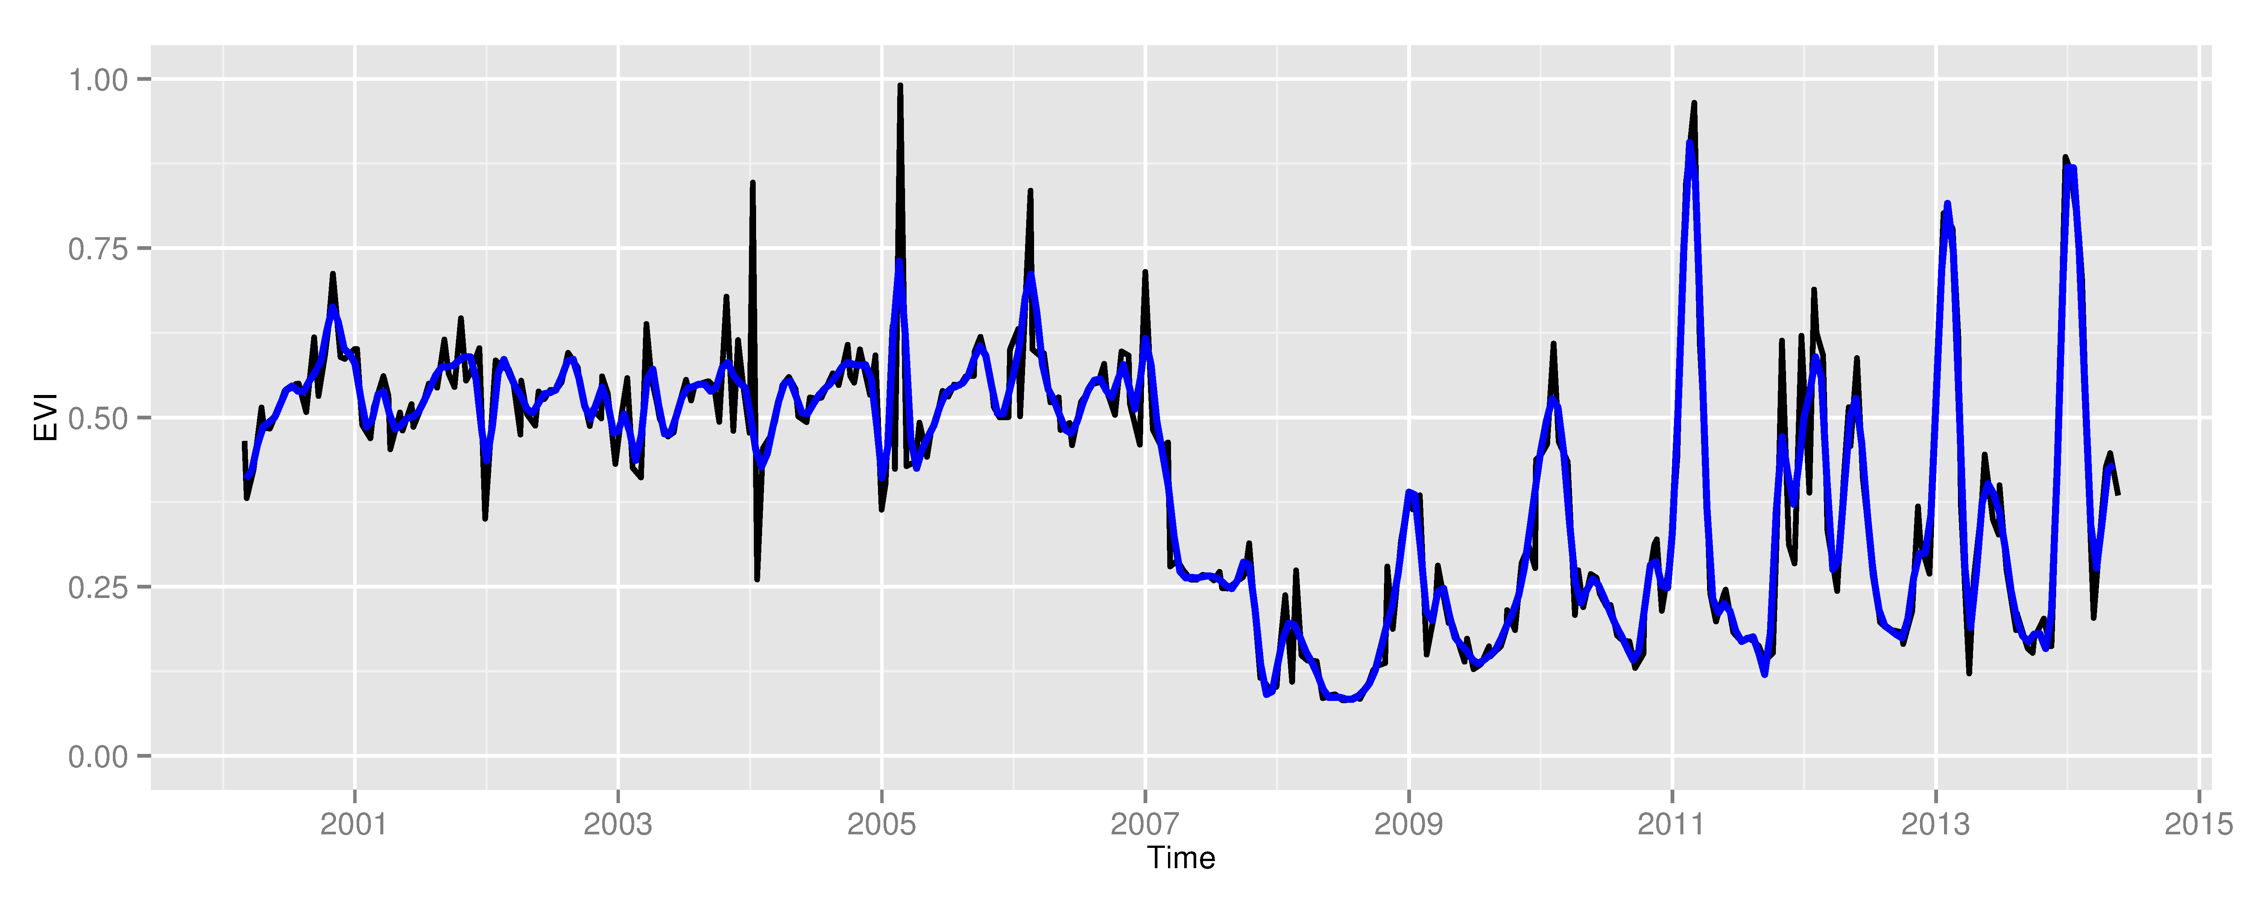
Space first, time later or time first, space later?
Space first: classify
images separately
Compare results in time
Time first: classify
time series separately
Join results to get maps

Slide 35
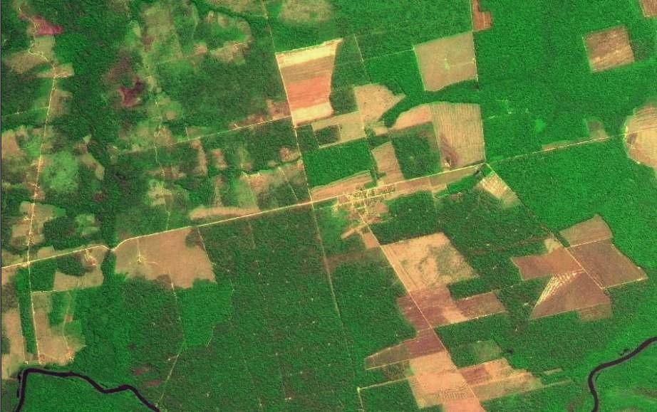
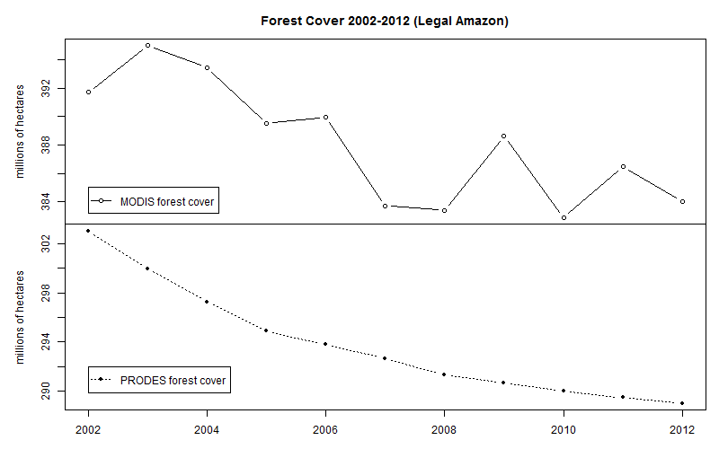
Space first can lead to inconsistent land trajectories
MODIS land cover: unrealistic forest gains and losses
Data sources: INPE, NASA. Analysis by M. Buurman

Slide 36
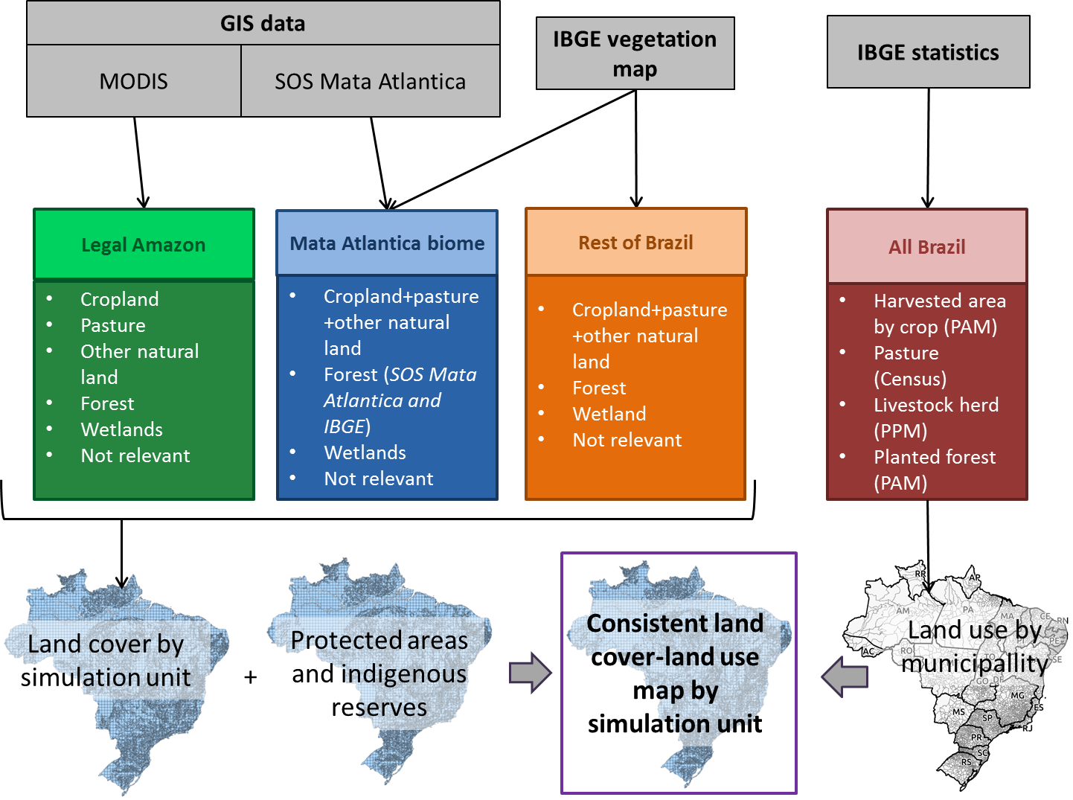

Slide 37
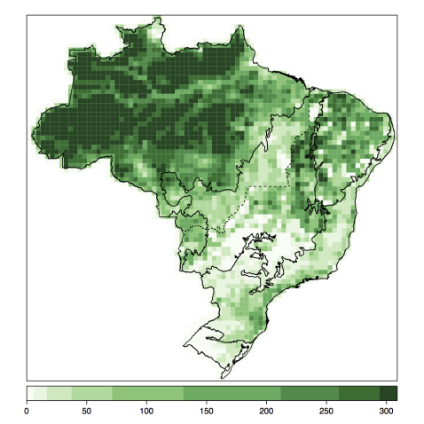
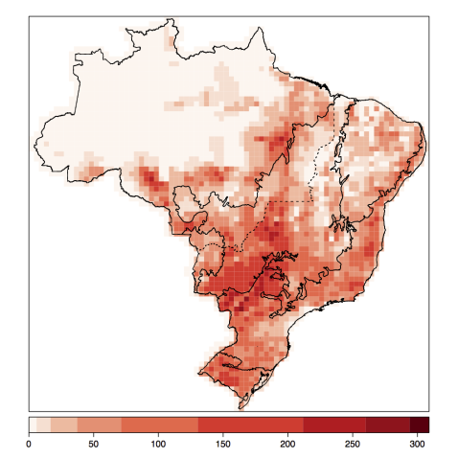
Base maps for GLOBIOM-Brazil
Forest 2000
Livestock 2000

Slide 38
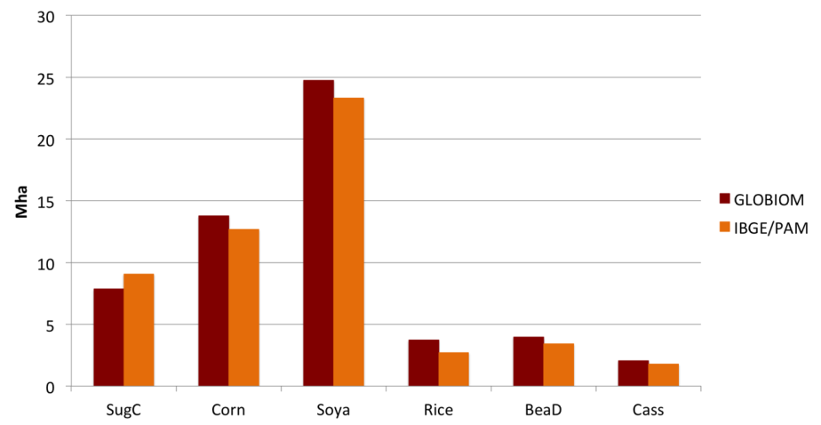
Validation: GLOBIOM x IBGE for 2010

Slide 39
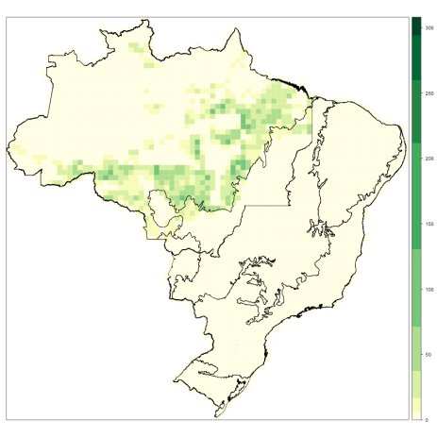
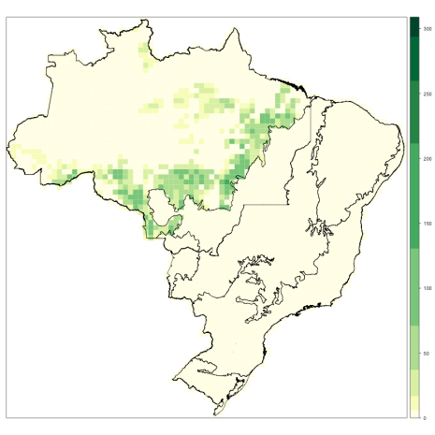
Validation: Accumulated Deforestation 2001-2010
PRODES/INPE
GLOBIOM-Brazil projection
16.53 Mha
16.93 Mha
model produces consistent estimate of deforestation (2000-2010)

Slide 40
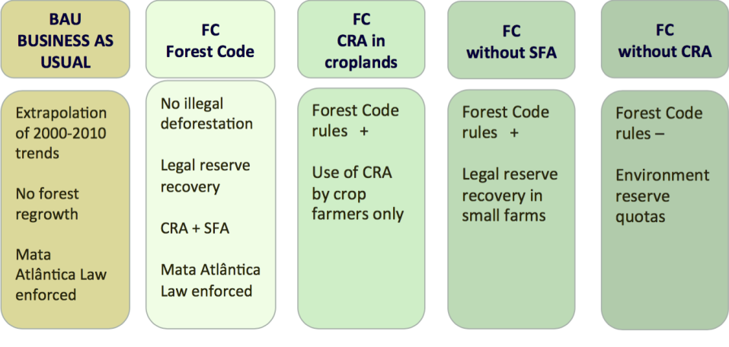
Scenarios for land use policies

Slide 41
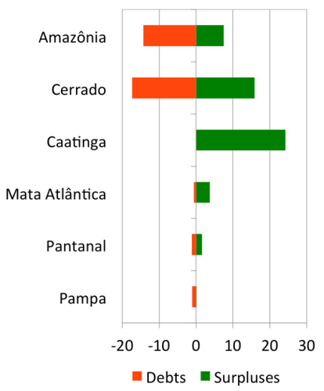
Environmental Debts and Surpluses (2010)
Debts
Surpluses

Slide 42
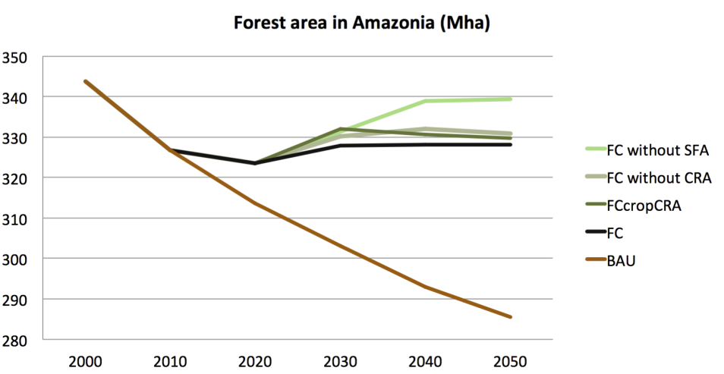
Projections for total forest in Amazonia

Slide 43
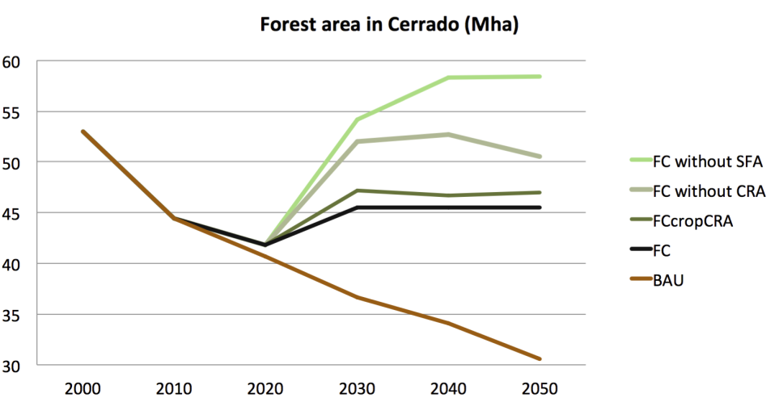
Projections for total forest in Cerrado

Slide 44
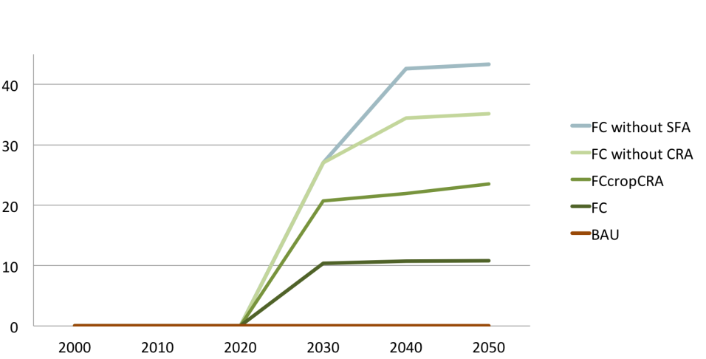
Projections for forest regrowth

Slide 45
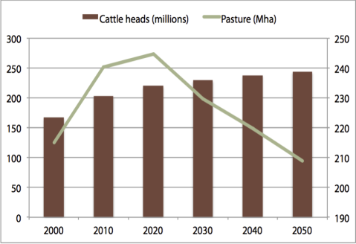
Crop production grows, grassland decreases
Croplands (Mha)
Cattle and pasture (heads and Mha)
Projections of GLOBIOM-Brasil model

Slide 46
Relative change in bovine productivity

Slide 47
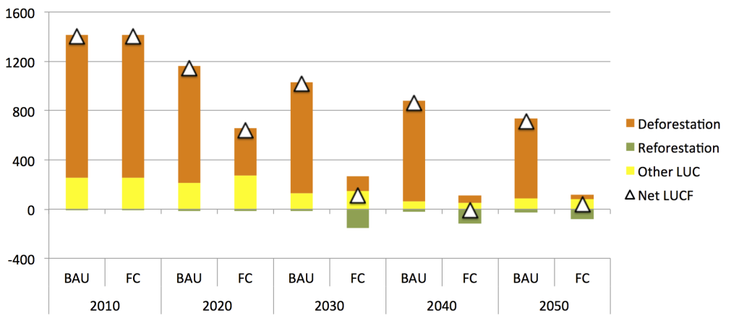
Brazil’s new Forest Code: zero net emissions from deforestation after 2030
Projections of GLOBIOM-Brasil model
(BAU = “business as usual”, FC = Forest Code)

Slide 48
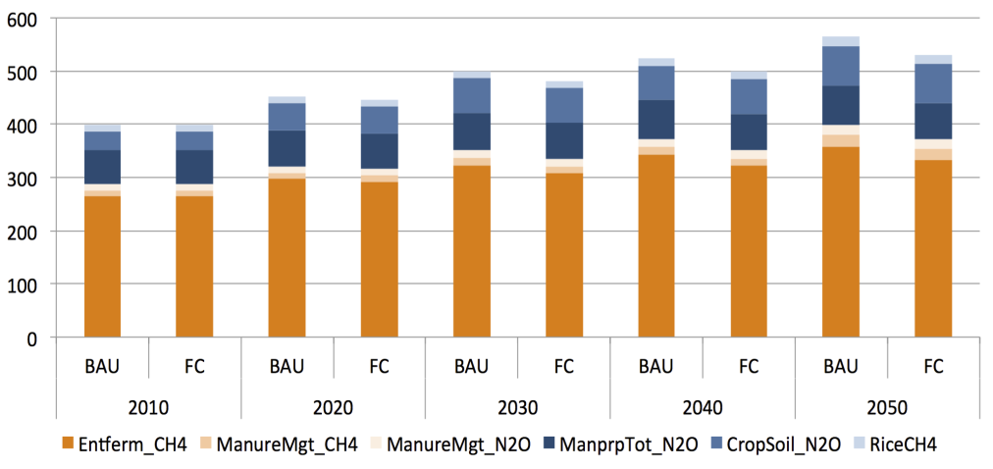
Brazil’s emissions from crops and cattle

Slide 49
Energy policy is crucial for our future emissions

Slide 50
Innovation + policies = low carbon economy
With the right carbon tax, biofuels can be 30% of energy matrix

Slide 51
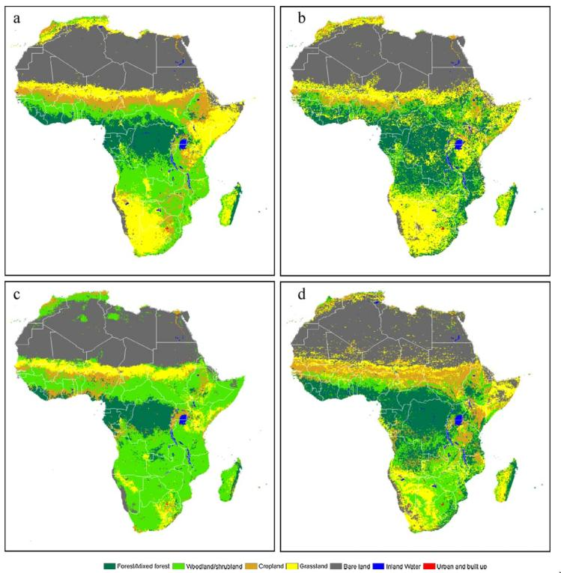
How do we go global?
Differences btw GLC, MODIS, GLOBCOVER (Kaptué et al., 2010)

Slide 52
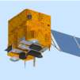
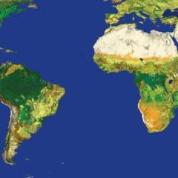
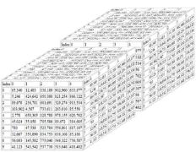
Global Land Observatory: describing change in a connected world
R: Powerful data analysis methods
SciDB: array database for big scientific data
Free satellite
images
Software goes where the data is!

