Slide 1
Trends in Amazon land change
Gilberto Câmara
National Institute for Space Research
Brazil
http://www.dpi.inpe.br/gilberto

Slide 2
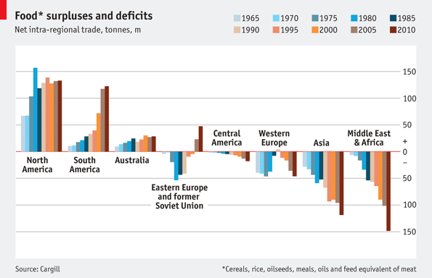
Where is the food coming from and going to?
graphics: The Economist

Slide 3
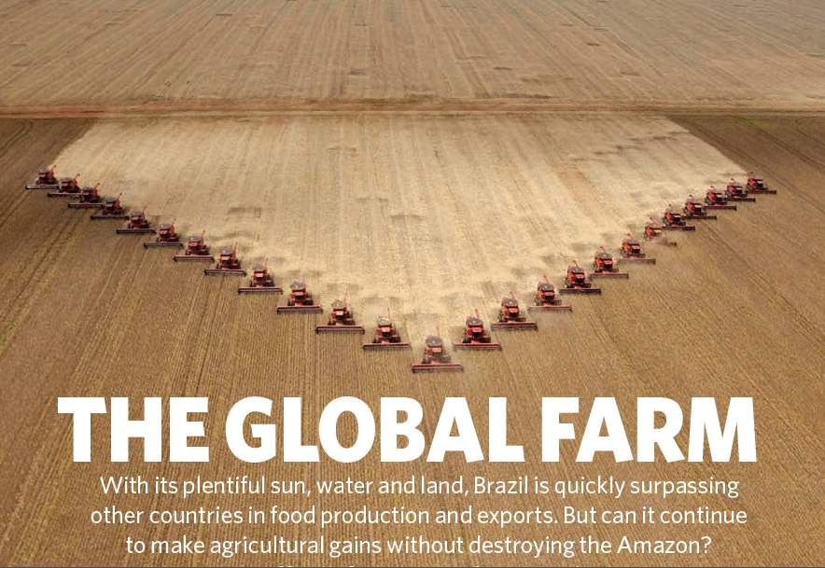
Nature, 29 July 2010

Slide 4
Nature, 29 July 2010
Brazil is the world’s current largest experiment on land change and its effects: will it also happen elsewhere?
Today’s questions about Brazil could be tomorrow’s questions for other countries

Slide 5
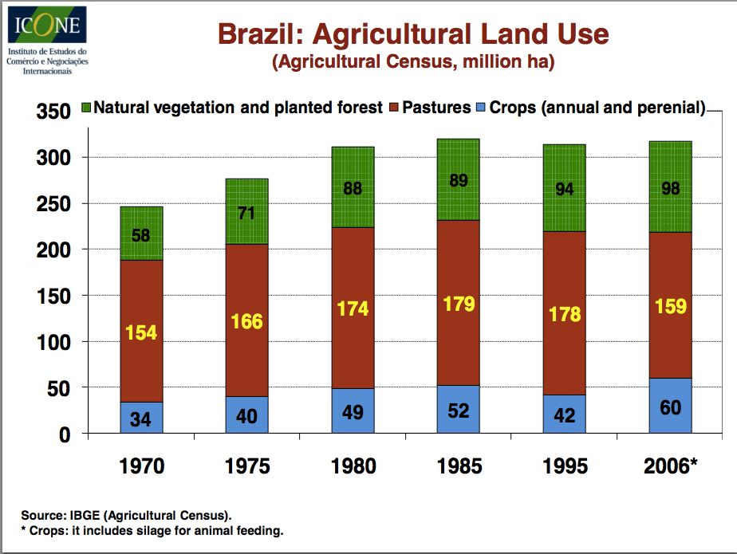

Slide 6
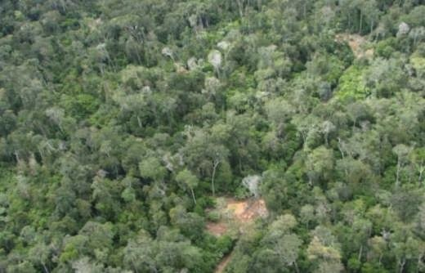
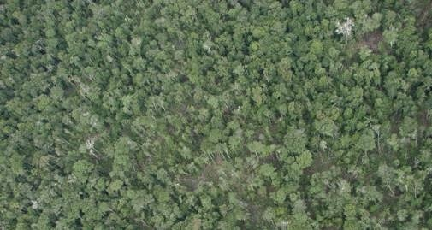
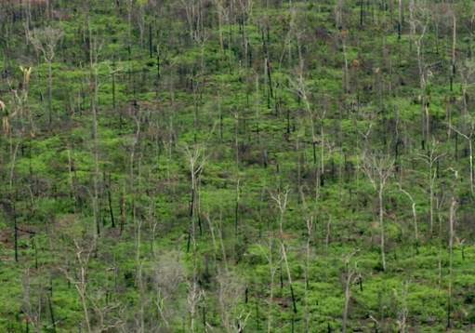
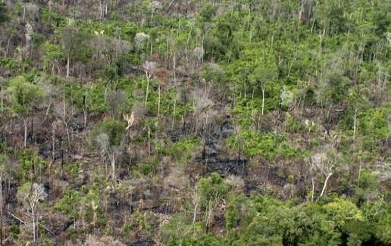
How does deforestation happen?
T1 – Selective logging
T2 – Loss of smaller trees
T3 – Loss >50% of forest
T4 – Loss >90% of forest

Slide 7
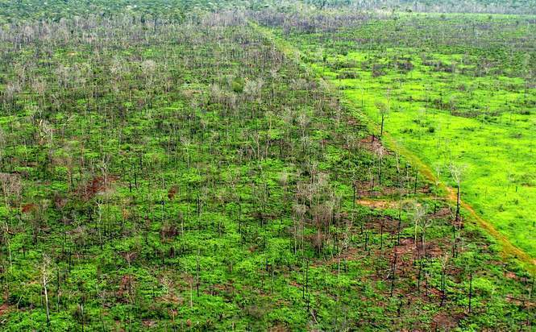
Final = Clear cut
Pasture

Slide 8
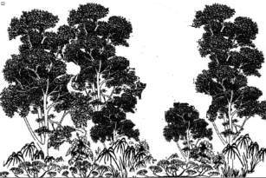
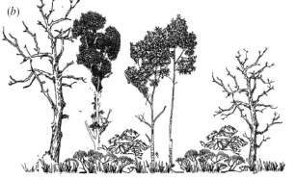

INPE’s Monitoring Systems
dialy deforestation alerts
time
Yearly rates of clear cuts
Floresta

Slide 9
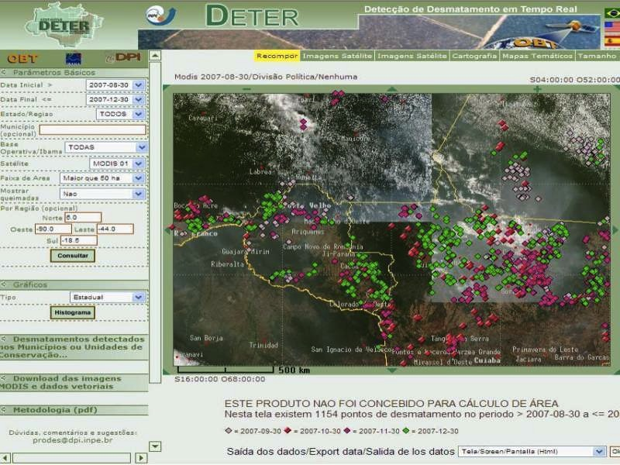

Real-time Deforestation Monitoring
Daily warnings of newly deforested large areas

Slide 10
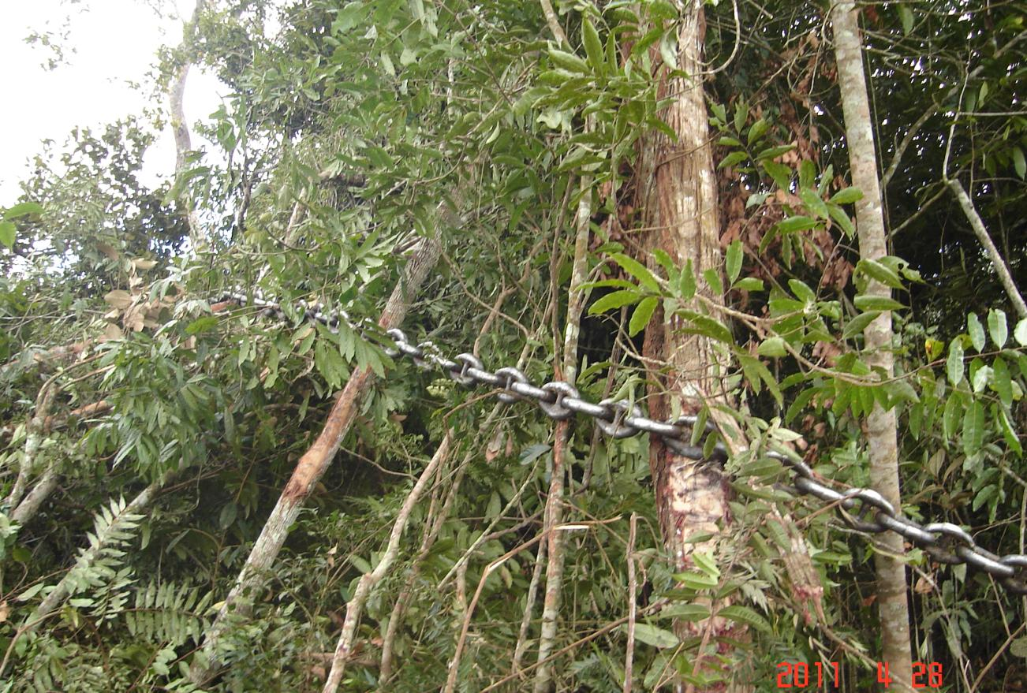
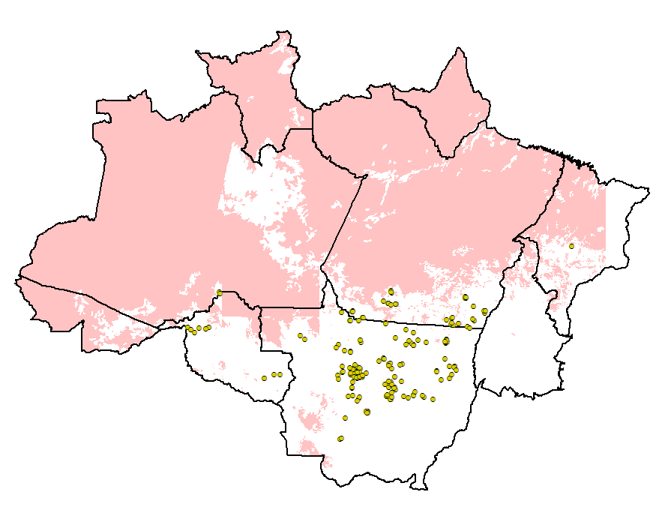
Keep watching!
Jan-April/2011: 126% increase

Slide 11
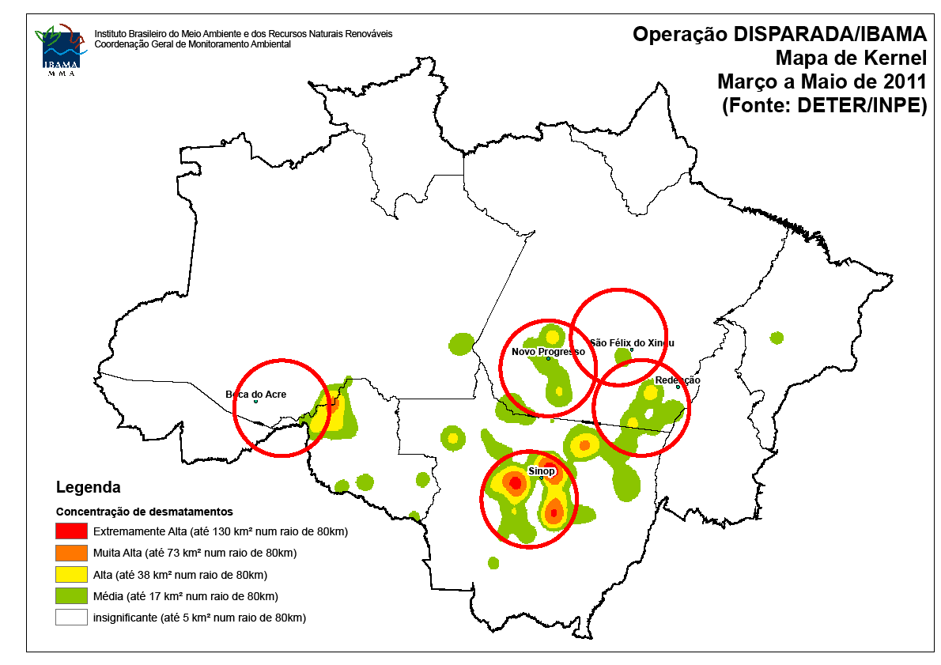
Deforestation hotspots: March-May 2011

Slide 12
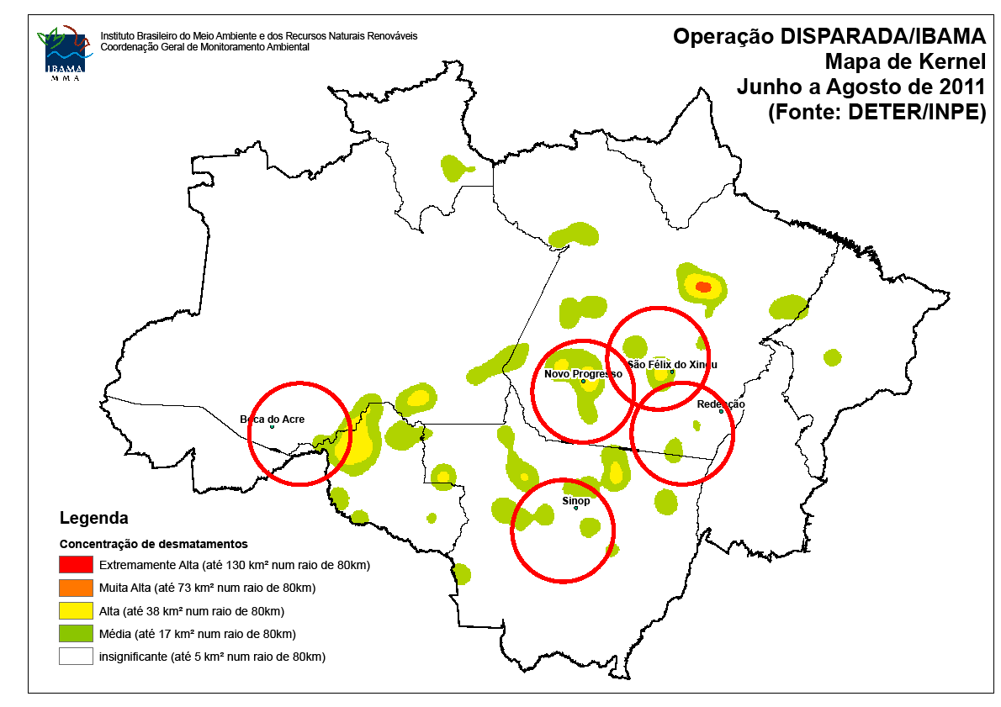
Deforestation hotspots: June-August 2011

Slide 13
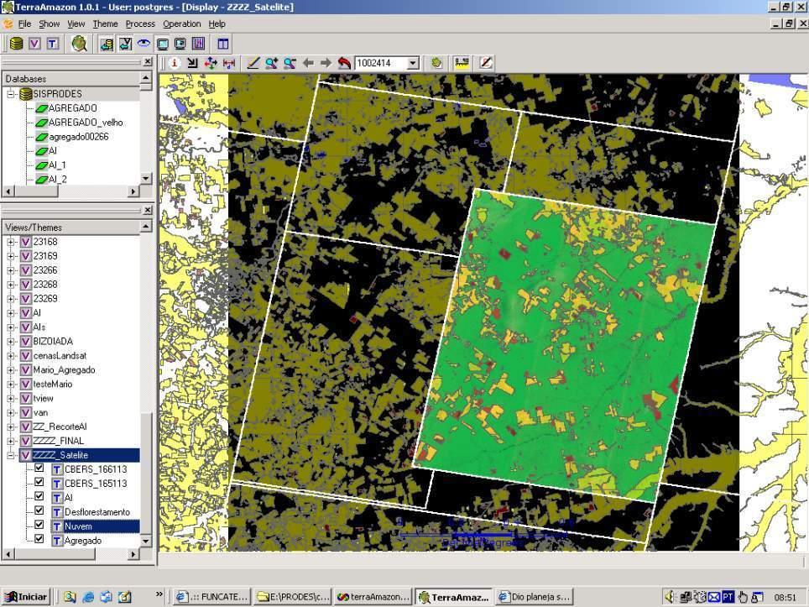
How much it takes to survey Amazonia?
116-112
30 Tb of data
500.000 lines of code
150 man/years of software dev
200 man/years of interpreters
116-113
166-112
Notes:
Cena de maior prioridade utilizou imagens CBRES na s tres principais areas: 166-112, 165-113 2 166-113. Sendo complementada por imagem TM

Slide 14
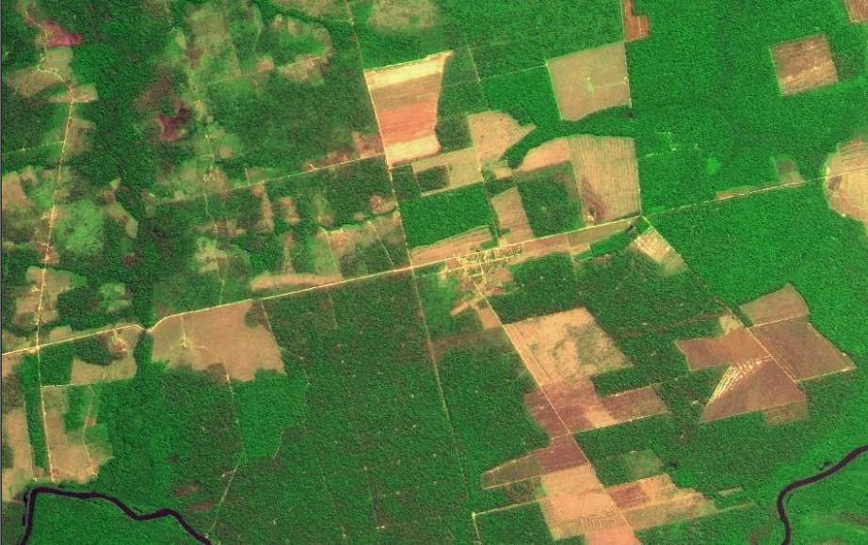
Finding: Transparency builds governance!
CBERS image
Degradation
Deforestation
Science (27 April 2007): “Brazil´s monitoring system is the envy of the world”.
Notes:
Este slide mostra uma imagem CBERS-2B da região de Marcelândia, norte de Mato Grosso. A imagem foi composta por uma imagem monocromática de alta resolução HRC (2,5 m) com uma imagem multespectral CCD (20 m). A imagem mostra que é possivel identificar com o sensor HRC, alem de desmatamentos por corte raso (áreas claras na imagem), as áreas de degradação florestal (áreas verdes com partes claras).

Slide 15
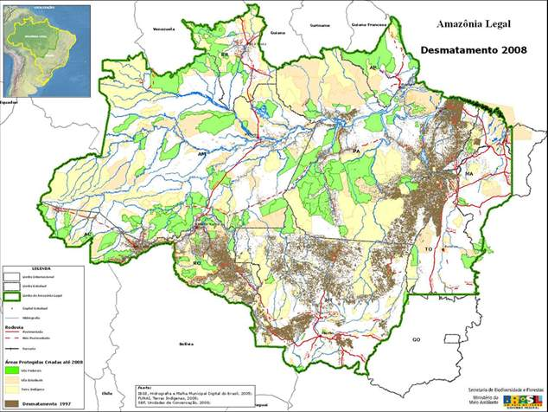
Finding: Protected areas deter deforestation

Slide 16
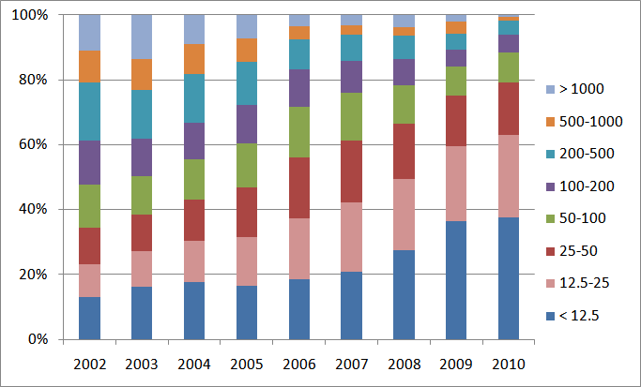
Finding: Deforestation is becoming harder to detect
Proportion of clear cuts by size (ha)
Clearings less than 50 ha: 35% of total in 2002 to 80% of total in 2010

Slide 17
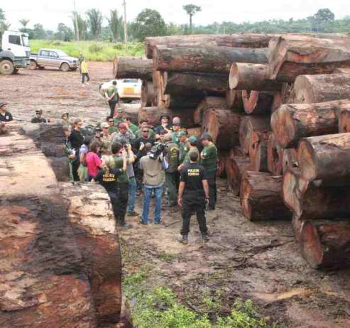
Finding: Command and control actions are effective means to curb deforestation
Almost all deforestation is illegal

Slide 18


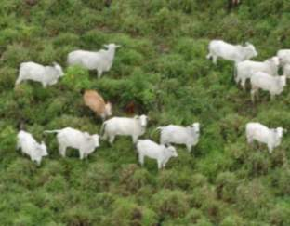

Finding: Markets have a positive rôle

Slide 19
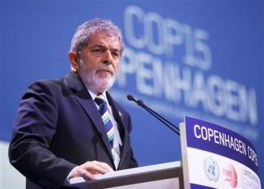
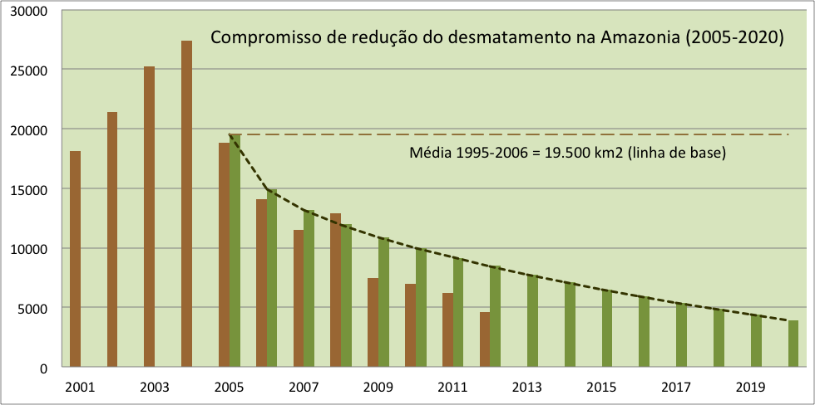
“By 2020, Brazil will reduce deforestation by 80% relative to 2005.” (pres. Lula in Copenhagen COP-15)

Slide 20
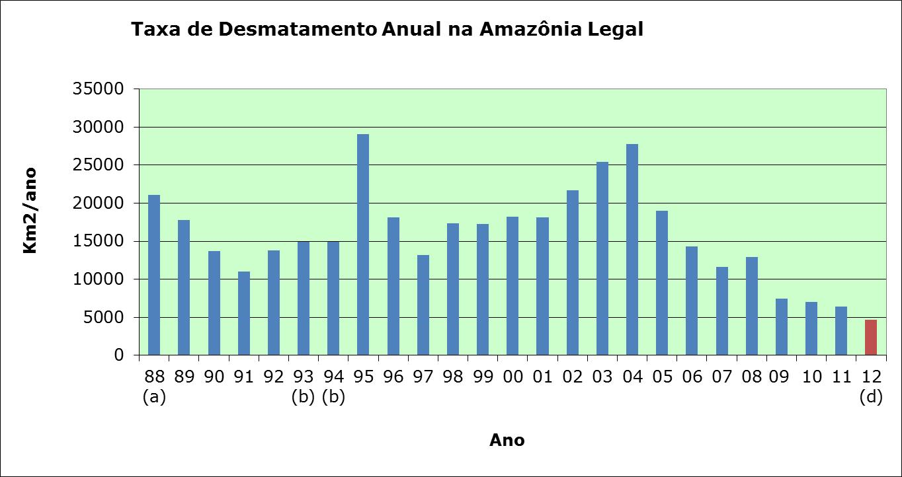
Transparency builds governance!
Deforestation in Brazilian Amazonia (1988-2011)
dropped from 27,000 km² to 6,200 km²

Slide 21
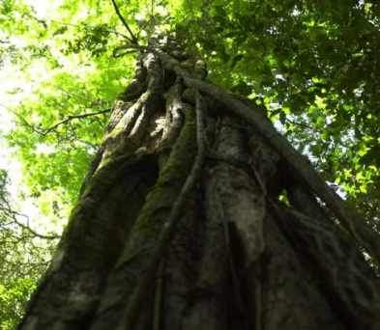

“Deforestation in the Brazilian Amazon is down by a whopping 78% from its recent high in 2004. If Brazil can maintain that progress, it would be the biggest environmental success story in decades, and would set an example to other countries that want to protect their tropical forests.” (Editorial, 7 June 2012)

Slide 22
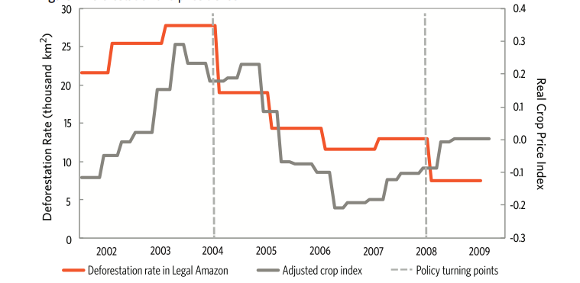
Deforestation and price trends

Slide 23
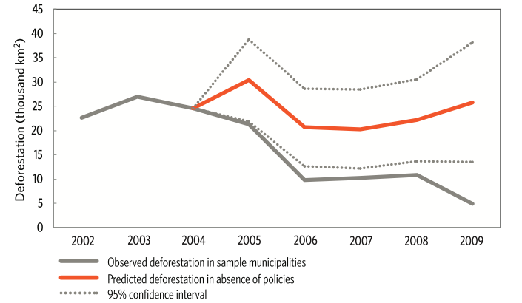
Prices or policies?
Deforestation Slowdown in the Legal Amazon: Prices or Policies?
http://www. climatepolicyinitiative.org

Slide 24
Prices or policies?
“Our analysis shows that approximately half of the deforestation that was avoided in the Amazon in the 2005 through 2009 period can be attributed to conservation policies introduced in the second half of the 2000s. This is equivalent to an avoided loss of 62,000 km2 of forest area, or approximately 620 million tons of stored C (2.3 billion tons of stored CO₂), which our estimates value at US$ 11.5 billion US dollars.” (Pinho et al., 2012)
Deforestation Slowdown in the Legal Amazon: Prices or Policies?
http://www. climatepolicyinitiative.org

Slide 25
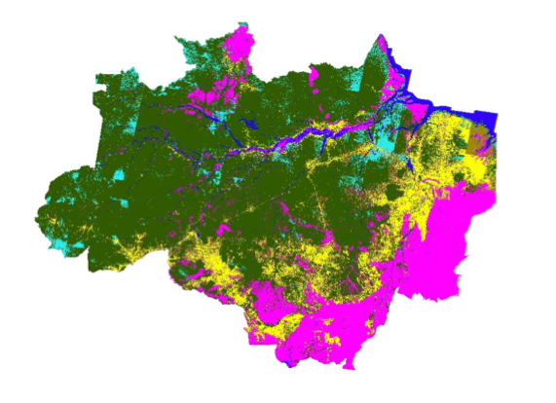
What happened with 720.000 km2 deforested?
First map of land use and land cover of Amazonia

Slide 26
What happened with 720.000 km2 deforested?
TerraClass - first map of land use and land cover of Amazonia

Slide 27
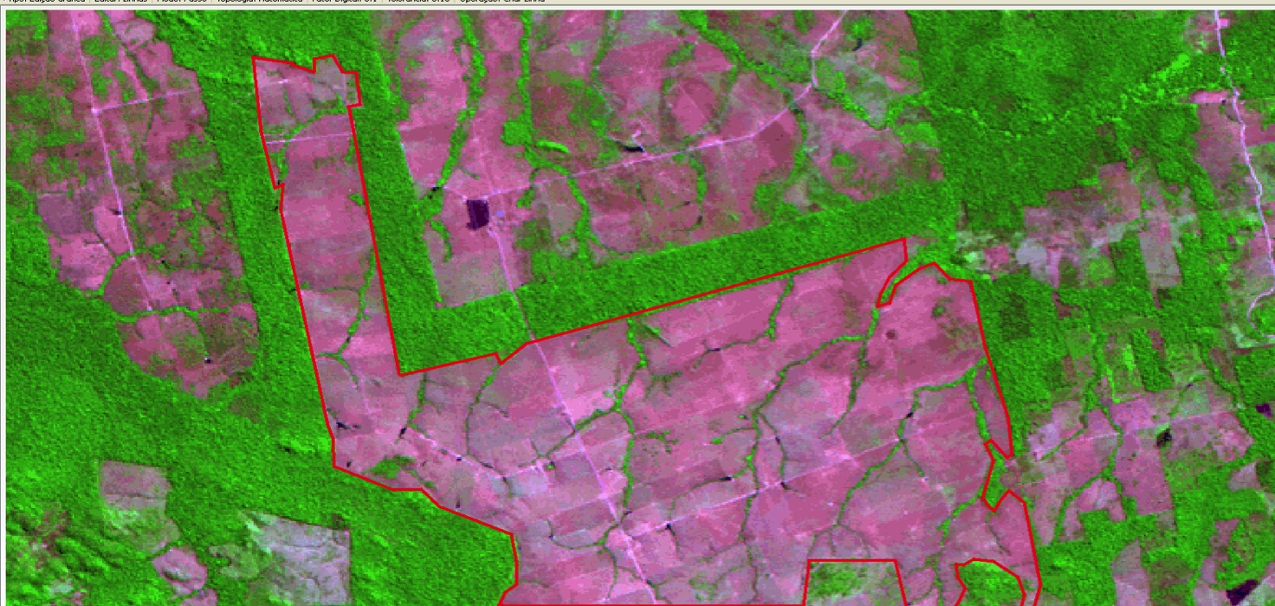
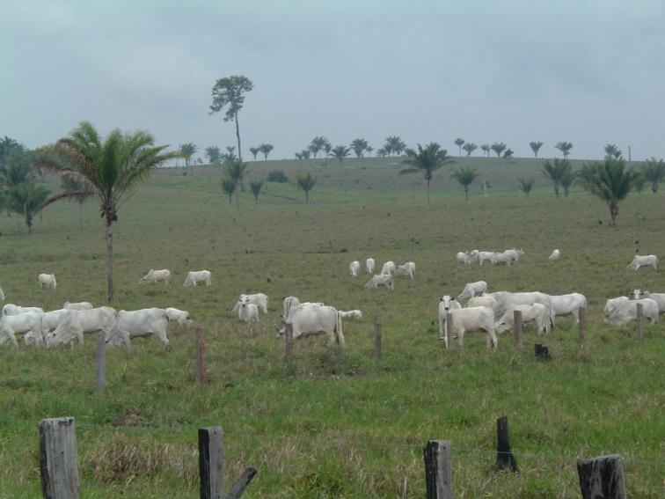
Nível inédito de detalhe espacial: 20 m (CBERS) e 30 m (LANDSAT)
Pasto limpo

Slide 28
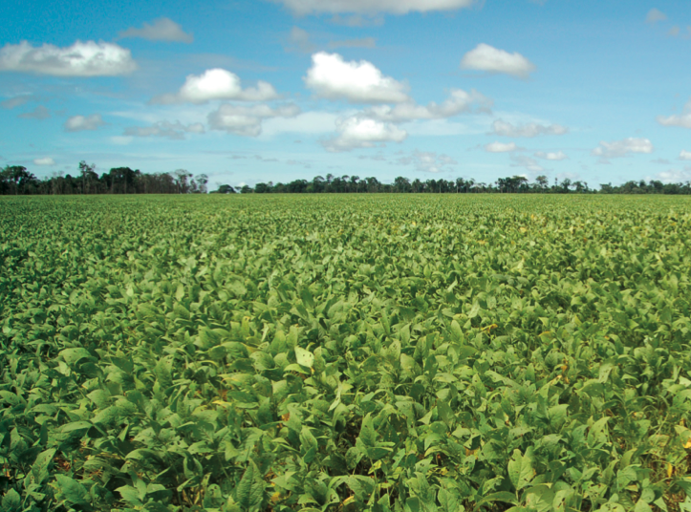
Agriculture (grains)

Slide 29
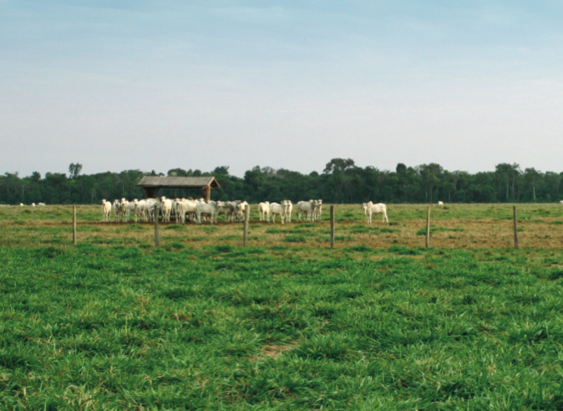
Cleared pasture

Slide 30
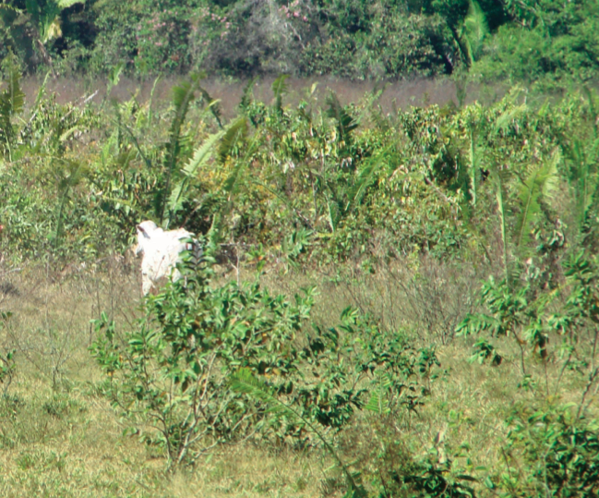
Degraded pasture

Slide 31
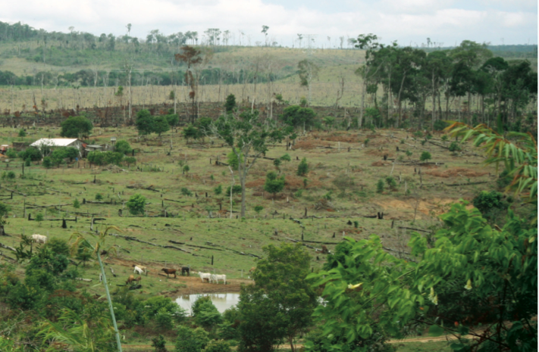
Small-scale agriculture

Slide 32
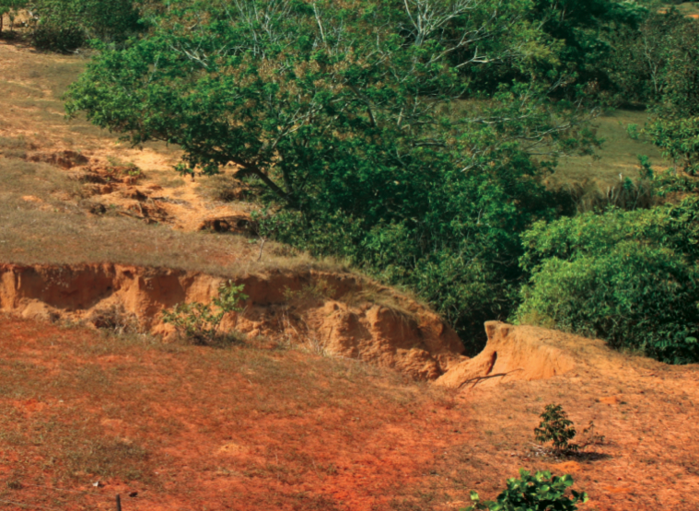
Degraded land

Slide 33
How are we using the forest?

Slide 34
The extent of illegal deforestation

Slide 35
Class | TOTAL (km²)
Clean Pasture | 335.714,94 | 46,7%
Secundary Vegetation | 150.815,31 | 21,0%
Dirty pasture | 62.823,75 | 8,7%
Regeneration with pasture | 48.027,37 | 6,7%
Non-observed areas | 45.406,27 | 6,3%
Agriculture (large-scale) | 34.927,24 | 4,9%
Small farms and settlers | 24.416,57 | 3,4%
Urban areas | 3.818,14 | 0,5%
Mining | 730,68 | 0,1%
Degraded areas | 594,19 | 0,1%
Others | 477,88 | 0,1%
Desflorestation 2008 | 11.458,64 | 1,6%
TOTAL | 719.210,99

Slide 36
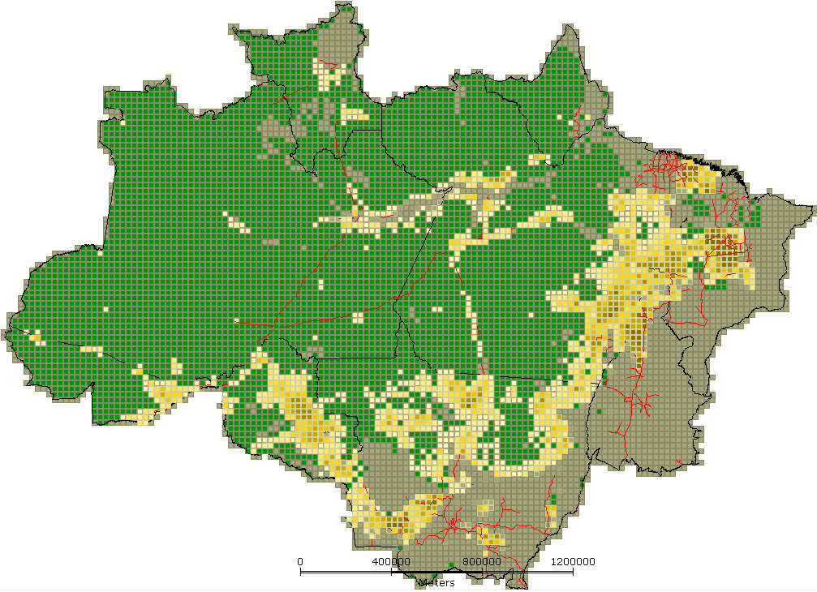
Brazil new Forest Code
Até 10%
10 - 20%
20 – 30%
30 – 40%
40 – 50%
50 – 60%
60 – 70%
70 – 80%
80 – 90%
90 – 100%
Illegal large farms have to recover 80% of area

Slide 37
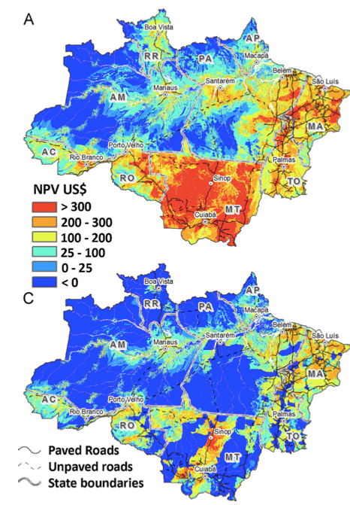
Sustainability?
NPV (net present value) of land in Amazonia for cattle ranching
Land speculation
Extensive ranching is only profitable for large farms
source: Bowman et al. (Land Use Policy, 2012)
Land purchase

Slide 38
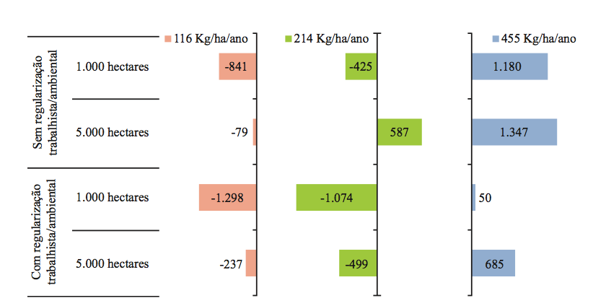
NPV (net present value) of land in Amazonia for cattle ranching
No regulation
Regulation
source: Silva and Barreto (Imazon, 2011)

Slide 39
Potential for CO2 sink in Amazonia
Clear-cut areas
200,000 km2 (30% of area)
10 Gt CO₂eq (2015-2020)
Floresta (biomass after 5 years)

Slide 40
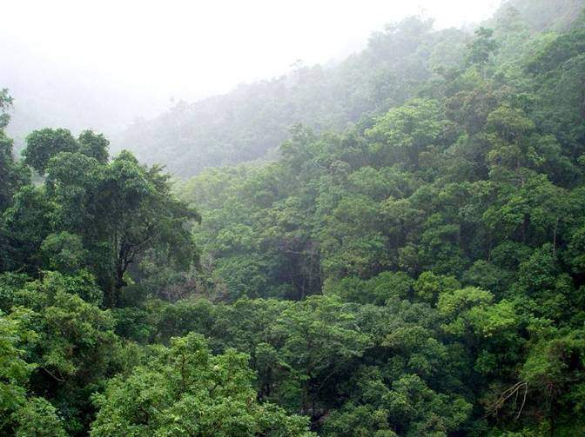
Impact of reforestation in Amazonia (30% of deforestation recovers from 2015-2025)
Net sink in Amazonia
(2015-2020)
World’s emission growth in
fossil fuels (2% a.a) (2015-2025)
3 Gt CO2eq
20 Gt CO2eq
From 2015 to 2025, reforestation in Amazonia could help reduce 15% of global emissions increase

Slide 41
Impact of reforestation in Amazonia (30% of deforestation recovers from 2015-2025)
Net sink in Amazonia
(2015-2020)
World’s emission growth in
fossil fuels (2% a.a) (2015-2025)
3 Gt CO2eq
20 Gt CO2eq
From 2015 to 2025, reforestation in Amazonia could help reduce 15% of global emissions increase

Slide 42
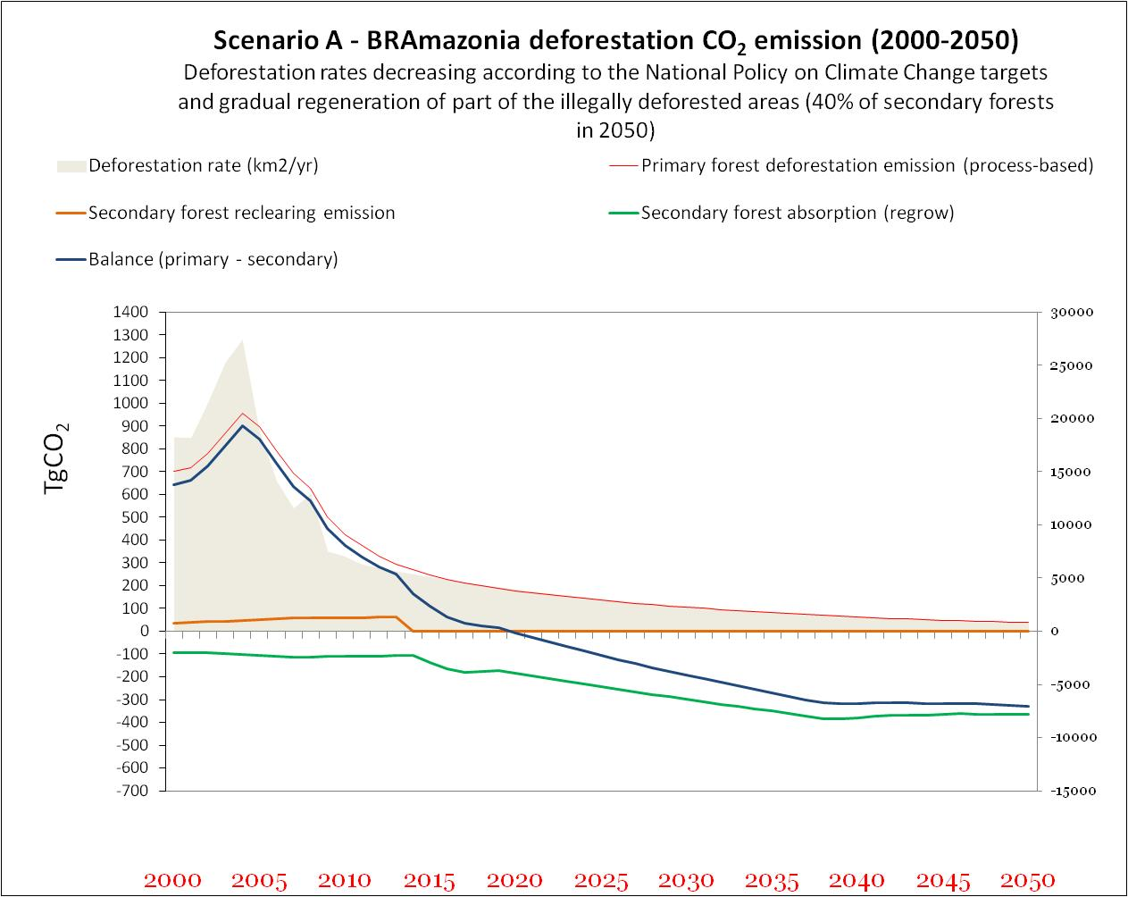
(40% of deforestation recovers from 2015-2050) = sink of 6 GtCO₂eq

Slide 43
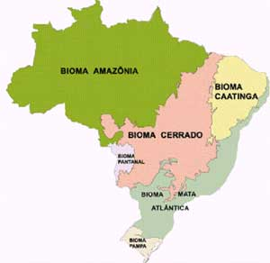
What about the rest of Brazil?
source: IBGE

Slide 44
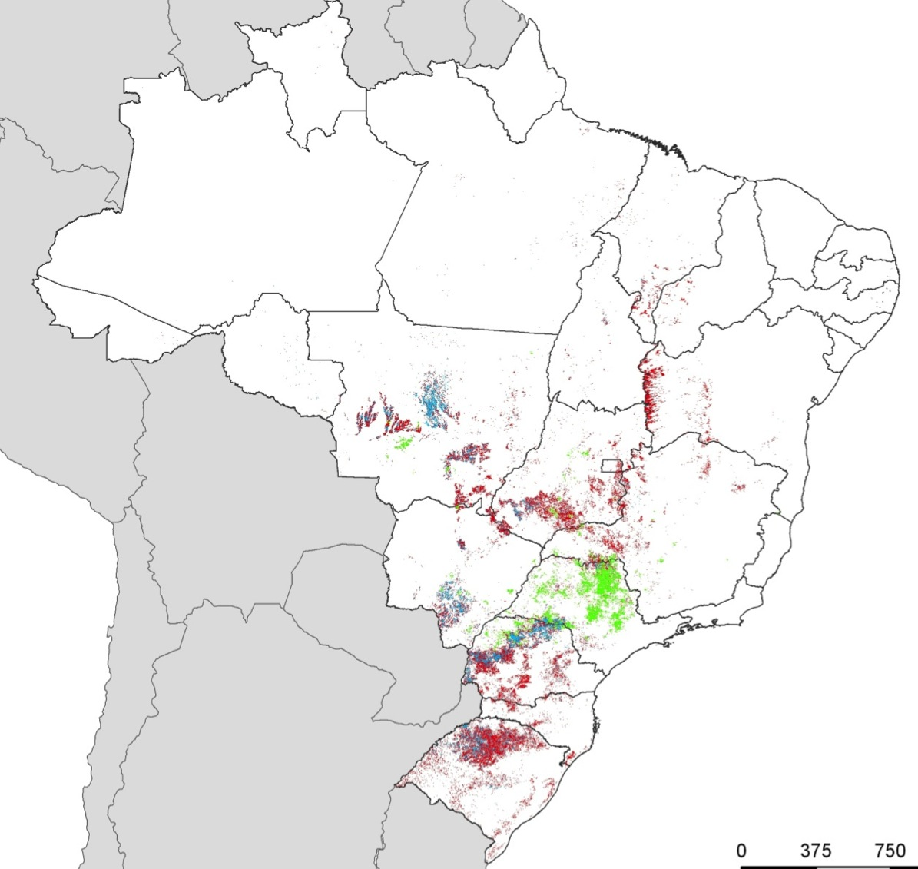
Crop Year 2002/2003
Annual Crop – 1 Crop per season
Annual Crop – 2 Crops per season
source: Bernardo Rudorff (INPE)
Sugarcane

Slide 45
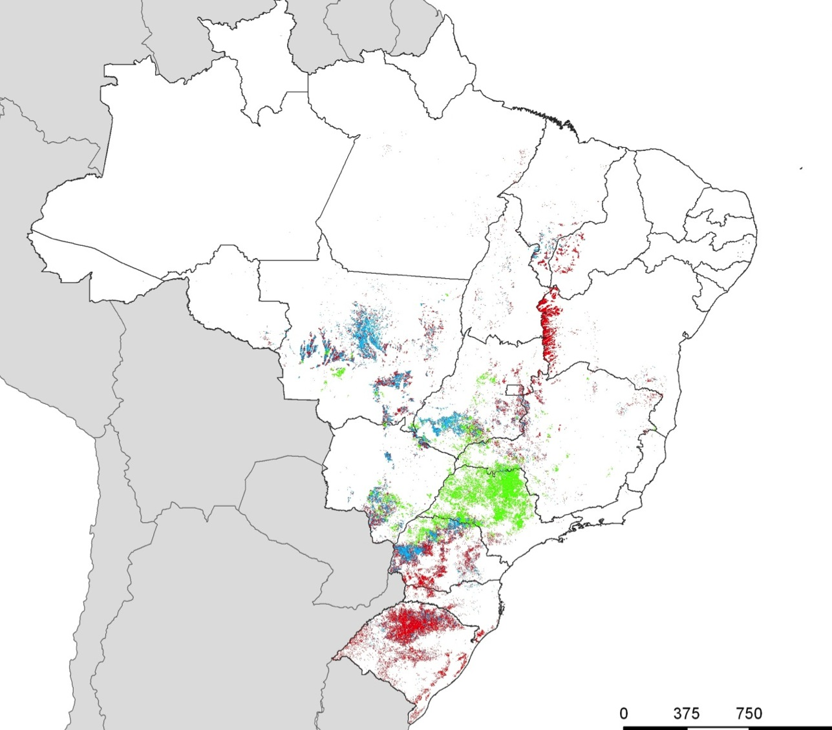
Crop Year 2010/2011
Annual Crop – 1 Crop per season
Annual Crop – 2 Crops per season
source: Bernardo Rudorff (INPE)
Sugarcane

Slide 46
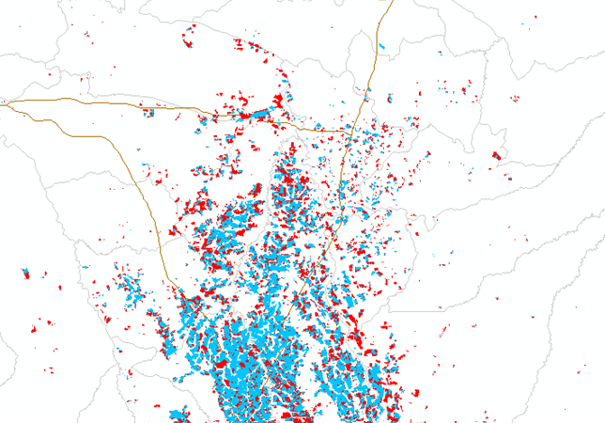
MATO GROSSO – Sorriso: Crop Year 2002/2003
source: Bernardo Rudorff (INPE)
Annual Crop - 2 Crops
Annual Crop - 1 Crop

Slide 47
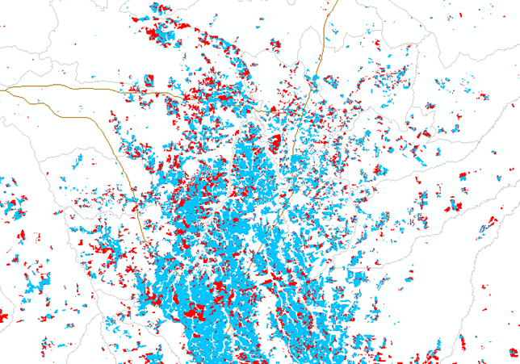
MATO GROSSO – Sorriso: Crop Year 2010/2011
source: Bernardo Rudorff (INPE)
Annual Crop - 2 Crops
Annual Crop - 1 Crop

Slide 48
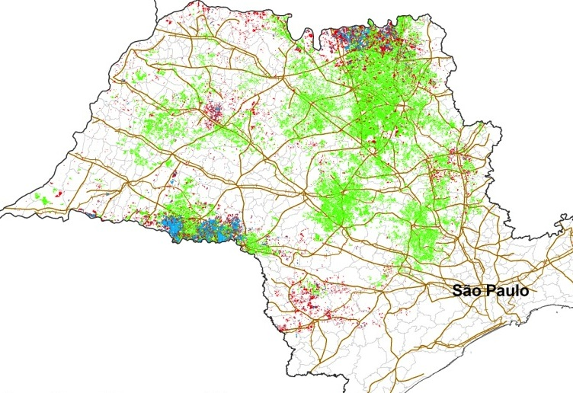
Crop Year 2002/2003
Annual Crop – 1 Crop per season
Annual Crop – 2 Crops per season
Sugarcane
source: Bernardo Rudorff (INPE)

Slide 49
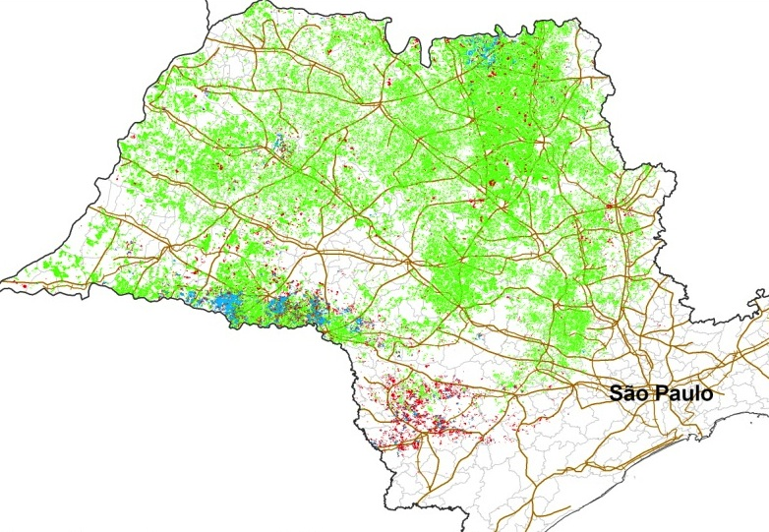
Crop Year 2010/2011
Annual Crop – 1 Crop per season
Annual Crop – 2 Crops per season
Sugarcane
source: Bernardo Rudorff (INPE)

Slide 50
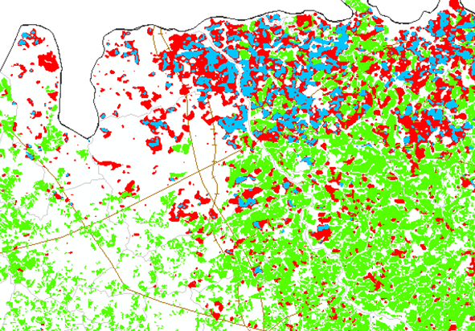
SÃO PAULO – Barretos: Crop Year 2002/2003
1
source: Bernardo Rudorff (INPE)
Annual Crop - 1 Crop
Annual Crop - 2 Crops
Sugarcane

Slide 51
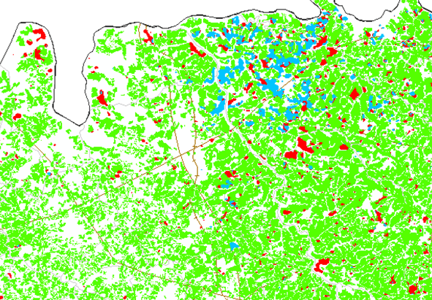
SÃO PAULO – Barretos: Crop Year 2010/2011
1
source: Bernardo Rudorff (INPE)
Annual Crop - 1 Crop
Annual Crop - 2 Crops
Sugarcane

Slide 52
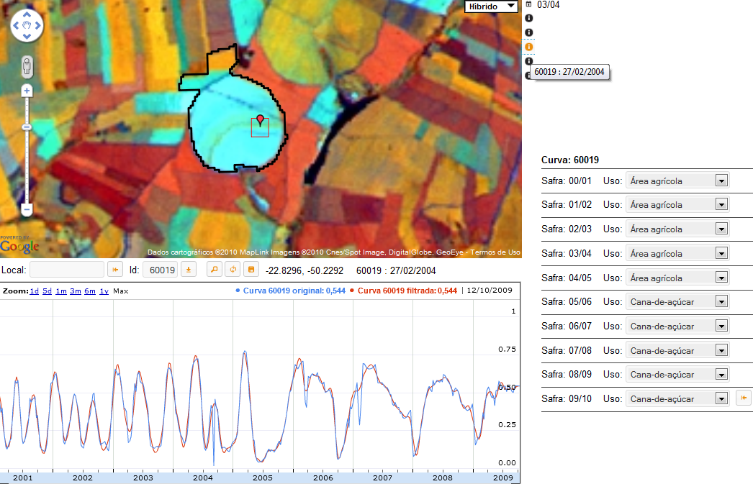
Are biofuels replacing food production in Brazil?
source: B. Rudorff, INPE

Slide 53
Are biofuels replacing food production in Brazil?

Slide 54



Brazil: Do biofuels cause indirect land change?

Slide 55

Brazil: Projected direct land change from biofuels (2020)
source: Lapola et al (PNAS, 2010)

Slide 56

Brazil: Projected indirect land change from biofuels (2020)
source: Lapola et al (PNAS, 2010)
source: Lapola et al (PNAS, 2010)

Slide 57


REDD-PAC project (IIASA, INPE, IPEA)
GLOBIOM, G4M, EPIC, TerraME
TerraLib
Land use data and drivers for Brazil
Model cluster - realistic assumptions
Globally consistent policy impact assessment
Information infrastructure

Slide 58

GLOBIOM

Slide 59


The conceptual debate on Future Earth
Malthus: Projecting the future from past trends
Schumpeter: Innovation builds unpredictable futures
Is Future Earth already locked into a Malthusian mindset?

Slide 60

Will REDD create self-defeating outcomes?
‘We have a resource we would like to get money for. Either you pay us for biodiversity services or we will sell the forest to Malaysian logging companies.’ (Guyana government officer)

Slide 61




Can we build REDD+ without institutions?
Justice
Public health
Knowledge
Information

Slide 62
Can we build REDD+ without institutions?
We cannot have REDD+ without institutions
If we have institutions, do we need REDD+?
Justice
Public health
Knowledge
Information

