Slide 1

E-sensing: Big Earth Observation Data Handling And Analysis On Array Databases
Gilberto Câmara
National Institute for Space Research (INPE), Brazil
Institute for Geoinformatics, University of Münster, Germany

Slide 2
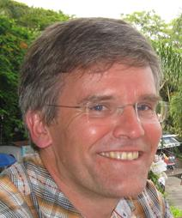


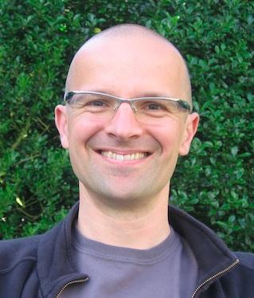
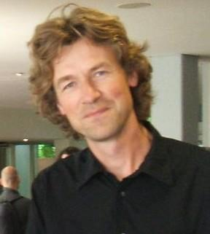
Be careful what you wish for…

Slide 3
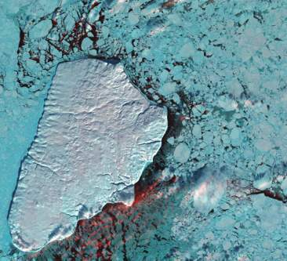
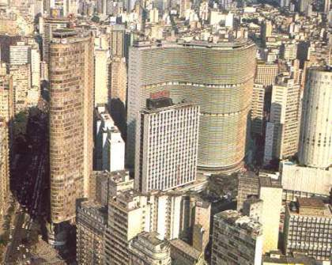
Geoinformatics enables crucial links between nature and society
Nature: Physical equations
describe processes
Society: Decisions on how to
use Earth´s resources

Slide 4
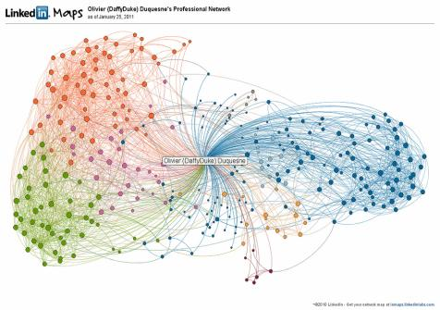
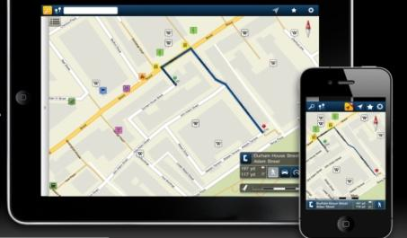
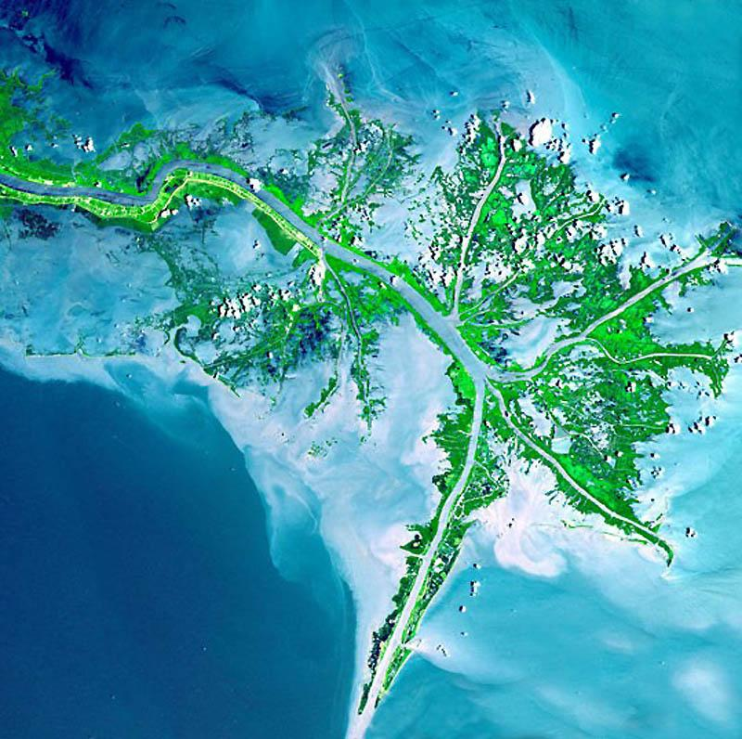
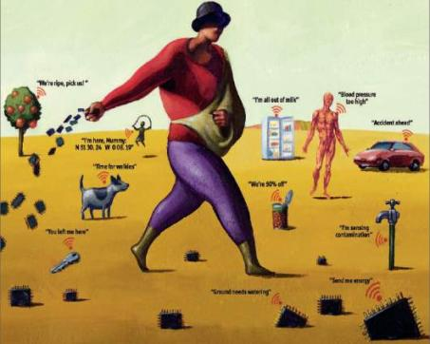
mobile devices
social network
Mobile devices, crowdsourcing, massive Earth observation sets: new technologies, new challenges
sensors everywhere
ubiquitous imagery

Slide 5
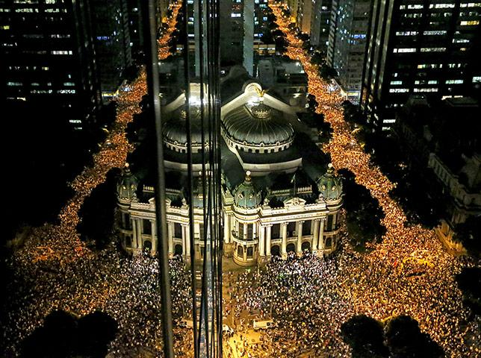
Semantics of big data
Records of interaction on human societies
primary aim: communication

Slide 6
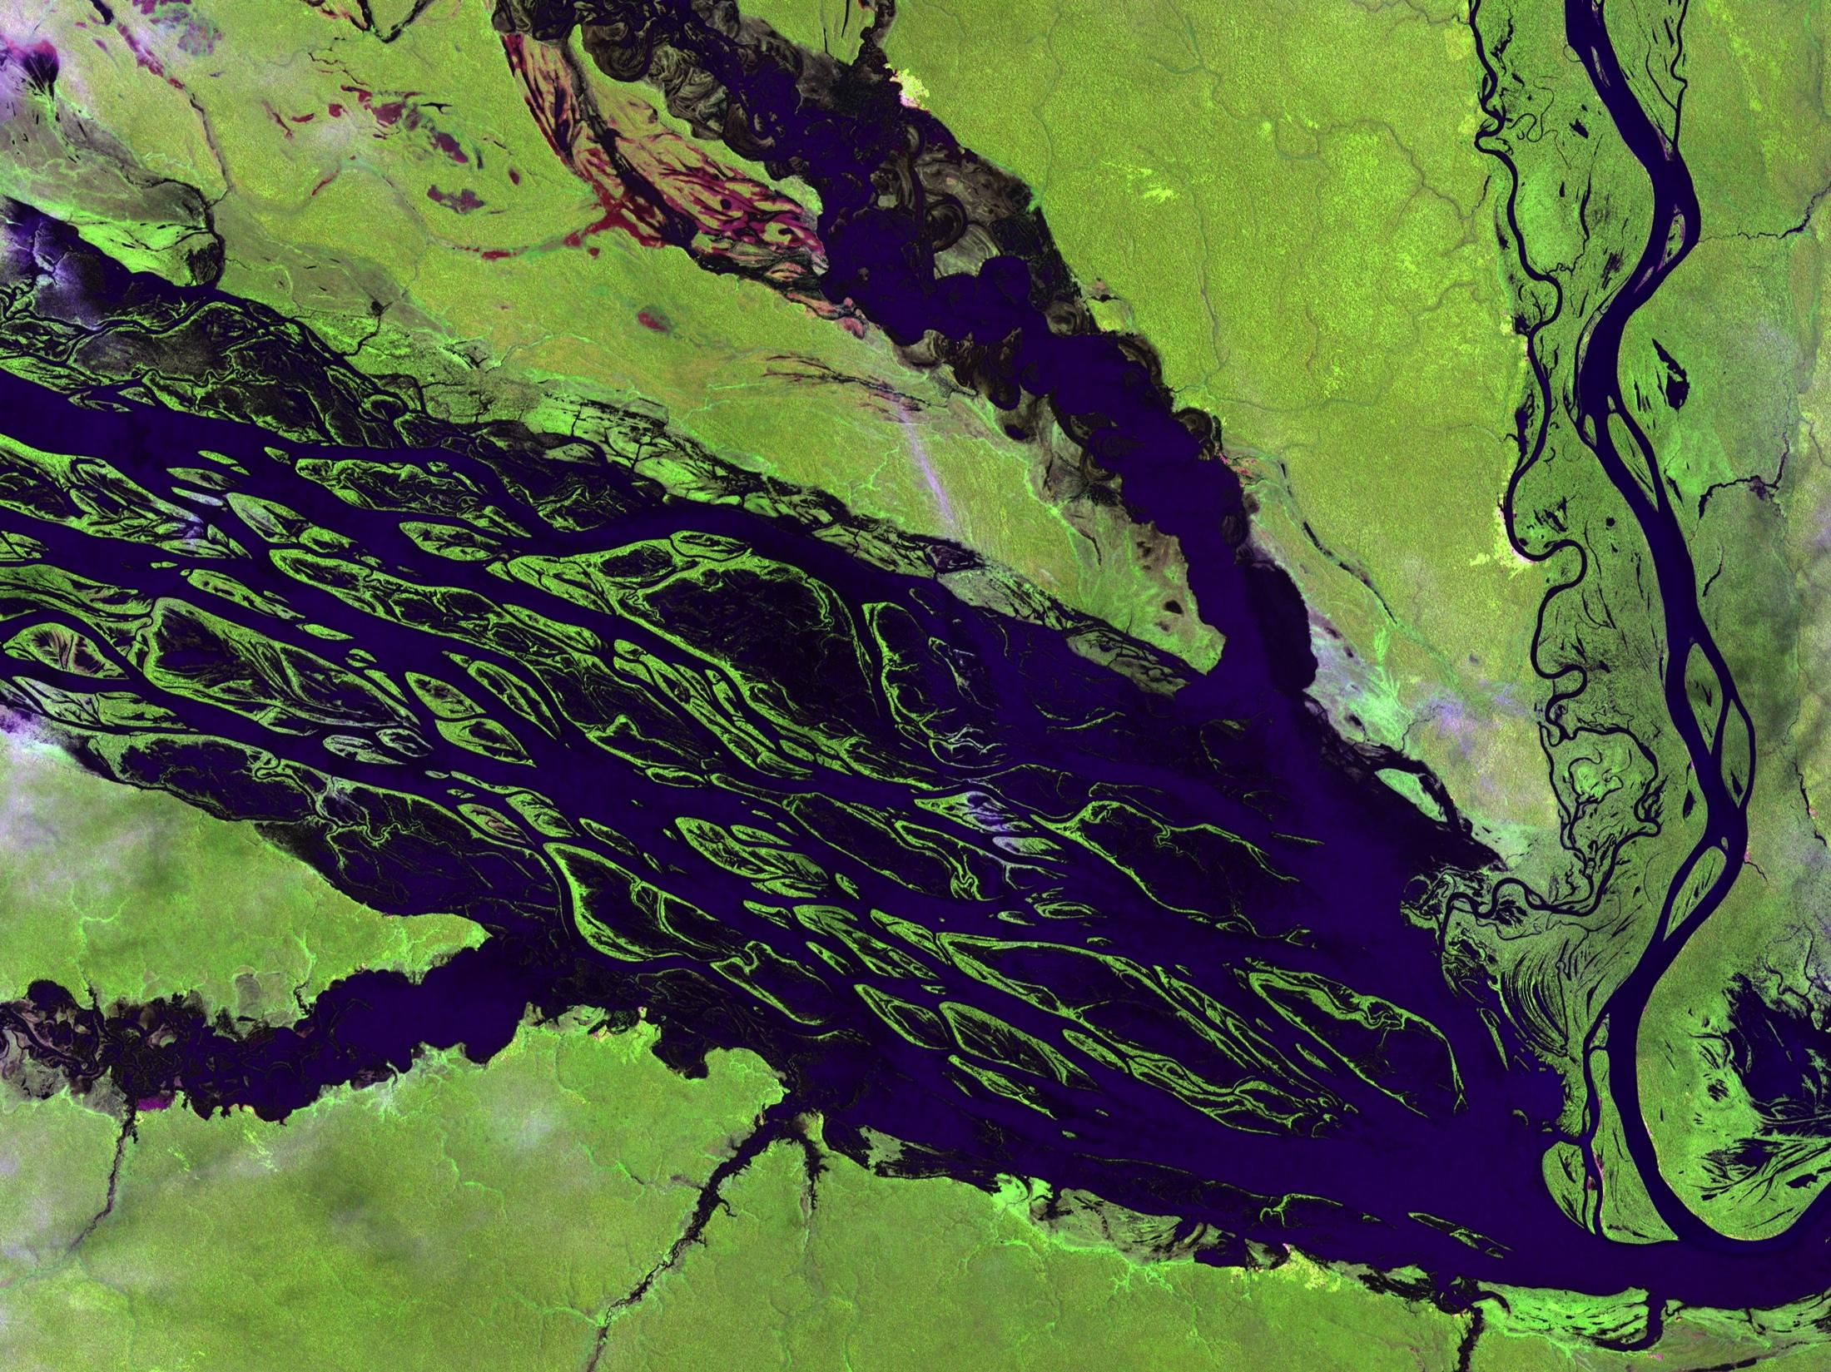
Semantics of big data
Observations of nature
primary aim: description

Slide 7
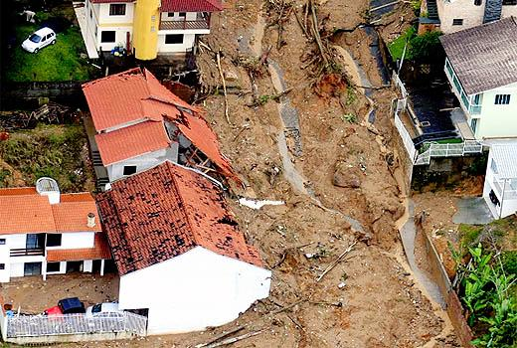
Measurements of nature-society interaction
Semantics of big data
primary aim: sustainability

Slide 8
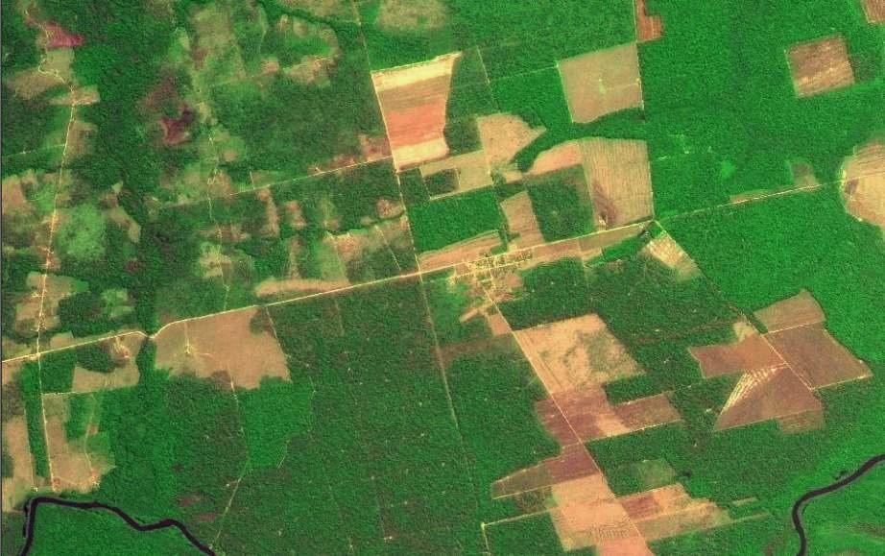
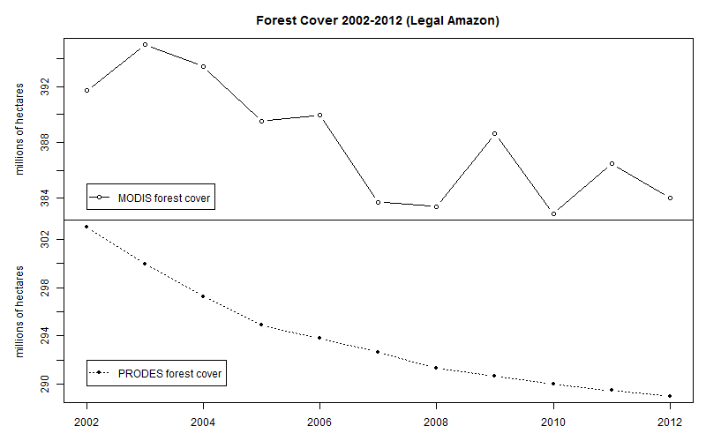
Why do we need big data?
Data sources: INPE, NASA. Analysis by M. Buurman

Slide 9
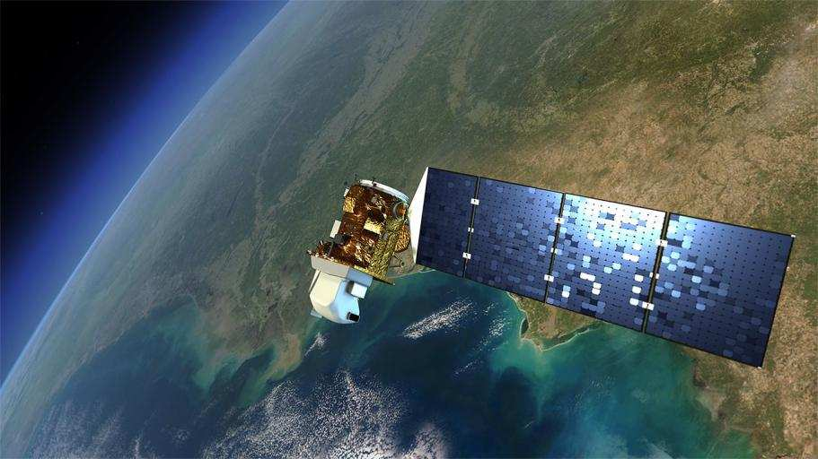
Earth Observation data is now free…and big
Image source: NASA
Sentinels: 3 Tb/day

Slide 10
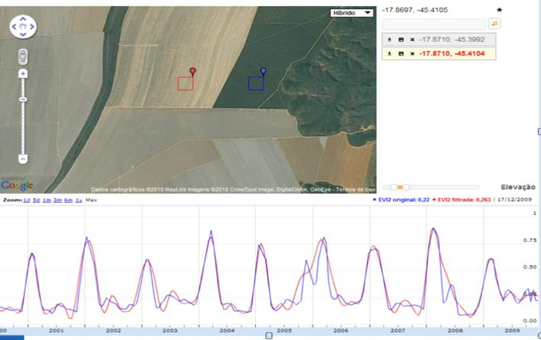
What’s in an image?
image: LAF/INPE
“Remote sensing images describe landscape dynamics”
(Câmara et al., COSIT 2001)

Slide 11
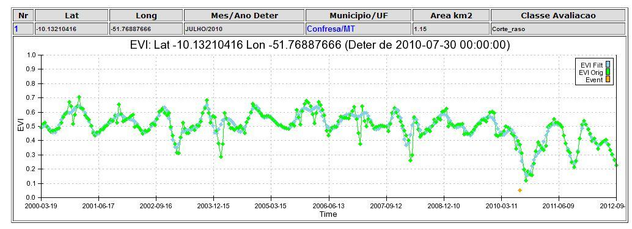
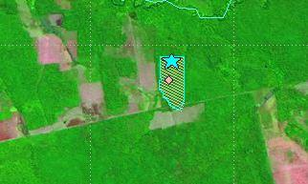
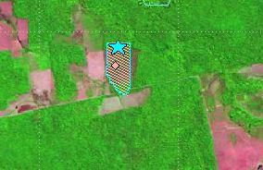
Deforestation event detection: images and time series
images: INPE
2010
2011

Slide 12
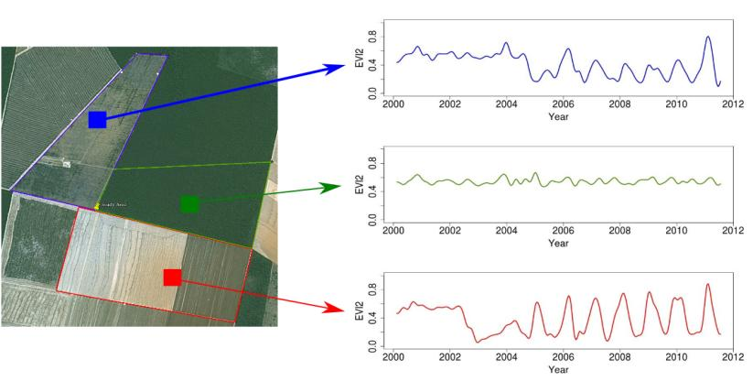
Time series analysis of land change
Forest
Pasture
Área 1
Forest
Área 2
Forest
Agriculture
Área 3
Vegetation index
time series
source: Victor Maus (INPE)

Slide 13
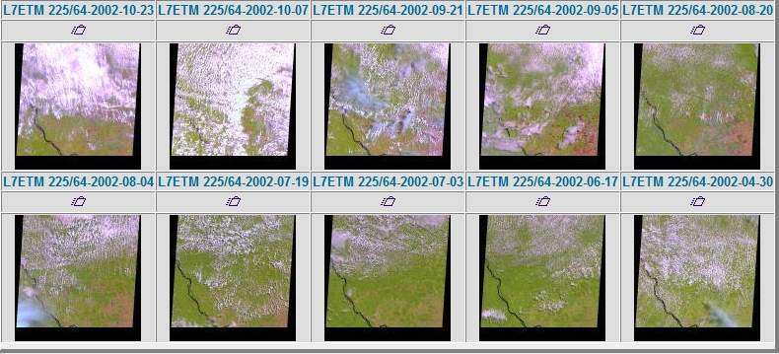
Is free data download our answer?
Currently, users download one snapshot at a time
How do you download a petabyte?
images: INPE
Notes:
Este slide mostra o impacto da cobertura de nuvens sobre a analise de imagens. Esta é uma região do Pará, onde todas as imagens durante o ano de 2002 tem cobertura de nuvens. Para reduzir este impacto, o INPE analisa varias imagens para uma mesma regiao.

Slide 14
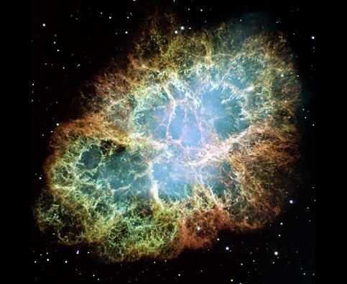
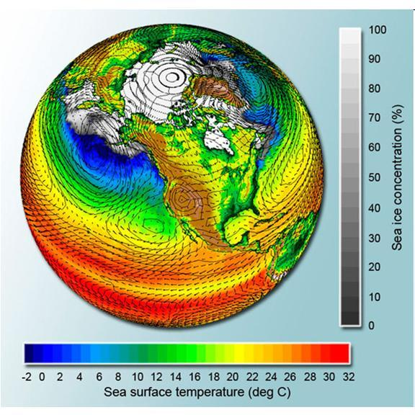
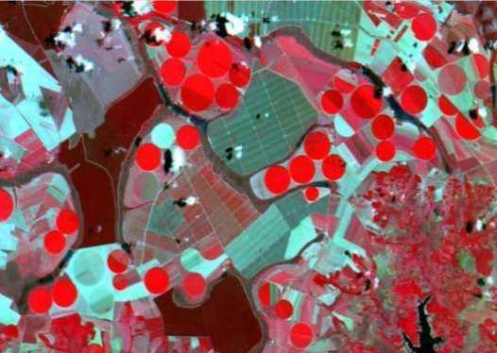
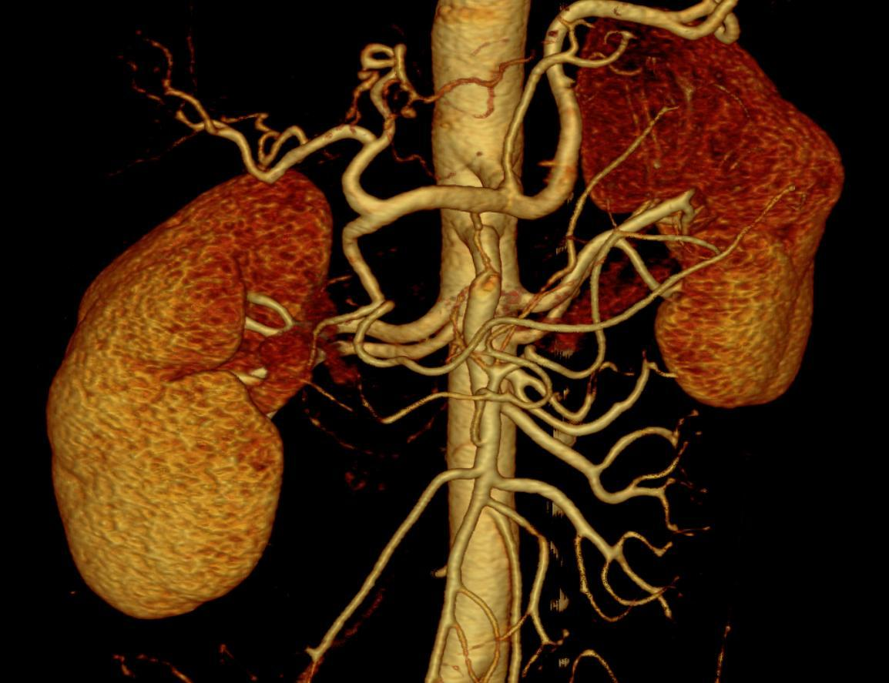
What do these data have in common?

Slide 15
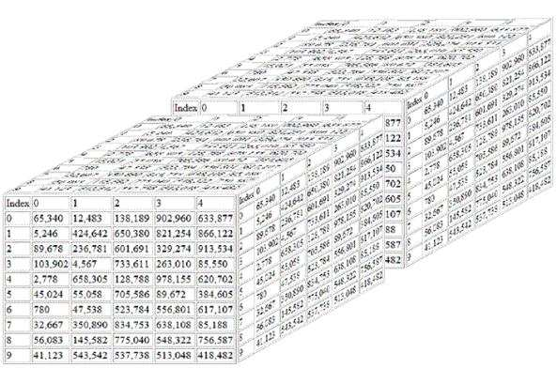
Scientific data: multidimensional arrays
y
t
X
g = f (<x,y,z> [a₁, ….a_{n}])

Slide 16
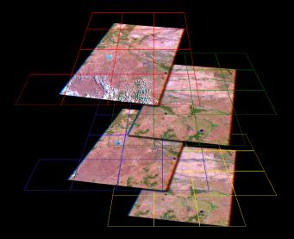
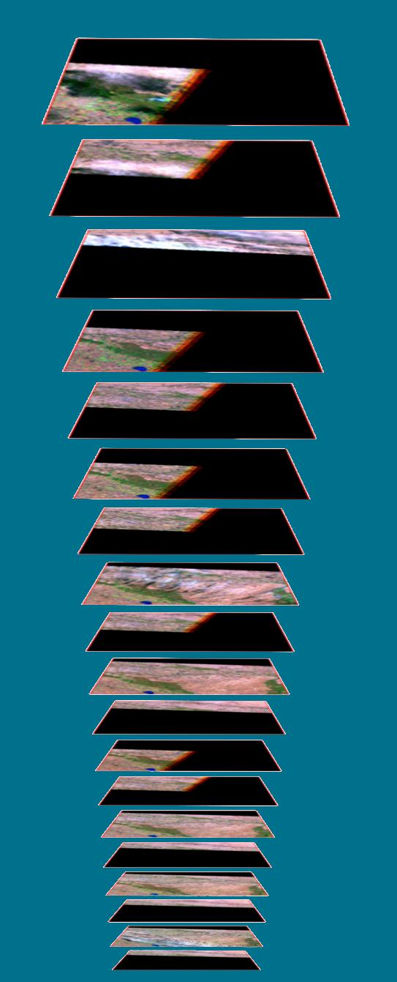
“Cubing” remote sensing images
Landsat
images
Tile
squares
→ space →
→ time →
& … Stack
Dice…

Slide 17
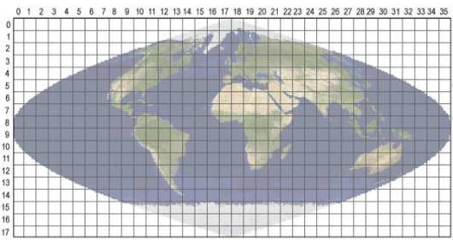
Array databases: all data from a sensor put together in a single array
t
y
y
X
result = analysis_function (points in space-time )

Slide 18
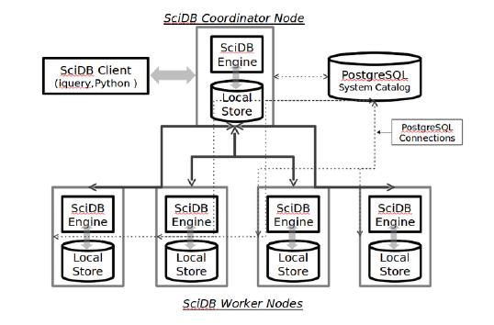
SciDB Architecture: “shared nothing”
image: Paul Brown (Paradigm 4)
Large data is broken into chunks
Distributed server process data in paralel

Slide 19
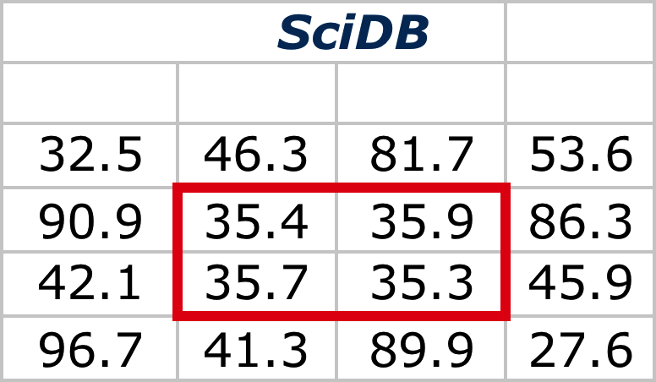
SciDB vs. RDBMSs on storage efficiency & complex computations
16 cells
Speeds up data access in a distributed database
Dramatic storage efficiencies as # of dimensions & attributes grows
Facilitates drill-down & clustering by like groups
Math functions like linear algebra run directly on native storage format
48 cells
source: Paul Brown (Paradigm 4)

Slide 20
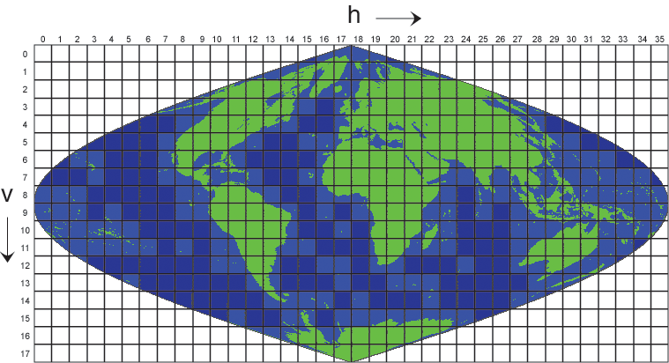
An example of array algebra using MODIS data set
image: NASA
MODIS: 36 spectral bands, global images every 2 days

Slide 21
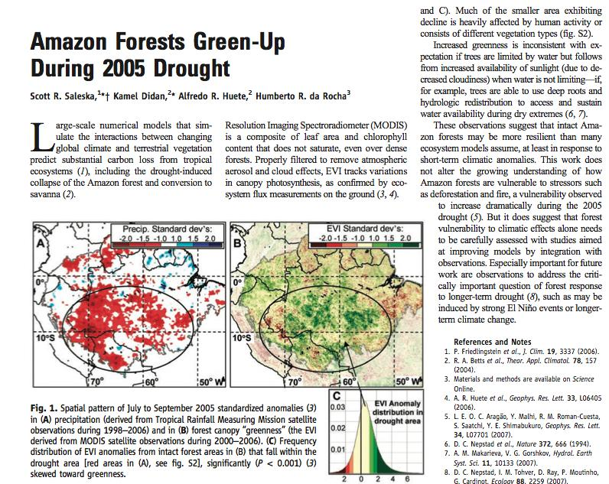

SciDB Architecture: “shared nothing”
image: Paul Brown (Paradigm 4)
Can we reproduce a Science paper?
Large data is broken into chunks
Distributed server process data in paralel

Slide 22
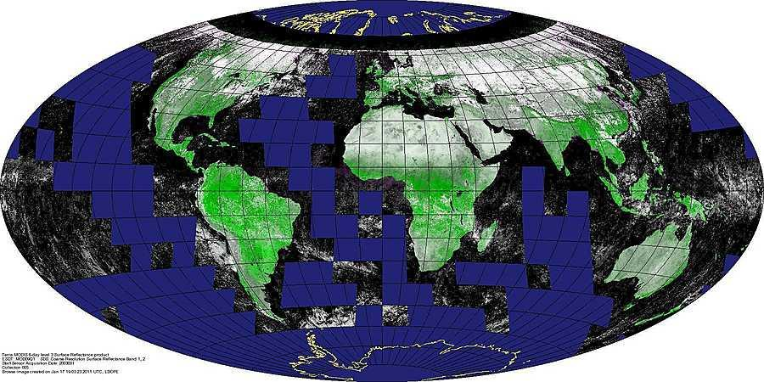
MOD09Q1 product
image: NASA
250 mts spatial resolution, 8 days temporal resolution
4800 x 4800 pixels, 3 bands (red, nir, qc)
13 years of data (since 2000)

Slide 23
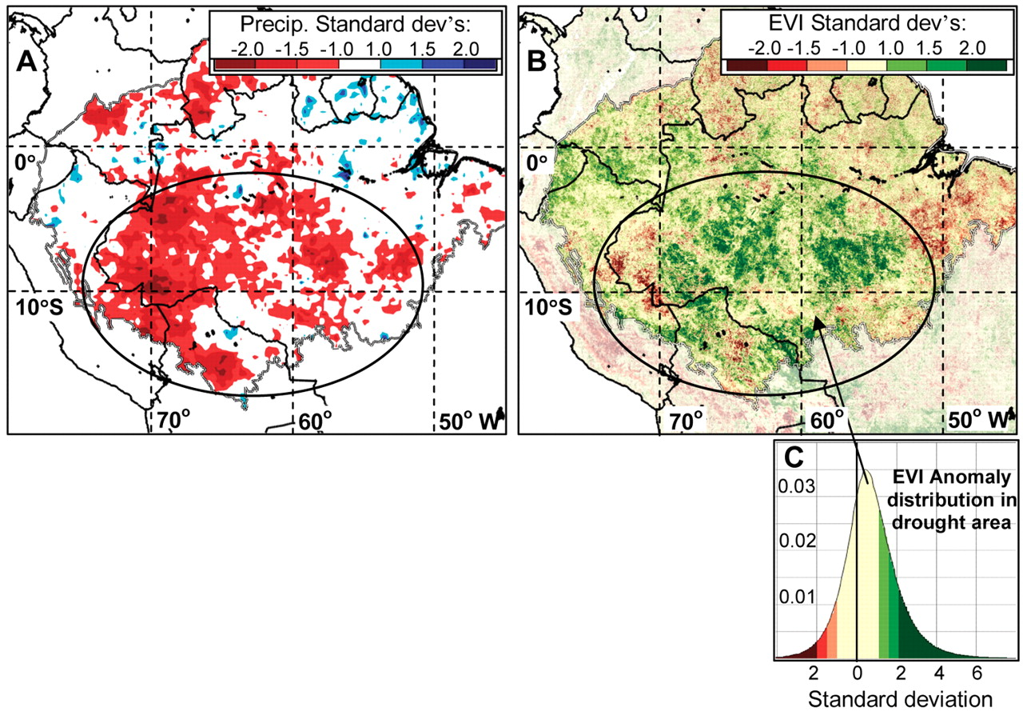
Did Amazon forests green up during 2005 drought? (An exercise on reproducible science)
July - September 2005 standardized anomalies
(A) precipitation (TRMM 1998–2006)
(B) forest canopy “greenness” (MODIS EVI 2000–2006)
S R Saleska et al., Science 2007;318:612
Published by AAAS
Notes:
Spatial pattern of July to September 2005 standardized anomalies (3) in (A) precipitation (derived from Tropical Rainfall Measuring Mission satellite observations during 1998–2006) and in (B) forest canopy “greenness” (the EVI derived from MODIS satellite observations during 2000–2006). (C) Frequency distribution of EVI anomalies from intact forest areas in (B) that fall within the drought area [red areas in (A), see fig. S2], significantly (P < 0.001) (3) skewed toward greenness.

Slide 24
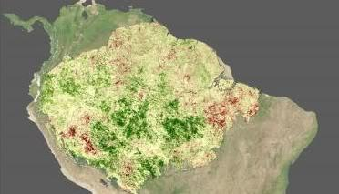
Reproducing Saleska’s paper in Science with SciDB Array Functional Language
Put all MODIS EVI-related bands in a single SciDB array
Extract the subarray covering Amazonia
Compute EVI for each cell in all time steps
Compute EVI mean and stdev for JAS 2000-2006 for each cell
Compute EVI mean for JAS 2005 for each cell
Compare EVI mean (JAS 2005) to the JAS 2000-2006 mean

Slide 25
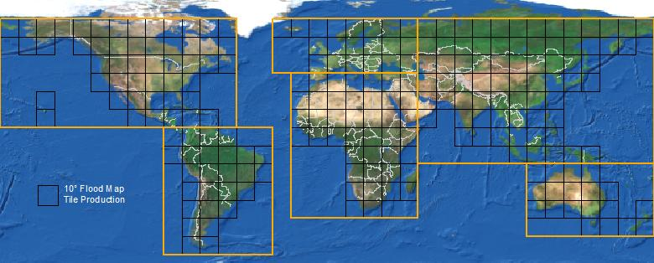
Extracting a subarray for JAS 2000-2006
(quality filter)
store(between(filter(MOD09Q1_BR_2000_2013,
time_id % 46 >= 23 and time_id % 46 <= 34
and quality = 4096),
48000, 38400, 0, 67199, 52799, 275),
MODIS_AMZ_BQ_JAS);
dimensions: col_id, row_id, time_id
attributes: red, nir, quality

Slide 26
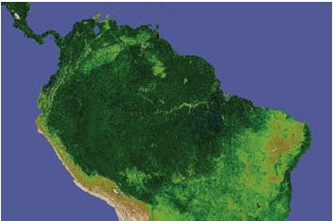
Calculate EVI2 for all cells in all time steps
store(apply(MODIS_AMZ_BQ_JAS, evi2,
2.5*((nir - red)/(nir + 2.4*red + 1))),
MODIS_AMZ_BQ_JAS_EVI2);
attributes: red, nir, quality, evi2
image: NASA

Slide 27
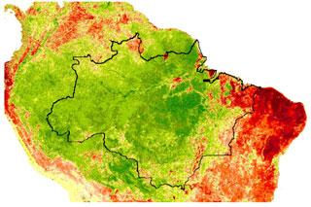
EVI2 mean and stdev (JAS 2000-2006)
image: U. Arizona
store (aggregate (MODIS_AMZ_BQ_JAS_EVI2,
avg(evi2) as evi2_avg_2000_2006,
stdev(evi2) as evi2_stdev_2000_2006,
col_id, row_id),
MODIS_AMZ_BQ_JAS_EVI2_AVG_2000_2006);
Attributes: evi2_avg_2000_2006,
evi2_stdev_2000_2006

Slide 28
EVI2 mean (JAS 2005)
image: U. Arizona
--Filters data for 2005's 3rd quarter
store(between (MODIS_AMZ_BQ_JAS_EVI2,
48000, 38400, 253,
67199, 52799, 264),
MODIS_AMZ_BQ_JAS_EVI2_2005);
--Average for 2005's 3rd quarter
store(aggregate(MODIS_AMZ_BQ_JAS_EVI2_2005,
avg(evi2) as evi2_avg_jas_2005,
col_id, row_id),
MODIS_AMZ_BQ_JAS_EVI2_2005_AVG);

Slide 29
Joining two arrays (JAS 2005 and JAS 2000-2006)
image: U. Arizona
store(join (MODIS_AMZ_EVI2_BQ_JAS_AVG_2000_2006,
MODIS_AMZ_EVI2_BQ_JAS_2005_AVG),
MODIS_AMZ_EVI2_COMP);
Attributes: evi2_avg_2000_2006, evi2_stdev_2000_2006
evi2_avg_jas_2005

Slide 30
AFL: EVI anomalies (JAS 2005)
store(apply (MODIS_AMZ_EVI2_COMP,
evi_anomaly,
(evi2_avg_jas_2005 - evi2_avg_2000_2006)
/evi2_stdev_2000_2006),
MODIS_AMZ_EVI2_ANOM);

Slide 31
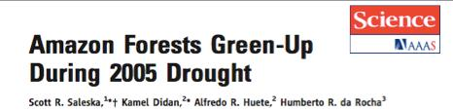
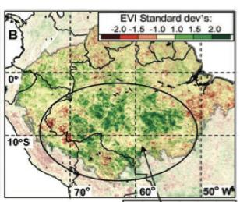
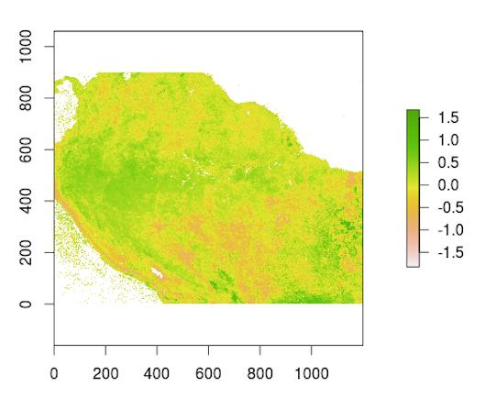
7 lines of SciDB commands
4,000 MODIS tiles (92 billion cells)
4.6 hours processing
6 months learning curve

Slide 32
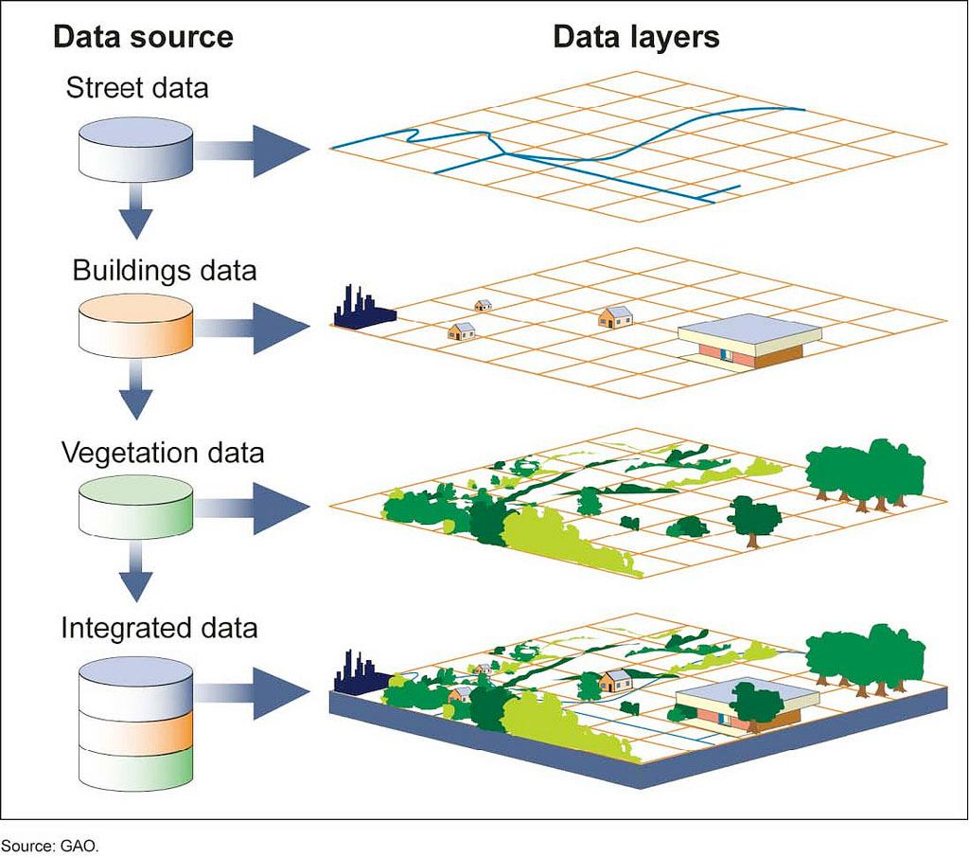
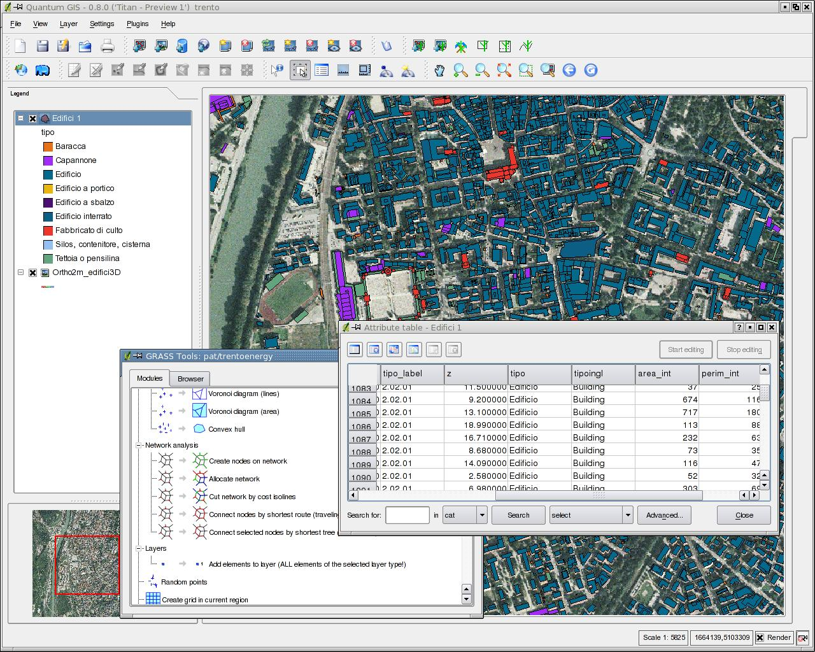
Current GIS is map-based
Big data does not fit in the “map as set of layers” model

Slide 33
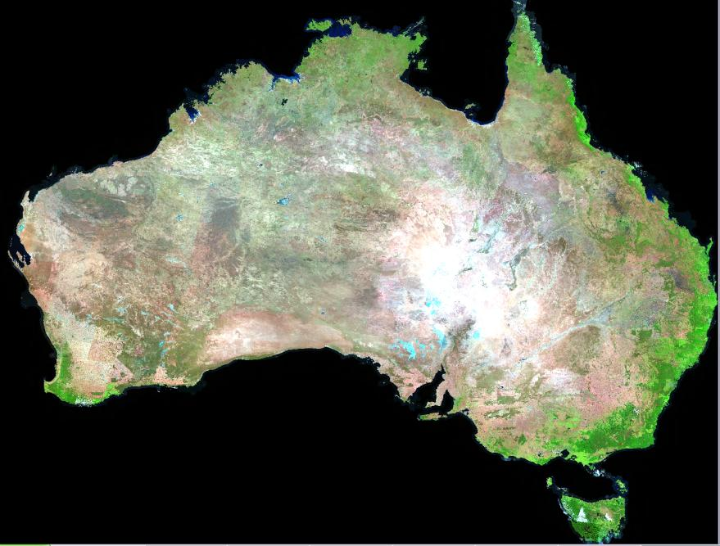

Big data requires new conceptual views
191610 (x)
575 (t) x 7 (λ)
The Space-time Data Cube concept

Slide 34
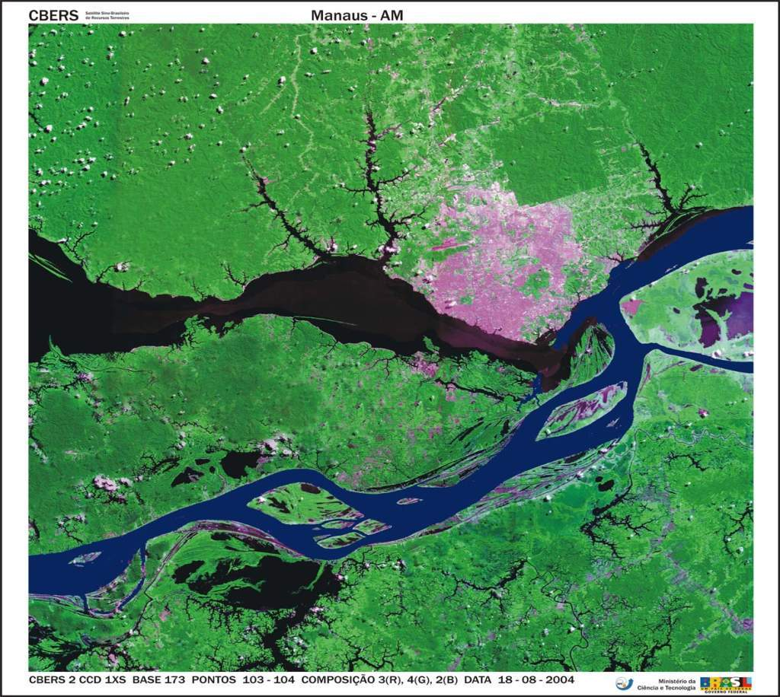
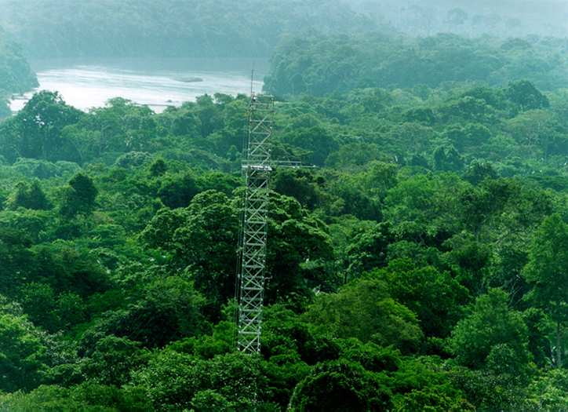
What is a geo-sensor?
What is a geo-sensor?
Field
function: Position → Value
“Conceiving big spatiotemporal data as fields captures their nature better than the layer-oriented view”
(Câmara, Egenhofer et al., GIScience 2014)
measure (s,t) = v
s ⋲ S - set of locations in space
t ⋲ T - is the set of times.
v ⋲ V - set of values

Slide 35
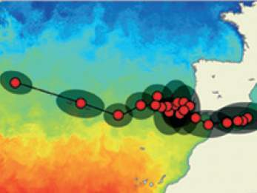
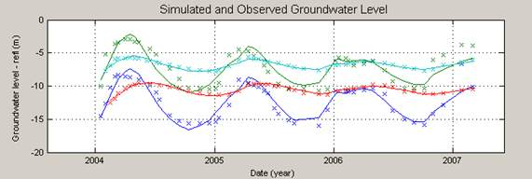
Properties of Fields
value: Position → Value
Positions at which estimations are made
Values that are estimated for each position

Slide 36
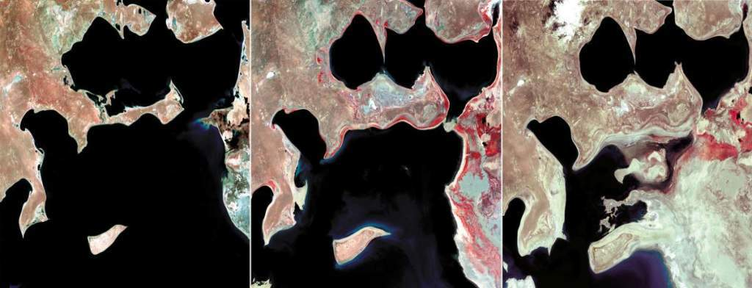
Three sets of (space,value) pairs + estimator: coverage set
LANDSAT images of the Aral Sea
images: USGS

Slide 37

Field: (time, space) pairs + estimator: trajectory
Virgin flight VX 112 (LAX-IAD) on 26 Apr 2012:
(time, space) pairs + estimator

Slide 38

Field: (time, value) pairs + estimator: time series
Buoy in Pacific ocean near the coast of Japan (11.03.2011)

Slide 39



Slide 40
Operations on fields
Field F [P:Position, V:Value, E: Extent, G: Estimator]
f₁
domain(f₁)= {p₁,p₂,p₃}
value (f₁, p_{new}) = g(f₁, p_{new})
p₂
p₃
p₁
p_{new}
Domain – defines granularity
Estimator provides value on all positions inside the extent

Slide 41
Operations on fields
Three fields, same extent,
different granularities, different estimators
•
•
•
•
•
•
•
•
•
•
•
•
•
•
f₁
f₂
f₃
How do we express the operation
f₃ = max (f1,f2)?

Slide 42
Operations on fields
Three fields, same extent,
different granularities, different estimators
•
•
•
•
•
•
•
•
•
•
•
•
•
•
f1
f2
f3

Slide 43
Map Algebra Operations
Set-based algebra for operations on maps (“raster layers”)
TOMLIN, D., Geographic Information System and Cartographic Modeling, 1990.
Local
Focal
Zonal
Global
Notes:
Tomlin (1983, 1990) defined and organized operations on raster data model as local, focal and zonal according to the spatial scope of the operations.
Geographic Information System and Cartographic Modeling, Englewood Cliffs: Prentice Hall, 1990.
Menton et al (1991) add global operations.

Slide 44

Map Algebra

Slide 45



Where we want to get to
Remote visualization and
method development
Big data EO management and analysis
40 years of Earth Observation data of land change accessible for analysis and modelling.

Slide 46
GIS-21: Distributed data sources, unified data access
Visualisation
Data discovery
Data access
Analysis
Data
source
Data
source
Data
source
Data
source
Remote Analysis
Remote Analysis
Remote Analysis
Remote Analysis

Slide 47




Global Land Observatory: describing change in a connected world
Powerful data analysis methods
Array database for big scientific data
Free satellite
images
Software goes where the data is!

Slide 48

Global Land Observatory: describing change in a connected world
Methods for land change for forestry and agriculture uses
40 years of LANDSAT + 12 years of MODIS + SENTINELs + CBERS
Free satellite
images
Unique repository of knowledge and data about global land change

