Slide 1

Monitoring Tropical Forests and Agriculture: the Roadmap for a Global Land Observatory
Copernicus Big EO data workshop, 2014
Gilberto Câmara
National Institute for Space Research (INPE), Brazil
Institute for Geoinformatics, University of Münster, Germany

Slide 2
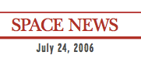
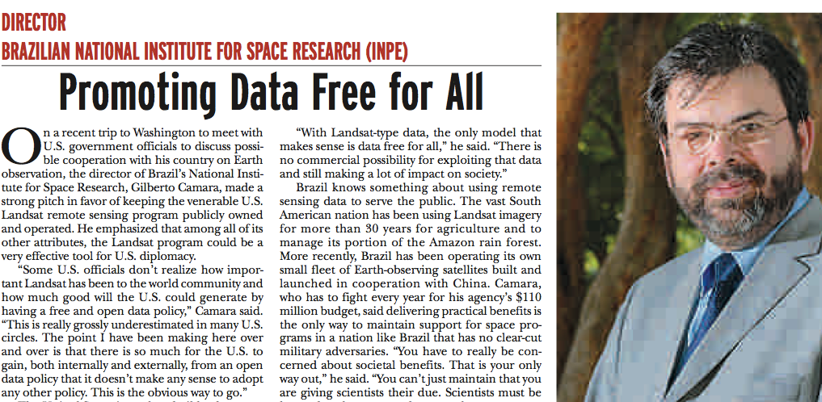
“With LANDSAT-type data, the only model that makes sense is data free for all” (July 2006)

Slide 3
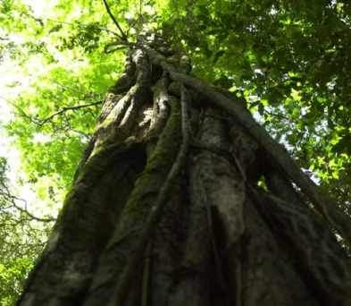
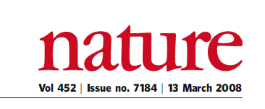
“A few satellites can cover the entire globe, but there needs to be a system in place to ensure their images are readily available to everyone who needs them. Brazil has set an important precedent by making its Earth-observation data available, and the rest of the world should follow suit.”

Slide 4
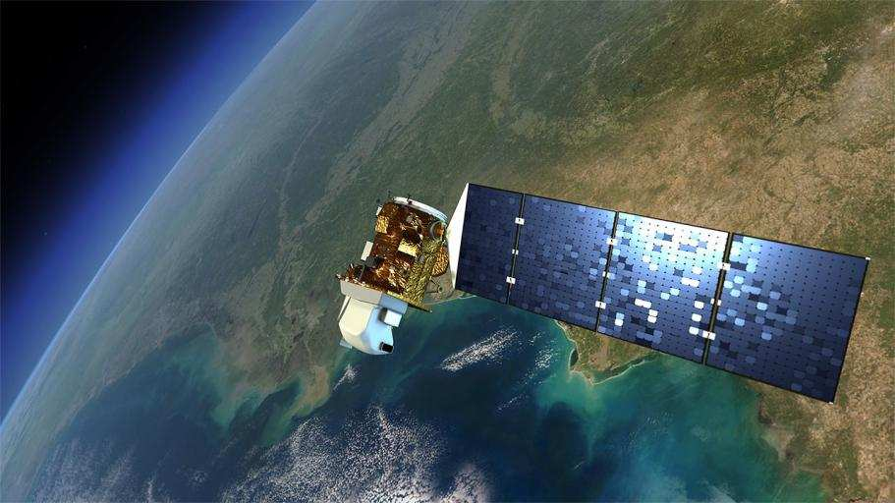
EO data is now free…and big
Image source: NASA
Sentinels: 3 Tb/day

Slide 5
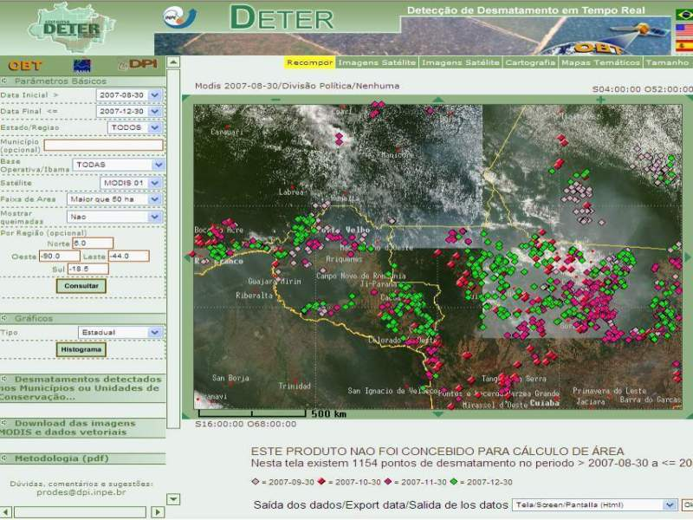

Real-time Deforestation Monitoring
Daily warnings of newly deforested large areas

Slide 6
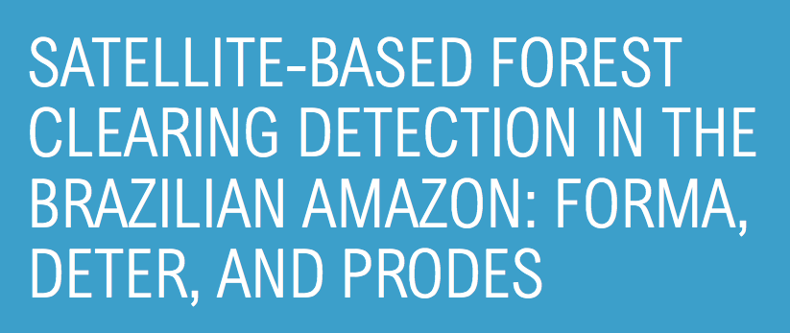

Real-time Deforestation Monitoring: how to make progress?
Evaluation of automated methods in one image only!

Slide 7
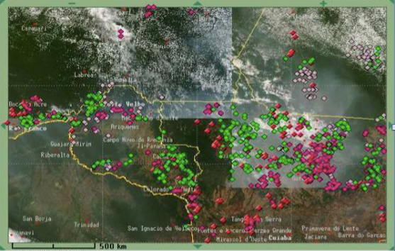
Real-time Deforestation Monitoring: how to make progress?
The practices of the research community
do not match the needs of the end-users!

Slide 8
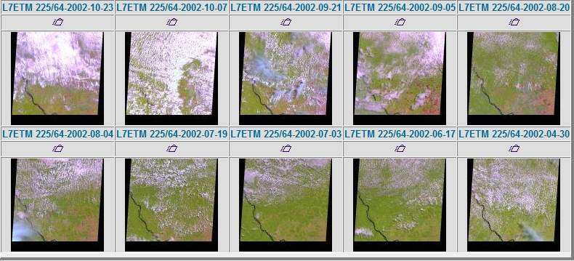
Is free data download our answer?
Currently, users download one snapshot at a time
Notes:
Este slide mostra o impacto da cobertura de nuvens sobre a analise de imagens. Esta é uma região do Pará, onde todas as imagens durante o ano de 2002 tem cobertura de nuvens. Para reduzir este impacto, o INPE analisa varias imagens para uma mesma regiao.

Slide 9
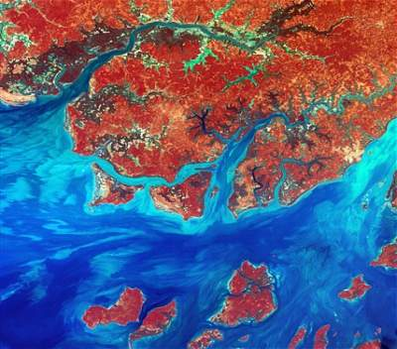
Data Access Hitting a Wall
How do you download a petabyte?
You don’t! Move the software to the archive

Slide 10


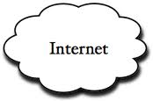
Where we want to get to
Remote visualization and
method development
Big data EO management and analysis
40 years of Earth Observation data of land change accessible for analysis and modelling.

Slide 11
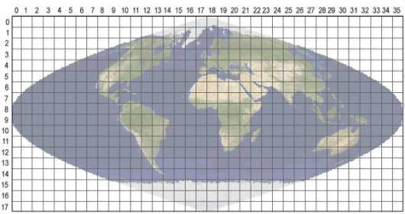
Array databases: all data from a sensor put together in a single array
t
y
y
X
result = analysis_function (points in space-time )

Slide 12
SciDB Architecture: “shared nothing”
Large data is broken into chunks
Distributed server process data in paralel

Slide 13
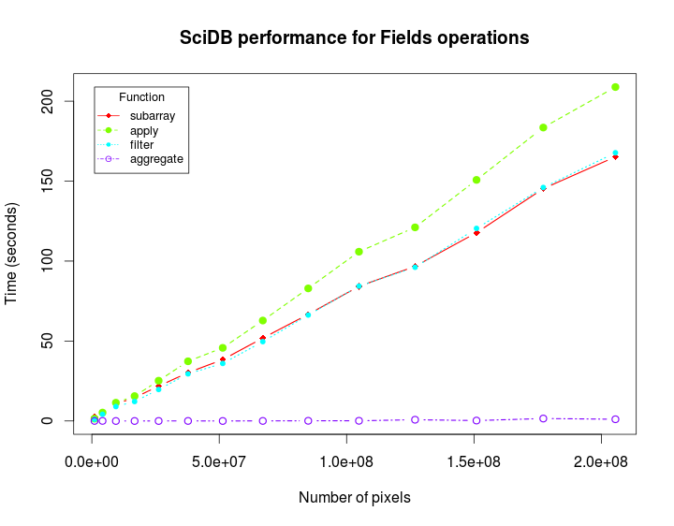
SciDB performance for large images

Slide 14
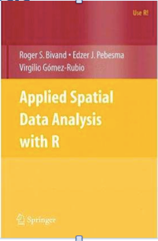

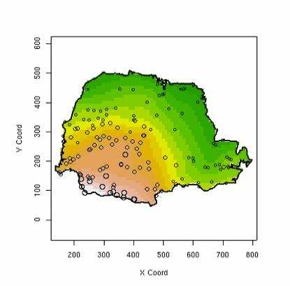
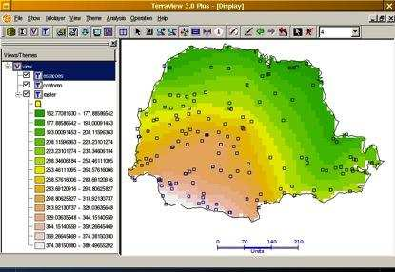


R: The lingua franca for data analysis
Database

Slide 15
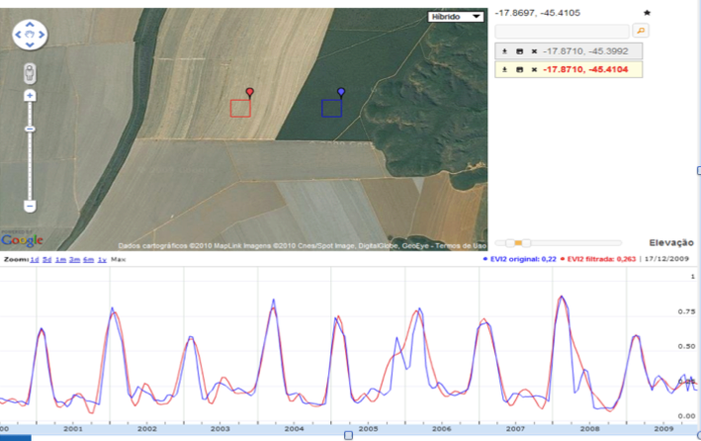
What’s in an image?
“Remote sensing images describe landscape dynamics”
data source: B. Rudorff (LAF/INPE)

Slide 16
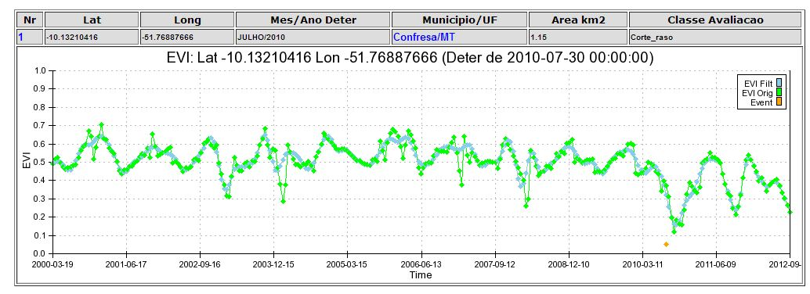
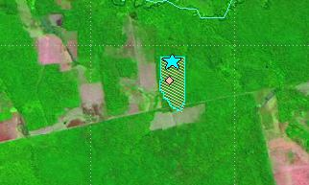
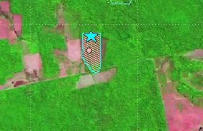
Deforestation event detection: images and time series
2010
2011

Slide 17
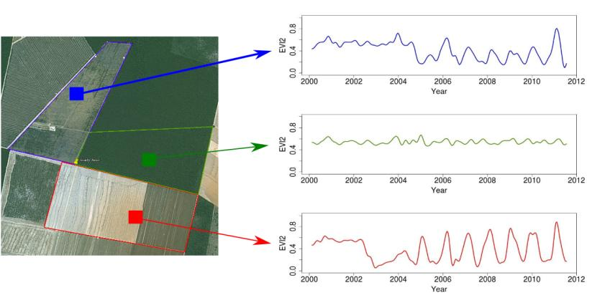
Time series analysis of land change
Forest
Pasture
Área 1
Forest
Área 2
Forest
Agriculture
Área 3
Vegetation index
time series
source: Victor Maus (INPE)

Slide 18

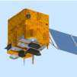


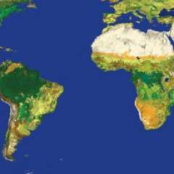
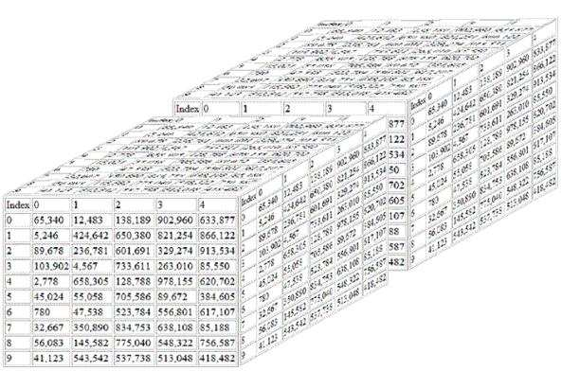

Global Land Observatory: describing change in a connected world
R: Powerful data analysis methods
SciDB: array database for big scientific data
Free satellite
images
Software goes where the data is!

Slide 19
Global Land Observatory: describing change in a connected world
Methods for land change for foresty and agriculture uses
40 years of LANDSAT + 12 years of MODIS + SENTINELs + CBERS
Unique repository of knowledge and data about global land change
Free satellite
images

