Slide 1
Spatial data and public policy: observing the Earth
WSSF 2013, Montreal
Gilberto Câmara
National Institute for Space Research (INPE)
Brazil
IFGI, University of Münster, Germany
http://www.dpi.inpe.br/gilberto

Slide 2
Nature, 29 July 2010

Slide 3
There is an urgent need for the international scientific community to develop the knowledge that can inform and shape effective responses to these threats in ways that foster global justice and facilitate progress toward sustainable development goals.

Slide 4
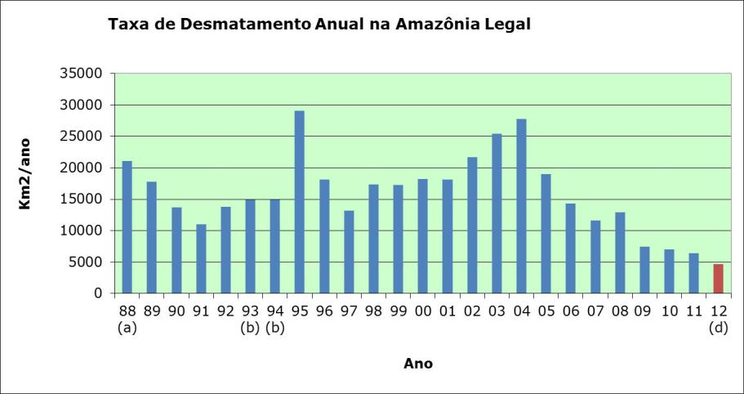
How does Science influence policy?
Deforestation in Brazilian Amazonia (1988-2011)
dropped from 27,000 km² to 6,200 km²

Slide 5
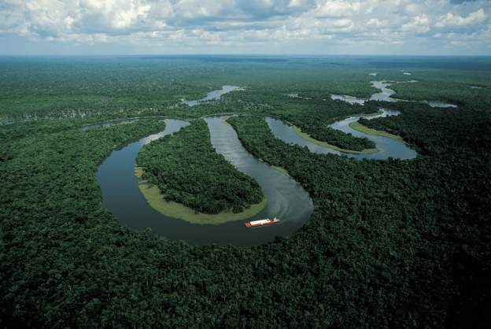
“Deforestation in Brazilian Amazonia is down by a whopping 78% from its recent high in 2004. If Brazil can maintain that progress — and Norway has put a US$1-billion reward on the table as encouragement — it would be the biggest environmental success in decades” (Nature, Rio + 20 editorial)

Slide 6
Foundations of modern democracies
source: Fukuyama (2011)
State (power by technical staff)
Rule of law
(limits power)
Society
(public accountability)
How the interplay between science,
public opinion and government?

Slide 7
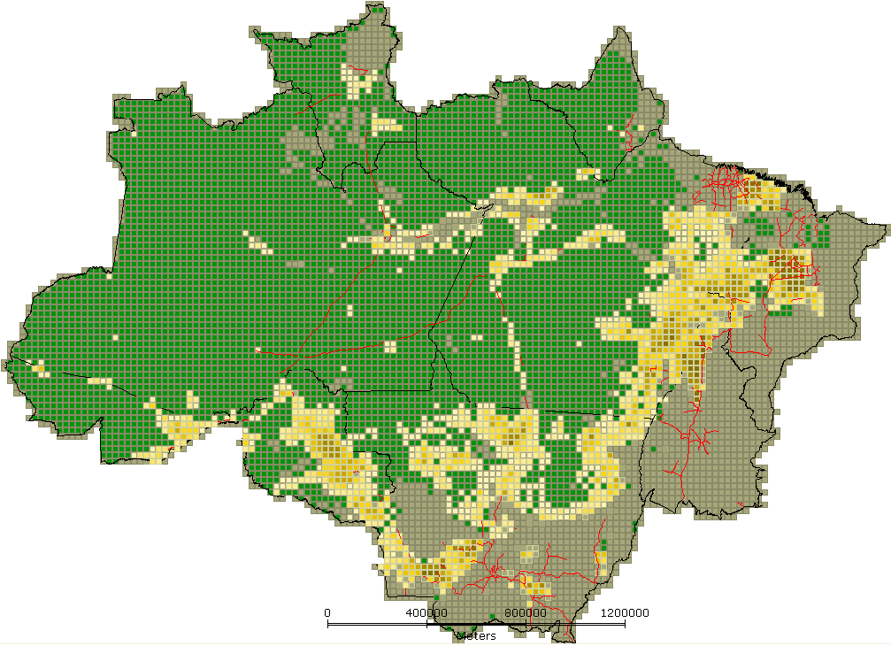
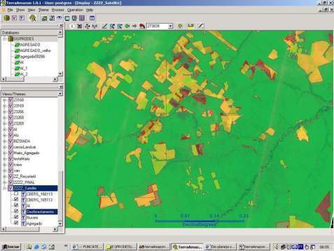
INPE: Clear-cut deforestation mapping of Amazonia since 1988
~230 scenes Landsat/year
Yearly detailed estimates of clear-cut areas
LANDSAT-class data (wall-to-wall)

Slide 8
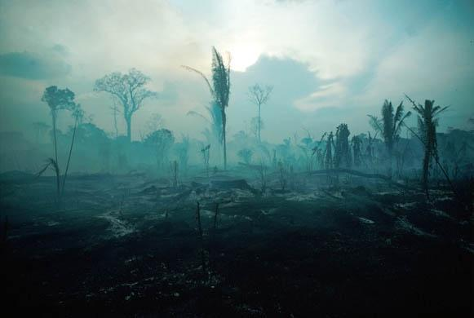
Then, in November, 2004....
Yearly deforestation rate for 2003-2004: 27,100 km2

Slide 9
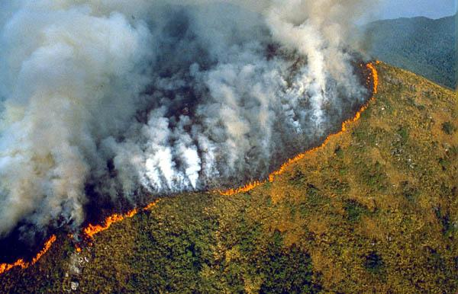
Public opinion reaction was strong
What is the proper scientific reaction?

Slide 10
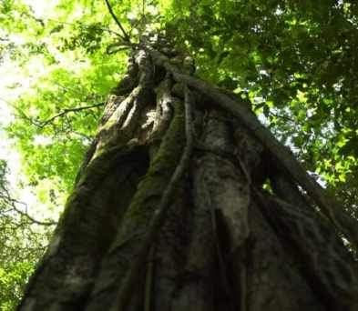
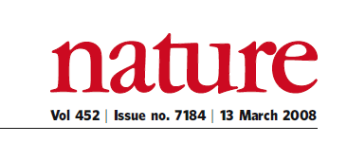
“A few satellites can cover the entire globe, but there needs to be a system in place to ensure their images are readily available to everyone who needs them. Brazil has set an important precedent by making its Earth-observation data available, and the rest of the world should follow suit.”

Slide 11
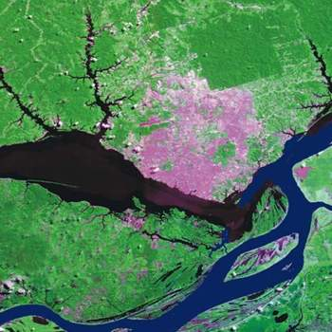
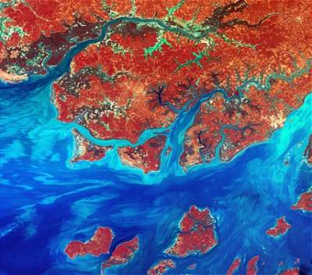
Open access data policy: a qualified success
CBERS@INPE:
2 million images (2004-2009)
LANDSAT @USGS:
9 million images since 2009

Slide 12
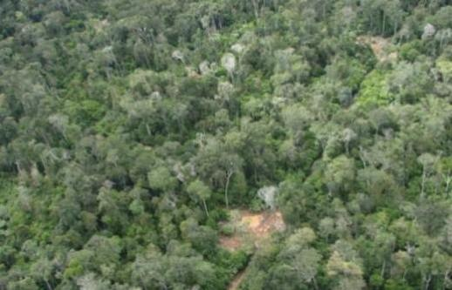
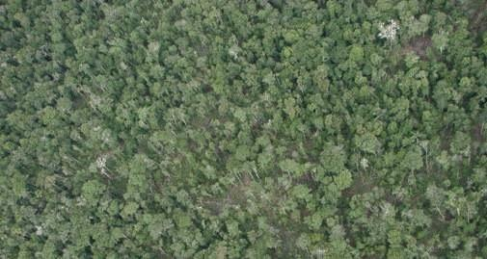
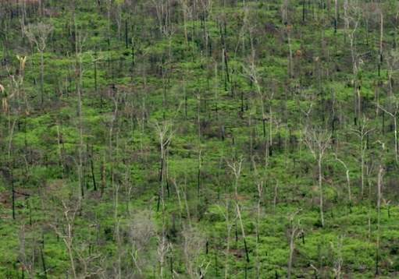
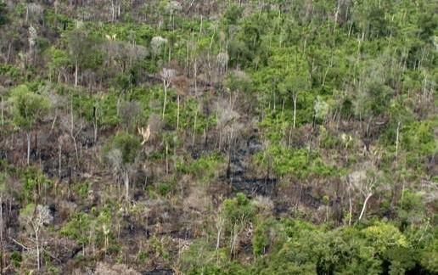
How does deforestation happen?
T1 – Selective logging
T2 – Loss of smaller trees
T3 – Loss >50% of forest
T4 – Loss >90% of forest

Slide 13
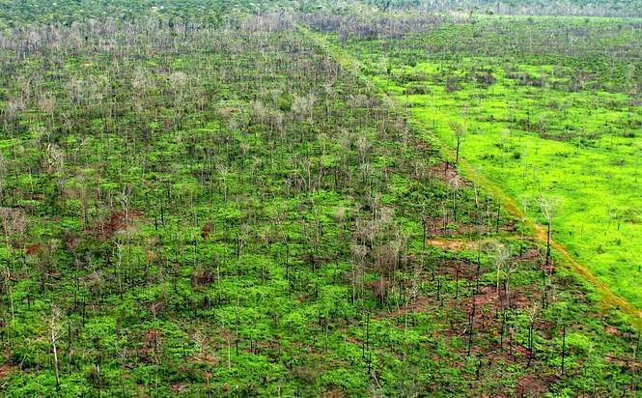
Final = Clear cut
Pasture

Slide 14
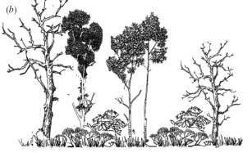
INPE’s Monitoring Systems
dialy deforestation alerts
time
Yearly rates of clear cuts
Floresta

Slide 15
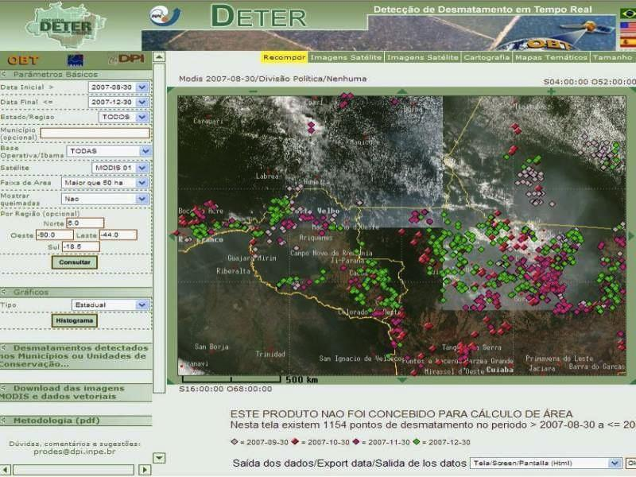
Real-time Deforestation Monitoring
Daily warnings of newly deforested large areas

Slide 16
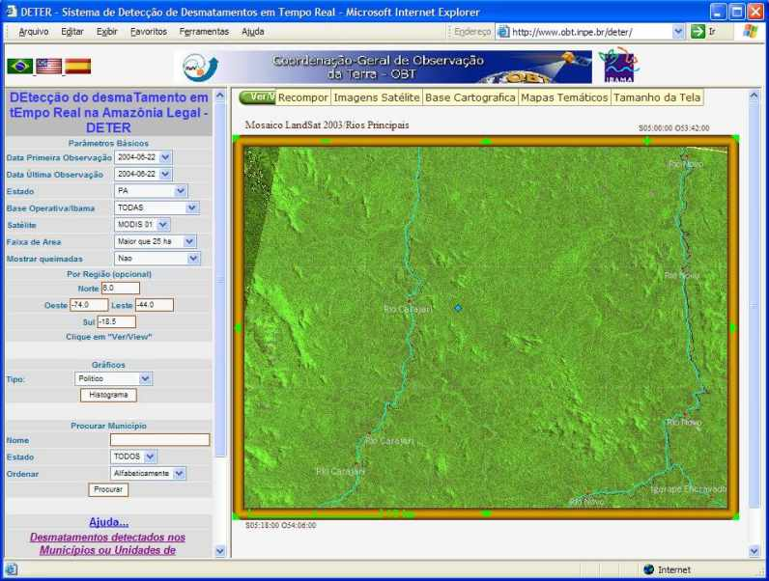
Altamira (Pará) – LANDSAT Image – 22 August 2003

Slide 17
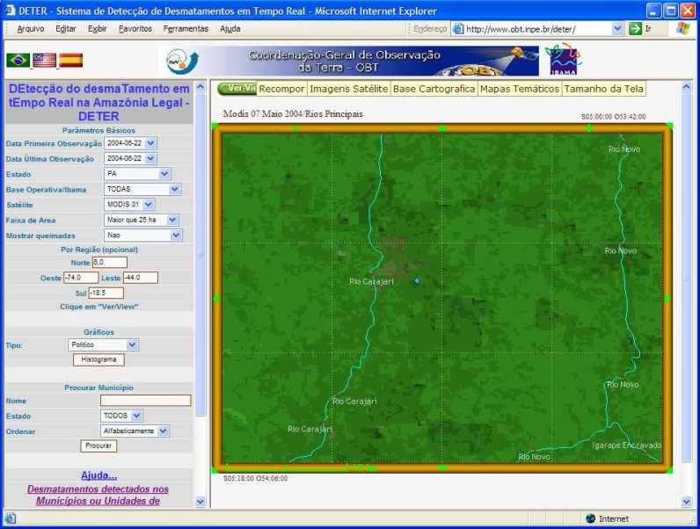
Altamira (Pará) – MODIS Image – 07 May 2004

Slide 18
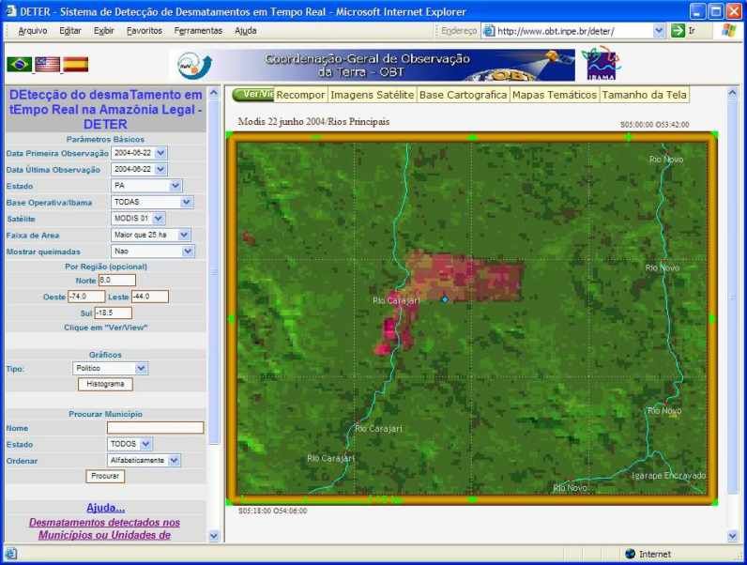
Altamira (Pará) – MODIS Image – 22 June 2004
6.000 hectares deforested in one month!

Slide 19
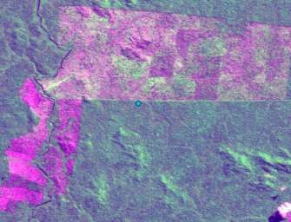
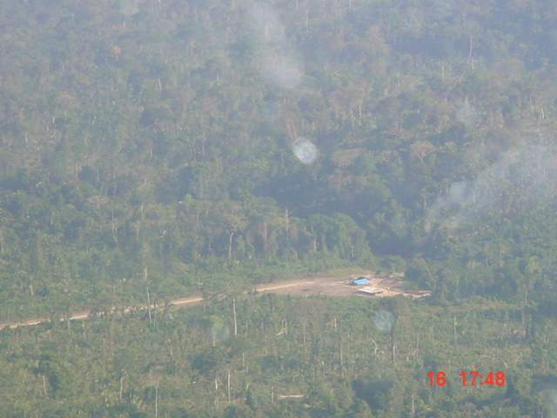
Go to the field....

Slide 20
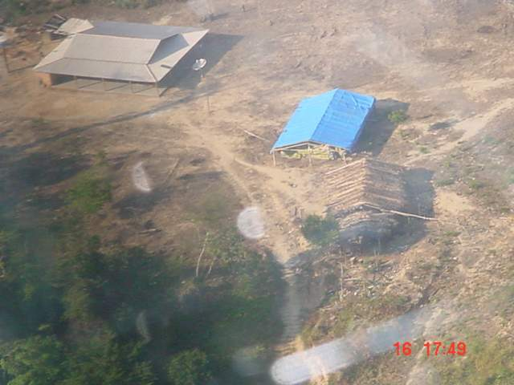
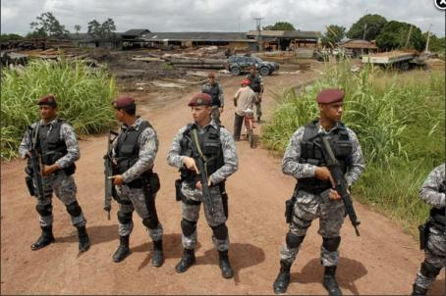
...and get the bad guys!

Slide 21
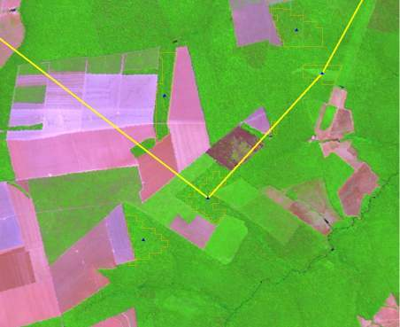
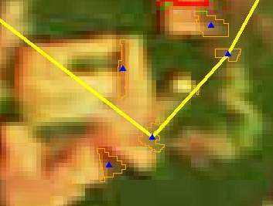
How hard is to use MODIS images to detect deforestation?
Landsat/TM
August 2007
MODIS
November 2007
Alerta DETER nov-2007

Slide 22
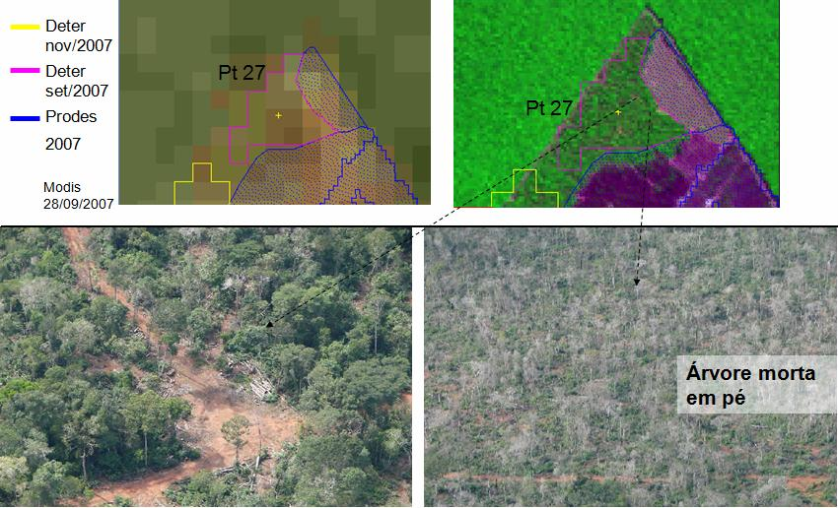
Monitoring forest degradation
(S 12,27⁰ ; W 54,13⁰)

Slide 23
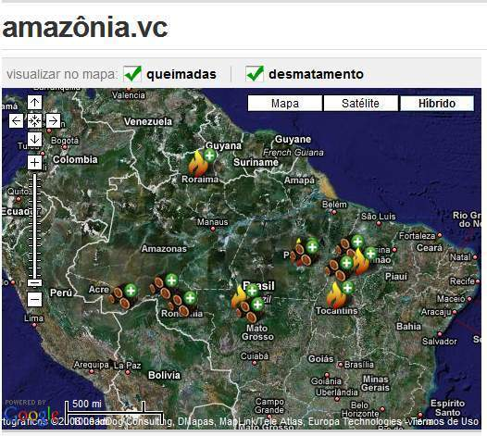
Reaching out to public policy
500.000 registrations
46 million protests

Slide 24
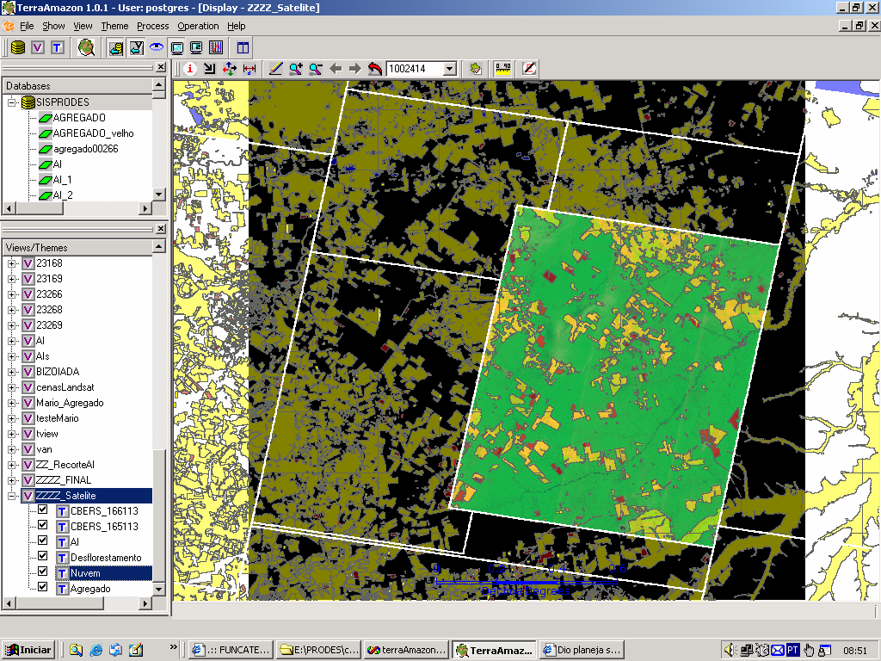
Transparency builds credibility
“Today, Brazil’s monitoring system is the envy of the world. INPE provides
automated bi-weekly alerts that
other tropical nations would love to emulate.”

Slide 25
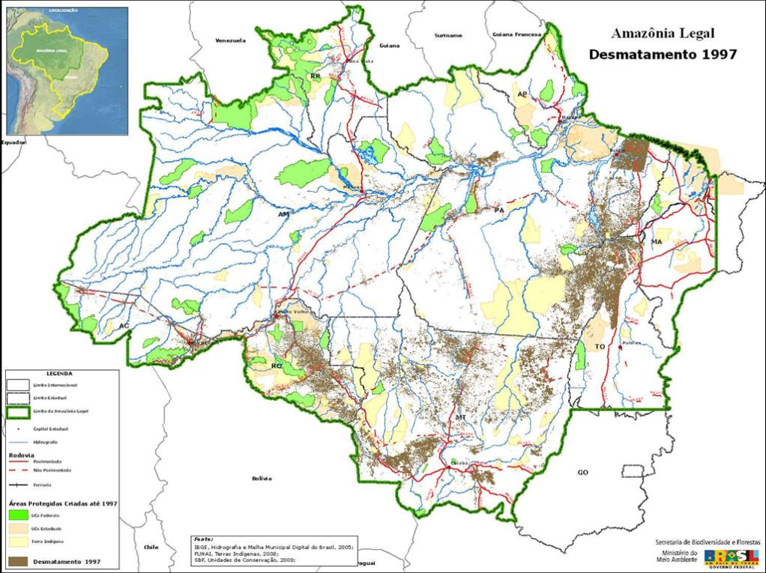
Protected areas and deforestation (1997)

Slide 26
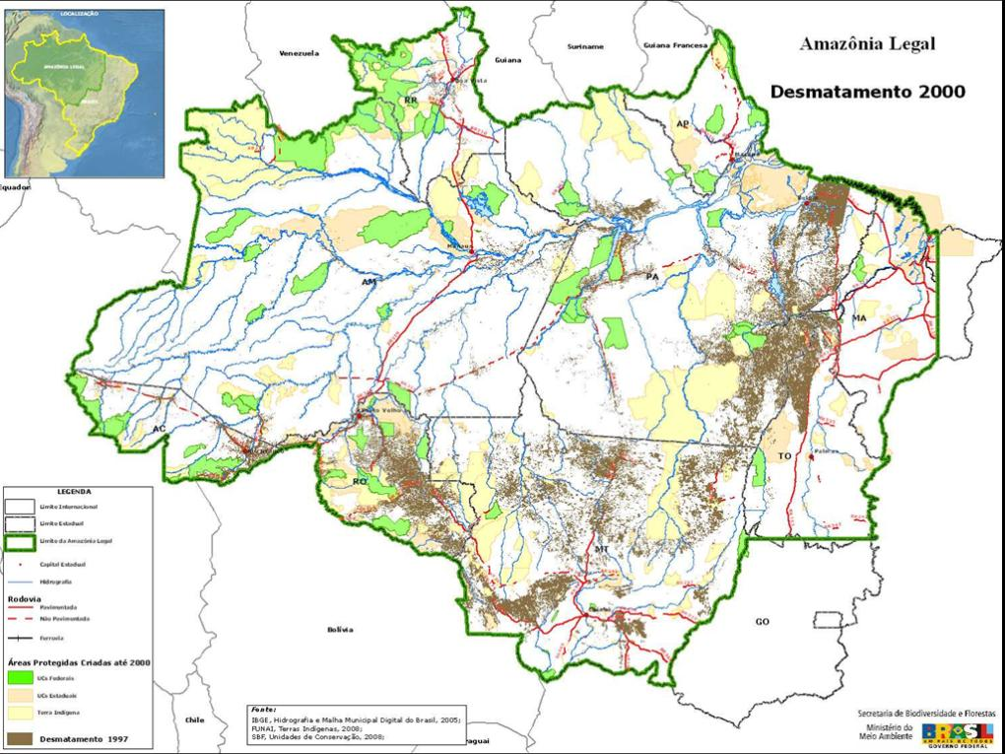
Protected areas and deforestation (2000)

Slide 27
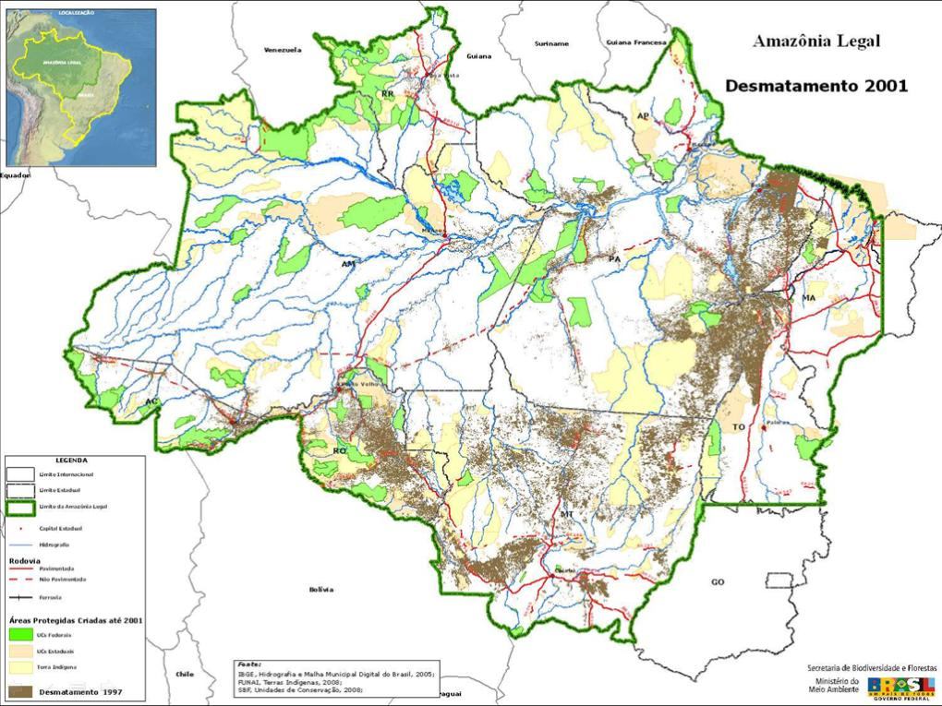
Protected areas and deforestation (2001)

Slide 28
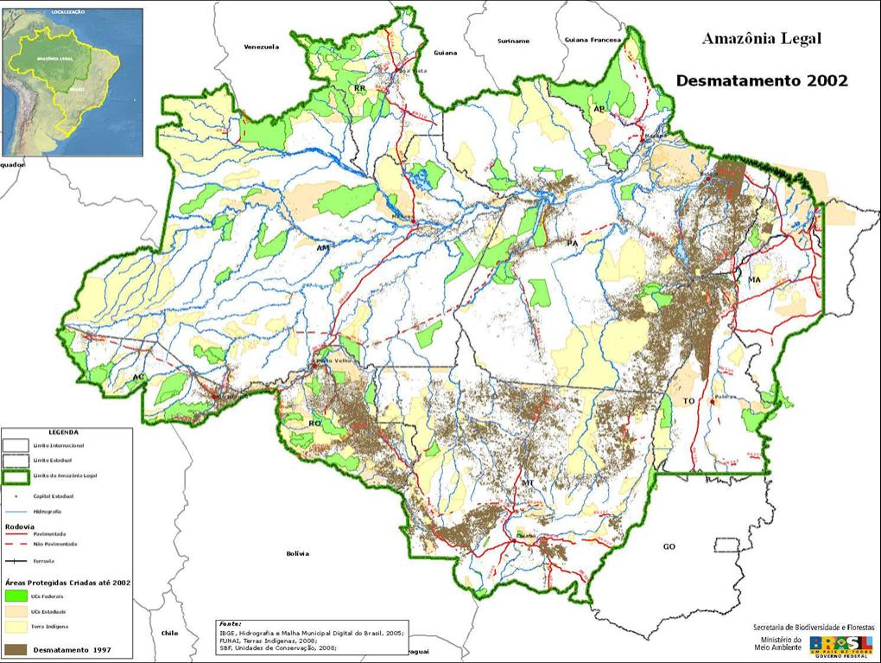
Protected areas and deforestation (2002)

Slide 29
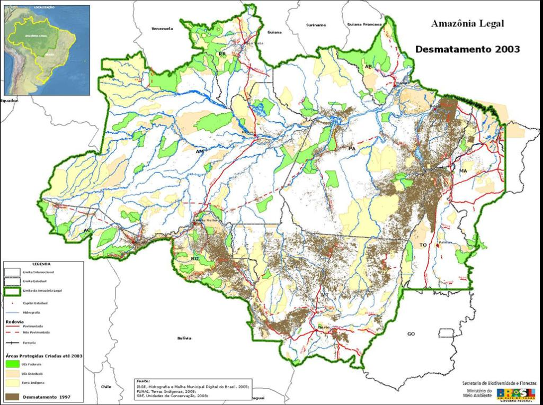
Protected areas and deforestation (2003)

Slide 30
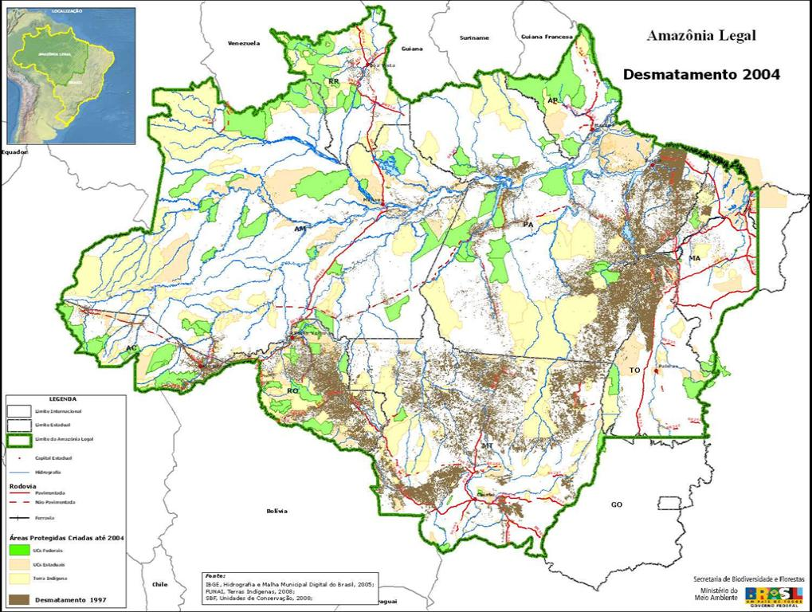
Protected areas and deforestation (2004)

Slide 31
Protected areas and deforestation (2005)

Slide 32
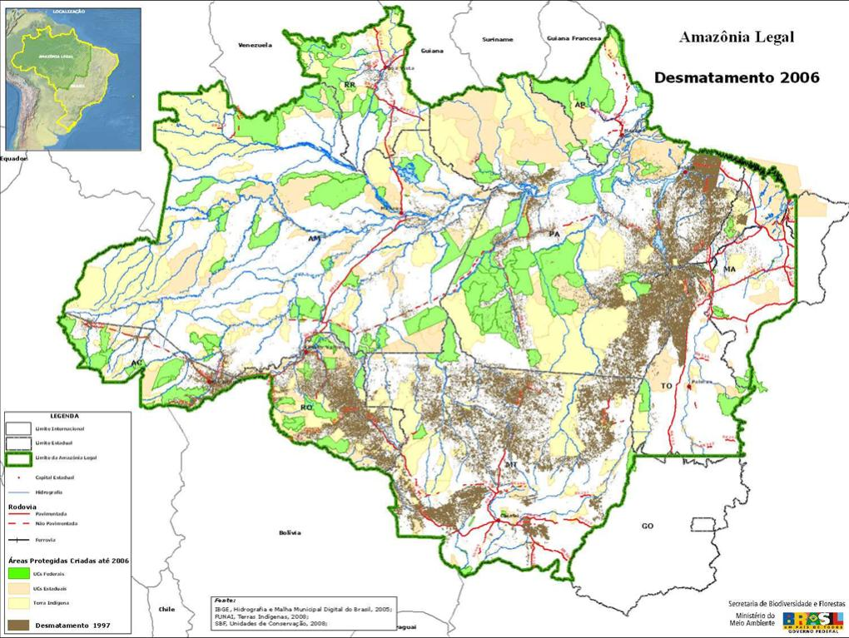
Protected areas and deforestation (2006)

Slide 33
Protected areas and deforestation (2007)

Slide 34
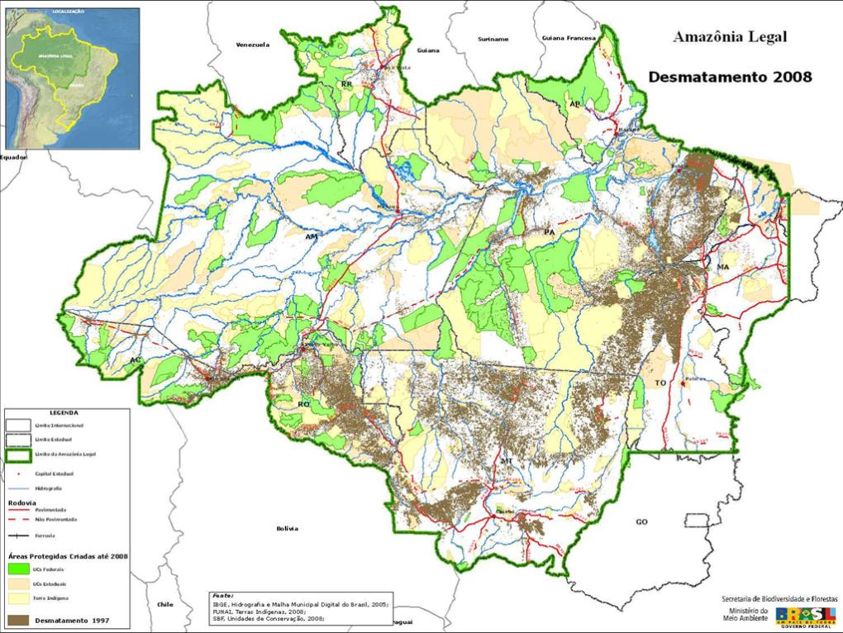
Protected areas and deforestation (2008)

Slide 35
Finding: Protected areas deter deforestation

Slide 36
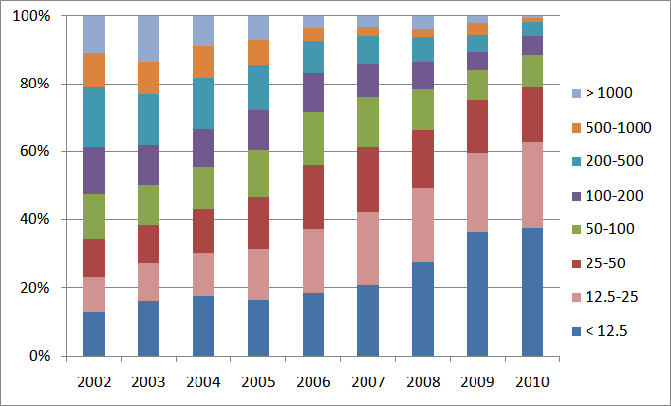
Finding: Deforestation is becoming harder to detect
Proportion of clear cuts by size (ha)
Clearings less than 50 ha: 35% of total in 2002 to 80% of total in 2010

Slide 37
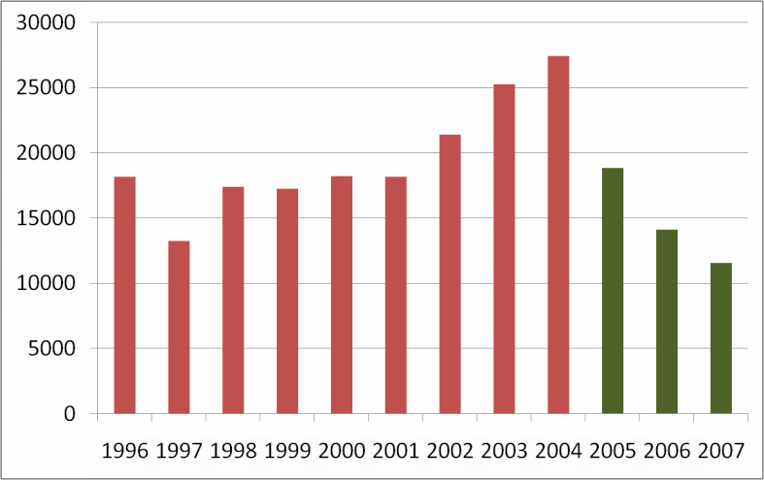
For a while, everything was well...

Slide 38
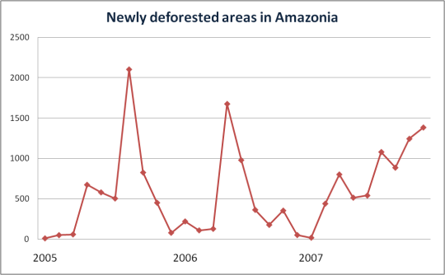
Then, in January 2008...

Slide 39
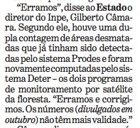
What do you do when you make an error?

Slide 41
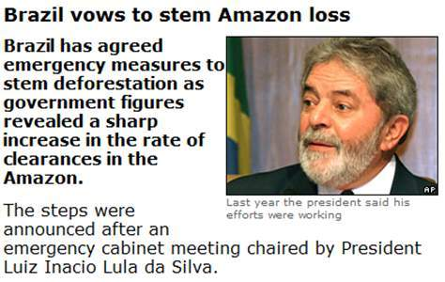
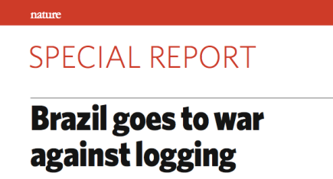
Public opinion – based on open data – forces government to act

Slide 42
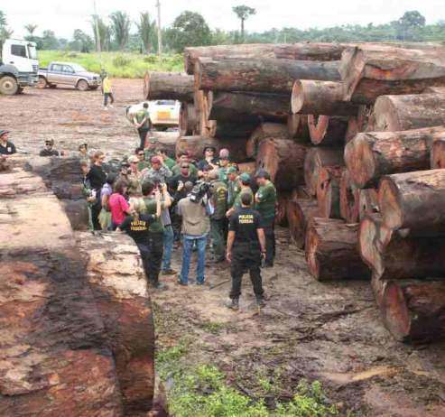
Finding: Command and control actions are effective means to curb deforestation
Almost all deforestation is illegal

Slide 43
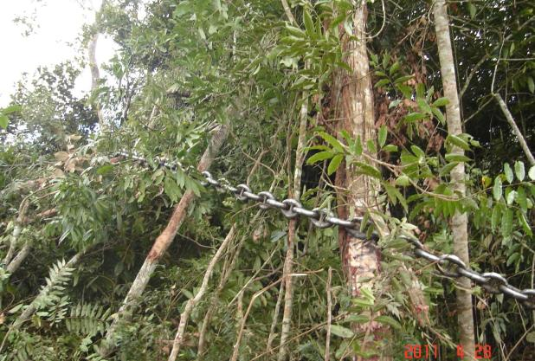
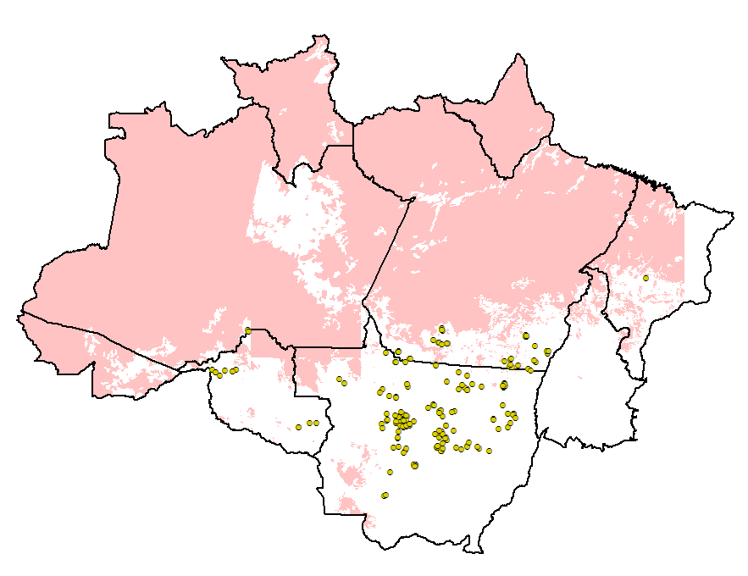
Keep watching!
Jan-April/2011: 126% increase

Slide 44
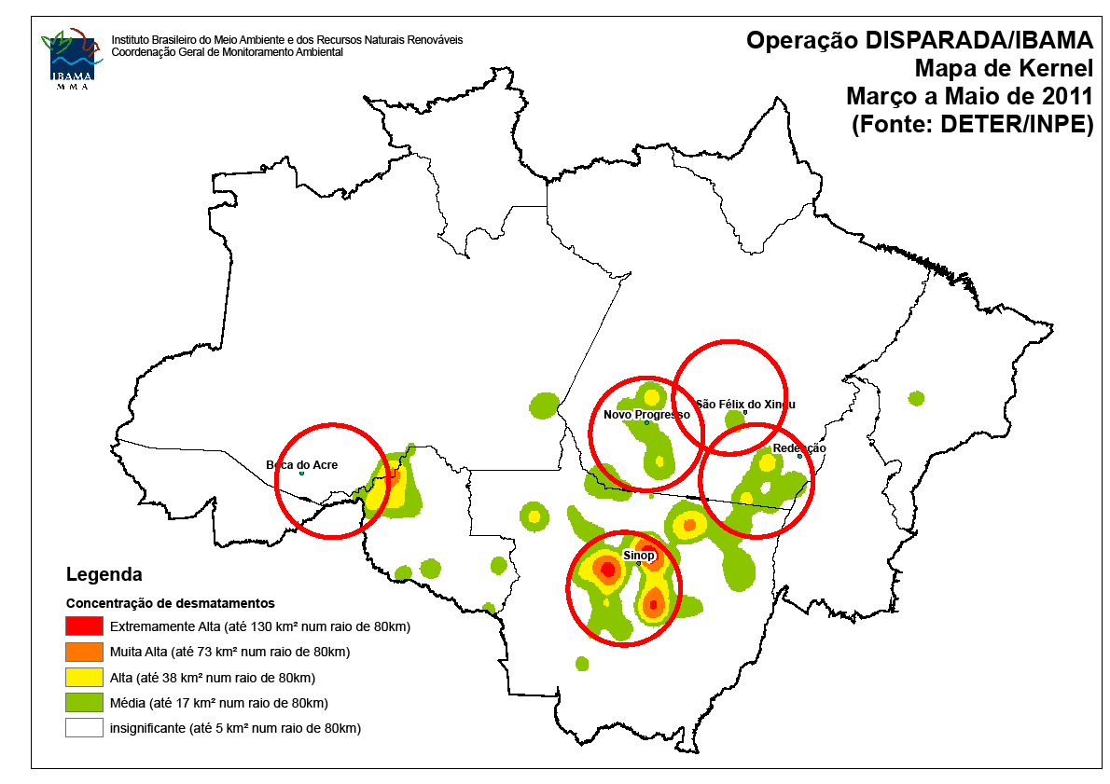
Deforestation hotspots: March-May 2011

Slide 45
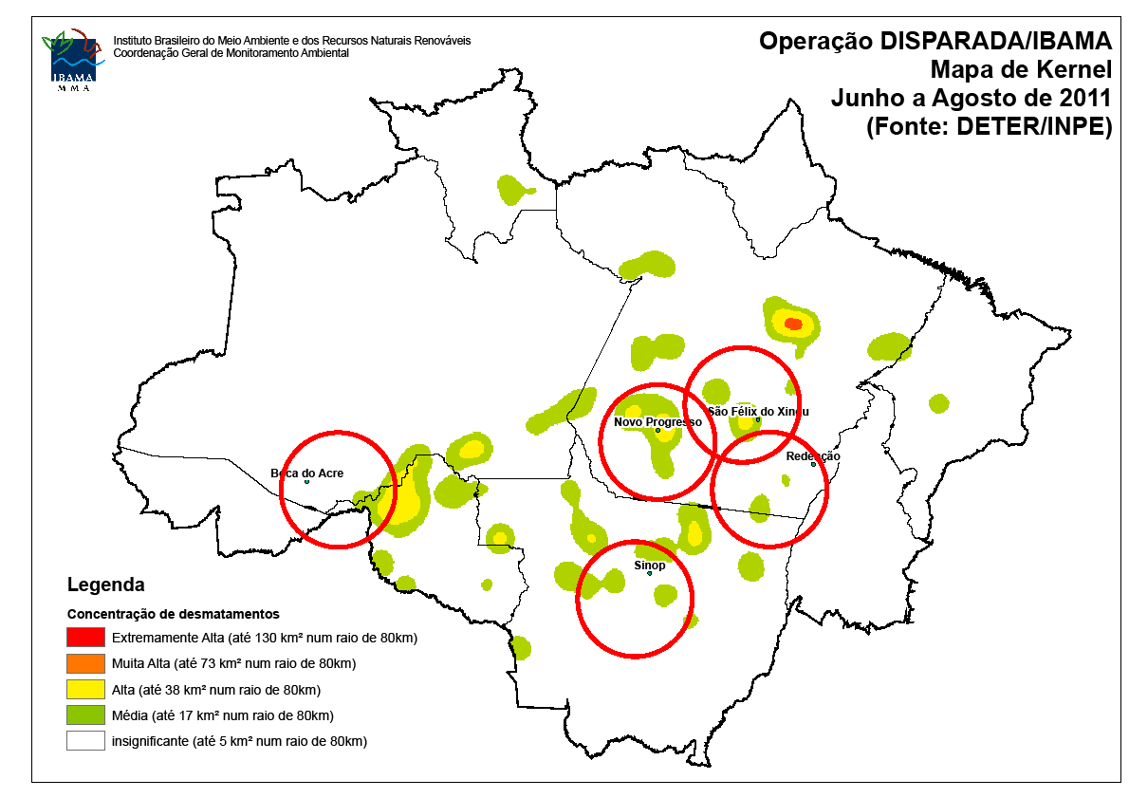
Deforestation hotspots: June-August 2011

Slide 46
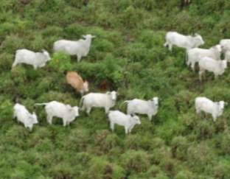
Finding: Markets have a positive rôle

Slide 47
How much it takes to survey Amazonia?
116-112
30 Tb of data
500.000 lines of code
150 man/years of software dev
200 man/years of interpreters
116-113
166-112
Notes:
Cena de maior prioridade utilizou imagens CBRES na s tres principais areas: 166-112, 165-113 2 166-113. Sendo complementada por imagem TM

Slide 48
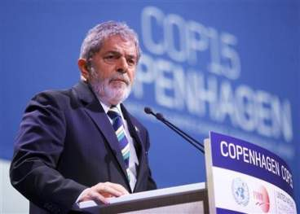
“By 2020, Brazil will reduce deforestation by 80% relative to 2005.” (pres. Lula in Copenhagen COP-15)

Slide 49
“Deforestation in the Brazilian Amazon is down by a whopping 78% from its recent high in 2004. If Brazil can maintain that progress, it would be the biggest environmental success story in decades, and would set an example to other countries that want to protect their tropical forests.” (Editorial, 7 June 2012)

Slide 50
Foundations of modern democracies
source: Fukuyama (2011)
State (power by technical staff)
Science
State
Institutions
Rule of law
(limits power)
Society
(public accountability)

Slide 51
Finding: Transparency builds governance!
CBERS image
Degradation
Deforestation
Science (27 April 2007): “Brazil´s monitoring system is the envy of the world”.
Notes:
Este slide mostra uma imagem CBERS-2B da região de Marcelândia, norte de Mato Grosso. A imagem foi composta por uma imagem monocromática de alta resolução HRC (2,5 m) com uma imagem multespectral CCD (20 m). A imagem mostra que é possivel identificar com o sensor HRC, alem de desmatamentos por corte raso (áreas claras na imagem), as áreas de degradação florestal (áreas verdes com partes claras).

