Slide 1
Biofuel production in Brazil: challenges for land use policy
Gilberto Câmara
Dialogo Brasil-Alemanha de Ciencia e Inovação
Licence: Creative Commons ̶̶̶̶ By Attribution ̶̶̶̶ Non Commercial ̶̶̶̶ Share Alike
http://creativecommons.org/licenses/by-nc-sa/2.5/

Slide 2
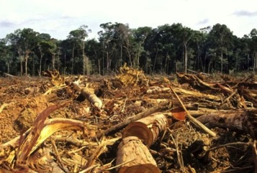
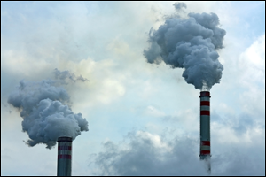
Global GHG emissions
10
8
Fossil fuel
6
CO₂ emissions (PgC y⁻¹)
4
Land use change
2
1960
1970
1980
1990
2000
2010
Land change < 10% of total GHG emissions in 2010
source: Global Land Project (2010)

Slide 3
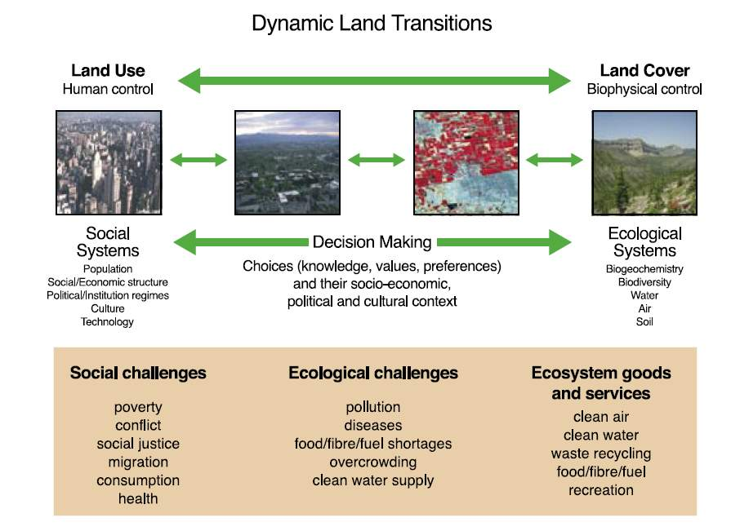
source: Global Land Project Science Plan (IGBP)

Slide 4
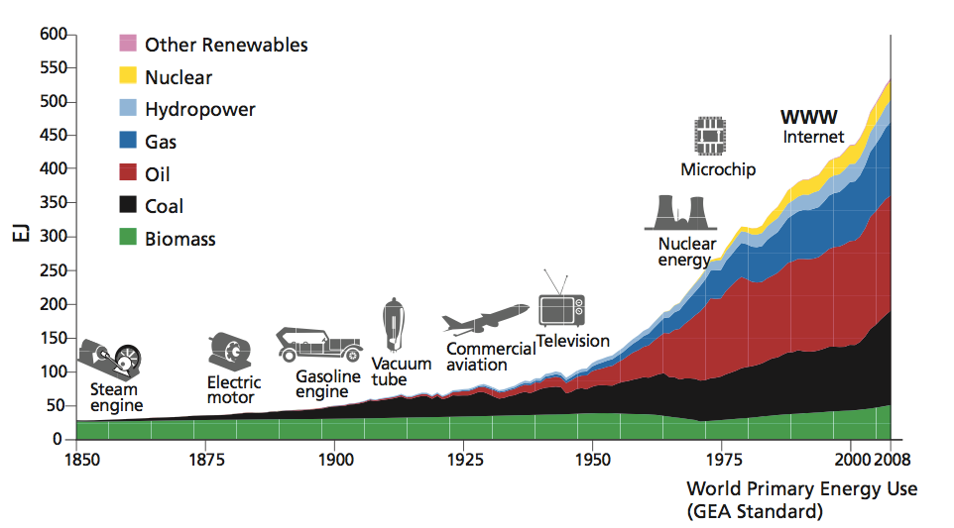
Evolution of energy sources (1850-2008)
source: Global Energy Assessment (IIASA)

Slide 5
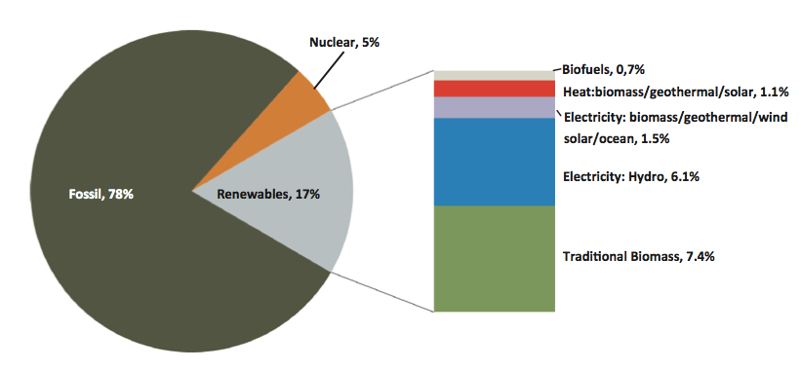
Renewable share of energy use (2009)
source: Global Energy Assessment (IIASA)

Slide 6
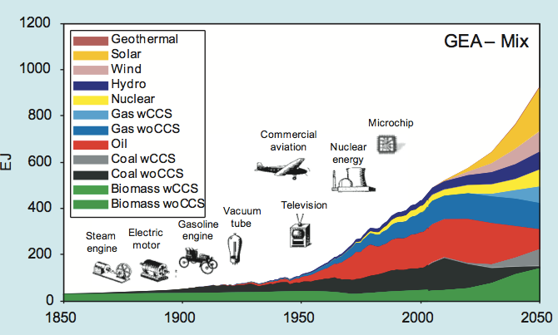
Sustainable pathways?
source: Global Energy Assessment (IIASA)

Slide 7
Food Security
18%
Others
14%
Maize
Rice
35%
20%
Wheat
Stock : 457 Mt = 2.5 mois
Trade : 265 Mt = 12% /utilis.
31%
Source : WASDE december 2009

Slide 8
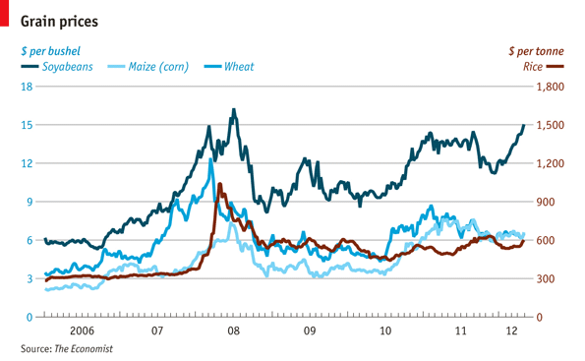
Food challenge: prices are increasing

Slide 9
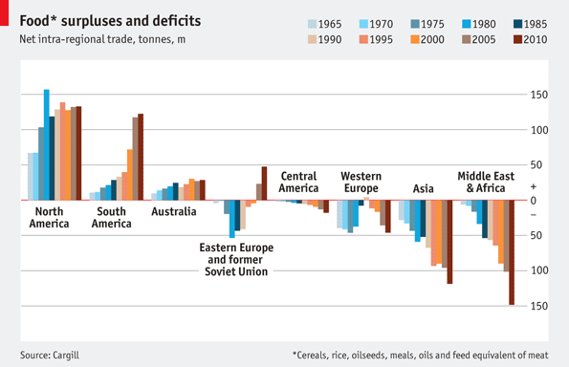
Where is the food coming from and going to?
graphics: The Economist

Slide 10
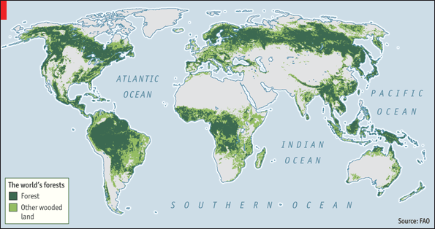
Forests and food production: potential conflicts
graphics: Nature

Slide 11
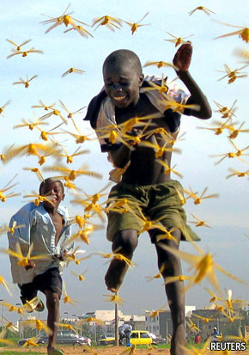
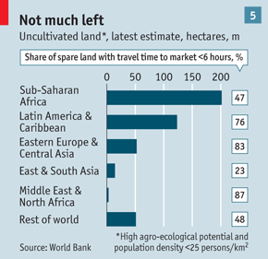
The food challenge: search for new land
graphics: The Economist

Slide 12
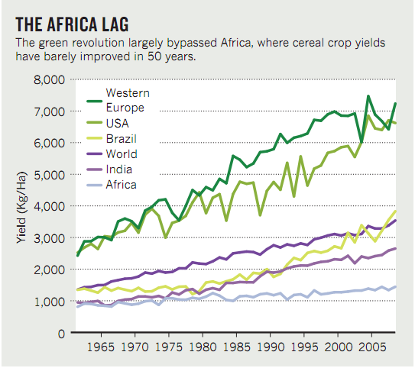
The food challenge: technology gaps
source: Nature

Slide 13
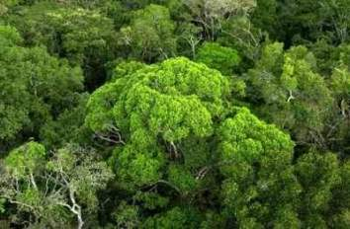
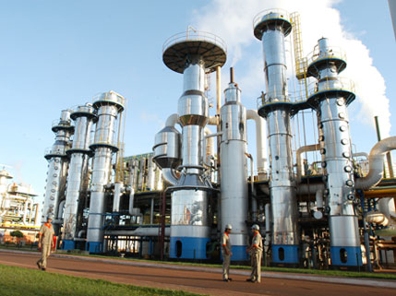
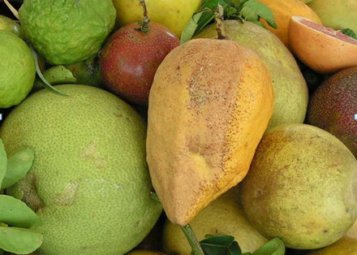
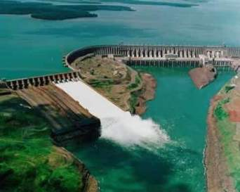
Brazil: a natural knowledge economy
Deforestation cut by 300% (2005-09)
Best technology in biofuels
World leader in tropical agriculture
46% of energy is renewable

Slide 14
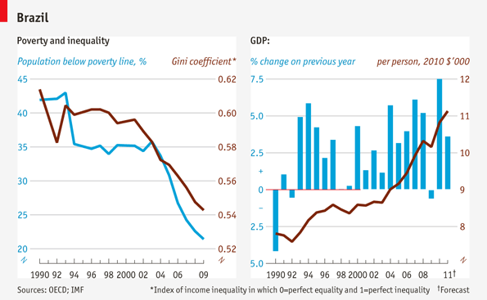
Brazil’s recent growth and reduced inequality

Slide 15
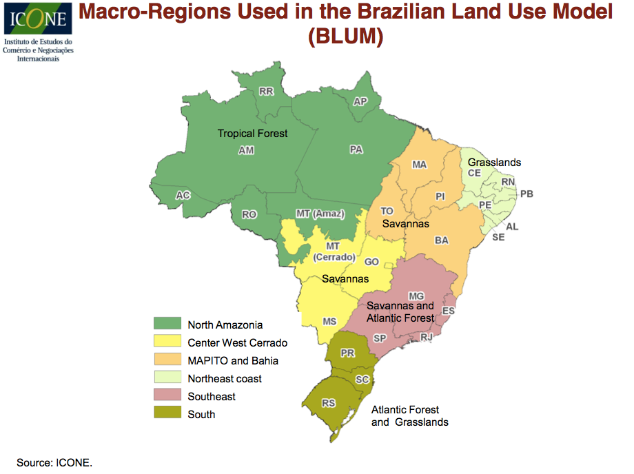

Slide 16
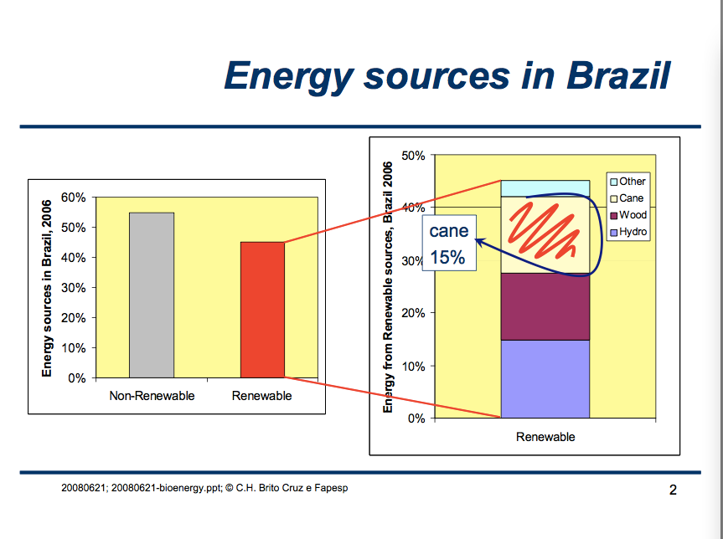

Slide 17
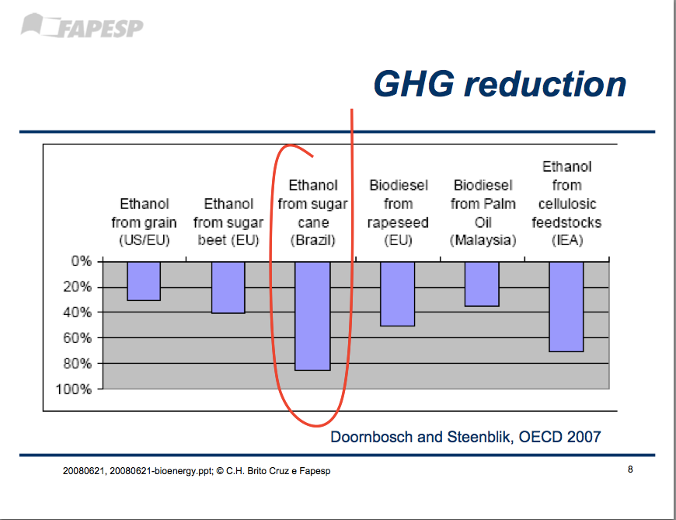

Slide 18
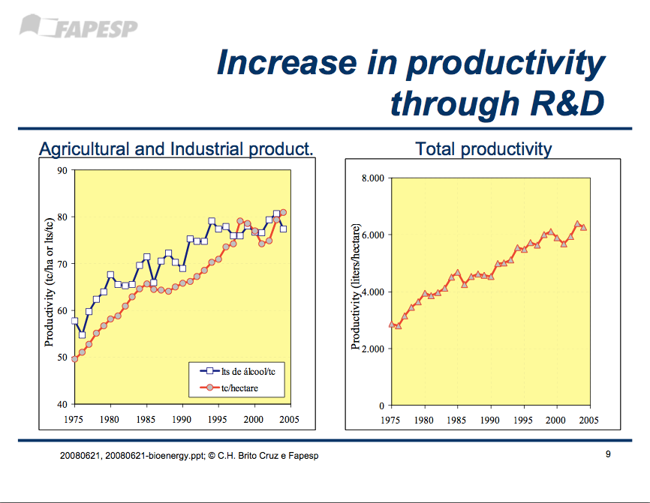

Slide 19
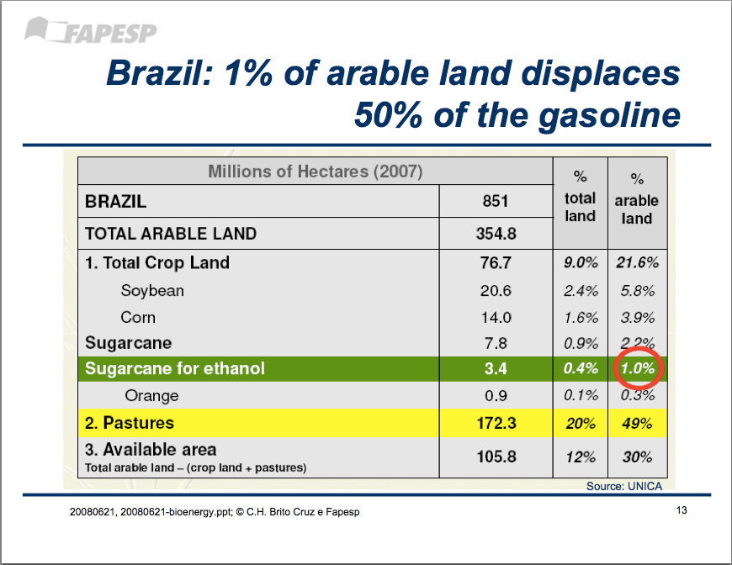

Slide 20
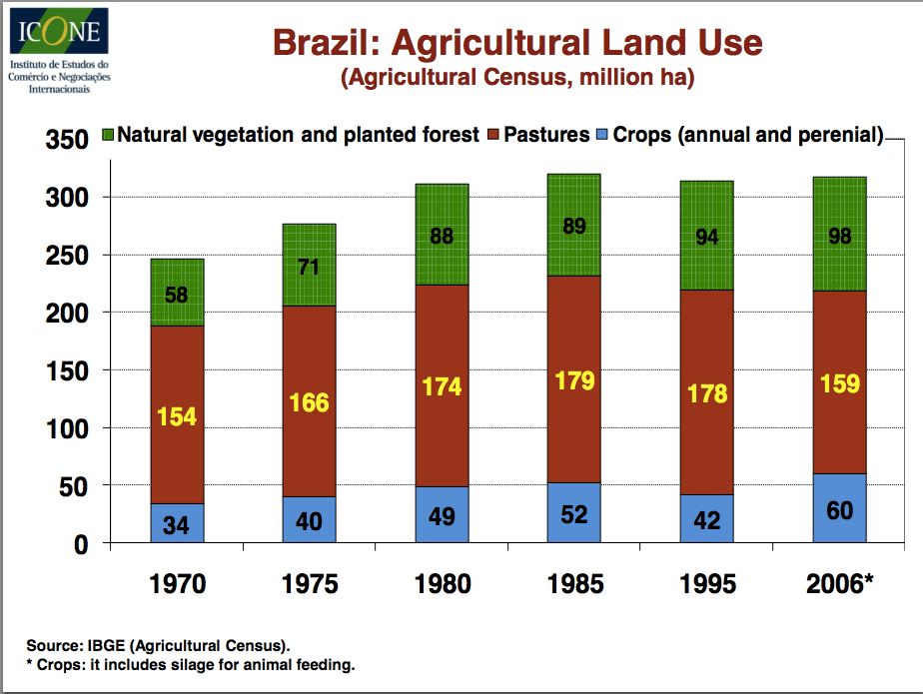

Slide 21
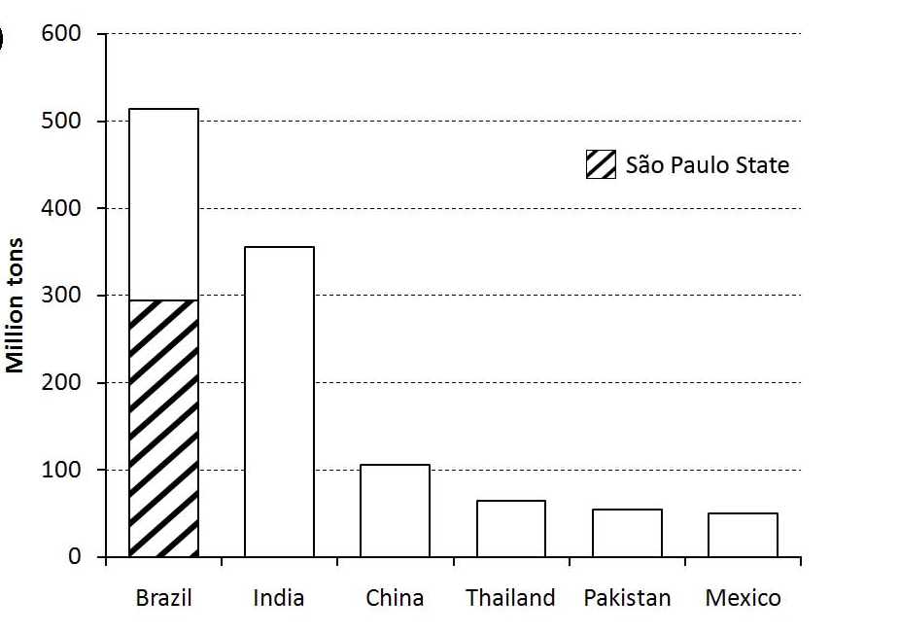
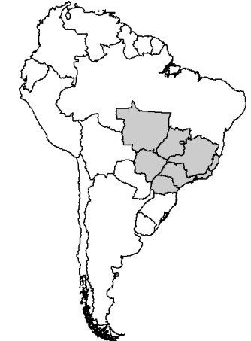
Brazil: world’s largest sugarcane producer
MT
GO
MG
MS
SP
PR
source: Bernardo Rudorff (INPE)

Slide 22
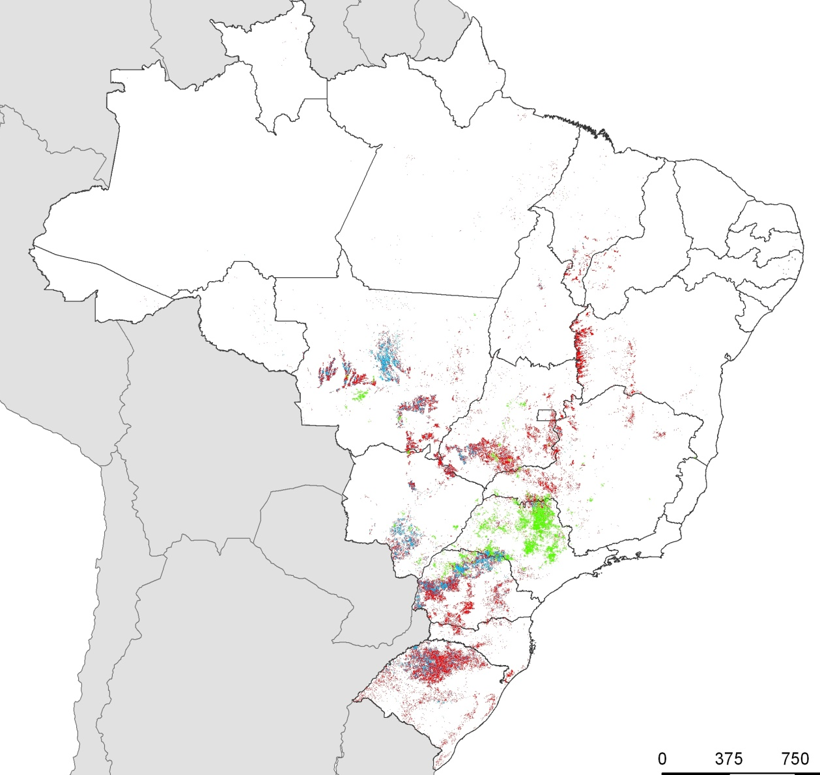
Crop Year 2002/2003
Annual Crop – 1 Crop per season
Annual Crop – 2 Crops per season
source: Bernardo Rudorff (INPE)
Sugarcane

Slide 23
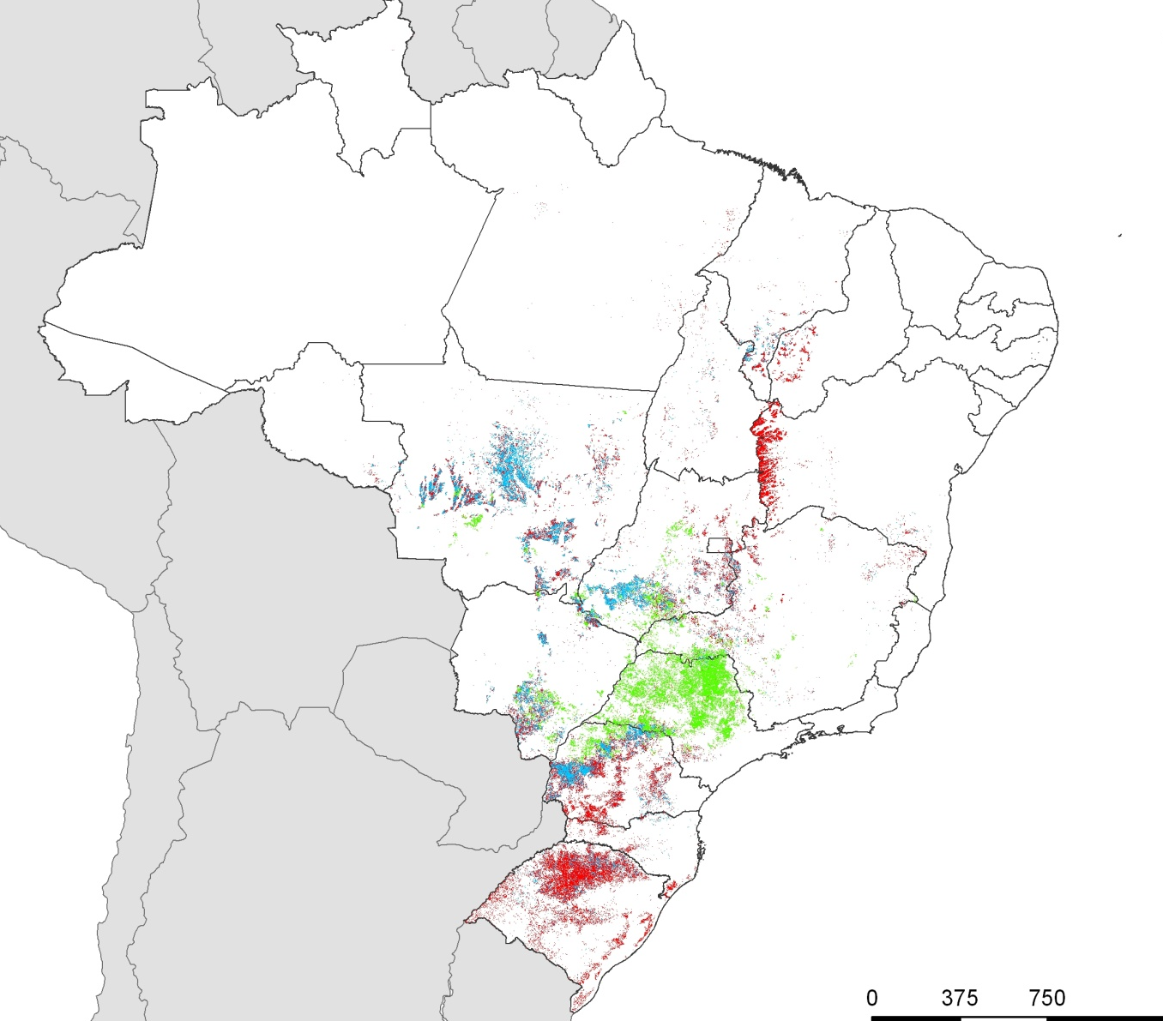
Crop Year 2010/2011
Annual Crop – 1 Crop per season
Annual Crop – 2 Crops per season
source: Bernardo Rudorff (INPE)
Sugarcane

Slide 24
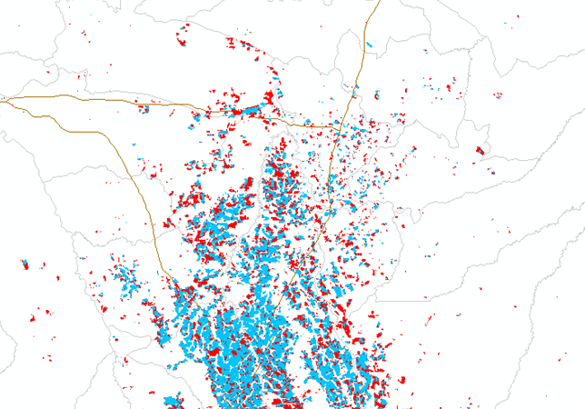
MATO GROSSO – Sorriso: Crop Year 2002/2003
source: Bernardo Rudorff (INPE)
Annual Crop - 2 Crops
Annual Crop - 1 Crop

Slide 25
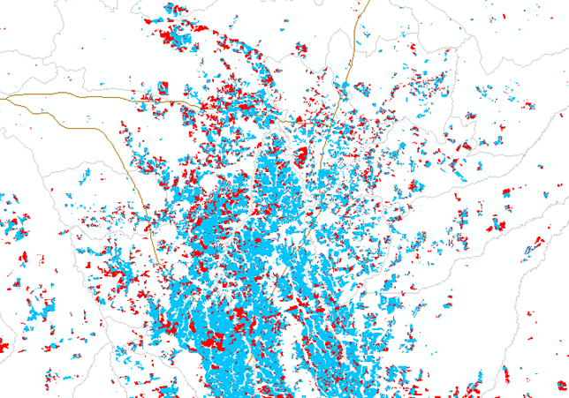
MATO GROSSO – Sorriso: Crop Year 2010/2011
source: Bernardo Rudorff (INPE)
Annual Crop - 2 Crops
Annual Crop - 1 Crop

Slide 26
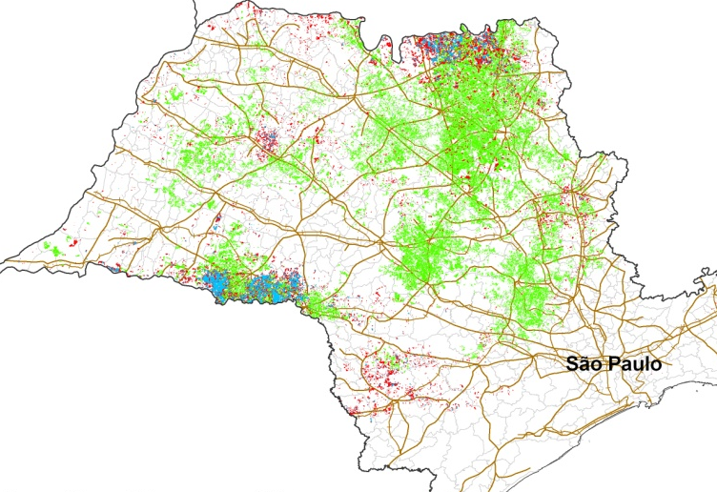
Crop Year 2002/2003
Annual Crop – 1 Crop per season
Annual Crop – 2 Crops per season
Sugarcane
source: Bernardo Rudorff (INPE)

Slide 27
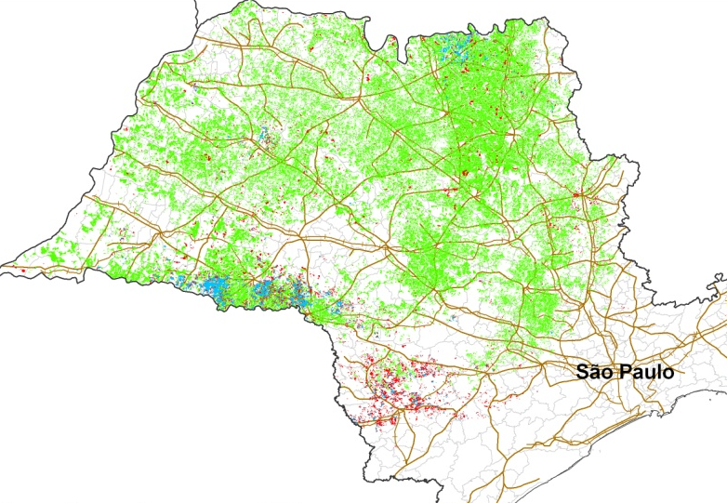
Crop Year 2010/2011
Annual Crop – 1 Crop per season
Annual Crop – 2 Crops per season
Sugarcane
source: Bernardo Rudorff (INPE)

Slide 28
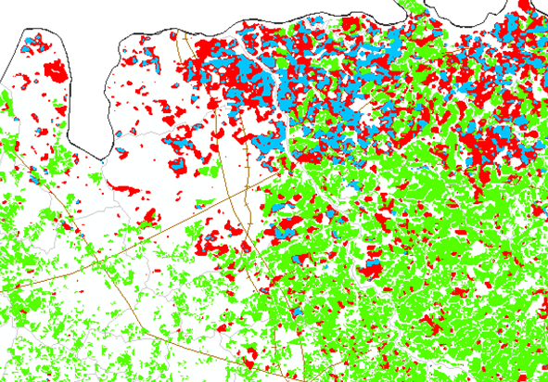
SÃO PAULO – Barretos: Crop Year 2002/2003
1
source: Bernardo Rudorff (INPE)
Annual Crop - 1 Crop
Annual Crop - 2 Crops
Sugarcane

Slide 29
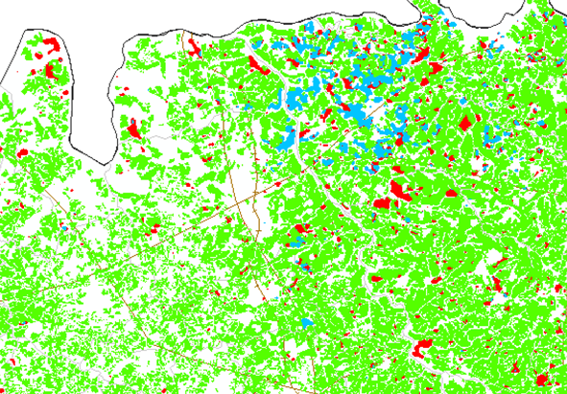
SÃO PAULO – Barretos: Crop Year 2010/2011
1
source: Bernardo Rudorff (INPE)
Annual Crop - 1 Crop
Annual Crop - 2 Crops
Sugarcane

Slide 30
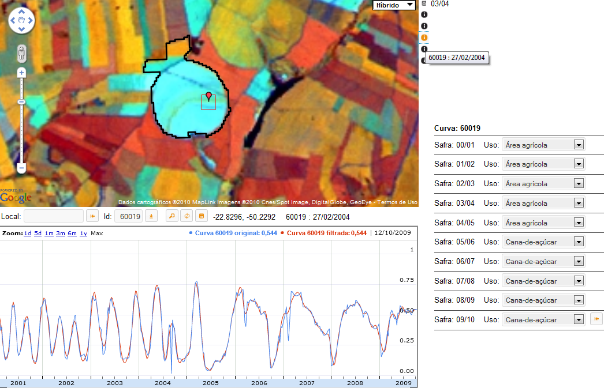
Are biofuels replacing food production in Brazil?
source: B. Rudorff, INPE

Slide 31
Are biofuels replacing food production in Brazil?

Slide 32
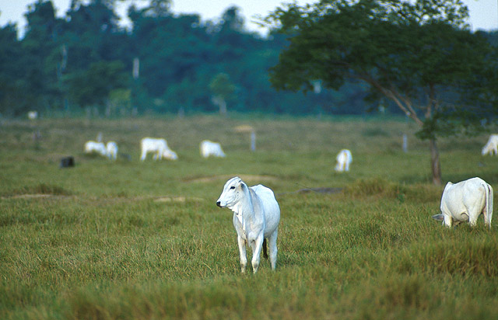
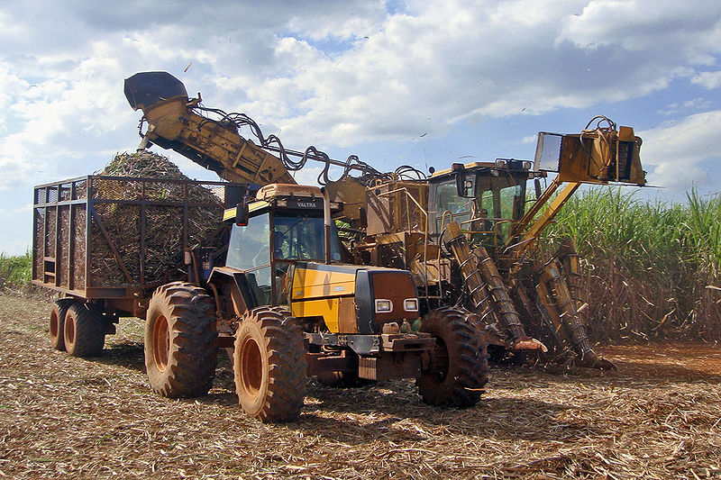
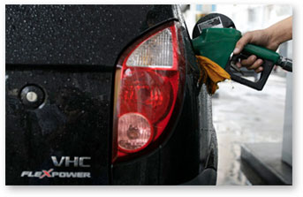
Brazil: Do biofuels cause indirect land change?

Slide 33
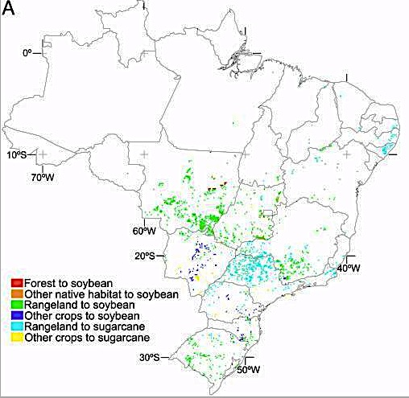
Brazil: Projected direct land change from biofuels (2020)
source: Lapola et al (PNAS, 2010)

Slide 34
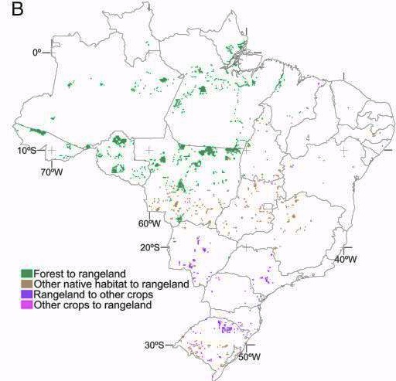
Brazil: Projected indirect land change from biofuels (2020)
source: Lapola et al (PNAS, 2010)
source: Lapola et al (PNAS, 2010)

Slide 35
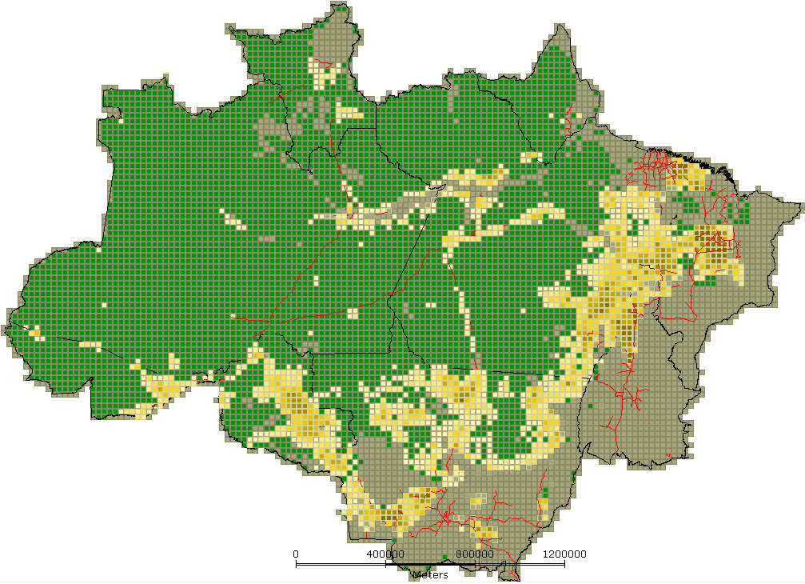
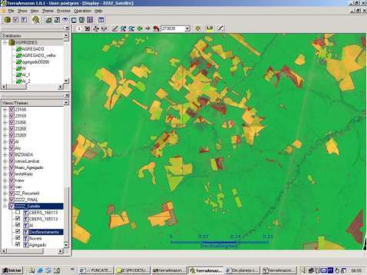
INPE: Clear-cut deforestation mapping of Amazonia since 1988
~230 scenes Landsat/year
Yearly detailed estimates of clear-cut areas
LANDSAT-class data (wall-to-wall)

Slide 36
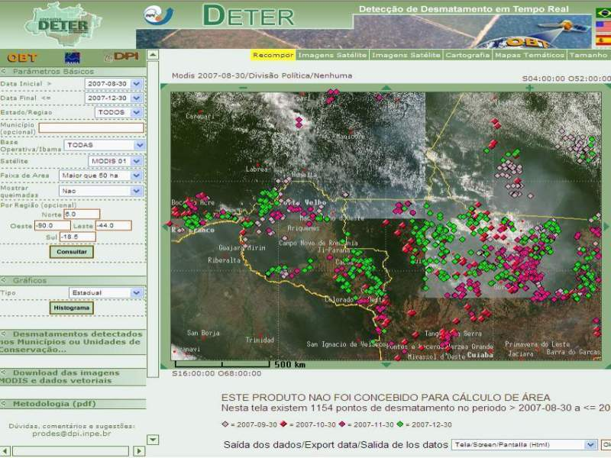

Real-time Deforestation Monitoring
Daily warnings of newly deforested large areas

Slide 37
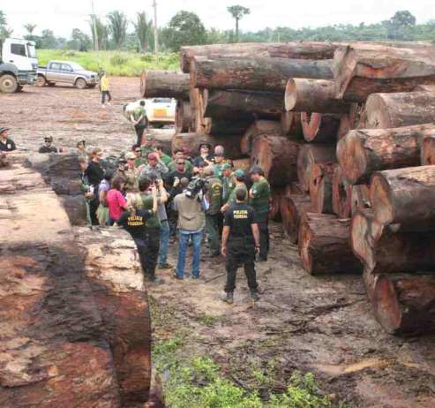
Policing actions: illegal wood seizure
50% of operations in 2% of the area

Slide 38
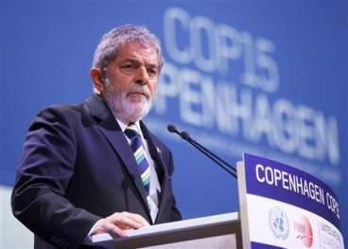
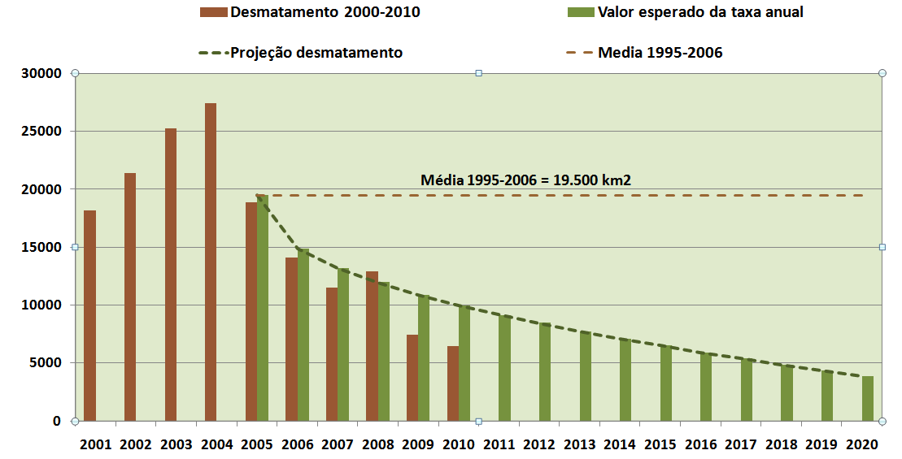
“By 2020, Brazil will reduce deforestation by 80% relative to 2005.” (pres. Lula in Copenhagen COP-15)

Slide 39

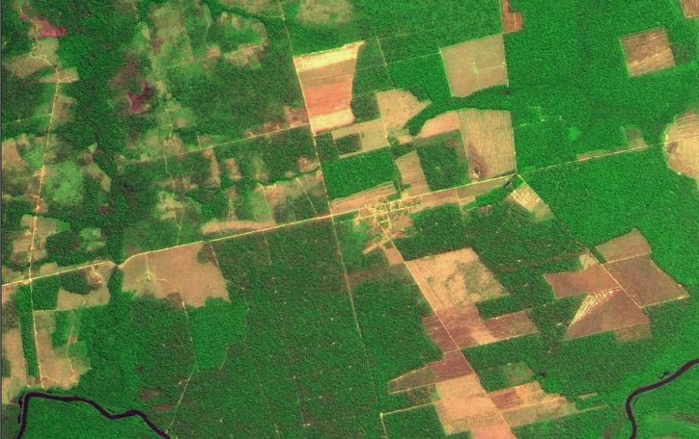
Transparency builds governance!
CBERS image
Degradation
Deforestation
Science (27 April 2007): “Brazil´s monitoring system is the envy of the world”.
Notes:
Este slide mostra uma imagem CBERS-2B da região de Marcelândia, norte de Mato Grosso. A imagem foi composta por uma imagem monocromática de alta resolução HRC (2,5 m) com uma imagem multespectral CCD (20 m). A imagem mostra que é possivel identificar com o sensor HRC, alem de desmatamentos por corte raso (áreas claras na imagem), as áreas de degradação florestal (áreas verdes com partes claras).

Slide 40
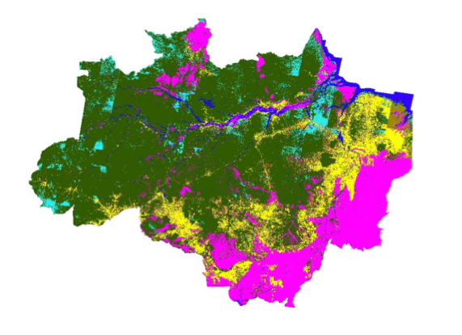
What happened with 720.000 km2 deforested?
First map of land use and land cover of Amazonia

Slide 41
How are we using the forest?

Slide 42
The extent of illegal deforestation

Slide 43
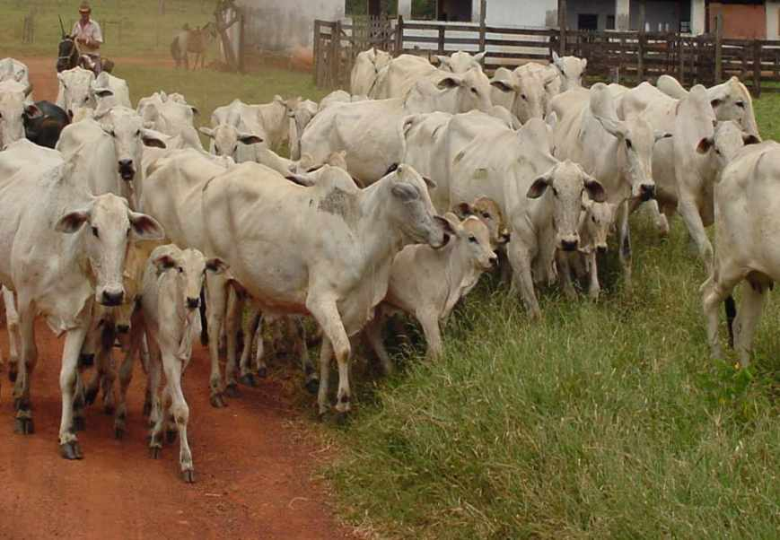
foto: Edson Sano (EMBRAPA)
Finding: Extensive and unproductive cattle raising is the main use of deforested areas
Cattle in Amazonia
 | 1992 | 2009 | head/ha
Legal Amazonia | 30 million | 70 million
Pará |  | 17 million | 1,15

Slide 44
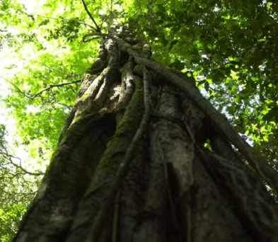

“Deforestation in the Brazilian Amazon is down by a whopping 78% from its recent high in 2004. If Brazil can maintain that progress, it would be the biggest environmental success story in decades, and would set an example to other countries that want to protect their tropical forests.” (Editorial, 7 June 2012)

Slide 45
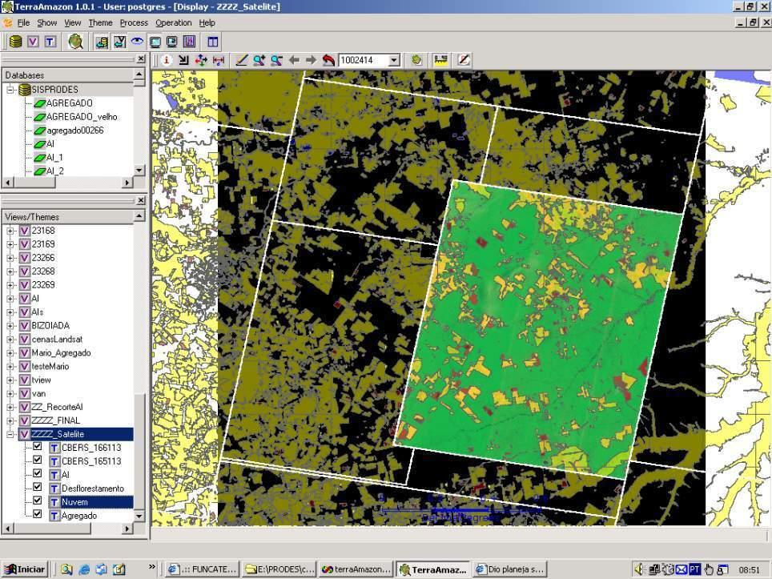
How much it takes to survey Amazonia?
116-112
30 Tb of data
500.000 lines of code
150 man/years of software dev
200 man/years of interpreters
116-113
166-112
Notes:
Cena de maior prioridade utilizou imagens CBRES na s tres principais areas: 166-112, 165-113 2 166-113. Sendo complementada por imagem TM

Slide 46

Impact of reforestation in Amazonia (30% of deforestation recovers from 2015-2025)
Net sink in Amazonia
(2015-2020)
World’s emission growth in
fossil fuels (2% a.a) (2015-2025)
3 Gt CO2eq
20 Gt CO2eq
From 2015 to 2025, reforestation in Amazonia could help reduce 15% of global emissions increase

Slide 48


Slide 49

Nature, 29 July 2010

Slide 50
Nature, 29 July 2010
Brazil is the world’s current largest experiment on land change and its effects: will it also happen elsewhere?
Today’s questions about Brazil could be tomorrow’s questions for other countries

Slide 51




Long term gains: understanding the tradeoffs between land use, emissions and biodiversity
(PRODES, 2008)
(Getty Images, 2008)
source: Espindola, 2012

Slide 52

REDD-PAC project (IIASA, INPE, IPEA)
GLOBIOM, G4M, EPIC, TerraME
TerraLib
Land use data and drivers for Brazil
Model cluster - realistic assumptions
Globally consistent policy impact assessment
Information infrastructure

Slide 53

GLOBIOM

Slide 54


Joint research opportunity (FAPESP-DFG)

