Slide 1
Understanding and Representing Change in Geospatial Data
ETH Geomatik Seminar, October 2013
Gilberto Camara
National Institute for Space Research, Brazil
Institut für Geoinformatik, Univ Münster

Slide 2
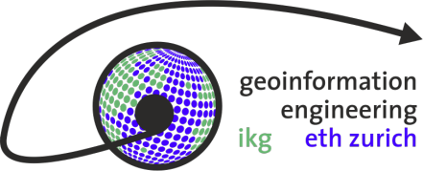
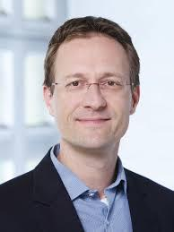
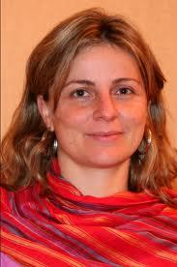
Thanks
Martin (for the invitation)
An Algebra for Spatiotemporal Data: From Observations to Events. K. Ferreira, G. Câmara, A. Monteiro. Transactions in GIS, 2013.
Karine Ferreira

Slide 3
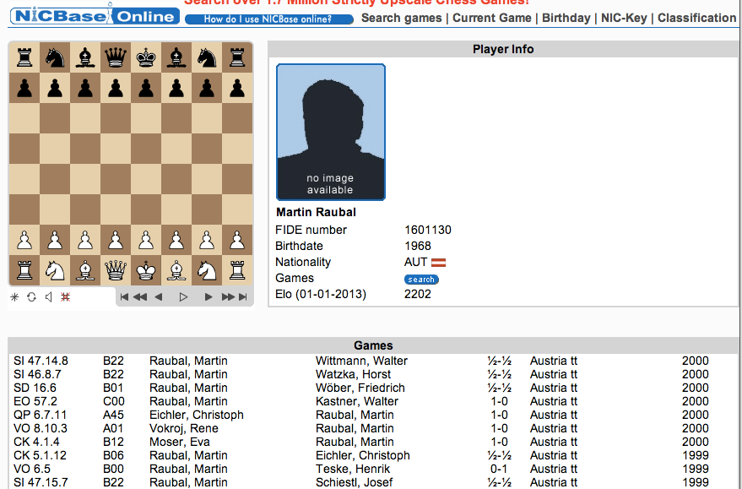
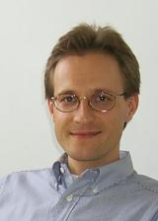
In a previous life…

Slide 4
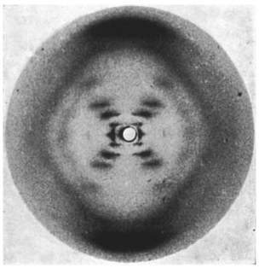
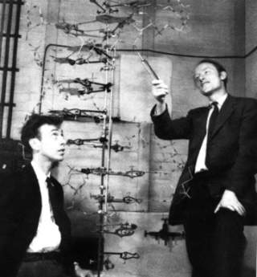
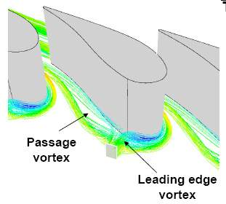
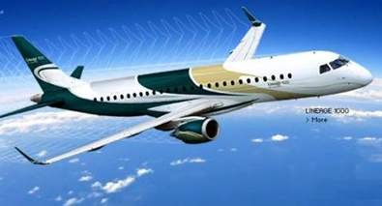
Scientists and Engineers
Photo 51(Franklin, 1952)
Scientists build in order to study
Engineers study in order to build

Slide 5
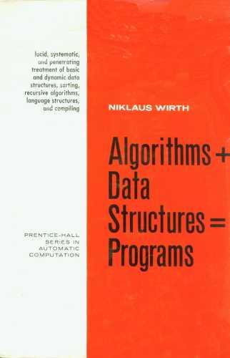
Challenges for GI software architects
Concepts +
Types +
Algorithms +
Data Structures +
Data Sources +
Custom programs =
Systems for solving
real-life problems
Classical view of software development
GI Engineering needs

Slide 6
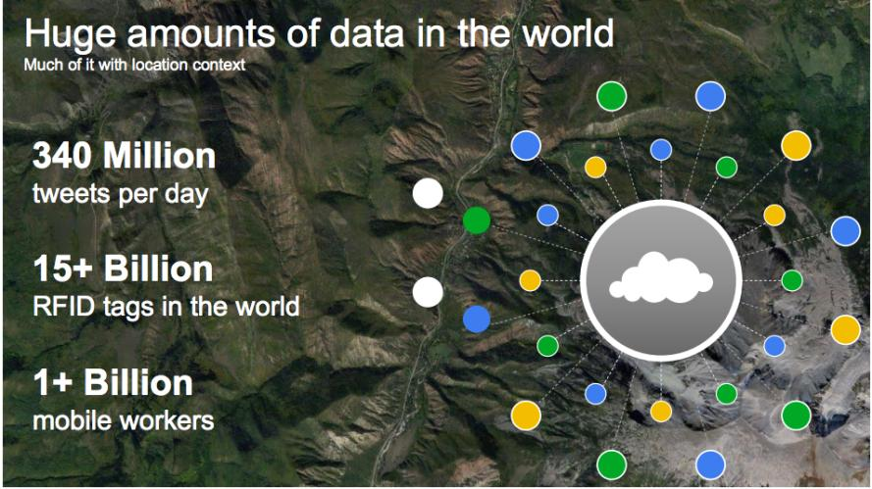
The motivation for “big data”
source: Louis Perrochon (Google)

Slide 7
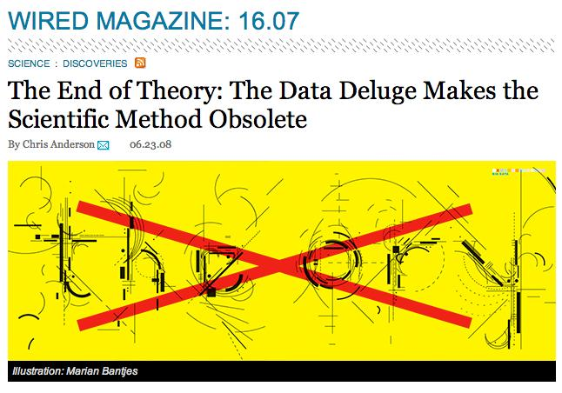
Is the scientific method obsolete?

Slide 8
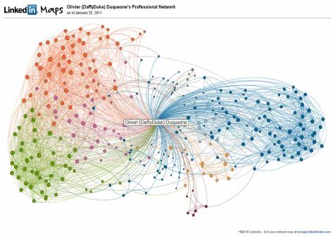
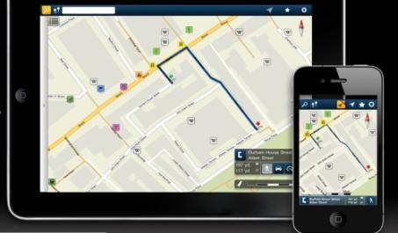
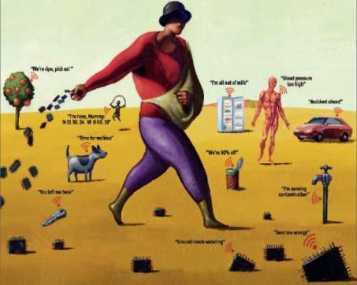
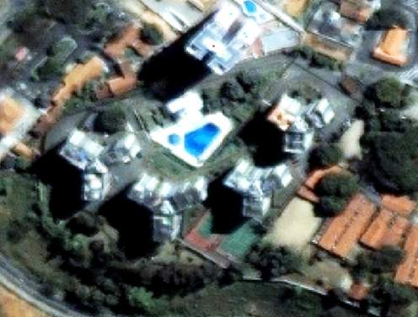
mobile devices
social network
Mobile devices, crowdsourcing, massive Earth observation sets: new technologies, new challenges
sensors everywhere
ubiquitous imagery

Slide 9
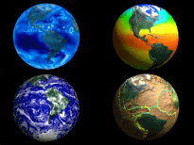
Data-intensive Geoinformatics = principles and applications of spatial information science for handling large and complex data sets

Slide 10
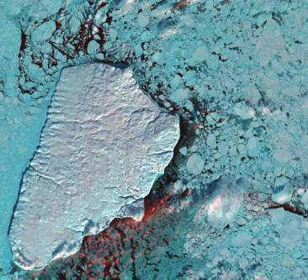
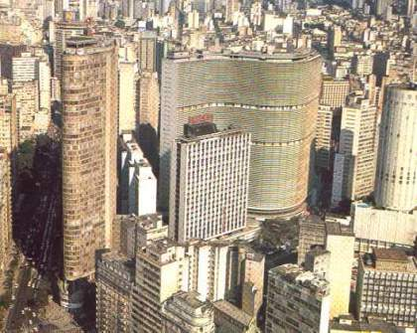
Geoinformatics enables crucial links between nature and society
Nature: Physical equations
Describe processes
Society: Decisions on how to
Use Earth´s resources

Slide 11
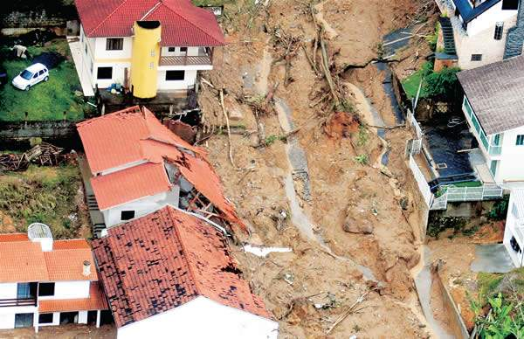
Representing and modelling change
Semantics of complex geospatial data
events and processes

Slide 12
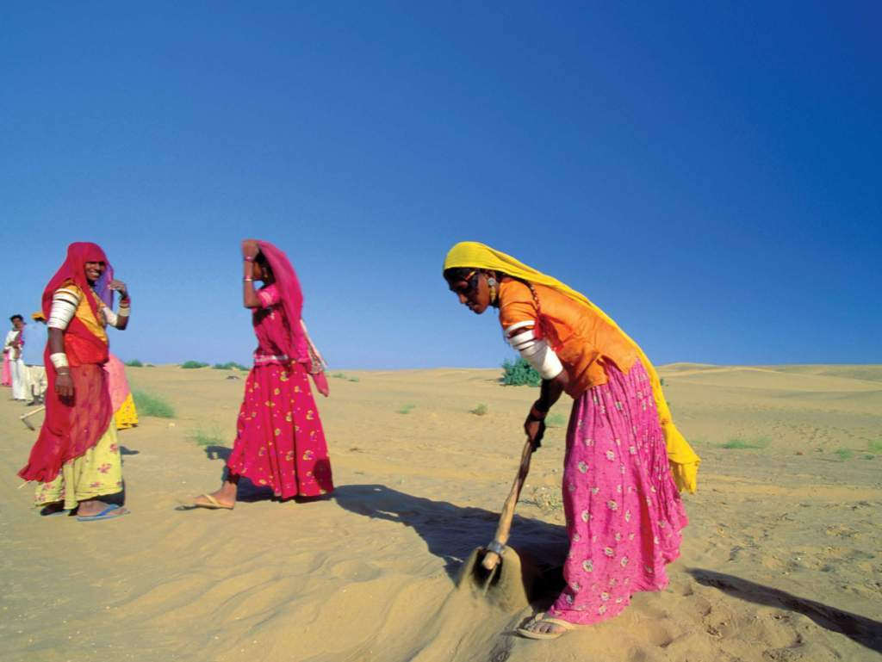
Representing condition
Semantics of complex geospatial data
vulnerability? climate change? poverty?
Image source: WMO

Slide 13
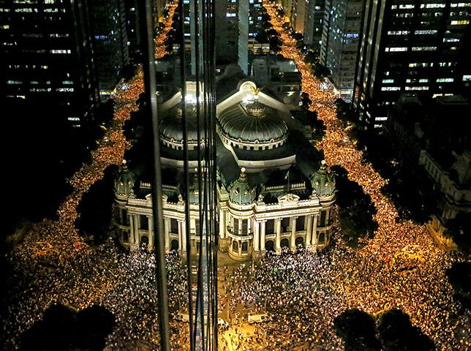
Semantics of complex geospatial data
Representing and modelling behaviour
How do social networks operate?

Slide 14
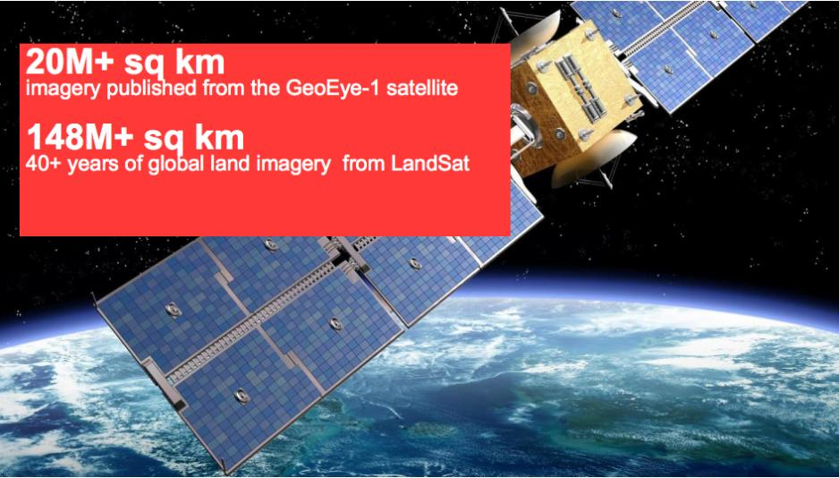
Google Earth Engine: massive image data
source: Louis Perrochon (Google)

Slide 15
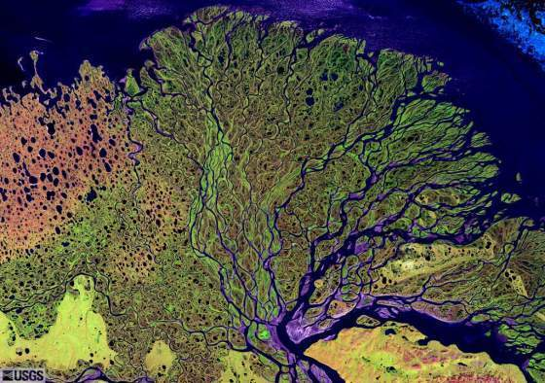
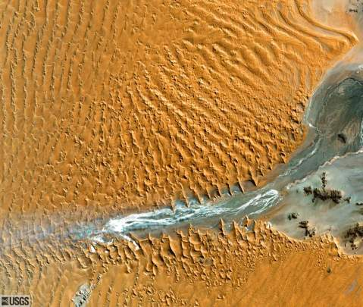
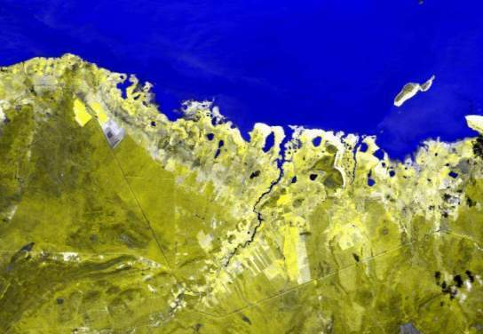
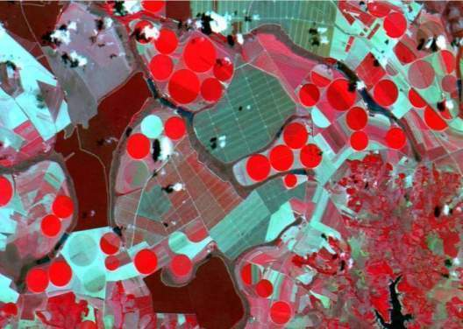
Earth observation satellites and geosensor webs provide key information about global change…
…but that information needs to be modelled and extracted

Slide 16
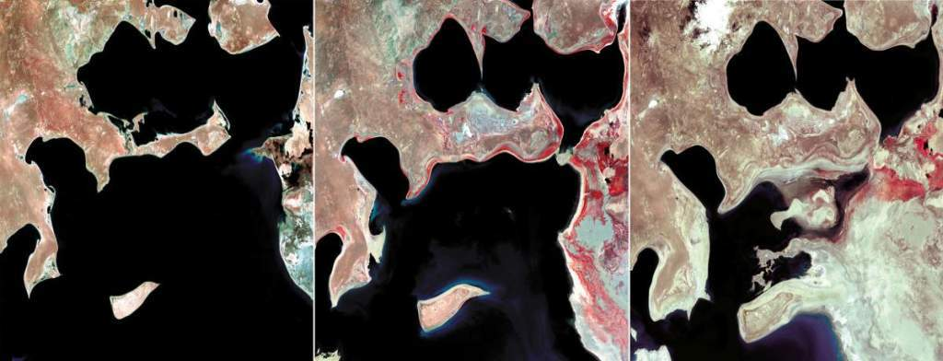
Information Extraction from Images
G Câmara, M Egenhofer, F Fonseca, A Monteiro. "What´s in An Image?“ COSIT 2001.
M. Silva, G.Câmara, M.I. Escada, R.C.M. Souza, “Remote Sensing Image Mining: Detecting Agents of Land Use Change in Tropical Forest Areas”. International Journal of Remote Sensing, vol 29 (16): 4803 – 4822, 2008.
“Remote sensing images provide data for describing landscape dynamics”

Slide 17
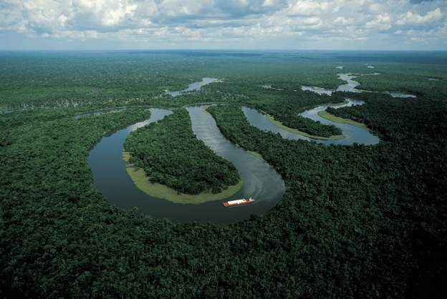
“Deforestation in Brazilian Amazonia is down by a whopping 78% from its recent high in 2004. If Brazil can maintain that progress, it would be the biggest environmental success in decades” (Nature, Rio + 20 editorial)

Slide 18
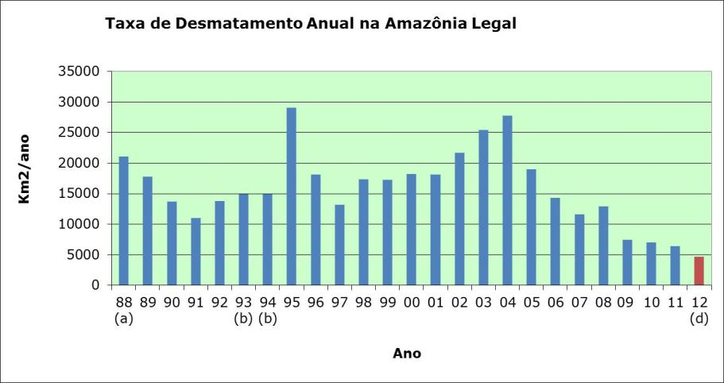
Transparency builds governance!
Deforestation in Brazilian Amazonia (1988-2012)
dropped from 27,000 km² to 4,800 km²

Slide 19
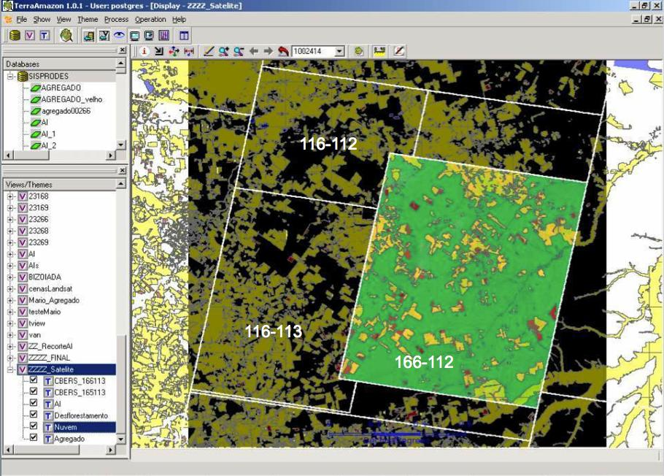
How much it takes to survey Amazonia?
116-112
30 Tb of data
500.000 lines of code
150 man-years of software dev
200 man-years of interpreters
116-113
166-112
Notes:
Cena de maior prioridade utilizou imagens CBRES na s tres principais areas: 166-112, 165-113 2 166-113. Sendo complementada por imagem TM

Slide 20
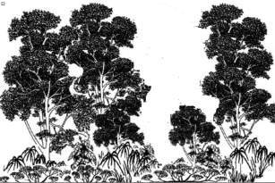
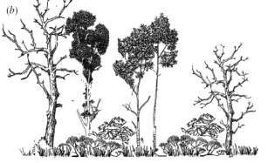
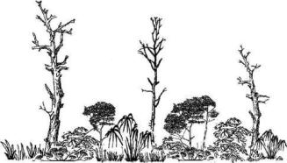
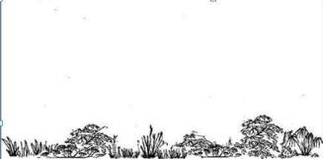
Event composition
Forest loss > 20%
Exploração intensiva
time
Event 1
Perda >50% do dossel
Loss > 50%
Event 2
Perda >90% do dossel
Loss > 90%
Event 3
Corte raso
Event 4
Clear cut
Floresta
Floresta

Slide 21
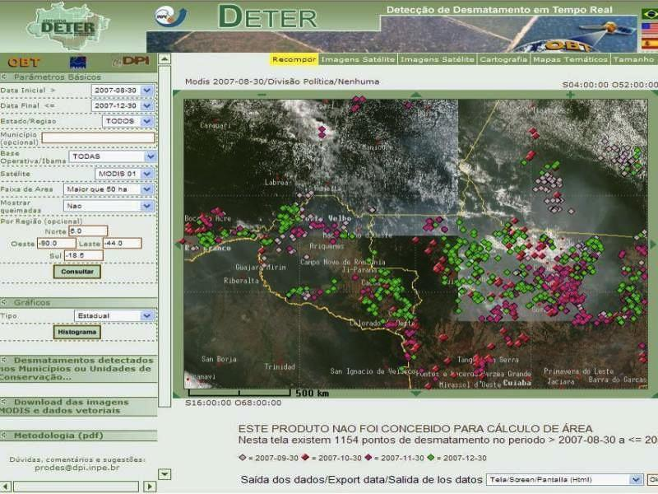
Real-time Deforestation Monitoring
Daily warnings of newly deforested large areas

Slide 22
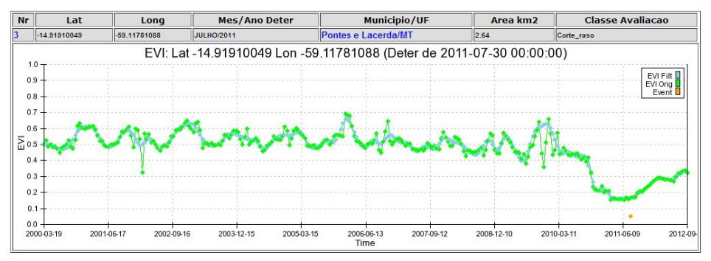
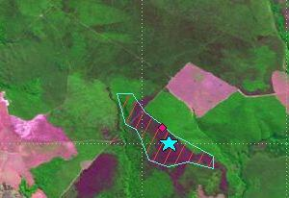
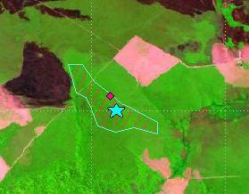
Deforestation event detection: coverages and time series
2010
2011

Slide 23
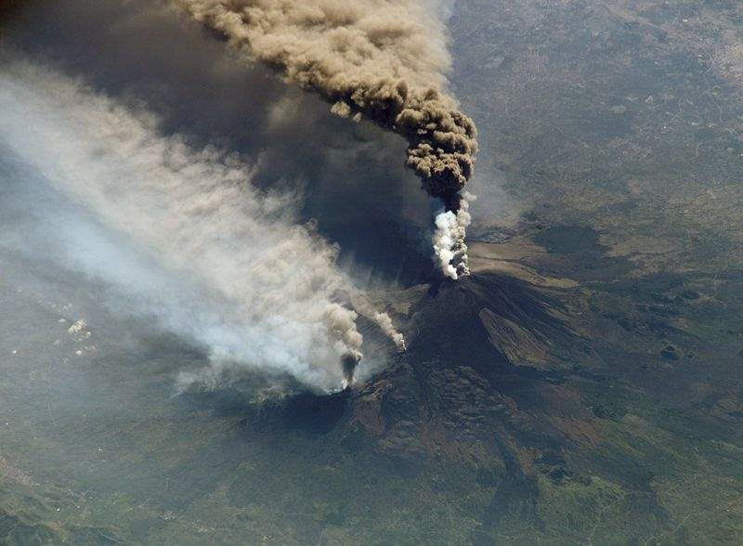
objects exist, events occur
Mount Etna is an object
Etna’s 2002 eruption was an event

Slide 24
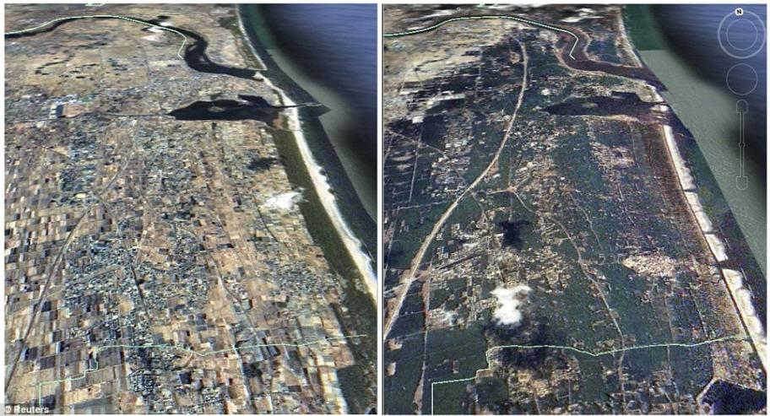
Objects and events
The coast of Japan is an object
The 2011 Tohoku tsunami was an event

Slide 25
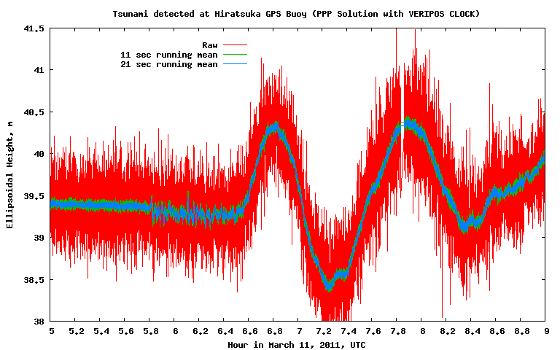
Object (GPS buoy) + event (tsunami)

Slide 26
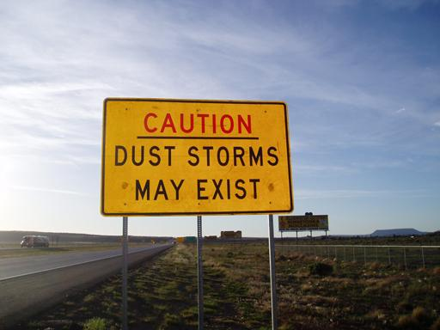

Slide 27
Why do we assign existence to events?

Slide 28
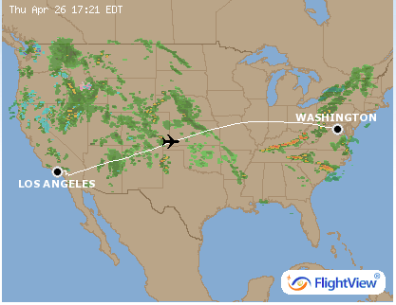
Processes and events
Flying is a process - Virgin flight VX 112 (LAX-IAD) on 26 Apr 2012 is an event

Slide 29
Aral Sea (an object) – desertification (a process) - disaster (an event)
When did the Aral Sea shrank to 10% of its original size?

Slide 30
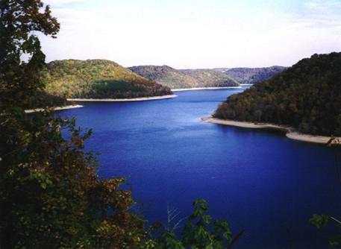
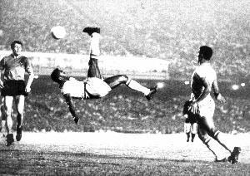
A view on processes and events
(Worboys & Galton)
Space
Time
Count
Objects | Events
Matter | Processes
Mass
water or lake?
football or game?

Slide 31
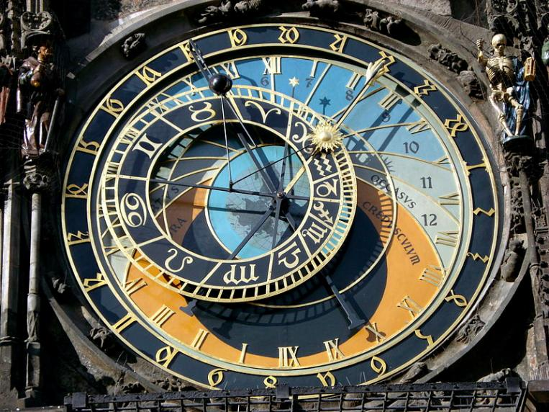
Clock Towers (Prague, 1410)
City life now guided by the hours on clock tower

Slide 32
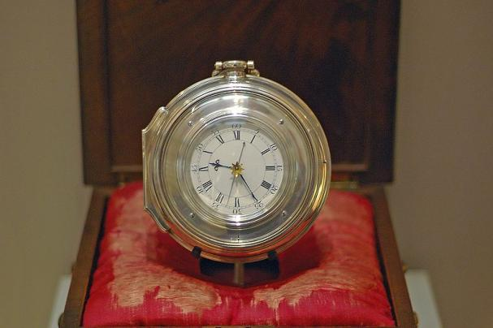
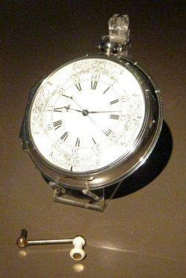
Harrison’s clocks (18th Century)
The longitude challenge was a triumph of technology over astronomy

Slide 33
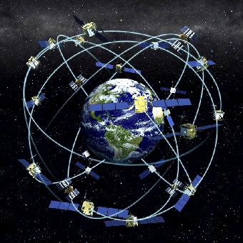
The ultimate victory of time over space: GPS
GPS satellites use relativistic clocks to get precise location

Slide 34
Mental maps and mental clocks
Where is our mental central clock?

Slide 35
Temporal perception as event-ordering
The brain represents time by means of time: events are recorded as relevant personal experiences

Slide 36
Reality and representation

Slide 37
Everything starts with measurements (Kuhn)
“All information ultimately rests on observations, whose semantics is physically grounded in processes and mathematically well understood. Exploiting this foundation to understand the semantics of information derived from observations would produce more powerful semantic models”.

Slide 38
Observations allow us to sense external reality

Slide 39
An observation is a measure of a value in a location in space and a position in time

Slide 40
Observations: Sinton's approach (1978)
An observation should have three attributes: space, time and theme.
We observe the world by fixing one attribute, controlling another and measuring the other:
(1) keep one attribute constant;
(2) vary the second attribute in a controlled way; and
(3) measure the third attribute, taking into consideration the constraints of the second attribute.

Slide 41
Inherent structure of geoinformation
(Sinton, 1978)
Fixing space, controlling time, and measuring value: a time series.
Fixing value, controlling time, and measuring space: a trajectory.
Fixing time, controlling space, and measuring value: a coverage.

Slide 42
Observations: Sinton's approach
Fixed | Controlled | Measured | Examples
Location | Time | Theme | Weather reports
Time | Location | Theme | Grid cell data
Theme | Time | Location | Tracks of animals
Location | Theme | Time | Arrival times by runners
Time | Theme | Location | Vegetation Map
Theme | Location | Time | Tide Tables
Time Series
Coverage
Trajectory
Notes:
Para ser útil uma observaçã o deve ter tres attributos: ...
The term “theme” refers to the real-world phenomenon or to the object being observed)

Slide 43
Observations: Sinton's approach
Fixed | Controlled | Measured | Examples
Location | Time | Theme | Weather reports
Time | Location | Theme | Grid cell data
Theme | Time | Location | Tracks of animals
Location | Theme | Time | Arrival times by runners
Time | Theme | Location | Vegetation Map
Theme | Location | Time | Tide Tables
Time Series
Coverage
Trajectory
Notes:
Para ser útil uma observaçã o deve ter tres attributos: ...
The term “theme” refers to the real-world phenomenon or to the object being observed)

Slide 44
Time Series
Continuous variation of a property value over time
in a fixed location

Slide 45
Moving objects have trajectories
trajectory : represents how locations or boundaries of an object evolve over time.

Slide 46
images: USGS
Coverage: variation of a property within a spatial extent at a time.
Two-dimensional grids whose values change.
Samples from fixed or moving geosensors.

Slide 47
Time Series
how the number of mosquito eggs varies over time
Trajectory
Observations
how animals move over time
Coverage
how precipitation varies within the limits of Rio de Janeiro state
Raw Data
Spatiotemporal Data Types
Notes:
Time series: fixed location, etc, etc...

Slide 48
Different Views on the Same Observation Set
Time Series
air pollution
Observations
Trajectory
car location
each observation contains a car identity, a time instant, a location and an air pollution value
Coverage
a set of cars equipped with GPS and air pollution sensors
air pollution
within the city
Notes:
Uma das grandes vantagens do nosso modelo é construir os data types sobre o mesmo tipo de dado. To meet different application needs!
A capacidade de criar diferentes views on the same observation set!

Slide 49
Different Views on the Same Observation Set
(1) “When the average pollution in the city was greater than x for more than five hours?”
(2) “How long did car c01 stay in the south region of the city?”
(3) “What city district had the worst pollution index in this day?”
Observations
each observation contains a car identity, a time instant, a location and an air pollution value
a set of cars equipped with GPS and air pollution sensors
Notes:
Uma das grandes vantagens do nosso modelo é construir os data types sobre o mesmo tipo de dado. To meet different application needs!
A capacidade de criar diferentes views on the same observation set!

Slide 50
Sensors: water monitoring
Brazilian Cerrado
Wells observation
50 points
50 semimonthly time series
(11 Oct 2003 – 06 March2007)
Manzione, Câmara, Knotters

Slide 51
Each sensor produces a time series
Continuous variation of a property value over time
(water table depth sensors) in a fixed location

Slide 52
Combined monthly sensor averages produce coverages
MAY
JUNE
JULY
AUGUST
SEPTEMBER
Manzione, Câmara, Knotters
Estimates of water table depth for an area in Brazilian Cerrado

Slide 53
Observations (fix, control, measure)
type: Observations [F:Type, C:Type, M:Type]
new: {(F,C,M)₁,…,(F,C,M)_{n}} → Observations
reference: Observations → F
positions: Observations → {C₁,…,C_{n}}
measure: Observations x C → M

Slide 54
Interpolators (estimate in unsampled places)
A
Z(x₁)
Z(x₂)
?
Z(x₃)
Z(x_{n})
type: Interpolator [F:Type, C:Type, M:Type]
estimate: Observations[F,C,M] x C → M

Slide 55
Building blocks: Geometry (OGC)
type GEOM = {Point, LineString, Polygon, MultiPoint, MultiLineString, MultiPolygon}
operations:
equals, touches, disjoint, crosses, within, overlaps, contains, intersects: GEOM x GEOM → Bool

Slide 56
Building blocks: Time (ISO 19108)
type TIME = {Instant, Period}
operations:
equals, before, after, begins, ends, during, contains, overlaps, meets, overlappedBy, metBy, begunBy, endedBy: TIME x TIME → Boolean

Slide 57
What do ST types have in common?
type ST [T: TIME, G: GEOM, V: VALUE]
operations:
getObs: ST → {Obs}
interpolator: ST → Interpolator
begins, ends: ST → Instant
boundary: ST → G
after, before: ST x T → ST
intersection: ST x Period → ST

Slide 58
Time Series
type TimeSeries [T: TIME, V: VALUE] uses ST
operations:
value: TimeSeries x T → V
less, greater: TimeSeries x V → {ts₁,…,ts_{n}}

Slide 59
Trajectory
type Trajectory [V: VALUE, T: TIME, G: GEOM] uses ST
operations:
value: Trajectory x T → G

Slide 60
Additional functions
distance: Trajectory x Trajectory → TimeSeries
enters, exits, reaches, leaves:
Trajectory x Geometry → {tj1,…,tjn}
speed: Trajectory → TimeSeries
direction: Trajectory → TimeSeries

Slide 61
source: USGS
type Coverage [T: TIME, G: GEOM, V: VALUE] uses ST
operations:
value: Coverage x G → V
min, max: Coverage → V
less, greater: Coverage x V → Coverage

Slide 62
source: USGS
type CoverageSeries [G: GEOM, T: TIME, CV: COVERAGE]
operations:
snapshot: CoverageSeries x T → Coverage
timeseries: CoverageSeries x Point → TimeSeries

Slide 63
Coverage and CoverageSeries
Observations[Period, Point, Float]
Coverage[Period, Point, Float]
CoverageSeries[Polygon, Period,
Coverage]
Rain in Angra dos Reis
Observations[Period, Point, Float]
Coverage[Period, Point, Float]
CoverageSeries[Polygon, Period,
Coverage]
Chlorophyll in an Amazon lake.
Notes:
Só tem uma função que estima o valor em uma posição não observada...
É uma interface abstrata pra outros interpoladores que devem implementar essa função -> não tem construtor...
Alguns interpoladores necessitam de parâmentros informados pelo usuário → isso será específico de cada construtor!

Slide 64
Functions on coverages
getWaterArea (Coverage cov, Time t)
area = 0
forall g inside cov.boundary()
if cov.value (g,t) == "water”
area = area + g
return area
}

Slide 65
What about objects?
Mont Blanc
Objects are language constructs, built upon observations
They require both an external reality and a conscious act to identify their existence

Slide 66
Objects as mental constructions derived from physical reality
Mont Blanc
“Mont Blanc” is a socially-accepted name for a specific topographic feature
Where does “Mont Blanc” start and “Dôme du Goûter” end?

Slide 67
Objects as mental constructions derived from physical reality
Walrus W1
To understand animal behaviour, we tag them and assign them an identity

Slide 68
Objects as mental constructions derived from physical reality
Walrus W1
To understand animal behaviour, we tag them, assign them an identity and track their movements

Slide 69
Objects as mental constructs derived from social reality
“Germany (1914)” is a geographical object whose existence is defined by laws and treaties
Die Proklamation des Deutschen Kaiserreiches 1871

Slide 70
Objects as mental constructs derived from social reality
“Germany (2013)” is a geographical object whose existence is defined by laws and treaties
Einigunsvertrag 1990
Two-plus-Four Agreement 1990

Slide 71
Was Germany a nation before it were a state?
Germania, in a 1834 fresco.
When did Germany start to exist?
What were the boundaries of Germany when Goethe lived?

Slide 72
The trajectory of German borders

Slide 73
Some time series of Germany

Slide 74
One of many coverages inside Germany (2013)

Slide 75
From observations to objects
Time series
How properties change
Observations
Trajectories
Object
How boundaries change
identity,
trajectories,
time series,
coverages
Coverages
How parts inside change

Slide 76
Object definition
type Object [ID:Value, TS:TimeSeries, TJ:Trajectory,
^{CV: Coverage]}
^{operations:}
^{new: ID x TS x TJ → Object}
^{id: Object → ID}
^{timeseries: Object → TS}
^{trajectory: Object → TJ}
^{coverage: Object} ^{→ CV}
state: Object x Time → (Value, Geometry)
Simple object with one time series (one attribute) and one coverage (inside variation)

Slide 77
Object definition
type Object [ID:Value, TS:TimeSeries, TJ:Trajectory, CV: Coverage]
^{operations:}
^{new: ID x TS x TJ → Object}
^{id: Object → ID}
^{timeseries: Object → TS}
^{trajectory: Object → TJ}
^{coverage: Object} ^{→ CV}
state: Object x Time → (Value, Geometry)
Germany
Boundary trajectory
Population time series
Topography coverage

Slide 78
From observations to events

Slide 79
Events
Time Series
If we know what conditions lead to an event, we can express them using operations over the proposed data types. Examples:
(1) “rain in Angra is more than 10 mm/hour for more than 5 hours” → ‘flood’ event
(2) “the average temperature is above 30º C for more than a week and more than 50 eggs on average were found in the same week” → ‘dengue epidemic’ event in Recife
(3) “the minimal distance between two sea elephants is shorter than 2 meters” → ‘meeting of two animals’ event
how the number of mosquito eggs varies over time
Trajectory
how animals move over time
Coverage
how precipitation varies in the Rio de Janeiro state

Slide 80
The event data type
An event is an individual episode with a beginning and end, which define its character as a whole.
An event does not exist by itself. Its occurrence is defined as a particular condition of one spatiotemporal type.
Notes:
INPE has a project called PROARCO responsible for monitoring fire spots in South America, In this application, each fire is presented by its location and the time instant when it was detected.
This picture is an example of the detected fires in a Brazilian state called Pará in august 2003.
The second demand is related to a project responsible for monitoring the Amazon deforestation called PRODES. In this application, each deforested area is represented by a polygon that limits the deforested region and the time when it was detected.

Slide 81
When did the large flood occur in Angra? When precipitation was > 10mm/hour for 5 hours
Coverage set (hourly precipitation grid)
⬇
Event (precipitation > 10 mm/hour for 5 hrs)
Notes:
INPE has a project called PROARCO responsible for monitoring fire spots in South America, In this application, each fire is presented by its location and the time instant when it was detected.
This picture is an example of the detected fires in a Brazilian state called Pará in august 2003.
The second demand is related to a project responsible for monitoring the Amazon deforestation called PRODES. In this application, each deforested area is represented by a polygon that limits the deforested region and the time when it was detected.

Slide 82
The event data type
Type Event [T₁: TIME, T₂: TIME] uses ST
operations:
new: {ST x (T₁, T₂) → Event
compose: Event x Event → Event
intersect: Event x Event → Event
Notes:
INPE has a project called PROARCO responsible for monitoring fire spots in South America, In this application, each fire is presented by its location and the time instant when it was detected.
This picture is an example of the detected fires in a Brazilian state called Pará in august 2003.
The second demand is related to a project responsible for monitoring the Amazon deforestation called PRODES. In this application, each deforested area is represented by a polygon that limits the deforested region and the time when it was detected.

Slide 83
When did the large flood occur in Angra?

Slide 84
When did the large flood occur in Angra?
Coverage prec = getData (weather forecast)
flood = new Event()
from t0 = prec.begin(); t0 <= prec.end(); t.next()
if getRain (prec, t0, t0 + 24) > 100
strong = new Event (prec, t0, t0 + 24)
flood.compose (strong)

Slide 85
From objects to events
Time series
How properties
change
Observations
Trajectories
Object
Events
How boundaries
change
identity,
trajectories,
time series,
coverages
Coverages
How parts inside
change

Slide 86
Did walrus W2 reach Baffin island?
Did he meet other walruses on his way?

Slide 87
When did walrus W1 meet walrus W2?
Object w1(“walrus1”, Trajectory tj1);
Object w2(“walrus2”, Trajectory tj2);
set<Event> meetings;
TimeSeries dist = tj1.distance(tj2);
set<TimeSeries> result = dist.less(10.0);
for each ts in result
{
Period p (ts.begins(), ts.ends());
Event ev("Meeting btw walruses", w1, w2, p);
meetings.add (ev);
}

Slide 88
source: USGS
Events are categories (Frank, Galton)
identity : id · a = a
composition : ∀a, ∀b, ∃c, c = a.b
associativity : a · (b · c) = (a · b) · c

Slide 89
source: USGS
Events are categories (Frank, Galton)
cause (a,b) = effect (b,a)
before (a,b) = after (b,a)
on-commutativity : a · (b · c) /= (b.a) · c

Slide 90
The TerraLib vision: FOSS4G for innovation
“Many developments (in industry and FOSS4G) have ignored scientific advances in GIScience. Thus, the geographical information community would benefit from the availability of a general, open source GIS library. This resource would make a positive impact by allowing researchers and solution developers access to wider range of tools than what is currently offered.”
Câmara, G. el al., “TerraLib: Technology in Support of GIS Innovation”. GeoInfo 2000

Slide 91
TerraLib: high-level GI abstractions on top of FOSS
DengueME
TerraAmazon
TerraMA²
TerraView
...
TerraME
GeoDMA
aRT
TerraHS
TerraOGC
TerraLib
R
Lua
GDAL
Boost,
Qt
Twitter
PostGIS,
SciDB
...
TerraLib is a common interface to FOSS and data sources
Application development becomes easier

Slide 92
Milestones of TerraLib project
TerraLib 1.0
TerraLib 2.0
TerraLib 3.0
TerraLib 4.0
TerraLib
5.0
2002
2004
2006
2008
2010
2012
2014
TerraView
aRT
TerraHS
Terra
Amazon
TerraME
GeoDMA
TerraMA²
TerraLib evolves together with its tools
Each new tools brings new concepts to TerraLib

Slide 93
Types in TerraLib ecosystem: new tools, new types
Time Series
Trajectory
Event
2014
Cellular Space
Social Network
Agent
2010
Object
Geometry
2002
Coverage

Slide 94
We need a mathematically and cognitively sound model of spatiotemporal events.

