Slide 1
We now have a Geo-Linux. What’s next?
FOSSGIS Germany, Münster 2015
Gilberto Câmara
National Institute for Space Research (INPE), Brazil
Institute for Geoinformatics, University of Münster, Germany

Slide 2
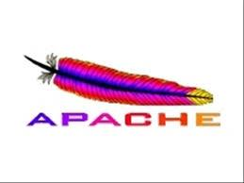
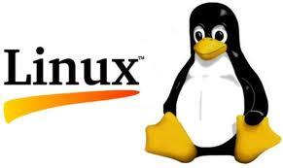
Brand awareness
Which brands first come to your mind when we talk about open source?

Slide 3
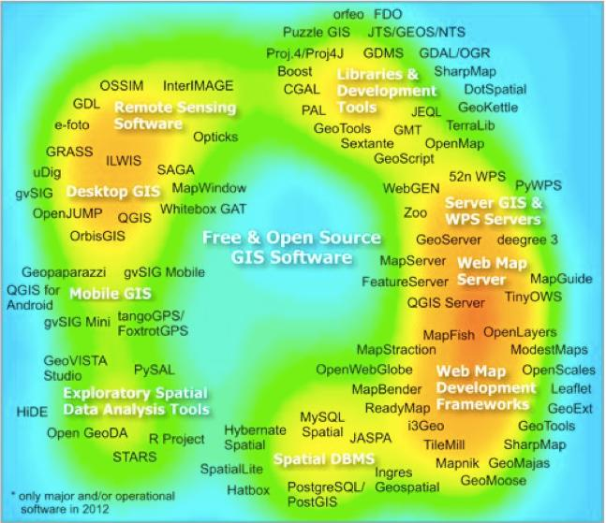
The 2012 FOSSGIS software map
Source: Steiniger and Hunter (2013)

Slide 4
Will there ever be a Geo-Linux?
will there ever be an FOSS4G equivalent to Linux or Apache?
Câmara et al., 2010: Open Source Geospatial Research Conference

Slide 5
Challenges to FOSSGIS (2010 Geo-Linux paper)
Leadership
Modularity
Code stability and avoidance of forking
Standards and shared conceptualization
Innovation
Câmara et al., 2010: Open Source Geospatial Research Conference

Slide 6
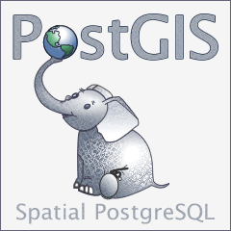
Brand awareness
Which brands first come to your mind when we talk about FOSSGIS?

Slide 7
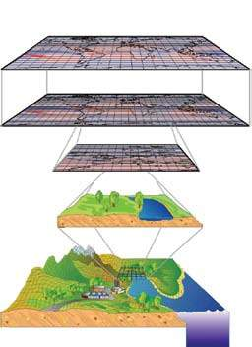
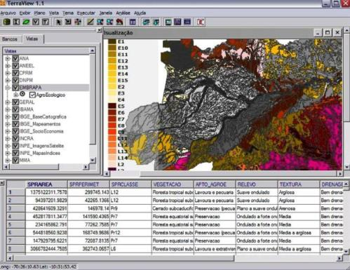
Why do we want free GIS?
Alternative to proprietary systems
Support for innovation

Slide 8
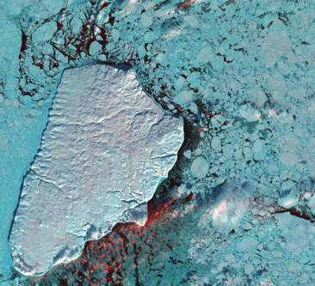
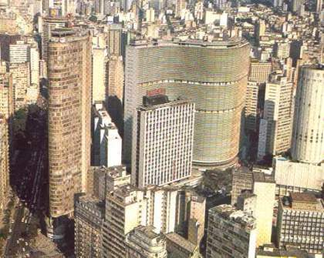
Open GIS can do much more: support decision-making in a changing world
Nature: Physical equations
Describe processes
Society: Decisions on how to
Use Earth´s resources

Slide 9
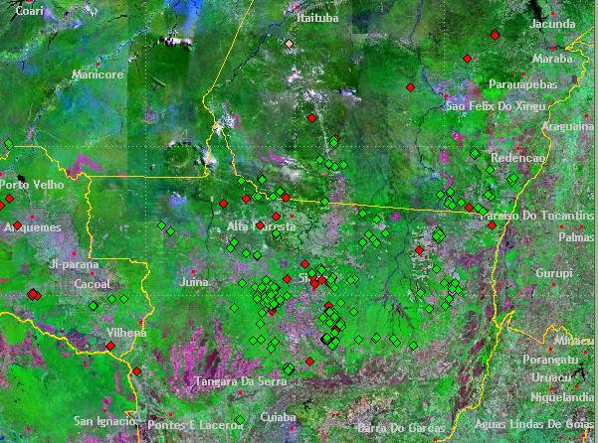
Representing location is easy
What do we know?
Deforestation hotspots in Amazonia

Slide 10
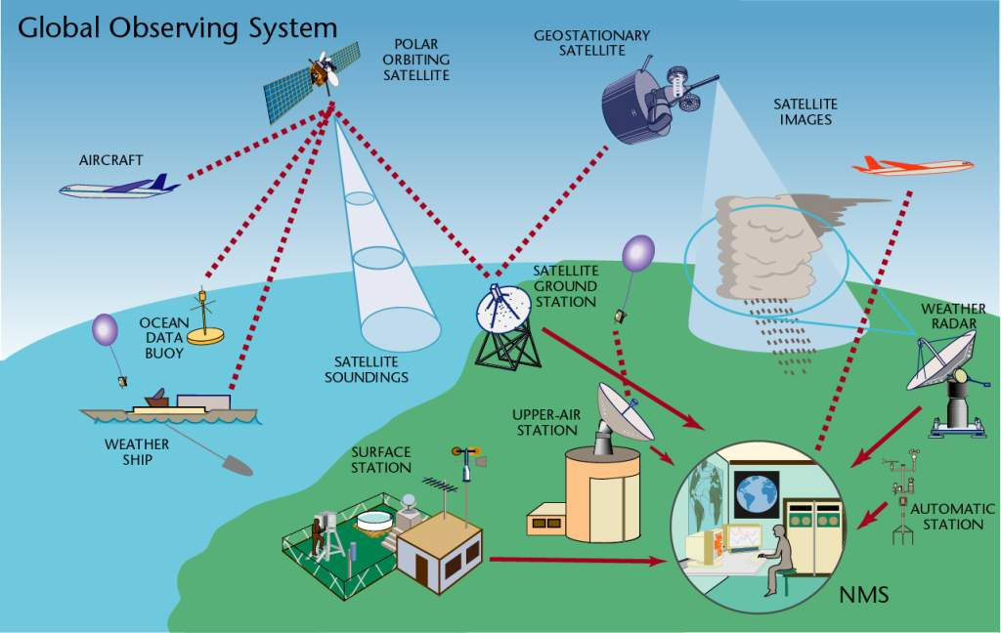
What do we know?
source: WMO
Communicating data is feasible
11,000 land stations (3000 automated)
900 radiosondes, 3000 aircraft
6000 ships, 1300 buoys
5 polar, 6 geostationary satellites

Slide 11
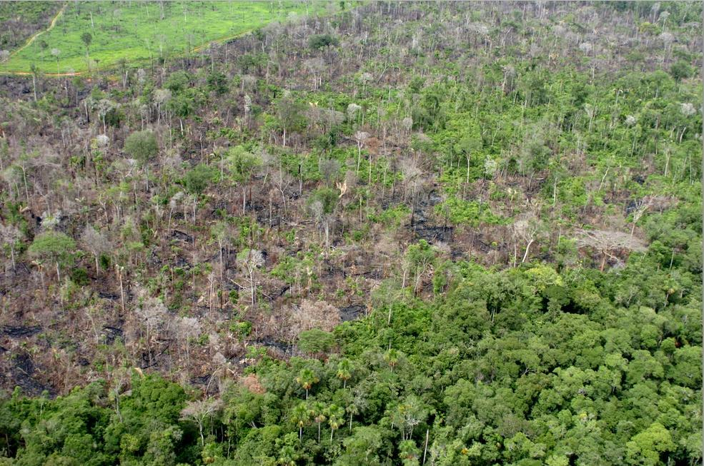
We’re bad at representing meaning
What do we know we don’t know?
Representing concepts is hard
degradation
deforestation? degradation? disturbance?

Slide 12
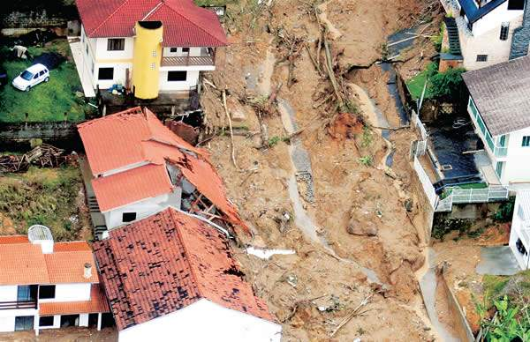
Representing and modelling change
Semantics of complex geospatial data
events and processes

Slide 13
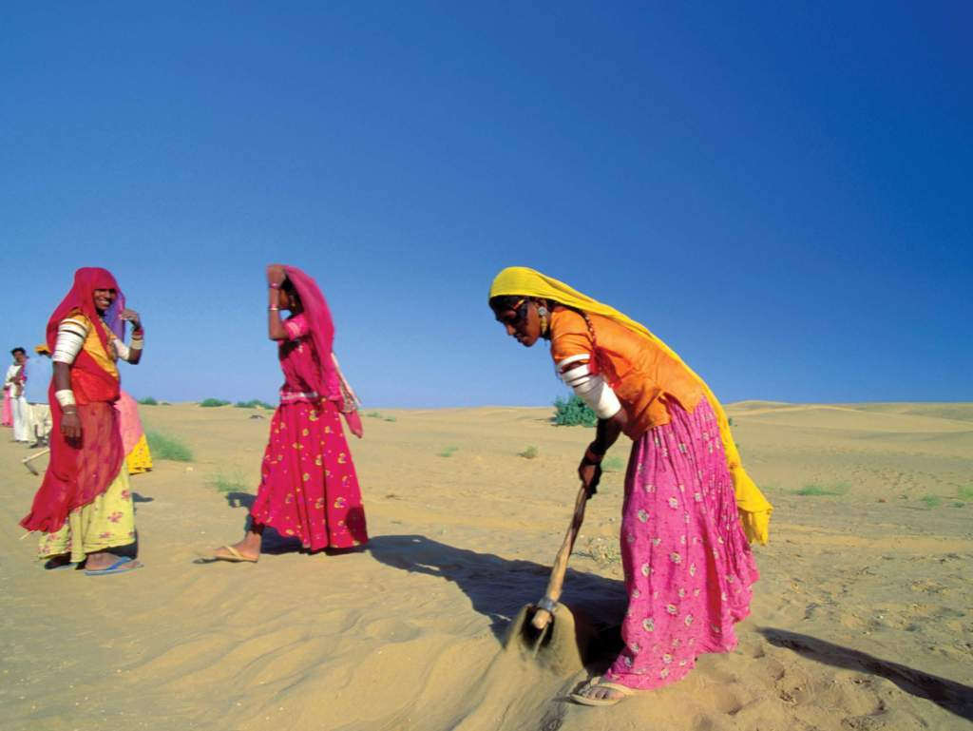
Representing condition
Semantics of complex geospatial data
vulnerability? climate change? poverty?
Image source: WMO

Slide 14
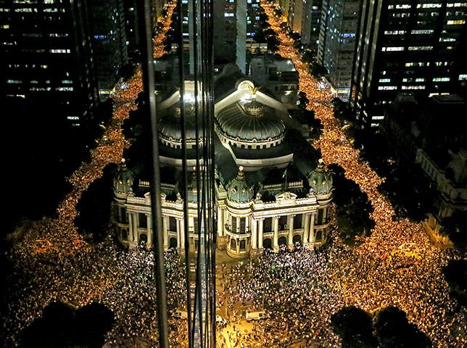
Semantics of complex geospatial data
Representing and modelling behaviour
How do social networks operate?

Slide 15
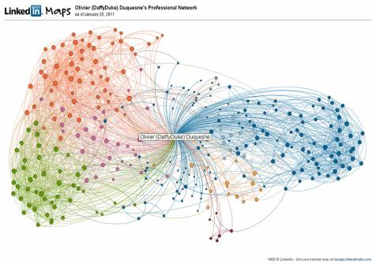
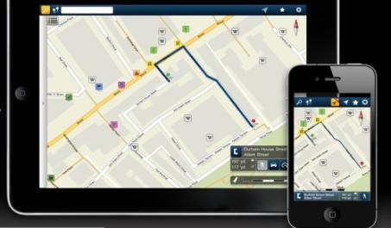
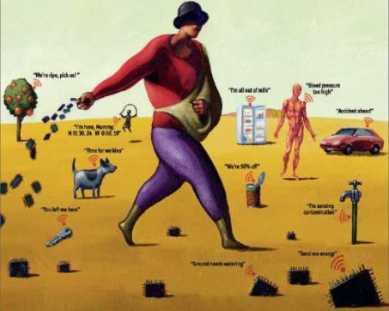
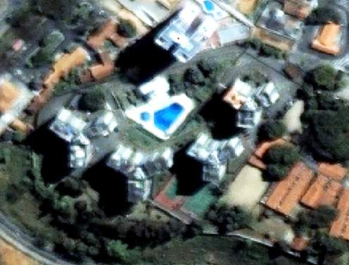
mobile devices
social network
Big data, mobile devices, crowdsourcing, massive Earth observation sets: new technologies bringing new problems
sensors everywhere
ubiquitous imagery

Slide 16
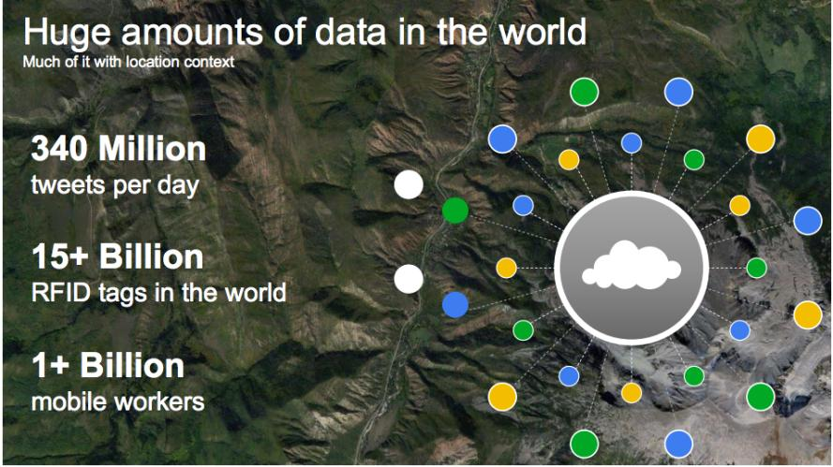
The motivation for “big data”
source: Louis Perrochon (Google)

Slide 17
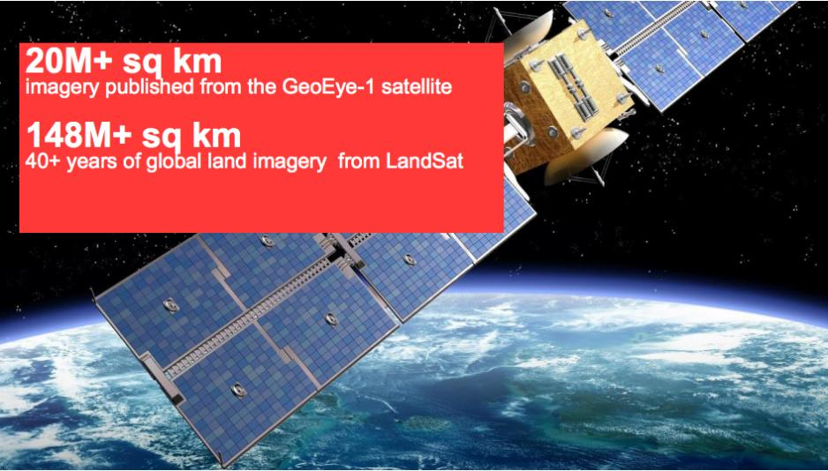
Google Earth Engine: massive image data
source: Louis Perrochon (Google)

Slide 18
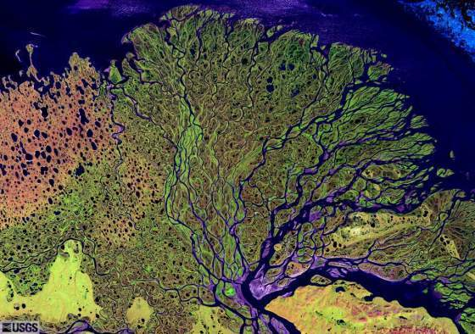
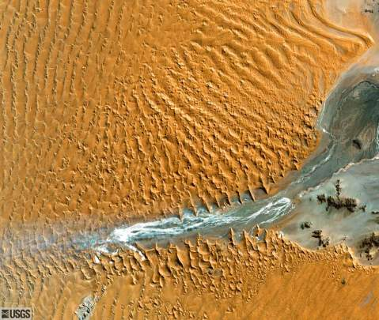
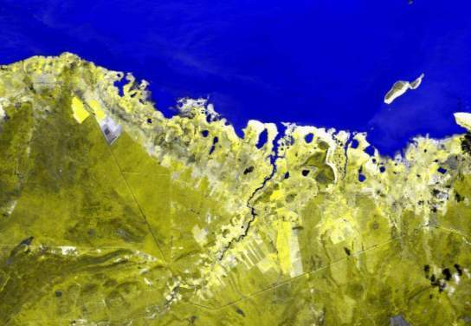
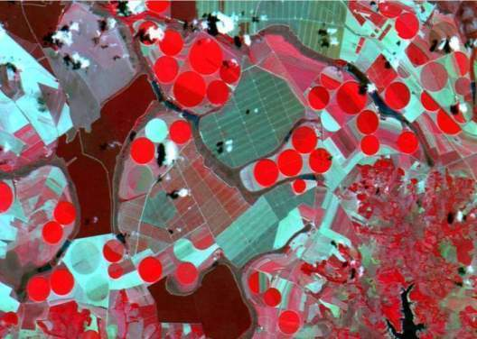
Earth observation satellites and geosensor webs provide key information about global change…
…but that information needs to be modelled and extracted

Slide 19
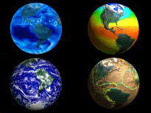
Data-intensive Geoinformatics = principles and applications of spatial information science for handling large and complex data sets

Slide 20
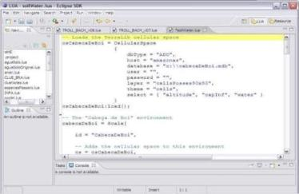
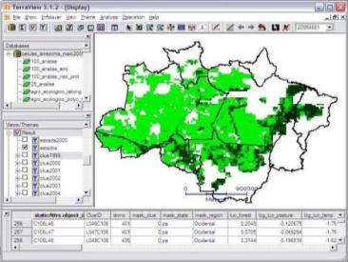
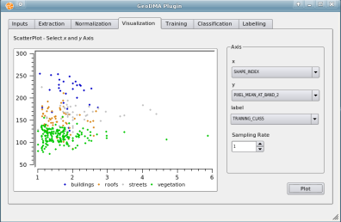
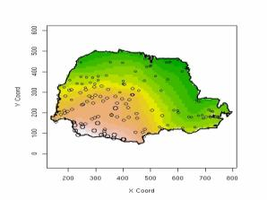
TerraLib: spatio-temporal database as a basis for innovation
G. Câmara et al.“TerraLib: An open-source GIS library for large-scale environmental and socio-economic applications”. In: B. Hall, M. Leahy (eds.), “Open Source Approaches to Spatial Data Handling”. Berlin, Springer, 2008.
Visualization (TerraView)
Modelling (TerraME)
Spatio-temporal
Database (TerraLib)
Statistics (aRT)
Data Mining(GeoDMA)

Slide 21
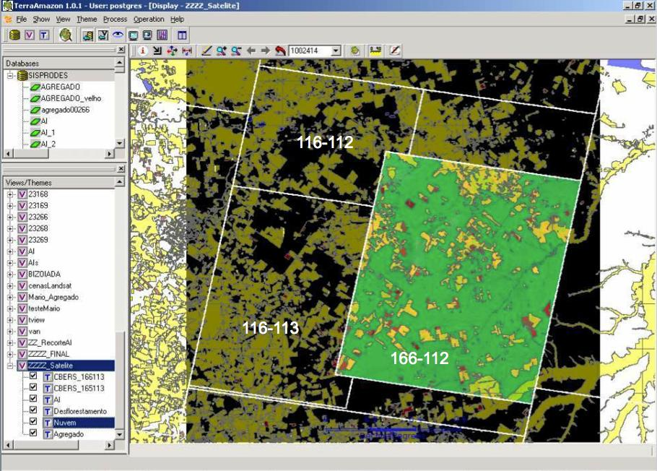
TerraAmazon data is freely available on the web
Data transparency helps society to put pressure on government
116-112
Deforestation in Brazilian Amazonia was reduced
from 27,000 km² in 2004 to 4,900 km² in 2012
116-113
166-112
Ribeiro V., Freitas U., Queiroz G., Petinatti M., Abreu E. , “The Amazon Deforestation Monitoring System”. OSGeo Journal 3(1), 2008.
Notes:
Cena de maior prioridade utilizou imagens CBRES na s tres principais areas: 166-112, 165-113 2 166-113. Sendo complementada por imagem TM

Slide 22
Nature-Society interaction models with TerraME
Sugarscape model – agents consuming renewable resources in a landscape (ants eating sugar)
Notes:
Simulando padrões de incêndios no Parque Nacional das Emas Rodolfo Almeida, Elbert Macau, Fernando Ramos, Helena França, Tiago Carneiro
GeoInfo 2008
CARNEIRO, T. Nested-CA: a foundation for multiscale modeling of land use and land change. PhD Thesis in Computer Science.Sao Jose dos Campos: INPE.

Slide 23
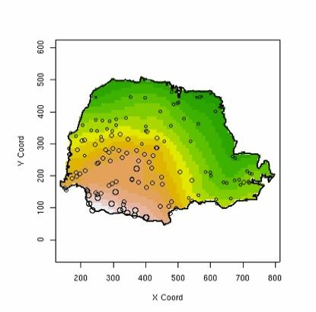
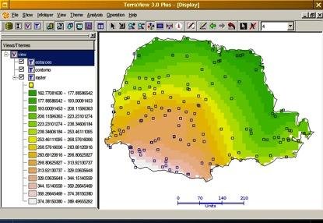
aRT: R-TerraLib programming interface
Accessing TerraLib databases using R-sp package standards
Database
P. Andrade et al., “A Process and Environment for Embedding The R Software into TerraLib.” GeoInfo 2005.
Notes:
ART is another tool developed in the TerraLib ecosystem that integrates TerraLib to R.
It allows the TerraView users to perform spatial analysis through R.
All the comunication between R and terrlib is done by the database.
A user working with a spatial database in TerraView can go to R access the same data and perform some spatial analysis an then come back to TerraView to display the result and further analysis.

Slide 24
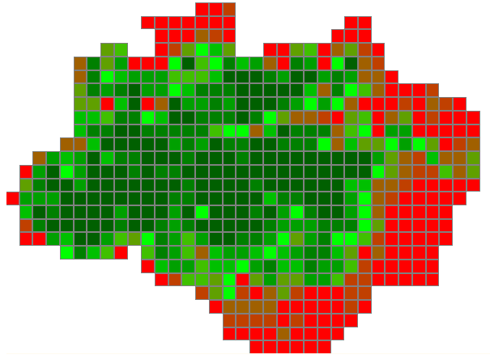
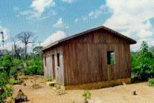
Data Types in most GIS (open or closed source)
date from the 1990s
2014
2010
Object
Geometry
2002
Coverage

Slide 25
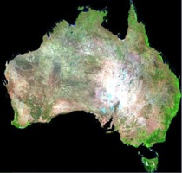
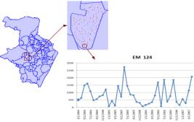
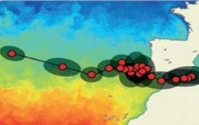
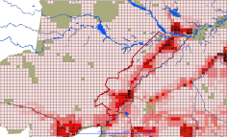
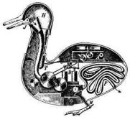
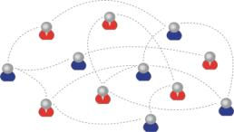
Data types in TerraLib: an example of GIS innovation
Time Series
Trajectory
Field
2014
Cellular Space
Social Network
Agent
2010
Object
Geometry
2002
Coverage

Slide 26
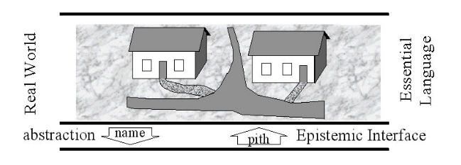
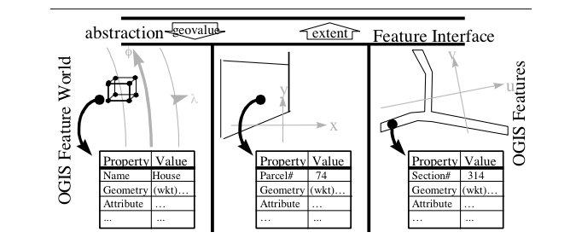
Conceptual models: built from abstractions

Slide 27
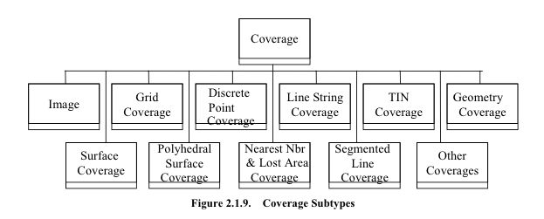
OGC coverage and its subtypes
Focus on concrete spatial representations: lots of complexity and reduced generality

Slide 28
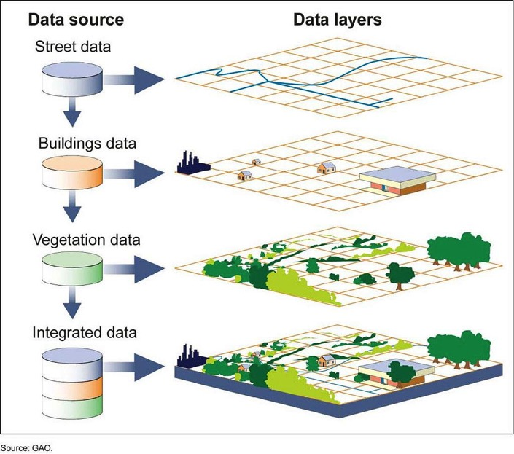
Layer-Based GIS: Few and different data sources Big Data GIS: Lots of similar data sources
Big data does not fit into the “map as set of layers” model
Image sources: GAO, Geoscience Australia

Slide 29
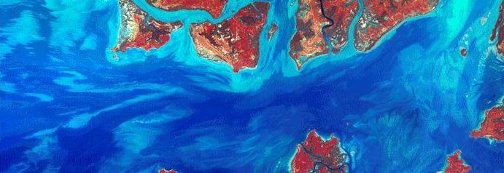
Câmara et al., GIScience 2014
Fields as a Generic Data Type
estimate: Position → Value
Instances of Position: space, time, and space-time
Instances of Value: numbers, strings, space-time

Slide 30
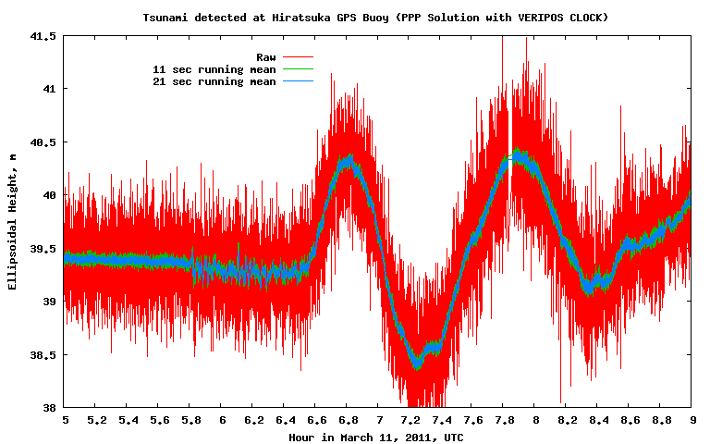
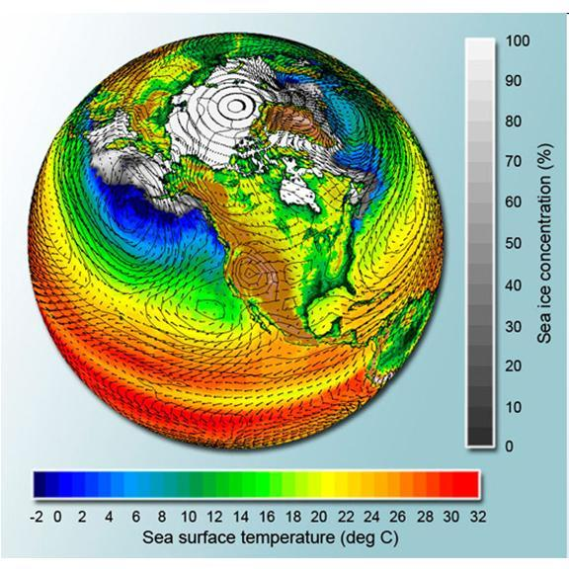
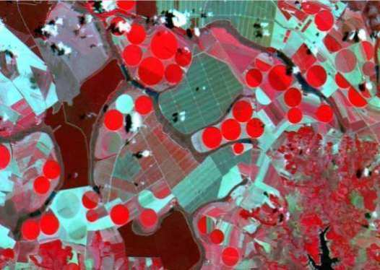
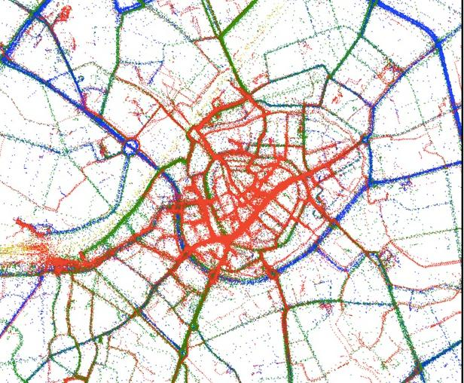
How can we make the Fields model work in practice?
Image sources: INPE, Filip Biljecki, UNAVCO

Slide 31
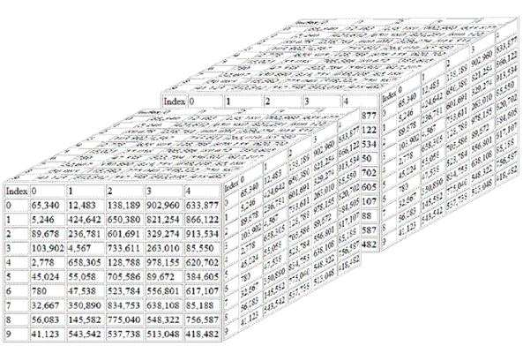
Scientific data: multidimensional arrays
y
t
X
g = f(<x,y,t> [a₁, ….a_{n}])

Slide 32
Array databases: all data from a sensor put together into a single array
y
t
X
Field operations on positions in space-time

Slide 33
SciDB architecture: “Shared nothing”
image: Paul Brown (Paradigm 4)
Large data is broken into chunks
Distributed server process data in parallel

Slide 34
SciDB performance for large images

Slide 35
Global Land Observatory: describing change in a connected world
Powerful data analysis methods
SciDB: array database for big scientific data
Free satellite
images
Software goes where the data is!

Slide 36
Global Land Observatory: describing change in a connected world
Methods for land change for forestry and agriculture uses
40 years of LANDSAT + 12 years of MODIS + SENTINELs + CBERS
Free satellite
images
Unique repository of knowledge and data about global land change

