Slide 1
Open Source and open data: what changes in academia?
Gilberto Câmara
Brazil Chair, University of Münster

Slide 2

GeoMundus 2013
Geospatial technology and open source movement
The potential of open source GIS is enormous, but so too are the risks.
What is the potential? What are the risks?

Slide 3
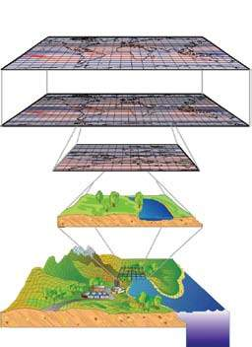
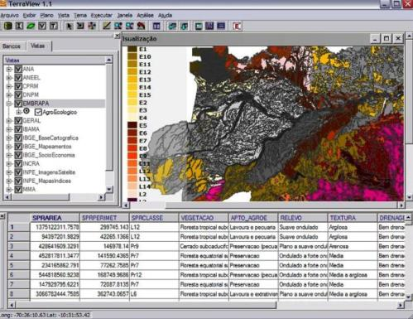
Why do we want free GIS?
Alternative to proprietary systems
Support for innovation

Slide 4




What do you remember of open source?

Slide 5
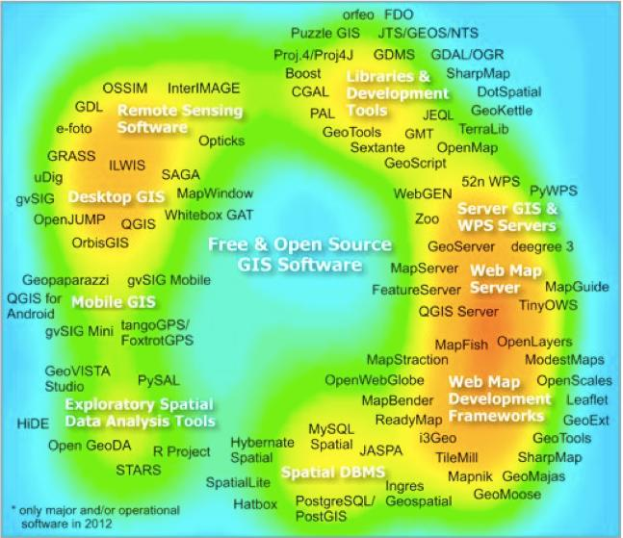
What do you think of open source GIS?

Slide 6
What do you think of open source GIS?
How much duplication exists?
How much innovation is there?

Slide 7
What has Open GIS given us?
Interfaces based on the
OpenGIS Specification
WMS, WCS, WFS
OGC SQL extension
File Format
File Format
File Format
NETWORKS AND CLIENT/SERVER TECHNOLOGY
File Format
File Format
File Format
File Format
File Format
File Format
File Format
Traditional
DBMS
Non-traditional
DBMS
Real-Time
Data Feed
File
Format
OGC archival formats
Notes:
35

Slide 8
What has Open GIS not given us?
Spatial analysis
Geosatistics
Simulation
Mobile applications
Remote sensing image processing
Spatial data mining
File Format
File Format
File Format
NETWORKS AND CLIENT/SERVER TECHNOLOGY
File Format
File Format
File Format
File Format
File Format
File Format
File Format
Traditional
DBMS
Non-traditional
DBMS
Real-Time
Data Feed
File
Format
What you don’t see in OGC you don’t get in FOSS4G
Notes:
35

Slide 9

What are the perils of Open GIS?
OGC is a trap for open source GIS developers!
image source: Raffles Museum, Singapore
Notes:
35

Slide 10
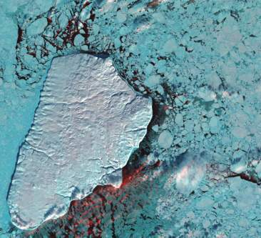
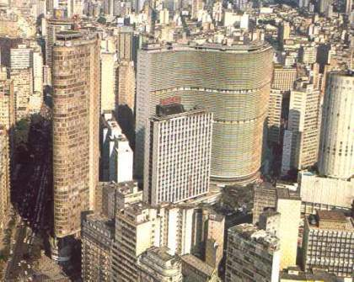
Open GIS can do much more: support decision-making in a changing world
Nature: Physical equations
Describe processes
Society: Decisions on how to
Use Earth´s resources

Slide 11
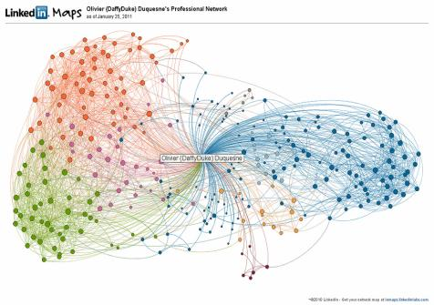
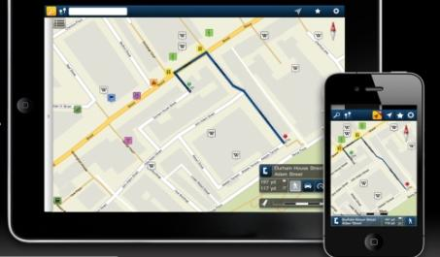
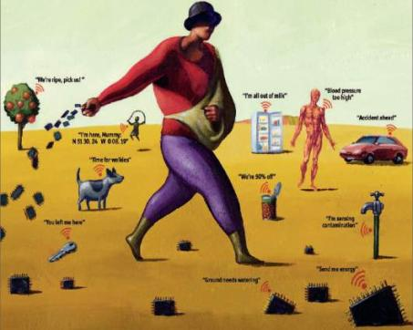
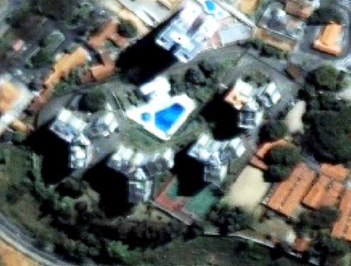
mobile devices
social network
Big data, mobile devices, crowdsourcing, massive Earth observation sets: new technologies bringing new problems
sensors everywhere
ubiquitous imagery

Slide 12
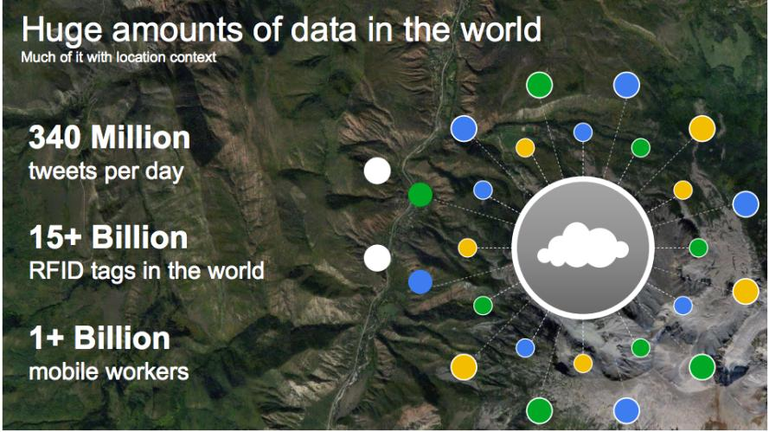
The motivation for “big data”
source: Louis Perrochon (Google)

Slide 13
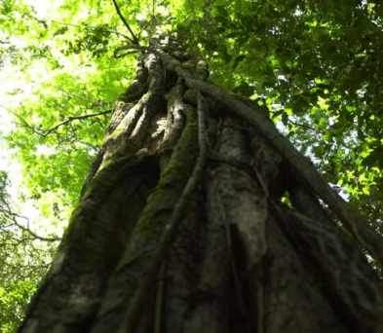

“The international community (should) explore ways to reduce global-warming emissions from deforestation. (…) This information can now be extracted fairly accurately from satellite images. (…) A few satellites can cover the entire globe, but there needs to be a system in place to ensure their images are readily available to everyone who needs them. Brazil has set an important precedent by making its Earth-observation data available, and the rest of the world should follow suit.”

Slide 14
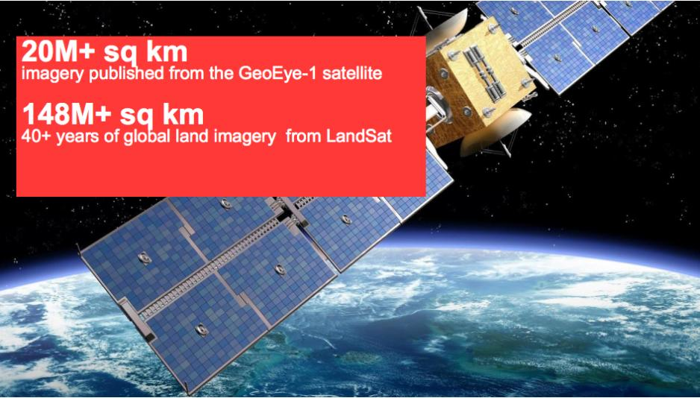
Google Earth Engine: massive image data
source: Louis Perrochon (Google)

Slide 15

A working definition of big data
≈
n << all Statistics: we have a small part of the data
n == all Big brother: we have all the data (do we?)
n ≈≈ all Big data: we have data close to problem size

Slide 16
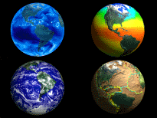
Data-intensive Geoinformatics = principles and applications of spatial information science for handling large and complex data sets

Slide 17
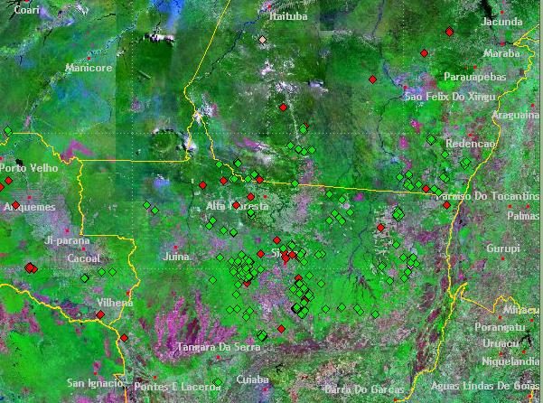
Representing location is easy
What do we know?
Deforestation hotspots in Amazonia

Slide 18
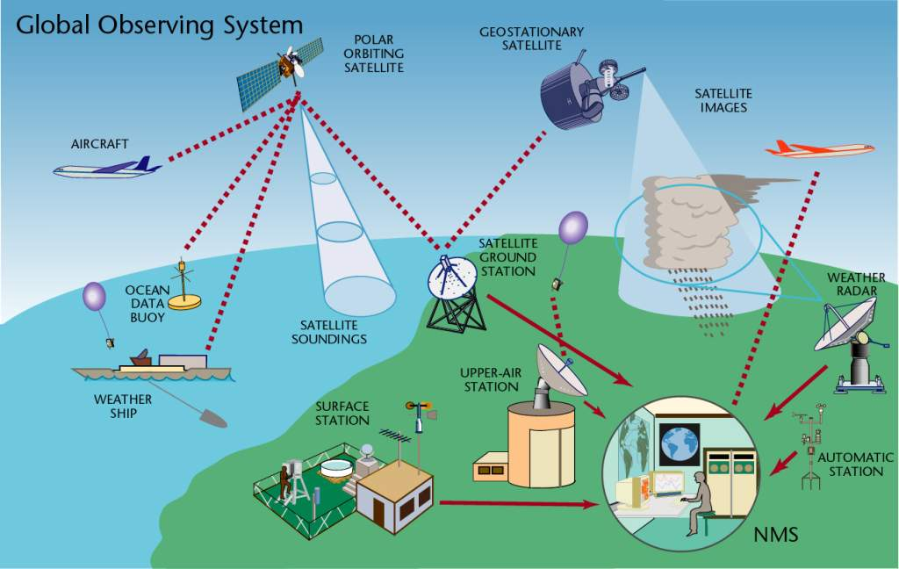
What do we know?
source: WMO
Communicating data is feasible
11,000 land stations (3000 automated)
900 radiosondes, 3000 aircraft
6000 ships, 1300 buoys
5 polar, 6 geostationary satellites

Slide 19
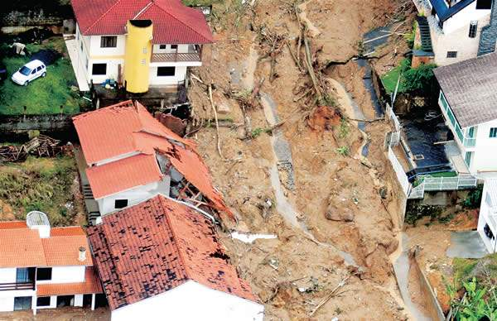
Representing and modelling change
Semantics of complex geospatial data
events and processes

Slide 20
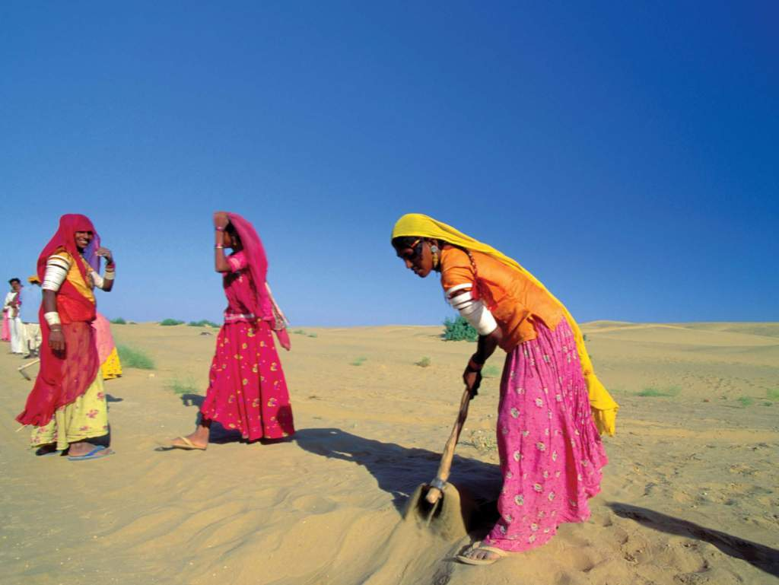
Representing condition
Semantics of complex geospatial data
vulnerability? climate change? poverty?
Image source: WMO

Slide 21
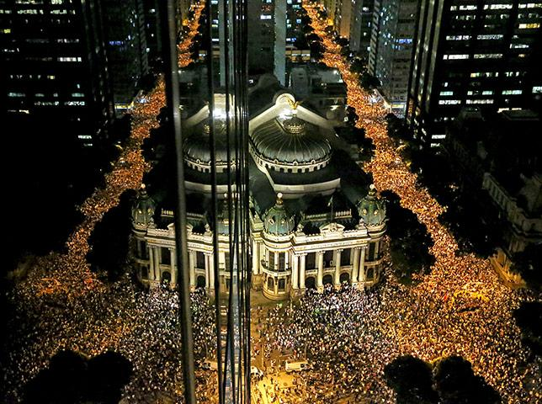
Semantics of complex geospatial data
Representing and modelling behaviour
How do social networks operate?

Slide 22
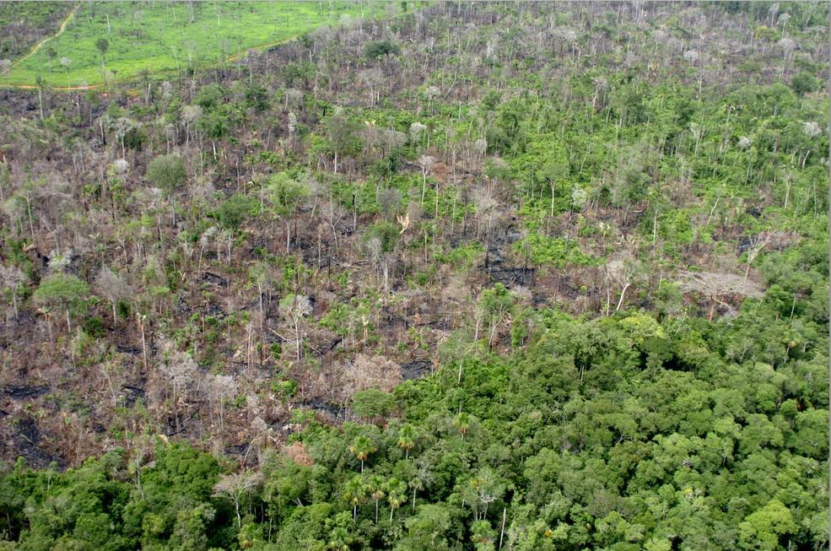
We’re bad at representing meaning
What do we know we don’t know?
Representing concepts is hard
degradation
deforestation? degradation? disturbance?

Slide 23
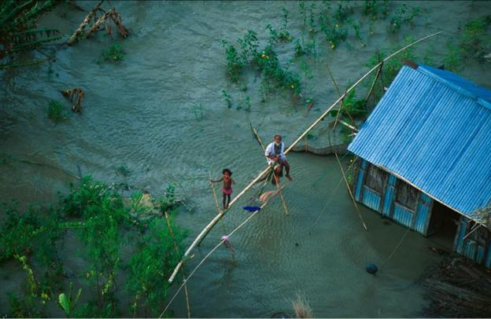
Representing concepts is hard
vulnerability
degradation

Slide 24
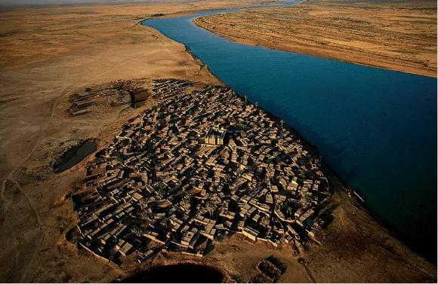
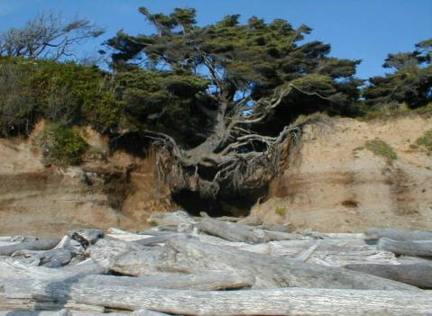
Representing concepts is hard
sustainability
resilience
and much more…
Human-environmental models need to describe complex concepts (and store their attributes in a database)

Slide 25
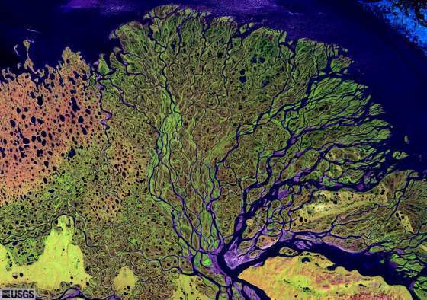
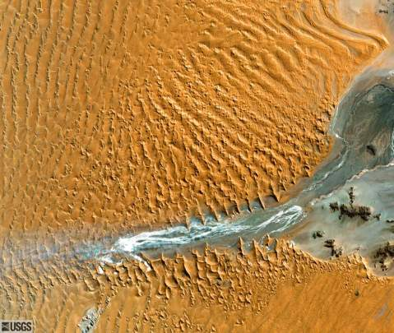
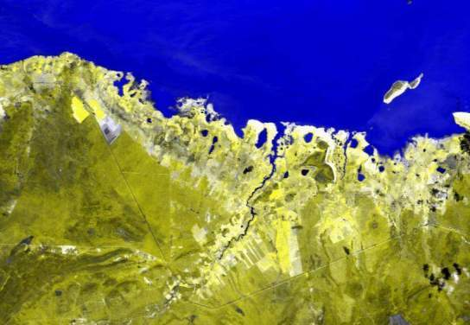
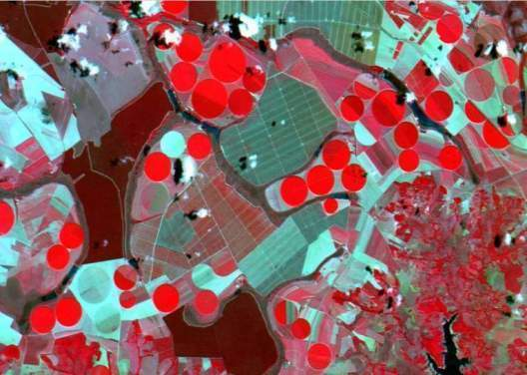
Earth observation satellites and geosensor webs provide key information about global change…
…but that information needs to be modelled and extracted

Slide 26
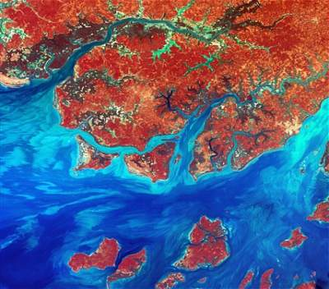
Data Access Hitting a Wall
Current science practice based on data download
How do you download a petabyte?

Slide 27
Data Access Hitting a Wall
Current science practice based on data download
How do you download a petabyte?
You don’t! Move the software to the archive

Slide 28
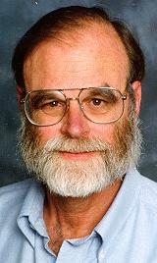
Scientific Data Management in the Coming Decade (Jim Gray, 2005)
Next-generation science instruments and simulations will produce peta-scale datasets. Such peta-scale datasets will be housed by science centers that provide substantial storage and processing for scientists who access the data via smart notebooks. The procedural stream-of-bytes-file-centric approach to data analysis is both too cumbersome and too serial for such large datasets. Database systems will be judged by their support of common metadata standards and by their ability to manage and access peta-scale datasets.

Slide 29
Current geospatial information systems
User interface
Database creation
Database access
Analysis
Local
database

Slide 30
Future geospatial information systems
Visualisation
Interface
Data discovery
Data access
Analysis Modelling
Data
source
Data
source
Data
source

Slide 31

The rôle and duties of a software engineer
“The essence of a software entity is a construct of interlocking concepts: data sets, relationships among data items, algorithms, and invocations of functions. The hard part of building software is the specification, design, and testing of this conceptual construct, not the labor of representing it and testing the fidelity of the representation. Building software will always be hard.”
Fred Brooks, “No Silver Bullet: Essence and Accidents of Software Engineering”. IEEE Computer, 1987

Slide 32
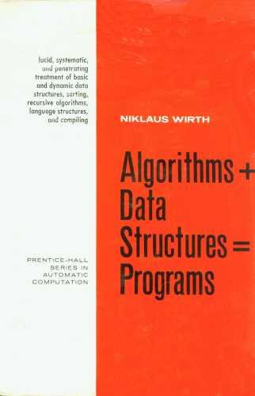
Challenges for GI software architects
Concepts +
Types +
Algorithms +
Data Structures +
Data Sources +
Custom programs =
Systems for solving
real-life problems
Classical view of software development
GI Engineering needs

Slide 33



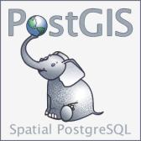




How to build systems that support GIS-21 needs with FOSS4G?
FOSS4G today: different concepts, different architects need higher-level abstractions

Slide 34

How to build systems that support GIS-21 needs with FOSS4G?
What are the (arguably) the FOSS4GIS tools that have the most innovative content?
What are the (arguably) the FOSS4GIS tools that provide the best building blocks for complex applications?

Slide 35


The TerraLib vision: FOSS4G for innovation
“Many developments (in industry and FOSS4G) have ignored scientific advances in GIScience. Thus, the geographical information community would benefit from the availability of a general, open source GIS library. This resource would make a positive impact by allowing researchers and solution developers access to wider range of tools than what is currently offered.”
Câmara, G. el al., “TerraLib: Technology in Support of GIS Innovation”. GeoInfo 2000

Slide 36
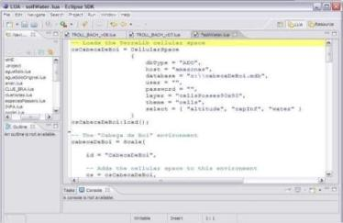
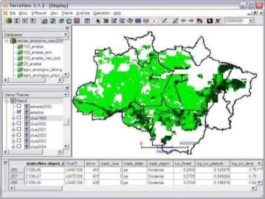
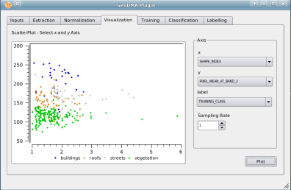
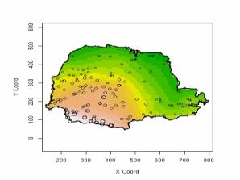
TerraLib: spatio-temporal database as a basis for innovation
G. Câmara et al.“TerraLib: An open-source GIS library for large-scale environmental and socio-economic applications”. In: B. Hall, M. Leahy (eds.), “Open Source Approaches to Spatial Data Handling”. Berlin, Springer, 2008.
Visualization (TerraView)
Modelling (TerraME)
Spatio-temporal
Database (TerraLib)
Statistics (aRT)
Data Mining(GeoDMA)

Slide 37
TerraLib: high-level GI abstractions on top of FOSS
DengueME
TerraAmazon
TerraMA²
TerraView
....
TerraME
GeoDMA
R - aRT
TerraHS
(TerraLua)
TerraLib
LOD
Lua
GDAL
Boost
Twitter
PostGIS,
SciDB
...
TerraLib is a common interface to FOSS and data sources
Application development becomes easier

Slide 38
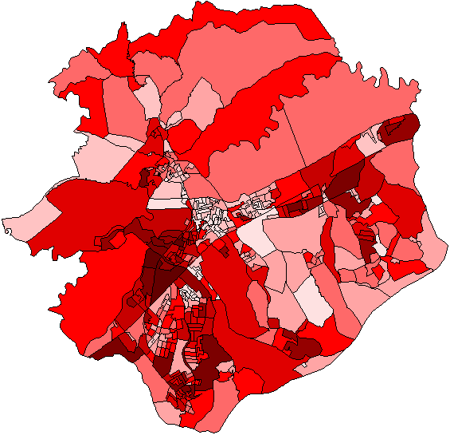
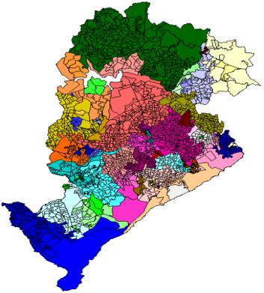
Innovative spatial analysis: available in TerraView using plugins
Spatial segregation indexes
Regionalization
F. Feitosa et al., “Global and local spatial indices of urban segregation”. IJGIS, 2007 (MsC).
R. Assunção et al. “Efficient regionalisation techniques for socio-economic geographical units using minimum spanning trees”. IJGIS, 2006 (PhD).
Notes:
These are two works on innovative spatial analysis, onde done by Feitosa wich developed a new spatial…
And the other
Done by assuncao e colab that developed regionalizatio techniques
Both works were developed using terralib and now they are available as plugins…

Slide 39
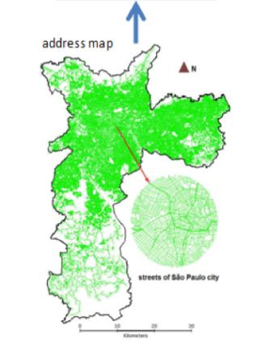
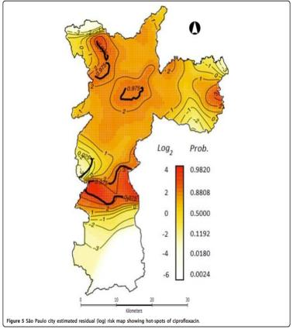
Applications in Health and Public Policies
Streets of Sao Paulo
Clusters of resistance to antibiotics
Spatial analysis
Address geocoding of resistance to antibiotics
Database of
antibiotic users
Kiffer, E., Camargo, E. et al., “A spatial approach for the epidemiology of antibiotic use and resistance in community-based studies: the emergence of urban clusters of Escherichia coli quinolone resistance in Sao Paulo”. IJ Health Geographics, 10, 2011.
Notes:
Another work using TerraView is the work from Carlos Kiffer which study the resistence of antobiotic in the population.
They used TerraView to spatialize their data according to Brazilian address model, then they performed some spatial analysis for creating a map with cluster of resistence to antibiotics….
O mais escuro é o mais resistente

Slide 40
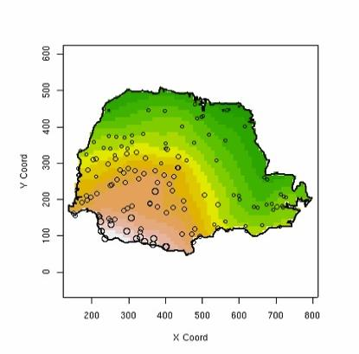
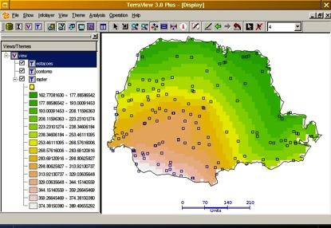



aRT: R-TerraLib programming interface
Accessing TerraLib databases using R-sp package standards
Database
P. Andrade et al., “A Process and Environment for Embedding The R Software into TerraLib.” GeoInfo 2005.
Notes:
ART is another tool developed in the TerraLib ecosystem that integrates TerraLib to R.
It allows the TerraView users to perform spatial analysis through R.
All the comunication between R and terrlib is done by the database.
A user working with a spatial database in TerraView can go to R access the same data and perform some spatial analysis an then come back to TerraView to display the result and further analysis.

Slide 41
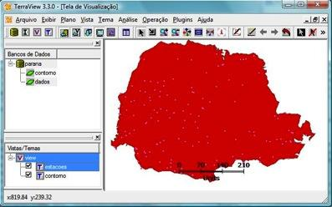
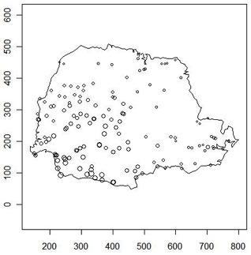
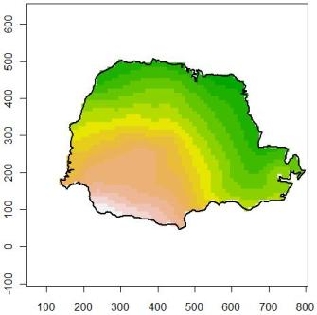
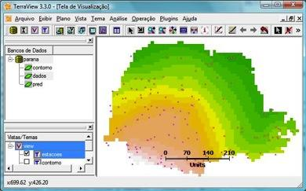
db = openDb(dbms="mysql", dbname = “parana”)
my_points = getPoints(db, “pointdata")
my_limits = getPolygons(db, “limits")
raster = kriging(my_points, my_limits)
createLayer(db, "lraster”, raster)
Notes:
These is an example that shows how a TerraView user can write an R script to perform a kriging.
In the first picture we have to datasets inside TerraView, one with point data and another one with the Parana State boundary.
So in R you can connect to the same database, access both layers and then call an R function that do kriging
All you need at the end is to save the data in database and then comeback to terraview to see the result and do something else.

Slide 42
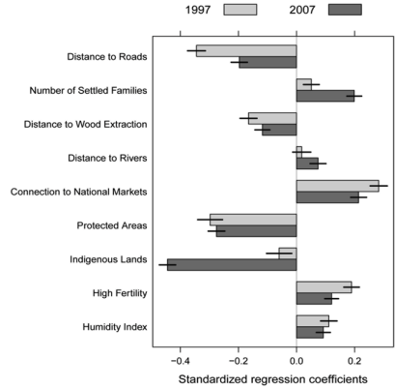
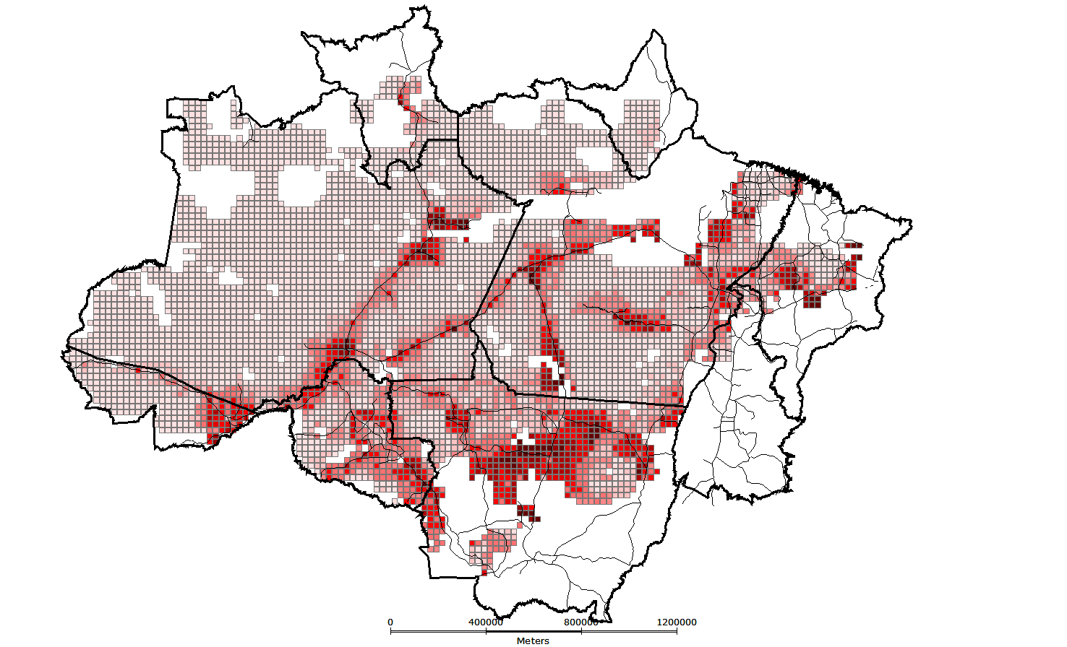
What are the drivers of deforestation in Amazonia?
aRT + deforestation maps + census data + R methods
A. Aguiar et al., “Spatial statistical analysis of land-use determinants in the Brazilian Amazon”. Ecological Modelling, 2007 (PhD).
G. Espíndola et al., “Agricultural land use dynamics in the Brazilian Amazon based on remote sensing and census data”, Applied Geography, 2012 (PhD).
Notes:
This tool was used in some works, we have here two examples onde from Aguiar and another from Giovana that used ART with deforestation dataset and census data to study the drivers of deforestation in Amazonia and they perform several ST to invesitigate the impact of different factors such as: ….
O impacto dessas variáveis no desmatamento!

Slide 43

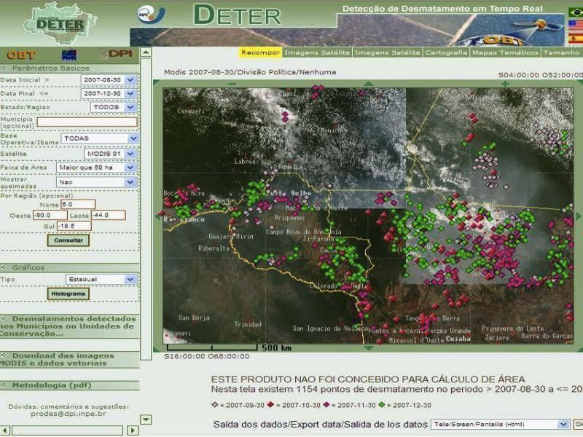
TerraAmazon: infrastructure for management of deforestation data
Fifteen years of remote sensing images,
deforestation polygons and forest fire occurrences
in a single information system

Slide 44
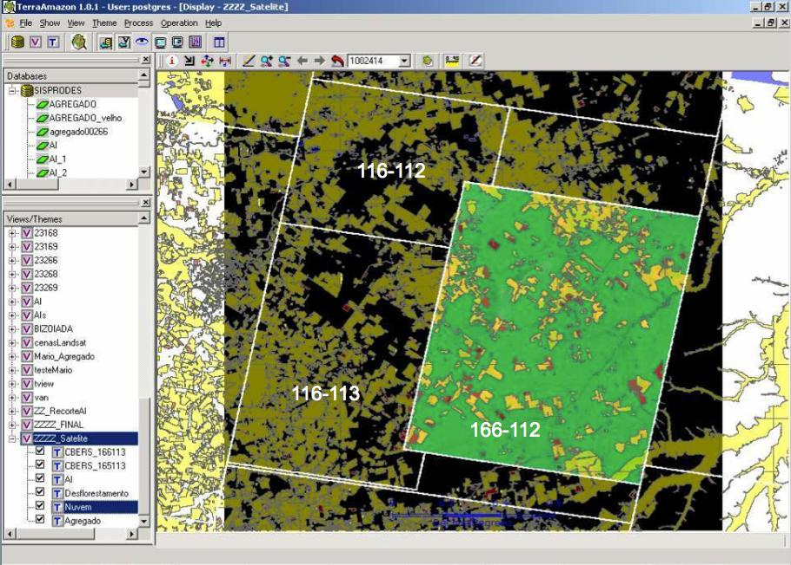
TerraAmazon data is freely available on the web
Data transparency helps society to put pressure on government
116-112
Deforestation in Brazilian Amazonia was reduced
from 27,000 km² in 2004 to 4,900 km² in 2012
116-113
166-112
Ribeiro V., Freitas U., Queiroz G., Petinatti M., Abreu E. , “The Amazon Deforestation Monitoring System”. OSGeo Journal 3(1), 2008.
Notes:
Cena de maior prioridade utilizou imagens CBRES na s tres principais areas: 166-112, 165-113 2 166-113. Sendo complementada por imagem TM

Slide 45
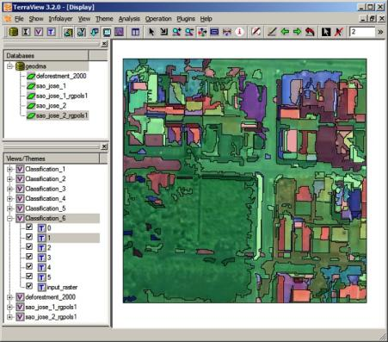
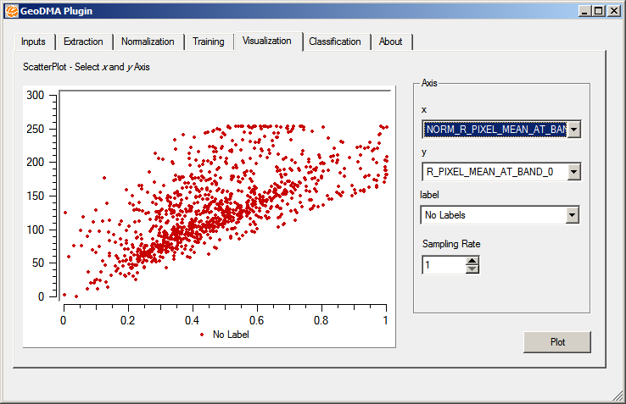
GeoDMA: Data mining using geospatial data
Classification and clustering of objects
extracted from remote sensing images
M. Silva et al., “Remote sensing image mining: detecting agents of land use change in tropical forest areas”. Int Journal Remote Sensing, 29 (16): 4803 – 4822, 2008.
T. Korting et al., “GeoDMA—Geographic Data Mining Analyst”. Computers & Geosciences, 57:133–145,2013.
Notes:
É uma ferramenta que usa técnicas de data mining para classificar e identificar padrões em imagens de sr.
Est;a dispon;ivel na forma de plugi do terraview
É fruto de uma tese de doutorado, o aluno agora faz parte do time de desenvolvimento da TL.

Slide 46




TerraME: nature-society modelling
Space Agent
Agent Space
Nature represented in cellular spaces, society represented as agents
T. Carneiro, P. Andrade, et al., “An extensible toolbox for modeling nature-society interactions”. Enviromental Modelling and Software, 2013 (Two PhDs).
Notes:
TerraME is…
It is capable of accessing data in a spatial database through terralib
It has

Slide 47

Nature-Society interaction models with TerraME
Sugarscape model – agents consuming renewable resources in a landscape (ants eating sugar)
Notes:
Simulando padrões de incêndios no Parque Nacional das Emas
Rodolfo Almeida, Elbert Macau, Fernando Ramos, Helena França, Tiago Carneiro
GeoInfo 2008
CARNEIRO, T. Nested-CA: a foundation for multiscale modeling of land use and land change. PhD Thesis in Computer Science.Sao Jose dos Campos: INPE.

Slide 48




DengueME: spatial model of dengue
Humans
60 days
110 days
260 days
Notes:
Where we study the dengue epidemics in Brazil

Slide 49





TerraMA²: Natural Disasters Monitoring, Analysis and Alert
Geology, soils,
slopes, houses
Likely risk areas
Users
Weather
River flows
(real-time)
Data
integration
Alerts
Roads
traffic
(real-time)

Slide 50

TerraMA²: Natural Disasters Monitoring and Alert
System operational in real-life situations
Notes:
50

Slide 51
Terralib 5: the next generation
Modelling
Data discovery
Data access
Analysis
Data
source
Data
source
Data
source
Data
source
Distributed data sources, unified data access

Slide 52







Different data sources, same interface
Linked open data
Abstract description of geospatial data, flexible data containers
Notes:
This core is also responsible for all the data access
We have the concept of data source and data access drivers and this is the low level o TerraLib.
The next release will be able to interpret queries over two or more data sources

Slide 53


Data Types in most GIS (open or closed source)
date from the 1990s
2014
2010
Object
Geometry
2002
Coverage

Slide 54






Data types in TerraLib: an example of GIS innovation
Time Series
Trajectory
Event
2014
Cellular Space
Social Network
Agent
2010
Object
Geometry
2002
Coverage

Slide 55


How to make a difference in open source GIS?
Follow your own agenda
Look to the future
Or would you rather be one more in the crowd?

