Slide 1
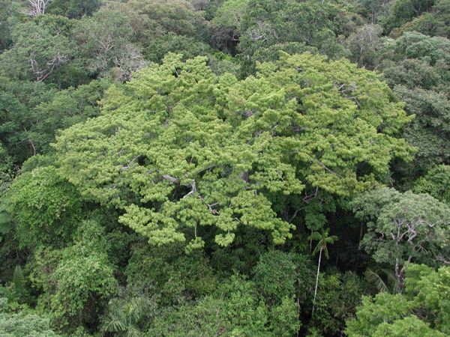

Using dynamic geospatial ontologies to support information extraction from big Earth observation data sets
Gilberto Câmara, Adeline Maciel, Victor Maus,
Lubia Vinhas, Alber Sanchez
www.esensing.org
Creative Commons License: By Attribution ̶̶̶̶ Non Commercial ̶̶̶̶ Share Alike

Slide 2
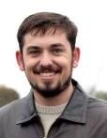
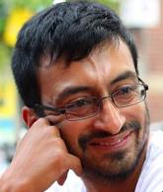
With many thanks to my co-authors…
Adeline
Lúbia
Victor
Alber

Slide 3
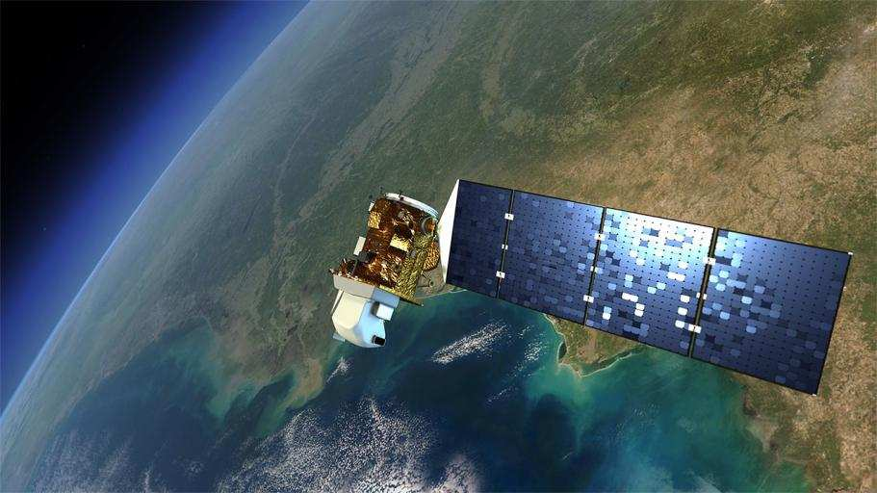
Earth Observation data is now free…and big
graphics: NASA
Sentinels + CBERS + LANDSAT + …: > 10Tb/day

Slide 4



Where we want to get to
Remote visualization and
method development
Big data EO management and analysis
40 years of Earth Observation data of land change accessible for analysis and modelling.

Slide 5
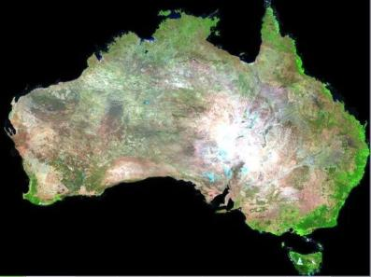


What changes with big geospatial data?
graphics: Geoscience Australia
Searching for changes instead of searching for objects

Slide 6
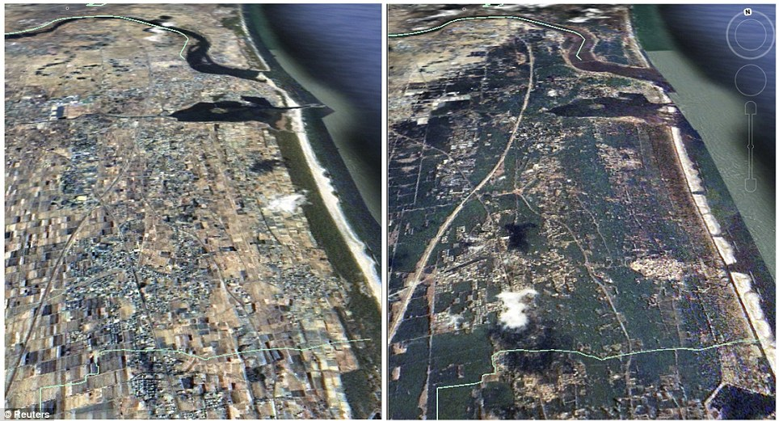
How can we describe change?
The 2011 Tohoku tsunami changed the coast of Japan

Slide 7
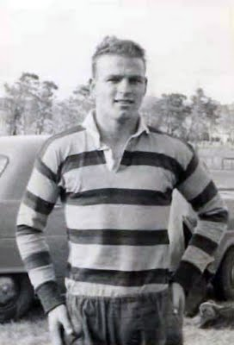
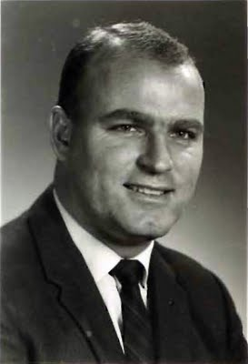
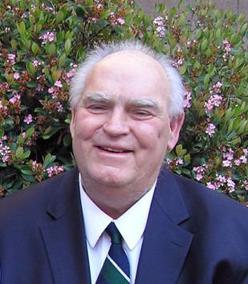
Temporal perception as event-ordering
The brain represents time by means of time: events are recorded as relevant personal experiences

Slide 8
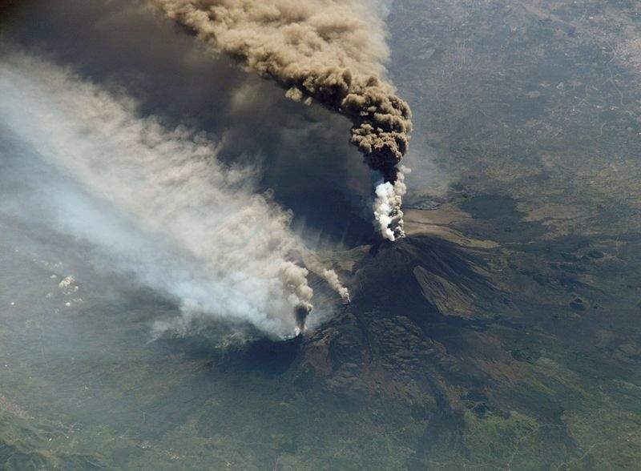
objects exist, events occur
Mount Etna is an object
Etna’s 2002 eruption was an event

Slide 9
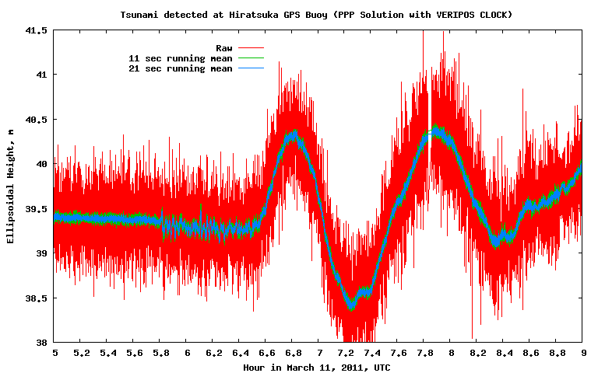
What is an event?
An event is an individual episode with a beginning and end, which define its character as a whole (Galton).
An event does not exist by itself. Its occurrence is defined as a particular condition of an object.
Notes:
INPE has a project called PROARCO responsible for monitoring fire spots in South America, In this application, each fire is presented by its location and the time instant when it was detected.
This picture is an example of the detected fires in a Brazilian state called Pará in august 2003.
The second demand is related to a project responsible for monitoring the Amazon deforestation called PRODES. In this application, each deforested area is represented by a polygon that limits the deforested region and the time when it was detected.

Slide 10
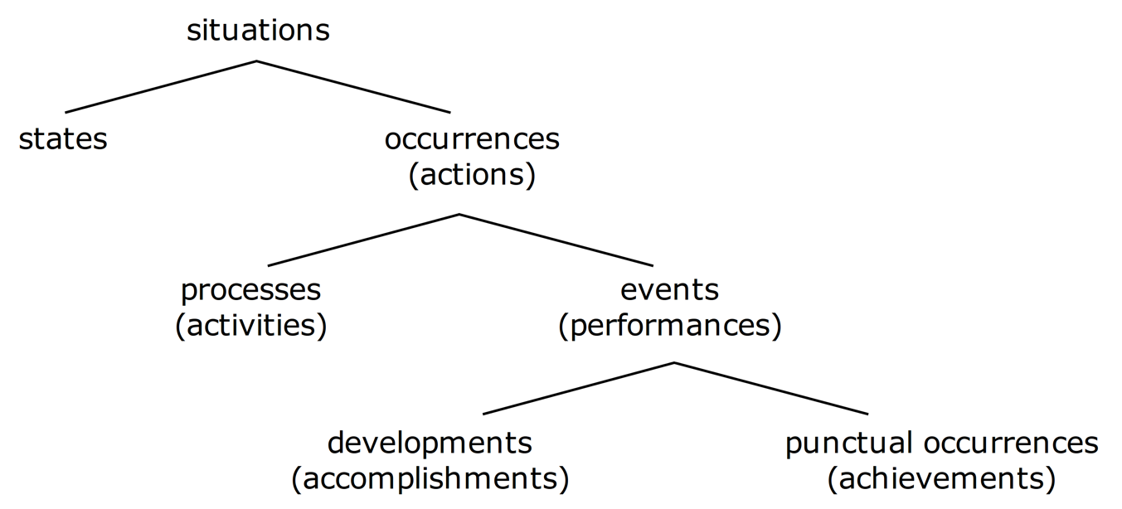
Events, processes and states
Mourelatos and Vendler
”I walked for 15 minutes” (accomplishment)
“I reached the Borges Centre” (achievement)

Slide 11
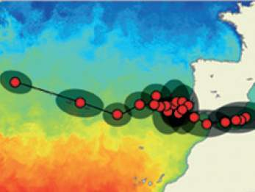
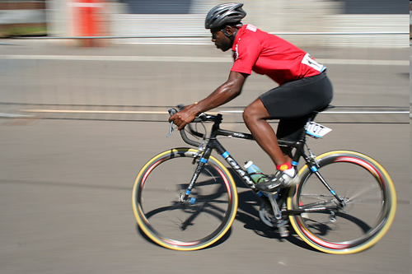
Reasoning with events (achievements)
“The cyclist crossed the finishing line at 1h35”
“The submarine crossed the Gibraltar on March 29th”

Slide 12
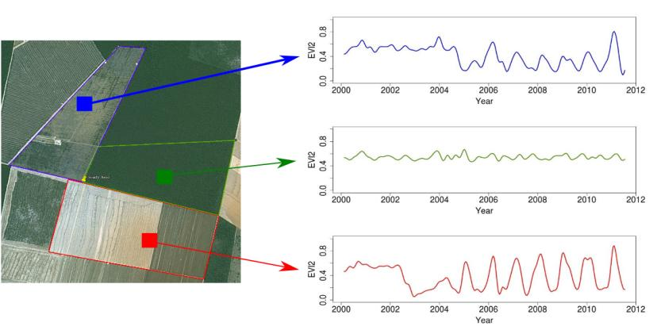
Reasoning with events (accomplishments)
Forest
Pasture
Agric
Área 1
Forest
Área 2
Forest
Agriculture
Área 3
”The area was a forest from 2000 to 2003, then it deforested from 2003 to 2005, and used for agriculture from 2005 to 2016”

Slide 13
Interval temporal logic (Allen)

Slide 14
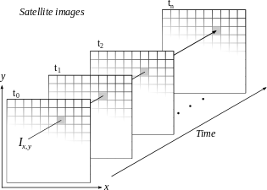
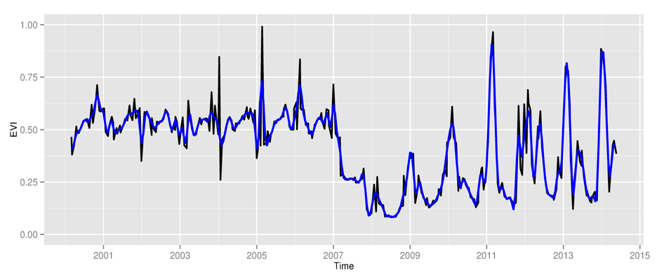
Space first, time later or time first, space later?
Space first: classify
images separately
Compare results in time
Time first: classify
time series separately
Join results to get maps

Slide 15
How to match land use patterns in a remote sensing time series?
A good match needs shape similarity and temporal coherence

Slide 16
Land use change trajectories in the Amazonian biome of Mato Grosso state (2001-2014)
33 million time series

Slide 17
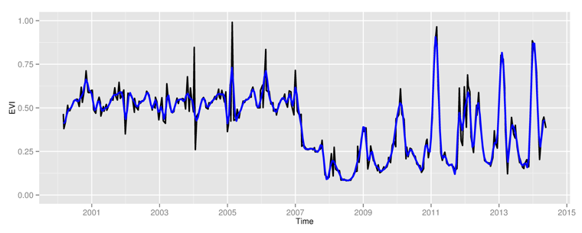
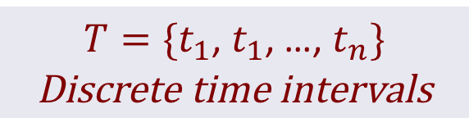
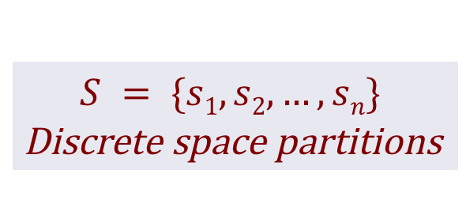
Spacetime event logic (discrete partitions)
$$S = \{s1, s2,…, sn\}$$
Discrete space partitions
$T=\{t_{1}$, $t_{1}$, …, $t_{n}\}$
Discrete time intervals
P = {p₁, p₂,…, p_{n}}
Discrete properties
Allen’s interval logic

Slide 18

Spacetime event logic (discrete partitions)
$$S = \{s1, s2,…, sn\}$$
Discrete space partitions
$T=\{t_{1}$, $t_{1}$, …, $t_{n}\}$
Discrete time intervals
  $$holds \left(s, p,t\right)→Bool$$
  occurs $\left(s, p,t\right)→Bool$
P = {p₁, p₂,…, p_{n}}
Discrete properties
Allen’s interval logic

Slide 19
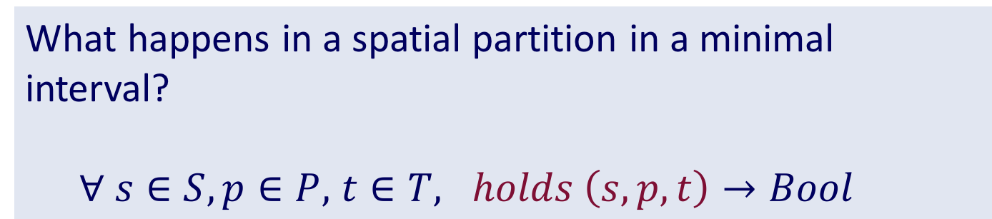
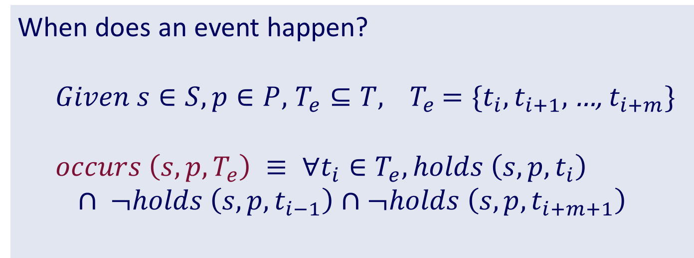
Spacetime event logic
What happens in a spatial partition in a minimal interval?
  $∀ s∈S,p∈P,$ $t∈T, holds \left(s, p,t\right)→Bool$
When does an event happen?
  $Given s∈S, p∈P,$ $T_{e}⊆T, { T}_{e}$ $=\{t_{i},t_{i+1},$…, $t_{i+m}\}$
  $$occurs \left(s, p,T_{e}\right) ≡ ∀t_{i}∈T_{e}, holds \left(s, p,t_{i}\right)$$
$$∩ ¬holds \left(s, p,t_{i−1}\right)∩¬holds \left(s, p,t_{i+m+1}\right)$$

Slide 20
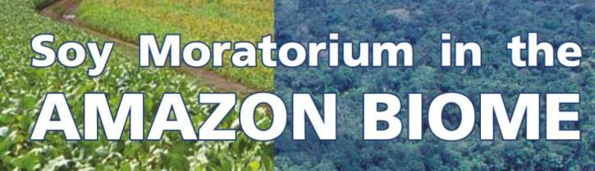
Markets chain arrangements: are they working?
Forest
Defor
Soy
NO
Forest
Defor
Pasture
Soy

Slide 21
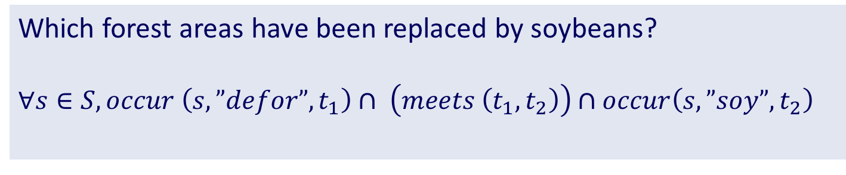
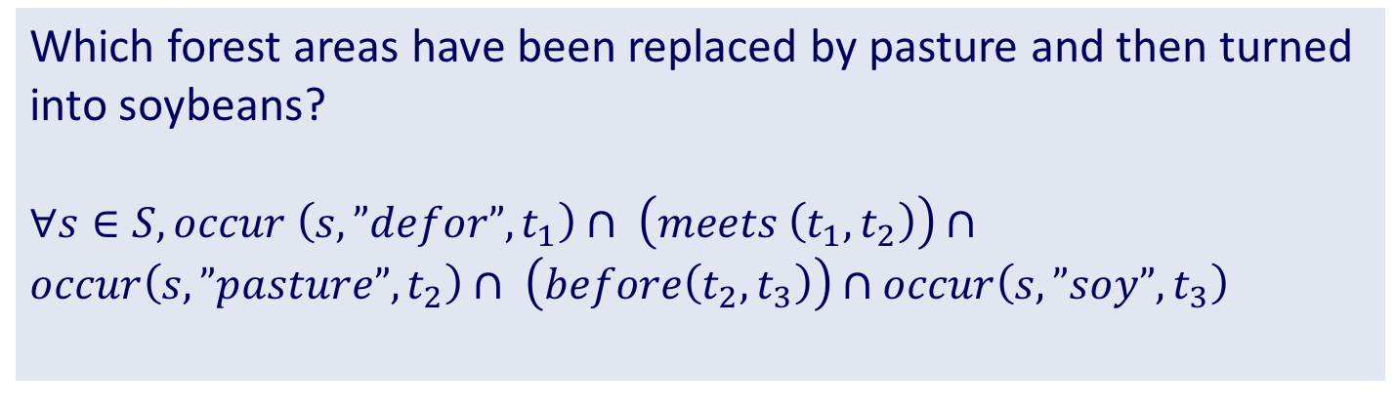
Deduction using spacetime temporal logic
Which forest areas have been replaced by soybeans?
$$∀s∈S, occur \left(s, ”defor”, t_{1}\right)∩ \left(meets \left(t_{1},t_{2}\right)\right)∩occur\left(s, ”soy”, t_{2}\right)$$
Which forest areas have been replaced by pasture and then turned into soybeans?
$∀s∈S, occur \left(s, ”defor”, t_{1}\right)∩ \left(meets \left(t_{1},t_{2}\right)\right)∩occur\left(s, ”pasture”, t_{2}\right)$ $∩ \left(before\left(t_{2},t_{3}\right)\right)∩occur\left(s, ”soy”, t_{3}\right)$

Slide 22
Using events to understand land transitions

Slide 23
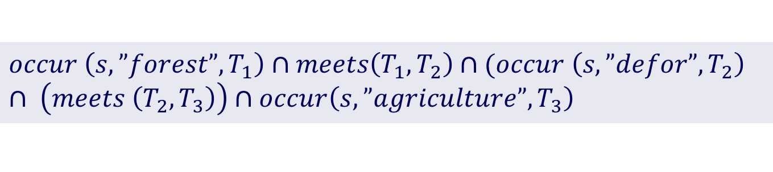
Land trajectories as event composition
Forest
Pasture
Agric
Área 1
Forest
Área 2
Forest
Agriculture
Área 3
Trajectory from forest to agriculture
$$occur \left(s,”forest”,T_{1}\right)∩meets\left(T_{1},T_{2}\right)∩(occur \left(s, ”defor”, T_{2}\right) ∩ \left(meets \left(T_{2},T_{3}\right)\right)∩occur\left(s, ”agriculture”, T_{3}\right)$$

Slide 24
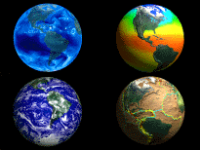
Conclusions
Managing change is a major challenge for the scientific community
Big data creates new challenges
Ontological thinking helps to understand big data
We need a mathematically and cognitively sound model of spatiotemporal events.

