Slide 1
Data-intensive Geoinformatics: using big geospatial data to address global change questions
Gilberto Câmara
GIScience 2012
Workshop on Big Data
Licence: Creative Commons ̶̶̶̶ By Attribution ̶̶̶̶ Non Commercial ̶̶̶̶ Share Alike
http://creativecommons.org/licenses/by-nc-sa/2.5/

Slide 2
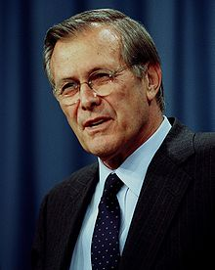
What’s it all about…
There are known knowns…
There are known unknowns…
But there are also unknown unknowns…

Slide 3
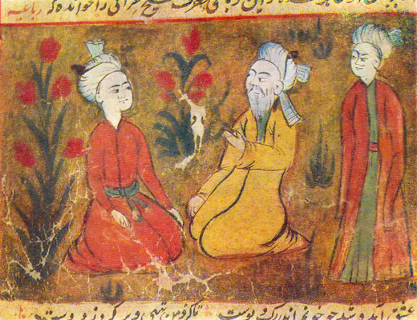
One who knows and knows that he knows... His horse of wisdom will reach the skies.
One who knows, but doesn't know that he knows... He is fast asleep, so you should wake him up!
One who doesn't know, but knows that he doesn't know... His limping mule will eventually get him home.
One who doesn't know and doesn't know that he doesn't know... He will be eternally lost in his hopeless oblivion!
(Ybn Yamin, Persia, 14th Century)

Slide 4

A bit of ancient wisdom
If you know yourself and your enemy, you need not fear the result of the battle…. (Sun Tzu, 5th Century)

Slide 5
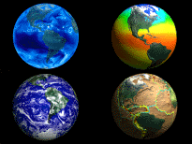
Data-intensive Geoinformatics = principles and applications of spatial information science for handling very large data sets

Slide 6
Conjectures
GIScience concepts are essential to global change researchers (but most of them don’t know it)
Global change challenges will motivate new research in GIScience (but most of us are not looking there)

Slide 7
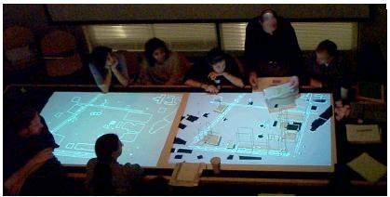
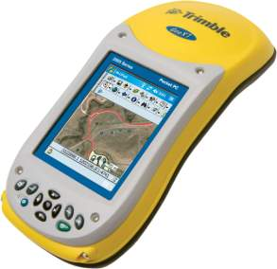
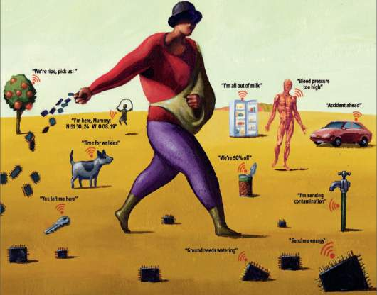
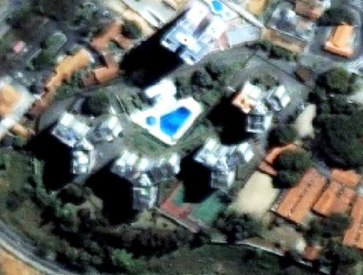
GIS-21
mobile devices
augmented reality
Data-centered, mobile-enabled, contribution-based, field-based modelling, spaces of fluxes
sensor networks
ubiquitous images and maps

Slide 8
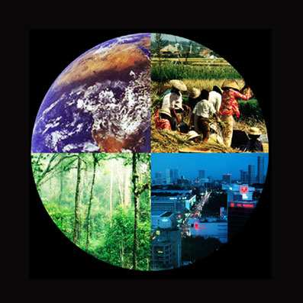
What do Earth Science scientists want to know?
How is the Earth’s environment changing, and what are the consequences for human civilization?
source: Guy Brasseur

Slide 9
What do the Earth Science scientists know?
By 2050...
8,5 billion people: 6 billion tons of GHG and 60 million tons of urban pollutants.
Resource-hungry: We will withdraw 30% of available fresh water.
Risky living: 80% urban areas, 25% near earthquake faults, 2% in coast lines less than 1 m above sea level.
source: Guy Brasseur

Slide 10
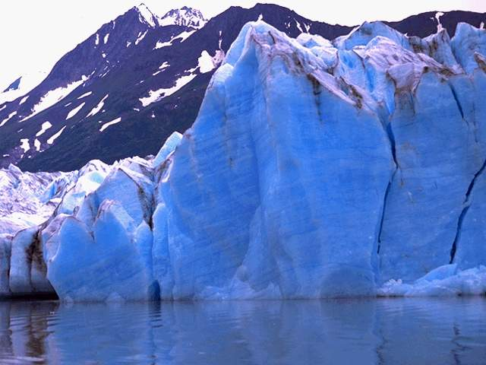
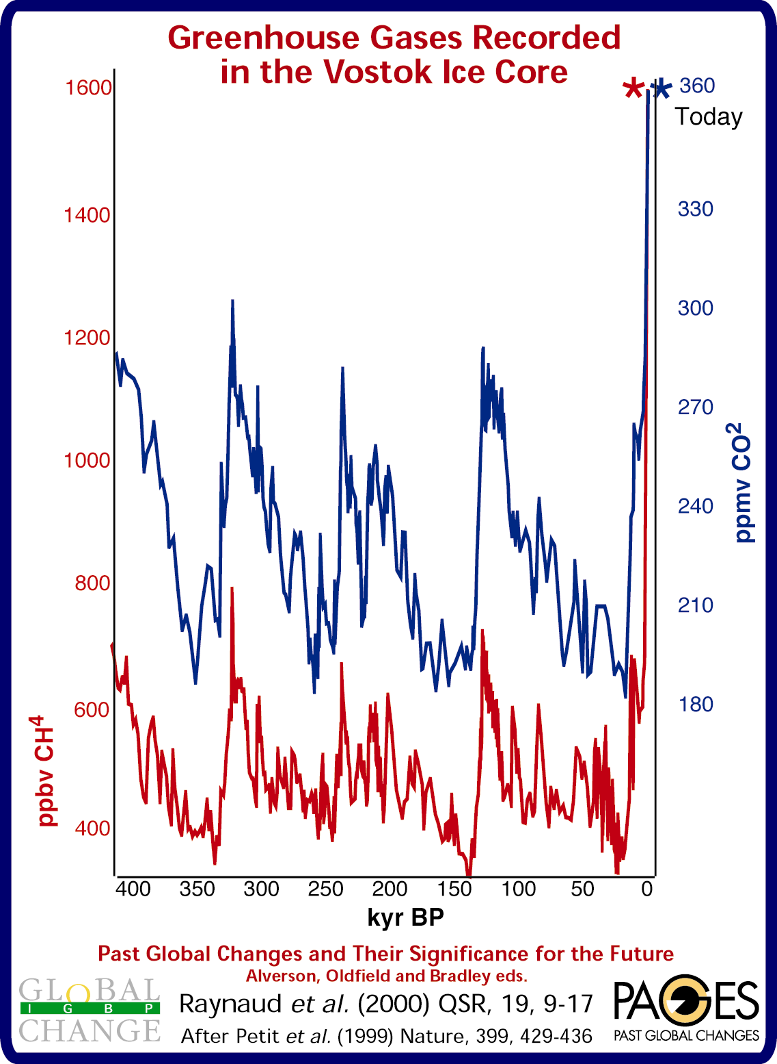
In the last 10,000 years, Earth’s average temperature has not varied more than 1⁰C

Slide 11
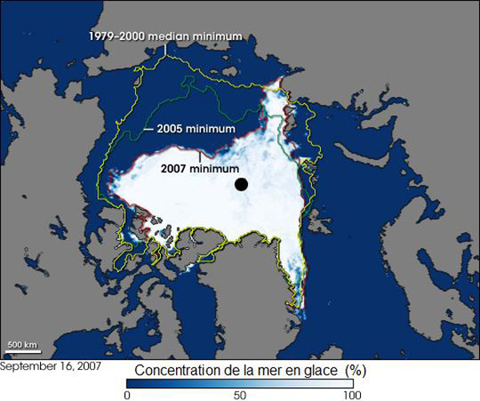
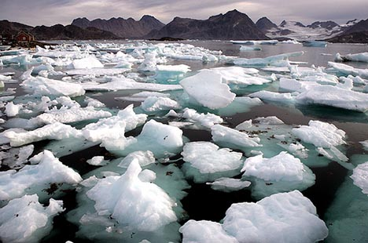
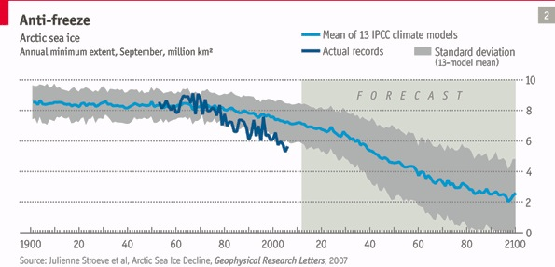
Will the Artic become an ice-free ocean?
The Economist

Slide 12
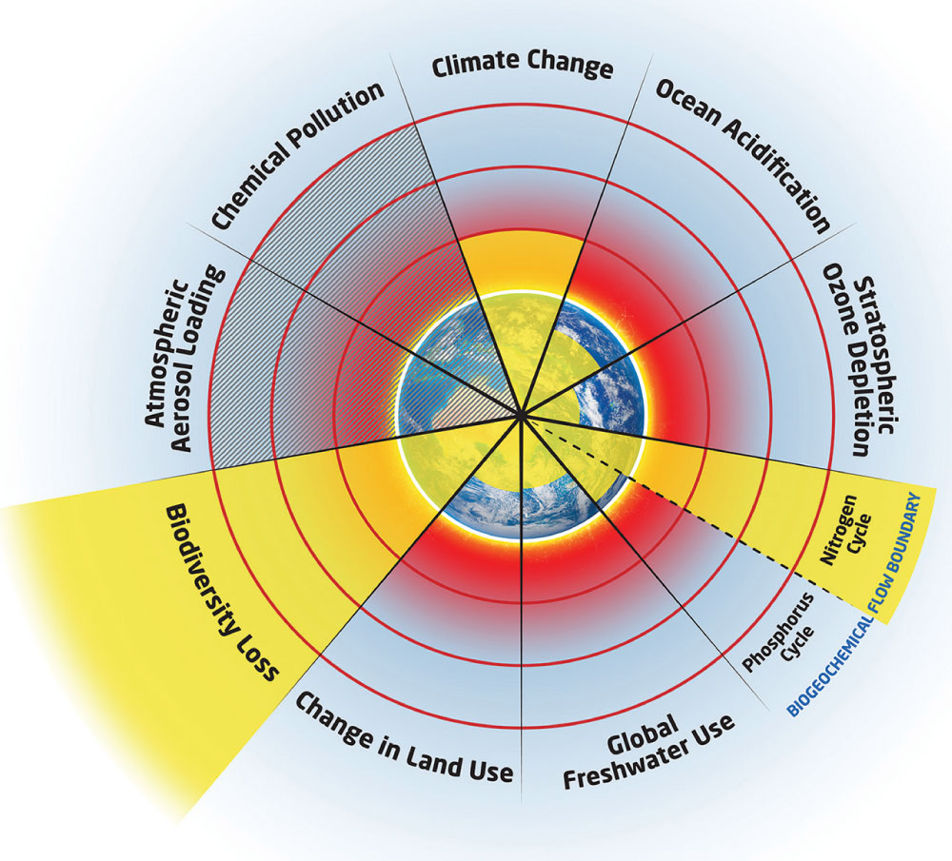
Are we crossing planetary boundaries?
Stockholm Resilience Centre

Slide 13




Slide 14
There is an urgent need for the international scientific community to develop the knowledge that can inform and shape effective responses to these threats in ways that foster global justice and facilitate progress toward sustainable development goals.

Slide 15
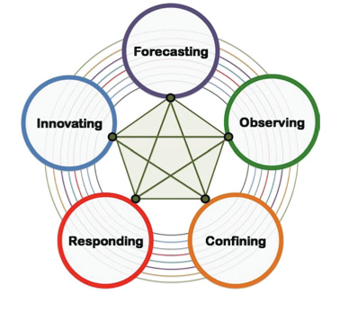
ICSU “Grand challenges”
Improve the usefulness of forecasts of future environmental conditions and their consequences for people.
Develop, enhance and integrate the observation systems needed to manage global and regional environmental change.
Determine what institutional, economic and behavioural changes can enable effective steps toward global sustainability.

Slide 16




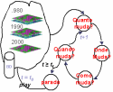
What do we (Geoinformatics scientists) know?
  Connect expertise from different fields
  Make the different conceptions explicit
If (... ? ) then ...
Desforestation?

Slide 17
What do we (Geoinformatics scientists) know?
  Connect expertise from different fields
  Make the different conceptions explicit
Territory
(Geography)
Money
(Economy)
Culture
(Antropology)
Modelling
(GIScience)

Slide 18
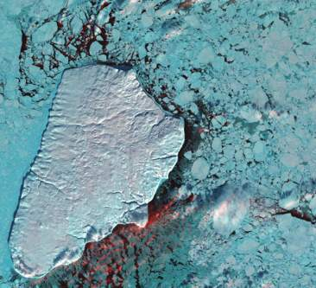
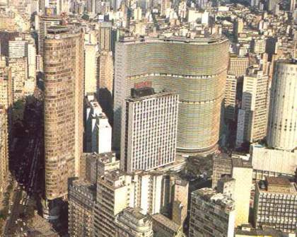
What do we know most of them don’t know?
Earth Science explains how nature works by proposing laws
GIScience explains how society work by describing interactions

Slide 19

We need spatially explicit models to understand human-environment interactions
Nature: Physical equations
Describe processes
Society: Decisions on how to
Use Earth´s resources

Slide 20
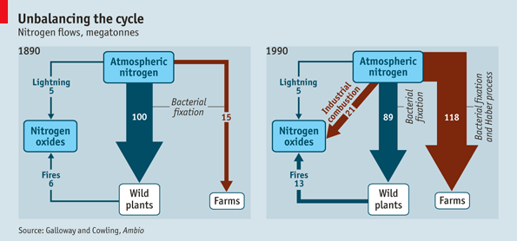
Negative consequences of the green revolution?
graphics: The Economist

Slide 21
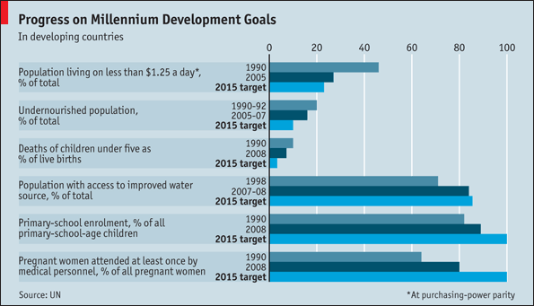
Good consequences of green revolution
graphics: The Economist

Slide 22
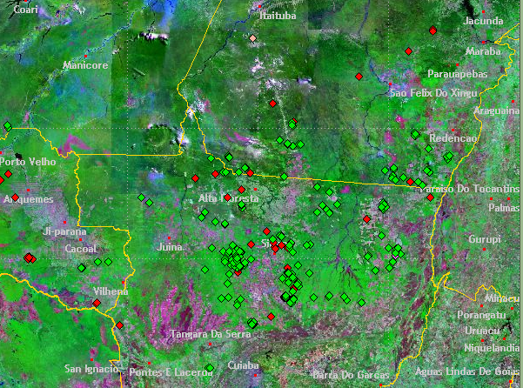
Representing location is easy
What do we know?
Deforestation hotspots in Amazonia

Slide 23
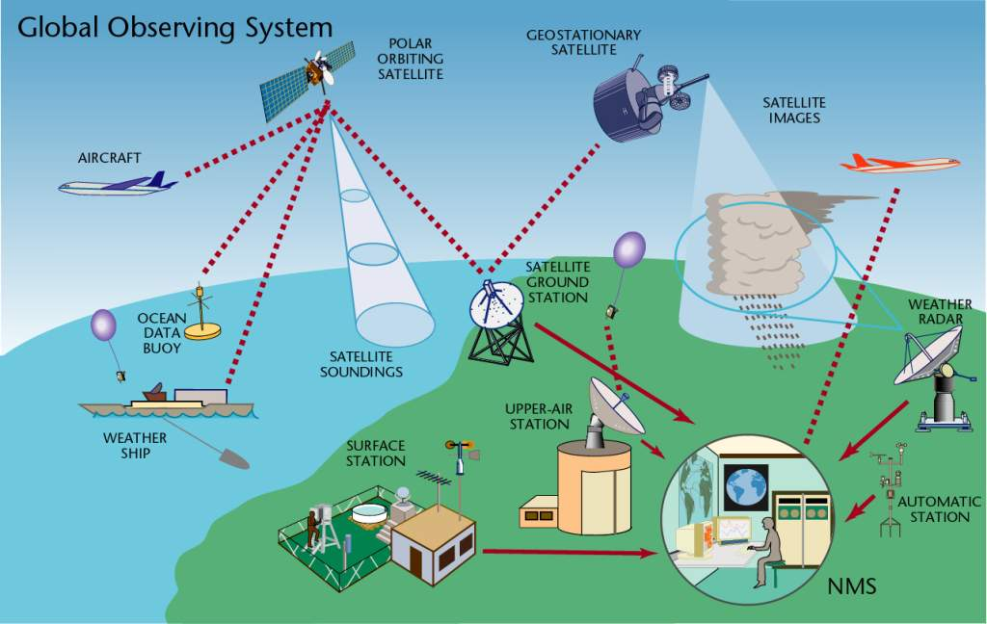
What do we know?
source: WMO
Communicating data is feasible
11,000 land stations (3000 automated)
900 radiosondes, 3000 aircraft
6000 ships, 1300 buoys
5 polar, 6 geostationary satellites

Slide 24
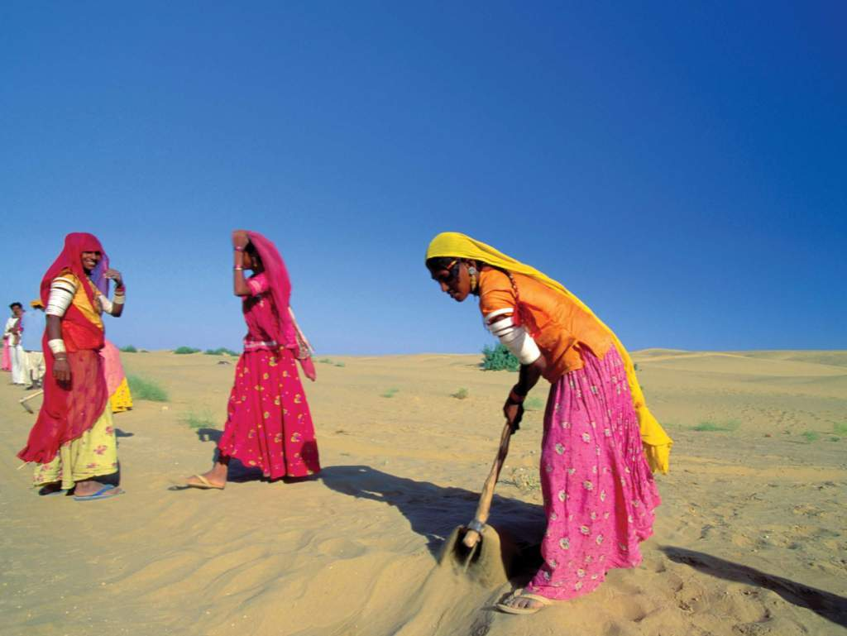
Representing concepts is hard
What do we know we don’t know?
vulnerability? climate change? poverty?
Image source: WMO

Slide 25
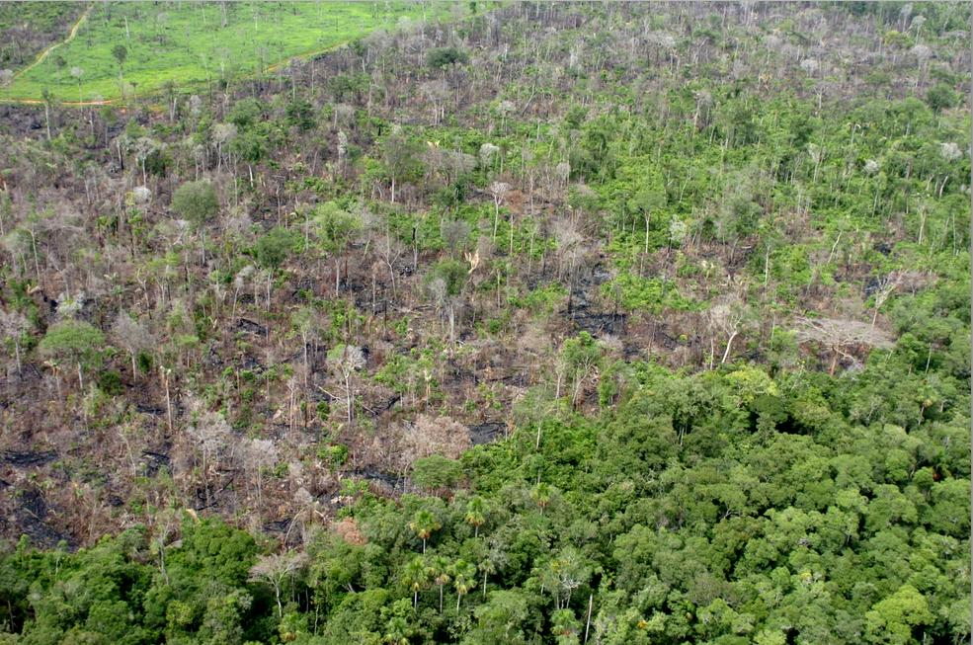
We’re bad at representing meaning
What do we know we don’t know?
Representing concepts is hard
degradation
deforestation? degradation? disturbance?

Slide 26
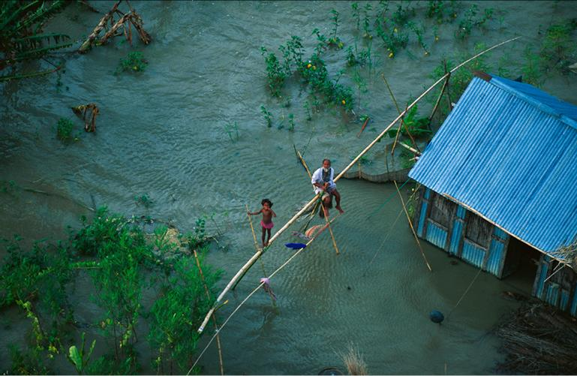
Representing concepts is hard
vulnerability
degradation

Slide 27
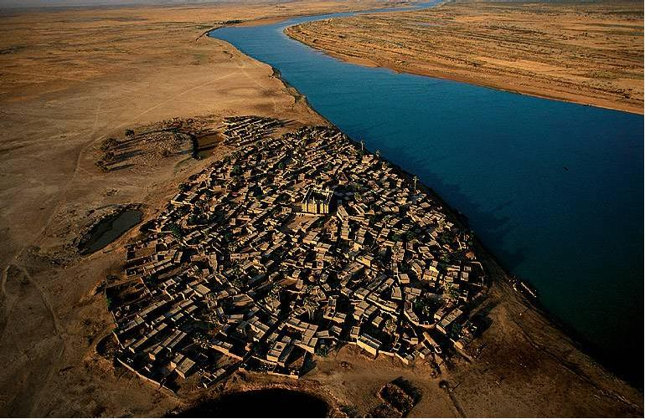
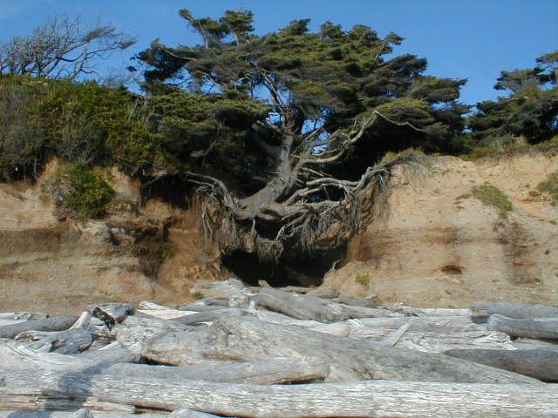
Representing concepts is hard
sustainability
resilience
and much more…
Human-environmental models need to describe complex concepts (and store their attributes in a database)

Slide 28
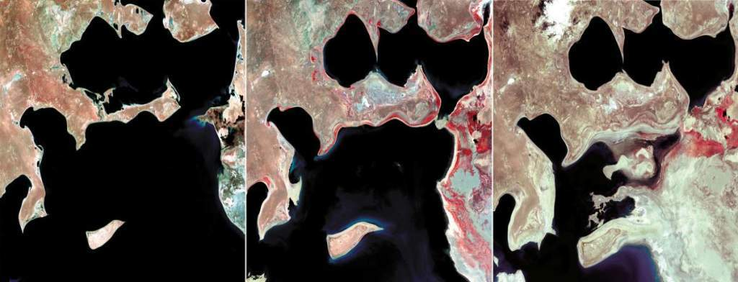
Representing change is very hard
What do we know we don’t know?

Slide 29
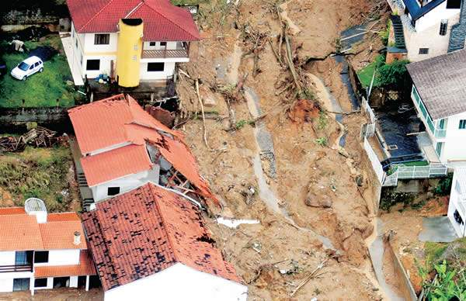
Describing events and processes is very hard
What do we know we don’t know?
When did the flood occur?

Slide 30
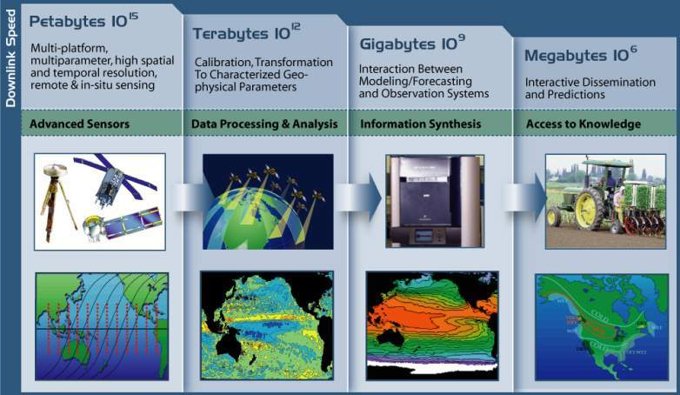
Data chain in Earth System Science
fonte: NASA

Slide 31
Data chain in Earth System Science
fonte: NASA
Why is this misleading?

Slide 32
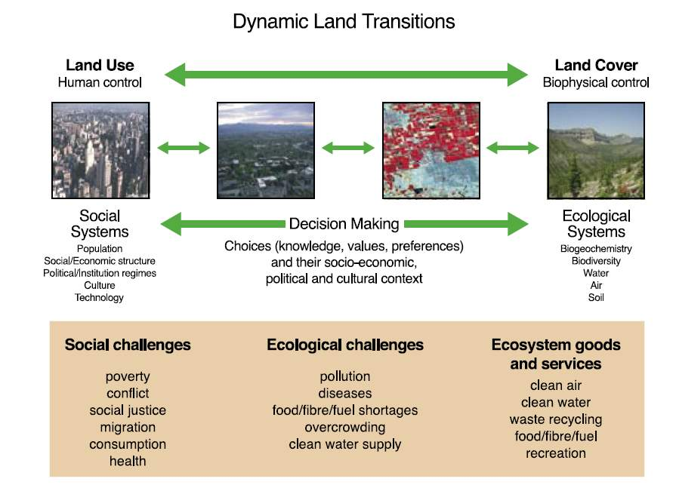
source: Global Land Project Science Plan (IGBP)

Slide 33
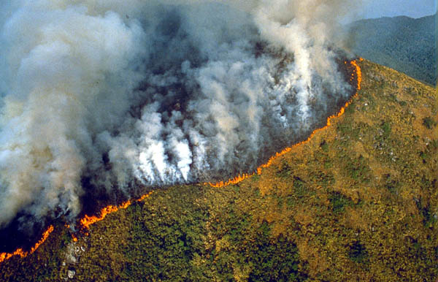
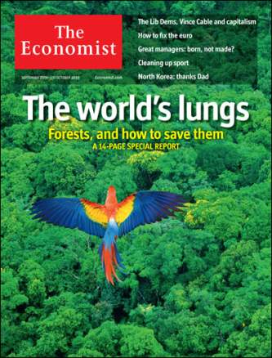
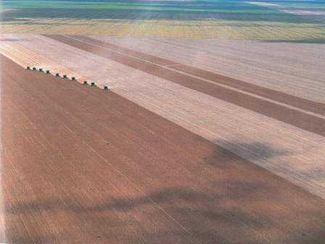
Land change is crucial for the world

Slide 34
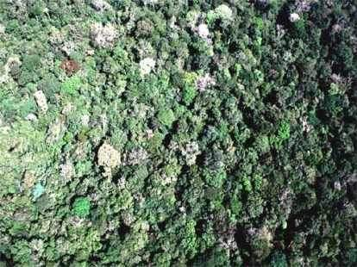
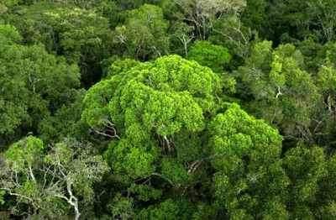
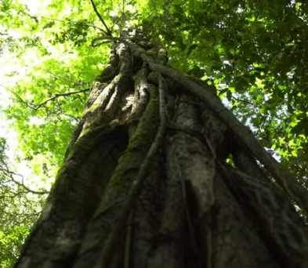
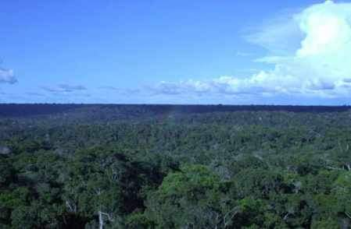
Can we avoid that this….
Source: Carlos Nobre (INPE)

Slide 35
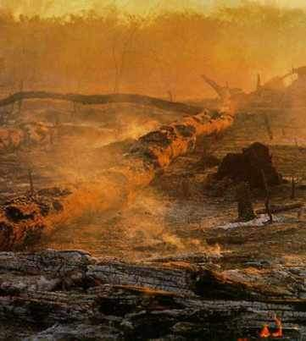
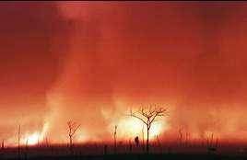
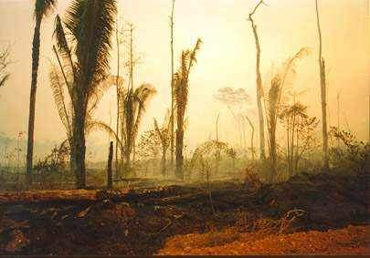
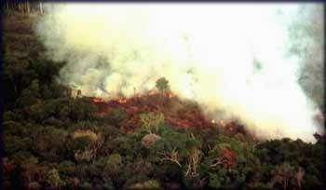
Fire...
….becomes this?
Source: Carlos Nobre (INPE)

Slide 36
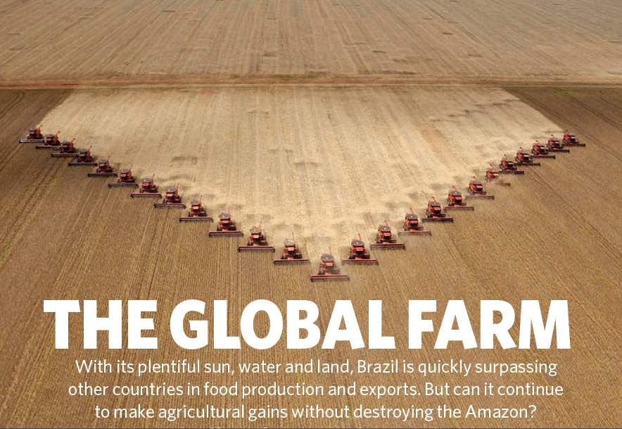
Nature, 29 July 2010

Slide 37
Nature, 29 July 2010
Brazil is the world’s current largest experiment on land change and its effects: will it also happen elsewhere?
Today’s questions about Brazil could be tomorrow’s questions for other countries

Slide 38
Data (we need a lot of it)
Deforestation in Brazilian Amazonia (1988-2011)
dropped from 27,000 km² to 6,200 km²

Slide 39
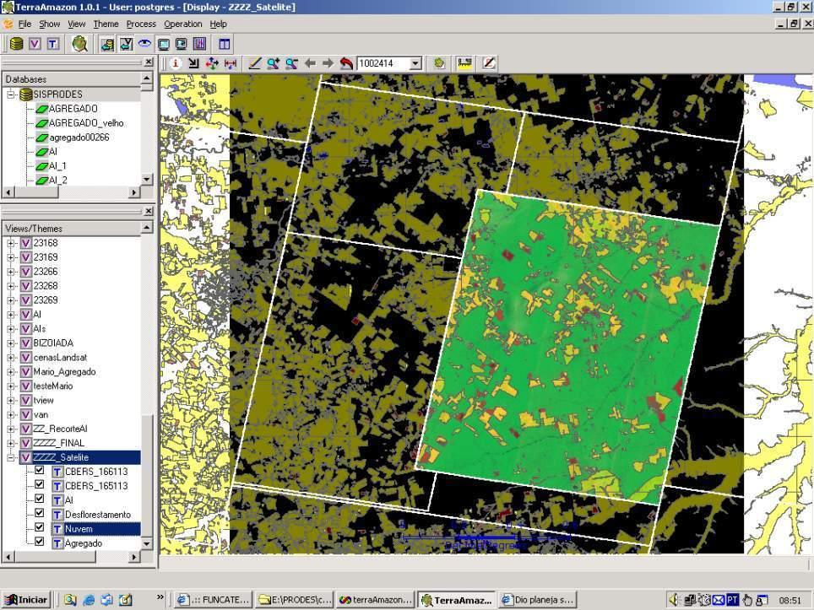
How much it takes to survey Amazonia?
116-112
30 Tb of data
500.000 lines of code
150 man/years of software dev
200 man/years of interpreters
116-113
166-112
Notes:
Cena de maior prioridade utilizou imagens CBRES na s tres principais areas: 166-112, 165-113 2 166-113. Sendo complementada por imagem TM

Slide 40
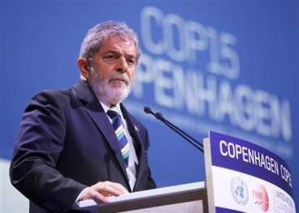
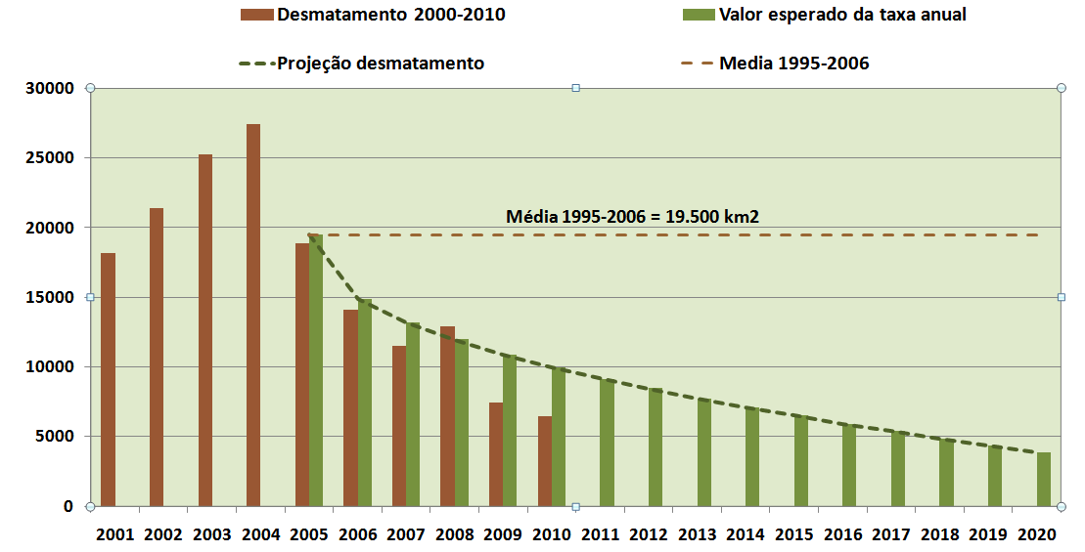
“By 2020, Brazil will reduce deforestation by 80% relative to 2005.” (pres. Lula in Copenhagen COP-15)

Slide 41

Challenges for data-intensive GIScience
Which data is out there?
How to find the data I need?
How to organize global spatial data?
How to get the data I need?
How to model global change data?
How to use global change data?

Slide 42
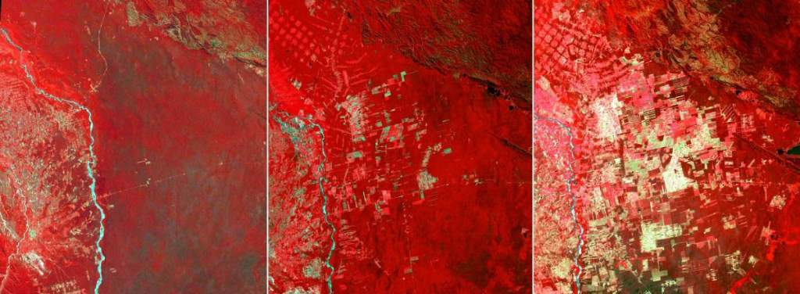
source: USGS
Using the Data
How to get the data I need?
How to model global change data?
How to use global change data?

Slide 43
source: USGS
Getting to the Data
Which data is out there?
How to find the data I need?
How to organize global spatial data?

Slide 44
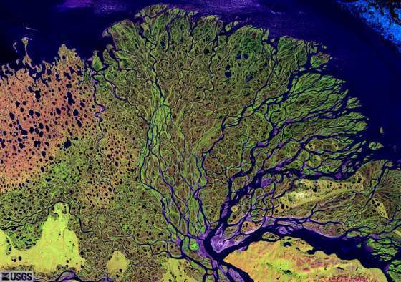
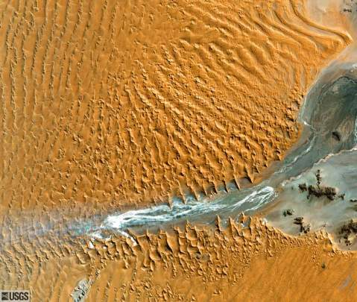
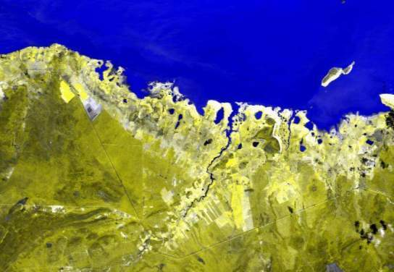

Earth observation satellites and geosensor webs provide key information about global change…
…but that information needs to be modelled and extracted

Slide 45

source: INPE

Slide 46

source: INPE

Slide 47

EVI soybean dynamic
source: INPE

Slide 48

source: INPE

Slide 49

Land use change by sugarcane expansion
source: INPE

Slide 50

Data Access Hitting a Wall
Current science practice based on data download
How do you download a petabyte?

Slide 51
Data Access Hitting a Wall
Current science practice based on data download
How do you download a petabyte?
You don’t! Move the software to the archive

Slide 52

Scientific Data Management in the Coming Decade (Jim Gray, 2005)
Next-generation science instruments and simulations will produce peta-scale datasets. Such peta-scale datasets will be housed by science centers that provide substantial storage and processing for scientists who access the data via smart notebooks. The procedural stream-of-bytes-file-centric approach to data analysis is both too cumbersome and too serial for such large datasets. Database systems will be judged by their support of common metadata standards and by their ability to manage and access peta-scale datasets.

Slide 53








Virtual Observatory
If data is online, internet is the world’s best telescope (Jim Gray)

Slide 54
Current geospatial information systems
User interface
Database creation
Database access
Analysis
Local
database

Slide 55
Future geospatial information systems
Visualisation
Interface
Data discovery
Data access
Analysis Modelling
Data
source
Data
source
Data
source

Slide 56





TerraLib: spatio-temporal database as a basis for innovation
Visualization (TerraView)
Modelling (TerraME)
Spatio-temporal
Database (TerraLib)
Statistics (aRT)
Data Mining(GeoDMA)

Slide 57
What about the unknown unknowns?
Uncertainty on basic equations
Quantum
Gravity
Social and Economic
Systems
Particle
Physics
Living
Systems
Global
Change
Chemical
Reactions
Hydrological
Models
Meteorology
Solar System Dynamics
Complexity of the phenomenon
source: John Barrow
(after David Ruelle)

Slide 58


Complex adaptive systems
Systems composed of many interacting parts that evolve and adapt over time.
Organized behavior emerges from the simultaneous interactions of parts without any global plan.

Slide 59




Is computing also a natural science?
http://www.red3d.com/cwr/boids/
“Information processes and computation continue to be found abundantly in the deep structures of many fields. Computing is not—in fact, never was—a science only of the artificial.” (Peter Denning, CACM, 2007).
Notes:
59

Slide 60


Computing is also a natural science
Computing studies information flows in natural systems...
...and how to represent and work with information flows in artificial systems
Notes:
60

Slide 61


Conections and flows are universal
Yeast proteins
(Barabasi and Boneabau, SciAm, 2003)
Scientists in Silicon Valley
(Fleming and Marx, Calif Mngt Rew, 2006)

Slide 62
Information flows generate cooperation
National Cancer Institute, EUA http://visualsonline.cancer.gov
White cells attact a cancer cell (cooperative activity)

Slide 63

Hanna Fry, CASA, UCL

Slide 64
Tobler’s first law in a connected world?
“People still live in places. The space of places is a consequence of human history. However, function and power in our societies are organized in the space of flows. Flows of capital, flows of information, flows of technology, flows of organizational interactions, flows of images, sounds and symbols”. (Castells, “The Rise of Network Society”).

Slide 65



Global Change
Human actions and global change
photo: C. Nobre
Where are changes taking place?
How much change is happening?
Who is being impacted by the change?
What is causing change?
photo: A. Reenberg

Slide 66
Slides from LANDSAT
images: USGS
Modelling Human-Environment Interactions
How do we decide on the use of natural resources?
What are the conditions favoring success in resource mgnt?
Can we anticipate changes resulting from human decisions?
Aral Sea
1973
1987
2000

Slide 67





How do we decide on the use of natural resources?
Soybeans
Loggers
Competition for Space
Ranchers
Small-scale Farming
Source: Dan Nepstad (Woods Hole)
Notes:
Temos que avaliar a potencialidade de uso das area em relacao aos seus usos

Slide 68




Modelling human-environment interactions
  What models are needed to describe human actions?

Slide 69
Dynamic Spatial Models
f (I_{t})
f (I_{t+1})
f (I_{t+2})
f ( I_{t+n} )
F
F
. .
"A dynamical spatial model is a computational representation of a real-world process where a location on the earth’s surface changes in response to variations on external and internal dynamics" (Peter Burrough)

Slide 70


What is a Model?
Deforestation in Amazonia in 2020?
simplified representation of a process
Model = entities + attributes + interactions + change rules
graphics: INPE, Pesquisa FAPESP

Slide 71




A typical spatial model: What causes tropical deforestation?
(PRODES, 2008)
(Getty Images, 2008)
source: Espindola, 2012

Slide 72




Dynamic Spatial Models
graphics: Cláudia Almeida
Projection
T_{now} - 20
T_{now} – 10
T_{now}
Calibration
t_{now} + 10
Validation

Slide 73

Multiscale modelling is hard
How do we combine independent multiscale models with feedback?

Slide 74




Clocks, clouds or ants?
Clouds: statistical distributions
Clocks: deterministic equations
Ants: emerging behaviour

Slide 75
Agent-Based Modelling: Computing approaches to complex systems
Representations
Goal
Communication
Communication
Action
Perception
Environment
Gilbert, 2003

Slide 76




Modelling collective spatial actions
Space Agent
Agent Space
Benenson and Torrens, “Geographic Automata Systems”, IJGIS, 2005
(but many questions remain...)

Slide 77

Some caution necessary...
“Agent-based modeling meets an intuitive desire to explicitly represent human decision making. (…)
However, by doing so, the well-known problems of modeling a highly complex, dynamic spatial environment are compounded by the problems of modeling highly complex, dynamic decision-making. (…)
The question is whether the benefits of that approach to spatial modeling exceed the considerable costs of the added dimensions of complexity introduced into the modeling effort. The answer is far from clear and in, my mind, it is in the negative. But then I am open to being persuaded otherwise ”.
(from “Why I no longer work with agents”, 2001 LUCC ABM Workshop)
Helen Couclelis

Slide 78

Some caution necessary...
“Complexity is more and more acknowledged to be a key characteristic of the world we
live in and of the systems that cohabit our world. It is not new for science to attempt to
understand complex systems: astronomers have been at it for millennia, and biologists,
economists, psychologists, and others joined them some generations ago. (…)
If, as appears to be the case, complexity (like systems science) is too general a subject
to have much content, then particular classes of complex systems possessing strong
properties that provide a fulcrum for theorizing and generalizing can serve as the foci
of attention.”
(from “The Sciences of the Artificial”, 1996)
Herbert Simon (1958)

Slide 79
Conclusions
Managing change is a major challenge for the scientific community
Images are a major source of new data
Move the software, not the data
We need new algebras, data representations and algorithms to handle spatio-temporal data

