Slide 1
“Big Data: Challenges and Possibilities for Geoinformatics Research”
Gilberto Câmara, INPE
Licence: Creative Commons ̶̶̶̶ By Attribution ̶̶̶̶ Non Commercial ̶̶̶̶ Share Alike
http://creativecommons.org/licenses/by-nc-sa/2.5/

Slide 2
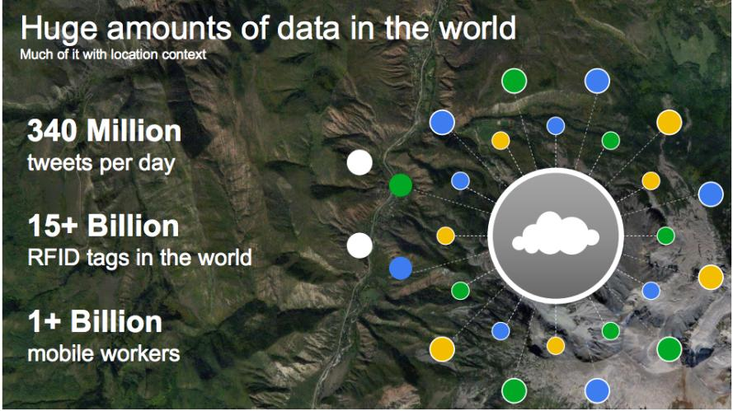
The motivation for “big data”
source: Louis Perrochon (Google)

Slide 3
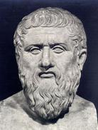
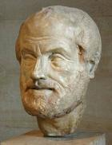
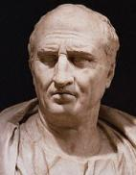
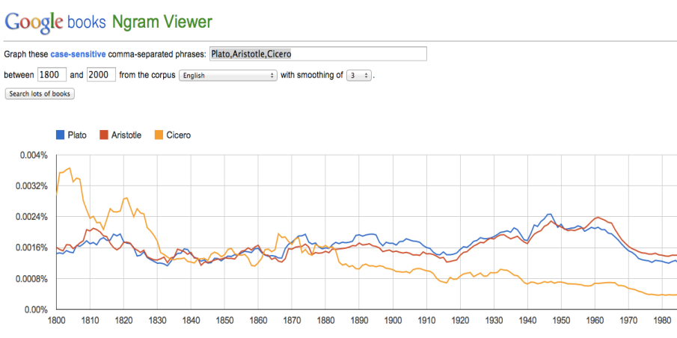
Greece or Rome: who has had more influence?
Plato
Aristotle
Cicero
5 million books, 500 billion words

Slide 4
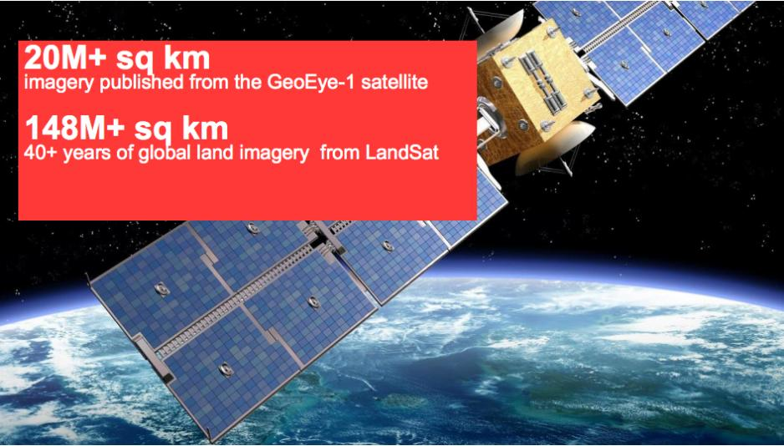
Google Earth Engine: massive image data
source: Louis Perrochon (Google)

Slide 5
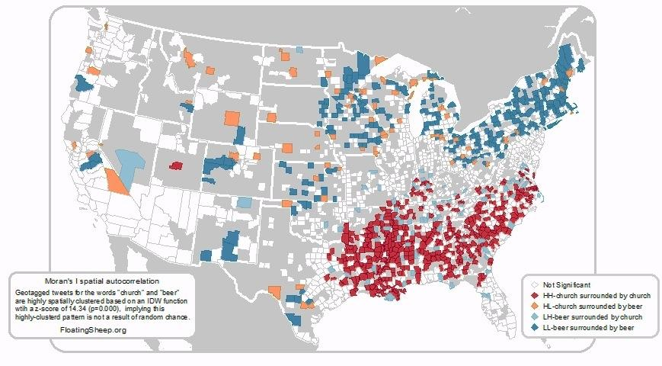
Beer or church? (evidence from tweets)
http:www.flyingsheep.org

Slide 6
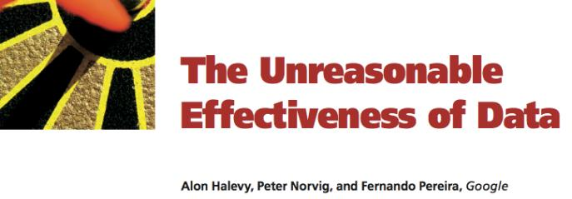
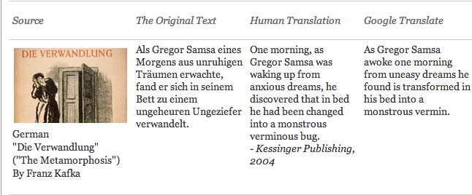
Google Translate

Slide 7
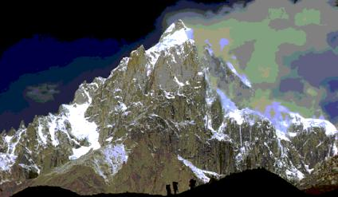
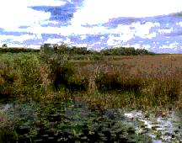
Openshaw saw it first…
Mountains of Data
Data Swamps
Source: Stan Openshaw

Slide 8

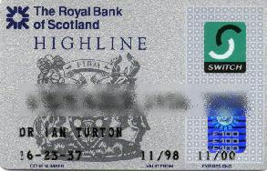
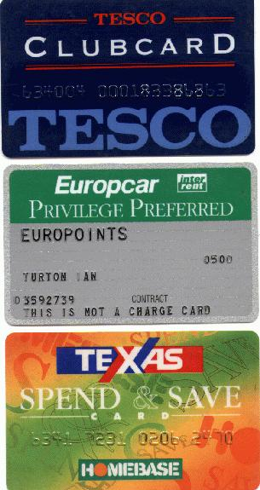
We know how much you spend...
…where you shop...
Source: Stan Openshaw

Slide 9

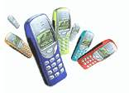
…who you talk to...
Source: Stan Openshaw

Slide 10
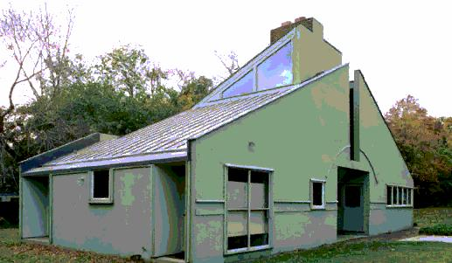
…where you live...
LS2 9JT
What your neighbours are like…
Source: Stan Openshaw

Slide 11
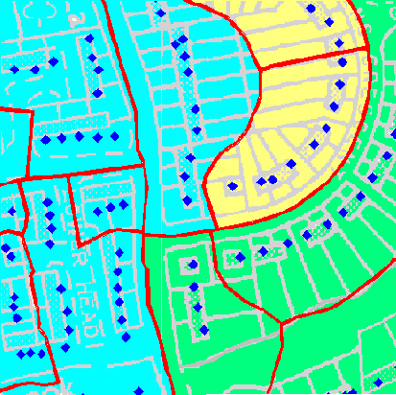
...what your neighbors are like...
Census tracts and
Houses for data collection

Slide 12
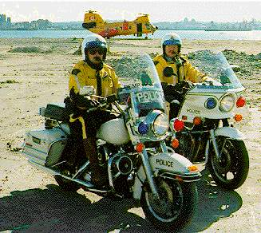
...your misbehaviour and...
crime type
crime location
insurance data
Source: Stan Openshaw

Slide 13

...your health
environmental data
socio-economic data
admissions data
Source: Stan Openshaw

Slide 14
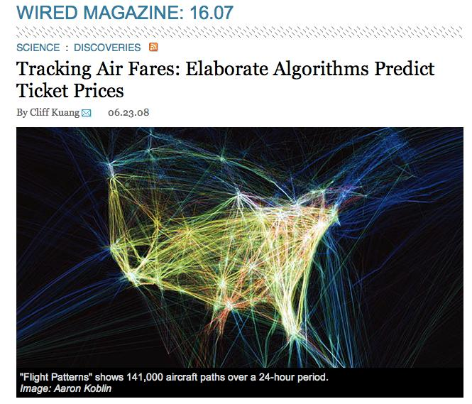
Big data allow new business models

Slide 15

A working definition of big data
≈
n << all Statistics: we have a small part of the data
n == all Big brother: we have all the data (do we?)
n ≈≈ all Big data: we have data close to problem size

Slide 16
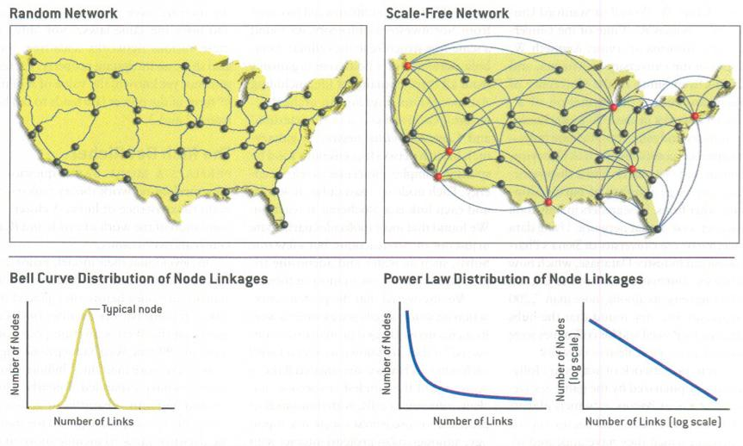
When does statistics work well?
Barabasi, “Scale-free networks”

Slide 17
When does statistics work well?
Measurement errors Independent events Gaussian or Poisson well-known cases | Strong dependence Results of human decisions Accumulation effect Distributions adapted to existing data
“Death and taxes”
mild randomness
“Death and taxes”
mild randomness

Slide 18
A working definition of big data
n ≈ all (big data)
“Big data for science is when your data collection approaches the size of the problem”

Slide 19
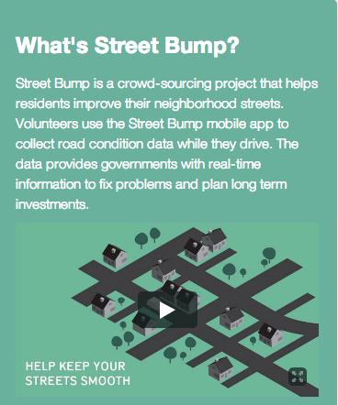
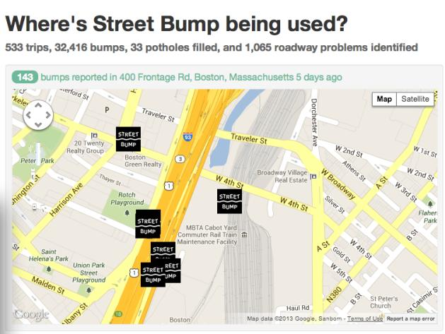
What is all?

Slide 20
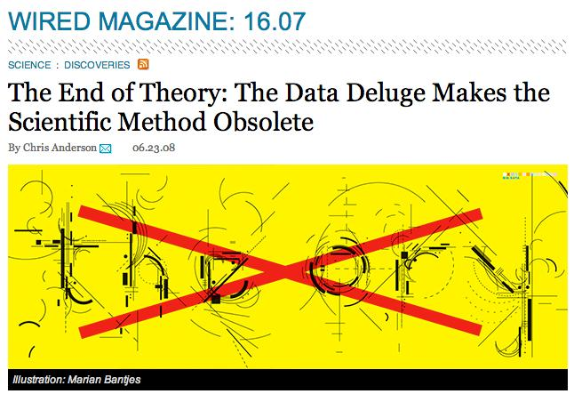
Is the scientific method obsolete?

Slide 21
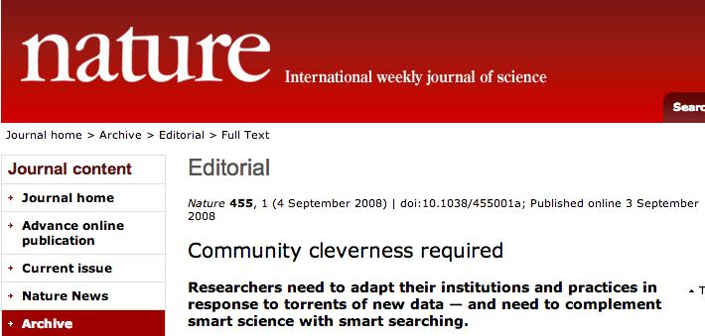
The view from the Science community

Slide 22
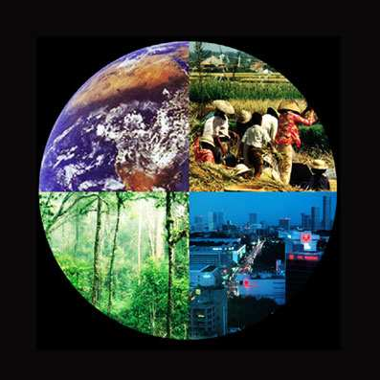
The fundamental question of our time
How is the Earth’s environment changing, and what are the consequences for human civilization?
source: IGBP

Slide 23
We need cooperation at a global level…
By 2050...
8,5 billion people: 6 billion tons of GHG and 60 million tons of urban pollutants.
Resource-hungry: We will withdraw 30% of available fresh water.
Risky living: 80% urban areas, 25% near earthquake faults, 2% in coast lines less than 1 m above sea level.
source: Guy Brasseur

Slide 24


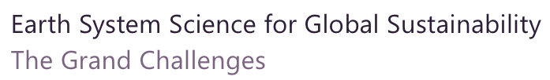

Slide 25
There is an urgent need for the international scientific community to develop the knowledge that can inform and shape effective responses to these threats in ways that foster global justice and facilitate progress toward sustainable development goals.

Slide 26
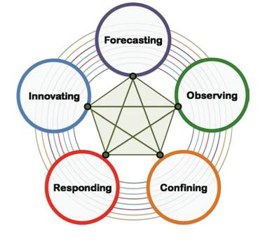
ICSU “Grand challenges”
Improve the usefulness of forecasts of future environmental conditions and their consequences for people.
Develop, enhance and integrate the observation systems needed to manage global and regional environmental change.
Determine what institutional, economic and behavioural changes can enable effective steps toward global sustainability.

Slide 27
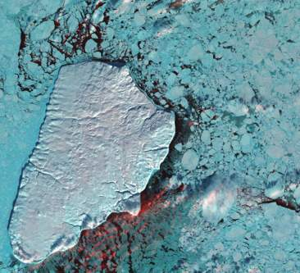
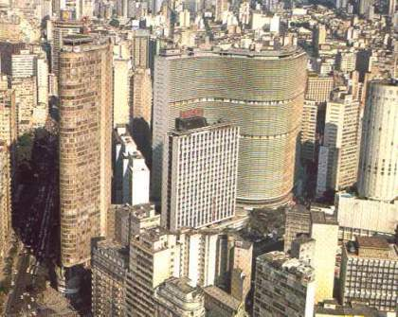
What do we know we don’t know?
Science explains how nature works by proposing laws
Science explains how society work by describing interactions

Slide 28
Geoinformatics enables crucial links between nature and society
Nature: Physical equations
Describe processes
Society: Decisions on how to
Use Earth´s resources

Slide 29
The known unknowns (limits of our knowledge)
Uncertainty on basic equations
Quantum
Gravity
Social and Economic
Systems
Particle
Physics
Living
Systems
Global
Change
Chemical
Reactions
Hydrological
Models
Meteorology
Solar System Dynamics
Complexity of the phenomenon
source: John Barrow
(after David Ruelle)

Slide 30
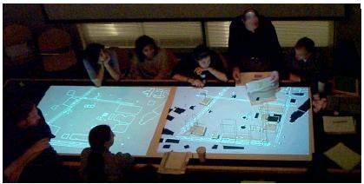
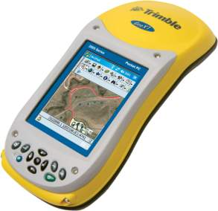
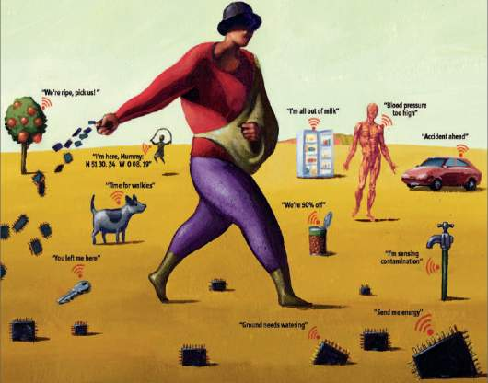
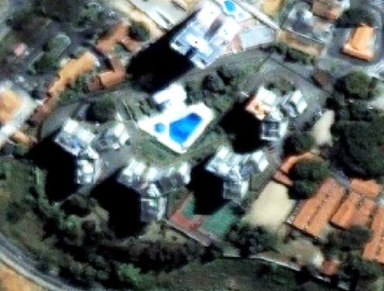
Big geospatial data
mobile devices
augmented reality
systematic data collection and integrative data analysis
sensor networks
ubiquitous images and maps

Slide 31
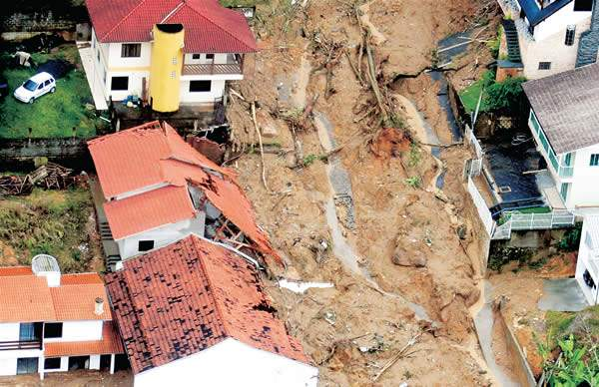
Representing and modelling change
Semantics of big geospatial data
Events and processes

Slide 32
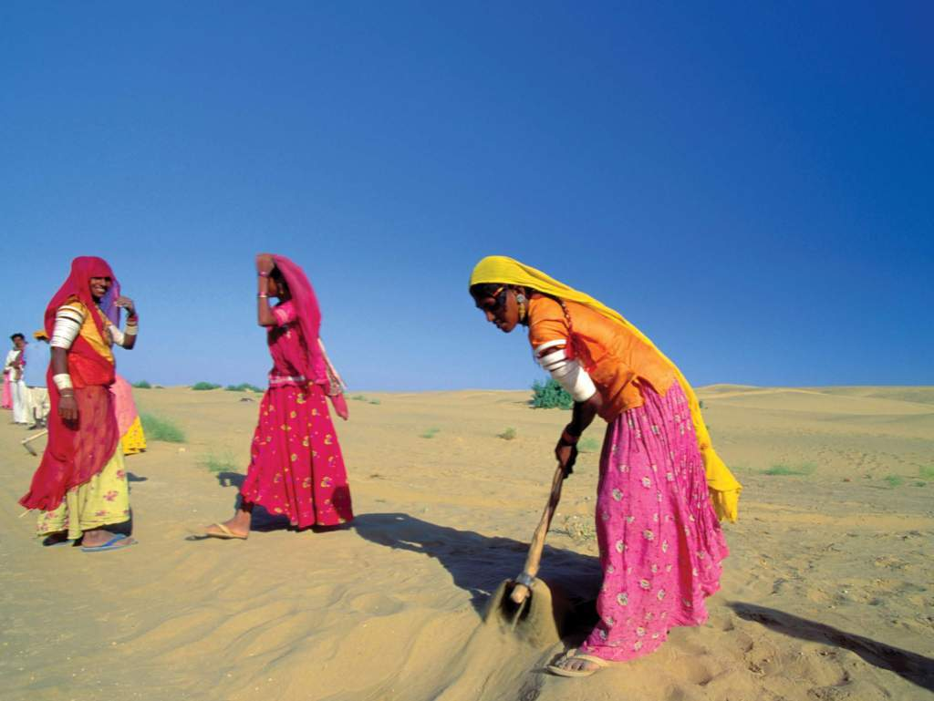
Representing condition
Semantics of big geospatial data
vulnerability? climate change? poverty?
Image source: WMO

Slide 33
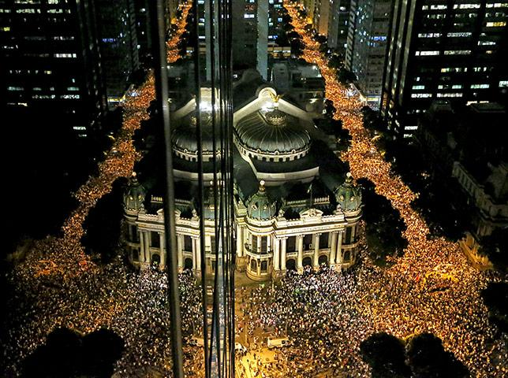
Semantics of big geospatial data
Representing and modelling behaviour
How social networks operate?

Slide 34
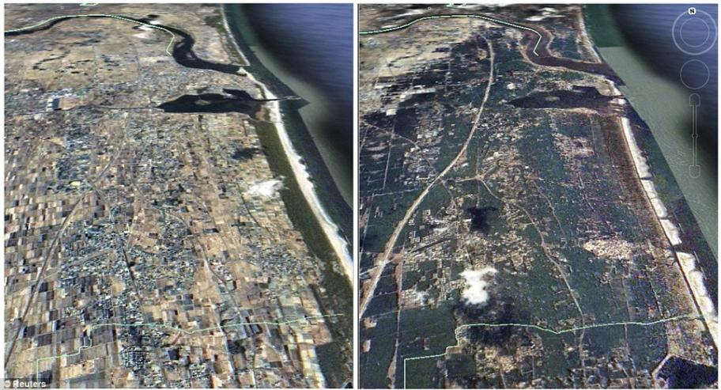
Objects and events
The coast of Japan is an object
The 2011 Tohoku tsunami was an event

Slide 35
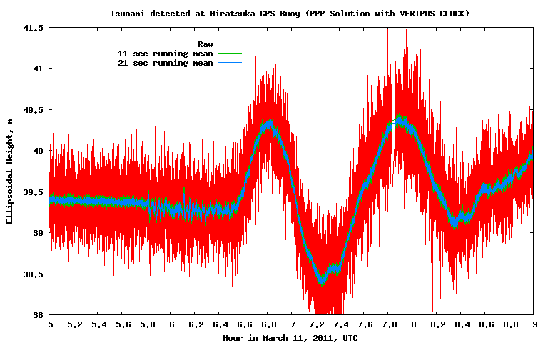
Object (GPS buoy) + event (tsunami)

Slide 36
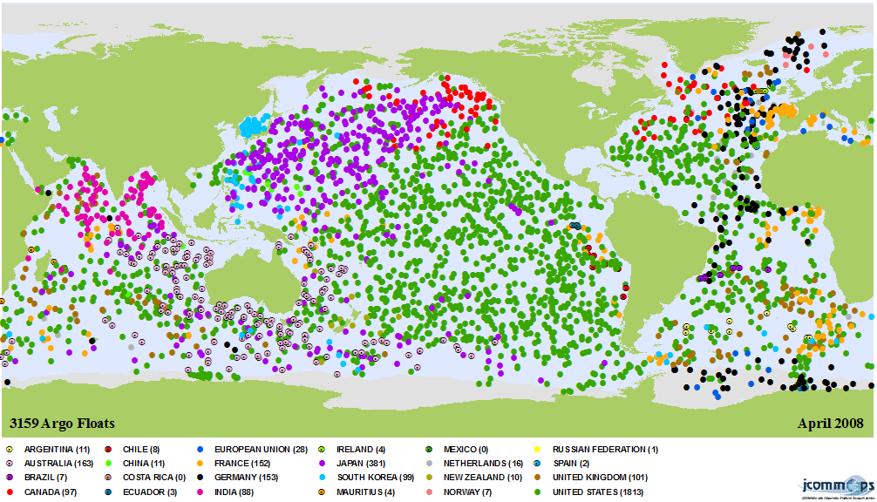
Inherent structure of geoinformation (Sinton, 1978)
Fixing space, controlling time, and measuring value:
a time series.
Fixing value, controlling time, and measuring space: a trajectory.
Fixing time, controlling space, and measuring value: a coverage.

Slide 37
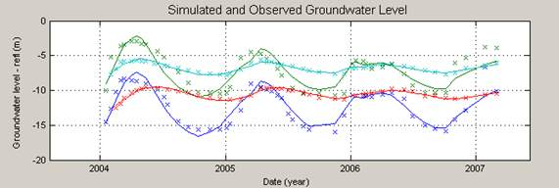
Time Series
Continuous variation of a property value over time
(water table depth sensors) in a fixed location

Slide 38

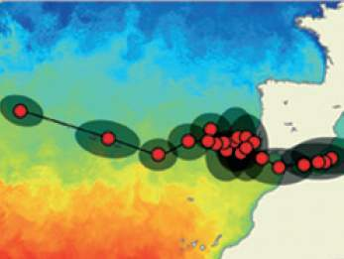
Moving objects have trajectories
trajectory : represents how locations or boundaries of an object evolve over time.

Slide 39
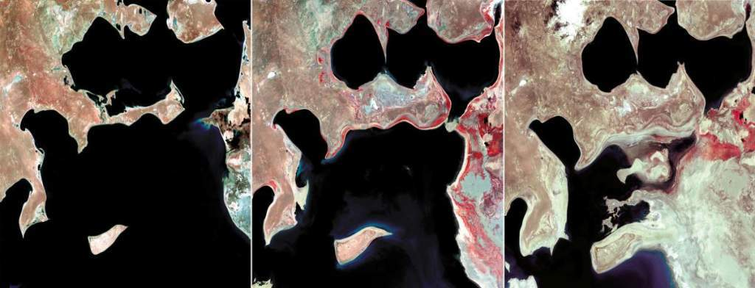
images: USGS
Coverage: variation of a property within a spatial extent at a time.
  Two-dimensional grids whose values change.
  Samples from fixed or moving geosensors.

Slide 40
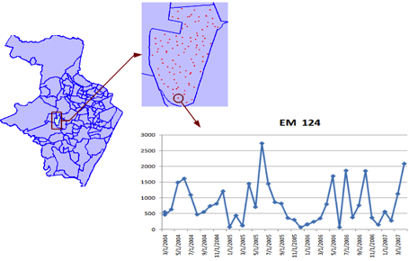
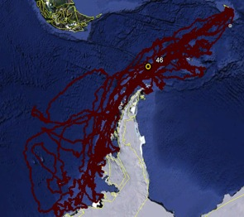
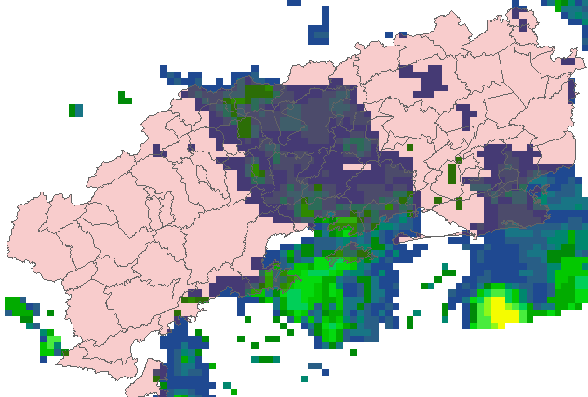
Time Series
how the number of mosquito eggs varies over time
Trajectory
Observations
how animals move over time
Coverage
how precipitation varies within the limits of Rio de Janeiro state
Raw Data
Spatiotemporal Data Types
Notes:
Time series: fixed location, etc, etc...

Slide 41
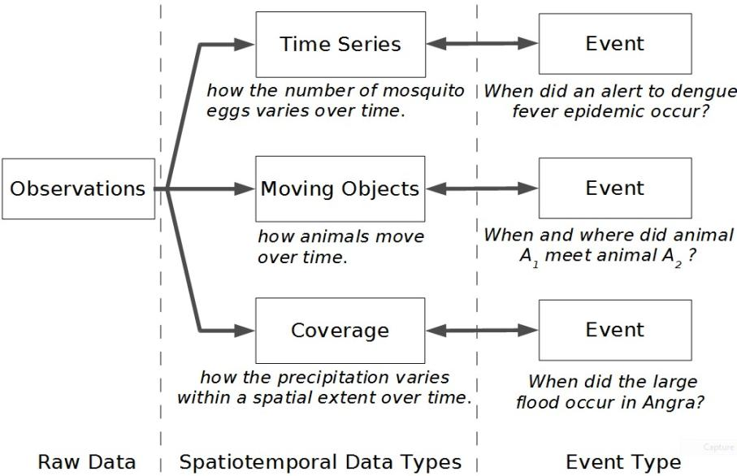
From observations to events

Slide 42
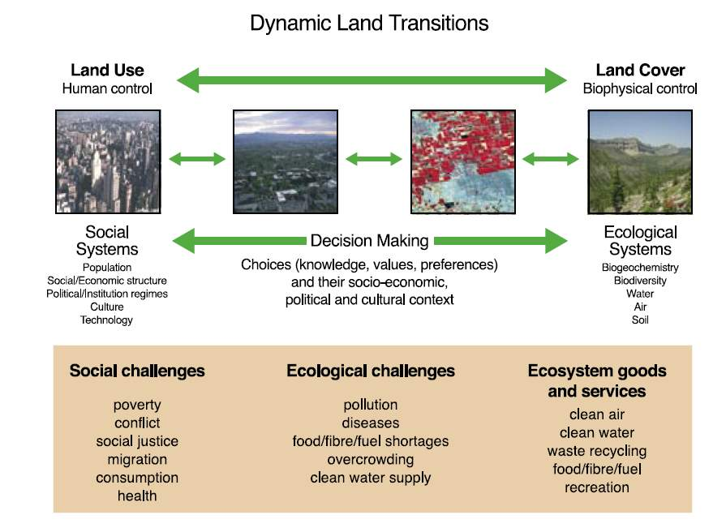
Land System
source: Global Land Project Science Plan (IGBP)

Slide 43
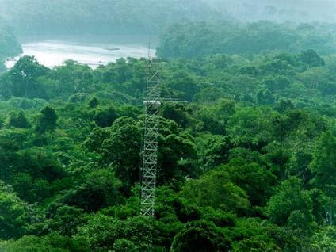
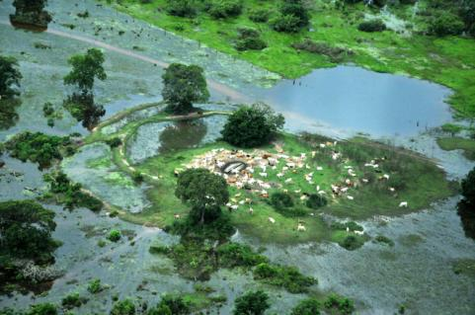
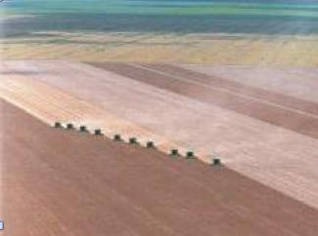
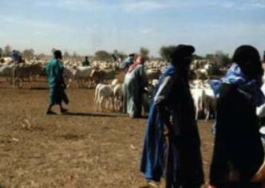
Land cover
  tropical forest
  wetlands
“the observed biophysical cover on the Earth’s surface"
  Non-natural vegetation
  shrublands

Slide 44
Land use
  non-managed forest
  cattle production
“the arrangements, activities and inputs people undertake in a certain land cover type to produce, change or maintain it”
  Temporary agriculture
  shifting cultivation

Slide 45



The transition from natural to managed land as seen by remote sensing
2010
2011

Slide 46

What’s in an image?
“Remote sensing images describe landscape dynamics”
data source: B. Rudorff (LAF/INPE)

Slide 47

Land use
Land region
Land cover
source: Tom Bittner, Barry Smith (SUNY Buffalo)

Slide 48

DTW for MODIS time series (first results)
Study area
Querência-MT,
near Parque Nacional do Xingu.
source: Victor Maus (INPE)

Slide 49

DTW for MODIS time series (first results)
EVI2 time series
Classes in 2008
Área 1
Pasture
Área 2
Forest
Área 3
Agriculture
source: Victor Maus (INPE)

Slide 50



DTW for MODIS time series (first results)
Temporal patterns:
Agriculture
Forest
Pasture
Baseados na classificação do TerraClass 2008
source: Victor Maus (INPE)

Slide 51

DTW for MODIS time series (first results)
Result for one pixel in area 1
Agriculture
Forest
Pasture
- Desflorestation in 2004 (PRODES).
- Land use change in 2011 of pasture to agriculture.
- Classified as pasture in 2008 by TerraClass.
source: Victor Maus (INPE)

Slide 52

DTW for MODIS time series (first results)
Result for one pixel in area 2
Agriculture
Forest
Pasture
- Florest during all the years.
- Classified as forest in 2008 by TerraClass.
source: Victor Maus (INPE)

Slide 53

Forget maps, think spatial databases!

Slide 54

Data Access Hitting a Wall
Current science practice based on data download
How do you download a petabyte?

Slide 55
Data Access Hitting a Wall
Current science practice based on data download
How do you download a petabyte?
You don’t! Move the software to the archive

Slide 56

Scientific Data Management in the Coming Decade (Jim Gray, 2005)
Next-generation science instruments and simulations will produce peta-scale datasets. Such peta-scale datasets will be housed by science centers that provide substantial storage and processing for scientists who access the data via smart notebooks. The procedural stream-of-bytes-file-centric approach to data analysis is both too cumbersome and too serial for such large datasets. Database systems will be judged by their support of common metadata standards and by their ability to manage and access peta-scale datasets.

Slide 57








Virtual Observatory
If data is online, internet is the world’s best telescope (Jim Gray)

Slide 58




Open source GIS for big geospatial data
TerraView
Modelling (TerraME)
Spatio-temporal
Database (TerraLib)
Statistics (R interface)
Data Mining(GeoDMA)

Slide 59




Land change information systems today
PRODES
DETER
TerraClass
AgriSAT
Database
TerraBR

Slide 60
Land change information systems: evolution 1
PRODES
DETER
TerraClass
AgriSAT
Analysis
Database
CDSR
TerraBR
Remote Analysis
Remote Analysis

Slide 61

Land change information systems: evolution 2
PRODES
DETER
TerraClass
AgriSAT
Analysis
Data base
Time series
Data mining
TerraBR
CDSR
Remote Analysis
Remote Analysis

Slide 62

Global Land Knowledge Platform
Coverages
Data Analysis
Data discovery and access
Trajectories
Time series
Spatiotemp
DB
Spatiotem DB
Remote Analysis
Remote Analysis

Slide 63

Global Land Knowledge Platform
Land Commodity Trade
Land Policy Scenarios
Coverages
Data Analysis
Data discovery and access
Trajectories
Time series
Spatiotemp
DB
Spatiotem DB
Remote Analysis
Remote Analysis

Slide 64
Semantic challenges for big geospatial data
Semantics of change, behaviour and condition
continuants/occurents
ontology of connnections
what is “all”?
Semantic data discovery
Dealing with incomplete, messy and conflicting data sets

Slide 65
Analytical challenges for big geospatial data
Analysis of inherent bias in big data
privacy x public (microsimulation)
Agent-based modelling?
What is “all”?
spatially sensitive time series
Calibration and validation
Better theoretical models

Slide 66




Global Change
Big data Lab for Interdisciplinary
Spatially-enabled Science (BLISS)
“How can we improve geospatial information systems to increase their capacity to deal with big geospatial data sets and to provide better information for researchers and decision-makers for public policies?”
“How can we build semantic models to capture change, behaviour and condition inherent in big data to help us better understand our world?
“How can we develop new data analysis methods to extract information from big data to support equitable public policy making?”
photo: A. Reenberg

