Slide 1
Land change in Brazilian Amazonia: A case study in nature-society interaction
ILÖK Kolloquium 2013, Münster
Gilberto Câmara
National Institute for Space Research (INPE)
Brazil
IFGI, University of Münster, Germany
http://www.dpi.inpe.br/gilberto

Slide 2

Nature, 29 July 2010

Slide 3
Nature, 29 July 2010
Brazil is the world’s current largest experiment on land change and its effects: will it also happen elsewhere?
Today’s questions about Brazil could be tomorrow’s questions for other countries

Slide 4
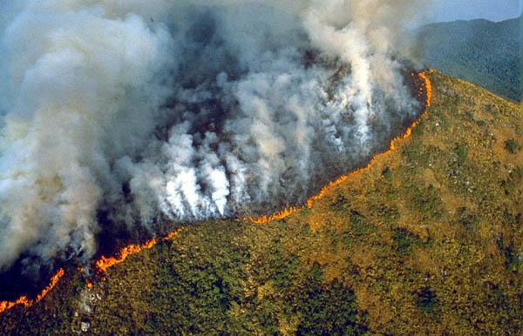

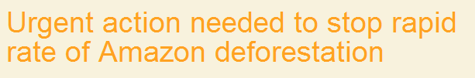
The challenge: reducing deforestation

Slide 5
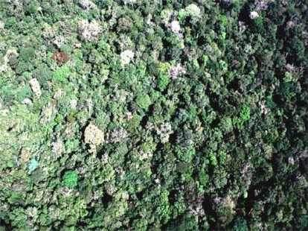
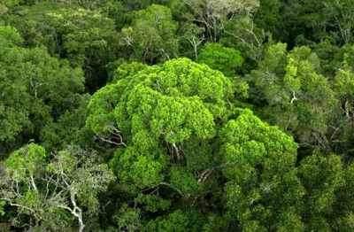
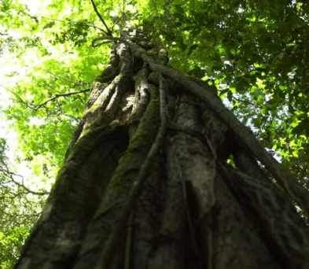
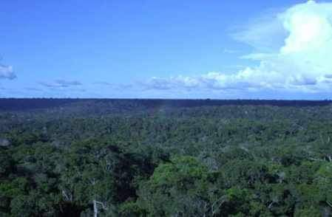
How can we avoid that the forest….
Source: Carlos Nobre (INPE)

Slide 6
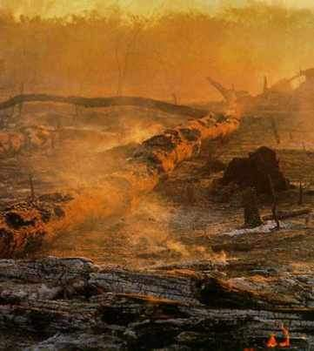
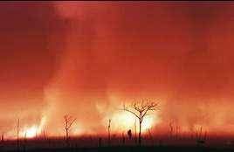
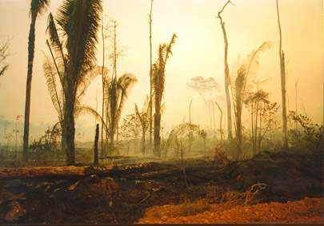
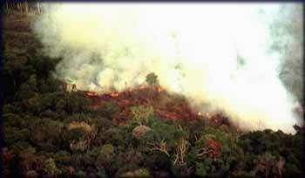
Fire...
… will not become a waste land?
Source: Carlos Nobre (INPE)

Slide 7
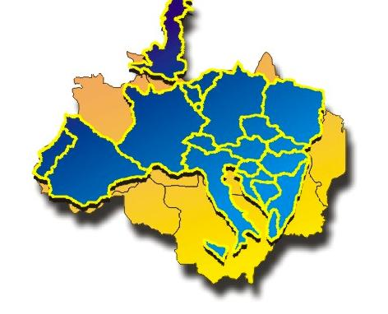
Amazonia and Europe
Brazilian Amazonia : 4.5 million km²
European Union: 4.3 million km²

Slide 8
Foundations of modern democracies
source: Fukuyama (2011)
State (power by technical staff)
Rule of law
(limits power)
Society
(public accountability)
How the interplay between science,
public opinion and government?

Slide 9
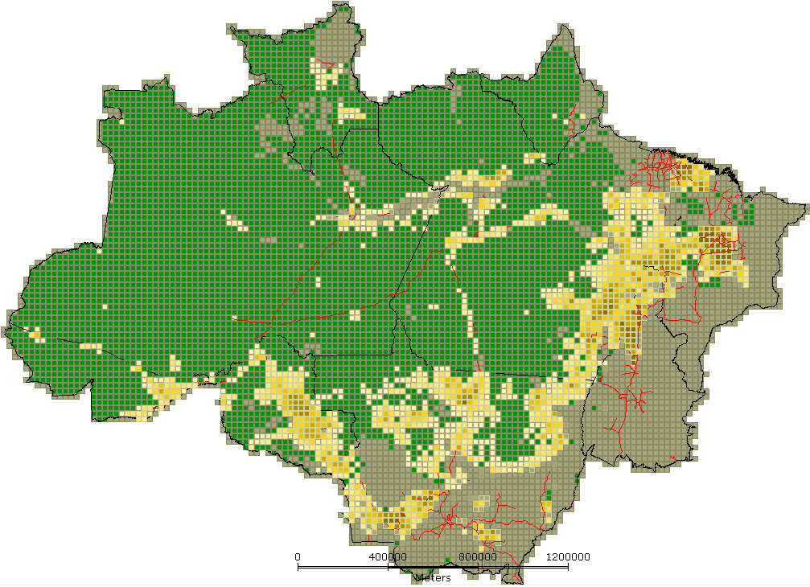
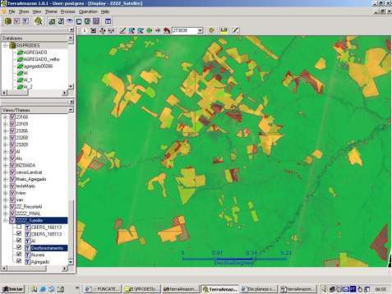
INPE: Clear-cut deforestation mapping of Amazonia since 1988
~230 scenes Landsat/year
Yearly detailed estimates of clear-cut areas (wall-to-wall)
Data released openly after 2003

Slide 10
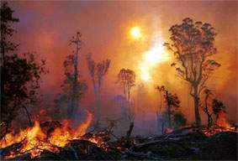
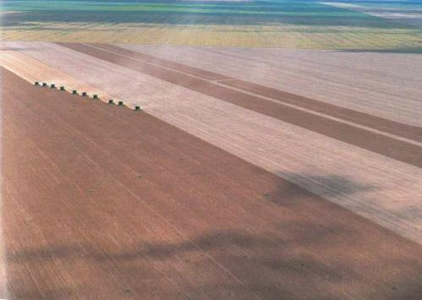
Global Change
How does change occurs?
How much change is happening?
Where are changes taking place?
Who is causing change?
What are the impacts of public policies?
What will happen in the future?

Slide 11
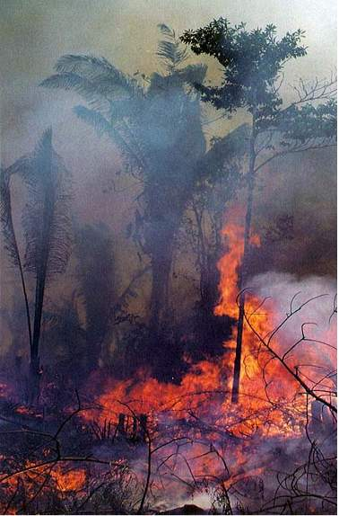
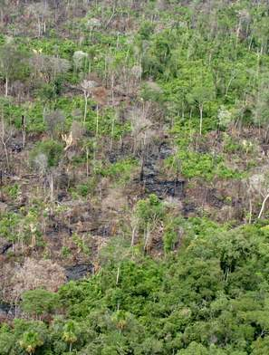
How does deforestation happen?
Slash and burn
Progressive degradation

Slide 12
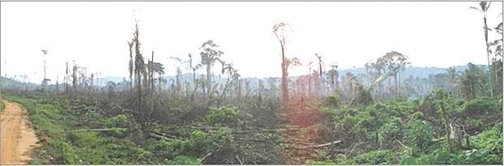
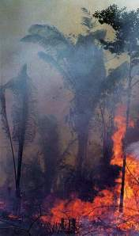
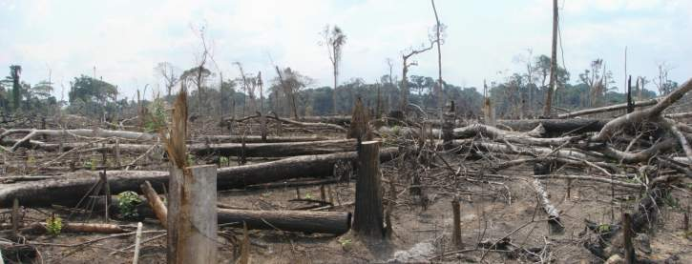
Slash and burn
Slash: start of dry season
Burn: end of dry season

Slide 13
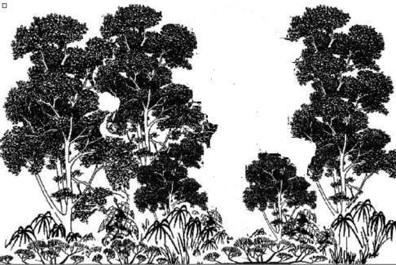
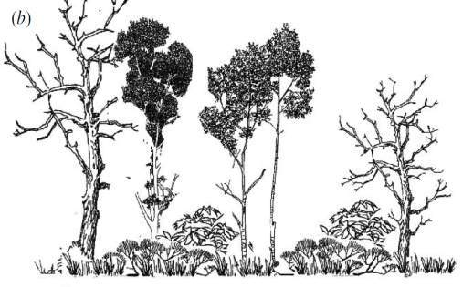
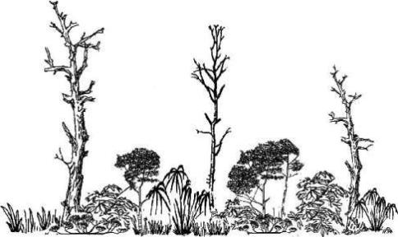
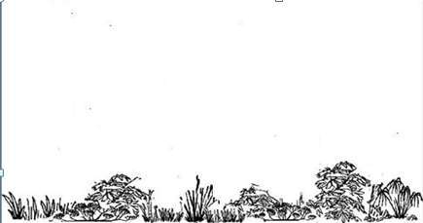
Progressive degradation
Barlow and Peters (2008)
Selective logging
Wood extraction and burning
Further burning and pasture
Clear cut

Slide 14
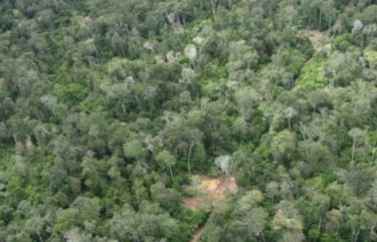
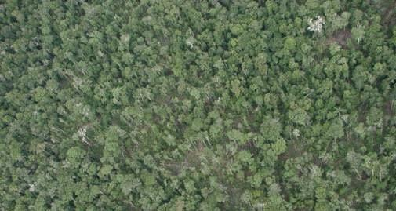
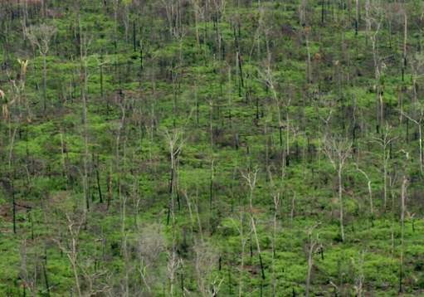
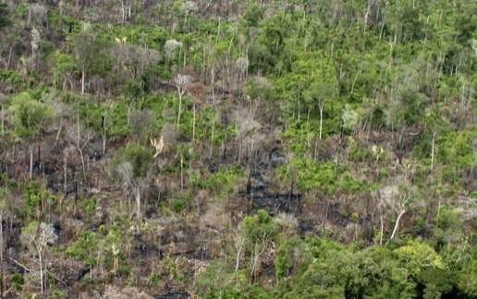
How does deforestation happen?
T1 – Selective logging
T2 – Loss of smaller trees
T3 – Loss >50% of forest
T4 – Loss >90% of forest

Slide 15
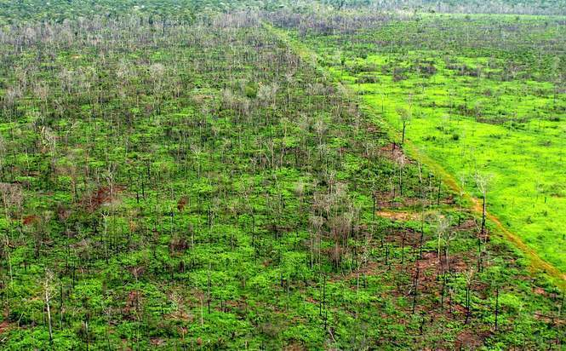
Final = Clear cut
Pasture

Slide 16

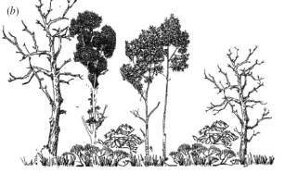

INPE’s Monitoring Systems
dialy deforestation alerts
time
Yearly rates of clear cuts
Floresta

Slide 17
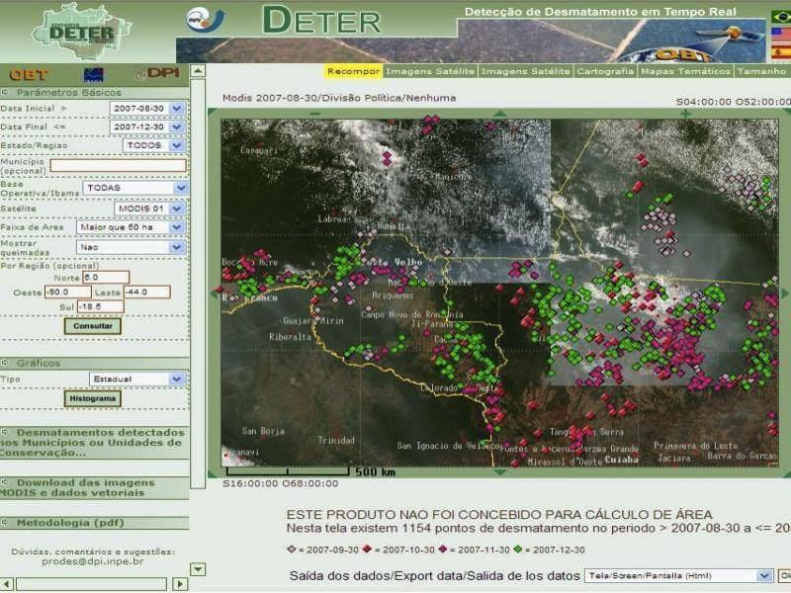

Real-time Deforestation Monitoring
Daily warnings of newly deforested large areas

Slide 18
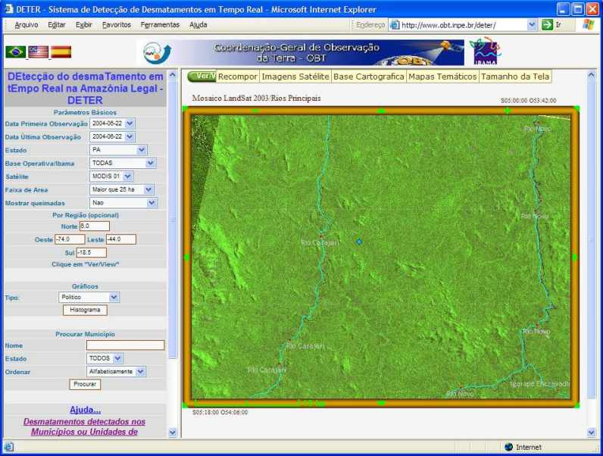
Altamira (Pará) – LANDSAT Image – 22 August 2003

Slide 19
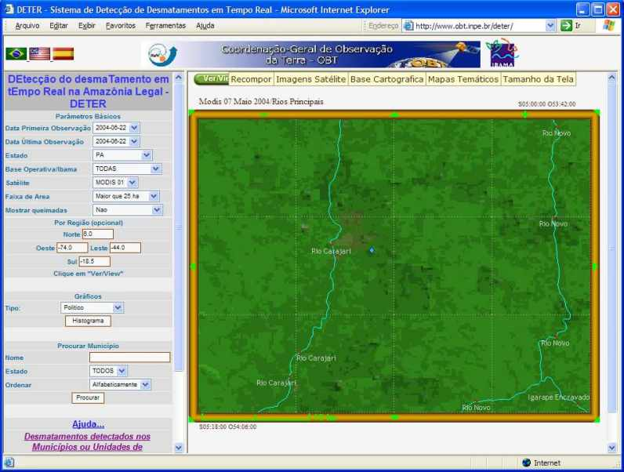
Altamira (Pará) – MODIS Image – 07 May 2004

Slide 20
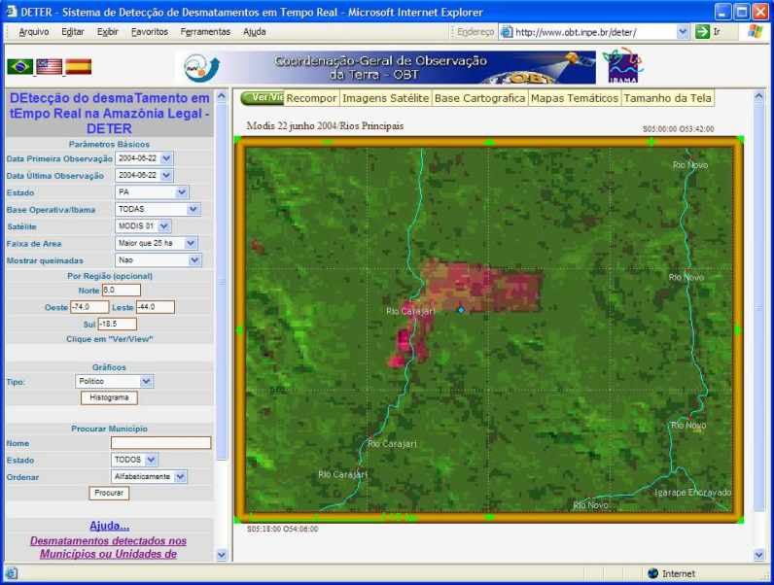
Altamira (Pará) – MODIS Image – 22 June 2004
6.000 hectares deforested in one month!

Slide 21
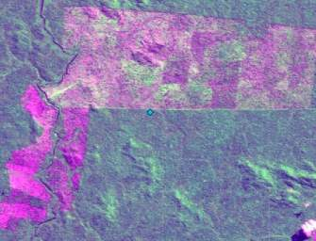
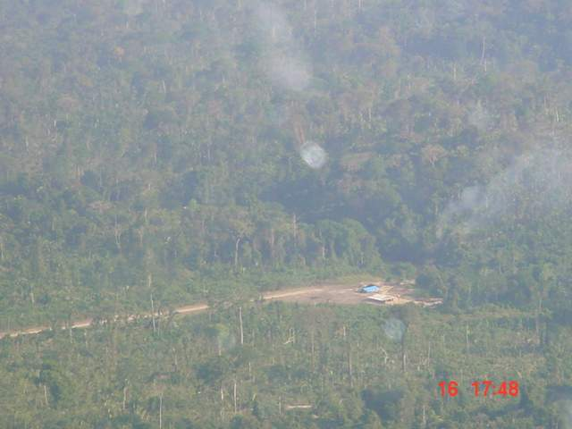
Go to the field....

Slide 22
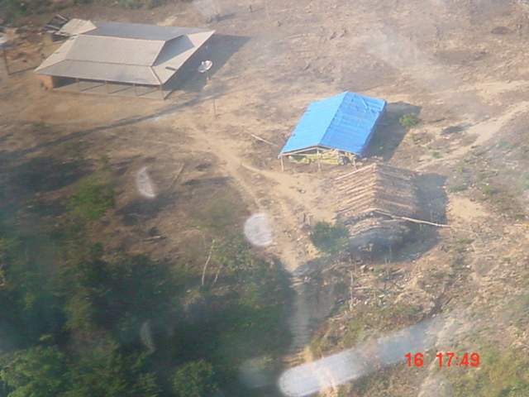
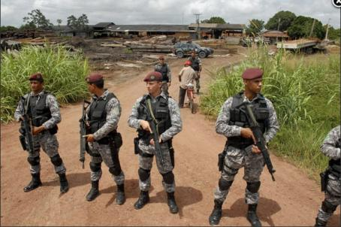
...and get the bad guys!

Slide 23
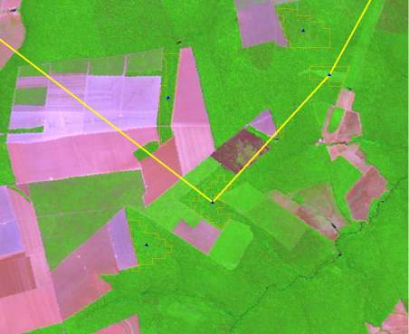
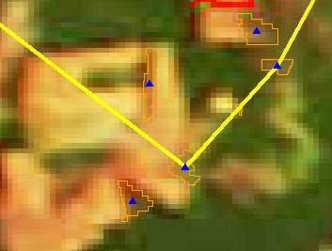
How hard is to use MODIS images to detect deforestation?
Landsat/TM
August 2007
MODIS
November 2007
Alerta DETER nov-2007

Slide 24
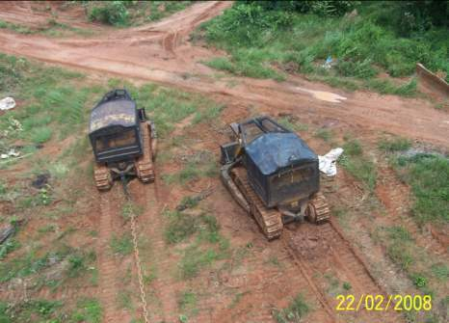
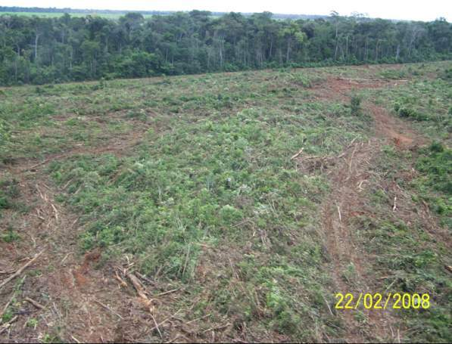
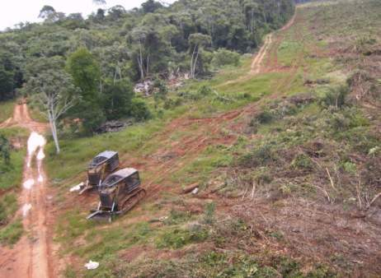
Checking DETER´s data (February 2008)
Clear-cut for pasture

Slide 25
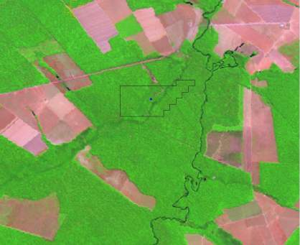
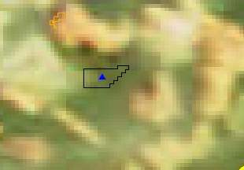
How hard is to use MODIS images to detect deforestation?
New deforestation shown by DETER
Landsat/TM 226/68
17/Ago/2007
DETER out-2007

Slide 26
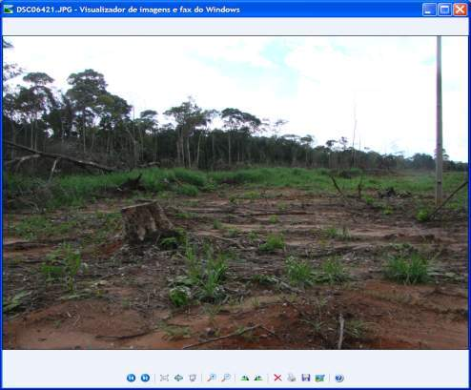
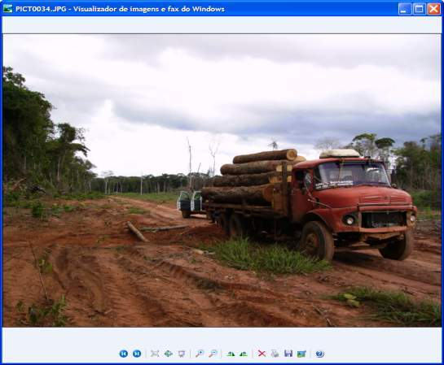
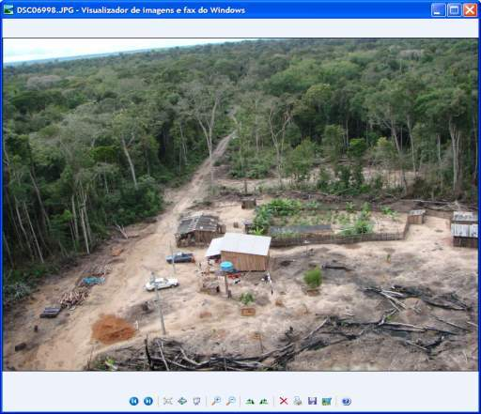
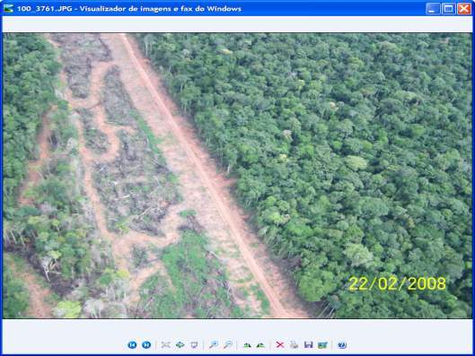
Intensive timber extraction
Exploração – estágio inicial

Slide 27
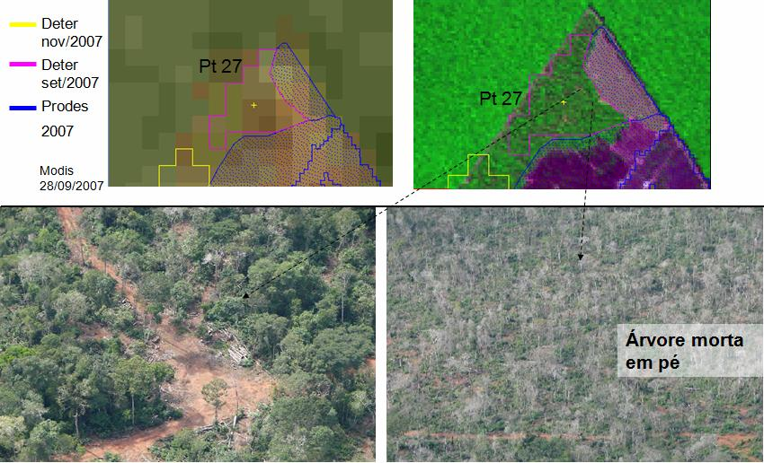
Monitoring forest degradation
(S 12,27⁰ ; W 54,13⁰)

Slide 28




Reaching out to public policy
500.000 registrations
46 million protests

Slide 29


Transparency builds credibility
“Today, Brazil’s monitoring system is the envy of the world. INPE provides
automated bi-weekly alerts that
other tropical nations would love to emulate.”

Slide 30

Protected areas and deforestation (1997)

Slide 31

Protected areas and deforestation (2000)

Slide 32

Protected areas and deforestation (2001)

Slide 33

Protected areas and deforestation (2002)

Slide 34

Protected areas and deforestation (2003)

Slide 35

Protected areas and deforestation (2004)

Slide 36

Protected areas and deforestation (2005)

Slide 37

Protected areas and deforestation (2006)

Slide 38

Protected areas and deforestation (2007)

Slide 39

Protected areas and deforestation (2008)

Slide 40

Finding: Protected areas deter deforestation

Slide 41

Finding: Deforestation is becoming harder to detect
Proportion of clear cuts by size (ha)
Clearings less than 50 ha: 35% of total in 2002 to 80% of total in 2010

Slide 42

For a while, everything was well...

Slide 43




Then, in January 2008...

Slide 44


What do you do when you make an error?

Slide 45



Slide 46



Public opinion – based on open data – forces government to act

Slide 47

Finding: Command and control actions are effective means to curb deforestation
Almost all deforestation is illegal

Slide 48


Keep watching!
Jan-April/2011: 126% increase

Slide 49

Deforestation hotspots: March-May 2011

Slide 50

Deforestation hotspots: June-August 2011

Slide 51




Finding: Markets have a positive rôle

Slide 52


“By 2020, Brazil will reduce deforestation by 80% relative to 2005.” (pres. Lula in Copenhagen COP-15)

Slide 53

How does Science influence policy?
Deforestation in Brazilian Amazonia (1988-2012)
dropped from 27,000 km² to 4,800 km²

Slide 54

“Deforestation in Brazilian Amazonia is down by a whopping 78% from its recent high in 2004. If Brazil can maintain that progress it would be the biggest environmental success in decades” (Nature, Rio + 20 editorial)

Slide 55

How much it takes to survey Amazonia?
116-112
30 Tb of data
500.000 lines of code
150 man/years of software dev
200 man/years of interpreters
116-113
166-112
Notes:
Cena de maior prioridade utilizou imagens CBRES na s tres principais areas: 166-112, 165-113 2 166-113. Sendo complementada por imagem TM

Slide 56

What happened with 720.000 km2 deforested?
TerraClass - first map of land use and land cover of Amazonia

Slide 57


Nível inédito de detalhe espacial: 20 m (CBERS) e 30 m (LANDSAT)
Pasto limpo

Slide 58

Agriculture (grains)

Slide 59

Cleared pasture

Slide 60

Degraded pasture

Slide 61

Small-scale agriculture

Slide 62

Degraded land

Slide 63
How are we using the forest?

Slide 64
The extent of illegal deforestation

Slide 65
Class | TOTAL (km²)
Clean Pasture | 335.714,94 | 46,7%
Secundary Vegetation | 150.815,31 | 21,0%
Dirty pasture | 62.823,75 | 8,7%
Regeneration with pasture | 48.027,37 | 6,7%
Non-observed areas | 45.406,27 | 6,3%
Agriculture (large-scale) | 34.927,24 | 4,9%
Small farms and settlers | 24.416,57 | 3,4%
Urban areas | 3.818,14 | 0,5%
Mining | 730,68 | 0,1%
Degraded areas | 594,19 | 0,1%
Others | 477,88 | 0,1%
Desflorestation 2008 | 11.458,64 | 1,6%
TOTAL | 719.210,99

Slide 66


Challenges in monitoring
Deforestation classes per area
2000
2001
2002
2003
2004
2005
2006
Less than 10 ha
5%
4%
6%
8%
9%
9%
10%
10 a 25 ha
11%
6%
12%
14%
16%
20%
25%
Aumento
25 a 50 ha
11%
5%
11%
11%
13%
16%
19%
50 a 100 ha
12%
6%
13%
12%
13%
14%
16%
Estável
100 a 150 ha
8%
3%
8%
7%
7%
7%
7%
150 a 300 ha
12%
6%
14%
12%
11%
11%
10%
More than 300 ha
38%
68%
31%
32%
27%
22%
13%
Redução
Tendência de Aumento
Aproxim. Estável
Tendência de Redução

Slide 67




Working hypothesis
The Brazilian Amazon has different institutional arrangements that influence the spatial and temporal patterns of deforestation.
Notes:
In distinct socioeconomic, biophysical and political contexts, multiple actors and institutional arrangements contribute to shape the different trajectories of changes in the region, which translates into diverse rates and patterns of land change in space and time.

Slide 68



Deforestation event detection: coverages and time series
2010
2011

Slide 69

How much it takes to survey Amazonia?
116-112
30 Tb of data
500.000 lines of code
150 man-years of software dev
200 man-years of interpreters
116-113
166-112
Notes:
Cena de maior prioridade utilizou imagens CBRES na s tres principais areas: 166-112, 165-113 2 166-113. Sendo complementada por imagem TM

Slide 70
TerraAmazon: infrastructure for management of deforestation data
Fifteen years of remote sensing images,
deforestation polygons and forest fire occurrences
in a single information system

Slide 71


GeoDMA: Data mining using geospatial data
Classification and clustering of objects
extracted from remote sensing images
M. Silva et al., “Remote sensing image mining: detecting agents of land use change in tropical forest areas”. Int Journal Remote Sensing, 29 (16): 4803 – 4822, 2008.
T. Korting et al., “GeoDMA—Geographic Data Mining Analyst”. Computers & Geosciences, 57:133–145,2013.
Notes:
É uma ferramenta que usa técnicas de data mining para classificar e identificar padrões em imagens de sr.
Est;a dispon;ivel na forma de plugi do terraview
É fruto de uma tese de doutorado, o aluno agora faz parte do time de desenvolvimento da TL.

Slide 72
Occupation patterns in Amazonia
Different human actions, different patterns
Notes:
This tool has being used to identify patterns of occupation footprints in Amazonia.
This table shows all the patterns informed by an specialist in order to prepare a complete map with the occupation footprints.
In this column we have some image samples, in this columns we have the deforestation patterns as indicated by an specialist, its desciption and semantics
NOME-DO-PADRAO; DESCRICAO DO PADRAO

Slide 73

GeoDMA: Classification of patterns of deforestation
Map shows main patterns in a 50 km x 50 km cell
Notes:
Here we have the resulting map where each cell was given a deforestation pattern.
The final classification is done for cells…

Slide 74




TerraME: nature-society modelling
Space Agent
Agent Space
Nature represented in cellular spaces, society represented as agents
T. Carneiro, P. Andrade, et al., “An extensible toolbox for modeling nature-society interactions”. Enviromental Modelling and Software, 2013 (Two PhDs).
Notes:
TerraME is…
It is capable of accessing data in a spatial database through terralib
It has

Slide 75
Deforestation: simulated x observed

Slide 76
Frontier evolution in Sao Felix
Consolidated (dark red), pre-frontier (light red), frontier (light green) and post-frontier (dark green).

Slide 77
Foundations of modern democracies
source: Fukuyama (2011)
State (power by technical staff)
Science
State
Institutions
Rule of law
(limits power)
Society
(public accountability)

Slide 78

Finding: Transparency builds governance!
CBERS image
Degradation
Deforestation
Science (27 April 2007): “Brazil´s monitoring system is the envy of the world”.
Notes:
Este slide mostra uma imagem CBERS-2B da região de Marcelândia, norte de Mato Grosso. A imagem foi composta por uma imagem monocromática de alta resolução HRC (2,5 m) com uma imagem multespectral CCD (20 m). A imagem mostra que é possivel identificar com o sensor HRC, alem de desmatamentos por corte raso (áreas claras na imagem), as áreas de degradação florestal (áreas verdes com partes claras).

