Slide 1
Global change and sustainable development: towards a research agenda for Brazilian science
MIT-ITV workshop, March 2012
Gilberto Câmara
National Institute for Space Research (INPE)

Slide 2
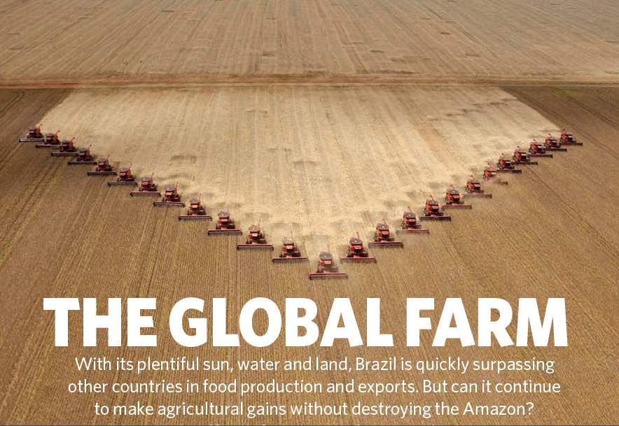
Nature, 29 July 2010

Slide 3
Nature, 29 July 2010
Brazil is the world’s current largest experiment on land change and its effects: will it also happen elsewhere?
Today’s questions about Brazil could be tomorrow’s questions for other countries

Slide 4

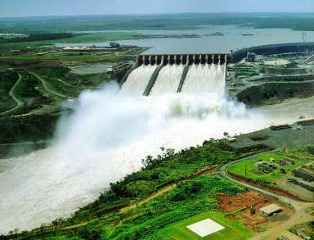
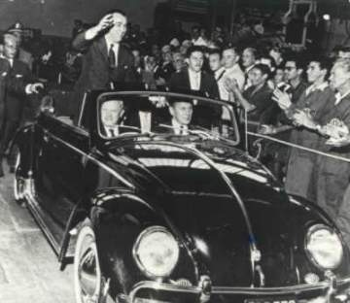
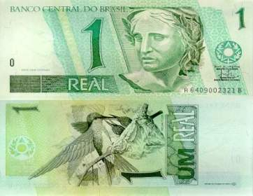
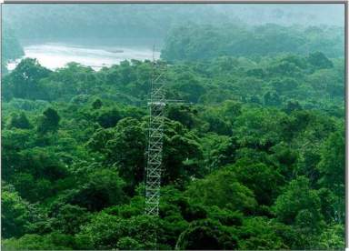
National projects – Brazil 1950-2010
1950s
1970s
Itaipu, Angra, Embraer,
Foreign dept, export substitution
Industrialization, Petrobrás
1990s
2010s
Privatization, superavit,
Economic stability
Amazônia, biofuels, Brazil in G-20

Slide 5
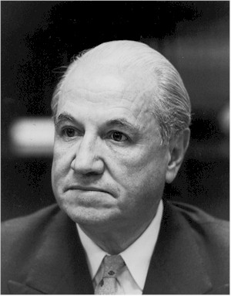
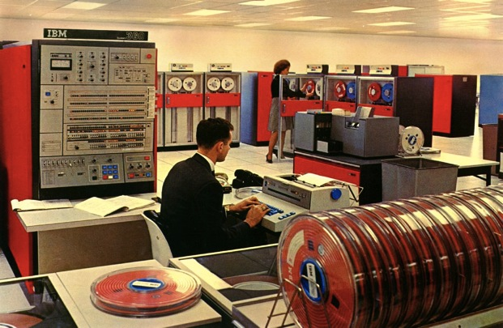
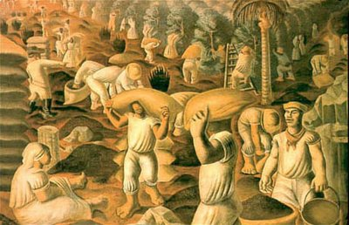
Traditional development economics
Raul Prebisch (CEPAL): the terms of trade between industrialised and non-industrialised countries change over time
Countries that export commodities would be able to buy fewer and fewer manufactured
goods

Slide 6


What would Prebisch say today?
1992 IBM ThinkPad 700, Windows 3.1, 25 MHz 486 processor, 120 MB hard disk drive, 10.4″ display, 3 kg
2009 Lenovo ThinkPad T500, Windows Vista, Intel® Core™2 Duo processor (2.26GHz), 14.1” display, 3 kg, 160 GB Hard Disk.
1992 – US$ 4,350
2009 – US$ 750

Slide 7
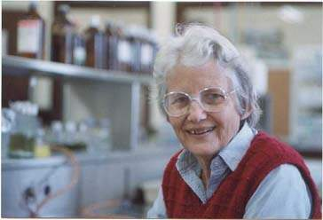
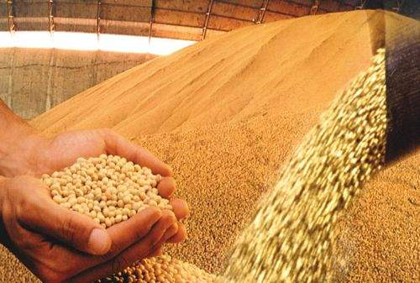
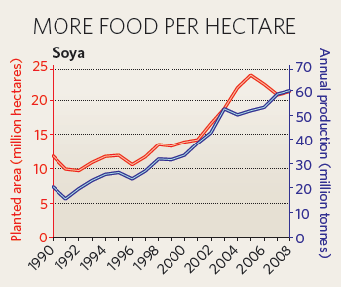
What would Prebisch say?
Soybean (ton)
1992 – US$ 209
2010 – US$ 484
Soy: 600 kg/ha in 1990
2.700 kg/ha in 2008
source: Index Mundi

Slide 8
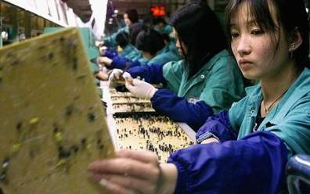
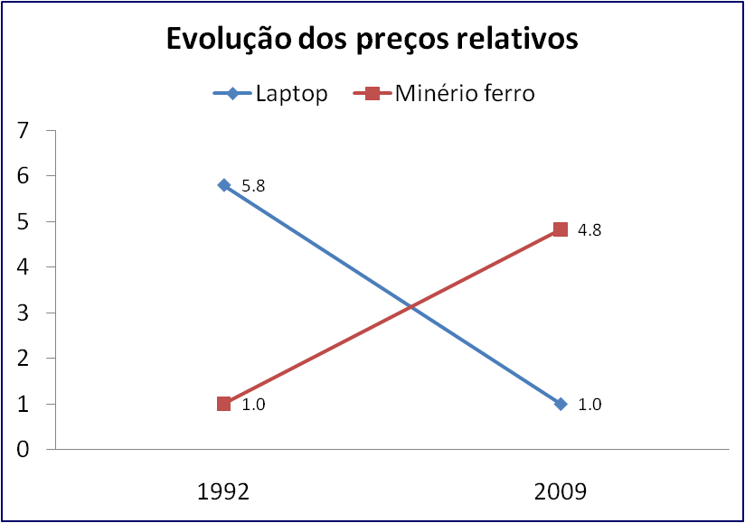
What happened? Terms of trade changed
China effect: Transfer of factories to China has reduced the price of manufactured goods and increased demand for commodities
Graph: G. Câmara, INPE Idea: J. Furtado, USP

Slide 9
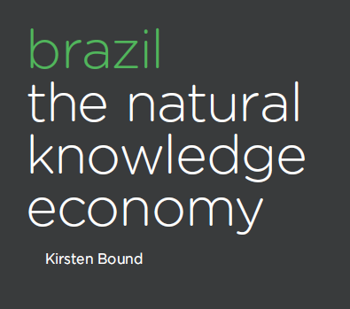
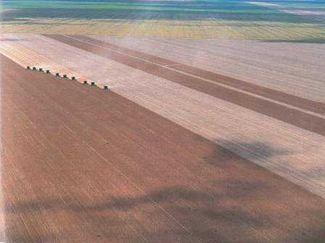
Brazil: a natural knowledge economy?
Brazil´s innovation system is in large part built upon its natural and environmental resources, endowments and assets.

Slide 10
Brazil: a natural knowledge economy?
We tend to regard a comparative advantage based on natural resources as indicative of an economy at a relatively immature stage in its development, one
that must be outgrown if it is to reach and start expanding the frontiers of technological possibility.
The Brazilian case, we suggest, challenges this linear
view.

Slide 11
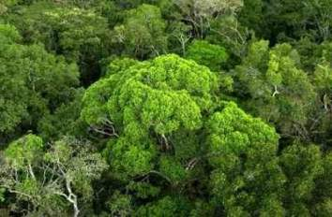
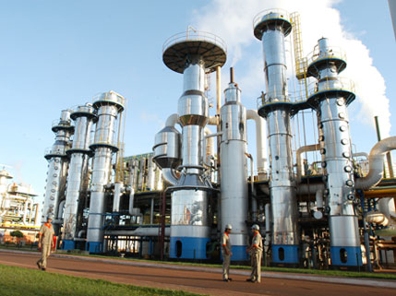
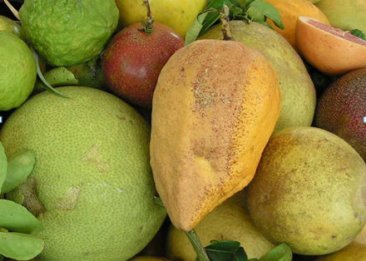
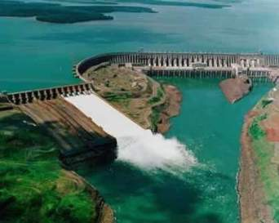
Brazil: a natural knowledge economy
Deforestation cut by 300% (2005-09)
Best technology in biofuels
World leader in tropical agriculture
46% of energy is renewable

Slide 12
The China effect

Slide 13

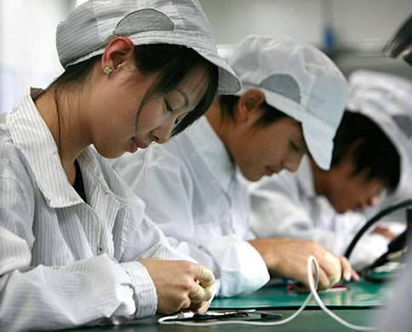
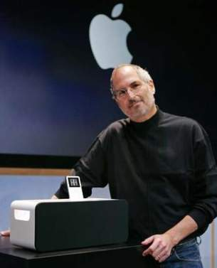
Where are the jobs? Where is the money?
Ipod: high technology (OECD)
ipod: exported by China, value added in California

Slide 14
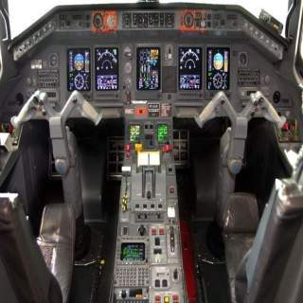
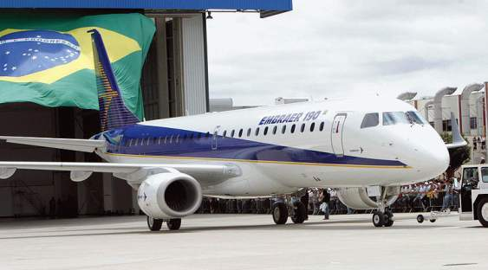
Where are the jobs? Where is the money?
Aerospace: high technology - OECD
EMBRAER EMB-190
EMB-190 avionics (Honeywell)
US avionics: high value on EMB planes

Slide 15
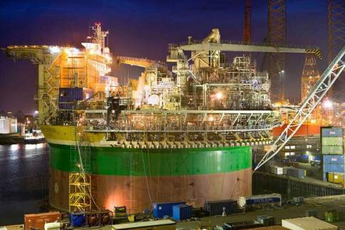
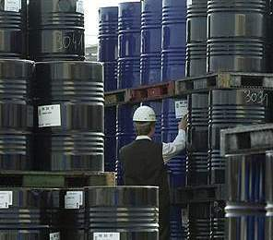
Will Brasil join OPEC?
Oil production: low technology (OECD)
Offshore platform
Brazilian oil exports
What will be the effects of the pre-salt on Brazilian economy?

Slide 16
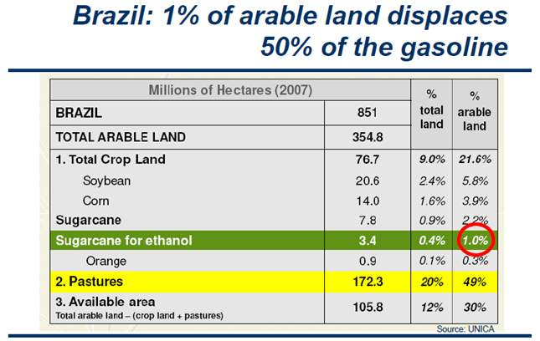
Fonte: CH Brito Cruz (FAPESP)

Slide 17
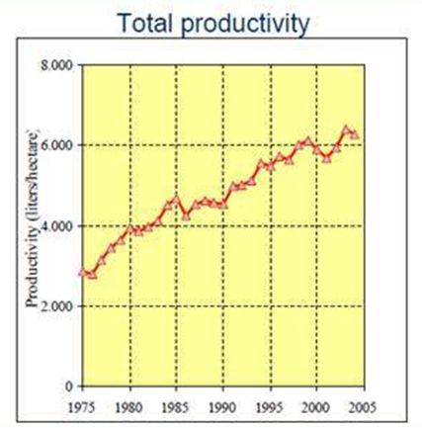
R&D impact on ethanol and soybeans
Ethanol: 2.800 litros/ha in 1975
6.000 litros/ha in 2005
Soya: 600 kg/ha in 1990
2.700 kg/ha in 2008
Fontes: CH Brito Cruz (FAPESP) e Nature

Slide 18
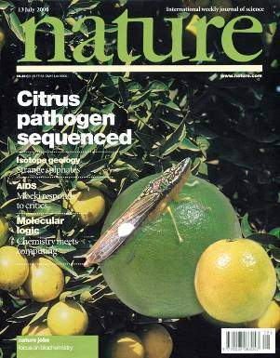
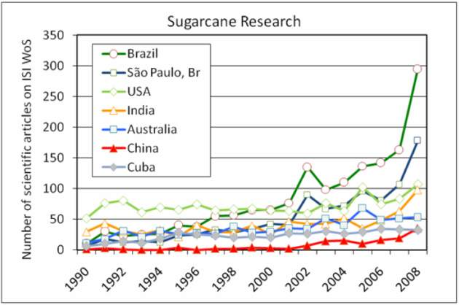
Prebisch´s paradox
source: CH Brito Cruz (FAPESP)
Brazil´s natural knowledge economy offers more opportunities for internal R&D than our manufacturing industry

Slide 19
Brazilian science and the Capricorn triangle
100%
Mathematics
Physics
Computer Science
External
Agenda
Engineering
Chemistry
Ecology and Environment
Tropical Health
Tropical Agriculture
Internal agenda
100%

Slide 20
Brazil’s science(% of world)
fonte: ISI

Slide 21
Brazilian science and the Capricorn triangle
100%
1,8%
2,3%
1,3%
1,4%
1,8%
2,7%
3,0%
5,4%
Mathematics
Physics
Computer Science
External
Agenda
Engineering
Chemistry
Ecology and Environment
Tropical Health
Tropical Agriculture
Internal agenda
100%

Slide 22
Brazilian science and the Capricorn triangle
100%
1,8%
2,3%
1,3%
1,4%
1,8%
2,7%
3,0%
5,4%
Mathematics
Physics
Computer Science
External
Agenda
Engineering
Chemistry
Ecology and Environment
Tropical Health
Tropical Agriculture
Internal agenda
100%
The areas of greatest production of Brazilian science are linked to the natural knowledge economy

Slide 23

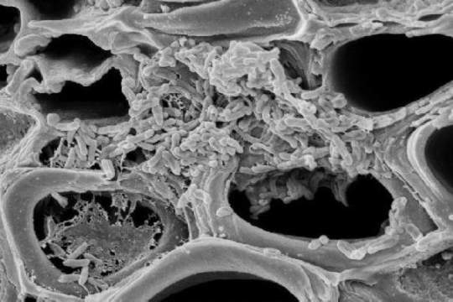
Challenge: Biotechnology increase agricultural productivity
Xyllela fastidiosa (10.000x)
Foto: E. Kitajima (ESALQ/USP).

Slide 24
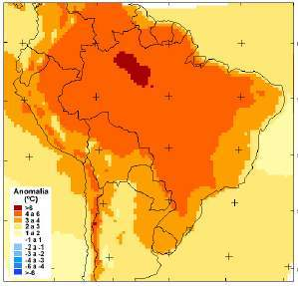
Challenge: Climate change adaptation
Aumento temperatura 2100
(C. Nobre e J. Marengo, INPE)
Impactos das mudanças do clima na agicultura
(E. Assad, EMBRAPA)
Potential impact of climate change on Brazilian agriculture

Slide 25
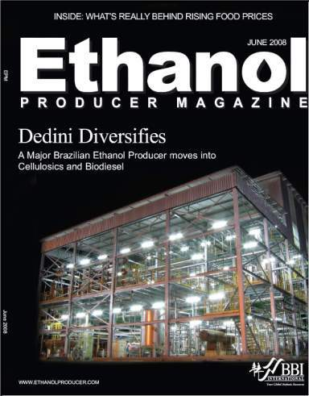
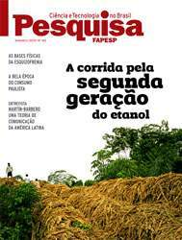
Challenge: renewable energy technology
Second-generation ethanol
Fonte: CH Brito Cruz, FAPESP

Slide 26
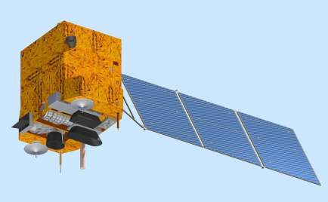
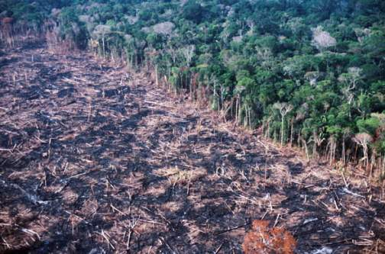
Challenge: space technology for sustainable development
Monitoring land change in Brazil by satellites

Slide 27
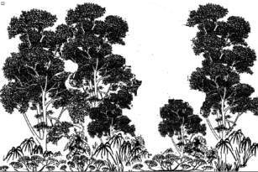
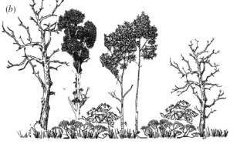

INPE’s Monitoring Systems
dialy deforestation alerts
time
Yearly rates of clear cuts
Floresta

Slide 28
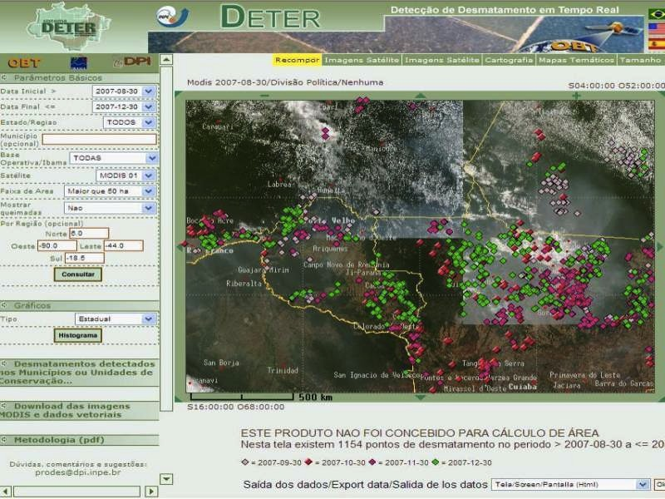

Real-time Deforestation Monitoring
Daily warnings of newly deforested large areas

Slide 29
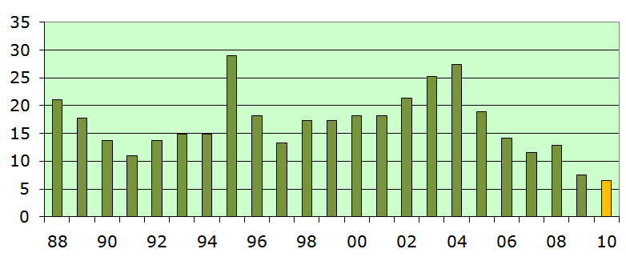
Result: major reduction in deforestation
Markets? Credit crunch? Coercion? Institutional arrangments?

Slide 30
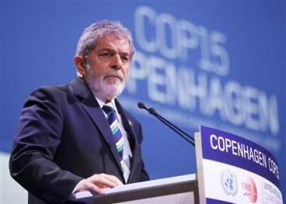
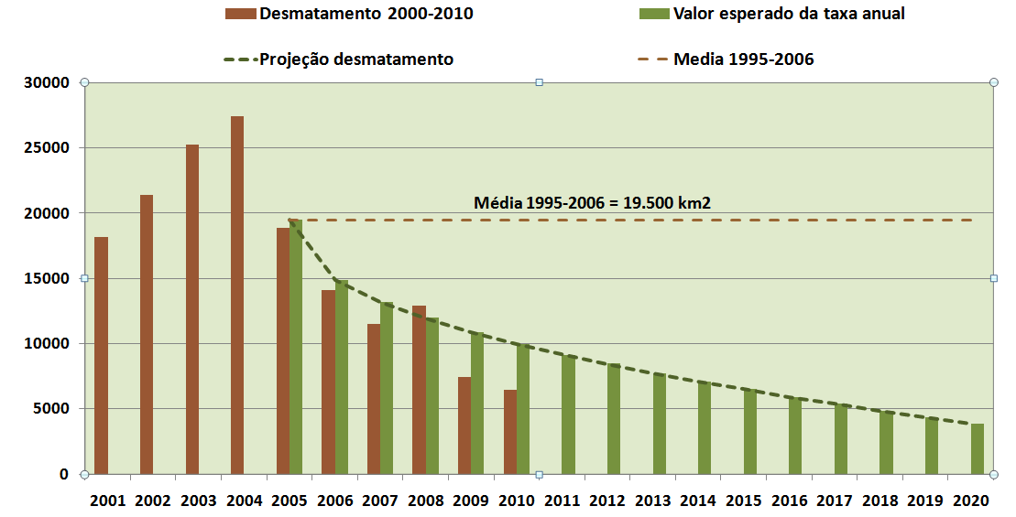
“By 2020, Brazil will reduce deforestation by 80% relative to 2005.” (pres. Lula in Copenhagen COP-15)

Slide 31
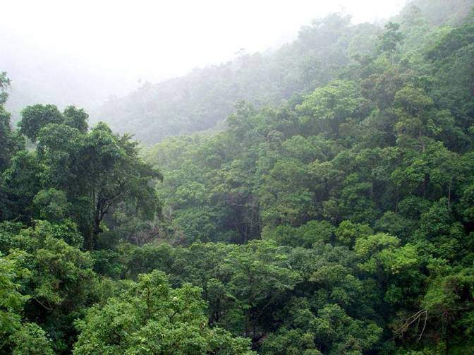
Market impact of deforestation reduction in Brazil
Avoided def Brazil
2005-2020
EU-15 reduction 2005-2020
20% of 1990 levels
4,9 Gt CO2eq
7,7 Gt CO2eq
From 2005 to 2020, avoided deforestation by Brazil would be 2/3 of the total proposed EU-15 cuts

Slide 32
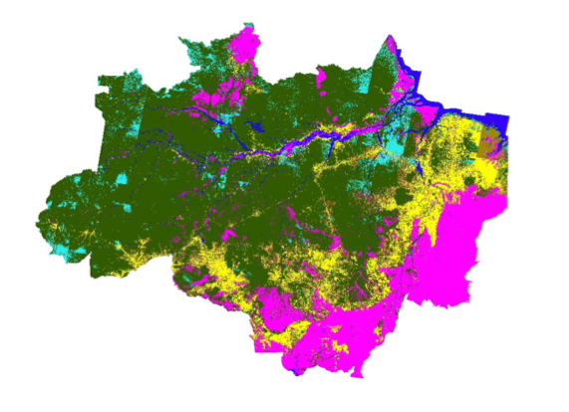
What happened with 720.000 km2 deforested?
First map of land use and land cover of Amazonia

Slide 33
How are we using the forest?

Slide 34
The extent of illegal deforestation

Slide 35
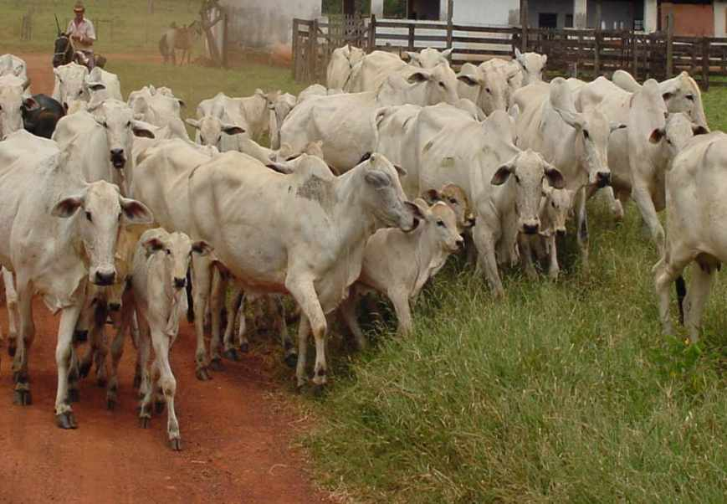
foto: Edson Sano (EMBRAPA)
Finding: Extensive and unproductive cattle raising is the main use of deforested areas
Cattle in Amazonia
 | 1992 | 2009 | head/ha
Legal Amazonia | 30 million | 70 million
Pará |  | 17 million | 1,15

Slide 36
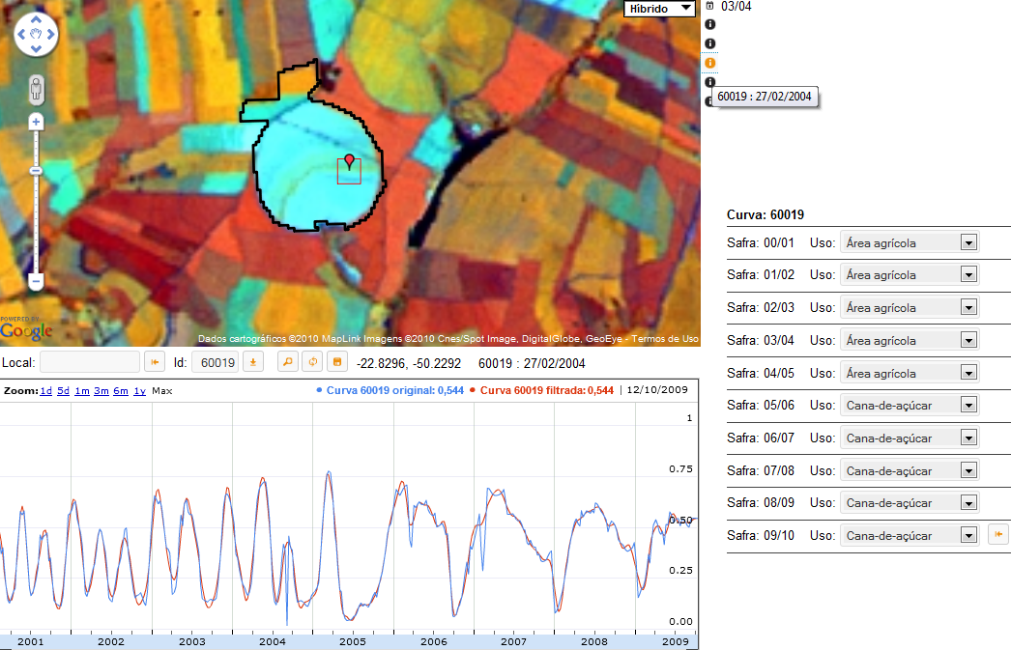
Are biofuels replacing food production in Brazil?
source: B. Rudorff, INPE

Slide 37
Are biofuels replacing food production in Brazil?

Slide 38


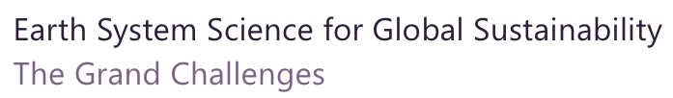

Slide 39
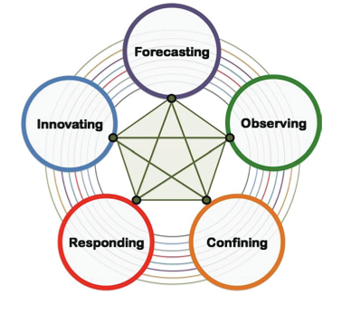
ICSU “Grand challenges”
Improve the usefulness of forecasts of future environmental conditions and their consequences for people.
Develop, enhance and integrate the observation systems needed to manage global and regional environmental change.
Determine what institutional, economic and behavioural changes can enable effective steps toward global sustainability.

Slide 40
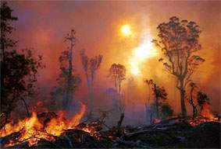
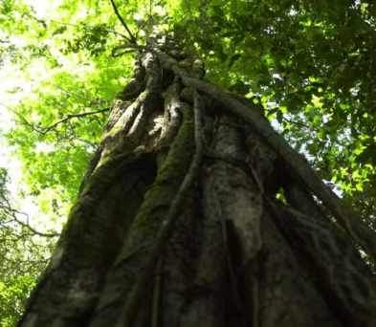
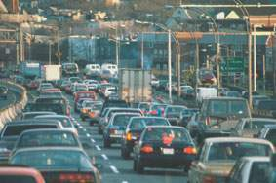

Global Change
Human actions and global change
photo: C. Nobre
Where are changes taking place?
How much change is happening?
Who is being impacted by the change?
photo: A. Reenberg

Slide 41


Earth system science needs to model the interactions between nature and society
Nature: Physical equations
Describe processes
Society: Decisions on how to
Use Earth´s resources

Slide 42





Full and open access to space-based information is indispensable for global sustainable development

Slide 43

“A few satellites can cover the entire globe, but there needs to be a system in place to ensure their images are readily available to everyone who needs them. Brazil has set an important precedent by making its Earth-observation data available, and the rest of the world should follow suit.”

Slide 44

CBERS as a global satellite
Urumchi
Miyun
Maspalomas
Aswan
Ghuangzhou
Chetumal
Bangcoc
Boa Vista
Gabon
Malindi
Darwin
Cuiabá
Alice Springs
Jo´burg
CBERS ground stations will cover most of the Earth’s land mass between 30⁰N and 30⁰S

Slide 45

Global Land Use 2010-2030
1.5 G Ha
Arable Land
3.5 G Ha
Pastures…
Additional Arable Land
0.2 to 0.5 G Ha ?
4 G Ha
Forests…
4.5 G Ha
Deserts, Cities, Etc.

Slide 46
Food Security?
Utilisation : 2 184 Mt
Production : 2 177 Mt
~ 700 M Ha
3,1 T/Ha
18%
Others
14%
Maize
Rice
35%
20%
Wheat
Stock : 457 Mt = 2.5 mois
Trade : 265 Mt = 12% /utilis.
31%

Slide 47
Changes in dietary patterns: Meat consumption
FAOSTAT 2007

Slide 48


Productivity and prices: the challenge

Slide 49

The food challenge

Slide 50


The food challenge: technology gaps

Slide 51

Forests and food production: potential conflicts

Slide 52
ICSU “Grand challenges”
Improve the usefulness of forecasts of future environmental conditions and their consequences for people.
Develop, enhance and integrate the observation systems needed to manage global and regional environmental change.
Determine what institutional, economic and behavioural changes can enable effective steps toward global sustainability.

Slide 53

source: Global Land Project Science Plan (IGBP)

Slide 54




Modelling nature-society interactions
  What models are needed to describe human actions?

Slide 55
Modelling nature-society interactions
What types of spatial relations exist in nature-society models?

Slide 56

Modelling nature-society interactions
How do we combine independent multi-scale models with feedback?

Slide 57
Modelling nature-society interactions
photos: Isabel Escada
How can we express behavioural changes in human societies?
When a small farmer becomes a medium-sized one, his behaviour changes
Medium-Sized Farmers
Small Farmers

Slide 58


Slides from LANDSAT
images: USGS
Modelling Nature-Society Interactions
How do humans use space?
How to describe and predict changes resulting from human actions?
What computational tools are needed to model nature-society interactions?
Aral Sea
1973
1987
2000
Bolivia
1975
1992
2000

Slide 59

ICSU “Grand challenges”: a bit of ancient wisdom
Be careful what you wish for….

