Slide 1
Land system modelling for a sustainable world
Gilberto Câmara, INPE
Licence: Creative Commons ̶̶̶̶ By Attribution ̶̶̶̶ Non Commercial ̶̶̶̶ Share Alike
http://creativecommons.org/licenses/by-nc-sa/2.5/

Slide 2
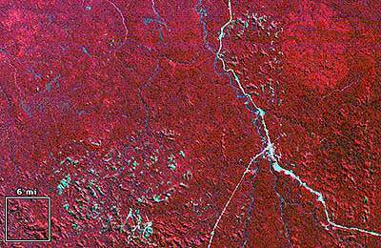
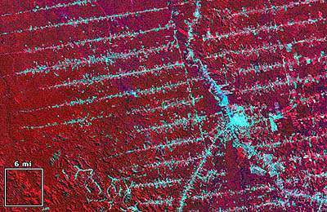
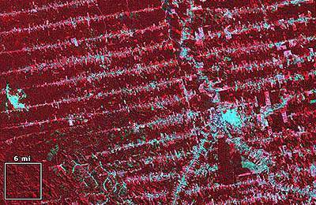
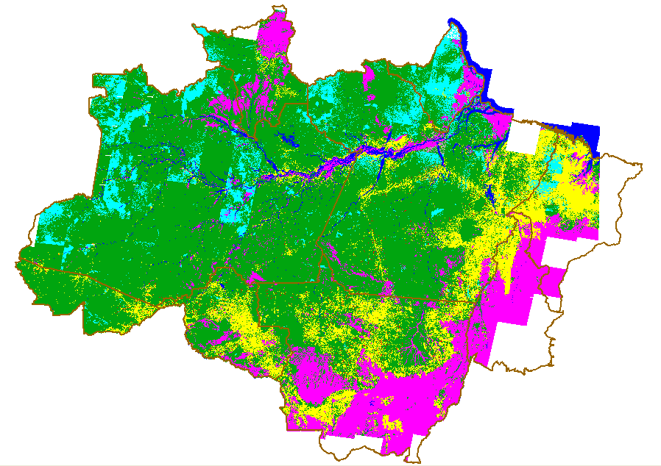
1975
1986
A new R&D agenda in Geoinformatics and Remote Sensing: modelling land change using large geospatial data sets
1992
Notes:
Amazon basin - Rondonia, Brazil

Slide 3

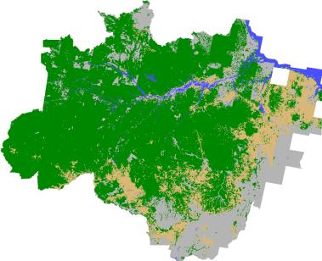
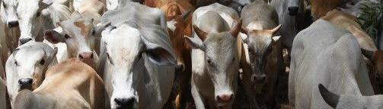
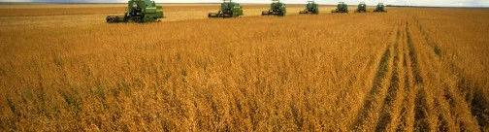
Two interrelated challenges: representation + modelling
(PRODES, 2008)
(Getty Images, 2008)
Representation: spatio-temporal partitions + attribute values

Slide 4


The representation problem as seen by Rafaello and Picasso

Slide 5
Spatio-temporal modelling
“A dynamical spatial model is a computational representation of a real-world process where a location on the earth’s surface changes in response to variations on external and internal dynamics on the landscape” (Peter Burrough)
f (I_{t})
f (I_{t+1})
f (I_{t+2})
f ( I_{t+n} )
F
F
. .
Dynamic Spatial Models need good representations

Slide 6
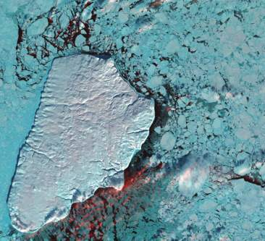
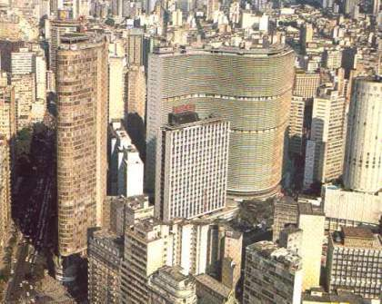
Nature-society interactions
Science explains how nature works by proposing laws
Science explains how society work by describing interactions

Slide 7
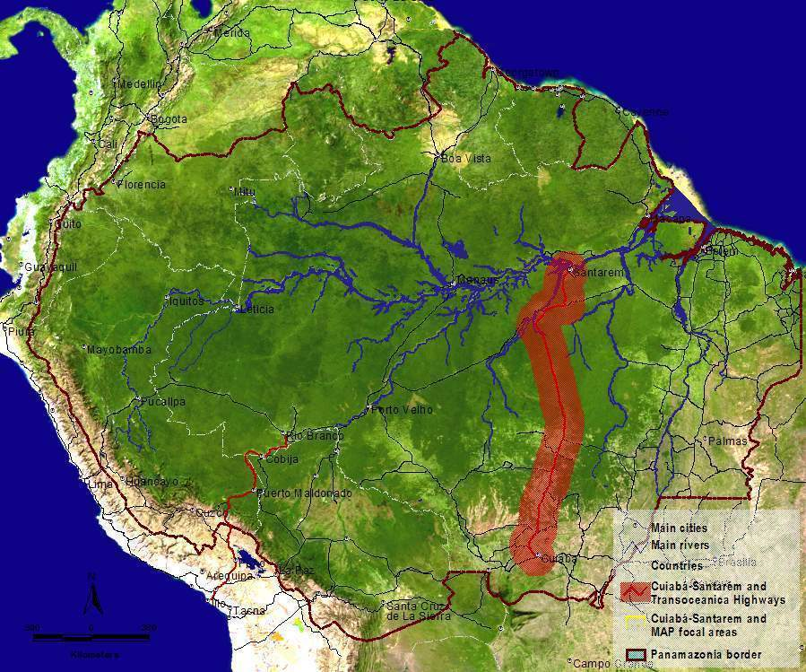
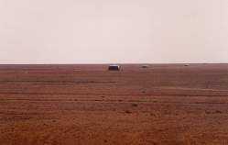
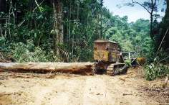
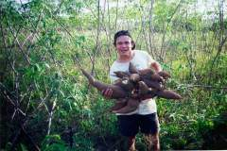
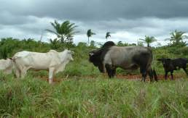
Land change: A quintessential spatial problem
Soybeans
Loggers
Small-scale Farming
Competition for land
Ranchers
Source: Dan Nepstad (Woods Hole)
Notes:
Temos que avaliar a potencialidade de uso das area em relacao aos seus usos

Slide 8
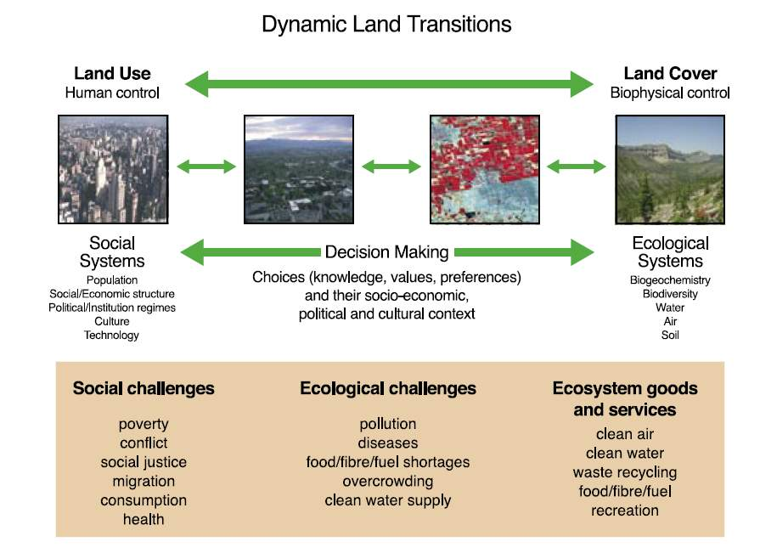
Land System
source: Global Land Project Science Plan (IGBP)

Slide 9
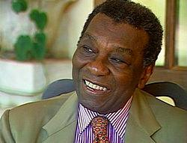
Learning from the classics: Milton Santos
“Forma, função, estrutura e processo, tomados individualmente, apresentam apenas realidades limitadas do mundo. Considerados em conjunto, esses conceitos constroem uma base teórica a partir da qual podemos discutir os fenômenos espaciais em totalidade”.
"Form, function, structure and process, taken individually, give us only a limited part of the world’s reality . Taken together, these concepts form a theoretical basis from which we can build a complete view of the geographical phenomena. "

Slide 10
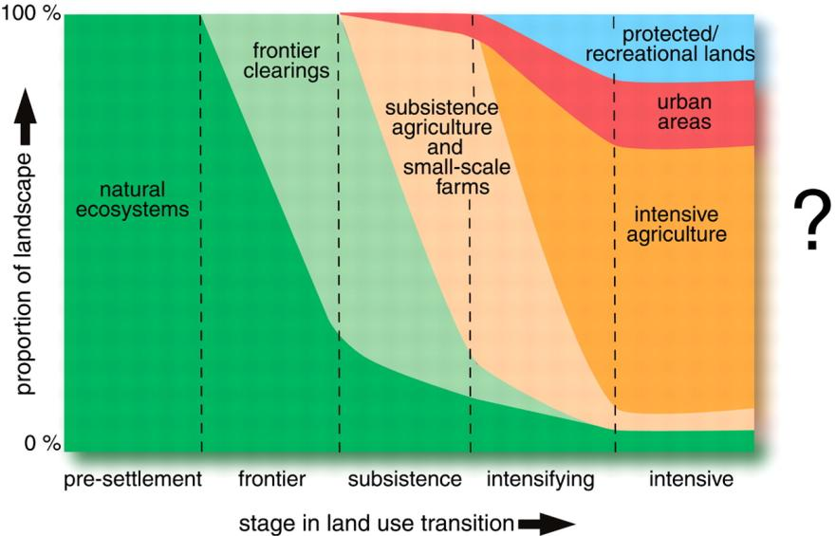
Land use transitions
source: Foley et al. (Science, 2007)

Slide 11

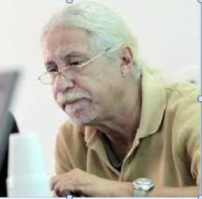
Why are most remote sensing researchers like Indiana Jones?

Slide 12


…because they search for the Holy Grail!

Slide 13
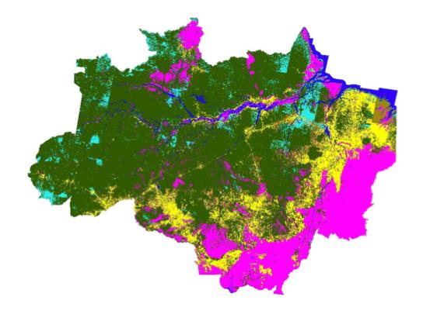
The unbearable lightness of PRODES
Map of complete transitions of forest to non-forest

Slide 14
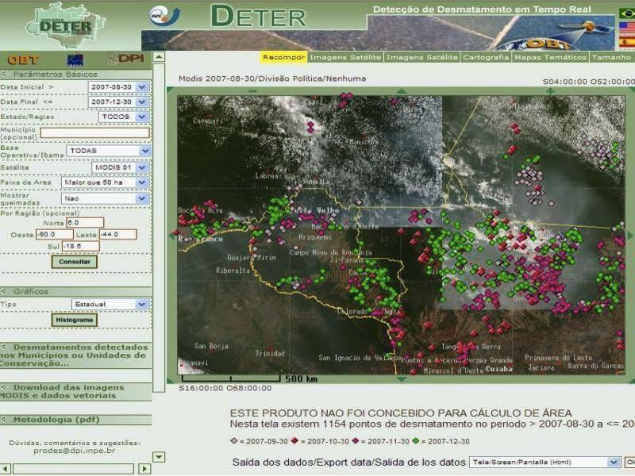

DETER’s simple ontology
Real-time Deforestation Monitoring
Daily warnings of newly deforested large areas

Slide 15
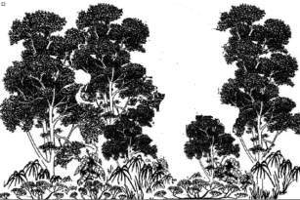
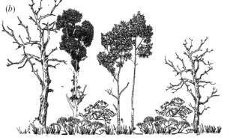
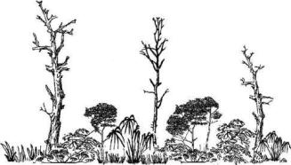

Event composition
Forest loss > 20%
Exploração intensiva
time
Event 1
Perda >50% do dossel
Loss > 50%
Event 2
Perda >90% do dossel
Loss > 90%
Event 3
Corte raso
Event 4
Clear cut
Floresta
Floresta

Slide 16
TerraClass tells us how are we using the deforested areas

Slide 17
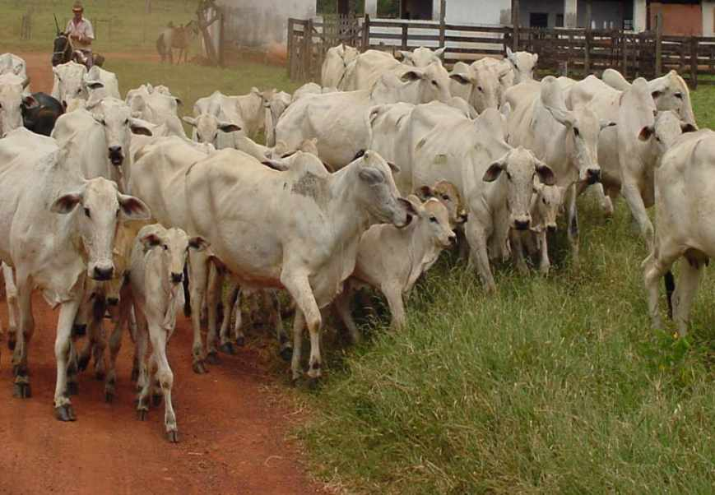
foto: Edson Sano (EMBRAPA)
Finding: Extensive and unproductive cattle raising is the main use of deforested areas
Cattle in Amazonia
 | 1992 | 2009 | head/ha
Legal Amazonia | 30 million | 70 million
Pará |  | 17 million | 1,15

Slide 18
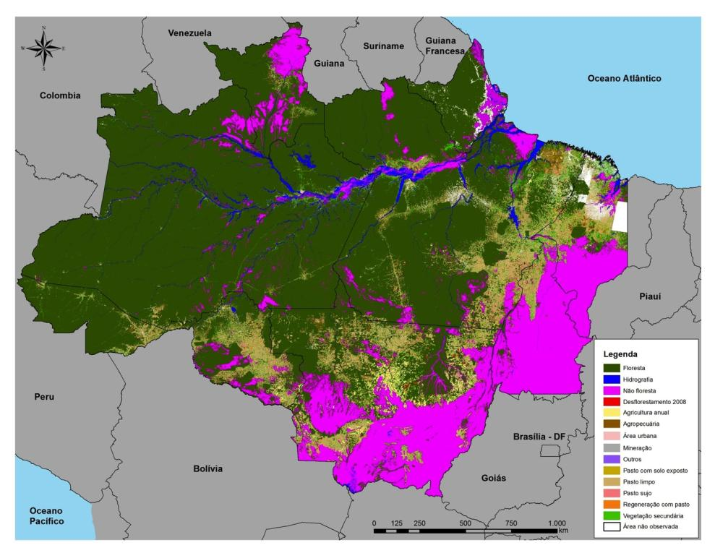
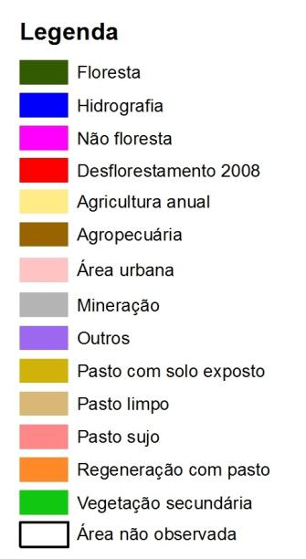
Informações Gerais
TerraClass: good information about deforested areas
No information about savannas
719 mil km² de informações de uso e cobertura distribuidos na Amazônia em 10 classes.

Slide 19
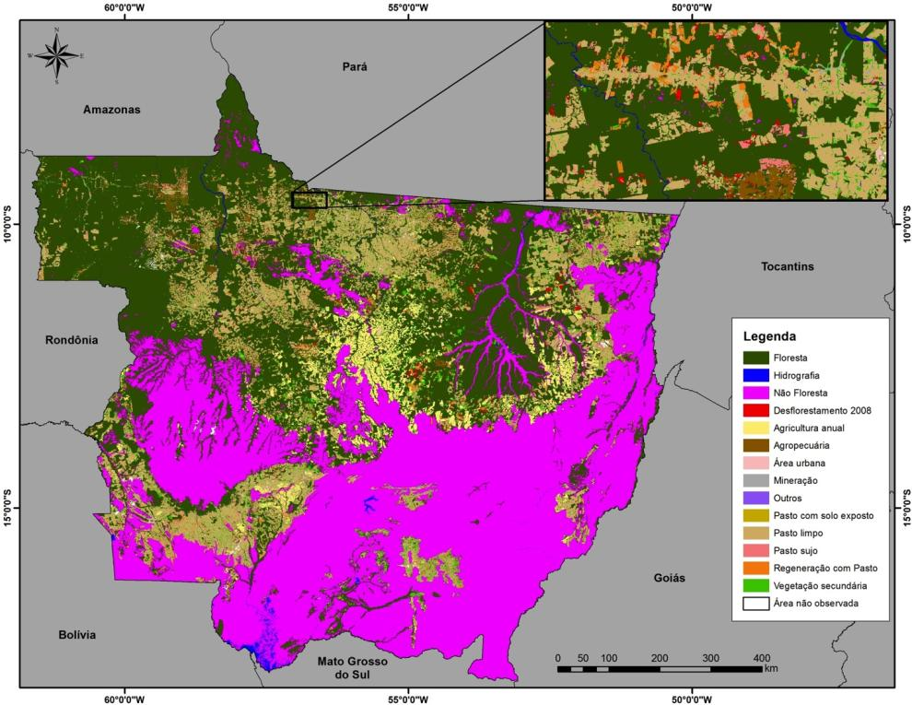
Agricultural expansion on Mato Grosso
uses deforested areas and Cerrado
Non-forest (magenta) is not a land use class

Slide 20
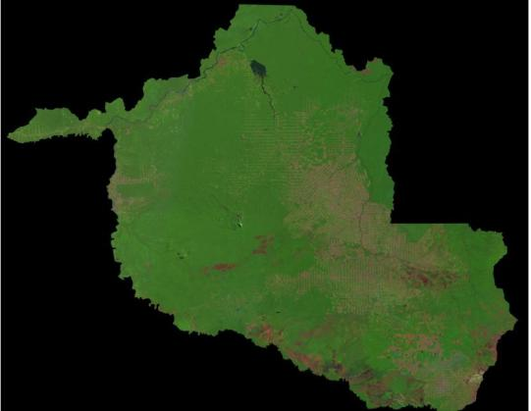
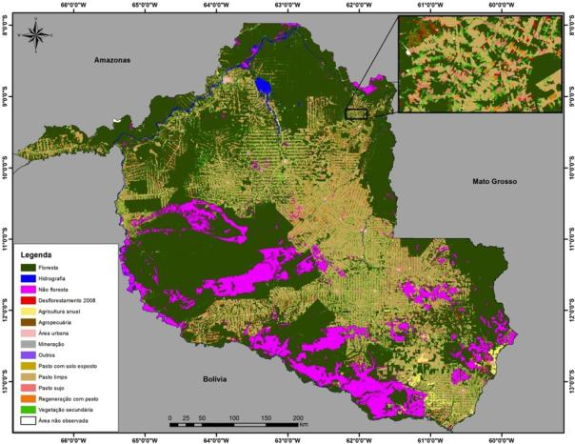
The quest for the perfect map
The world is divided in cells. Each cell has a single class.
There is a correct classification.
The more our classification approaches the ideal, the better.

Slide 21
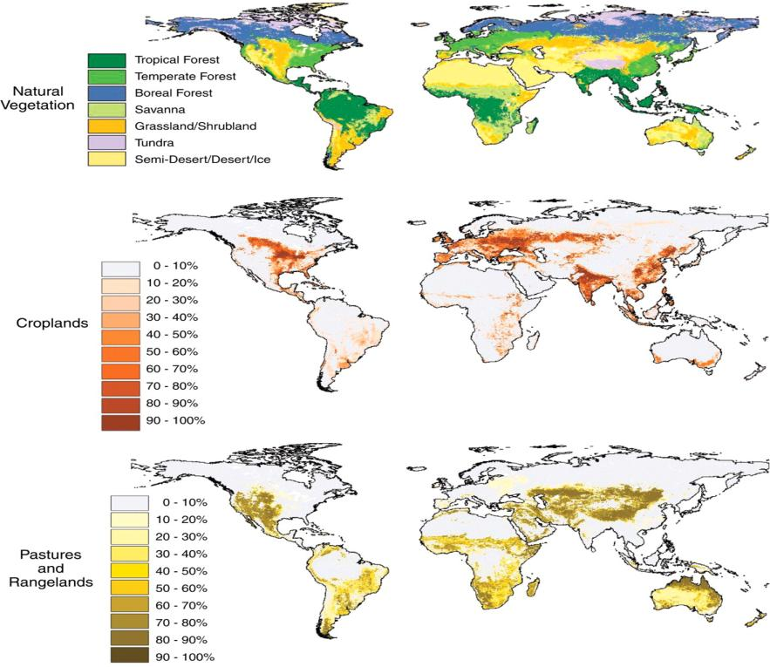
Structural contradictions on global land cover and land use mapping
Global competition for land
source: Foley et al. (Science, 2007)

Slide 22
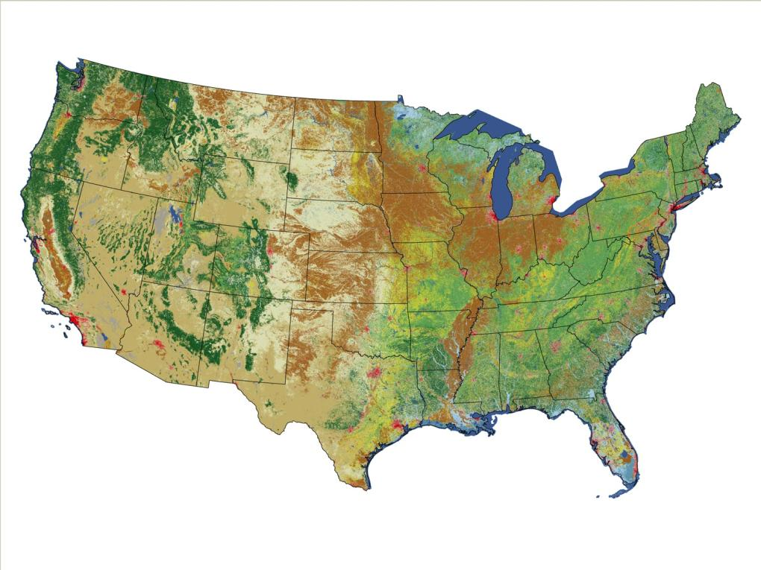
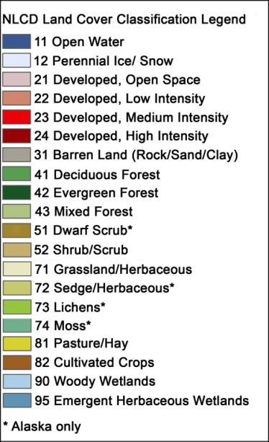
US National Land Cover 2006
What about land use?

Slide 23

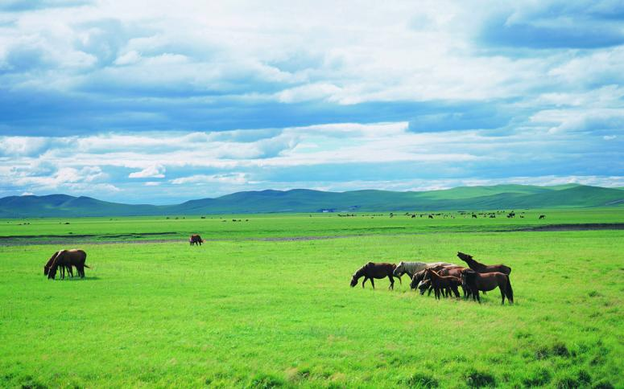

Land cover or land use?

Slide 24
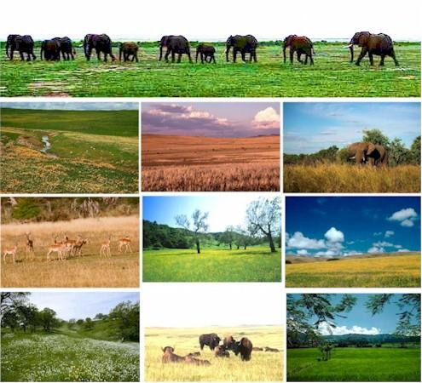
The ambiguity of grasslands

Slide 25
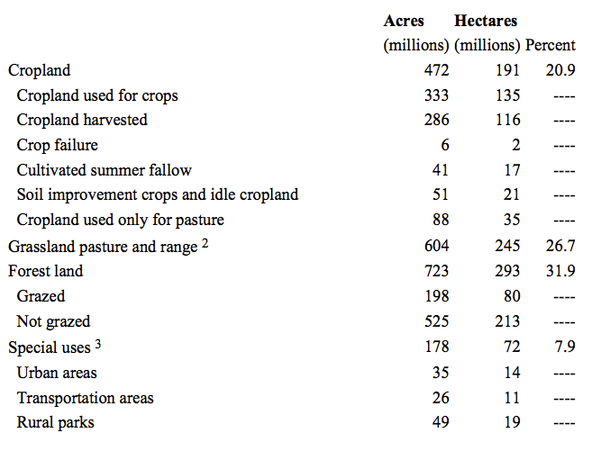
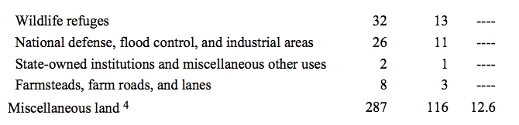
US National Land Cover 2006

Slide 26
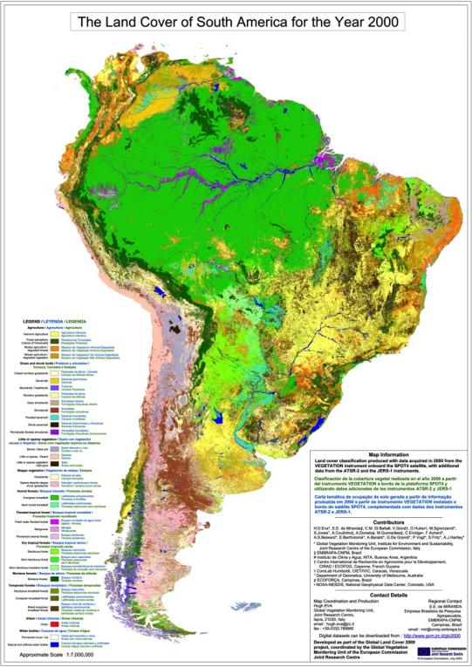
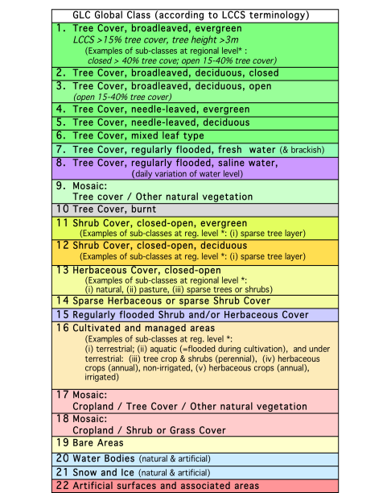
In search of the perfect map?
GLC 2000

Slide 27
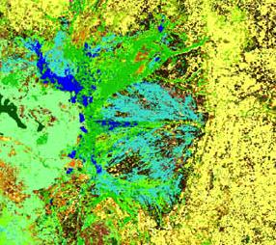
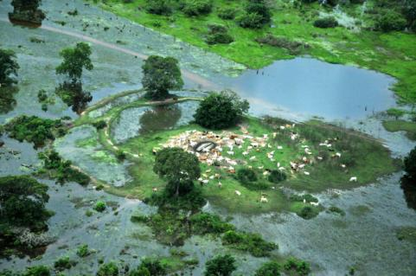
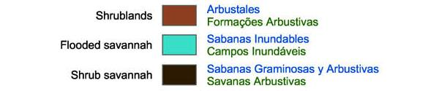
What is the land system in the Pantanal?
GLC 2000
Real world

Slide 28
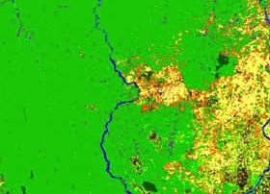

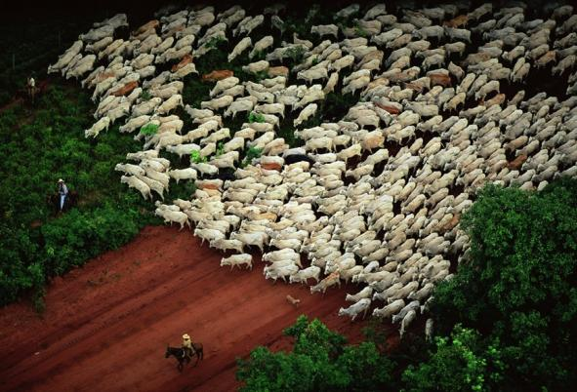
What about São Felix do Xingu?
GLC 2000
 | Cattle heads | Deforest (ha)
1970 | 190
1980 | 22,534
1985 | 32,000 | 63,800
1991 | 110,854
1996 | 443,039
2000 | 1,182,621 | 967,400
2007 | 1,932,519 | 1,890,900
2010 | 2,472,053 | 2,051,100
Real world

Slide 29
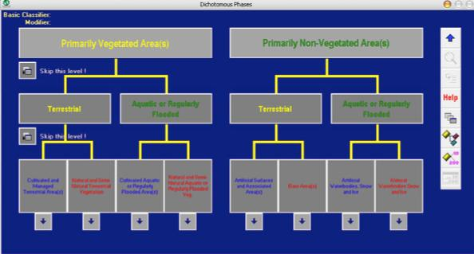
FAO’s Land Cover Classification System (LCCS)
LCCS was created to ensure fundamental rules of unambiguous definitions of each class

Slide 30
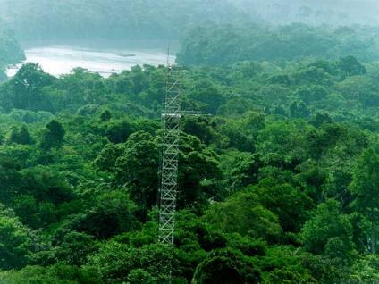
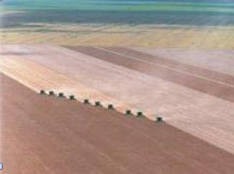
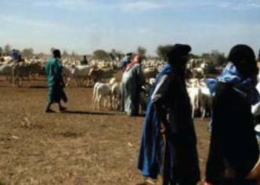
The natural part of the land system
  tropical forest
  wetlands
  non-forest
  shrublands

Slide 31
The managed part of the land system
  non-managed
  cattle production
  large-scale agriculture
  shifting cultivation

Slide 32
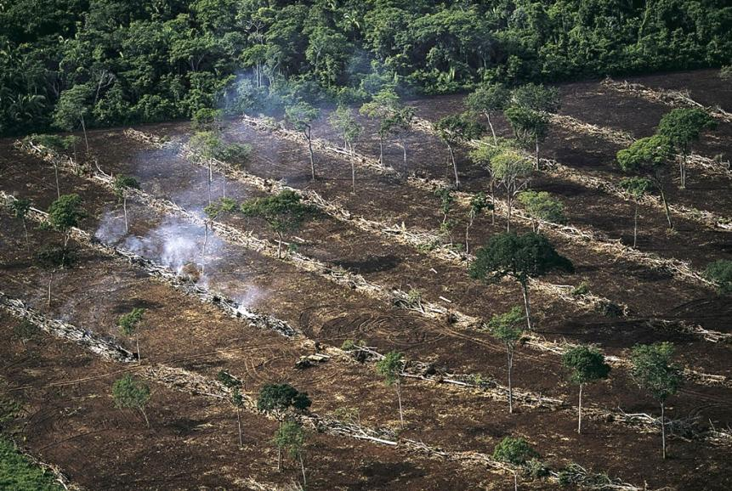
The transition from natural to managed land
photo: Yan Arthus Bertrand

Slide 33
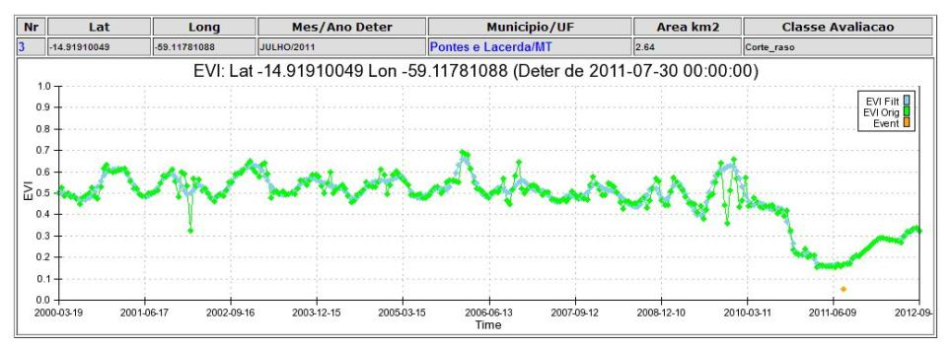
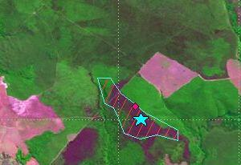

The transition from natural to managed land as seen by remote sensing
2010
2011

Slide 34

What’s in an image?
“Remote sensing images describe landscape dynamics”
data source: B. Rudorff (LAF/INPE)

Slide 35

Forget maps, think spatial databases!

Slide 36

What advances in spatiotemporal data representation and spatial databases are needed for dealing with big data?

Slide 37

We need big data for modelling global land change
Current science practice based on data download
How do you download a petabyte?

Slide 38
We need big data for modelling global land change
Current science practice based on data download
How do you download a petabyte?
You don’t! Move the software to the archive

Slide 39

Big geospatial data on the cloud (Terralib 5+)
Modelling
Data discovery
Data access
Analysis
Data
source
Data
source
Data
source
Remote Analysis
Remote Analysis
Remote Analysis

Slide 40
Big geospatial data on the cloud (Terralib 5+)
Modelling
The good: long-term data preservation
shared costs on data admin
access to large external database
The bad: rewrite software for cloud processing
finding data is a major problem
Data discovery
Data access
Analysis
Data
source
Data
source
Data
source
Remote Analysis
Remote Analysis
Remote Analysis

Slide 41

Representing concepts is hard
What do we know we don’t know?
vulnerability? climate change? poverty?
Image source: WMO

Slide 42

We’re bad at representing meaning
What do we know we don’t know?
Representing concepts is hard
degradation
deforestation? degradation? disturbance?

Slide 43


Representing concepts is hard
sustainability
resilience
and much more…
Human-environmental models need to describe complex concepts (and store their attributes in a database)

Slide 44

Representing change is very hard
What do we know we don’t know?

Slide 45

Describing events and processes is very hard
What do we know we don’t know?
When did the flood occur?

Slide 46



Temporal perception as event-ordering
The brain represents time by means of time: events are recorded as relevant personal experiences

Slide 47

Inherent structure to geoinformation (Sinton, 1978)
Fixing space, controlling time, and measuring theme results in a time series.
Fixing theme, controlling time, and measuring space results in a trajectory.
Fixing time, controlling space, and measuring theme results in a coverage.

Slide 48

Time Series
Continuous variation of a property value over time
(water table depth sensors) in a fixed location

Slide 49
source: USGS
Coverage:
A coverage represents the variation of a property within a spatial extent at a time.
  Two-dimensional grids whose values change
  Samples from fixed or moving geosensors.

Slide 50


Moving objects have trajectories
trajectory : represents how locations or boundaries of an object evolve over time.

Slide 51

Trajectories of change
"Case-Based Reasoning for Eliciting the Evolution of Geospatial Objects". Joice Mota, Gilberto Câmara et al, COSIT 2009.
Reconstructing the history of a landscape

Slide 52

objects exist, events occur
Mount Etna is an object
Etna’s 2002 eruption was an event

Slide 53

Objects and events
The coast of Japan is an object
The 2011 Tohoku tsunami was an event

Slide 54

Object (GPS buoy) + event (tsunami)

Slide 55

Objects and events in remote sensing data
Land use change by sugarcane expansion
data source: B. Rudorff (LAF/INPE)

Slide 56

From observations to events

Slide 57


The event data type
An event is an individual episode with a beginning and end, which define its character as a whole.
An event does not exist by itself. Its occurrence is defined as a particular condition of one spatiotemporal type.
Notes:
INPE has a project called PROARCO responsible for monitoring fire spots in South America, In this application, each fire is presented by its location and the time instant when it was detected.
This picture is an example of the detected fires in a Brazilian state called Pará in august 2003.
The second demand is related to a project responsible for monitoring the Amazon deforestation called PRODES. In this application, each deforested area is represented by a polygon that limits the deforested region and the time when it was detected.

Slide 58


When did the large flood occur in Angra?

Slide 59
Two interrelated challenges: representation + modelling
(PRODES, 2008)
(Getty Images, 2008)
Modelling: projecting the future,
given the present and the forces of change

Slide 60




Global Change
Human actions and global change
Where are changes taking place?
How much change is happening?
Who is being impacted by the change?
What is causing change?
photo: A. Reenberg

Slide 61

Our challenge...
“Indeed even in science itself there is substantial questioning of the traditional canons of scientific inquiry as the quest for parsimony, simplicity, and homogeneity is increasingly being confronted by the need for plausibility, richness, and heterogeneity. The question turns on whether or not a simple, parsimonious model that can completely explain a limited set of system characteristics is as useful as one which contains many characteristics which are plausible in terms of the functioning of the system but cannot be proven as being of definitive explanatory value.”
Mike Batty

Slide 62
Computational models
  Connect expertise from different fields
  Make the different conceptions explicit
Territory
(Geography)
Money
(Economy)
Culture
(Antropology)
Modelling
(GIScience)

Slide 63


Slide 64


Brazil: world’s largest sugarcane producer
MT
GO
MG
MS
SP
PR
source: Bernardo Rudorff (INPE)

Slide 65

Crop Year 2002/2003
Annual Crop – 1 Crop per season
Annual Crop – 2 Crops per season
source: Bernardo Rudorff (INPE)
Sugarcane

Slide 66

Crop Year 2010/2011
Annual Crop – 1 Crop per season
Annual Crop – 2 Crops per season
source: Bernardo Rudorff (INPE)
Sugarcane

Slide 67

MATO GROSSO – Sorriso: Crop Year 2002/2003
source: Bernardo Rudorff (INPE)
Annual Crop - 2 Crops
Annual Crop - 1 Crop

Slide 68

MATO GROSSO – Sorriso: Crop Year 2010/2011
source: Bernardo Rudorff (INPE)
Annual Crop - 2 Crops
Annual Crop - 1 Crop

Slide 69

Crop Year 2002/2003
Annual Crop – 1 Crop per season
Annual Crop – 2 Crops per season
Sugarcane
source: Bernardo Rudorff (INPE)

Slide 70

Crop Year 2010/2011
Annual Crop – 1 Crop per season
Annual Crop – 2 Crops per season
Sugarcane
source: Bernardo Rudorff (INPE)

Slide 71

SÃO PAULO – Barretos: Crop Year 2002/2003
1
source: Bernardo Rudorff (INPE)
Annual Crop - 1 Crop
Annual Crop - 2 Crops
Sugarcane

Slide 72

SÃO PAULO – Barretos: Crop Year 2010/2011
1
source: Bernardo Rudorff (INPE)
Annual Crop - 1 Crop
Annual Crop - 2 Crops
Sugarcane

Slide 73

Tradeoffs in double cropping?
source: Avery Cohn (NCAR)

Slide 74
Tradeoffs in double cropping?
 | Early Rainy Season | Late Rainy Season
Increase in soya prices | No trend | 1st crop ↑ 2nd crop ↓
Decrease in soya prices | 1st crop ↓ 2nd crop ↑ | No trend
source: Avery Cohn (NCAR)

Slide 75
Are biofuels replacing food production in Brazil?
source: B. Rudorff, INPE

Slide 76
Are biofuels replacing food production in Brazil?

Slide 77



Brazil: Do biofuels cause indirect land change?

Slide 78

Brazil: Projected direct land change from biofuels (2020)
source: Lapola et al (PNAS, 2010)

Slide 79

Brazil: Projected indirect land change from biofuels (2020)
source: Lapola et al (PNAS, 2010)
source: Lapola et al (PNAS, 2010)

Slide 80


Slide 81




Bernardo Strassburg (Instituto Internacional para Sustentabilidade)
  Current productivity : 118 million Animal Units;
  Potential sustainable carrying capacity: 367 mi Animal Units;
    Current productivity only 32-34% of potential
Current Productivity
Potential Productivity

Slide 82

Potential Allocation in 2040 that fulfil all demands
Results
Bernardo Strassburg (Instituto Internacional para Sustentabilidade)
Brazil has already enough cleared land for all land-related needs, respecting environmental constraints, up to at least 2040;
An increase from 32-34% to 49-52% would suffice to meet all future demands without further deforestation

Slide 83

Sustainability?
NPV (net present value) of land in Amazonia for cattle ranching
Land speculation
Extensive ranching is only profitable for large farms
source: Bowman et al. (Land Use Policy, 2012)
Land purchase

Slide 84

NPV (net present value) of land in Amazonia for cattle ranching
No regulation
Regulation
source: Silva and Barreto (Imazon, 2011)

Slide 85




Clocks, clouds or ants?
Clouds: statistical distributions
Clocks: deterministic equations
Ants: emerging behaviour

Slide 86

Pattern-based land change models

Slide 87

Typical pattern-based land change model

Slide 88
How good are statistical models?

Slide 89
Long term gains: understanding the tradeoffs between land use, emissions and biodiversity
(PRODES, 2008)
(Getty Images, 2008)
source: Espindola, 2012

Slide 90

Where is the food coming from and going to?
graphics: The Economist

Slide 91

GLOBIOM: a global model for projecting how much land change could occur
source: A. Mosnier (IIASA)

Slide 92

GLOBIOM: land use types and products
source: A. Mosnier (IIASA)

Slide 93


Slide 94


Slide 95


Slide 96


Slide 97


Slide 98


Slide 99
Global Change
Human actions and global land change
“Can we improve the architecture of land use information systems to increase their capacity to deal with big geospatial data sets and to provide better information for researchers and decision-makers?”
“Can we develop models and statistical analysis methods that increase our knowledge of what causes land change and our capacity to project scenarios of future change?”
photo: A. Reenberg

