Slide 1
Trends in Amazon land change and possible consequences for REDD+
Planet Under Pressure 2012, London
Gilberto Câmara
National Institute for Space Research
Brazil
http://www.dpi.inpe.br/gilberto

Slide 2



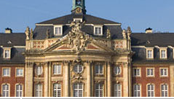
Can we build REDD+ without institutions?
Justice
Public health
Knowledge
Information

Slide 3
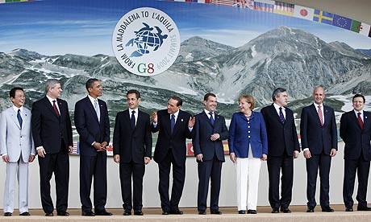

The rôle of forests in global climate
Aware that deforestation accounts for approximately 20% of annual CO₂ emissions, we remain engaged in seeking the reduction of emissions from deforestation and forest degradation (REDD) (G8 L’Aquila Declaration, 2009)

Slide 4
The rôle of forests in global climate
Aware that deforestation accounts for approximately 20% of annual CO₂ emissions, we remain engaged in seeking the reduction of emissions from deforestation and forest degradation (REDD) (G8 L’Aquila Declaration, 2009)
MYTH

Slide 5
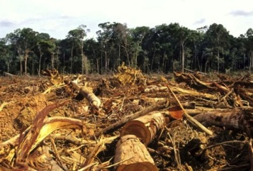
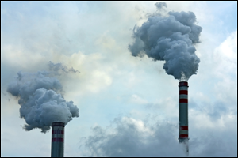
Global GHG emissions
10
8
Fossil fuel
6
CO₂ emissions (PgC y⁻¹)
4
Land use change
2
1960
1970
1980
1990
2000
2010
Land change < 10% of total GHG emissions in 2010
source: Global Land Project (2010)

Slide 6
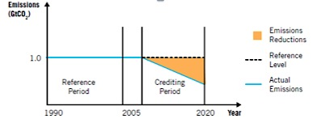
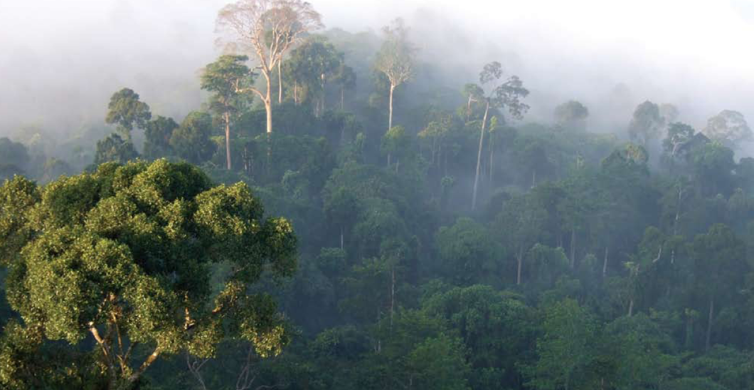
REDD+: payments for avoided deforestation
Growth in developing countries will produce emissions from deforestation

Slide 7
REDD+: payments for avoided deforestation
MYTH
Growth in developing countries will produce emissions from deforestation

Slide 8
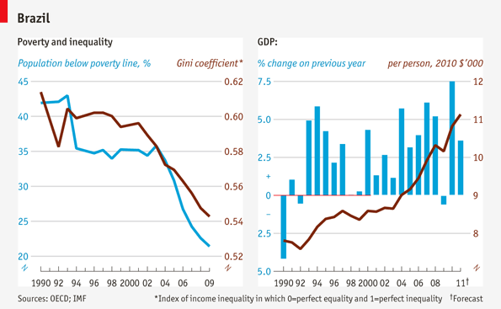
Brazil’s recent growth and reduced inequality

Slide 9
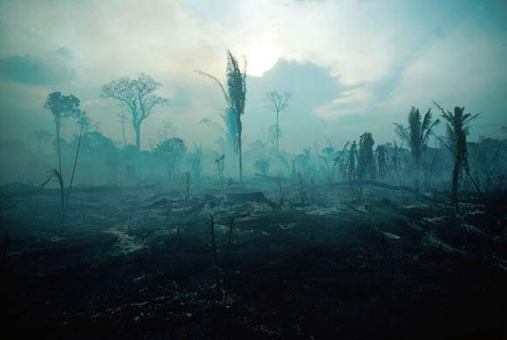
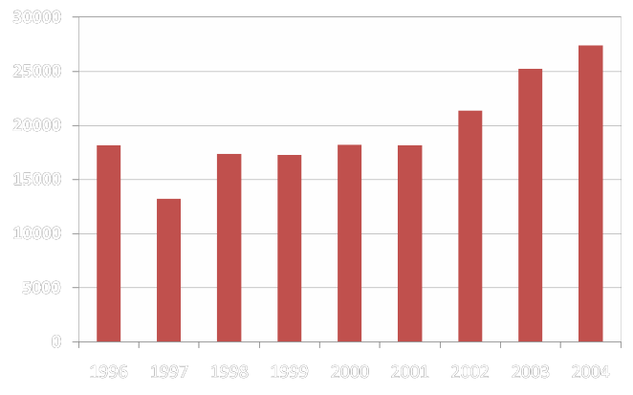
Economic recovery and deforestation: 2001-2004
Yearly deforestation rate for 2003-2004: 27,100 km2

Slide 10
Economic growth without increased deforestation
Deforestation in Brazilian Amazonia (1988-2011)
dropped from 27,000 km² to 6,200 km²

Slide 11
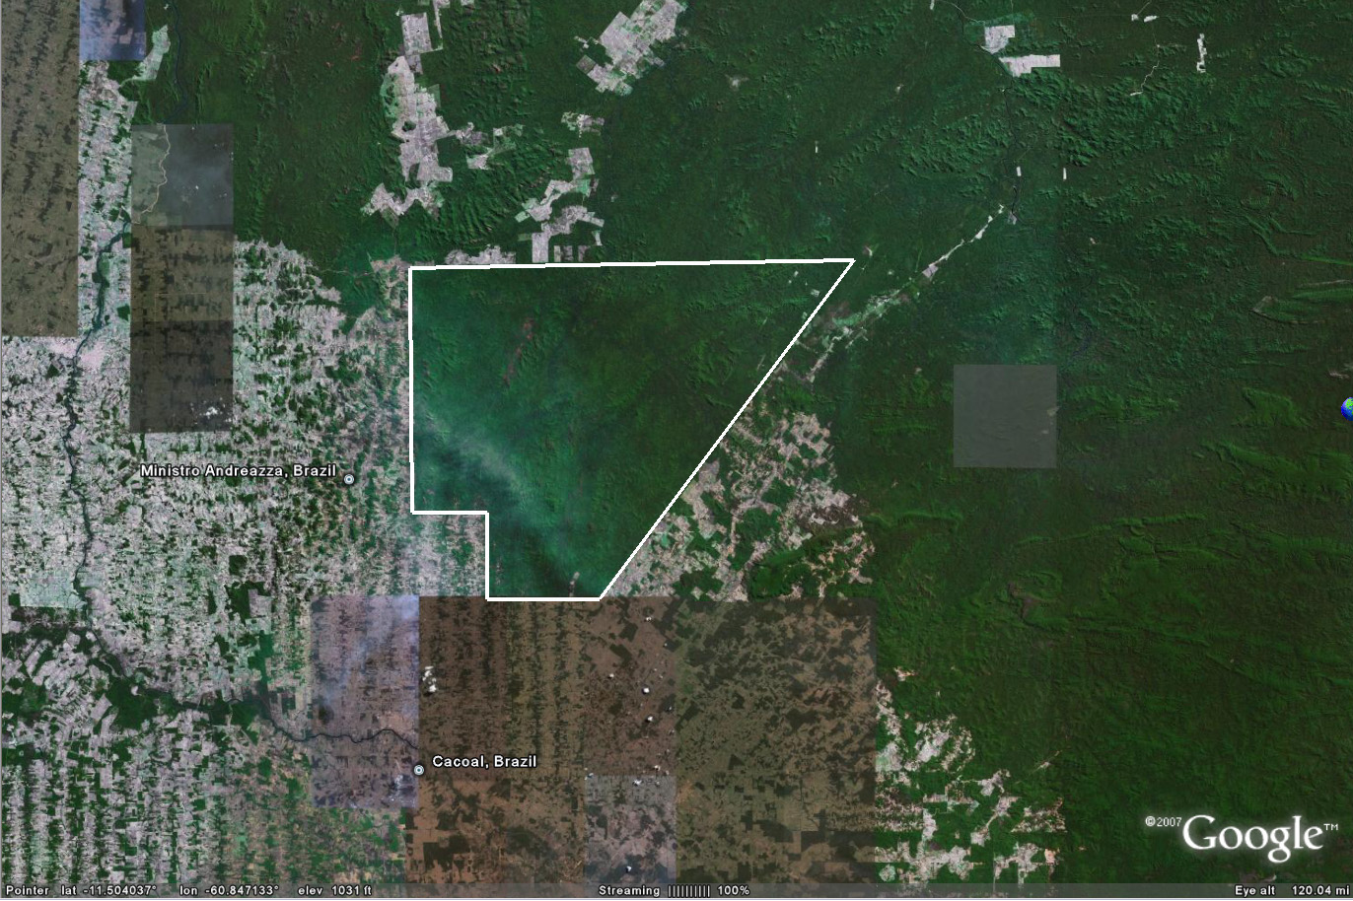
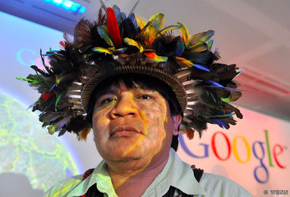
REDD+ can be built bottom-up
Chief Almir and Suruí reserve

Slide 12
REDD+ can be built bottom-up
MYTH
Chief Almir and Suruí reserve

Slide 13
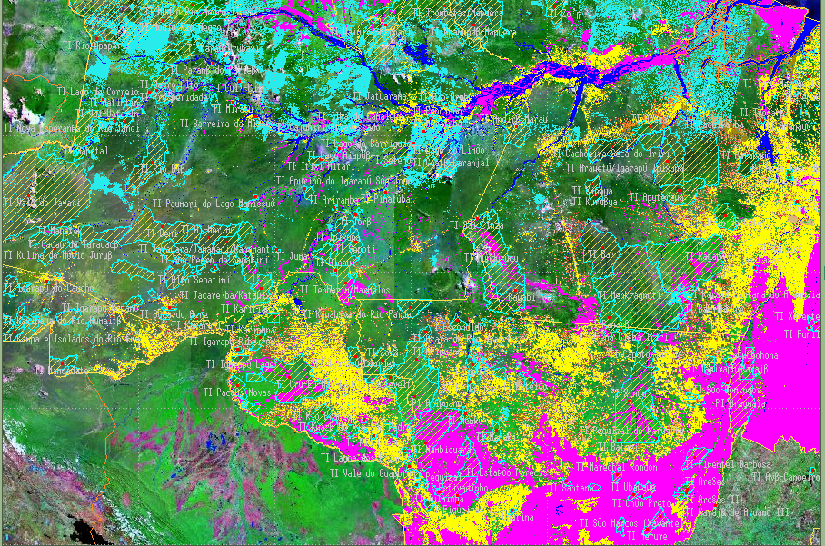
Amazonia: 400.000.000 ha
Suruí reserve: 250.000 ha

Slide 14
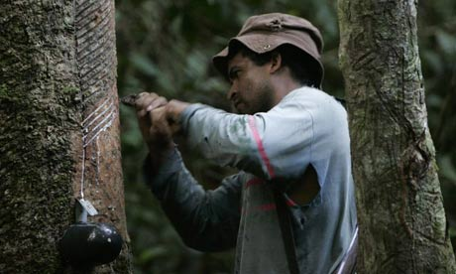

Why developing countries need REDD+?
They cannot control their lands
They do not have monitoring technology
They do not have transparency

Slide 15
Why developing countries need REDD+?
MYTH
They cannot control their lands
They do not have monitoring technology
They do not have transparency

Slide 16
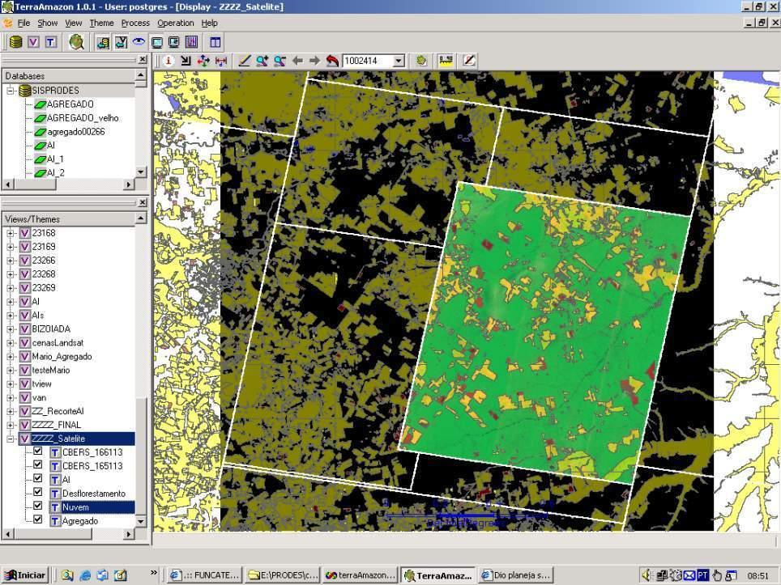
How much it takes to survey Amazonia?
116-112
30 Tb of data
500.000 lines of code
150 man/years of software dev
200 man/years of interpreters
116-113
166-112
Notes:
Cena de maior prioridade utilizou imagens CBRES na s tres principais areas: 166-112, 165-113 2 166-113. Sendo complementada por imagem TM

Slide 17
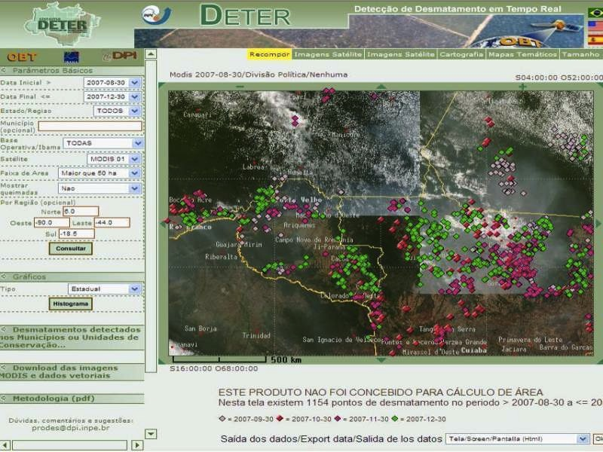

Real-time Deforestation Monitoring
Daily warnings of newly deforested large areas

Slide 18
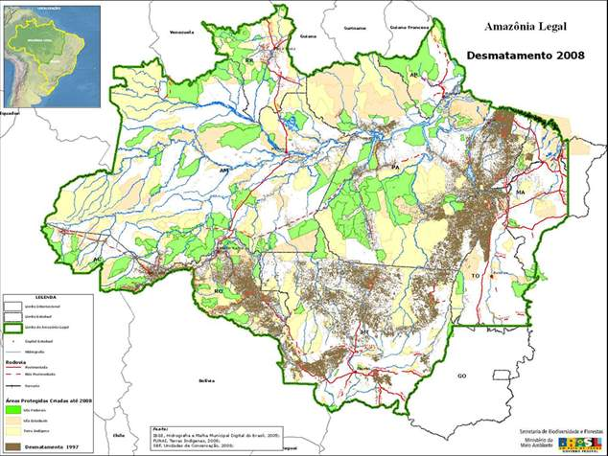
Protected areas and deforestation

Slide 19
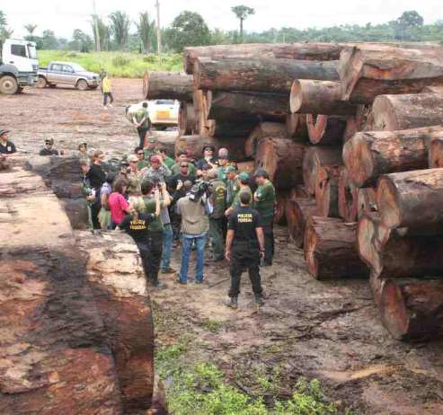
Policing actions: illegal wood seizure
50% of operations in 2% of the area

Slide 20


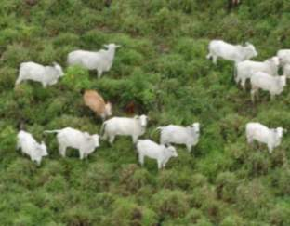

Markets have a positive rôle

Slide 21
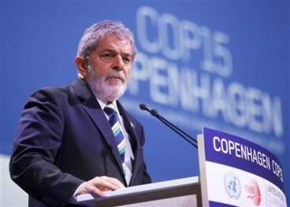
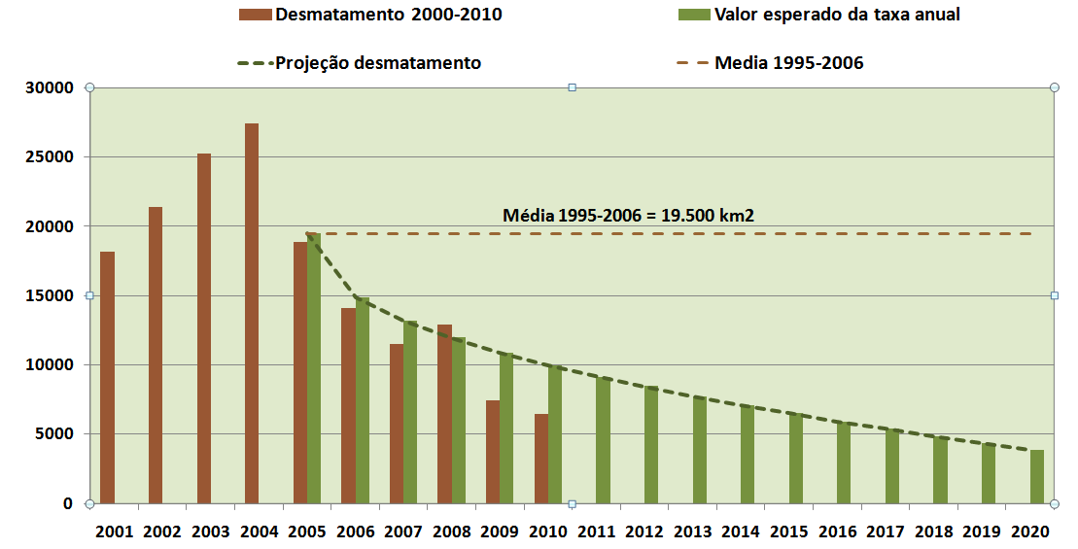
“By 2020, Brazil will reduce deforestation by 80% relative to 2005.” (pres. Lula in Copenhagen COP-15)

Slide 22
Transparency builds governance!
Deforestation in Brazilian Amazonia (1988-2011)
dropped from 27,000 km² to 6,200 km²

Slide 23
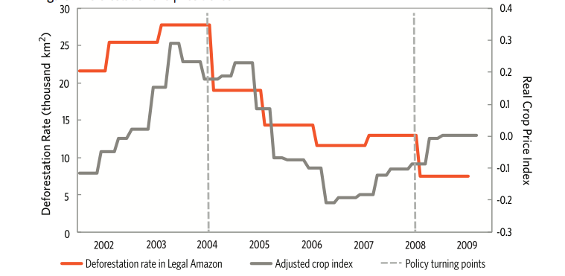
Deforestation and price trends

Slide 24
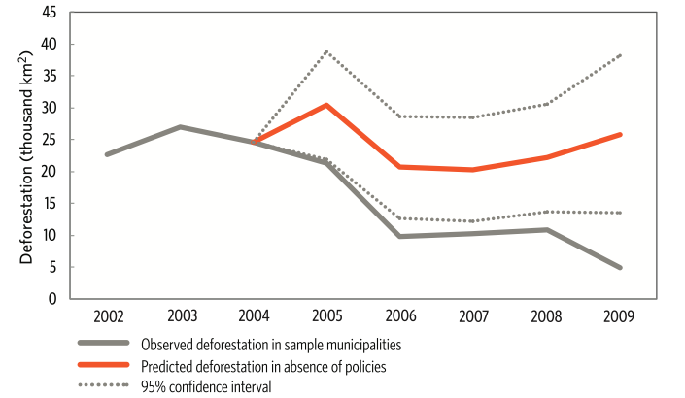
Prices or policies?
Deforestation Slowdown in the Legal Amazon: Prices or Policies?
http://www. climatepolicyinitiative.org

Slide 25
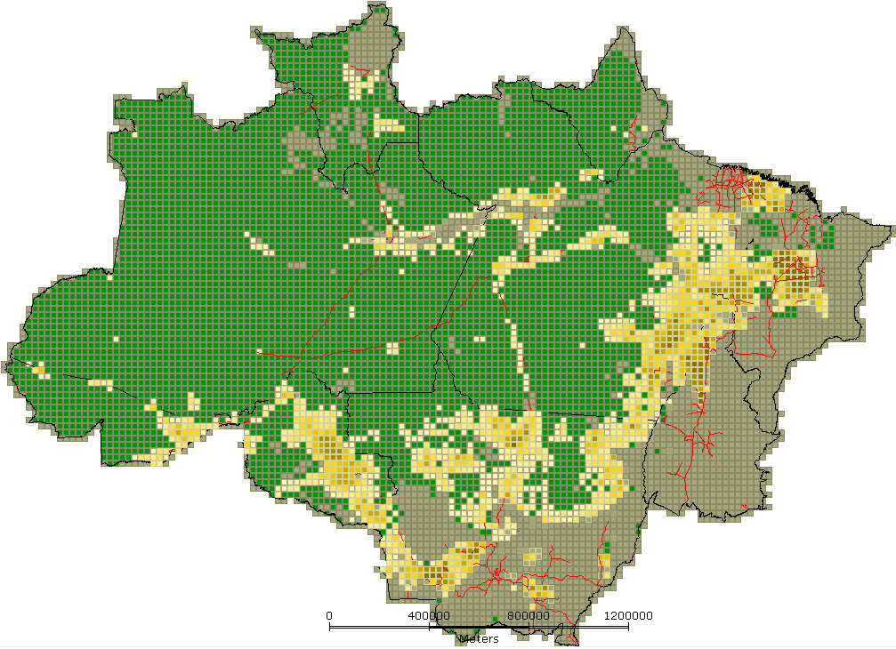
Deforestation in Amazonia
Até 10%
10 - 20%
20 – 30%
30 – 40%
40 – 50%
50 – 60%
60 – 70%
70 – 80%
80 – 90%
90 – 100%
700.000 km2 deforested since 1970s

Slide 26
How are we using the forest?

Slide 27
Class | TOTAL (km²)
Clean Pasture | 335.714,94 | 46,7%
Secundary Vegetation | 150.815,31 | 21,0%
Dirty pasture | 62.823,75 | 8,7%
Regeneration with pasture | 48.027,37 | 6,7%
Non-observed areas | 45.406,27 | 6,3%
Agriculture (large-scale) | 34.927,24 | 4,9%
Small farms and settlers | 24.416,57 | 3,4%
Urban areas | 3.818,14 | 0,5%
Mining | 730,68 | 0,1%
Degraded areas | 594,19 | 0,1%
Others | 477,88 | 0,1%
Desflorestation 2008 | 11.458,64 | 1,6%
TOTAL | 719.210,99

Slide 28
Brazil new Forest Code
Até 10%
10 - 20%
20 – 30%
30 – 40%
40 – 50%
50 – 60%
60 – 70%
70 – 80%
80 – 90%
90 – 100%
Illegal large farms have to recover 80% of area

Slide 29

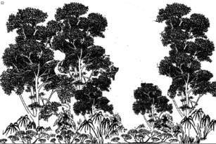
Potential for CO2 sink in Amazonia
Clear-cut areas
200,000 km2 (30% of area)
10 Gt CO₂eq (2015-2020)
Floresta (biomass after 5 years)

Slide 30
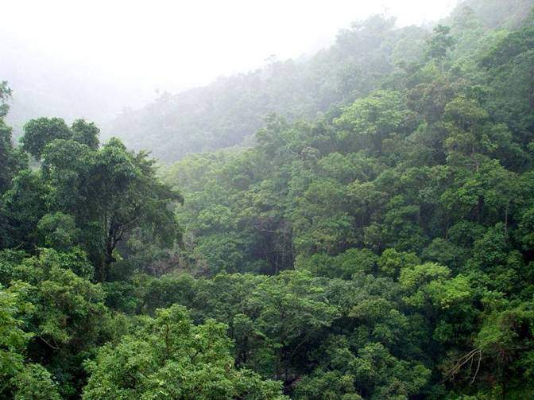
Impact of reforestation in Amazonia
Net sink in Amazonia
(2015-2020)
World’s emission growth in
fossil fuels (2% a.a) (2015-2020)
10 Gt CO2eq
12 Gt CO2eq
From 2015 to 2020, reforestation in Amazonia could stabilize global emissions

Slide 31
Can Brazil hold back REDD+?
Possible sink in Amazonia
10 Gt CO2eq
From 2015 to 2020, the potential carbon sink in Brazil would be double the entire worldwide market for REDD
REDD
5 Gt CO2eq

Slide 32
Impact of reforestation in Amazonia
Net sink in Amazonia
(2015-2020)
World’s emission growth in
fossil fuels (2% a.a)
10 Gt CO2eq
12 Gt CO2eq
Why pay for avoided deforestation when you can stabilize the world’s emissions?

Slide 33
Can we build REDD+ without institutions?
We cannot have REDD+ without institutions
If we have institutions, do we need REDD+?
Justice
Public health
Knowledge
Information

Slide 34
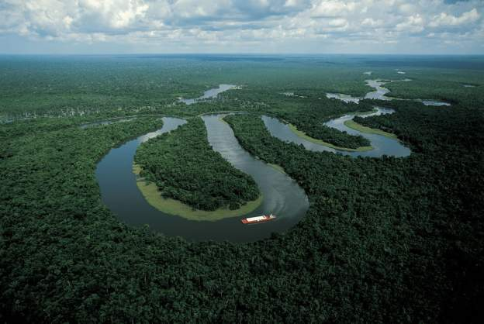
Will REDD create self-defeating outcomes?
‘We have a resource we would like to get money for. Either you pay us for biodiversity services or we will sell the forest to Malaysian logging companies.’ (Guyana government officer)

Slide 35
Thanks to INPE’s Land Change team
Dalton Valeriano
Cláudio Almeida
Luiz Maurano
Isabel Escada
Silvana Amaral
…and also to
Bertha Becker (UFRJ)
Tiago Carneiro (UFOP)
Roberto Araújo
Ana Aguiar
Pedro Andrade-Neto
Miguel Monteiro

