Slide 1
Prebisch’s paradox and the Capricorn triangle: S&T for Brazil in 21st Century
Brazil-US: Partnership for 21st Century
Gilberto Câmara
National Institute for Space Research (INPE)

Slide 2
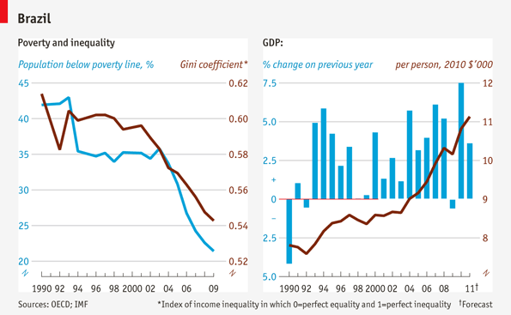
Brazil: success now, risks later?

Slide 3
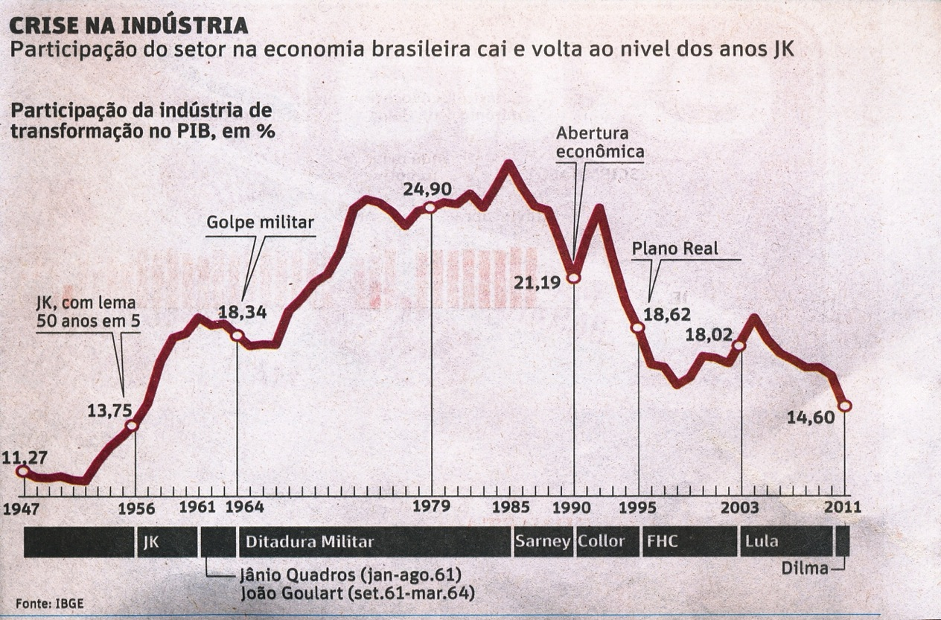
The (inevitable?) decline of Brazilian industry
Industrial slice of GDP is less than in the 1960s

Slide 4

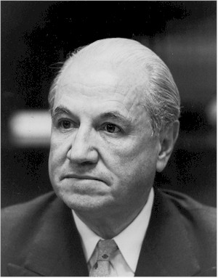
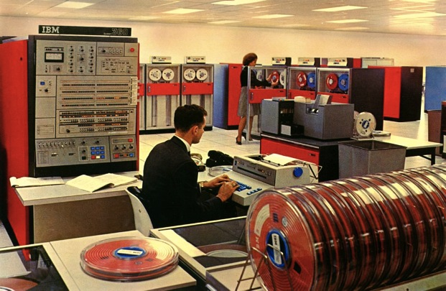
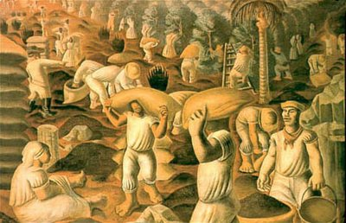
Traditional development economics (1960s view)
Raul Prebisch (ECLAC): the terms of trade between industrialised and non-industrialised countries change over time
Countries that export commodities would be able to buy fewer and fewer manufactured
goods

Slide 5
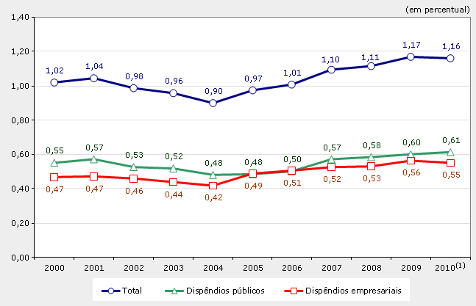
The legacy of import substitution policies

Slide 6
Traditional development economics (1960s view)
Raul Prebisch (ECLAC): the terms of trade between industrialised and non-industrialised countries change over time
Countries that export commodities would be able to buy fewer and fewer manufactured
goods
“When the facts change, I change my mind. What do you do, sir?” (J.M. Keynes)

Slide 7


What would Prebisch say today?
1992 IBM ThinkPad 700, Windows 3.1, 25 MHz 486 processor, 120 MB hard disk drive, 10.4″ display, 3 kg
2012 Lenovo ThinkPad Edge, Windows 7, Intel® i3 (2.3 GHz), 14.1” display, 320 GB HD, 3 kg
1992 – US$ 4,350
2011 – US$ 700

Slide 8
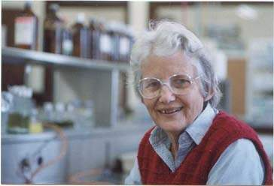
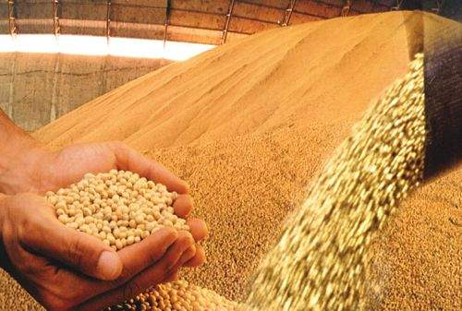
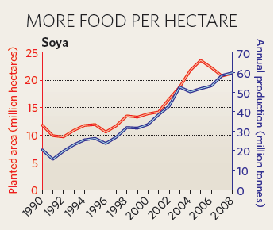
What would Prebisch say?
Soybean (ton)
1992 – US$ 209
2010 – US$ 484
Soy: 600 kg/ha in 1990
2.700 kg/ha in 2008
source: Index Mundi

Slide 9
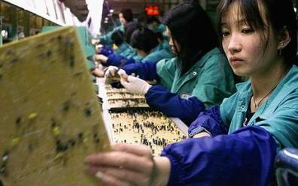
What happened? Terms of trade changed
China effect: Transfer of factories to China has reduced the price of manufactured goods and increased demand for commodities
Graph: G. Câmara, INPE Idea: J. Furtado, USP

Slide 10


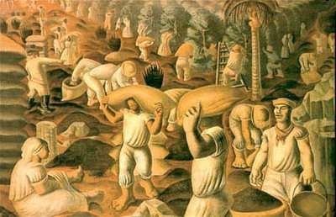
Prebisch’s (and many others'...) paradox
As import substitution created an industry without local R & D, opportunities for the Brazilian S & T are linked to the new natural knowledge economy

Slide 11
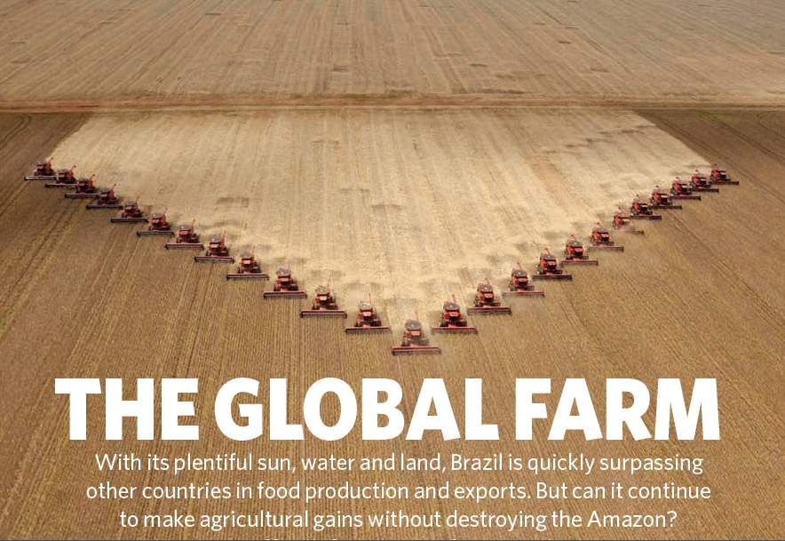
Nature, 29 July 2010

Slide 12
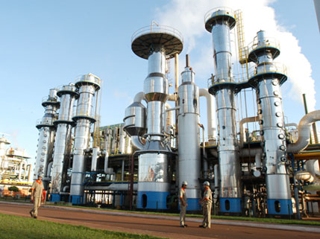
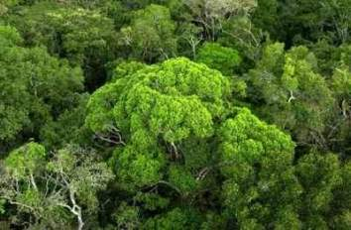
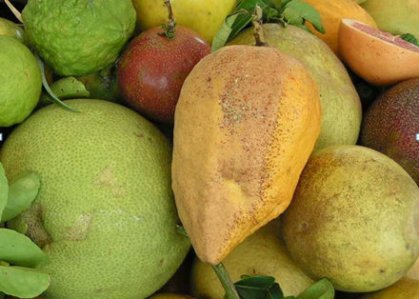

Brazil: a natural knowledge economy
World leader in environmental monitoring
Best technology in biofuels
World leader in tropical agriculture
46% of energy is renewable

Slide 13
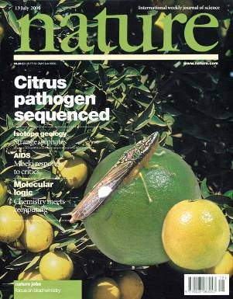
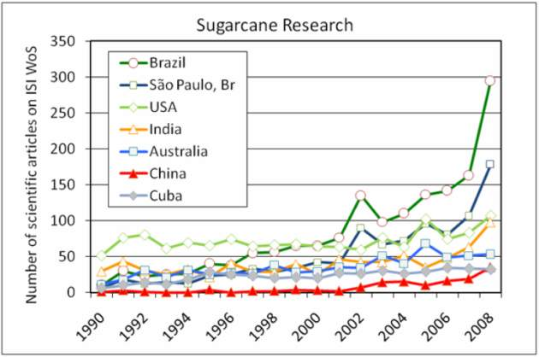
Prebisch´s paradox
source: CH Brito Cruz (FAPESP)
Brazil´s natural knowledge economy offers more opportunities for internal R&D than our manufacturing industry

Slide 14
Brazilian science and the Capricorn triangle
100%
1,8%
2,3%
1,3%
1,4%
1,8%
2,7%
3,0%
5,4%
Mathematics
Physics
Computer Science
External
Agenda
Engineering
Chemistry
Ecology and Environment
Tropical Health
Tropical Agriculture
Internal agenda
100%
The areas of greatest production of Brazilian science are linked to the natural knowledge economy

Slide 15

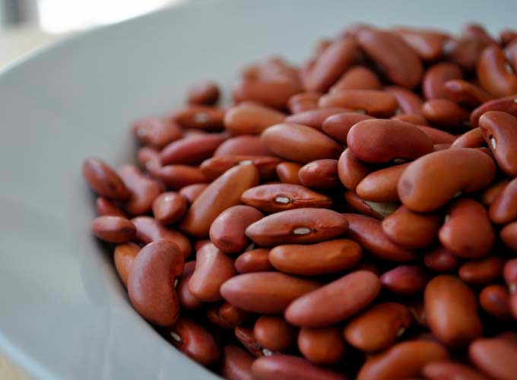
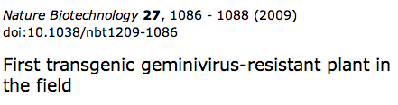
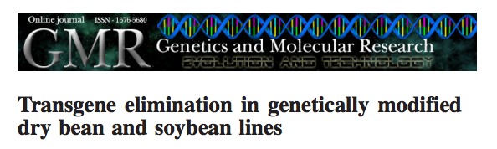
Challenge: Biotechnology for agriculture
Genetically-modified, virus-resistant beans (EMBRAPA)

Slide 16
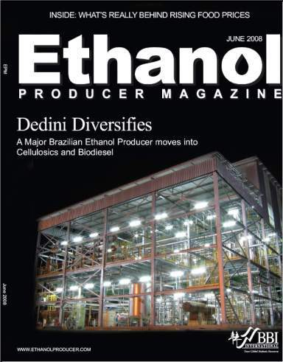

Challenge: renewable energy technology
Production of second-generation ethanol
Fonte: CH Brito Cruz, FAPESP

Slide 17
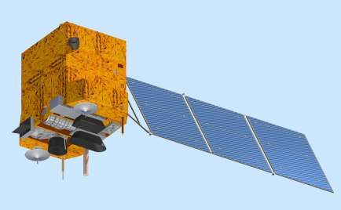
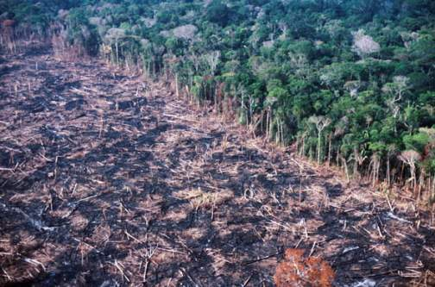
Challenge: space technology for sustainable development
Monitoring land change in Brazil by satellites:
Amazon deforestation cut by 300% (2004-2010)
Pioneering use of Innovation Law

Slide 18
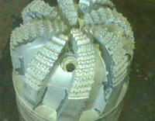

Challenge: technology for oil and gas exploration
Synthetic diamonds drills for oil extraction in pre-salt layer (developed at INPE).

Slide 19




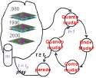
Interdisciplinary research: hallmark of joint US-Brazil research programmes?
If (... ? ) then ...
  Can we develop barrier-breaking research agendas?

