Slide 1

The Road Map for a Global Land Observatory
Gilberto Câmara
National Institute for Space Research (INPE), Brazil
Institute for Geoinformatics, University of Münster, Germany

Slide 2








With many thanks to…
Merret Buurman
Karine Ferreira
Lúbia Vinhas
Ricardo Cartaxo
Victor Maus
Gilberto Ribeiro
Alber Sanchez
Dalton Valeriano

Slide 3
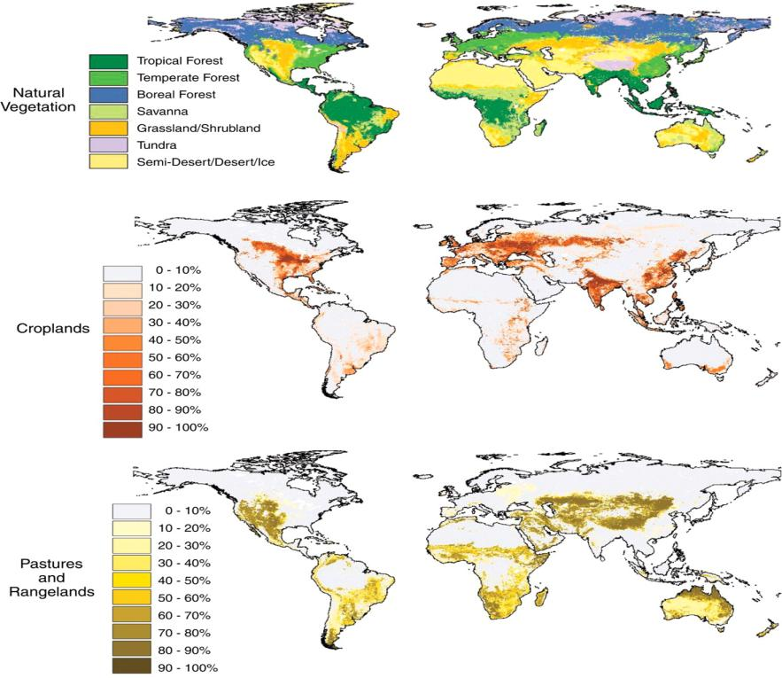
Why do we need global land observatories?
source: Foley et al. (Science, 2007)

Slide 4
Structural contradictions on land systems
Global competition for land
source: Foley et al. (Science, 2007)

Slide 5
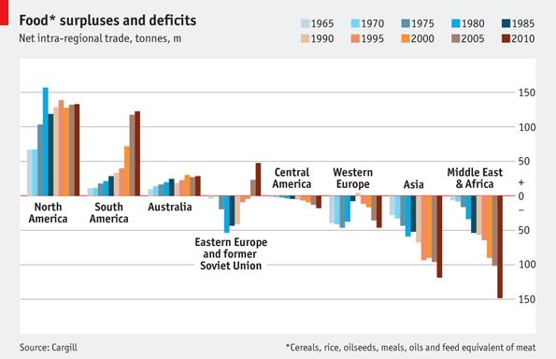
Food: producers and consumers
graphics: The Economist

Slide 6
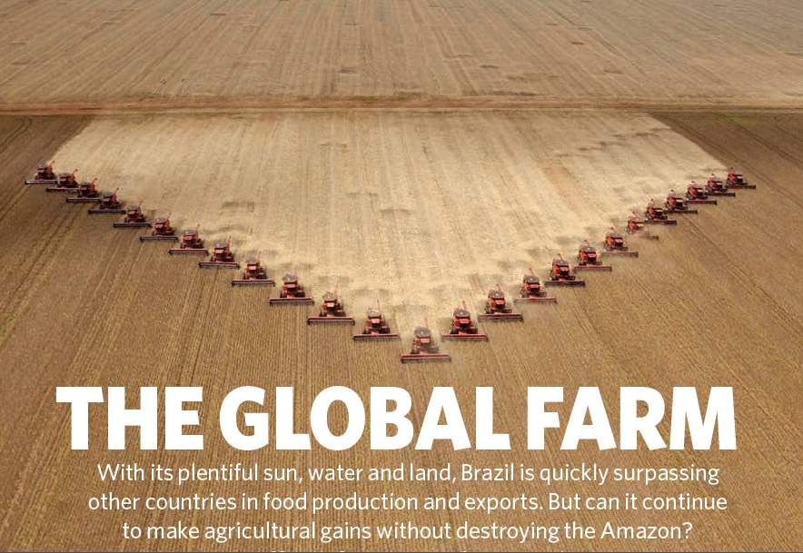
Nature, 29 July 2010

Slide 7
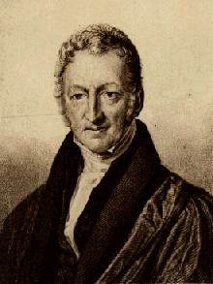
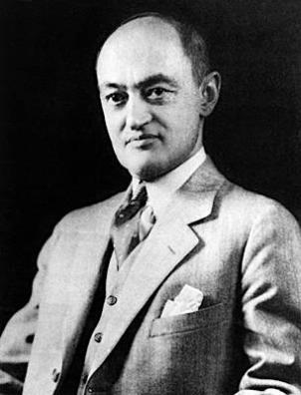
Conceptual debate on Future Earth
Malthusians
“the future is just like the past; only a bit worse”
Schumpeterians
“the future will not be like the past, for better or worse”

Slide 8
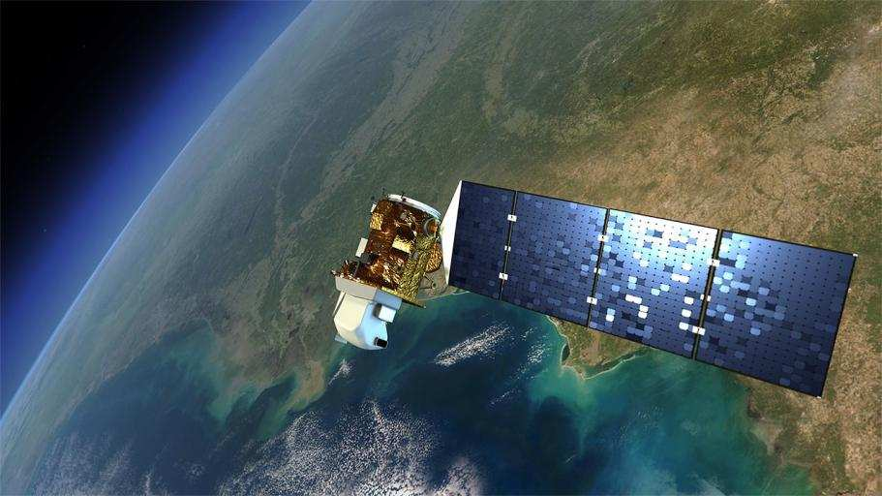
Earth Observation data is now free…and big
graphics: NASA
Sentinels + CBERS + LANDSAT + …: > 10Tb/day

Slide 9
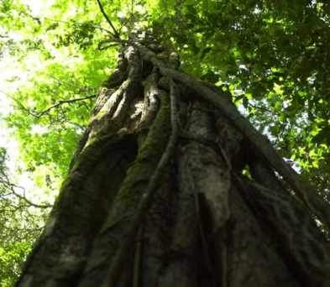

“A few satellites can cover the entire globe, but there needs to be a system in place to ensure their images are readily available to everyone who needs them. Brazil has set an important precedent by making its Earth-observation data available, and the rest of the world should follow suit.”

Slide 10

A working definition of big data
≈
n << all Statistics: we have a small part of the data
n == all Big brother: we have all the data (do we?)
n ≈≈ all Big data: we have data close to problem size

Slide 11
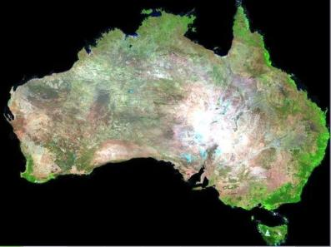


What changes with big EO data?
graphics: Geoscience Australia
What are we looking for in big EO data?
Can we find what we want?
Can we share what we find?

Slide 12
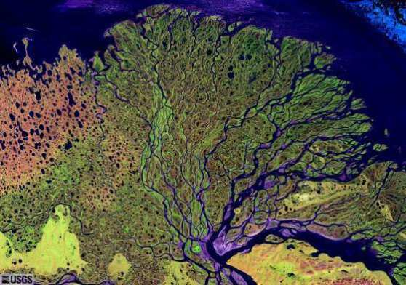
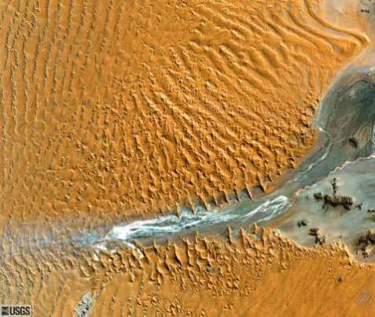
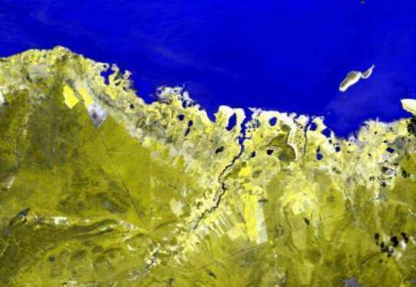
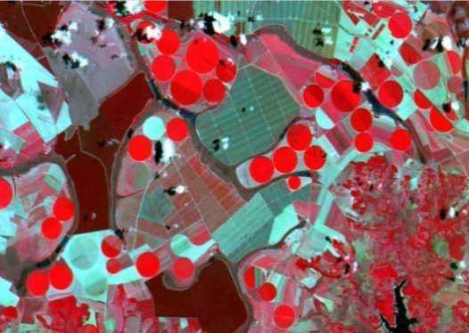
What are we looking for in big EO data?
“If you don't know where you are going,
you'll end up someplace else.” (Yogi Berra)

Slide 13
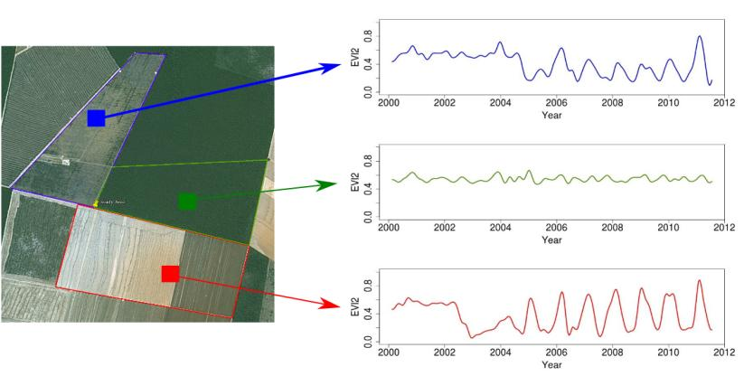
What are looking for in big EO data?
Forest
Pasture
Agric
Área 1
Forest
Área 2
Forest
Agriculture
Área 3
Land trajectories: a key concept for big EO data
source: Victor Maus (INPE, IFGI)

Slide 14
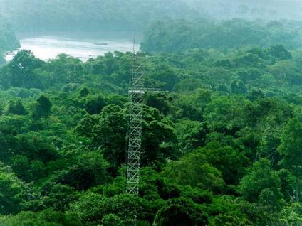
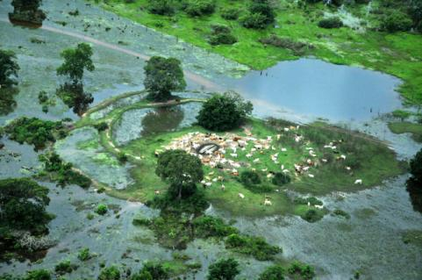
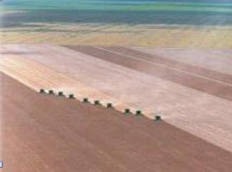
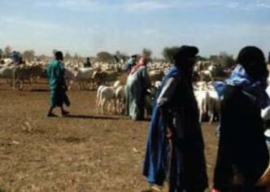
Land cover
  tropical forest
  wetlands
“the observed biophysical cover on the Earth’s surface"
  Non-natural vegetation
  shrublands

Slide 15
Land use
  unmanaged forest
  cattle production
“the arrangements, activities and inputs people undertake in a certain land cover type to produce, change or maintain it”
  Temporary agriculture
  shifting cultivation

Slide 16
Land trajectories
Forest
Pasture
Agric
Área 1
Forest
Área 2
Forest
Agriculture
Área 3
“The transformations of land cover due to actions of land use”
graphics: Victor Maus (INPE, IFGI)

Slide 17
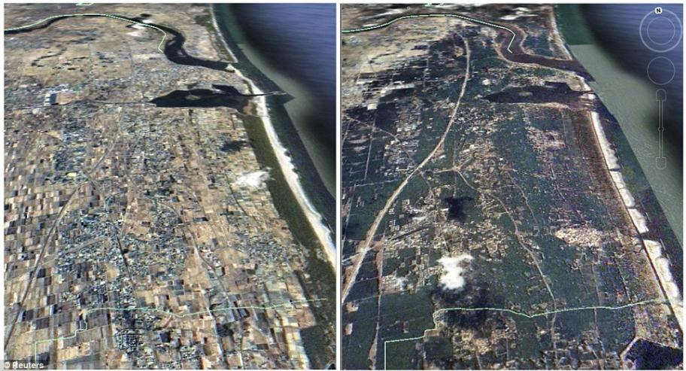
Objects exist, events occur
The coast of Japan is an object
The 2011 Tohoku tsunami was an event

Slide 18

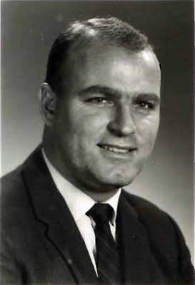
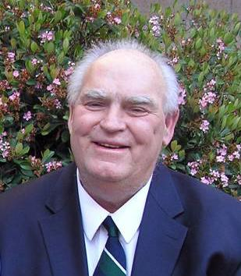
How does our brain represent time?
…by means of events: relevant moments of change
photos: Reginald Gooledge

Slide 19
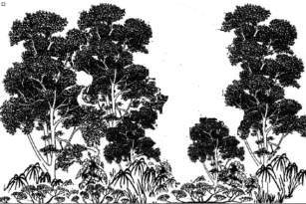
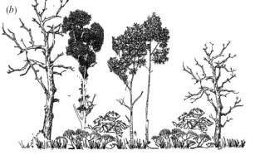
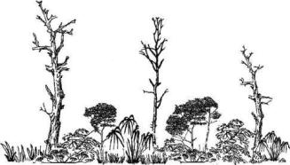
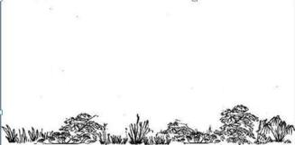
Land trajectories in forests
Exploração intensiva
80%
Event 1
Perda >50% do dossel
Event 2
50%
Perda >90% do dossel
Event 3
10%
Event 4
Corte raso
Floresta
0%
Floresta
Events of forest cover loss

Slide 20
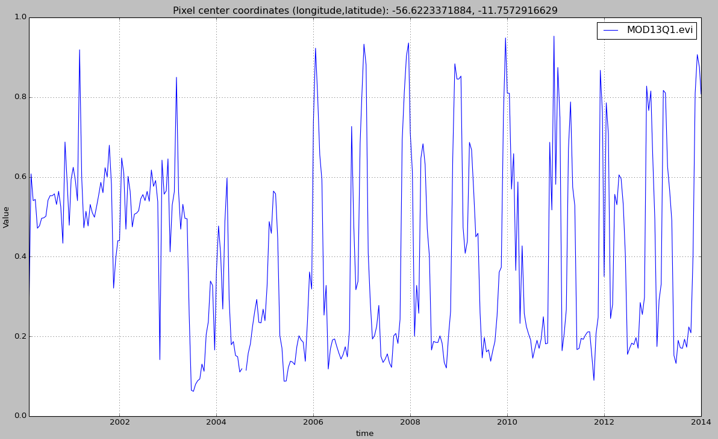

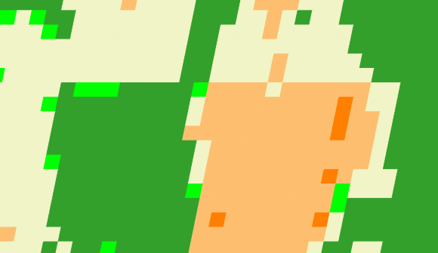
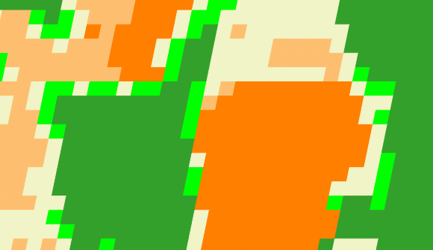
Land trajectories
Forest
Single cropping
Double cropping
2001
2006
2013

Slide 21
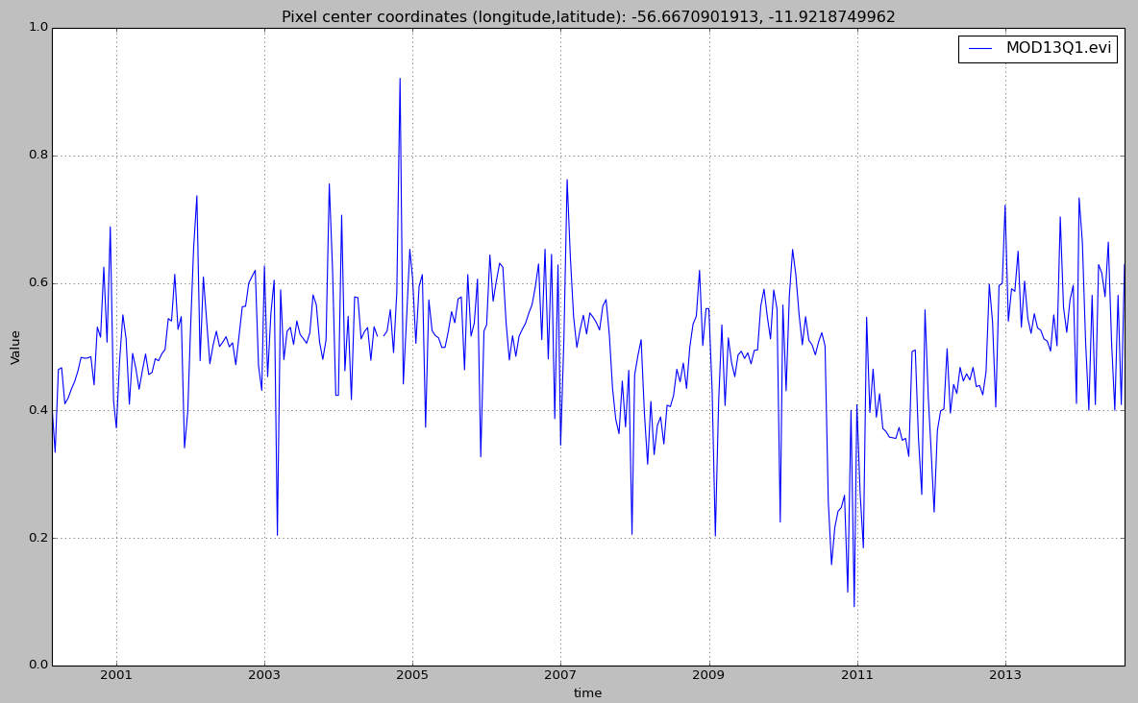
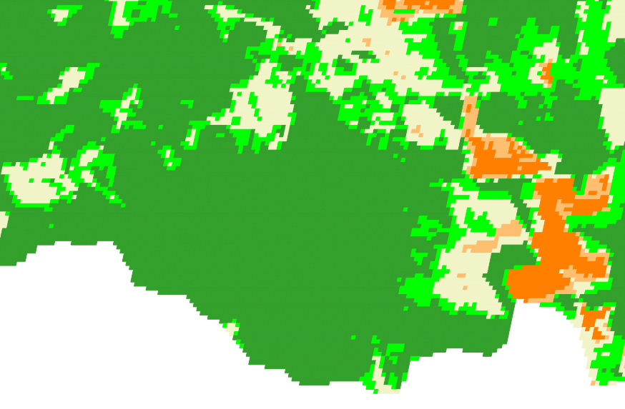
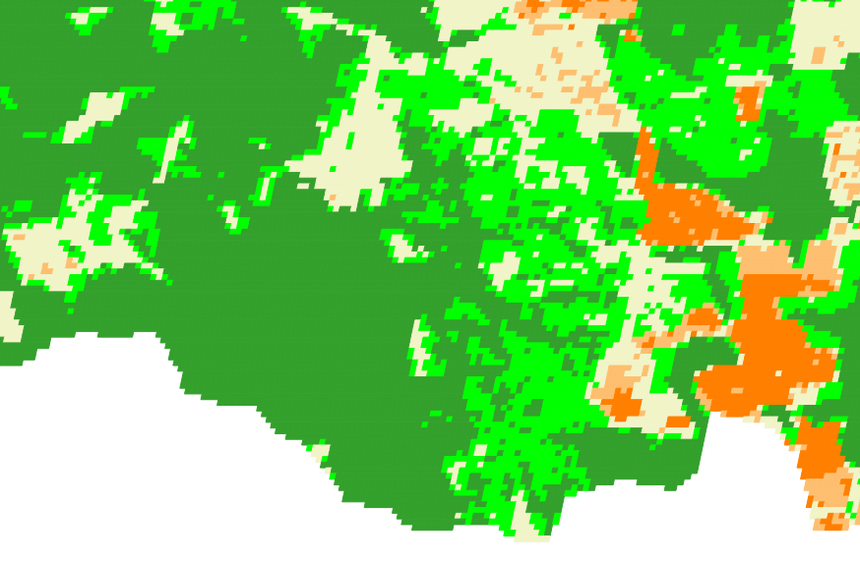
Land trajectories: forest degradation
EVI Time Series
2007
2009
2007
2009

Slide 22
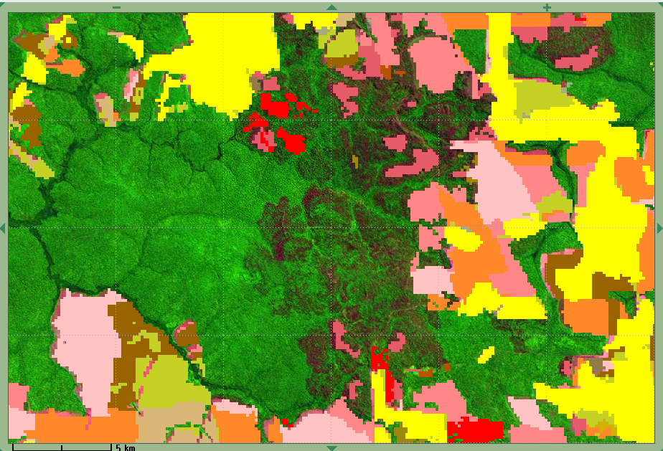
Land trajectories: forest degradation
EVI Time Series
2007
2009
PRODES
2007
2008

Slide 23
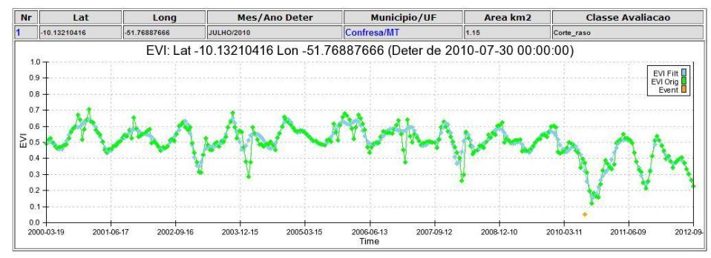
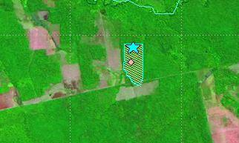
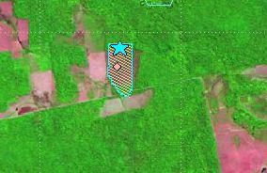
Land trajectories: deforestation events
images: INPE
2010
2011

Slide 24
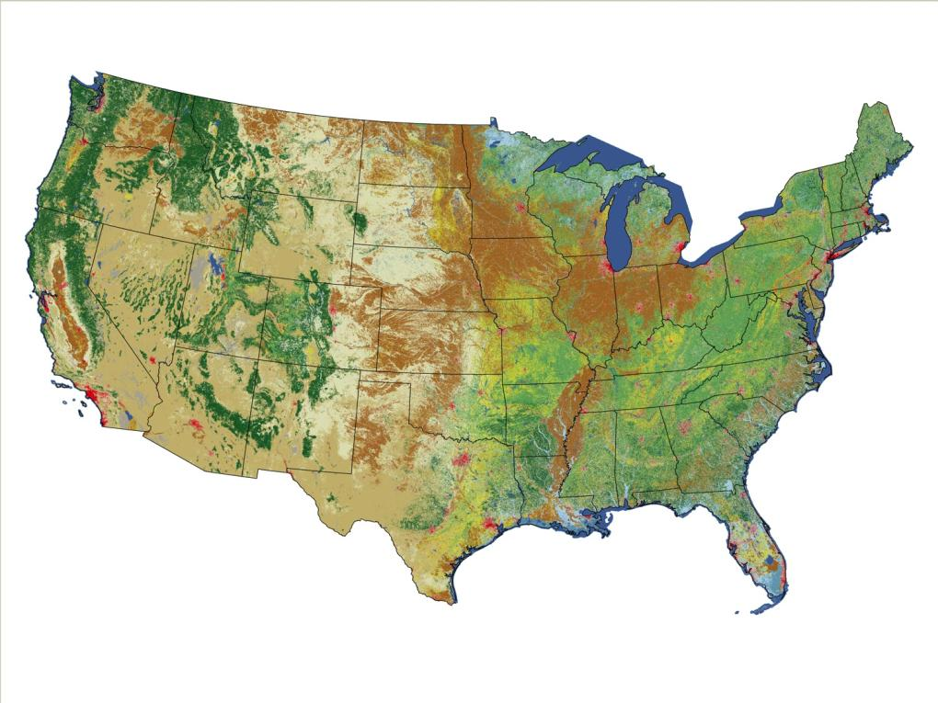
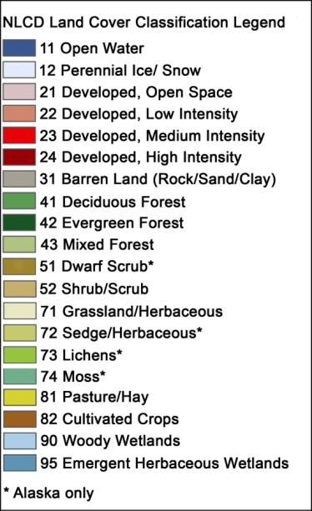
Is this what we want from big EO data?
US National Land Cover 2006
source: USGS

Slide 25
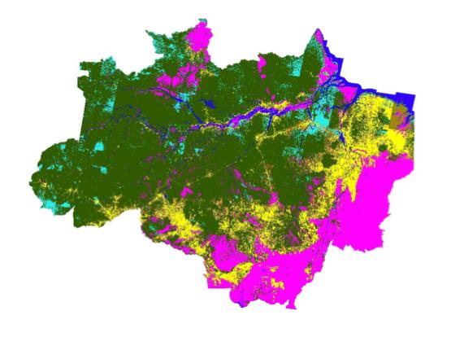
In search of a minimal land trajectory definition
graphics: INPE
The unbearable lightness of PRODES: complete transitions of forest to non-forest

Slide 26
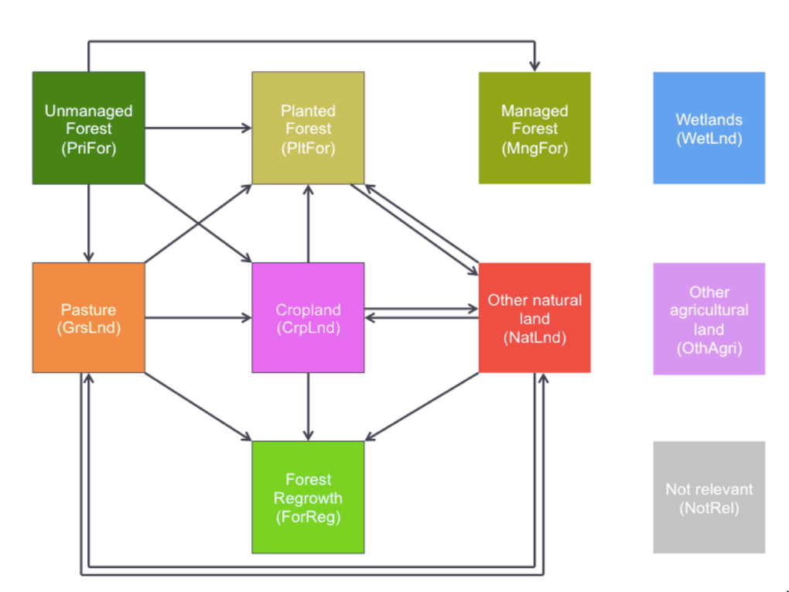
In search of a minimal land trajectory definition
source: IIASA
Transitions for land use modelling (GLOBIOM-Brazil)

Slide 27
How do we find what we want in big EO data?
“In theory there is no difference between theory and practice. In practice there is.” (Yogi Berra)

Slide 28
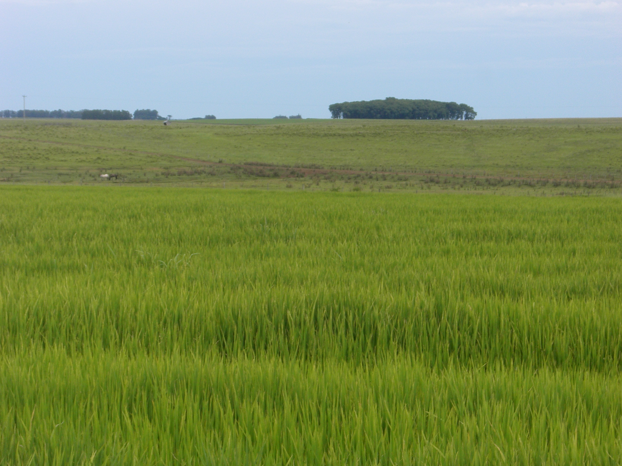
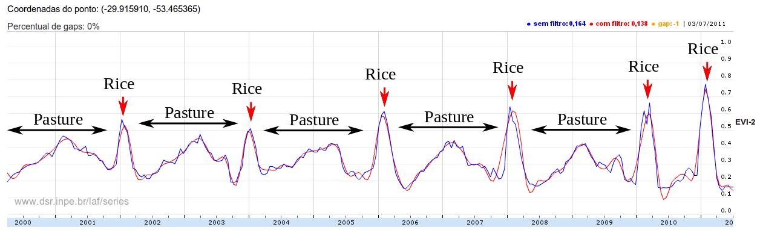
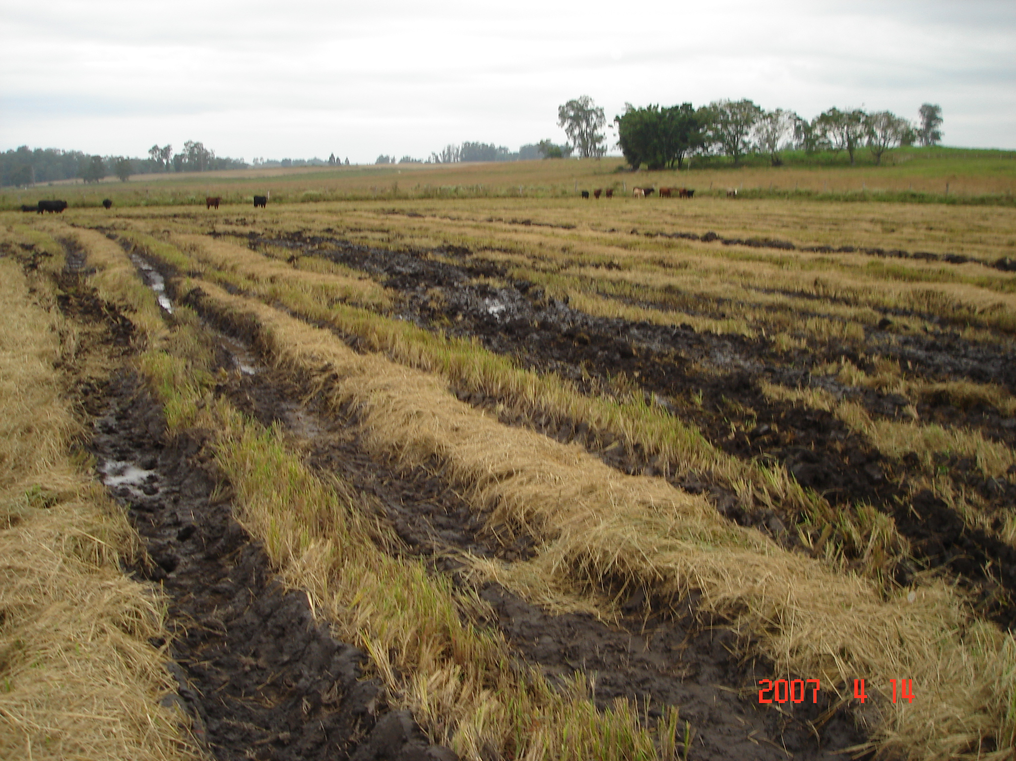
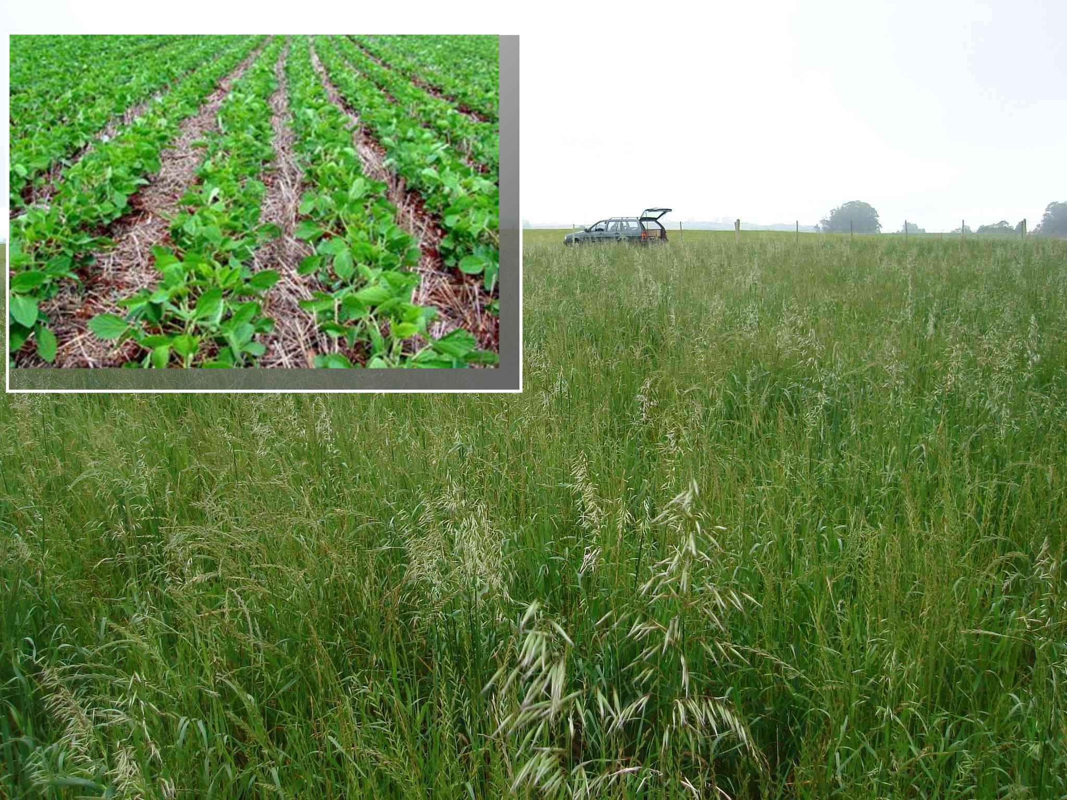
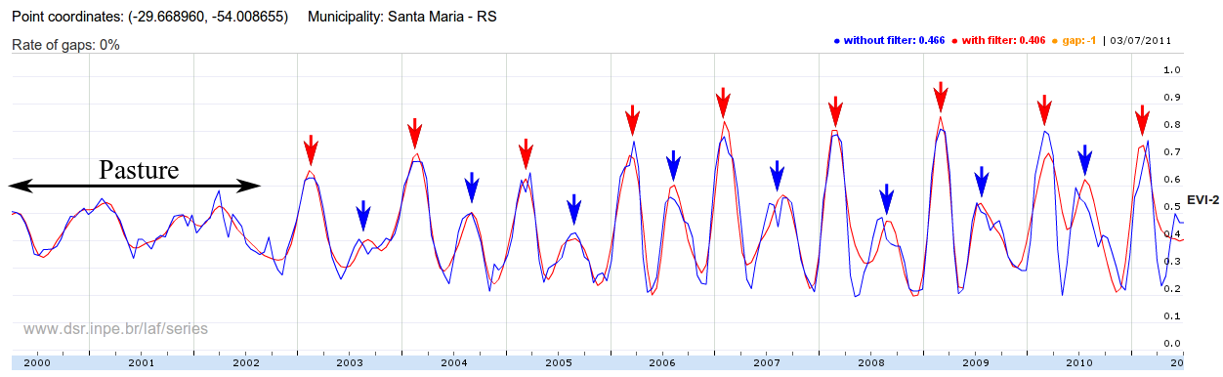
Land trajectories require adequate data
Fallow
Fallow
Fallow
Fallow
Fallow
Soybean
Ryegrass
Victor Maus

Slide 29
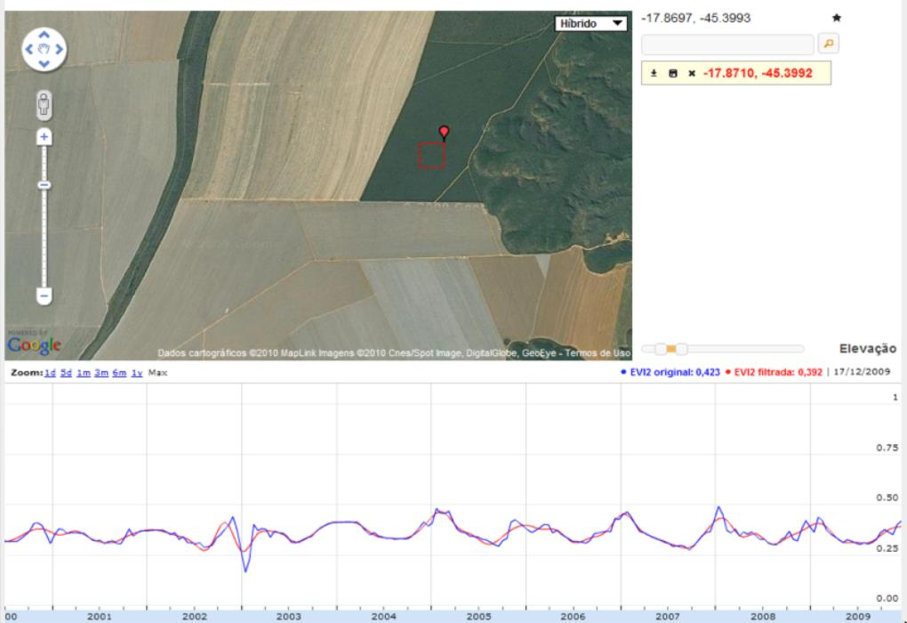
Tropical forest: stable signal + low seasonal change
One sample per year (PRODES)
graphics: LAF/INPE
source: INPE

Slide 30
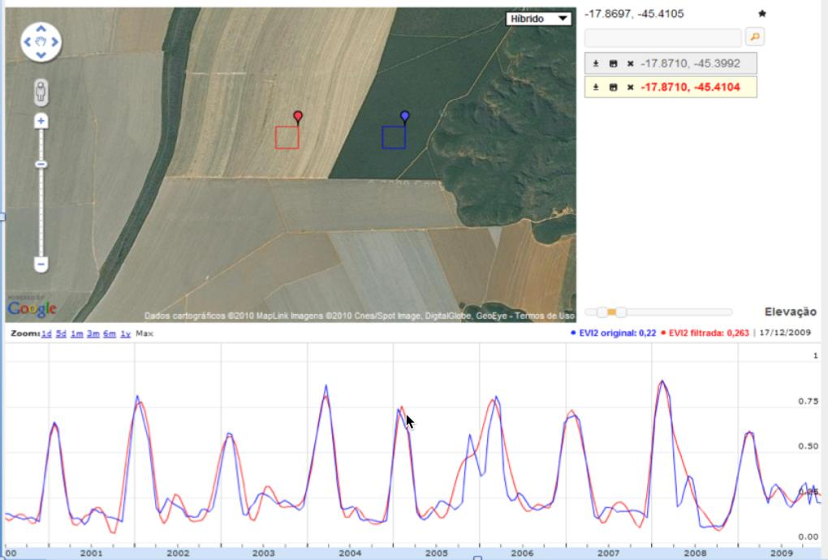
Single-crop grain production: soybeans
One sample per month (?)
graphics: LAF/INPE
source: INPE

Slide 31
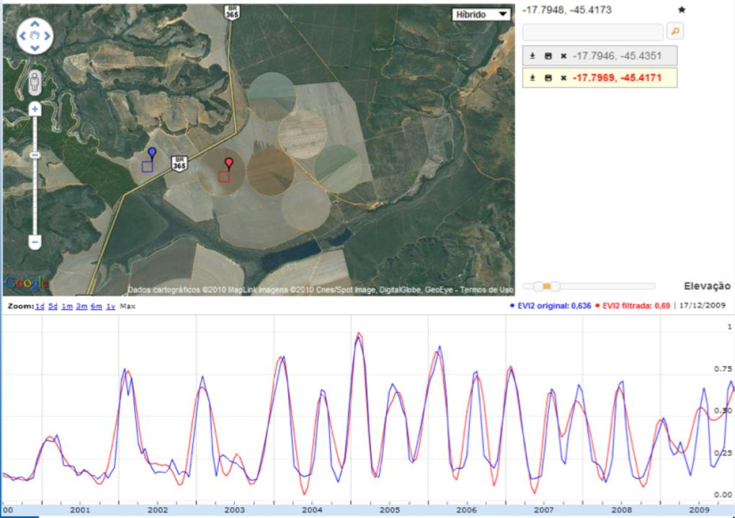
Double-cropping: soybeans + corn
Two samples per month (?)
graphics: LAF/INPE
source: INPE

Slide 32
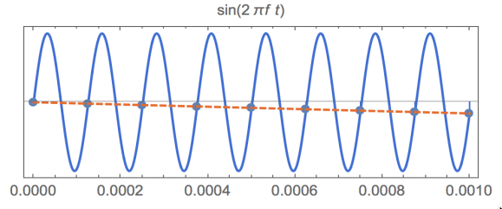
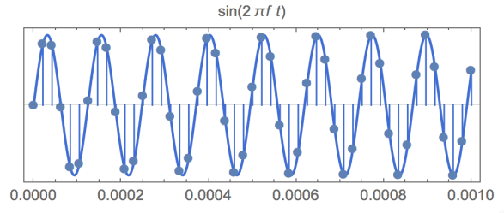
Sampling theorem: minimum rate to reconstruct a periodic signal
In theory: insufficient (above) and sufficient (below) sampling rates to reconstruct a periodic signal

Slide 33
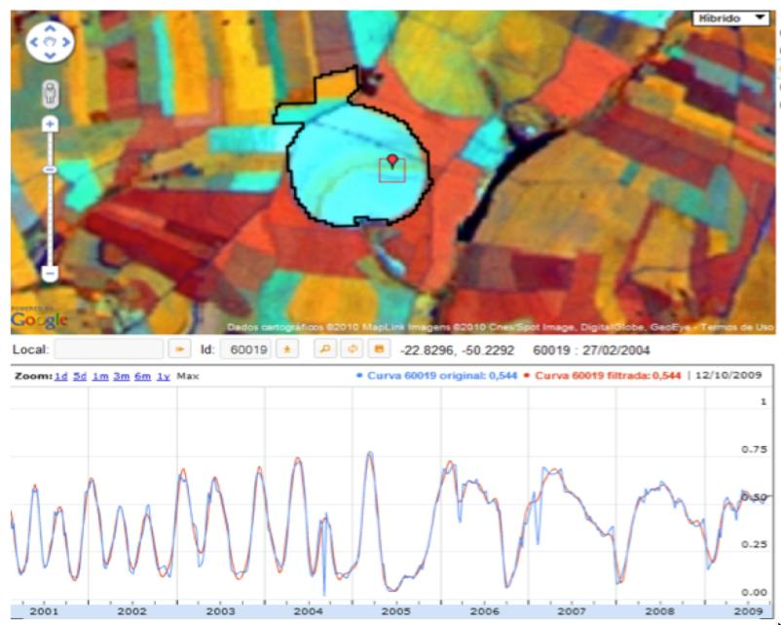
In practice: signals of varying frequencies
graphics: LAF/INPE

Slide 34
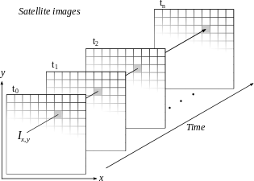

Space first, time later or time first, space later?
Space first: classify
images separately
Compare results in time
Time first: classify
time series separately
Join results to get maps

Slide 35

Space first, time later
Spatial data resolution is better than temporal resolution
Hansen et al. (2013)

Slide 36


Space first can lead to inconsistent land trajectories
MODIS land cover: unrealistic forest gains and losses
Data sources: INPE, NASA. Analysis by M. Buurman

Slide 37

Time series analysis: parametric methods
TIMESAT: relate time series with crop phenology
limited to agriculture, dependent on training data
Zhang et al. (2003), Jönsson and Eklundh (2004)

Slide 38


Time series mining: prediction
Esling & Agon (2012), Zhu et al.(2012)
Predict the next LANDSAT image
predicted vs. observed forest pixels (pine forest)

Slide 39

Time series mining: event detection
Deviation from standard behaviour:
find subsequences that do not follow the model
Esling & Agon (2012)

Slide 40

Time series mining: event detection
BFAST: changes in a pine plantation (trend breaks)
Verbesselt et al. (2010)

Slide 41

Time series mining: pattern matching
Finding subsequences in a time series
High computational complexity
Patterns are idealized, data is noisy
Esling & Agon (2012)

Slide 42


Dynamic Time Warping: pattern matching
Arvor et al (2012), Eamon Keogh
DTW “warps” the time axis: nonlinear matching

Slide 43

Victor Maus

Slide 44

Victor Maus

Slide 45

Victor Maus

Slide 46
How do we share what we have found with big EO data?
“You have to go to other people’s funerals. Otherwise, they won’t go to yours” (Yogi Berra)

Slide 47



SciDB Architecture: “shared nothing”
image: Paul Brown (Paradigm 4)
Can we reproduce a Science paper?
Large data is broken into chunks
Distributed server process data in paralel

Slide 48

Is free data download our answer?
Currently, users download one snapshot at a time
How do you download a petabyte?
images: INPE
Notes:
Este slide mostra o impacto da cobertura de nuvens sobre a analise de imagens. Esta é uma região do Pará, onde todas as imagens durante o ano de 2002 tem cobertura de nuvens. Para reduzir este impacto, o INPE analisa varias imagens para uma mesma regiao.

Slide 49

Data Access Hitting a Wall
How do you download a petabyte?
You don’t! Move the software to the archive

Slide 50
Big data requires new conceptual views
How can we best use the information provided by big data sources?
Image source: Geoscience Australia

Slide 51


Current GIS is map-based
Big data does not fit in the “map as set of layers” model

Slide 52


Big data = lots of files?
“…by the time a file system can deal with billions of files, it has become a database system” (Jim Gray)

Slide 53
Big EO data + analysis technologies
Data management
  Map-reduce (Google Earth Engine)
  Object-relational databases (PostGIS, Rasdaman)
  Array databases (SciDB)
Data analytics
  Google Earth Engine API
  R statistical environment
  SciDB APL (array processing language)
  Python/Lua interpreters

Slide 54
Map-Reduce Operation
MAP: Input data ➔ <key, value> pair
REDUCE: <key, value> pair ➔ <result>
Map
Reduce
Data
Collection: split1
Split the data to
Supply multiple
processors
Reduce
Data
Collection: split 2
Map
……
…
Data
Collection: split n
Map
Reduce

Slide 55

Array databases: all data from a sensor put together in a single array
t
y
y
X
result = analysis_function (points in space-time )

Slide 56

Image segmentation using map-reduce or array databases?

Slide 57

How do we go global?
Differences btw GLC, MODIS, GLOBCOVER (Kaptué et al., 2010)

Slide 58

Global land observatory
Google
Earth
Engine
Space
agencies
Research
Labs
Environment
agencies,
NGOs

Slide 59


Bringing the user to the data
algorithms
results
Remote visualization and
method development
Big data EO management and analysis
40 years of Earth Observation data of land change accessible for analysis and modelling.

