Slide 1
Science and Technology in Brazil: from Prebisch’s paradox to the Capricorn triangle
Gilberto Câmara
CAPES-WWU Brazil Chair
IFGI, University of Münster
INPE – Brazil

Slide 2
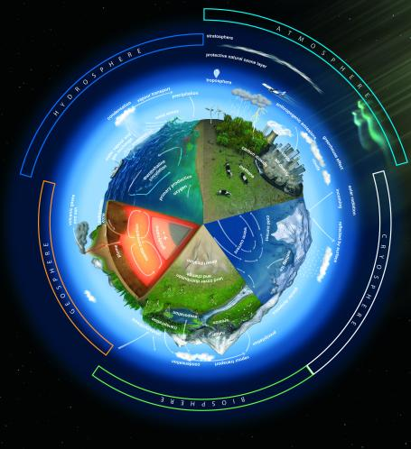


What is a research agenda?
Research questions set up by the scientific community on

Slide 3
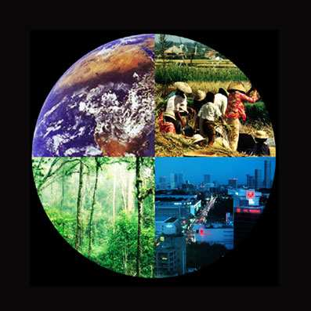
The Global Change agenda
How is the Earth’s environment changing, and what are the consequences for human civilization?
source: IGBP

Slide 4

The Human Brain Project
Understanding the human brain is one of the greatest challenges facing 21st century science (135 institutions, 26 countries, EU 1.2 billion)

Slide 5
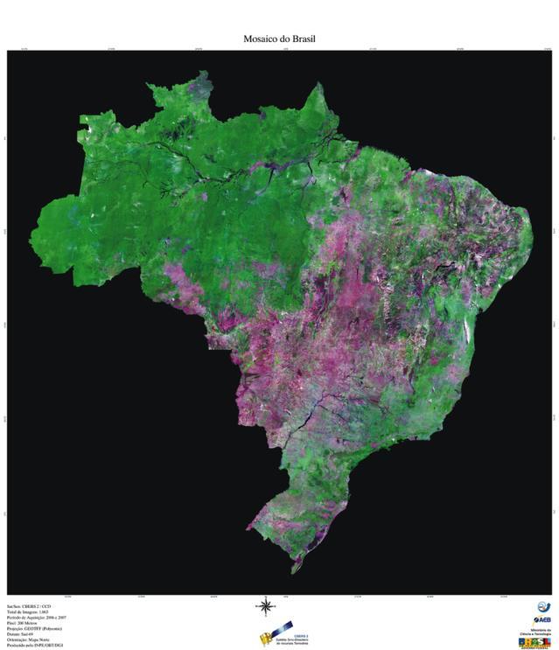
Brazil
What is Brazil?
What is it to be a Brazilian?

Slide 6
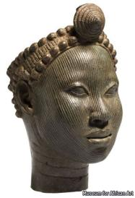

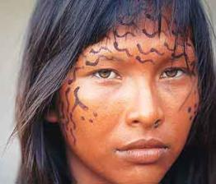


“Die brasilianische melange”
Daiane dos Santos
40% African
40% European
20% Amerindian
Neguinho da Beija-Flor
32% African
57% European
1% Amerindian

Slide 7








Brazil - Country, population and economy:
Challenging combination
Area
> 4 million km²
Population
> 100 million
Indonesia
Nigeria
Russia
Bangladesh
USA
Pakistan
Brazil
India
Canada
China
Mexico
Australia
Japan
France
Spain
UK
Soul Korea
Germany
Netherlands
GNP*
> US$ 400 billon
Italy
Notes:
7
7

Slide 8
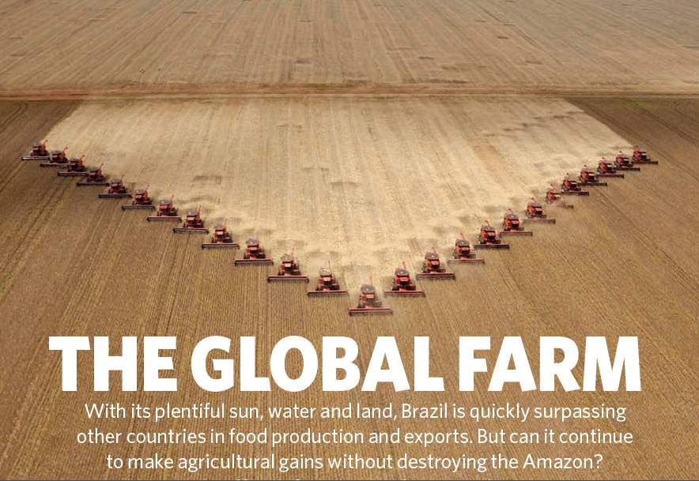
Nature, 29 July 2010

Slide 9
Nature, 29 July 2010
Can Brazil become the first developed country in the tropics?

Slide 10
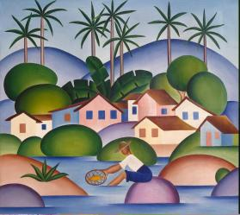
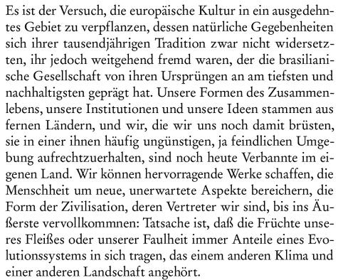

Die Wurzeln Brasiliens

Slide 11

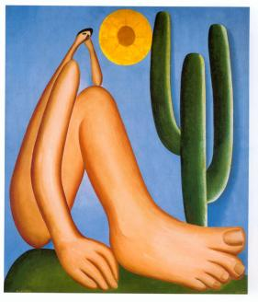
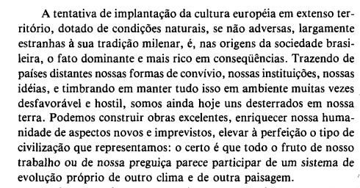

Slide 12
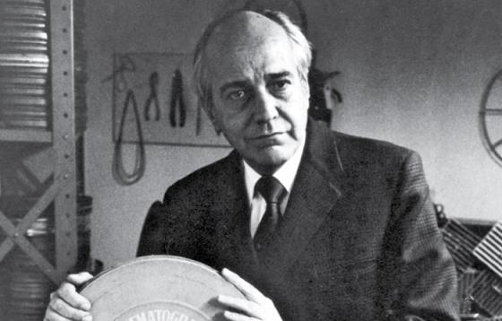
Paulo Emilio Salles Gomes
"Não somos europeus nem americanos do norte, mas destituídos de cultura original, nada nos é estrangeiro, pois tudo o é."
”Being neither Europeans nor North Americans and lacking an original culture, nothing is foreign to us, because everything is."

Slide 13
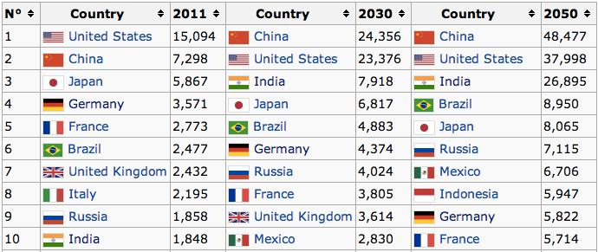
Forecasts: 2010-2050
Top ten world economies (in 2011 US$ billions)
source: PriceWaterhouseCoopers (2013)

Slide 14
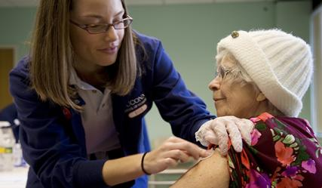
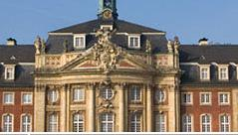
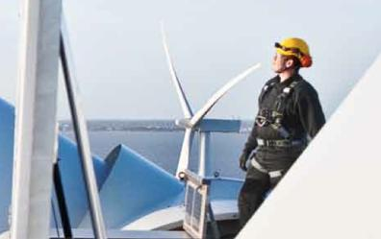

Germany’s national project (outsider view)
Social security state
Knowledge society
Industrial transition to green economy
European integration and leadership

Slide 15
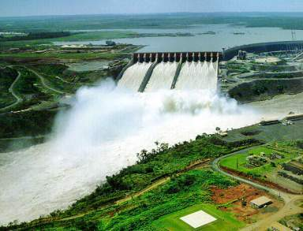
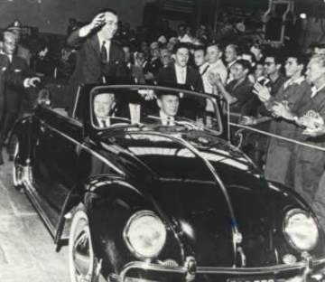
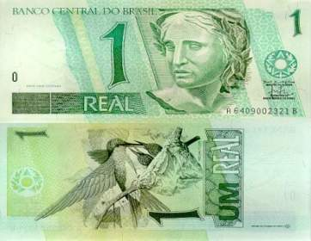
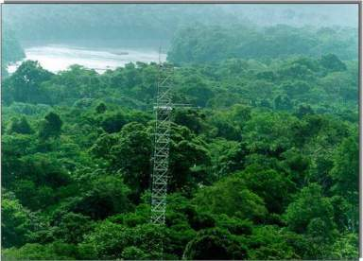
Brazil’s national projects: 1950-2010
1950s
1970s
Itaipu, Angra, Embraer,
external debt, import substitution
auto industry, Petrobras
1990s
2010s
privatization, fiscal discipline
open markets, subsidies reduction
Green energy, environment,
offshore oil production

Slide 16
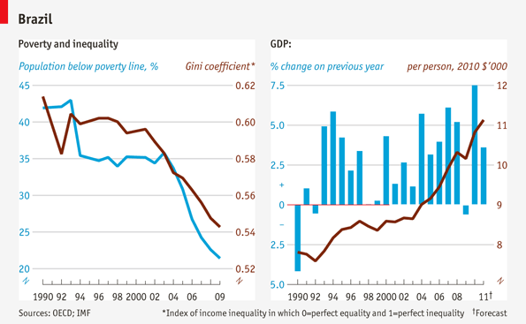
Recent success, future risks?

Slide 17
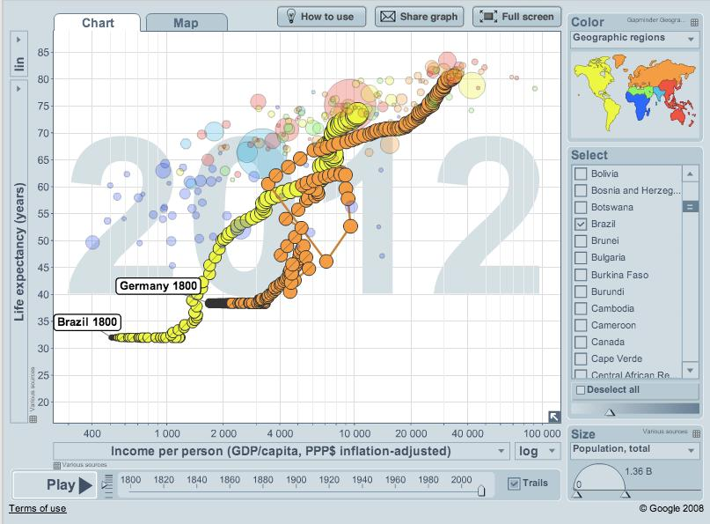
Brazil and Germany: income vs life expectancy (1800-2010)

Slide 18
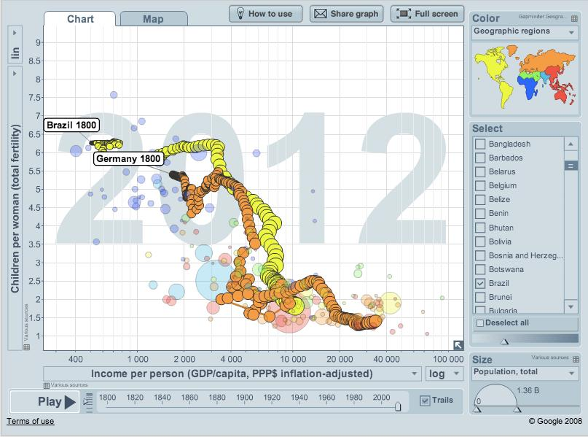
Brazil and Germany: income vs children/woman (1800-2010)
BR 1960: (3.000, 6.2)
DE 1875: (3.300, 5.5)
BR 1990: (7.700, 6.2)
DE 1960: (13.500, 2.5)

Slide 19

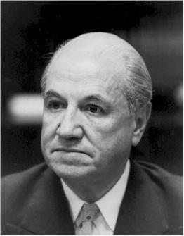
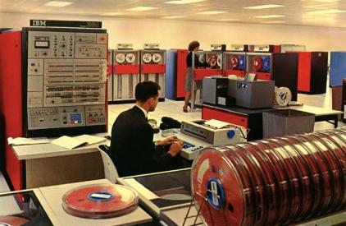
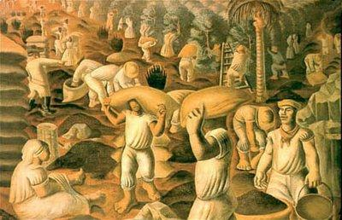
Traditional development economics
Raul Prebisch (CEPAL): the terms of trade between industrialised and non-industrialised countries change over time
Countries that export commodities would be able to buy fewer and fewer manufactured
goods

Slide 20
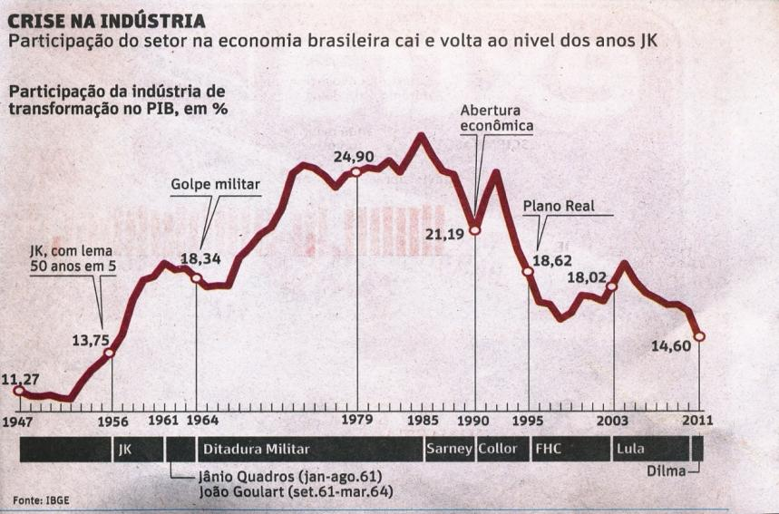
The China effect on the Brazilian industry
Industry share of GDP is now at a 50-year low

Slide 21
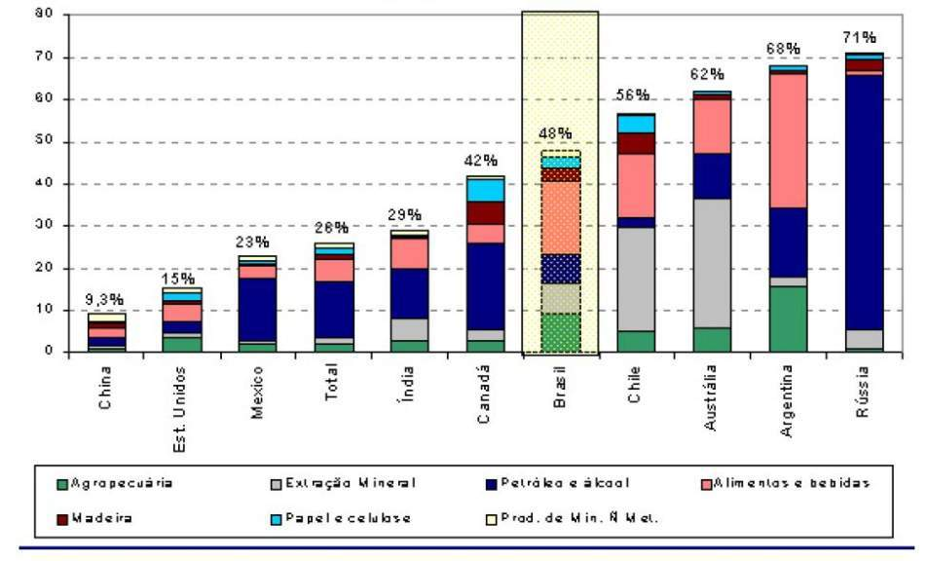
Share (%) of natural resources in exports, 2005
Fonte:BNDES, Visão de Desenvolvimento, nº 36, 2007

Slide 22
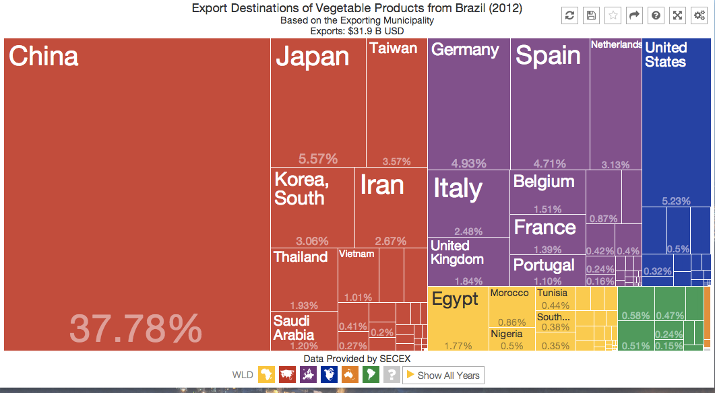
Export destinations of Brazilian products

Slide 23
Traditional development economics
Raul Prebisch (CEPAL): the terms of trade between industrialised and non-industrialised countries change over time
Countries that export commodities would be able to buy fewer and fewer manufactured
goods
“When the facts change, I change my mind. What do you do, sir?” (J.M. Keynes)

Slide 24
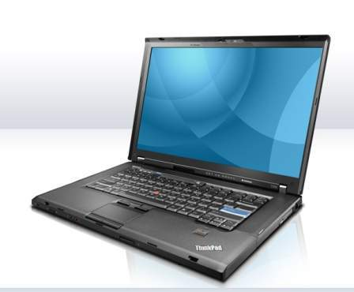

What would Prebisch say today?
1992 IBM ThinkPad 700, Windows 3.1, 25 MHz 486 processor, 120 MB hard disk drive, 10.4″ display, 3 kg
2009 Lenovo ThinkPad T500, Windows Vista, Intel® Core™2 Duo processor (2.26GHz), 14.1” display, 3 kg, 160 GB Hard Disk.
1992 – US$ 4,350
2009 – US$ 750

Slide 25
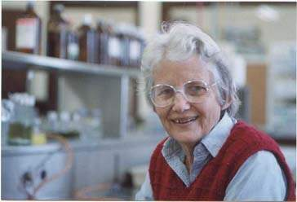
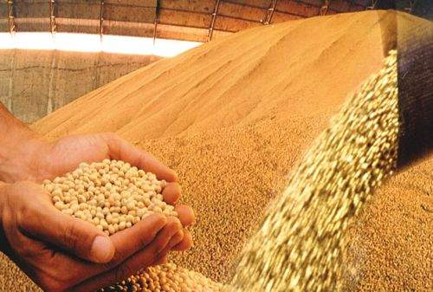
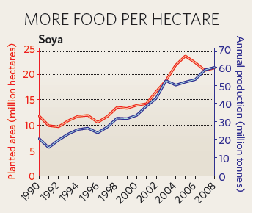
What would Prebisch say?
Soybean (ton)
1992 – US$ 209
2010 – US$ 484
Soy: 600 kg/ha in 1990
2.700 kg/ha in 2008
source: Index Mundi

Slide 26
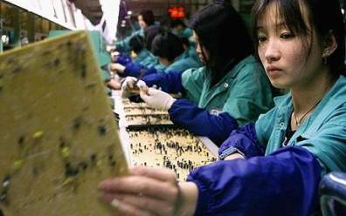
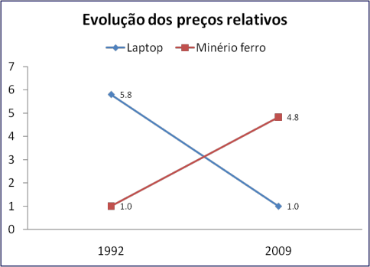
What happened? Terms of trade changed
China effect: Transfer of factories to China has reduced the price of manufactured goods and increased demand for commodities
Graph: G. Câmara, INPE Idea: J. Furtado, USP

Slide 27

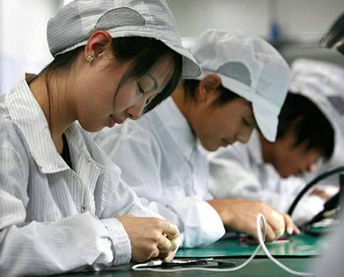
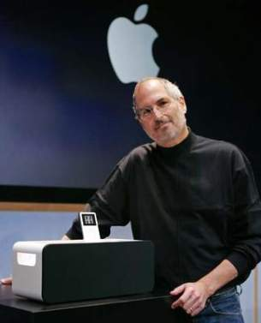
Where are the jobs? Where is the money?
Ipod: high technology (OECD)
ipod: exported by China, value added in California

Slide 28
Who earns with an iphone?
Foxconn: 1,2%
Apple: 65%

Slide 29
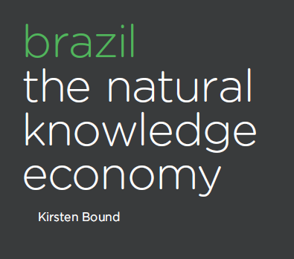
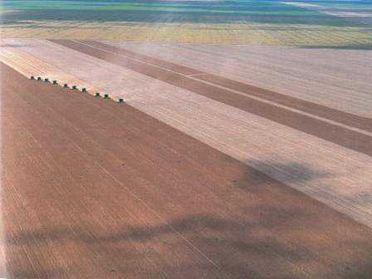
Brazil: a natural knowledge economy?
Brazil´s innovation system is in large part built upon its natural and environmental resources, endowments and assets.

Slide 30
Brazil: a natural knowledge economy?
We tend to regard a comparative advantage based on natural resources as indicative of an economy at a relatively immature stage in its development, that must be outgrown to expand the frontiers of technological possibility. The Brazilian case challenges this linear view. (Kristen Bound, DEMOS).

Slide 31
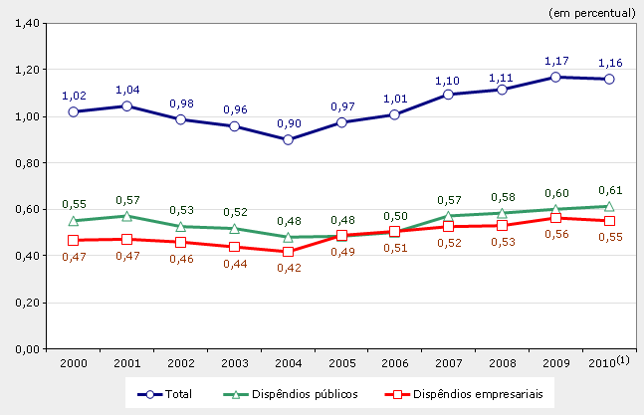
The legacy of import substitution policies: public and private investment in S&T
Most private investment is done by Petrobras

Slide 32
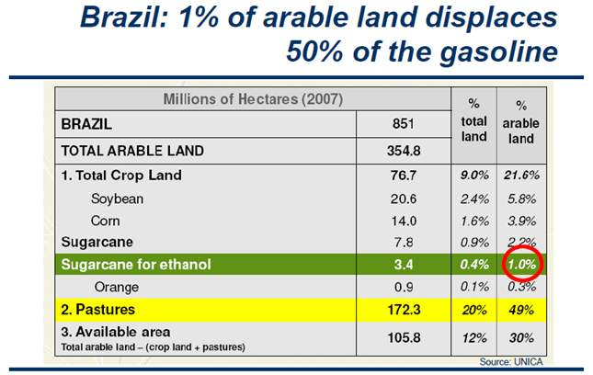
source: CH Brito Cruz (FAPESP)

Slide 33
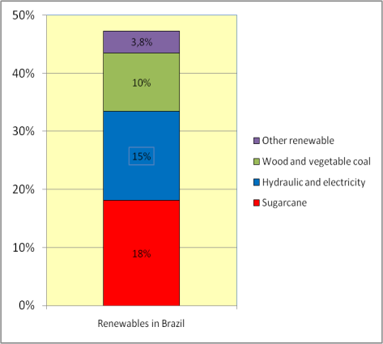
Brazil: 47% of energy from renewable sources (2009); 18% from sugarcane
60%
50%
40%
Energy sources in Brazil, 2006
30%
20%
cane
18%
10%
0%
Non-Renewable
Renewable
Renewables in Brazil: 47%; World: 13%; OECD: 7,2%
source: CH Brito Cruz (FAPESP)

Slide 34
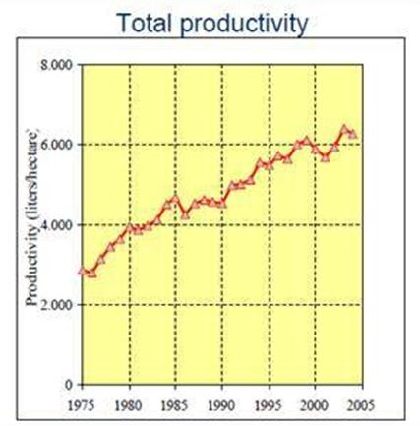
R&D impact on ethanol and soybeans
Ethanol: 2.800 litros/ha in 1975
6.000 litros/ha in 2005
Soya: 600 kg/ha in 1990
2.700 kg/ha in 2008
sources: CH Brito Cruz (FAPESP), Nature

Slide 35
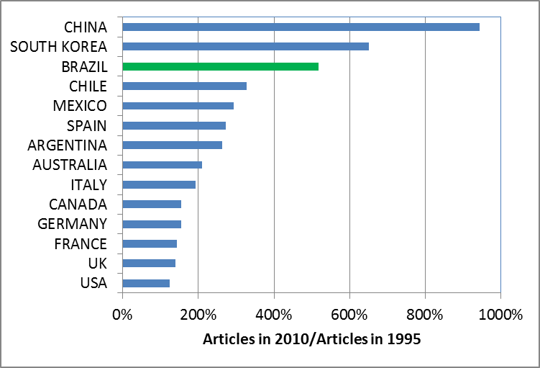
Brazil: strong growth in international scientific articles, 1995-2010

Slide 36
CAPES Budget
US$ = 1.67/R$

Slide 37
Brazilian Science: Europeans in the tropics?
Brazilian science covers all areas of knowledge: makes us wiser, but not richer (resources are spread too thinly)

Slide 38
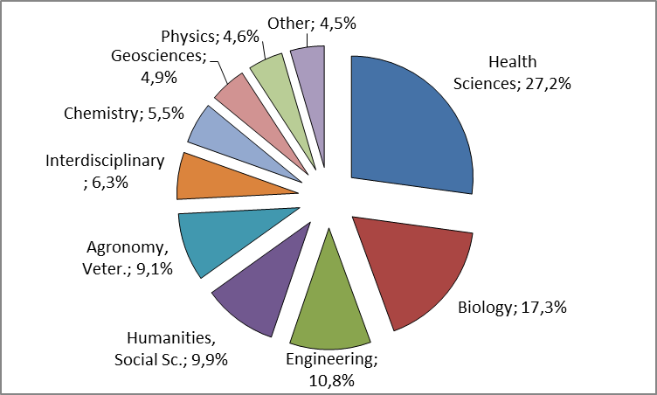
FAPESP expenditures, 2011 (US$ 500 million)
source: CH Brito Cruz (FAPESP)

Slide 39
Brazil’s science (% of world)
source: ISI

Slide 40
source: Jorge Guimarães (CAPES)

Slide 41
Brazilian science and the Capricorn triangle
100%
1,8%
2,3%
1,3%
1,4%
1,8%
2,7%
3,0%
5,4%
Mathematics
Physics
Computer Science
External
Agenda
Engineering
Chemistry
Ecology and Environment
Tropical Health
Tropical Agriculture
Internal agenda
100%
Graphics: G. Camara based on ISI data

Slide 42
Brazilian science and the Capricorn triangle
100%
1,8%
2,3%
1,3%
1,4%
1,8%
2,7%
3,0%
5,4%
Mathematics
Physics
Computer Science
External
Agenda
Engineering
Chemistry
Ecology and Environment
Tropical Health
Tropical Agriculture
Internal agenda
100%
The areas of greatest impact of Brazilian science are linked to the natural knowledge economy

Slide 43
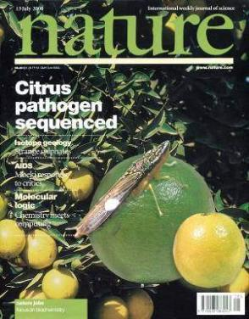
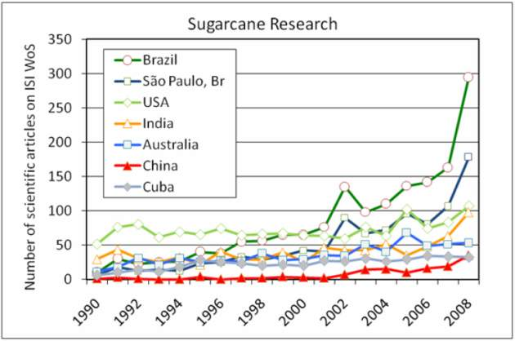
Prebisch´s paradox
source: CH Brito Cruz (FAPESP)
Brazil´s natural knowledge economy offers more opportunities for internal R&D than our manufacturing industry

Slide 44

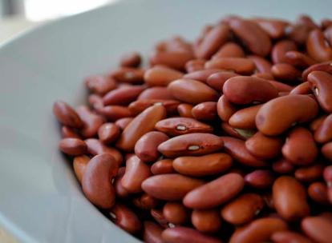
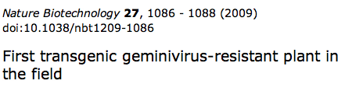
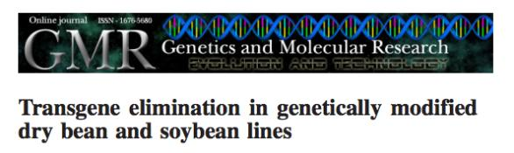
Challenge: Biotechnology for agriculture
Genetically-modified, virus-resistant beans (EMBRAPA)

Slide 45

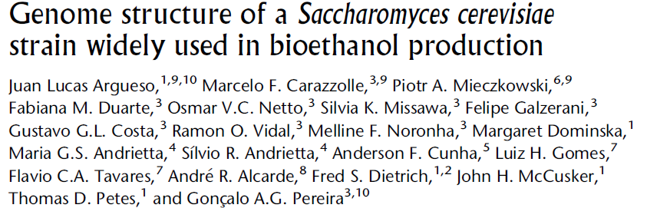
Microorganisms for bioethanol
Interaction between UNICAMP and private company
source: CH Brito Cruz (FAPESP)

Slide 46


FAPESP’s BIOEN research program:
84 → 148 → 212 → 381 ton/Ha??
source: CH Brito Cruz (FAPESP)

Slide 47


Challenge: Can Brazil increase its renewable energy technological portfolio?
Second-generation ethanol
Fonte: CH Brito Cruz, FAPESP

Slide 48


FAPESP: Sugarcane genomics,
1999
Started 1999
Molecular Biology tools for improving sugarcane
Science and Technology of sugarcane
  Articles, thesis and patents
  Human resources
Partners:
  CTC and Ridesa

Slide 49


Challenge: can Brasil use space technology for sustainable development?
Monitoring land change in Brazil by satellites

Slide 50


Challenge: can Brazil keep its few high-tech industries?
EMBRAER EMB-190
EMB-190 avionics (Honeywell)
EMBRAER: 4th largest plane manufacturer, dependent on US avionics and software

Slide 51

Professors have ideas, often times because they love challenges

Slide 52


Then the academic idea may develop into na application
source: CH Brito Cruz (FAPESP)

Slide 53




Result: Embraer-FAPESP-USP Center for Aircraft Comfort Engineering
source: CH Brito Cruz (FAPESP)

Slide 54


Challenge: ?
Oil production: low technology (OECD)
Offshore platform
Brazilian oil exports
What will be the effects of the pre-salt on Brazilian economy?

Slide 55





Interdisciplinary research: hallmark of Brazil’s international cooperation?
If (... ? ) then ...
  Can we develop barrier-breaking research agendas?

Slide 56

What does it mean to be a “neglected disease”?
Poor man’s diseases are not hot scientific topics!
source: ISI

Slide 57



From Prebisch’s paradox to Capricon triangule
Carlos Chagas
When will our S&T policy reflect our destiny?

Slide 58


How can you make a difference as a Brazilian scientist?
Follow your own agenda
Look to the future
Or would you rather be one more in the crowd?

