Slide 1
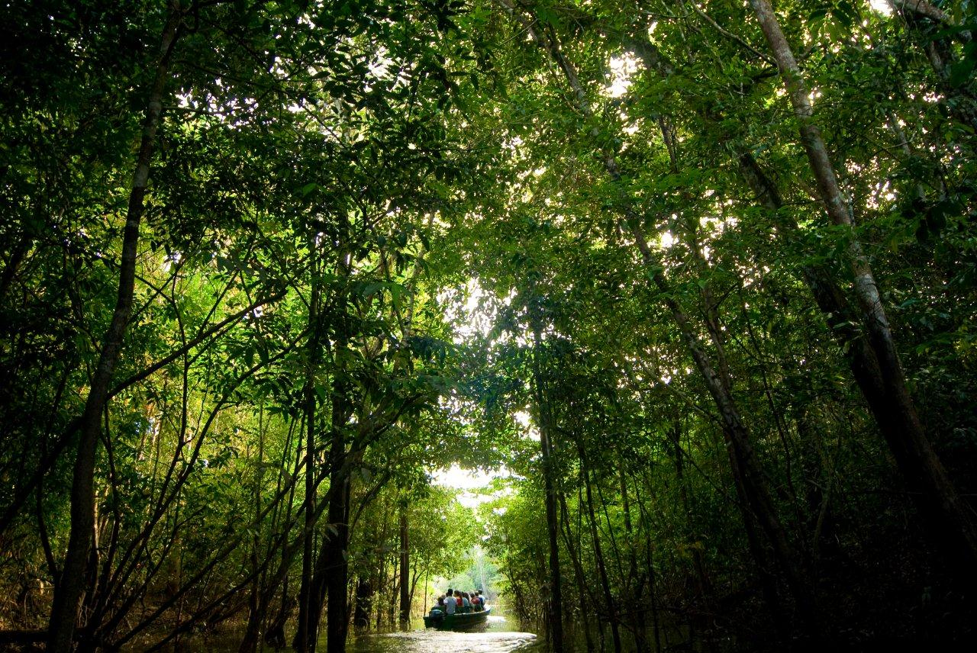
How did Brazil reduce deforestation in Amazonia?

Slide 2
The Roots of Brazil
”Being neither Europeans nor North Americans and lacking an original culture, nothing is foreign to us, because everything is.” (Paulo Emilio Salles Gomes)

Slide 3
Nature, 29 July 2010

Slide 4
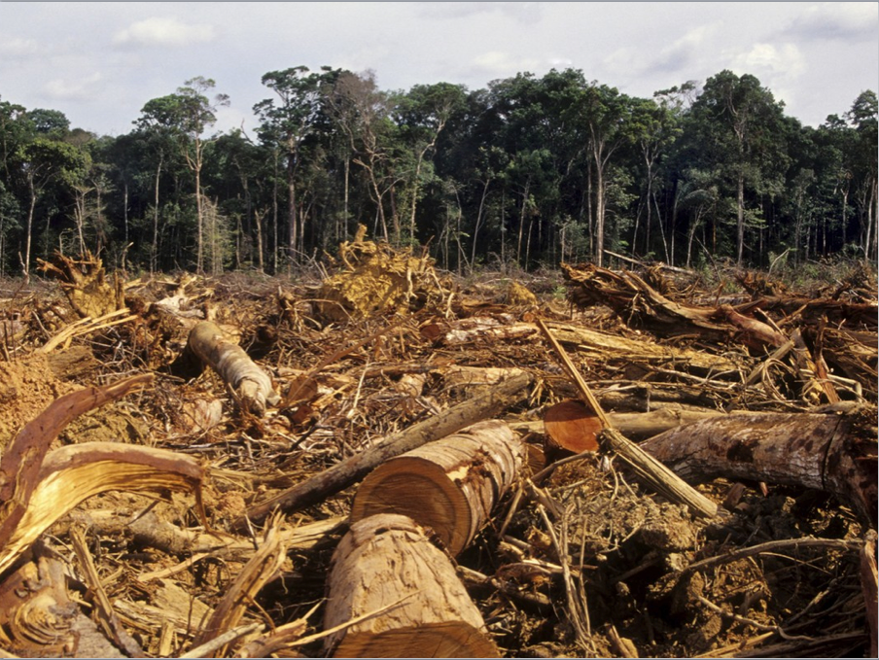
How can Science support enviromental accountability?

Slide 5
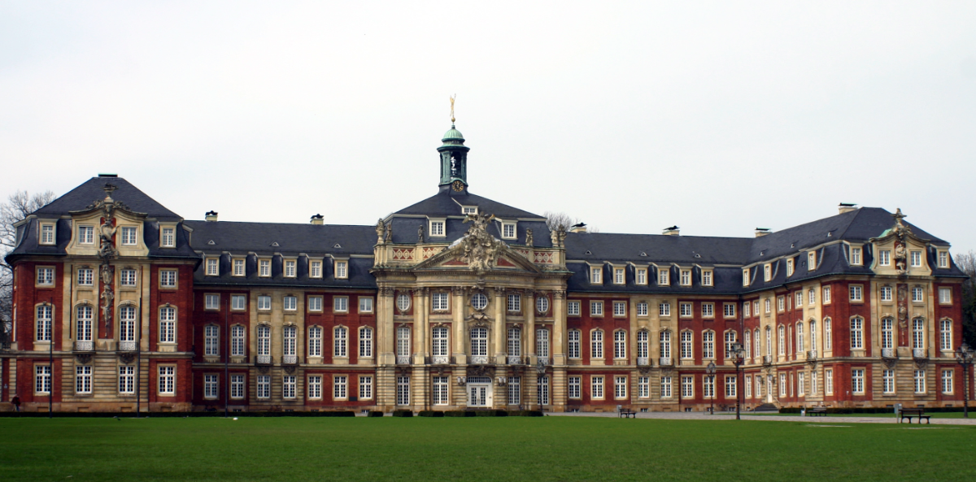
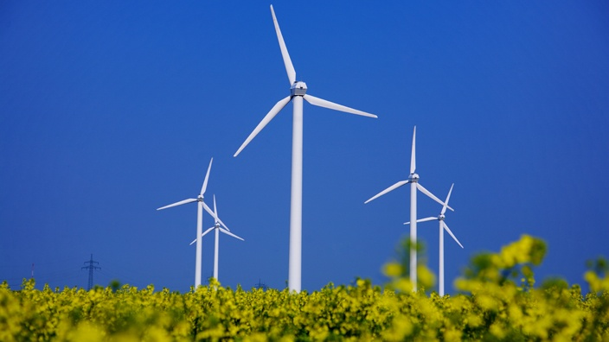
Institutions create developed societies
Social security
Knowledge society
Energiewende
Europe

Slide 6
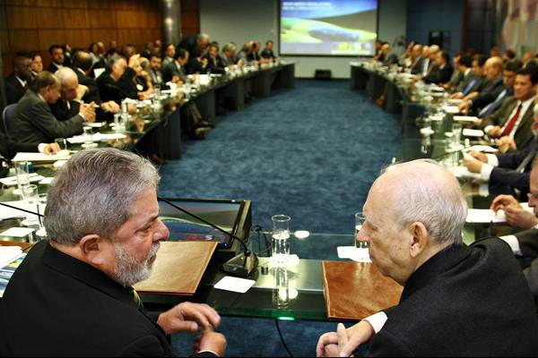
Can Science help society to make politicians act?

Slide 7
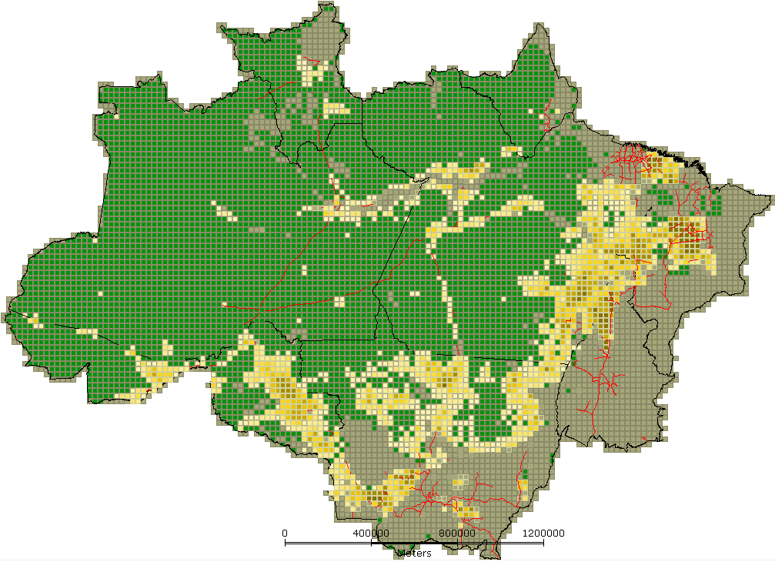
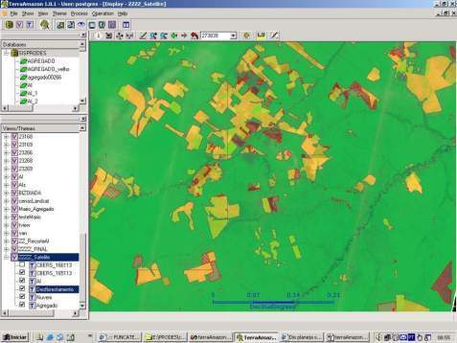
INPE: Clear-cut deforestation mapping of Amazonia since 1988
~230 scenes Landsat/year
Yearly detailed estimates of clear-cut areas

Slide 8
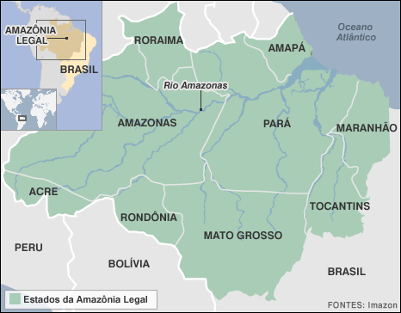
Where was deforestation happenning?
?
No location, no public policy

Slide 9
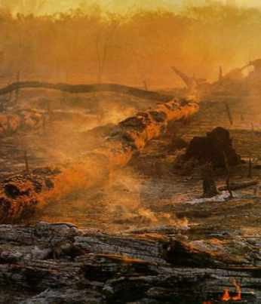
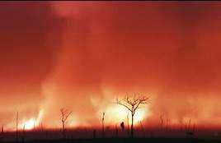
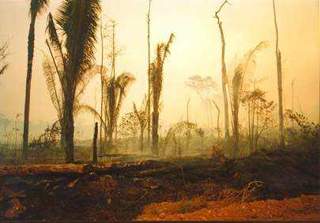
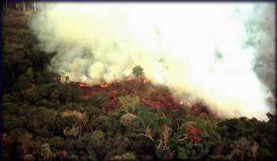
Hic sunt leones et dragones
fonte: Carlos Nobre

Slide 10
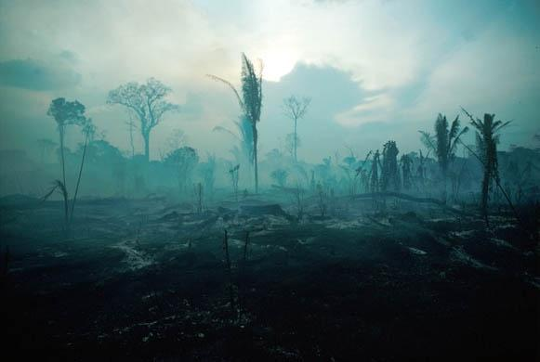
Finally in 2004....
Yearly deforestation rate for 2003-2004: 27,100 km2

Slide 11
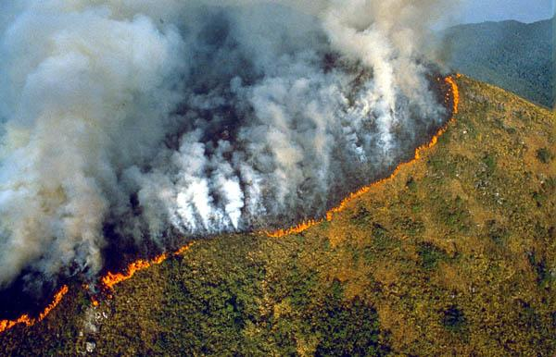
Public opinion reaction was strong
What is the proper scientific reaction?

Slide 12
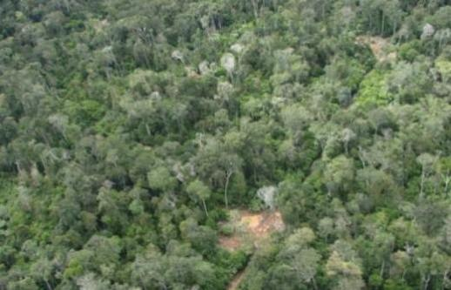
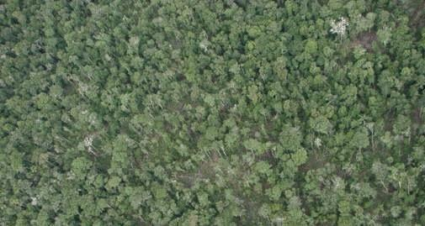
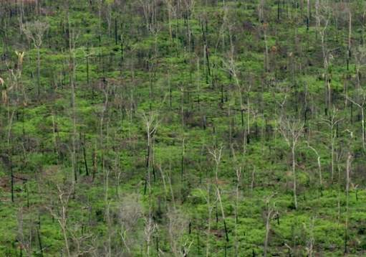
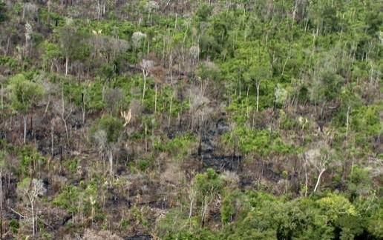
How does deforestation happen?
T1 – Selective logging
T2 – Loss of smaller trees
T3 – Loss >50% of forest
T4 – Loss >90% of forest

Slide 13
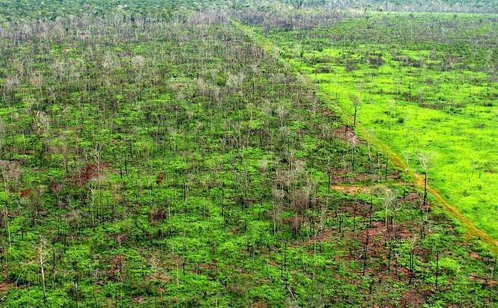
Final = Clear cut
Pasture

Slide 14
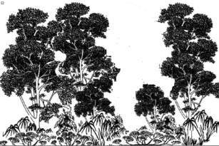
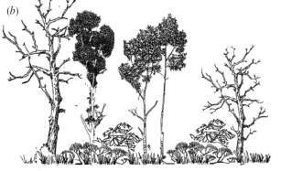
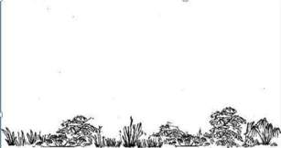
INPE’s Monitoring Systems
dialy deforestation alerts
time
Yearly rates of clear cuts
Floresta

Slide 15
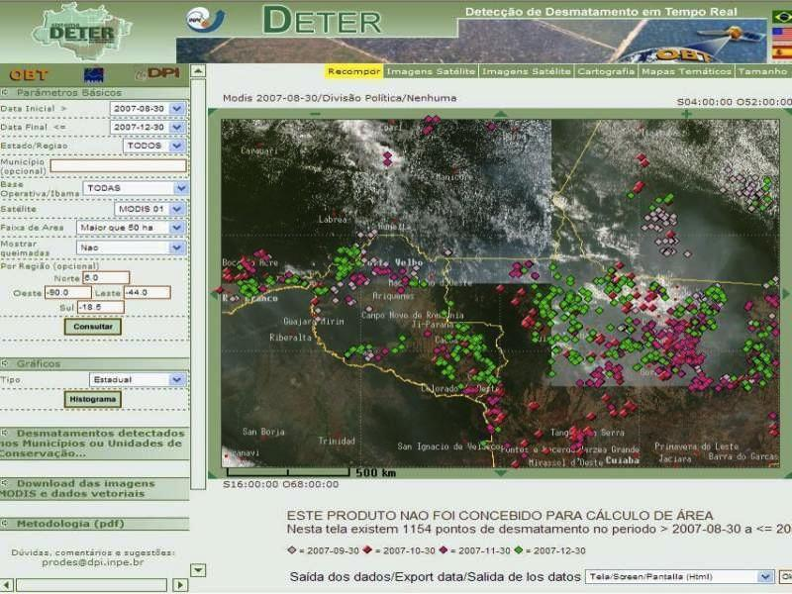
Real-time Deforestation Monitoring
Daily warnings of newly deforested large areas

Slide 16
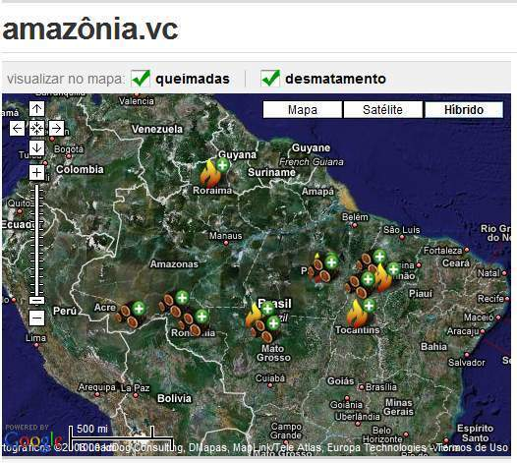
Reaching out to public policy
500.000 registrations
46 million protests

Slide 17
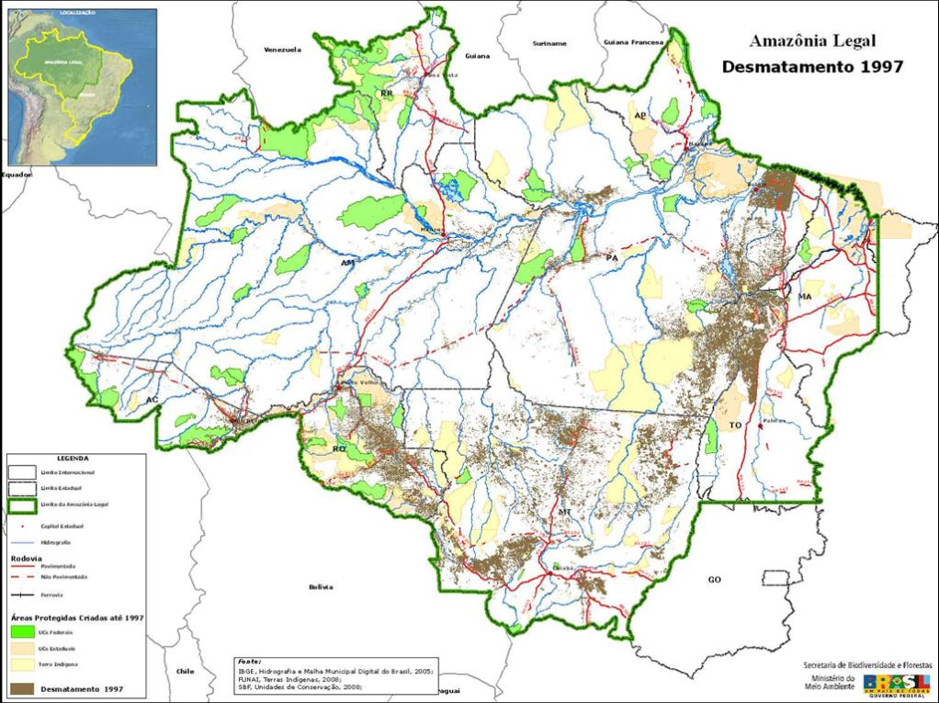
Protected areas and deforestation (1997)

Slide 18
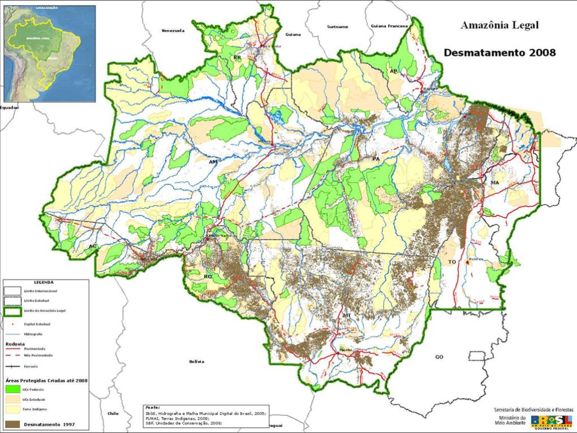
Protected areas and deforestation (2008)

Slide 19
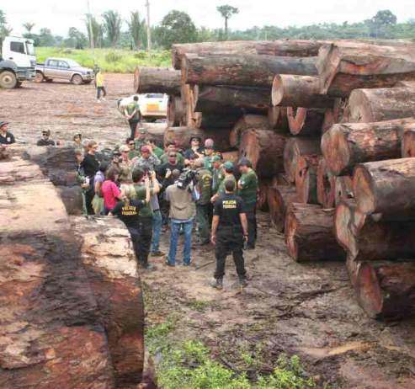
Command and control actions
90% of operations in 2% of area

Slide 20
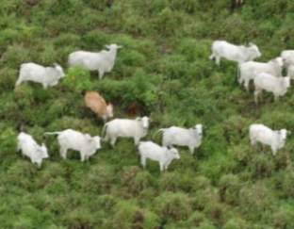
Finding: Markets have a positive rôle

Slide 21
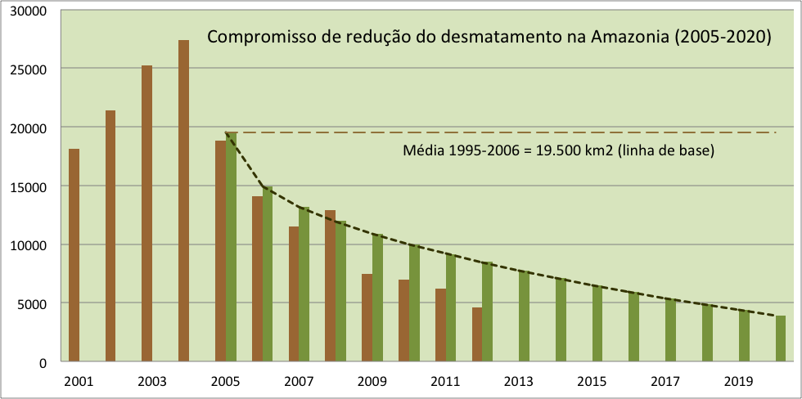
“By 2020, Brazil will reduce deforestation by 80% relative to 2005.” (pres. Lula in Copenhagen COP-15)

Slide 22
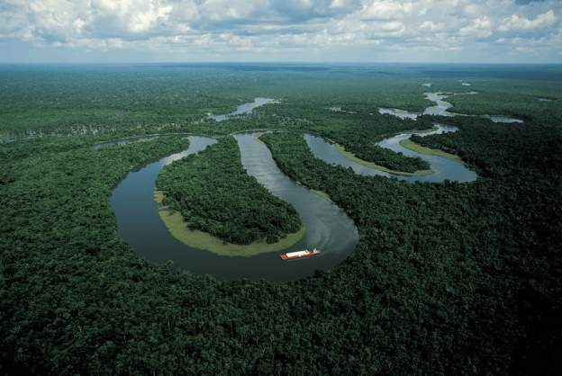
“Deforestation in the Brazilian Amazon is down by a whopping 78% from its recent high in 2004. If Brazil can maintain that progress, it would be the biggest environmental success story in decades, and would set an example to other countries that want to protect their tropical forests.” (Editorial, 7 June 2012)

Slide 23
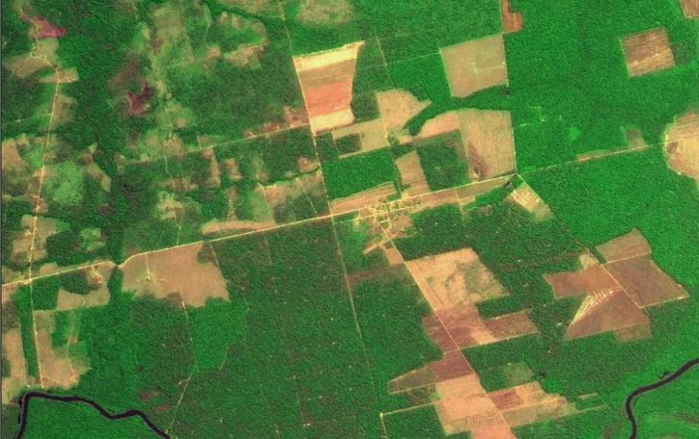
Transparency builds governance!
CBERS image
Degradation
Deforestation
Science (27 April 2007): “Brazil´s monitoring system is the envy of the world”.
Notes:
Este slide mostra uma imagem CBERS-2B da região de Marcelândia, norte de Mato Grosso. A imagem foi composta por uma imagem monocromática de alta resolução HRC (2,5 m) com uma imagem multespectral CCD (20 m). A imagem mostra que é possivel identificar com o sensor HRC, alem de desmatamentos por corte raso (áreas claras na imagem), as áreas de degradação florestal (áreas verdes com partes claras).

