Slide 1


The road to Paris: projections of GHG emissions from land use change in Brazil
Gilberto Câmara (INPE)

Slide 2





GLOBIOM-Brazil team
REDD+ Policy Assessment Center
Aline Soterroni (INPE)
Fernando Ramos (INPE)
Gilberto Câmara (INPE)
Alexandre Ywata (IPEA)
Pedro Andrade (INPE)
Ricardo Cartaxo (INPE)
+ REDD^{pac} team

Slide 3


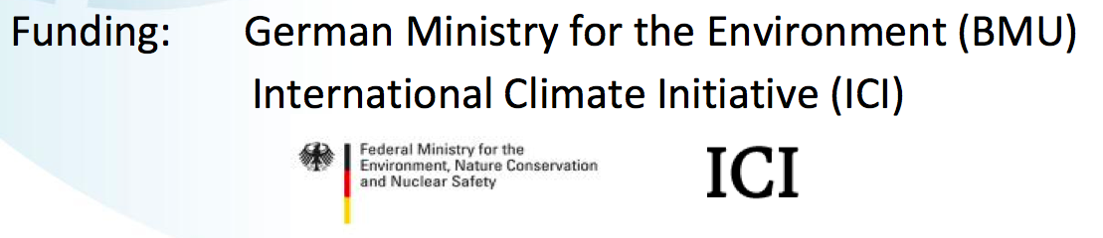
REDD+ Policy Assessment Center
www.red-pac.org.br
Partner
Institutions:
Duration: November 2011 – March 2015

Slide 4
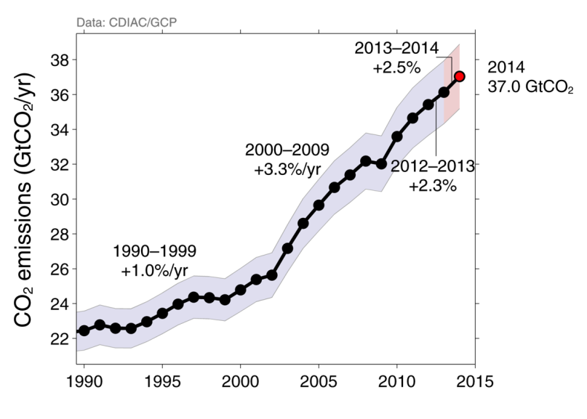
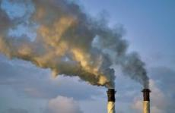
Fossil Fuel and Cement Emissions
Uncertainty is ±5% for one standard deviation (IPCC “likely” range)
Projection for 2014 : 37.0 ± 1.9 GtCO₂, 65% over 1990

Slide 5
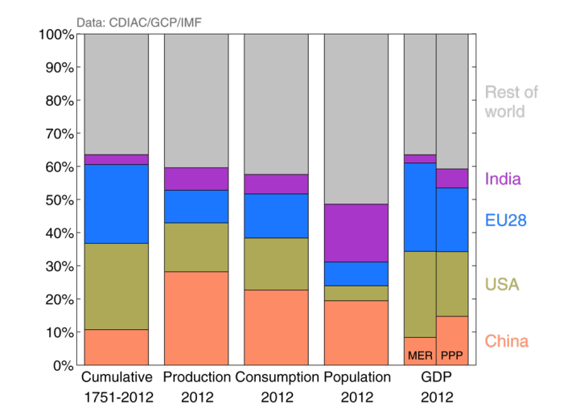
Alternative Ranking of Countries
“Common but differentiated responsibilities”
GDP: Gross Domestic Product in Market Exchange Rates (MER) and Purchasing Power Parity (PPP)

Slide 6
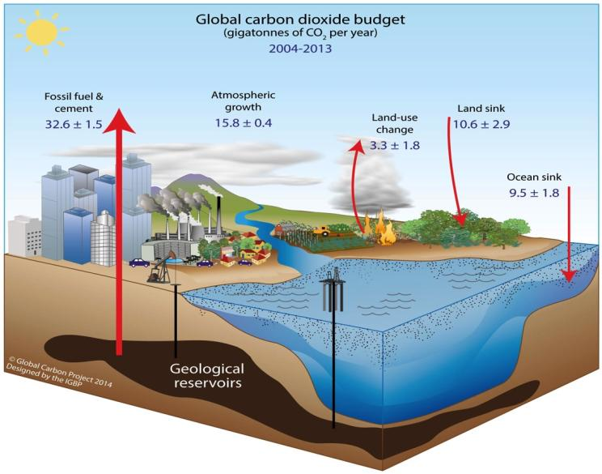
Global Carbon Cycle
Data: CDIAC/NOAA-ESRL/GCP
GHG emissions and sinks for 2004–2013 (GtCO₂/yr)

Slide 7
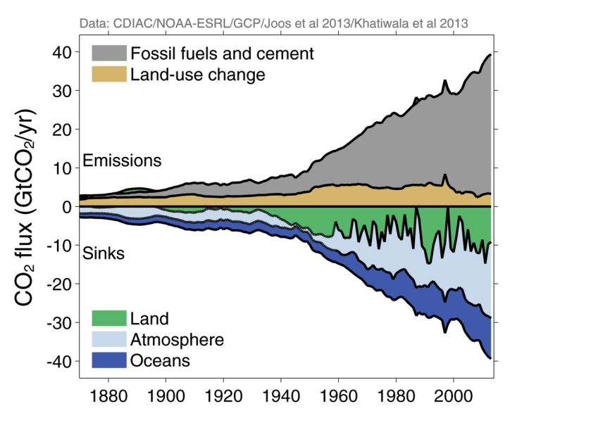
Global Carbon Budget

Slide 8
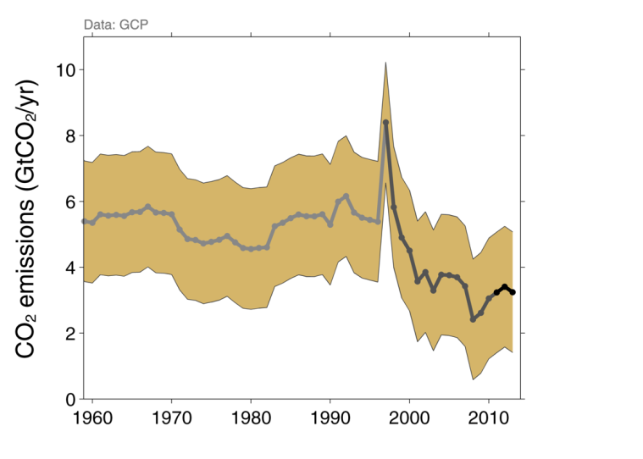
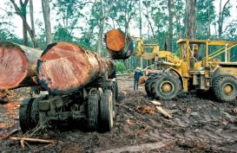
Land-Use Change Emissions
Indonesian peat fires
CO₂ emissions: 3.3 ± 1.8 GtCO₂ during 2004–2013
Decrease in emissions since 1990

Slide 9
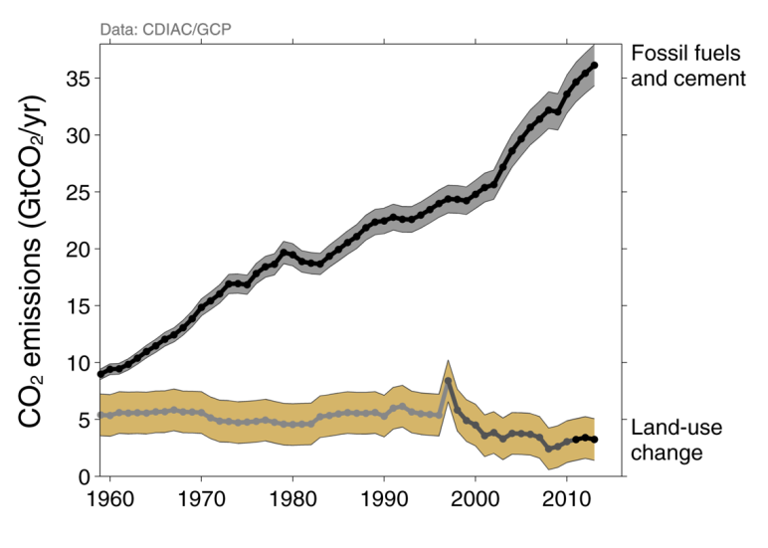
Total Global Emissions
Total global emissions: 39.4 ± 3.4 GtCO₂ in 2013, 42% over 1990
Land-use change: 36% in 1960, 19% in 1990, 8% in 2013

Slide 10
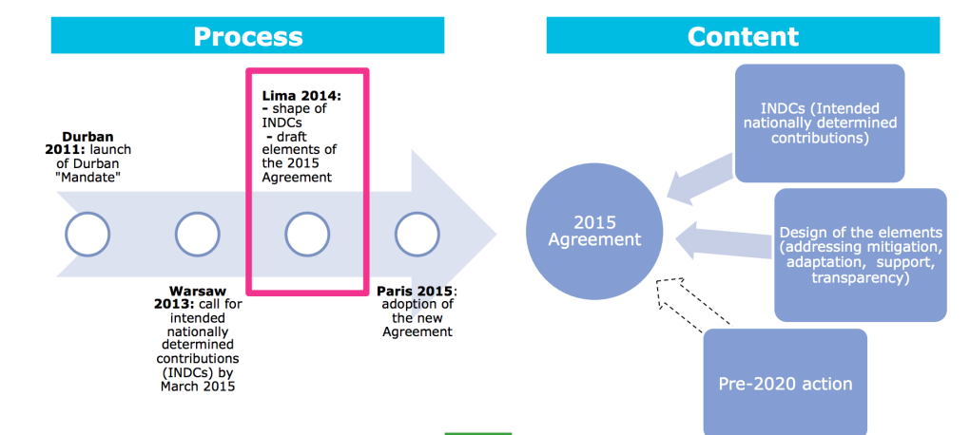
UNFCCC roadmap: Durban, Warsaw, Lima, Paris
A new international agreement with contributions from all countries to keep global warming less than 2⁰ C
source: EC DG Climate Action

Slide 11
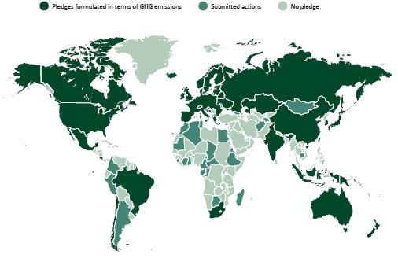
Preparing for Paris:
Broadening global climate action well beyond Kyoto
Global agreement on staying below 2°Celsius
Countries need to make concrete pledges in Paris COP-21
source: EC DG Climate Action

Slide 12
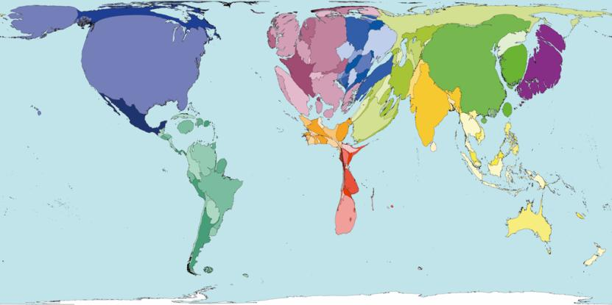
Preparing for Paris:
Higher emissions = more responsibilities
GHG emissions in 2000
All countries should present their INDCs
INDC = intended nationally determined contributions
source: worldmapper.org

Slide 13
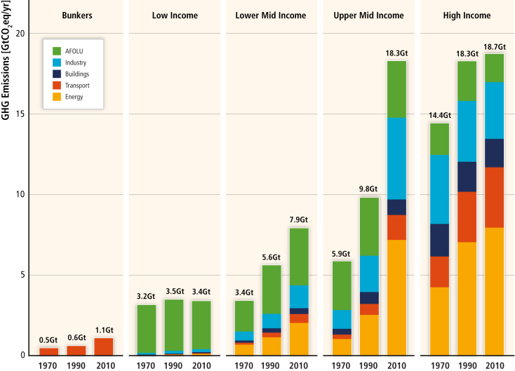
Regional patterns of GHG emissions are shifting along with changes in the world economy
source: EC DG Climate Action

Slide 14
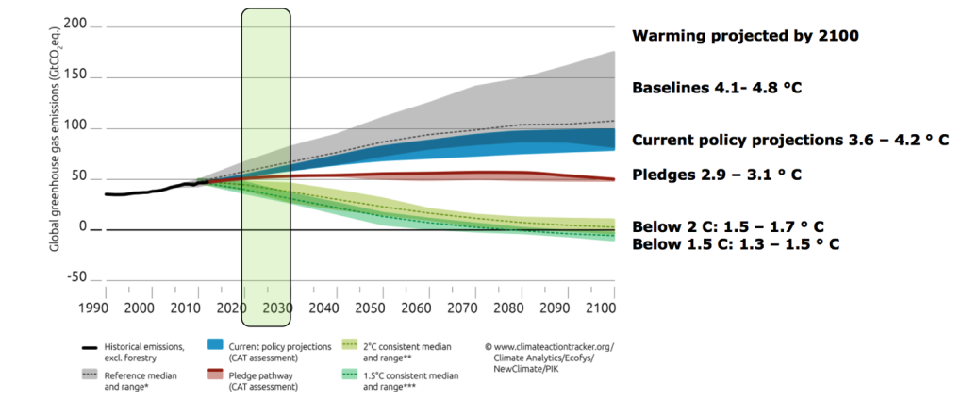
Preparing for Paris
GHG emissions in 2000
Current best policy scenarios point to 3⁰ C warming
Need much bigger effort to stay below 2⁰ C warming
source: EC DG Climate Action

Slide 15
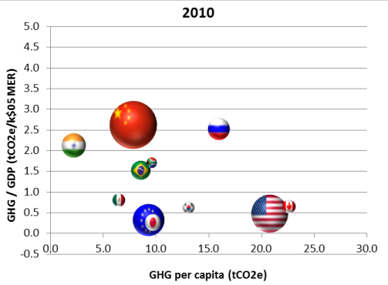
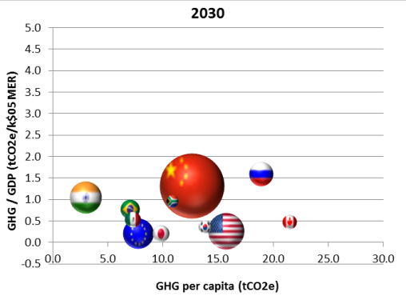
Global emission profiles by 2030 (business-as-usual)
source: EC DG Climate Action
GHG emission intensity vs. per capita, major economies,
2010-2030 BAU

Slide 16
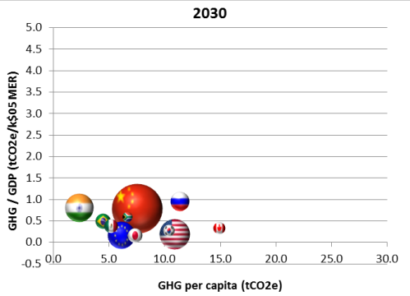
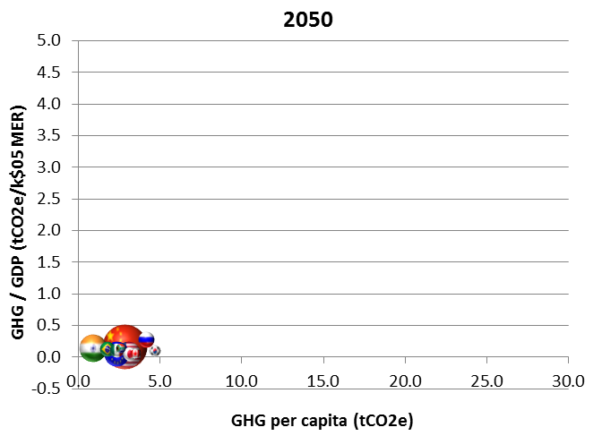
Staying below 2°C – a global mitigation scenario
source: EC DG Climate Action
GHG emission intensity vs. per capita, major economies, 2030-2050 Global mitigation scenario

Slide 17
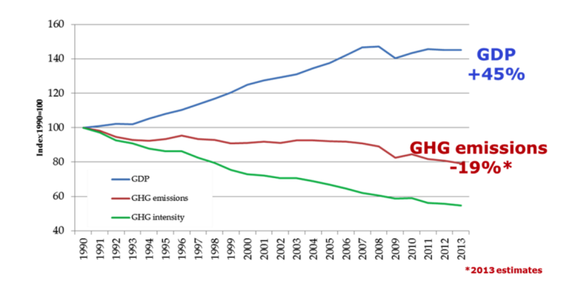
Trends in emissions: Europe
European emissions have peaked
Carbon intensity of the economy is down 60%
source: EC DG Climate Action

Slide 18
Brazilian pledge in COP-15 (based on BAU)
Compromisso do Brasil na COP 15
BAU Scenario
2,7 Gt
Voluntary commitment of Brasil-reduction of
~ 1 Gt CO2eq
(~ 37 %)
Notes:
18

Slide 19
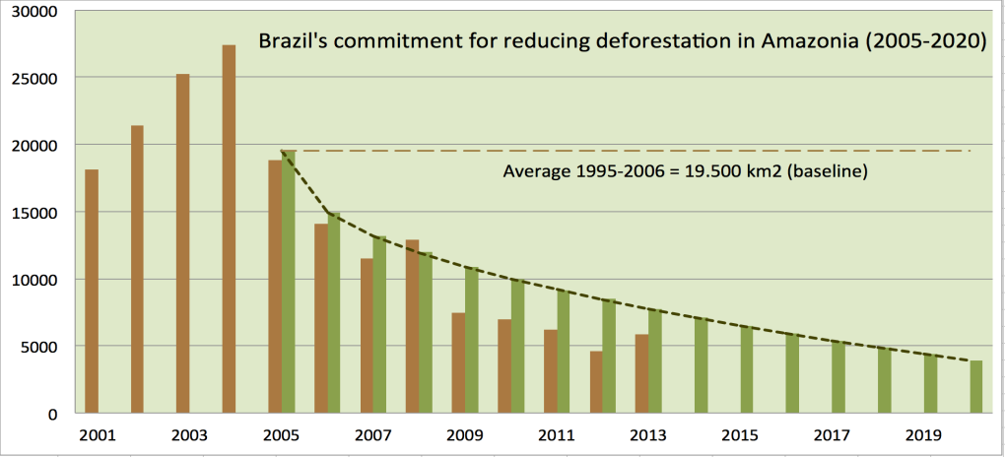
Brazil’s pledge to COP-15: reducing deforestation
Brazil has a policy for Amazon deforestation until 2020
Brazil needs sound guidance for land use policies beyond 2020

Slide 20
Brazilian pledge in COP-15 (based on BAU)
NAMAS | 2020 (BAU) | Reduction 2020 |  | Reduction %
 |  | (M tCO₂)
Land Use | 1084 | 669 | 669 | 24,70% | 24,70%
Amazônia (80%) |  | 564 | 564 | 20,90% | 20,90%
Cerrado (40%) |  | 104 | 104 | 3,90% | 3,90%
Agriculture | 627 | 133 | 166 | 4,90% | 6,10%
Pasture Recovery |  | 83 | 104 | 3,10% | 3,80%
Integration Pasture-Crop |  | 18 | 22 | 0,70% | 0,80%
Plantio Direto |  | 16 | 20 | 0,60% | 0,70%
Nitrogen fixation |  | 16 | 20 | 0,60% | 0,70%
Energy | 901 | 166 | 207 | 6,10% | 7,70%
Efficiency gains |  | 12 | 15 | 0,40% | 0,60%
Biofuels expansion |  | 48 | 60 | 1,80% | 2,20%
Hidropower expansion |  | 79 | 99 | 2,90% | 3,70%
Alternatives (solar, wind) |  | 26 | 33 | 1,00% | 1,20%
Others | 92 | 8 | 10 | 0,30% | 0,40%
Iron metallurgy |  | 8 | 10 | 0,30% | 0,40%
Total | 2703 | 975 | 1052 | 36,10% | 38,90%

Slide 21
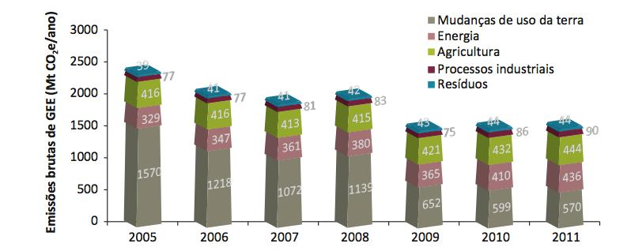
Brazilian emissions (2005-2011)
source: D. Santos, T.Azevedo

Slide 22
GHG emissions Brazil for 2020 (estimate)
source: G.Câmara
Energy GHG emissions: 5% growth/year
Agriculture GHG emissions: 4% growth/year
37% decrease from BAU set in COP-15

Slide 23
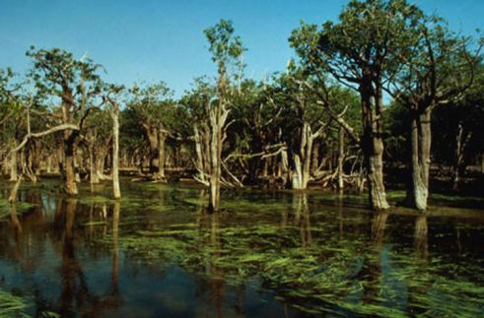
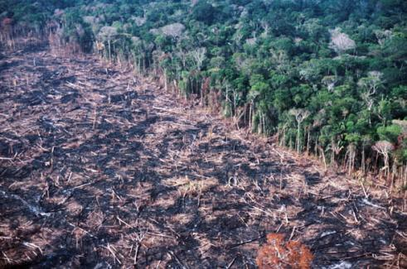
Land use change emissions in Brazil
LUC emissions decreased: 1.6 Mt CO₂eq (2005) to 500 MtCO₂eq (2020)
Can Brazil achieve further gains in LUC emissions for 2030?

Slide 24
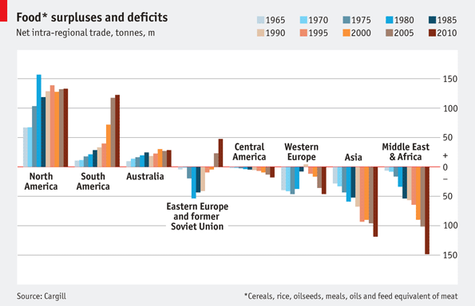
Trends in global food trade: 1965-2010
sources: Cargill and the Economist
Notes:
http://www.economist.com/blogs/feastandfamine/2012/05/food
Cargill is a grain trading company
This picture shows which regions of the world have a food surplus or deficit, and how imports or exports have changed since 1965.
The big changes in food production during that time came in South America (Brazil, mainly) and in Eastern Europe (Russia, mainly).
On the consumption side, it seems that Asia and Middle East and Africa will continue increasing imports to satisfy growing populations.
To feed itself for the next half century, the world needs an agricultural revolution.

Slide 25
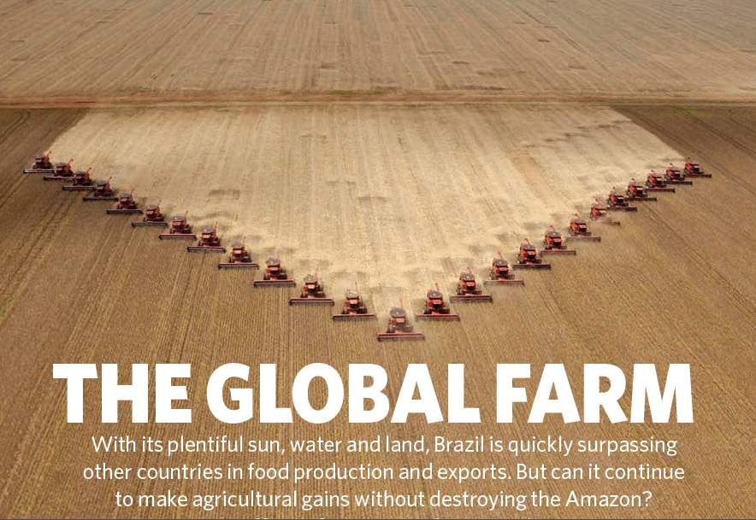
Nature, 29 July 2010
Brazil has a policy for Amazon deforestation until 2020
What about the other biomes? What happens after 2020?

Slide 26
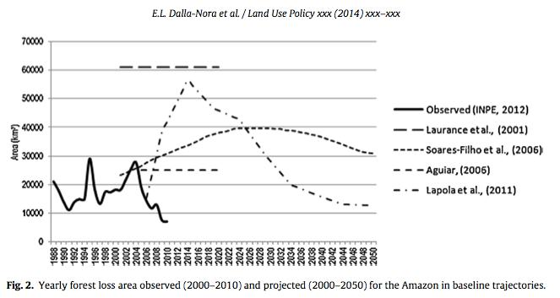
Challenges in land use modelling
Dalla-Nora et al. (Land Use Policy, 2014)
Land use change models have failed to capture the interactions between policies, markets and farmers in Amazônia

Slide 27
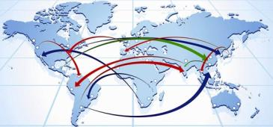




GLOBIOM: Global Biosphere Management Model
Partial equilibrium model: Agriculture, Forestry and Bioenergy sectors
Population & Economic Growth & Exogenous Demand Shocks
Commodity
Prices and Quantities
DEMAND
REGION
MARKETS
Wood
Crops
Livestock
Land Use
SUPPLY
SPATIAL RESOLUTION
Forest Cropland Pasture Other
Environmental effects
LAND
source: IIASA

Slide 28
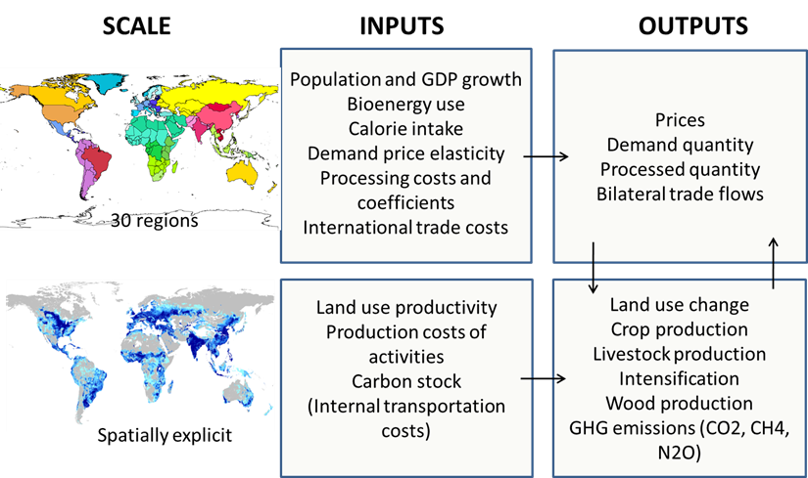
GLOBIOM: inputs and outputs
source: IIASA
Notes:
The model directly represents production from four major land cover types : cropland, managed forests, short rotation tree plantations and grassland
2 land ‘reserves’ = natural forests and natural land
Account for associated GHG emissions from land use change
Main outputs
land use (cropland, natural and managed forests, short rotation tree plantations, grassland and other natural land),
spatially explicit agricultural production (19 crops, 6 livestock products),
spatially explicit forest production,
food consumption and food prices,
bilateral trade flows
Biofuels
Feedstock: rapeseed, soybean, palm oil for biodiesel, sugarcane, wheat, corn for ethanol
Process data: from the literature (Haas et al., 2006; Hermann and Patel, 2007)
Use of biofuel by-products for animal feeding(Gallagher review)
For crops = expressed in primary equivalents => no explicit procesing for food products

Slide 29

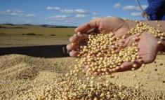
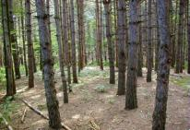

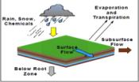
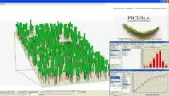
GLOBIOM components
Demand
Exogenous drivers
Population, economic growth
Wood products
Food
Bioenergy
PROCESS
OPTIMIZATION
53 regions
Supply
Raw wood
Crops
Partial equilibrium model
EPIC
G4M
RUMINANT
Biophysical models
source: IIASA
Notes:
Gathering available information in a consistent framework
Helps identifying information gap
Better understanding of the economic mechanisms
Analysis of local issues in a global context
Analysis of cross-sector interactions
Forward looking approach highlights the need for a long term strategy

Slide 30
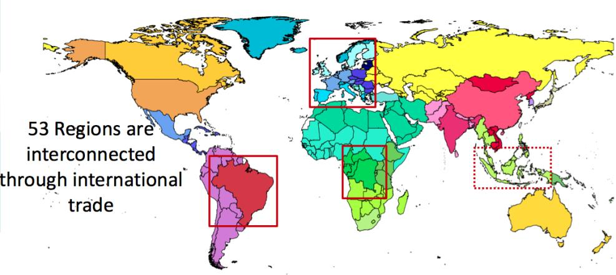
GLOBIOM – A global model with the possibility to zoom in one region
source: IIASA
30
Regional zooming allows detailed spatial representation of land (50x50km) and introduction of regional policies

Slide 31
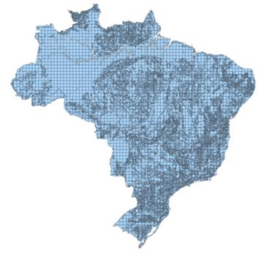
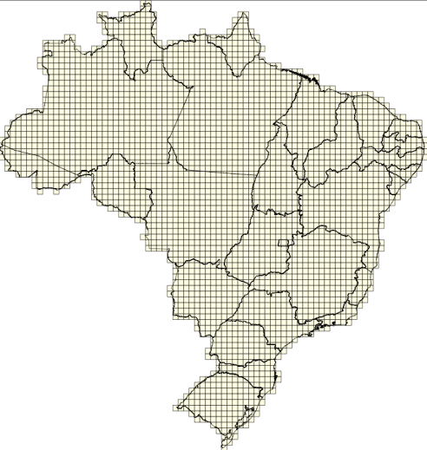

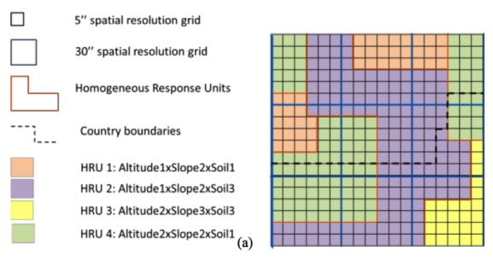
Spatial resolution in GLOBIOM
11,003 Simulation Units (SimUs)
HRUs (hom. response units)
3,001 Spatial units (ColRow)
50x50km
source: IIASA

Slide 32



Spatially explicit input data in GLOBIOM
CROPS
LIVESTOCK
FORESTRY
BIOENERGY
Wheat
Rice
Maize
Soybean
Barley
Sorghum
Millet
Cotton
Dry beans
Rapeseed
Groundnut
Sugarcane
Potatoes
Cassava
Sunflower
Chickpeas
Palm oil
Sweet potatoes
Cattle
Sheep Goat
Pig
Poultry
Beef
Lamb and Pork
Poultry and Eggs
Milk
Biomass for logs
Fuel wood
Other wood
Pulp wood
Logs
Ethanol
FAME
Methanol
Heat
Electricity
Biogas
source: IIASA

Slide 33
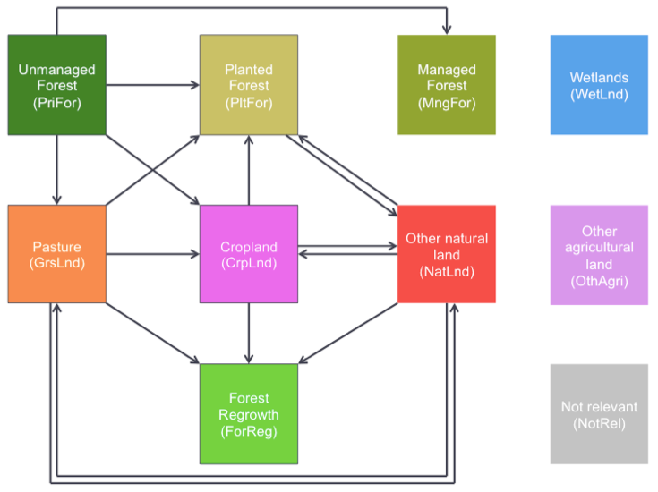
Land use transitions in GLOBIOM-Brazil

Slide 34











Land use and supply chain
LAND USE CHANGE
Natural
Forests
Wood
Managed
Forests
Saw and pulp mills
Bioenergy
Planted
Forests
Biorefinery
Cropland
Crops
Crop processing
Grassland
Livestock
Meat
Other Natural
Land
Forest
Regrowth
Notes:
The model directly represents production from four major land cover types : cropland, managed forests, short rotation tree plantations and grassland
2 land ‘reserves’ = natural forests and natural land
Account for associated GHG emissions from land use change
Main outputs
land use (cropland, natural and managed forests, short rotation tree plantations, grassland and other natural land),
spatially explicit agricultural production (19 crops, 6 livestock products),
spatially explicit forest production,
food consumption and food prices,
bilateral trade flows
Biofuels
Feedstock: rapeseed, soybean, palm oil for biodiesel, sugarcane, wheat, corn for ethanol
Process data: from the literature (Haas et al., 2006; Hermann and Patel, 2007)
Use of biofuel by-products for animal feeding(Gallagher review)
For crops = expressed in primary equivalents => no explicit procesing for food products

Slide 35
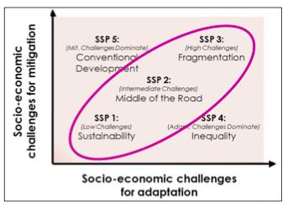
GLOBIOM projections use SSP scenarios
SSP3 - fragmented world. Unmitigated emissions are high, low adaptive capacity and large number of people vulnerable to climate change.
SSP1 - strong development goals, reduced fossil fuel dependency and rapid technological changes
SSP2 current trends with some effort to reach development goals and reduction in resource and energy intensity.
source: IPCC AR5 (2012)

Slide 36
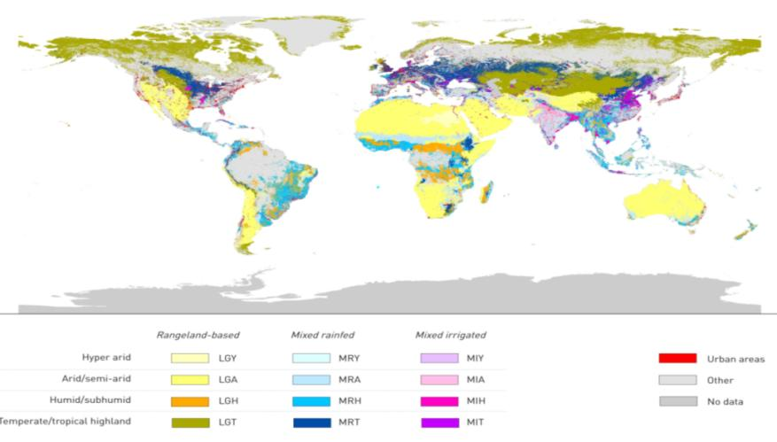
Data for GLOBIOM: Global Livestock
14 livestock production systems
(Buffalo, Cattle, Sheep, Goat, Pig, Poultry)
source: FAO/ILRI (2012)

Slide 37
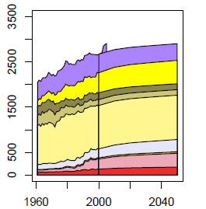
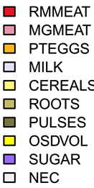
Projections for Brazil: Food Consumption
Food consumption per capita (kcal/day)
source: Alexandratos and Bruinsma (FAO) 2012

Slide 38
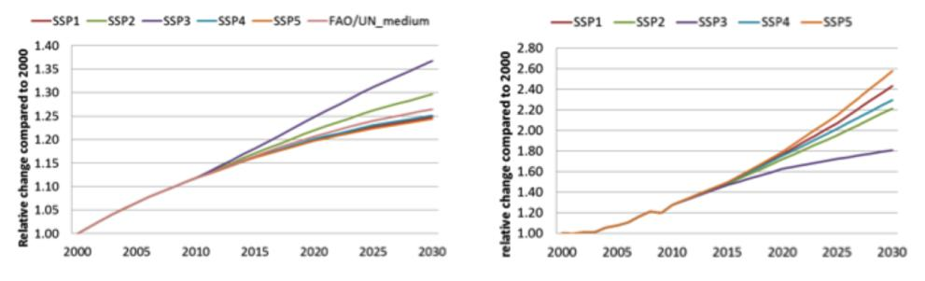
Brazil: Population and GDP Projections
Population growth
Brazil less than world average
GDP per capita
Brazil more than world average
source: IPCC AR5 (2012)

Slide 39
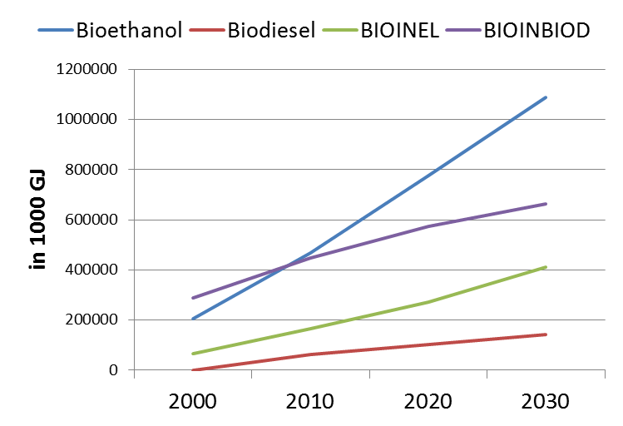
Brazil: Bionergy Projections to 2030
Heat and power generation (BIOINEL), Biomass consumption (BIOINBIOD), Bioethanol, Biodiesel
source: World Energy Outlook (2010)

Slide 40
GLOBIOM-Brazil validation and projections
Base
Year
Projections
Validation
2000 | 2010 | 2020 | 2030 | 2040 | 2050
LAND USE
Unmanaged Forests
Cropland
Land use changes are consistently transferred from one period to another
Managed Forests
Pasture
Planted
Forest
Other natural
land
Forest Regrowth

Slide 41
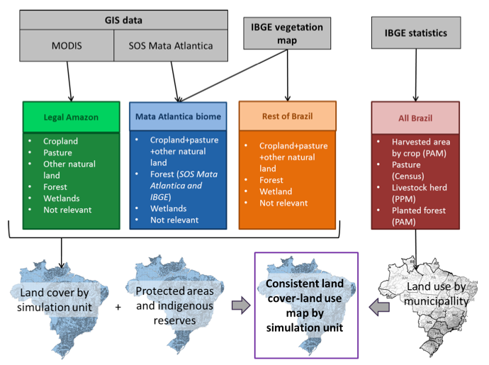
GLOBIOM- Brazil base data consistent land cover/land use map

Slide 42
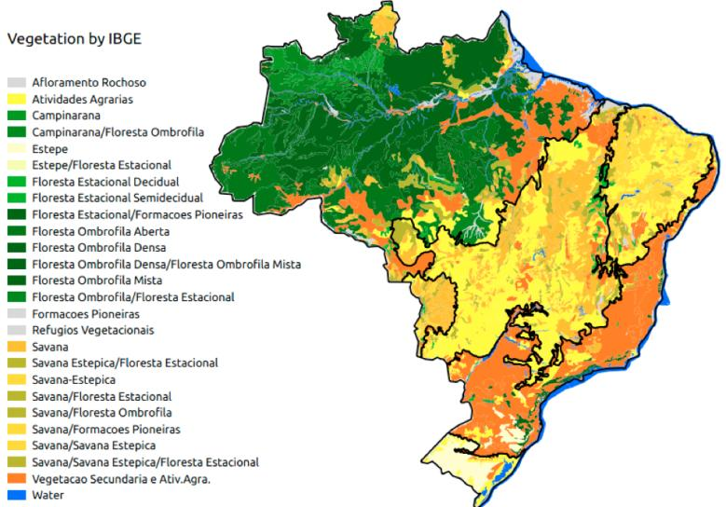
IBGE Vegetation Map
GLOBIOM-Brazil is consistent with Brazil’s 2014 forest reference emissions level submission to UNFCCC
source: IBGE (2012)

Slide 43
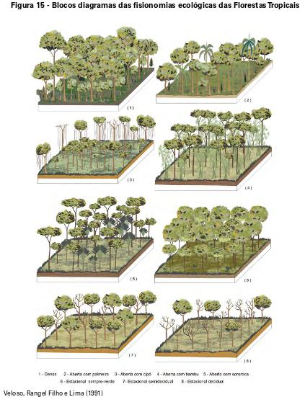
IBGE has defined different forest types in Brazil
Brazil’s FREL (forest reference emissions level) and GLOBIOM-Brazil use the same IBGE forest definion
source: IBGE (2012)

Slide 44
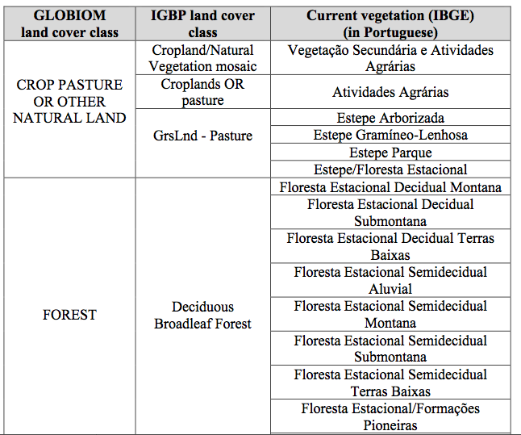
Correspondence between GLOBIOM, IGBP and IBGE land cover classes
…

Slide 45
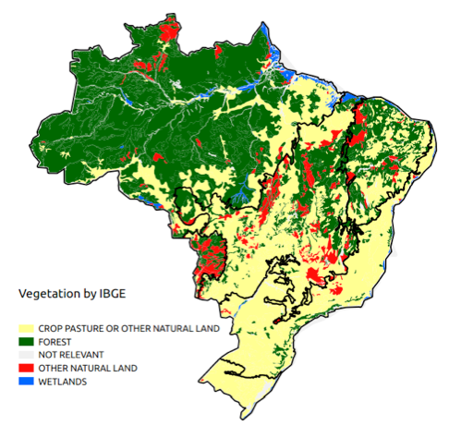
IBGE Vegetation Map reclassified into GLOBIOM classes

Slide 46
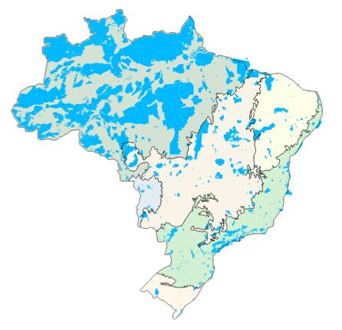
Protected Areas in GLOBIOM-Brazil
Federal, State and Municipal Conservation Units (full protection and sustainable use)
Indigenous lands
Model assumption: 100% protection in PA
source: MMA (2015)
Notes:
UCs federais de proteção integral
UCs federais de uso sustentável
UCs estaduais de proteção integral
UCs estaduais de uso sustentável
UCs municipais de proteção integral
UCs municipais de uso sustentável
Terras indígenas
Florestas Públicas

Slide 47
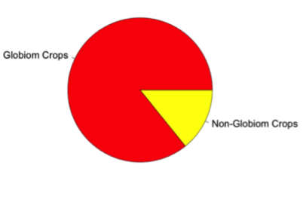

Cropland in GLOBIOM-Brazil: 18 crops
Pota: Potato
Rape: Rapeseed
Rice: Rice
Soya: Soybeans
Srgh: Sorghum
SugC: Sugar cane
Sunf: Sunflower
SwPo: Sweet potatoes
Whea: wheat
Barl: Barley
BeaD: Dry beans
Cass: Cassava
ChkP: Chickpea
Corn: Corn
Cott: Cotton
Gnut: Groundnuts
Mill: Millet
OPAL: Palm oil
IBGE Data | 2000
 | Mha | Share
GLOBIOM Crops | 43 | 86%
Non-GLOBIOM Crops | 7 | 14%
Total | 50 | 100%
source: IBGE PAM (2000)
Notes:
Introduction of CrpLnd from IBGE

Slide 48


Cropland and Pasture in GLOBIOM-Brazil (2000)
Cropland 43 Mha
Pasture
170 Mha

Slide 49







GLOBIOM-Brazil Land Cover Map for 2000
Forest Pasture Cropland Other agricultural land
Other natural land Wetland Not relevant
Consistent land cover-land map for whole Brazil

Slide 50







Transportation Costs (per product and destination)
Pulp Biomass
Costs to state
capitals
Roads
Nearest
state capital
Nearest
sea port
Costs to
sea port
Bovine Meat
Notes:
Data produced by IIASA with Aline and others. Its corresponds to the average cost to transport one ton of crop to the closest city above 50000 inhabitants.

Slide 51


Validation: Accumulated Deforestation 2001-2010
PRODES/INPE
GLOBIOM-Brazil projection
16.53 Mha
16.93 Mha
model produces consistent estimate of deforestation (2000-2010)

Slide 52



Validation: Crop Area in 2010
IBGE/PAM GLOBIOM-Brazil
Crop Area [Mha]
 | 2000 | 2010
IBGE/PAM | 43 | 57
GLOBIOM Brazil | 40 | 61

Slide 53

Validation: Crop area in 2010
IBGE/PAM x GLOBIOM-Brazil
Differences btw model and validation ± 10%
Notes:
5% changes in Crop area
-10 % changes in Crop production
2% difference in live numbers

Slide 54


Validation: Soybean area in 2010
IBGE/PAM
GLOBIOM-Brazil
23 Mha
25 Mha

Slide 55


Validation: Sugarcane area in 2010
IBGE/PAM
GLOBIOM-Brazil
9 Mha
8 Mha

Slide 56


Validation: Bovine Numbers in 2010
IBGE PPM GLOBIOM
142 Mtlu
143 Mtlu
One tropical livestock unit (tlu) is one cattle with a body weight of 250 kg

Slide 57

Validation: Bovine numbers in 2010
Notes:
Major differences in Amazon and Caatinga

Slide 58

Livestock numbers in 2010:
IBGE/PAM x GLOBIOM-Brazil

Slide 59



Brazil’s new Forest Code (FC)
  Legal Reserve (LR)
  Small farms amnesty (SFA)
  Environmental Reserve Quota (CRA)
LR
SFA
CRA
IPAM
Soares et al.

Slide 60

Source: Letícia Guimarães, MMA (2015)

Slide 61
MMA scenarios for LUC 2020-2030
BAU
BUSINESS AS USUAL
FC
COMMAND AND CONTROL
FC+
COMAND AND CONTROL
+ INCENTIVES
Extrapolation of 2000-2010 trends
No forest regrowth
Mata Atlântica Law enforced
Forest Code enforced
No illegal deforestation
Legal reserve recovery
Debt offset using quotas
Small farms amnesty
Mata Atlântica Law enforced
Forest Code rules +
Legal reserve recovery in small farms by forest regrowth
Source: Letícia Guimarães, MMA (2015)

Slide 62
GLOBIOM-Brazil Scenarios (2020-2050)
BAU (Business as usual)
FC (forest code)
FC with 75% CRA
FC with 50% CRA
FC with 25% CRA
FC without CRA
FC without SFA (small farms amnesty)
Environmental
reserve
quotas

Slide 63


Environmental Debts and Surpluses (2010)
Debts
Surpluses
Potential surpluses from Amazonas, Amapá and Roraima were not considered

Slide 64

GLOBIOM-Brazil projections for forest cover
Small farms amnesty is 30 million ha
BAU results in 30 million ha additional deforestation

Slide 65

Brazil: forest cover in BAU scenario
BAU causes major losses in Cerrado and Caatinga biomes

Slide 66

Brazil: forest cover if Forest Code is enforced
Amazonia rain forest stabilizes in the long run towards 320 million ha

Slide 67




BAU
FC
388 Mha
419 Mha
Spatial Distribution of Total Forest
in 2050
FC without
SFA
FC without
CRA
451 Mha
422 Mha

Slide 68




BAU
FC
0 Mha
9 Mha
Projections of forest regrowth
in 2050
FC without
SFA
FC without
CRA
42 Mha
36 Mha

Slide 69




GLOBIOM-Brazil: regional projections of forest cover
Amazônia
Cerrado
Caatinga
Mata Atlântica

Slide 70


GLOBIOM-Brazil projections for Forest Code scenario: pristine and regrown forest
Pristine forest in 2050 (410 Mha)
Forest regrowth in 2050 (9 Mha)

Slide 71


Projected expansion of planted forests in Brazil (Forest Code scenario)
2010
2050
16Mha
7.6 Mha
16 Mha

Slide 72


Projected expansion of croplands in Brazil (Forest Code scenario)
2010
2050
61 Mha
117 Mha
Major growth in MATOPIBA and potentially fertile regions of NE Brazil

Slide 73

Potential expansion of pasture in Brazil (FC scenario)
GLOBIOM projects stabilization of pasture area around 240 million ha
No major conversion from pasture to croplands

Slide 74

Projection of Bovines in Brazil 2010-2050 (Mtlu)
GLOBIOM projects growth by moderate intensification
Density will grow from 0.5 tlu/ha in 2000 to 0.65 tlu/ha in 2050

Slide 75

Projection of other natural lands (non-productive areas) in Brazil 2010-2050
GLOBIOM projects major land conversion of areas in Cerrado, Caatinga and Mata Atlântica biomes (keeping Amazonia protected)

Slide 76


source: Liu et al., Nature Climate Change, 2015
Base data for CO₂ emissions from LUC in Brazil
Tropical forests
125 MgC/ha
Grasslands
Woody savannahs
5 MgC/ha
a
22 MgC/ha
Aboveground biomass carbon density by biome

Slide 77


Uncertainty in biomass maps for Brazil
Saatchi et al. (2011) biomass map in MgC/ha
Biomass densities in MgC/ha in Amazônia biome for different biomass maps

Slide 78
Building an ensemble of biomass density maps
Uptake from Afforestation (Biomass Maps)
SAATCHI
BACCINI
FRA2010
IncG4M_TBC
Emissions from Deforestation (Biomass Maps)
SAATCHI
BACCINI
FRA2010
2 CRA levels (75% or 100%) = 24 cases

Slide 79

Forest regrowth schedule
Artwork credit: Gareth Railton
Decades | Amazônia and Mata Atlântica | Cerrado, Caatinga And Pantanal | Pampa
First | 40% | 70% | 100%
Second | 22% | 30% | -
Third | 16% | - | -
Fourth | 12% | - | -
Fifth | 10% | - | -

Slide 80
Emissions from Amazon deforestation
Source | Emissions [MtCO₂eq/yr] | Statistics
FREL (2014) | 872 | Mean (2001 - 2010)
Aguiar et al. (2012) | 831 | Mean (2000 - 2009)
GLOBIOM-Brazil | 858 | Median (2001 - 2010)
+ 88
- 24
GLOBIOM estimates are based on an ensemble of 24 cases, considering different biomass maps

Slide 81
Brazil’s Total LUC Emissions
Source | Emissions [MtCO₂eq/yr] | Statistics
Observatório do Clima (SEEG) | 1326 | Mean (2001 – 2010)
GLOBIOM-Brazil | 1301 | Median (2001 – 2010)
+ 417
- 302
SEEG is based on official data from Brazilian government (2nd inventory of GHG emissions)

Slide 82
GLOBIOM emission scenarios (same as MMA)
BAU
BUSINESS AS USUAL
FC
COMMAND AND CONTROL
FC+
COMAND AND CONTROL
+ INCENTIVES
Extrapolation of 2000-2010 trends
No forest regrowth
Mata Atlântica Law enforced
Forest Code enforced
No illegal deforestation
Legal reserve recovery
Debt offset using quotas
Small farms amnesty
Mata Atlântica Law enforced
Forest Code rules
+
Legal reserve recovery in small farms by forest regrowth
Source: Letícia Guimarães, MMA (2015)

Slide 83

Projected LUC emissions in Brazil (MtCO₂eq/year)
BAU ➔ FC : -3.9 GtC
BAU ➔ FC+: -5.4 GtC
Brazil needs REDD+ incentives to achieve zero net LUC emissions by 2030

Slide 84


Projected LUC emissions in Brazil (MtCO₂eq/year)
Amazônia
Cerrado
REDD+ incentives are more relevant in Amazonia than in Cerrado Amazonia becomes a net sink with REDD+

Slide 85

Total LUC Emissions in Brazil

Slide 86
FC deforestation emissions decrease
(2010 to 2050)
Transitions | Brazil |  | Amazônia |  | Cerrado
 | MtCO₂eq/ year | % | MtCO₂eq/ year | % | MtCO₂eq/year | %
PriFor ➔ CrpLnd | 184 | 18 | 45 | 6 | 128 | 52
PriFor ➔ GrsLnd | 855 | 82 | 713 | 94 | 120 | 48
Total | 1038 | 100 | 758 | 100 | 248 | 100

Slide 87


Forest Regrowth in 2030 (100%CRA)
Forest Code
FC+ (Forest code & REDD+)
9.3Mha
30.8 Mha
6.8 Mha
15.9 Mha
0 Mha
4.1 Mha
1.5 Mha
4.5 Mha
0 Mha
5 Mha
1 Mha
1.5 Mha
Reduction in cropland area with REDD+: 4%
Reduction in bovine numbers with REDD+: 2.5%

Slide 88
Projected impact of forest regrowth in LUC emissions in 2030 (with 100%CRA)
Forest Code
FC+ (Forest code & REDD+)
-92 MtCO₂eq/yr
-505 MtCO₂eq/yr
-68 MtCO₂eq/yr
-291 MtCO₂eq/yr
-31 MtCO₂eq/yr
-47 MtCO₂eq/yr
Increase in C capture with REDD+: 450%

Slide 89

Projected Brazilian LUC emissions in Forest code scenario for different levels of reserve quota usage (CRA)
Less CRA, more deforestation, more afforestation, more net emissions

Slide 90

Total LUC Emissions Amazônia
%CRA within FC
Projected LUC emissions for Amazonia in Forest code scenario for different levels of reserve quota usage (CRA)
more CRA, less deforestation, less afforestation, smaller net emissions

Slide 91
Conclusions
GLOBIOM-Brazil model makes consistent projects for LUC in Brazil for 2020-2050: major advance in science-based guidance for land use policy
Brazil can balance production and protection if Forest Code is enforced (including CRAs)
REDD+ enables Brazil to reach negative LUC emissions
REDD+ Policy Assessment Center

