Slide 1
Time Series Analysis of Earth Observation Data for Land Degradation in Amazonia
Gilberto Câmara
National Institute for Space Research (INPE), Brazil

Slide 2








With many thanks to…
Merret Buurman
Karine Ferreira
Lúbia Vinhas
Ricardo Cartaxo
Victor Maus
Gilberto Ribeiro
Alber Sanchez
Dalton Valeriano

Slide 3
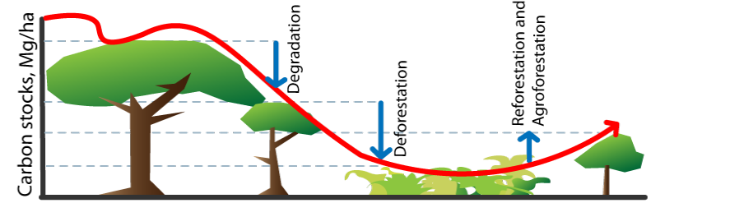

How much degradation has happened?
Degradation: loss of forest cover by logging and fire
Degradation causes GHG emission and biodiversity loss
Not all degradation leads to clear-cut areas
source: Ima Vieira
Notes:
Uma outra evluçao das pastagems e reflorestamento.

Slide 4
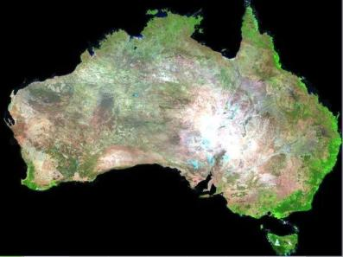


What changes with big EO data?
graphics: Geoscience Australia
What are we looking for in big EO data?

Slide 5
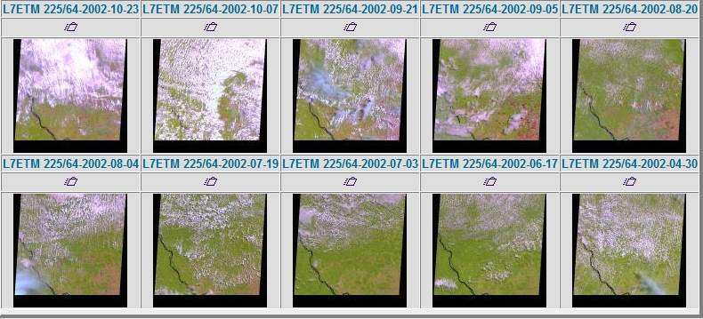
Is free data download our answer?
Currently, users download one snapshot at a time
Notes:
Este slide mostra o impacto da cobertura de nuvens sobre a analise de imagens. Esta é uma região do Pará, onde todas as imagens durante o ano de 2002 tem cobertura de nuvens. Para reduzir este impacto, o INPE analisa varias imagens para uma mesma regiao.

Slide 6
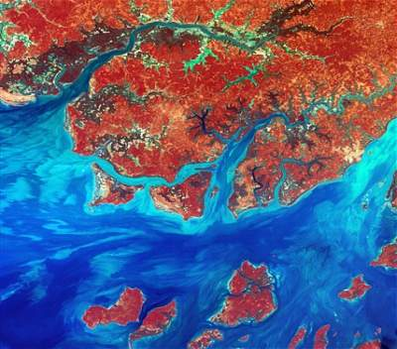
Data Access Hitting a Wall
How do you download a petabyte?
You don’t! Move the software to the archive

Slide 7



Where we want to get to
Remote visualization and
method development
Big data EO management and analysis
40 years of Earth Observation data of land change accessible for analysis and modelling.

Slide 8
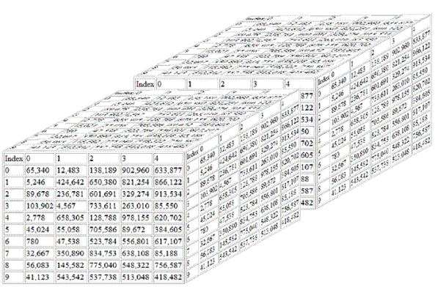
Analysis on multidimensional ST arrays
y
t
X
g = f (<x,y,t> [a₁, ….a_{n}])

Slide 9
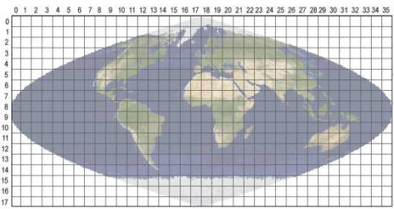
Array databases: all data from a sensor put together in a single array
t
y
y
X
result = analysis_function (points in space-time )

Slide 10
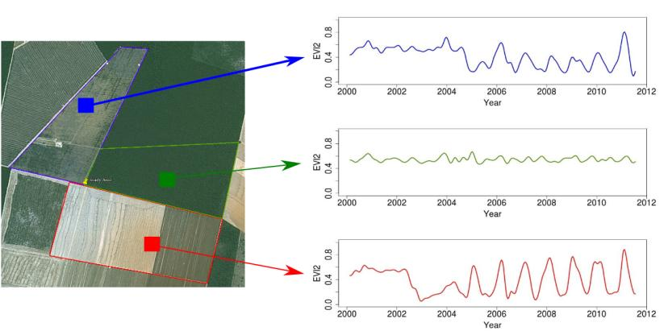
Time series of remote sensing satellite data
Forest
Pasture
Agric
Área 1
Forest
Área 2
Forest
Agriculture
Área 3
“Remote sensing time series with adequate resolution provide data for describing landscape dynamics”
source: Victor Maus (INPE, IFGI)

Slide 11
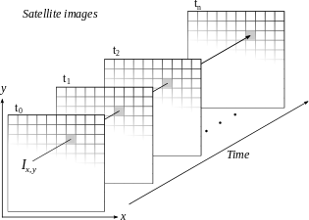
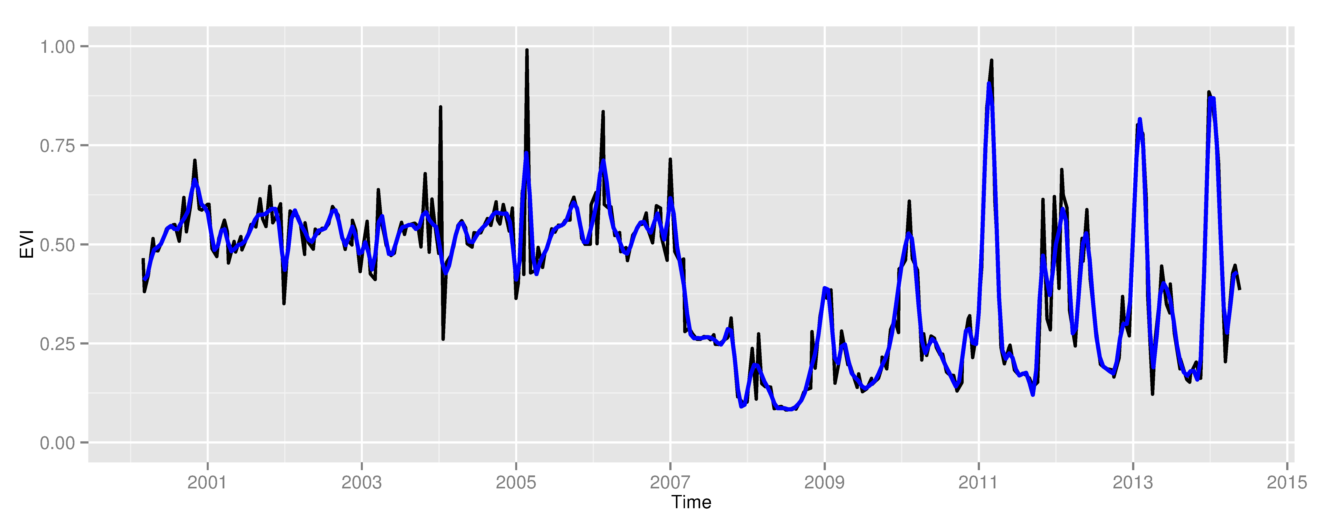
Space first, time later or time first, space later?
Space first: classify
images separately
Compare results in time
Time first: classify
time series separately
Join results to get maps

Slide 12
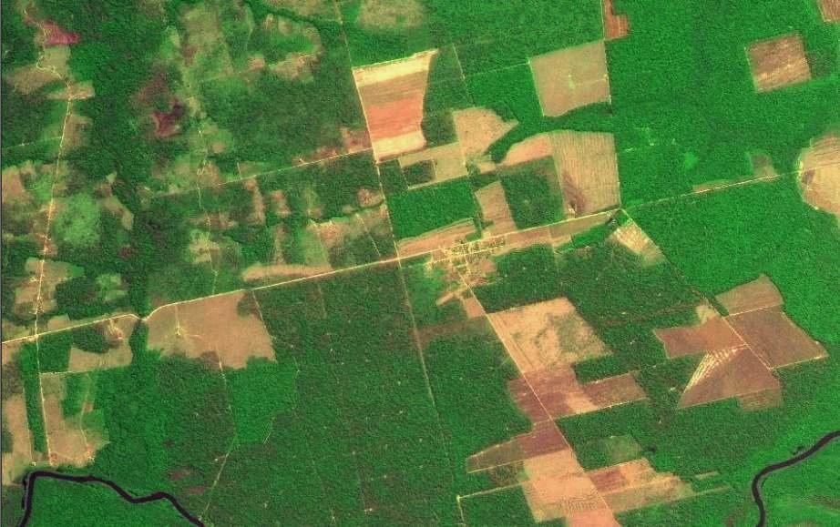
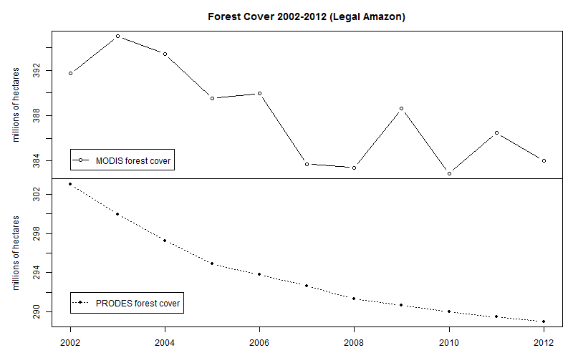
Space first can lead to inconsistent land trajectories
MODIS land cover: unrealistic forest gains and losses
Data sources: INPE, NASA. Analysis by M. Buurman

Slide 13
Land trajectories
Forest
Pasture
Agric
Área 1
Forest
Área 2
Forest
Agriculture
Área 3
“The transformations of land cover due to actions of land use”
graphics: Victor Maus (INPE, IFGI)

Slide 14
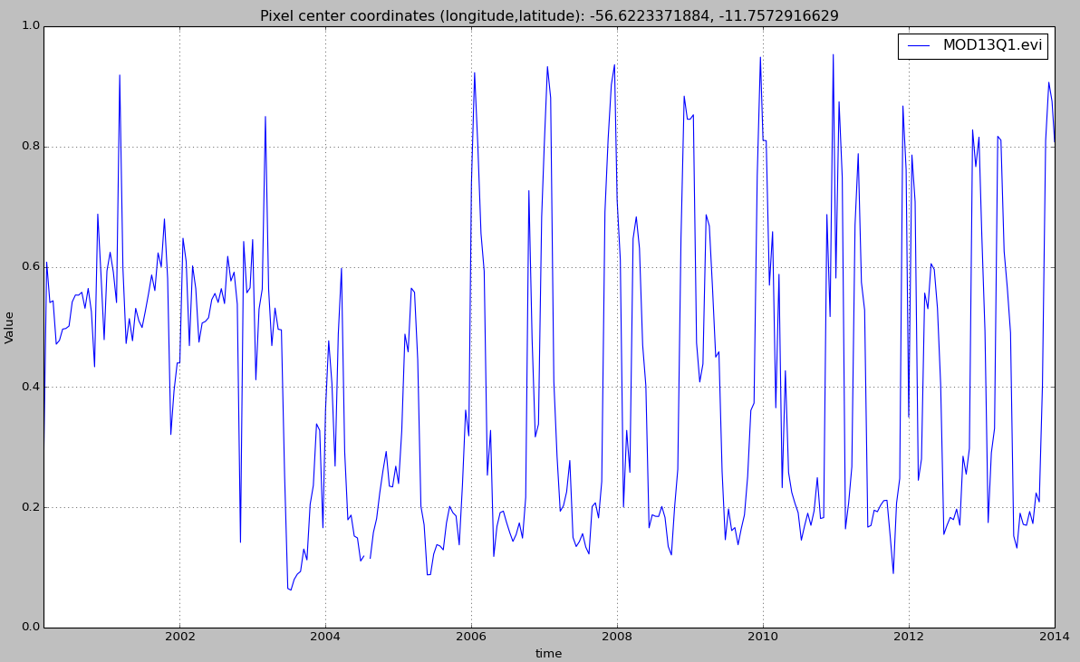

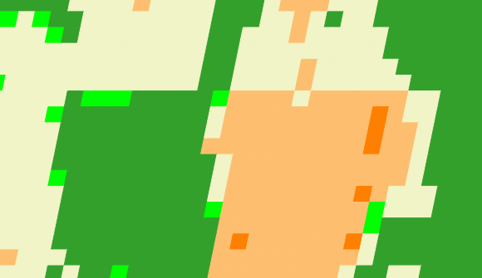
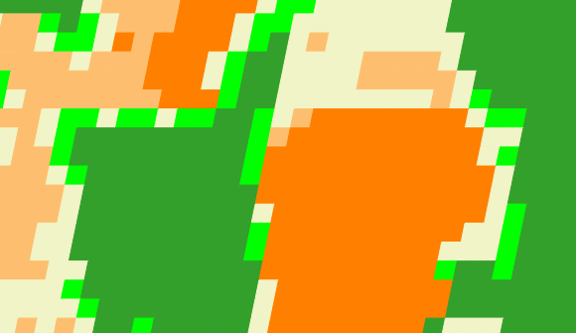
Land trajectories
Forest
Single cropping
Double cropping
2001
2006
2013

Slide 15
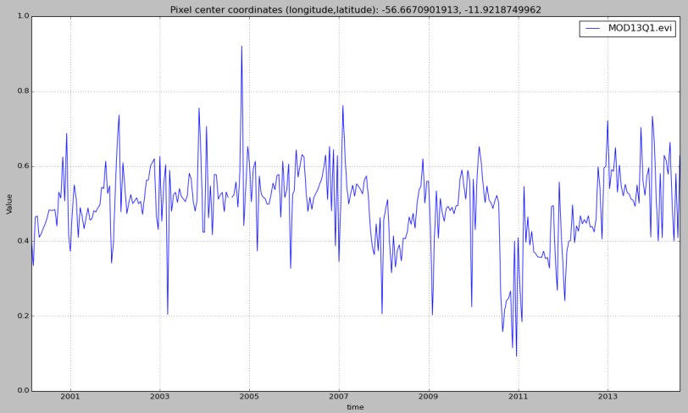
Time series of remote sensing satellite data
Hypothesis: large-scale fires that cause degradation are measurable by MODIS remote sensing time series
source: Victor Maus (INPE, IFGI)

Slide 16
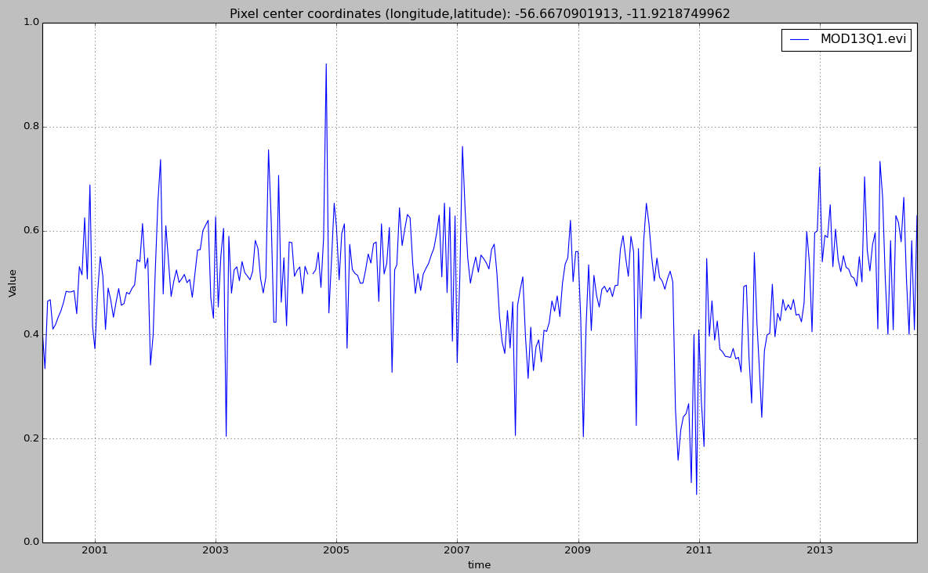
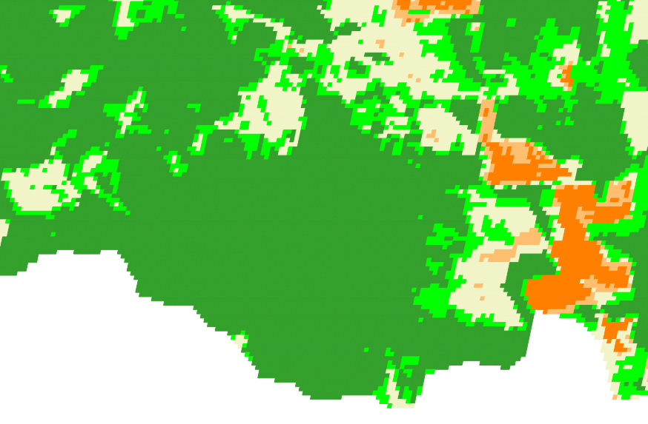
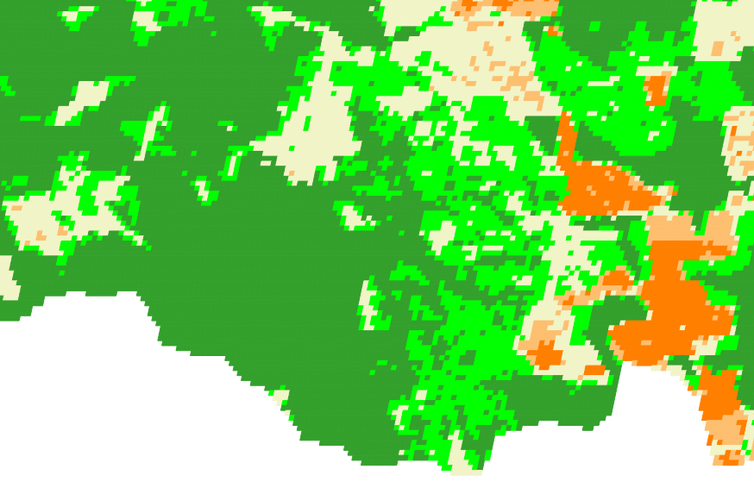
Land trajectories: forest degradation
EVI Time Series
2007
2009
2007
2009

Slide 17
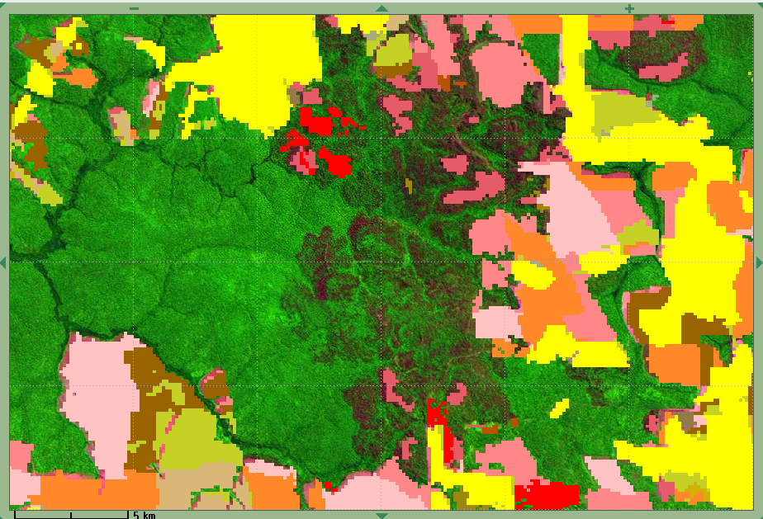
Land trajectories: forest degradation
EVI Time Series
2007
2009
PRODES
2007
2008

Slide 18
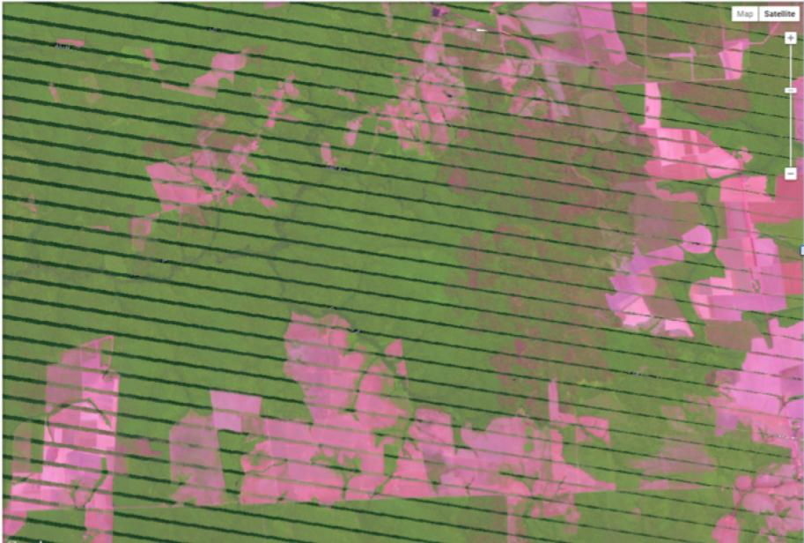
Large-scale fire in Porto dos Gauchos (2008)

Slide 19
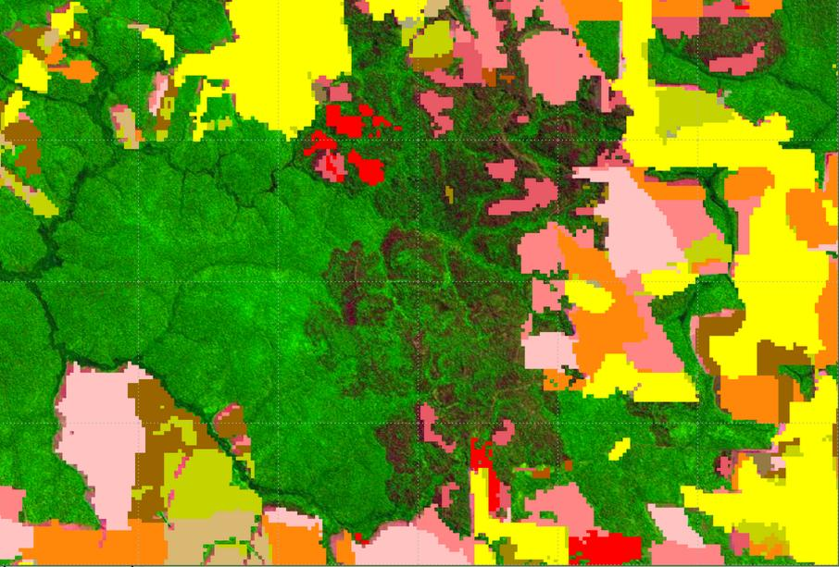
Large-scale fire and PRODES data
LANDSAT image 2008 and PRODES 2011

Slide 20
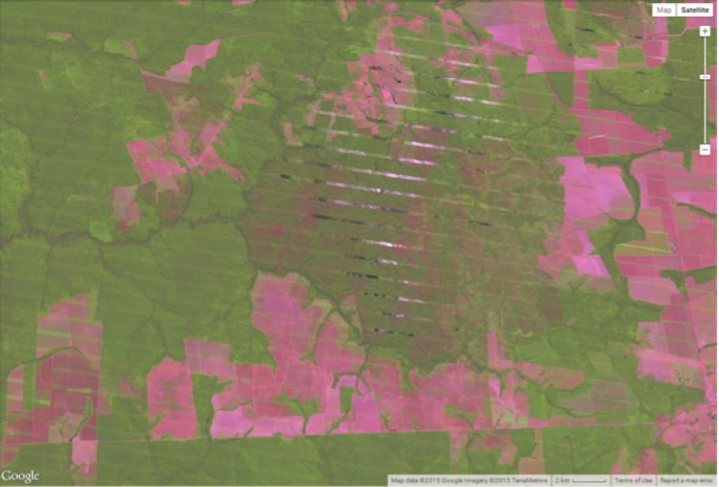
Large-scale fire in Porto dos Gauchos (2011)

Slide 21
Hypotesis: land patterns have distinct shapes
Forest
Pasture
Agric
Área 1
Forest
Área 2
Forest
Agriculture
Área 3
source: Victor Maus (INPE, IFGI)

Slide 22
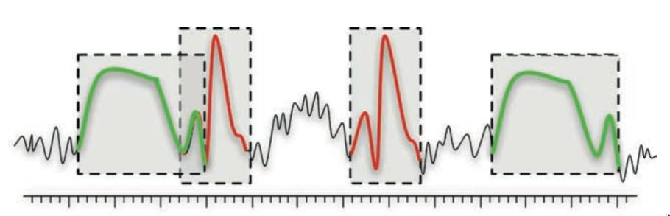
Time series mining: pattern matching
Finding subsequences in a time series
High computational complexity
Patterns are idealized, data is noisy
Esling & Agon (2012)

Slide 23

What is similarity?
resemblance, likeness, sameness, comparability, correspondence, analogy, parallel, equivalence;
adapted from Keogh (2006)

Slide 24
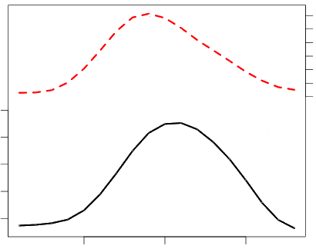
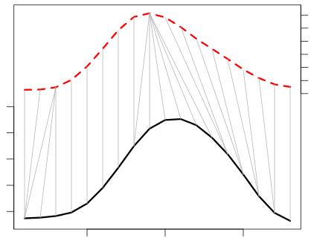
Dynamic Time Warping (DTW)
Euclidean
DTW
Jan
Feb
Sep
May
Sep
May
Similarity between patterns even with different phase
… and/or patterns with different lengths

Slide 25
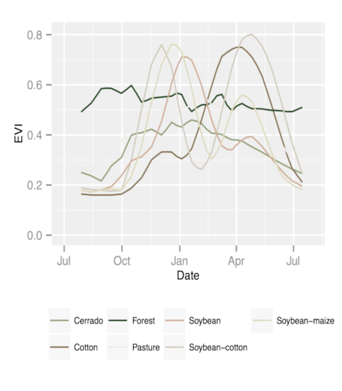
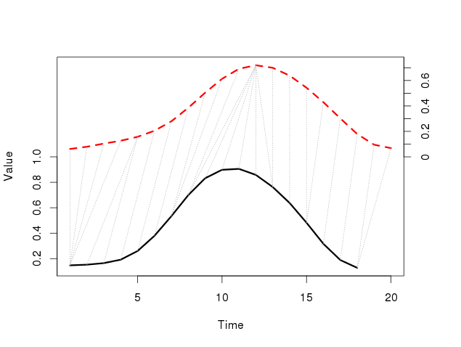
Dynamic Time Warping: pattern matching
Arvor et al (2012), Eamon Keogh
DTW “warps” the time axis: nonlinear matching

Slide 26
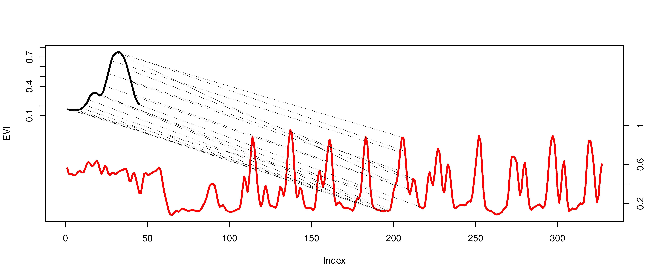
Open boundary Dynamic Time Warping
Single cropping
~1 year
does not require two time series to be of the same length
considers the agricultural calendar

Slide 27
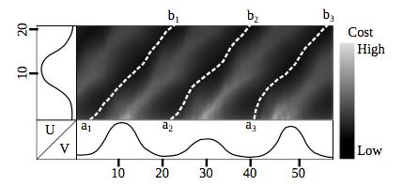
Accumulated cost matrix
Three possible alignments of the pattern U within the long-term time series V
Maus et al. (2015)

Slide 28
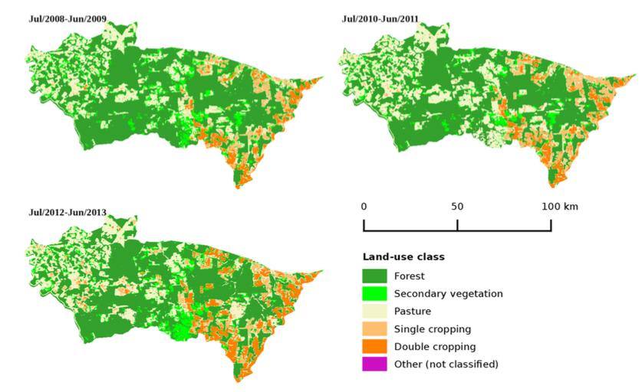
Porto dos Gaúchos, MT
Maus et al. (2015)

Slide 29
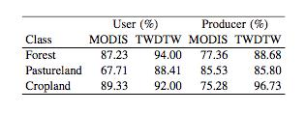
MODIS x Time-weighted DTW
Producer's accuracy: fraction of correctly classified pixels compared to all pixels of that ground truth class
User's accuracy (reliability): fraction of correctly classified pixels of a class compared to all pixels classified as being that class

Slide 30
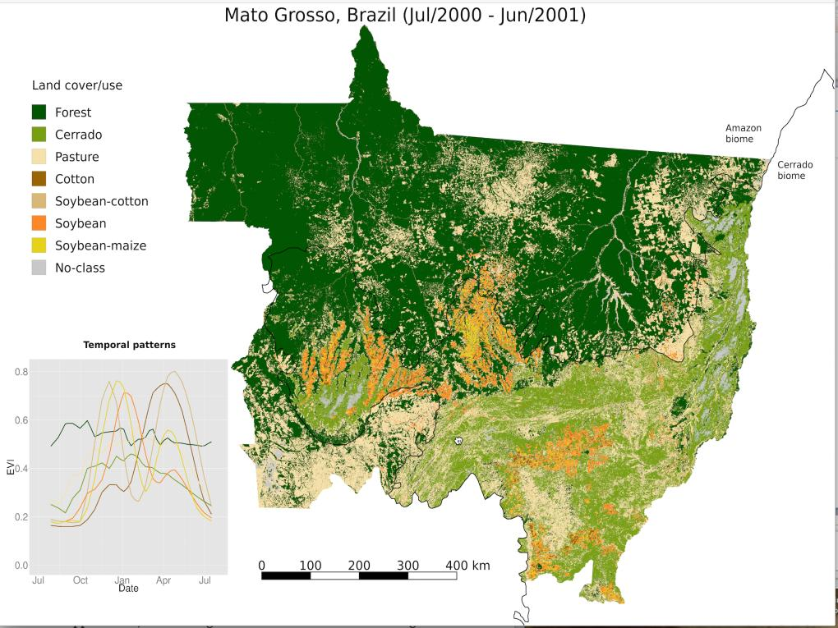
On-going work: identify forest degradation from large-scale fires
for Amazonia from 2000-2015

Slide 31
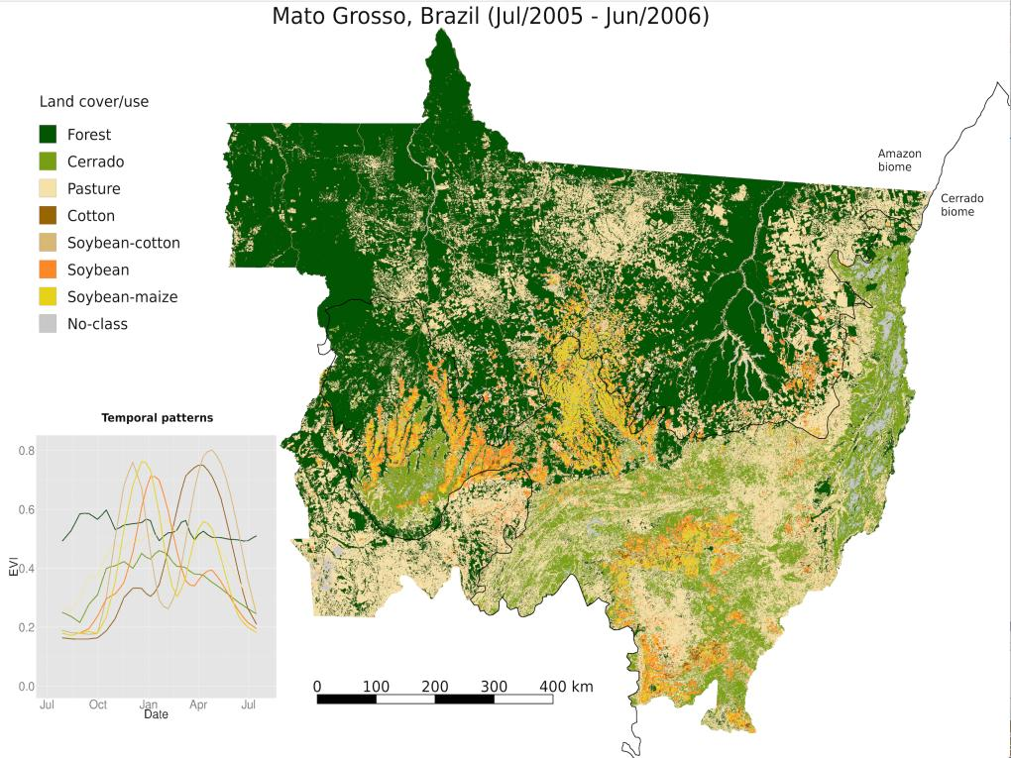
On-going work: identify forest degradation from large-scale fires
for Amazonia from 2000-2015

Slide 32
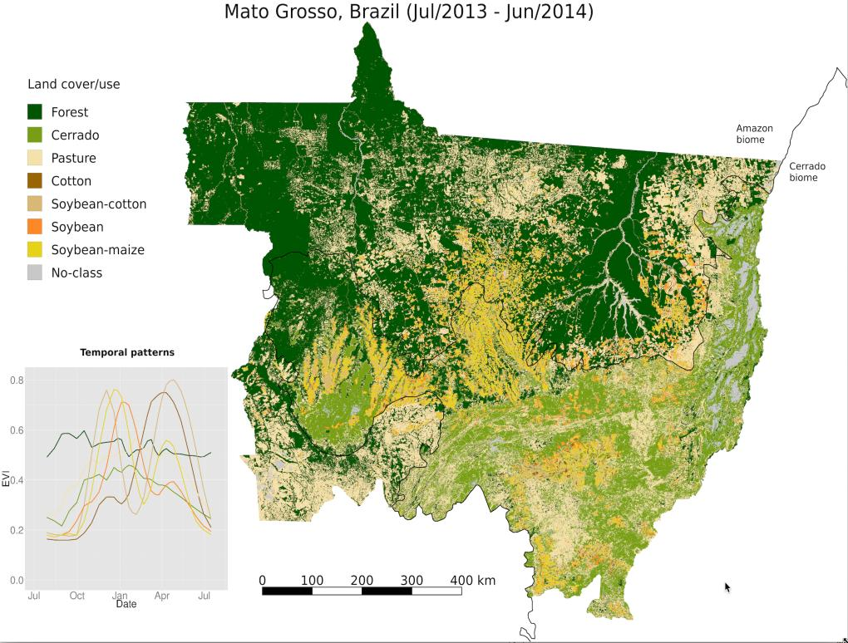
On-going work: identify forest degradation from large-scale fires
for Amazonia from 2000-2015

