Slide 1
Revisiting research agendas in Geographic Information Science
Vespucci Week Maine, 2015
Advancing GIScience
Gilberto Câmara
National Institute for Space Research (INPE)
Brazil

Slide 2
NCGIA: original research initiatives
Spatial Database Accuracy
Languages of Spatial Relations
Multiple Representations
Use & value of geographical information
Large spatial databases
Spatial-decision support systems
Visualisation of Spatial data
Institutions sharing GIS
Spatial-temporal reasoning
Integration RS – GIS
User interfaces for GIS
GIS & Spatial Analysis
GIS & Global Change
Law, IP and Databases
Collaborative decision-making
Interoperating GIS
Common-sense geographical worlds

Slide 3
NCGIA today + Vespucci + Las Navas + ….
Accuracy and uncertainty
Spatial cognition
Modelling and representation
Spatial ontologies
Semantics
Interoperability
Volunteered geographical information
Digital Earth
Big spatial data
Smart cities and Science of cities
CyberGIS
Geovisualisation
Land use science
(…)

Slide 4
All things spatial…
Information
Cognition
Spatial
Statistics
Computing
What’s misleading here?

Slide 5




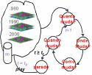
What’s central about spatial thinking?
  Spatial representations connect different expertises
  Makes the different conceptions explicit
If (... ? ) then ...
Desforestation?

Slide 6
What’s central about spatial thinking?
  Spatial thinking does not replace disciplinary knowledge
Territory
(Geography)
Money
(Economy)
Culture
(Antropology)
Spatial Modelling
(GIScience)

Slide 7
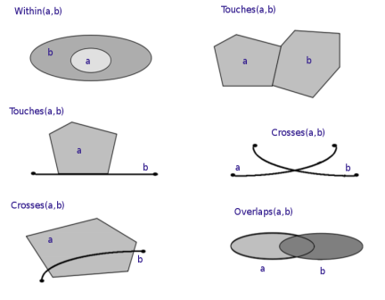
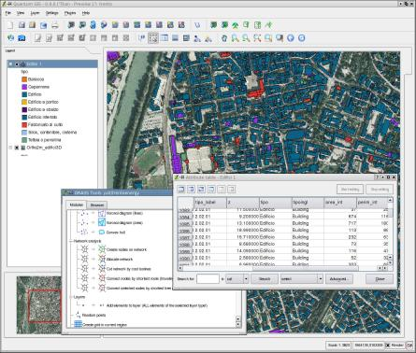
Does GIScience have a basic ambiguity?
computational representations of geographical space
or
formal theories of geographical information?

Slide 8
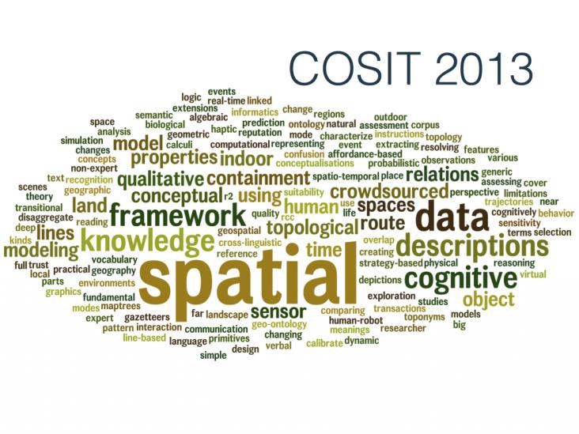
Path-dependence in GIScience
Cartsen Kessler
What’s in common btw GIScience and the QWERTY keyboard?

Slide 9
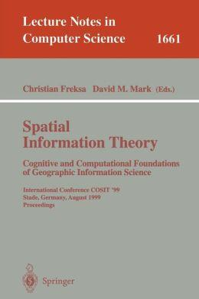
Path-dependence in GIScience
Weltanschauung
GIScience deals with foundations
Implementation and large-scale experimentations are left for engineers
What are the risks of this world view?

Slide 10
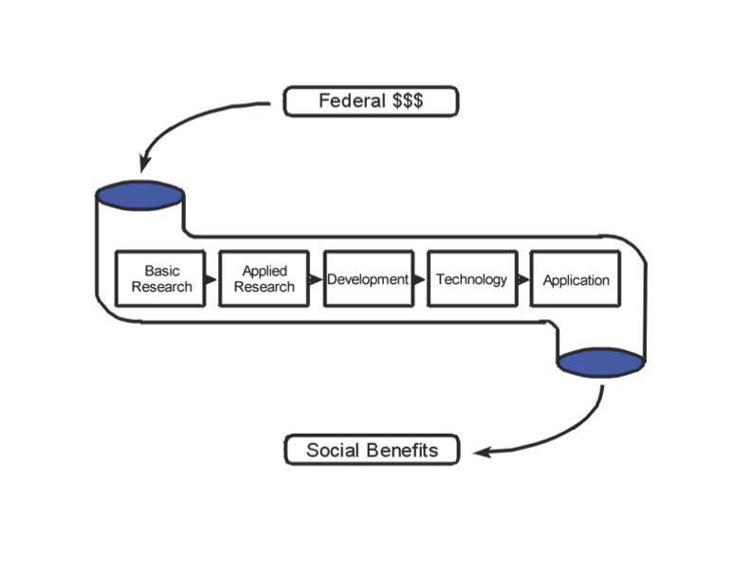
Pipeline model of Science
Does this model apply to GIScience?

Slide 11
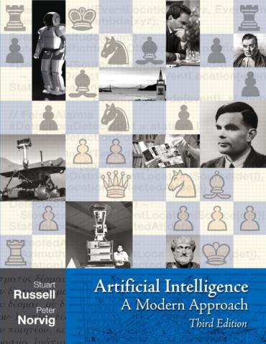
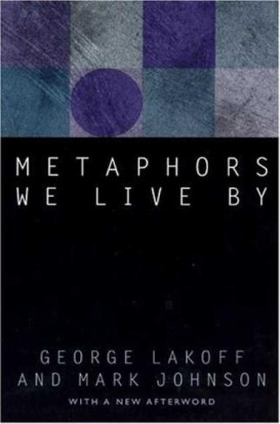
The fascination with Artificial Intelligence and Cognitive Science
Las Navas 1990: Cognitive and linguistics aspects of GIScience 1990: start of second “AI winter”

Slide 12
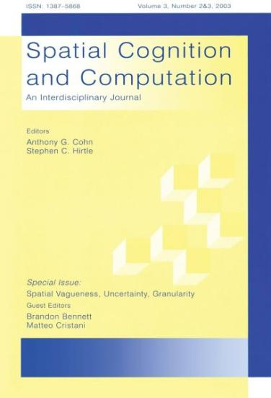
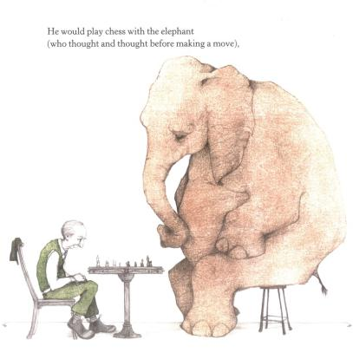
The fascination with Artificial Intelligence and Cognitive Science
...but “Elephants don’t play chess” (R. Brooks)

Slide 13
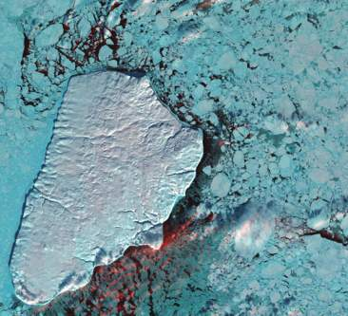
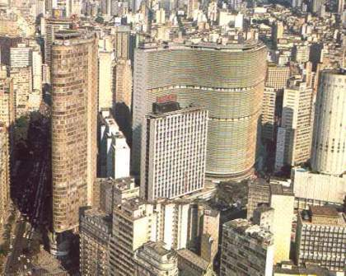
GIScience x Earth Sciences
Earth Science explains how nature works by stating laws
GIScience explains how society work by describing interactions

Slide 14


Are there laws of GIScience?
“Physics envy”: Popper
“Science without laws”

Slide 15
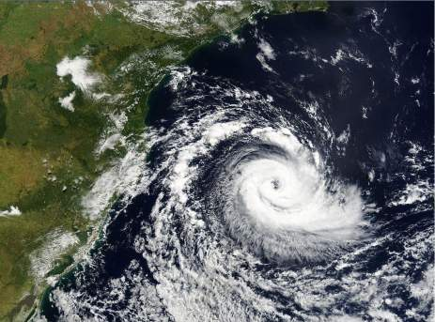

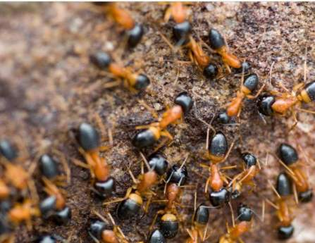
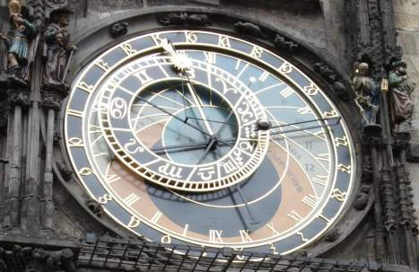
Clocks, clouds or ants?
Clouds: statistical distributions
Clocks: deterministic methods
Ants: emerging behaviour

Slide 16

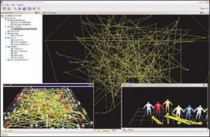
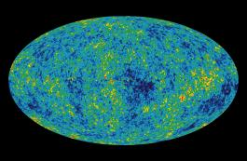
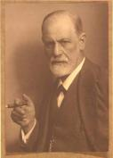
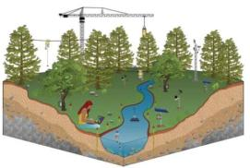
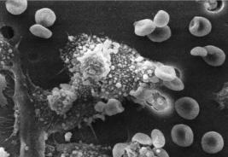
Science: theory vs. experiments
Representation (theories and laws)
Mathematics
Informatics
Cosmology
Psychology
Earth Sciences
Biosciences
Experiments (reproducible practice)

Slide 17
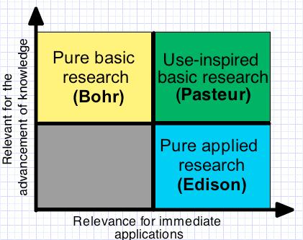
Science and applications feed each other
Pasteur’s quadrant (Donald Stokes)

Slide 18
The original plan for GIScience
theory
applications
engineering

Slide 19
The original plan for GIScience
QSR
WFS
GEOS suite

Slide 20
Multiple paths to Science
ontologies

Slide 21
Multiple paths to Science
FOSS4GIS

Slide 22
Multiple paths to Science
spatial
statistics

Slide 23
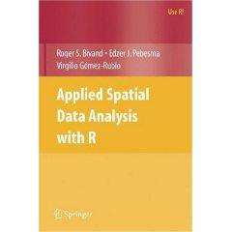
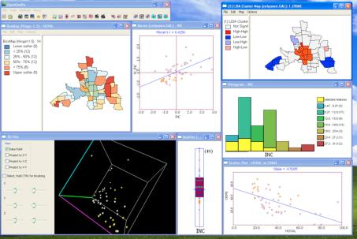
The case of spatial statistics
GeoDa
R spatial
High-citation rates for R packages

Slide 24
A Pasteur’s quadrant view of GIScience
ontologies
QSR
ST reasoning
Spatial statistics
FOSS4GIS
use & value

Slide 25
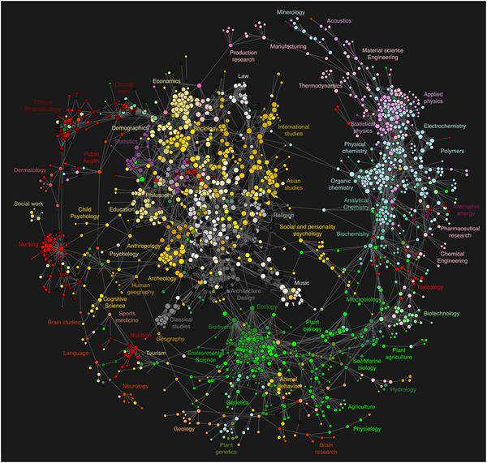
GIScience inside the big picture

Slide 26
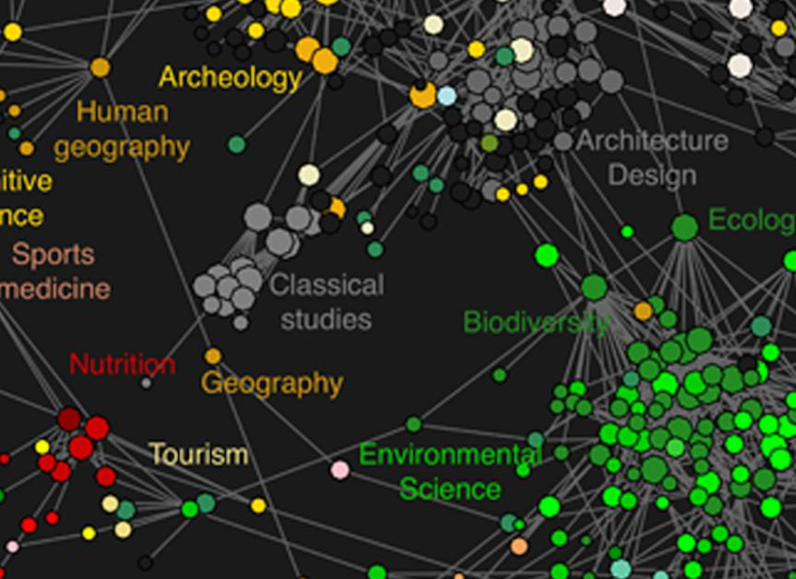
GIScience inside the big picture

Slide 27
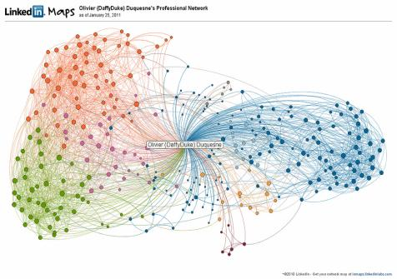
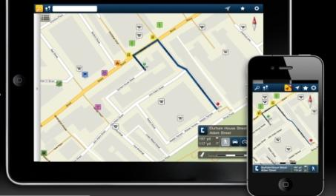
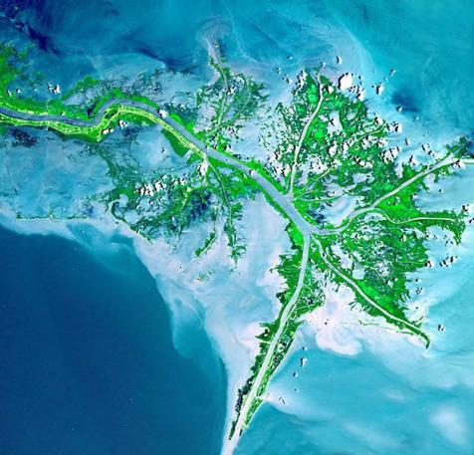
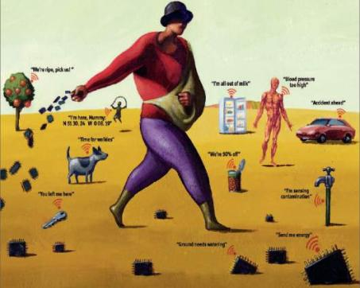
mobile devices
social network
Mobile devices, crowdsourcing, massive Earth observation sets: new technologies, new challenges
sensors everywhere
ubiquitous imagery

Slide 28
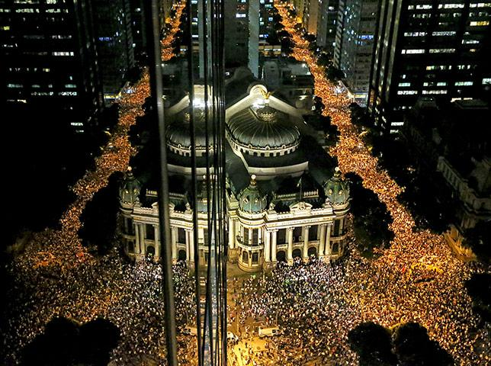
Semantics of big data
Records of interaction on human societies
primary aim: communication

Slide 29
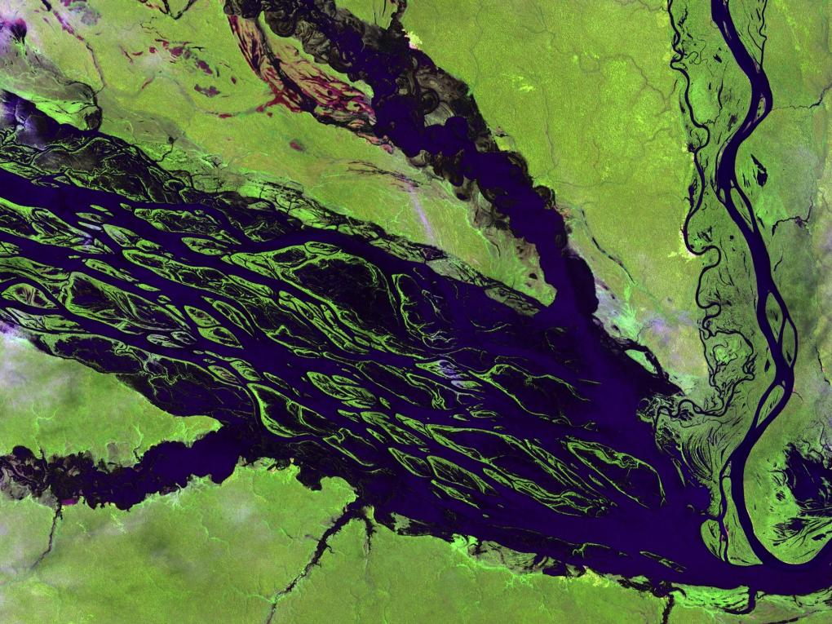
Semantics of big data
Observations of nature
primary aim: description

Slide 30
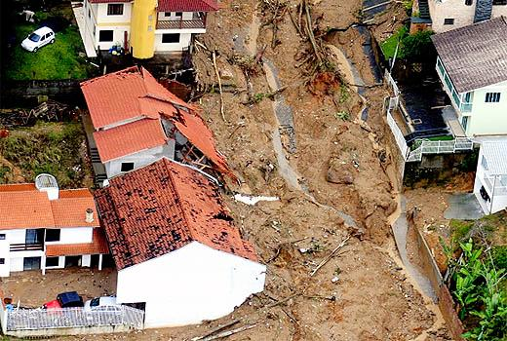
Measurements of nature-society interaction
Semantics of big data
primary aim: sustainability

Slide 31
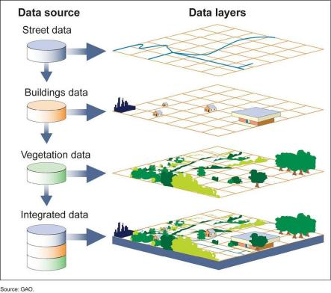
Current GIS is map-based
Big data does not fit in the “map as set of layers” model

Slide 32
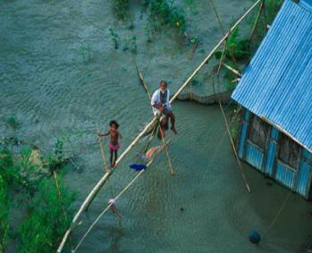
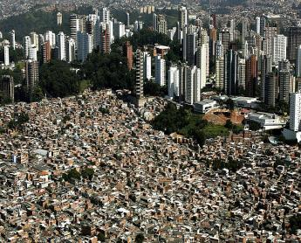
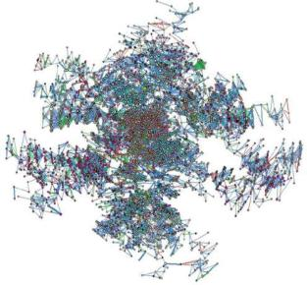
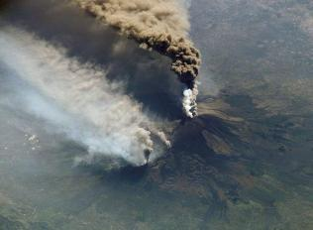
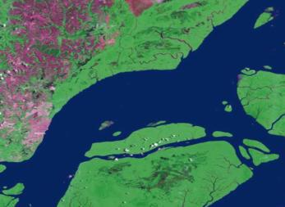
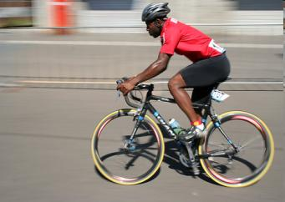
Core concepts of spatial information (Kuhn, IJGIS, 2012)
network
neighborhood
location
field
object
event
Notes:
Na TerraLib partimos do principio que existem core concepts compartilhados na area de geoinformatica e uma idéia interessante que vem crescendo em aceitacao na comunidade\

Slide 33
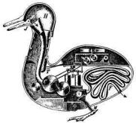
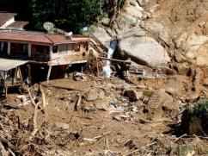
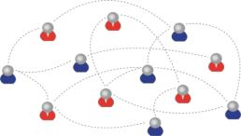
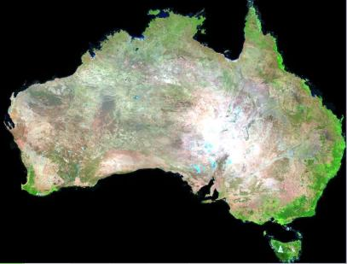
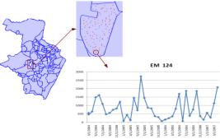
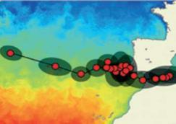

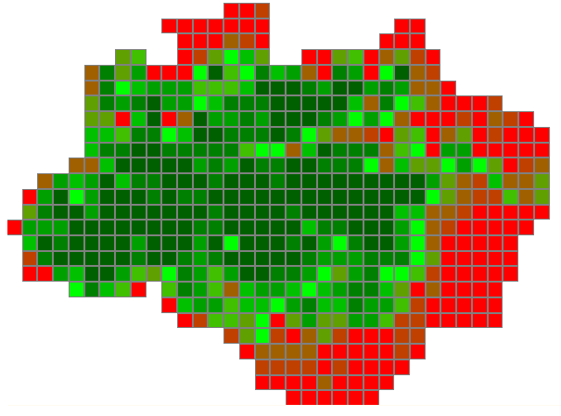
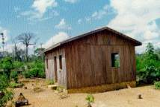
Core concepts as abstract data types
Agent
Network
Event
Coverage Set
Time Series
Trajectory
191610 (x)
Geometry
Field
Object

Slide 34
Big data requires new conceptual views
191610 (x)
575 (t) x 7 (λ)
The Space-time Data Cube concept

Slide 35
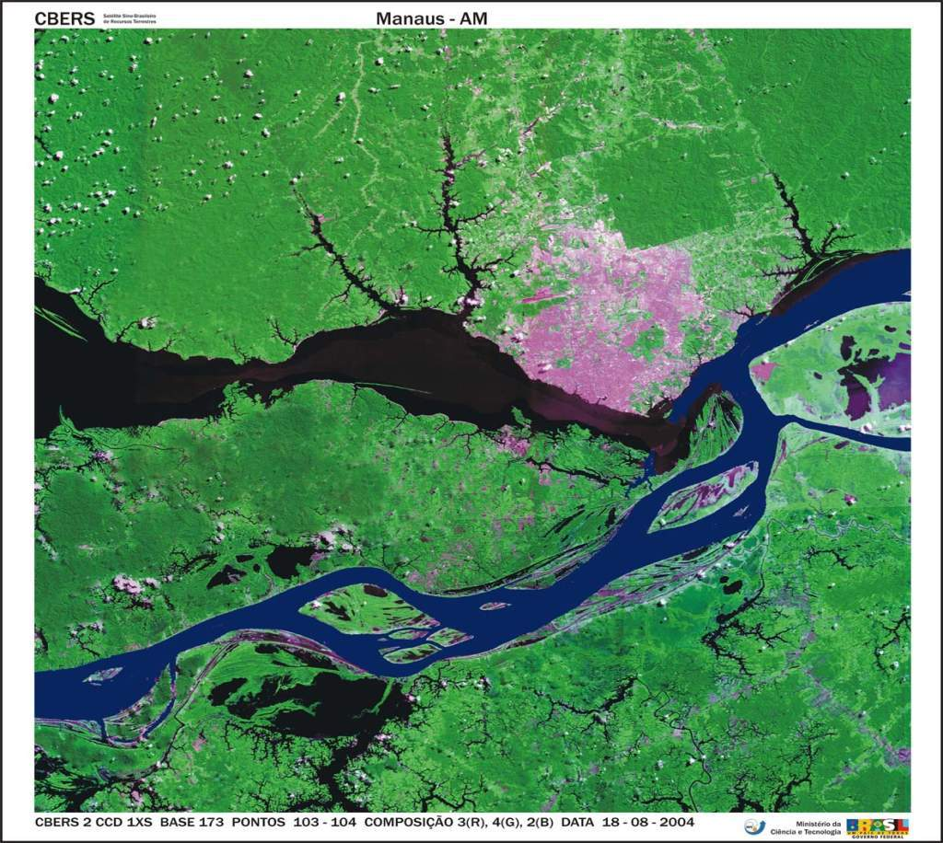
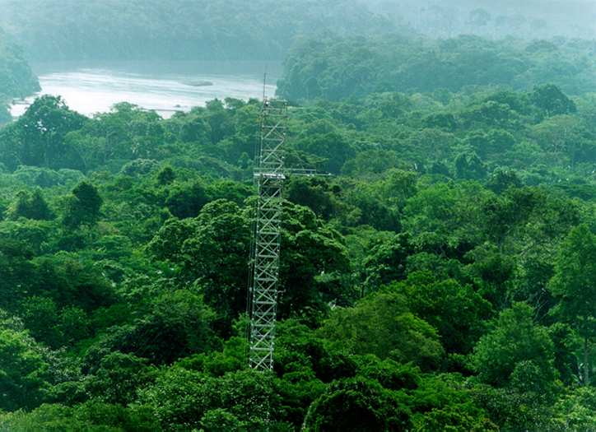
What is a geo-sensor?
What is a geo-sensor?
Field
function: Position → Value
“Conceiving big spatiotemporal data as fields captures their nature better than the layer-oriented view”
(Câmara, Egenhofer et al., GIScience 2014)
measure (s,t) = v
s ⋲ S - set of locations in space
t ⋲ T - is the set of times.
v ⋲ V - set of values

Slide 36
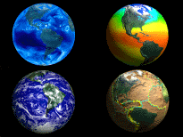
GIScience has a great future if we embrace a mix of theory and experiments
We would we be better transforming our field into Geoinformatics

