Slide 1
VGI for Policy: what are the known unknowns?
Vespucci VGI and Policy, 2016
Gilberto Câmara
National Institute for Space Research (INPE)
Brazil

Slide 2
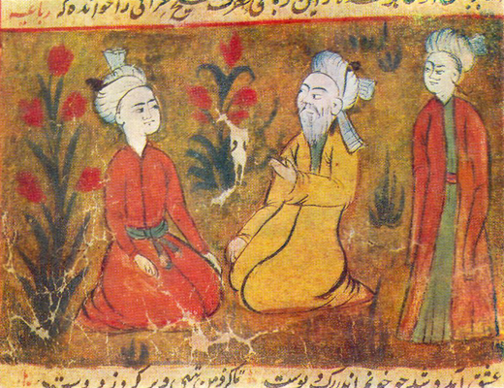
One who knows and knows that he knows... His horse of wisdom will reach the skies.
One who knows, but doesn't know that he knows... He is fast asleep, so you should wake him up!
One who doesn't know, but knows that he doesn't know... His limping mule will eventually get him home.
One who doesn't know and doesn't know that he doesn't know... He will be eternally lost in his hopeless oblivion!
(Ybn Yamin, Persia, 14th Century)

Slide 4
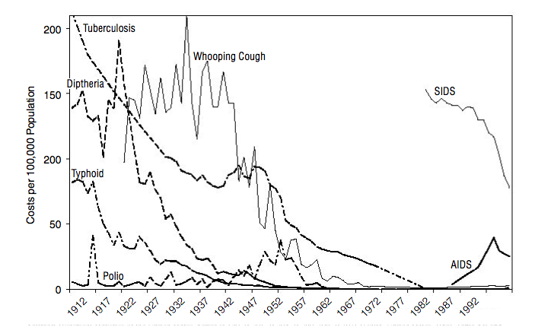
Infections diseases in US: XXth Century

Slide 5
Gravitational waves detection

Slide 6
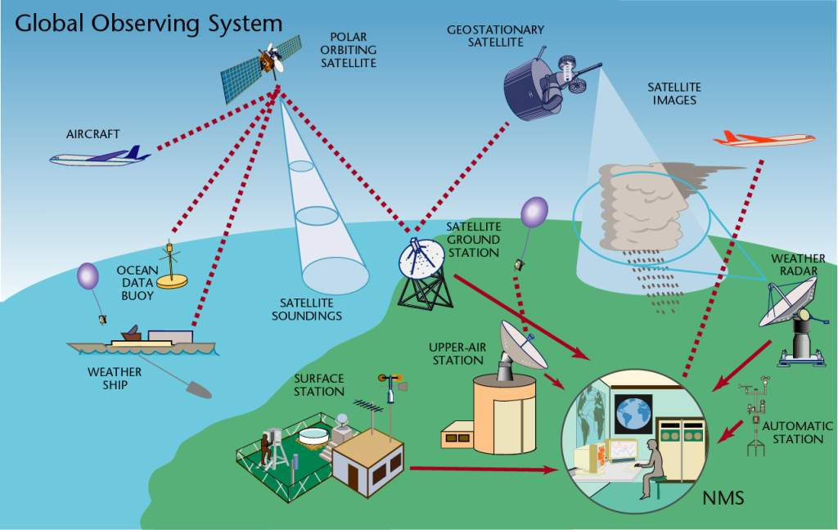
Weather
11,000 land stations (3000 automated), 900 radiosondes, 3000 aircraft, 6000 ships, 1300 buoys
5 polar, 6 geostationary satellites
source: WMO

Slide 7
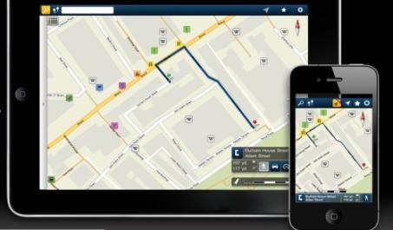
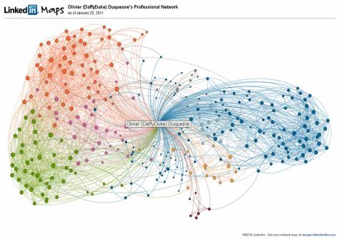
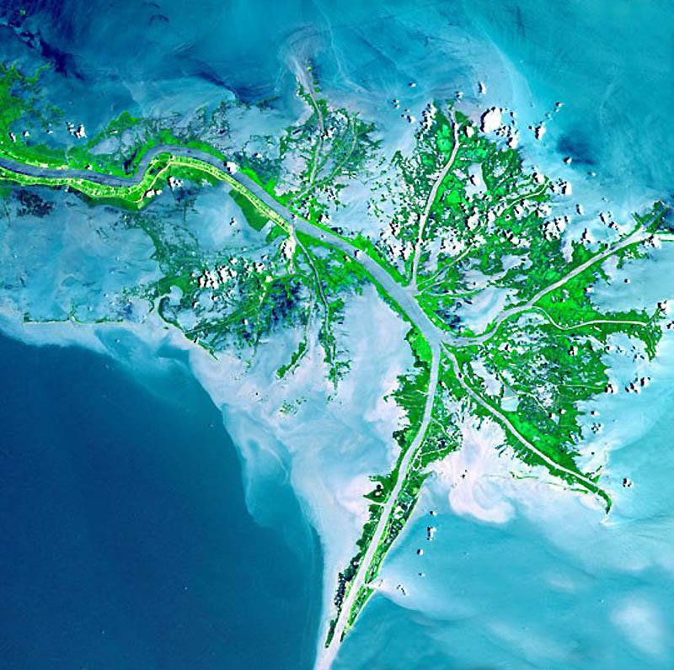
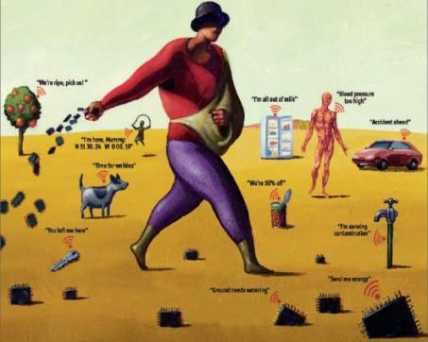
Enabling technologies
mobile devices
social networks
sensors everywhere
ubiquitous imagery

Slide 8
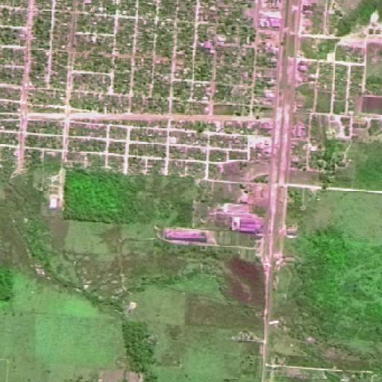
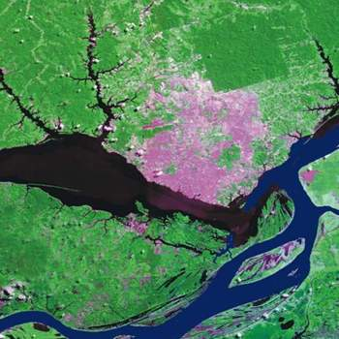
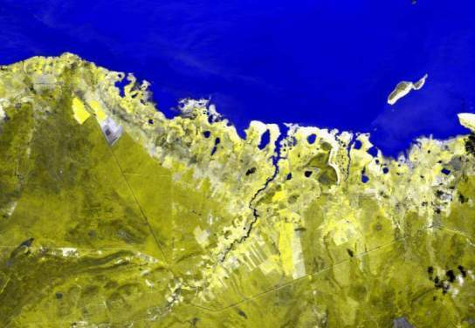
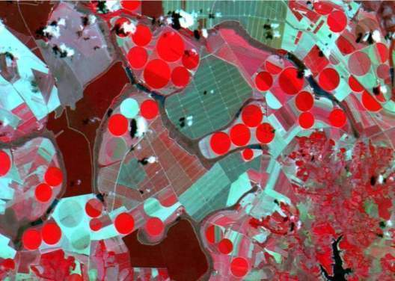
RIO-92 Declaration – principle #10
Environmental issues are best handled with participation of all citizens.
Each individual shall have appropriate access to information concerning the environment.

Slide 9
There is an urgent need for the international scientific community to develop the knowledge that can inform and shape effective responses to these threats in ways that foster global justice and facilitate progress toward sustainable development goals.

Slide 11
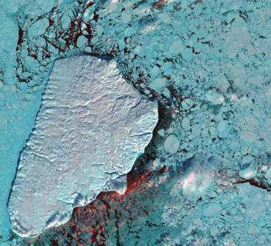
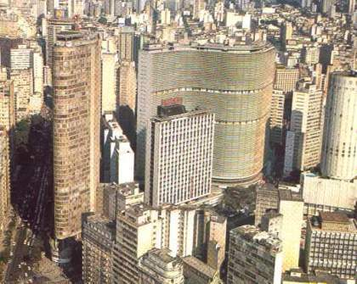
Future Earth = linking knowledge about nature and society
Nature: Physical equations
Describe processes
Society: Decisions on how to
Use Earth´s resources

Slide 12
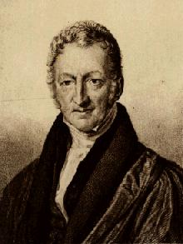
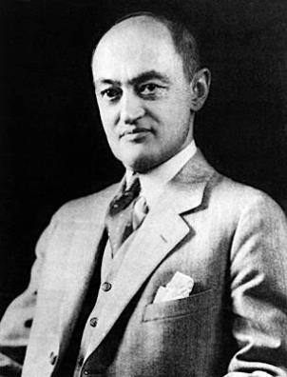
Conceptual debate on Future Earth
Malthusians
“the future will be just like the past; only a bit worse”
Schumpeterians
“the future will not be like the past, for better or worse”

Slide 13
Conceptual debate on Future Earth
Popper: Objective Knowledge
“Science progresses by conjectures and refutations”
Rawls: Public Reason
“all citizens should be able to examine whether their political and social institutions are just”

Slide 14
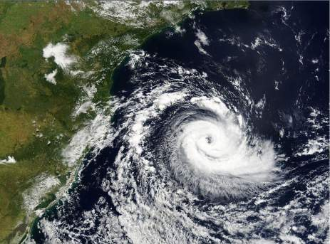
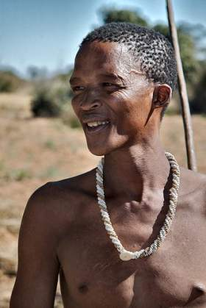
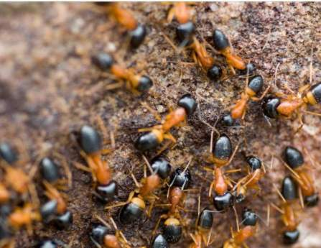
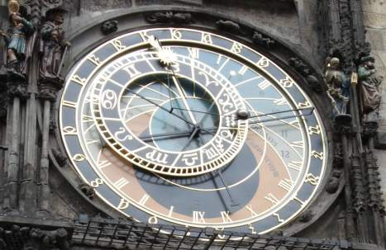
Clocks, clouds or ants?
Clouds: statistical distributions
Clocks: deterministic equations
Ants: emerging behaviour

Slide 15
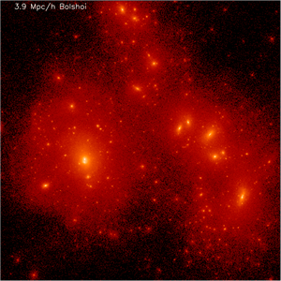
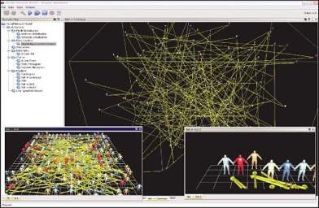
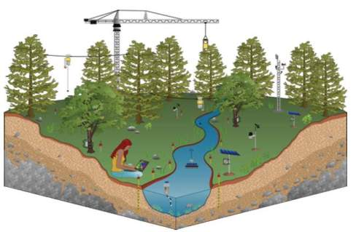
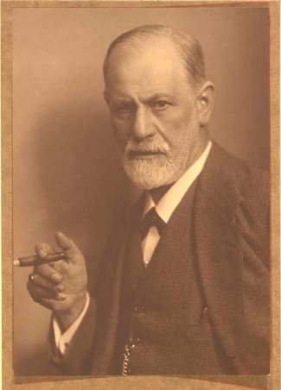
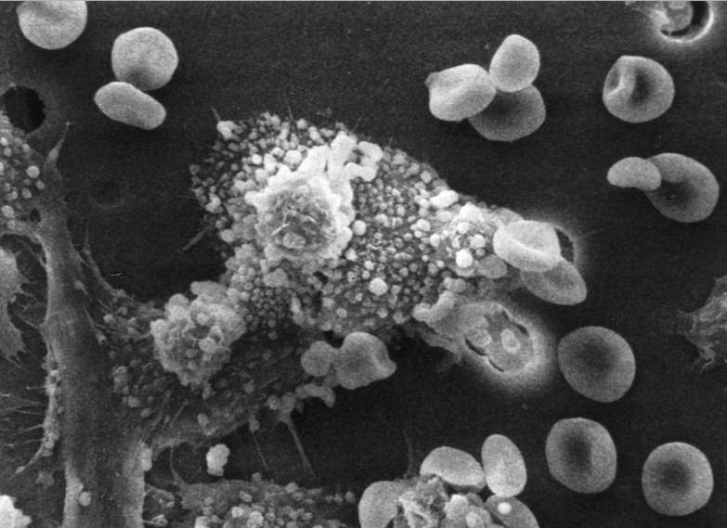
Ways to do Science
Theories and laws
Mathematics
Informatics
Cosmology
Geosciences
Psychology
Biosciences
Experiments (reproducible practice)

Slide 16
The known unknowns (limits of our knowledge)
Uncertainty on theory
Quantum
Gravity
Social and Economic
Systems
Particle
Physics
Living
Systems
Global
Change
Chemical
Reactions
Meteorology
Gravitational waves
Experimental and modelling complexity
source: John Barrow
(after David Ruelle)

Slide 17
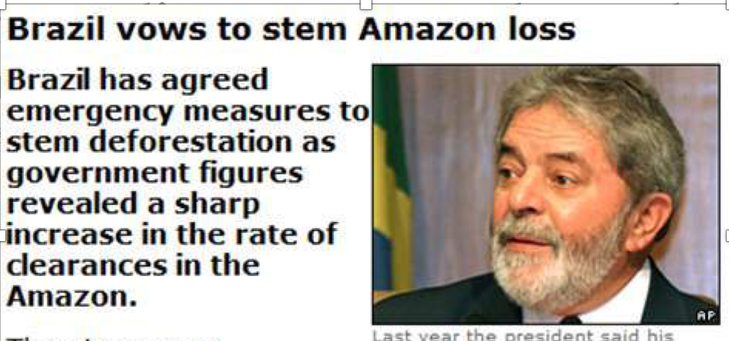
How big is the gap between science and policy?

Slide 18
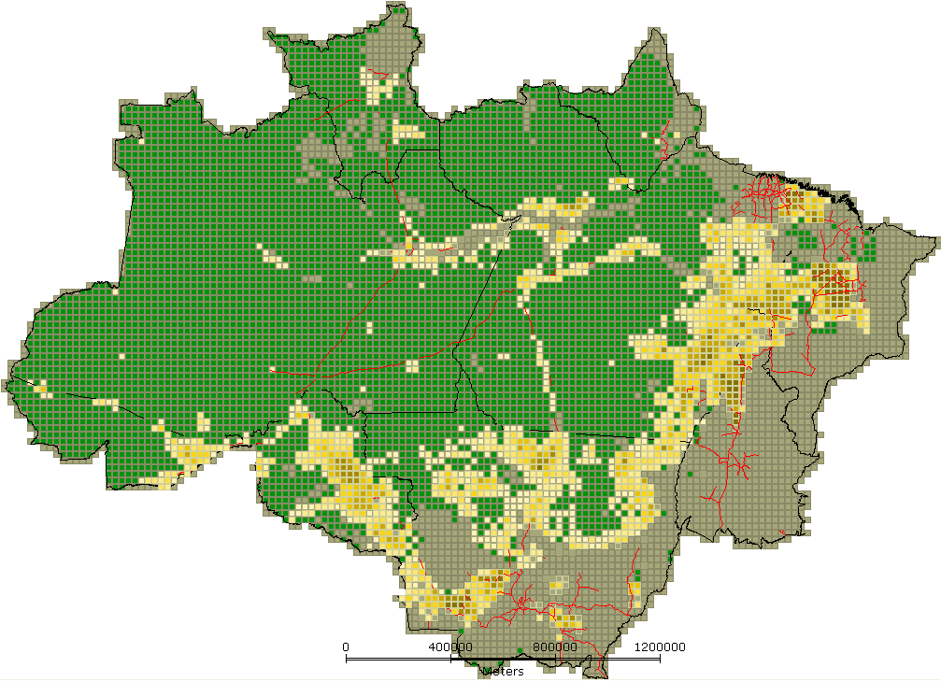
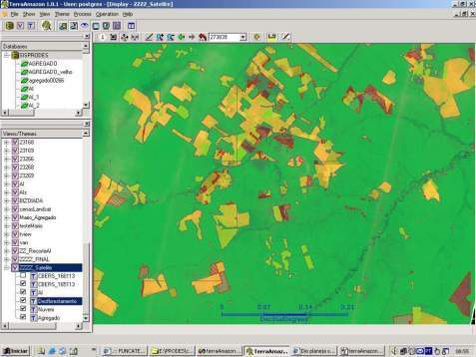
INPE: Clear-cut deforestation mapping of Amazonia since 1988
~230 scenes Landsat/year
Yearly detailed estimates of clear-cut areas
LANDSAT-class data (wall-to-wall)

Slide 19
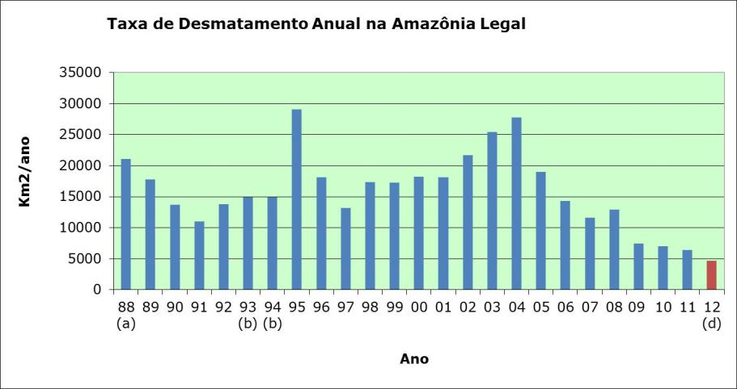
How does Science influence policy?
Deforestation in Brazilian Amazonia (1988-2011)
dropped from 27,000 km² to 6,200 km²

Slide 20
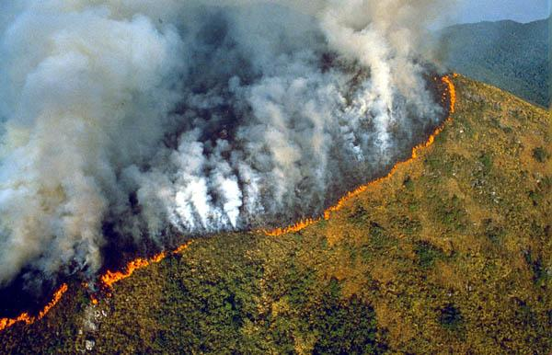
Public opinion was strong force
What is the proper scientific reaction?

Slide 21
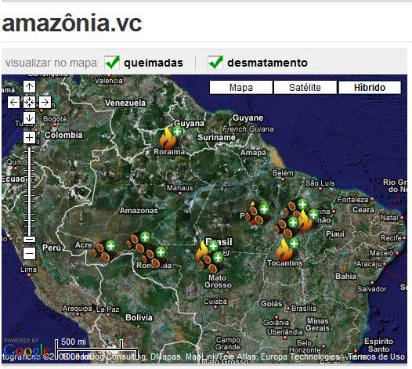
Society is watching!
500.000 registrations
46 million protests

Slide 22
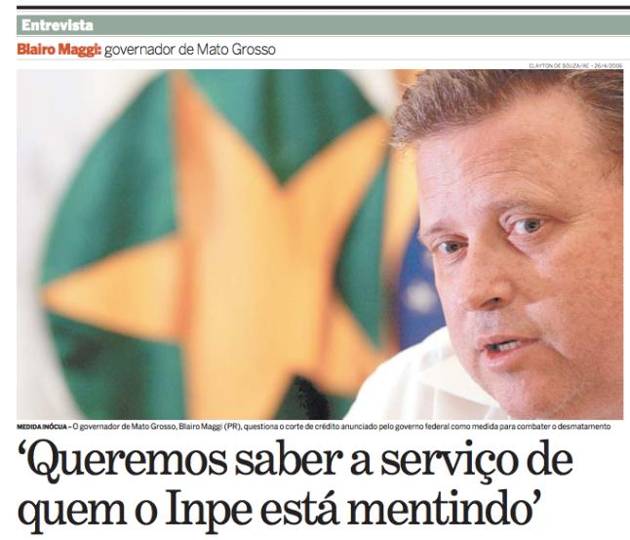
Public reason x objective knowledge
Public questioning on INPE’s data on deforestation

Slide 23
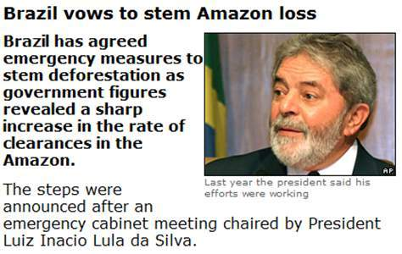
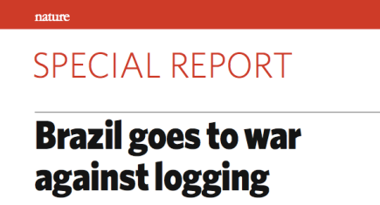
Public opinion – based on open data – forces government to act

Slide 24
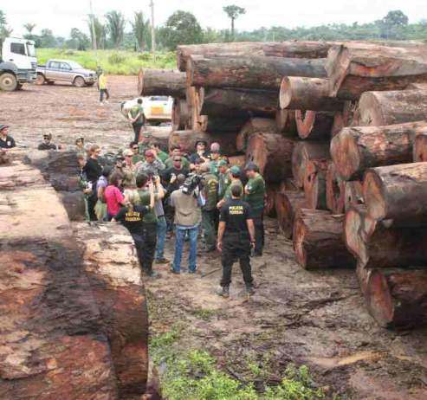
Finding: Command and control actions are effective means to curb deforestation
Almost all deforestation is illegal

Slide 25
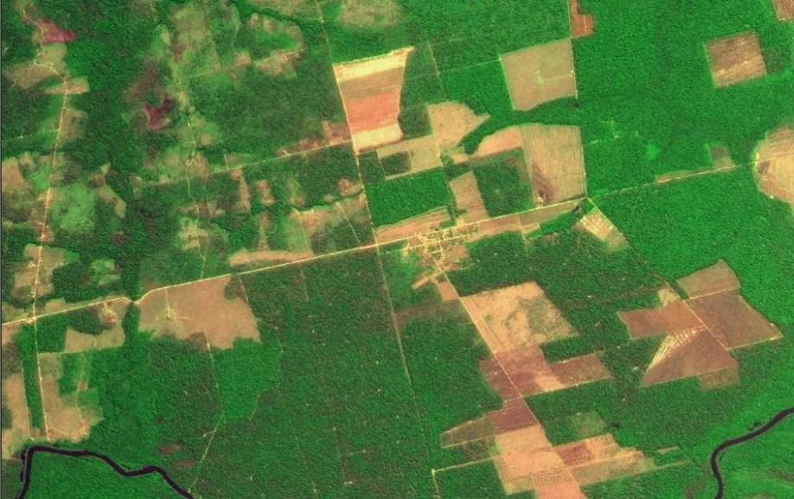
Finding: Transparency builds governance!
CBERS image
Degradation
Deforestation
Science (27 April 2007): “Brazil´s monitoring system is the envy of the world”.
Notes:
Este slide mostra uma imagem CBERS-2B da região de Marcelândia, norte de Mato Grosso. A imagem foi composta por uma imagem monocromática de alta resolução HRC (2,5 m) com uma imagem multespectral CCD (20 m). A imagem mostra que é possivel identificar com o sensor HRC, alem de desmatamentos por corte raso (áreas claras na imagem), as áreas de degradação florestal (áreas verdes com partes claras).

Slide 26
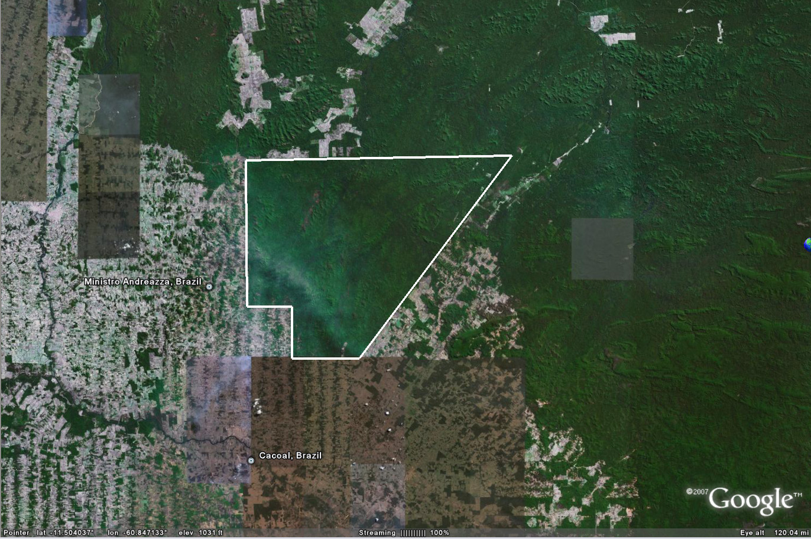
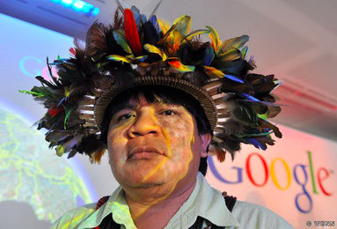
Who is empowering whom?
Chief Almir and Suruí reserve

Slide 27
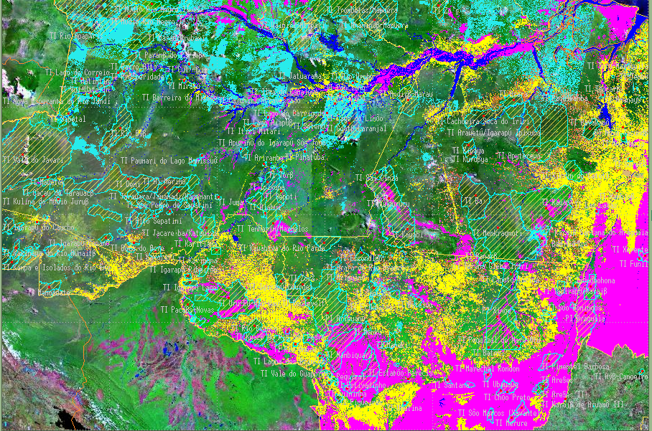
Amazonia: 400.000.000 ha
Suruí reserve: 250.000 ha

Slide 28
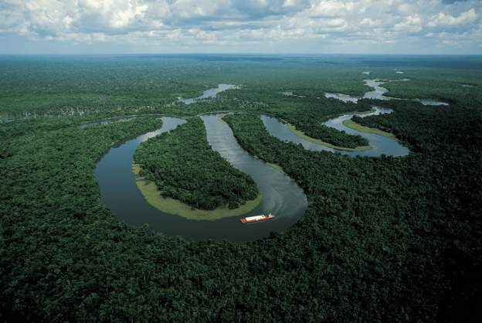
“Deforestation in Brazilian Amazonia is down by a whopping 78% from its recent high in 2004. If Brazil can maintain that progress — and Norway has put a US$1-billion reward on the table as encouragement — it would be the biggest environmental success in decades” (Nature, Rio + 20 editorial)

Slide 29
Flint water crisis: Science + VGI exemplar
Virginia Tech prof. Marc Edwards (funded by NSF and EPA) with volunteers from Flint

Slide 30
Foundations of modern democracies
source: Fukuyama (2011)
State (power by technical staff)
Rule of law
(limits power)
Society
(public accountability)
How the interplay between science,
public opinion and government?

Slide 31
Foundations of modern democracies
source: Fukuyama (2011)
State (power by technical staff)
Science
State
Institutions
Rule of law
(limits power)
Society
(public accountability)

