Slide 1
Geographical ontologies for land use and land cover change: distinguishing continuants from occurents
FOIS 2016, Annecy
Gilberto Câmara, INPE
Licence: Creative Commons ̶̶̶̶ By Attribution ̶̶̶̶ Non Commercial ̶̶̶̶ Share Alike
http://creativecommons.org/licenses/by-nc-sa/2.5/

Slide 2
What can Big Data learn from Ontology?
FOIS 2016, Annecy
Gilberto Câmara, INPE
Licence: Creative Commons ̶̶̶̶ By Attribution ̶̶̶̶ Non Commercial ̶̶̶̶ Share Alike
http://creativecommons.org/licenses/by-nc-sa/2.5/

Slide 3
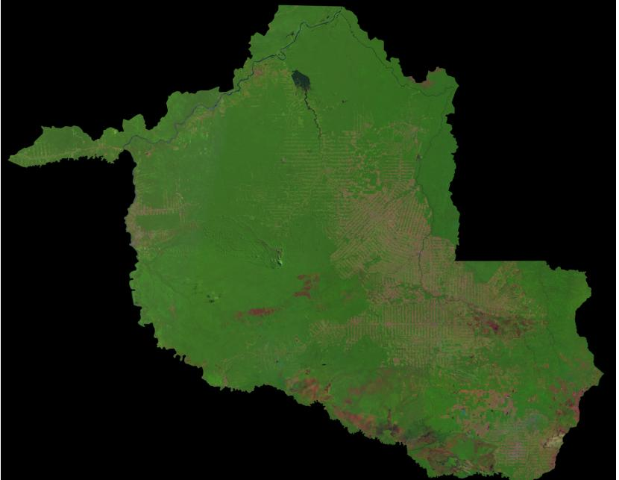
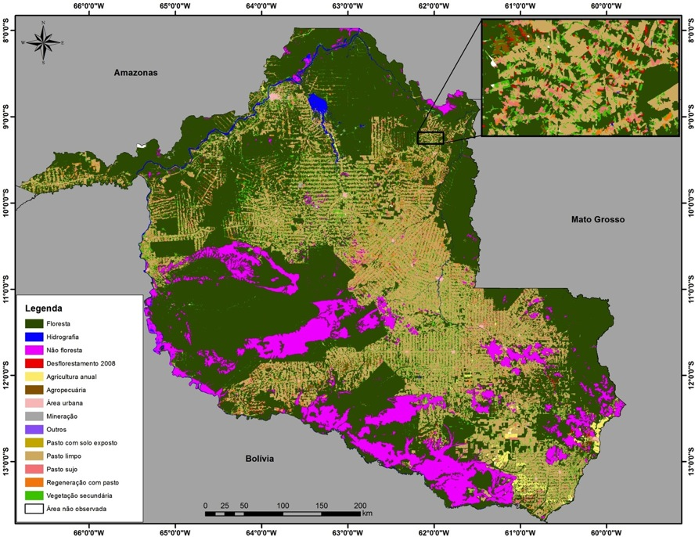
The quest for the perfect map
The world is divided in cells. Each cell has a single class.
There is a correct classification.
The more our classification approaches the ideal, the better.

Slide 4
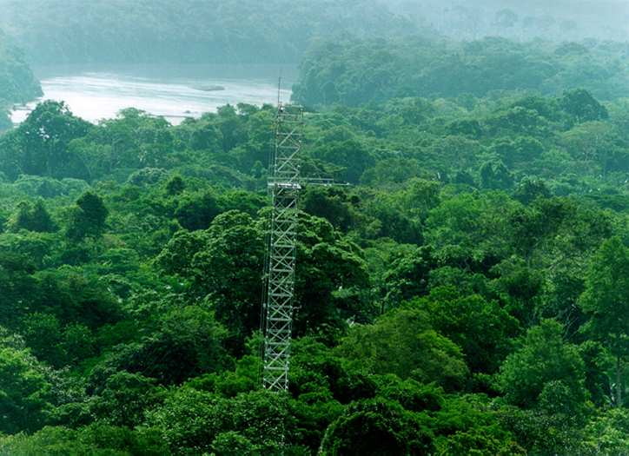
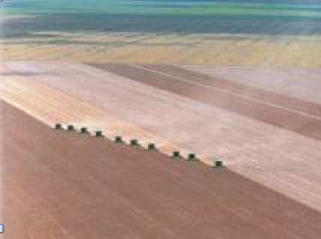
Land cover
  tropical forest
  wetlands
Land cover: “the observed biophysical cover on the Earth’s surface"
  Non-natural vegetation
  shrublands

Slide 5
Land cover
  non-managed forest
  pasture
Land use:“arrangements, activities and inputs people do in a certain land cover type to produce, change or maintain it”
  large-scale agriculture
  subsistence agriculture

Slide 6
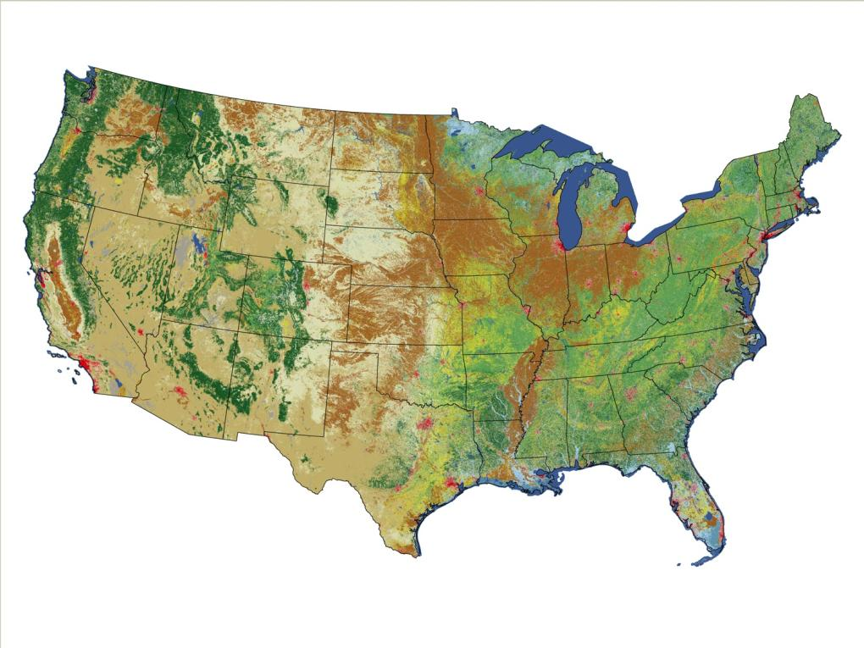
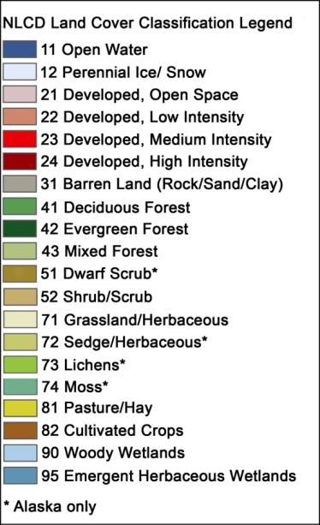
Classification systems are purpose-specific and mix land cover and land use classes
US National Land Cover 2006
source: USGS

Slide 7
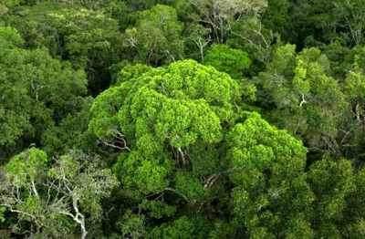
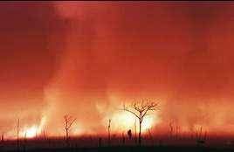
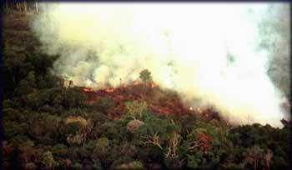
A scientific question linked to public policy
When is a forest a forest?

Slide 8
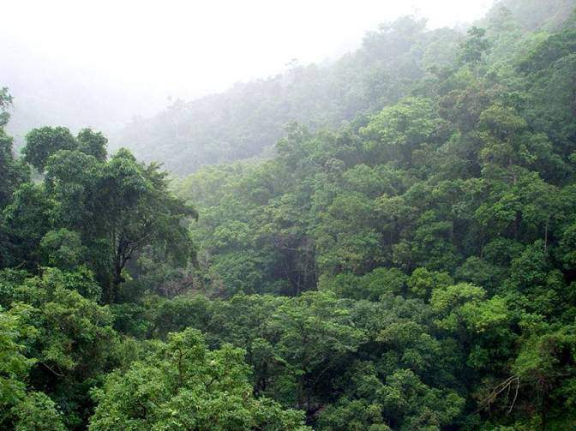
Tropical rainforest

Slide 9
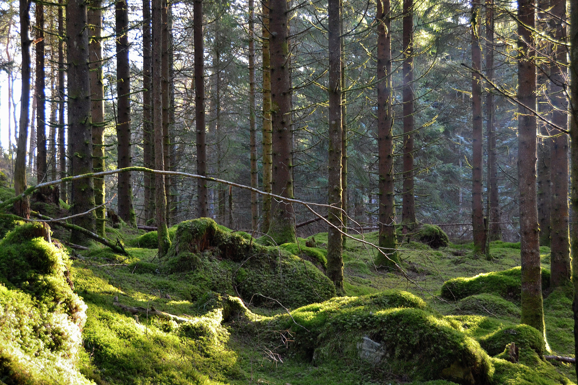
Taiga (boreal forest)

Slide 10
Tropical dry forest (caatinga)

Slide 11
Planted forest of oil palms

Slide 12
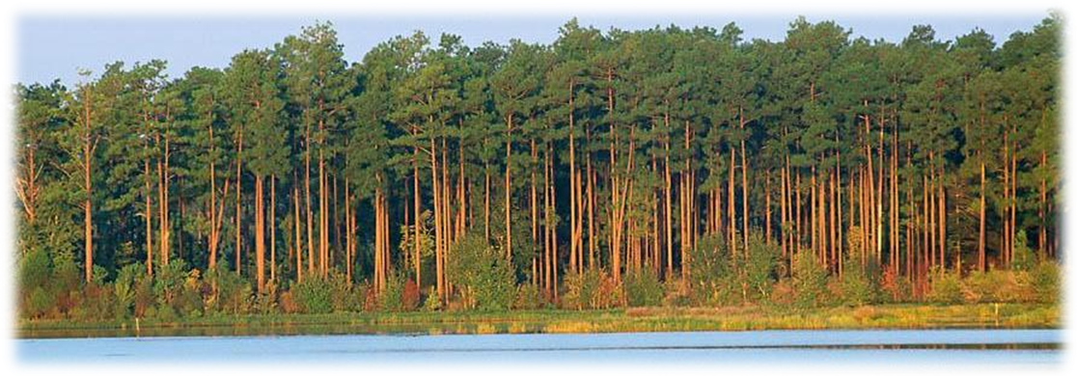
Forest (FAO definition)
Land spanning more than 0.5 hectares with trees higher than 5 meters and a canopy cover of more than 10 percent, or trees able to reach these thresholds in situ.

Slide 13
Multiple definitions of forest
Comber (2006), Ahlqvist(2015)

Slide 14
When is a forest a forest?
Chadzon et al (2016)

Slide 15
Distinguishing forests by temporal evolution
Chadzon et al (2016)

Slide 16
Distinguishing forests by temporal evolution
Chadzon et al (2016)

Slide 17
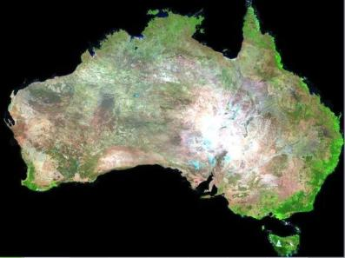


Big Earth Observation data
graphics: Geoscience Australia
Searching for changes instead of searching for objects

Slide 18
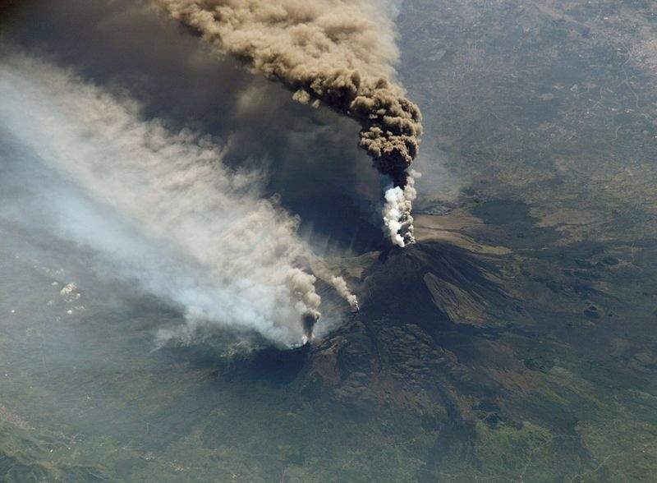
objects exist, events occur
Mount Etna is an object
Etna’s 2002 eruption was an event

Slide 19
objects exist, events occur
How do we know?

Slide 20
objects exist, events occur
”In God we trust; all others must bring data” (W. Edwards Deming)

Slide 21
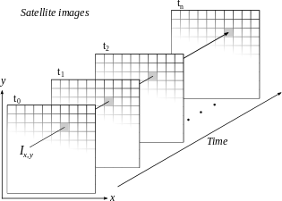
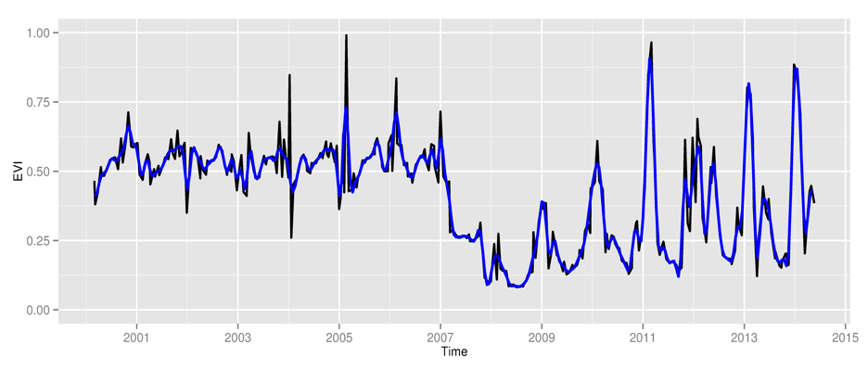
Classification: continuants x occurents
Space first: classify
images separately
(object-centered view)
Time first: classify
time series
(event-centered view)

Slide 22
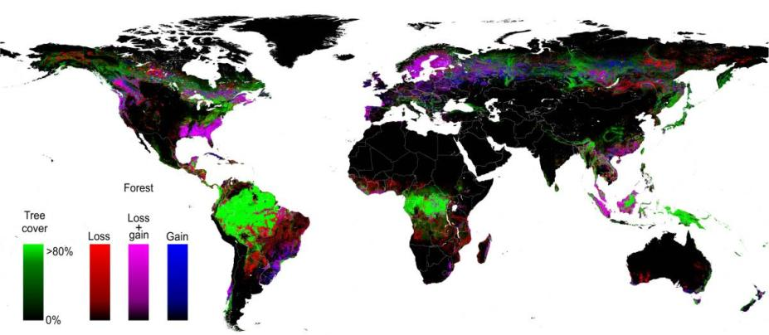
A continuant-based approach to big data
Hansen et al. (2013)
Find forest areas in images from 2000 and from 2010
Compare the results to account for forest loss
(650,000 LANDSAT images – 140 x 10⁹ pixels)

Slide 23
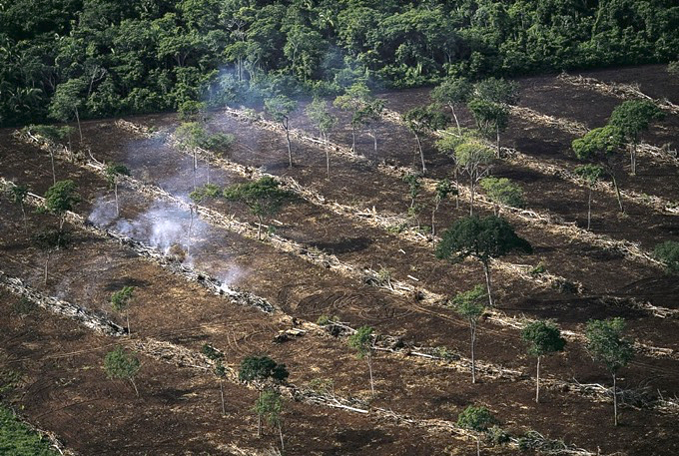
When the continuant view fails
Removal of natural forest
Cuts on planted forests

Slide 24
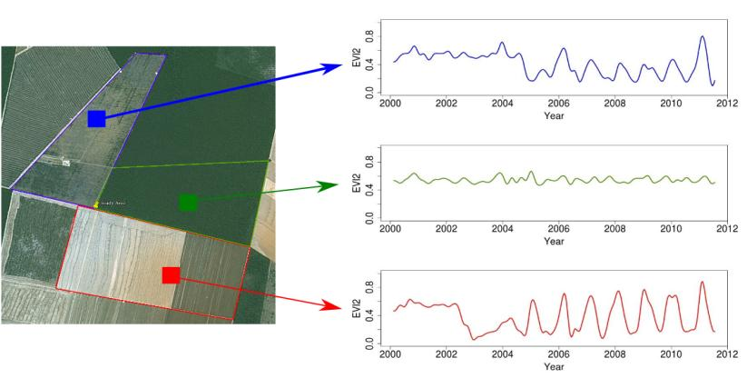
Land trajectories: an occurent perspective
Forest
Pasture
Agric
Área 1
Forest
Área 2
Forest
Agriculture
Área 3
“The transformations of land cover due to actions of land use”
graphics: Victor Maus (INPE, IFGI)

Slide 25
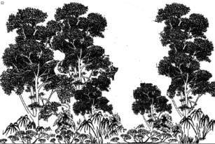
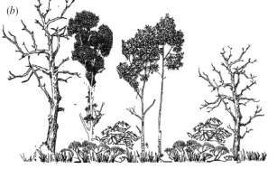
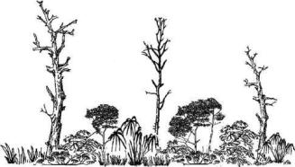
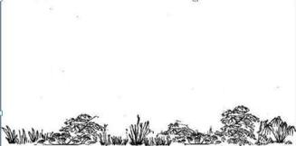
Land trajectories in forests
Exploração intensiva
Event 1
80%
Perda >50% do dossel
Event 2
50%
Perda >90% do dossel
Event 3
10%
Corte raso
Event 4
0%
Floresta
Floresta
Events of forest cover loss

Slide 26
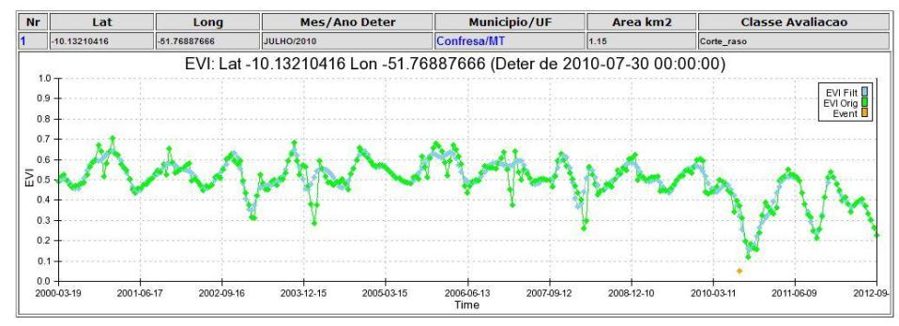
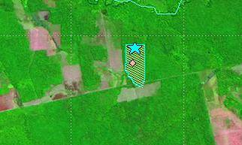
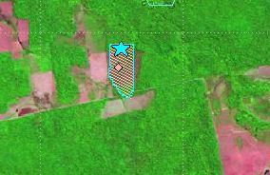
Land trajectories: deforestation events
images: INPE
2010
2011

Slide 27
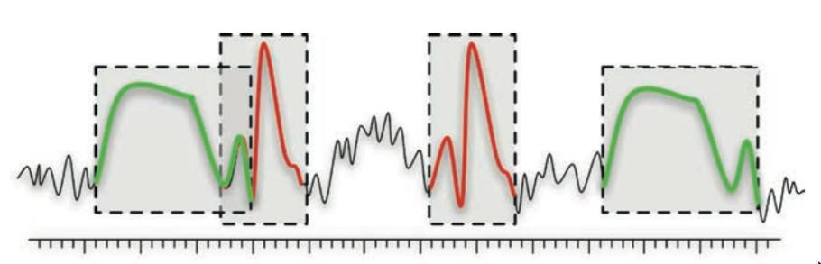
Time series mining: pattern matching
Finding subsequences in a time series
High computational complexity
Patterns are idealized, data is noisy
Esling & Agon (2012)

Slide 28
Finding events in remote sensing time series
Prototypical event signatures are matched against a long time series of remote sensing data

Slide 29
Mato Grosso – Amazonia biome (2001)
33 Million time series = 3 x 10⁹ pixels

Slide 30
Mato Grosso – Amazonia biome (2005)

Slide 31
Mato Grosso – Amazonia biome (2009)

Slide 32
Mato Grosso – Amazonia biome (2013)

Slide 33
Interval temporal logic (Allen)

Slide 34
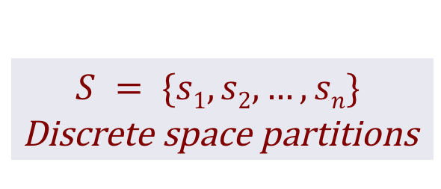
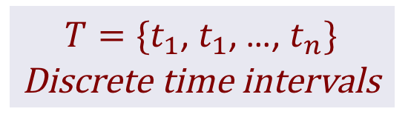
Spacetime event logic (discrete partitions)
$$S = \{s1, s2,…, sn\}$$
Discrete space partitions
$T=\{t_{1}$, $t_{1}$, …, $t_{n}\}$
Discrete time intervals

Slide 35
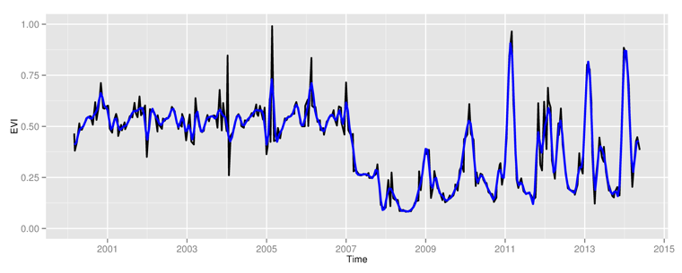
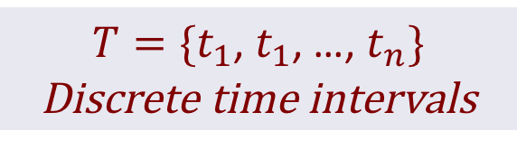
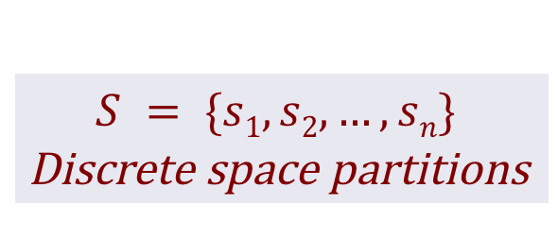
Spacetime event logic (discrete partitions)
$$S = \{s1, s2,…, sn\}$$
Discrete space partitions
$T=\{t_{1}$, $t_{1}$, …, $t_{n}\}$
Discrete time intervals
P = {p₁, p₂,…, p_{n}}
Discrete properties
Allen’s interval logic

Slide 36
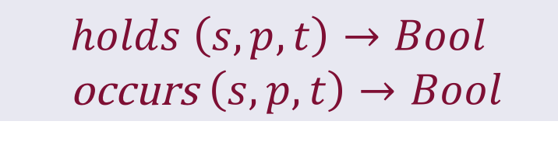
Spacetime event logic (discrete partitions)
$$S = \{s1, s2,…, sn\}$$
Discrete space partitions
$T=\{t_{1}$, $t_{1}$, …, $t_{n}\}$
Discrete time intervals
  $$holds \left(s, p,t\right)→Bool$$
  occurs $\left(s, p,t\right)→Bool$
P = {p₁, p₂,…, p_{n}}
Discrete properties
Allen’s interval logic

Slide 37
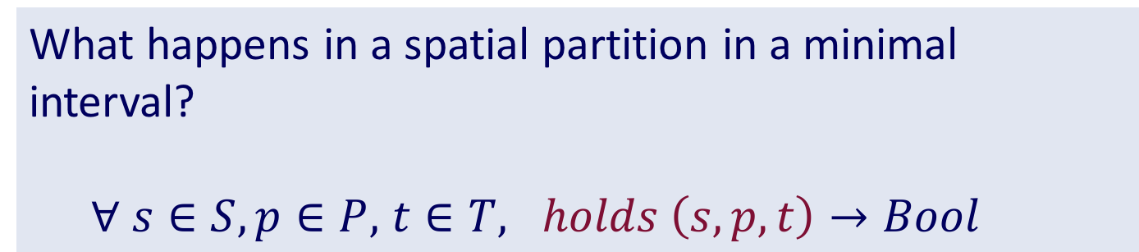
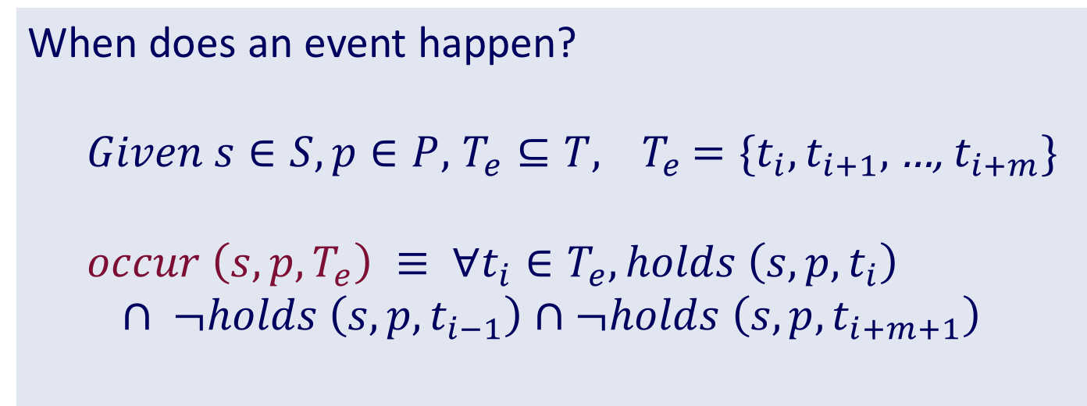
Spacetime event logic
What happens in a spatial partition in a minimal interval?
  $∀ s∈S,p∈P,$ $t∈T, holds \left(s, p,t\right)→Bool$
When does an event happen?
  $Given s∈S, p∈P,$ $T_{e}⊆T, { T}_{e}$ $=\{t_{i},t_{i+1},$…, $t_{i+m}\}$
  $$occur \left(s, p,T_{e}\right) ≡ ∀t_{i}∈T_{e}, holds \left(s, p,t_{i}\right)$$
$$∩ ¬holds \left(s, p,t_{i−1}\right)∩¬holds \left(s, p,t_{i+m+1}\right)$$

Slide 38
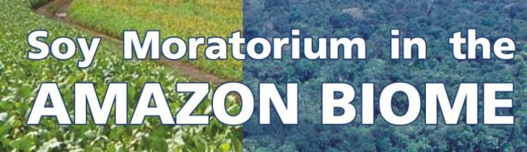
Markets chain arrangements: are they working?
Forest
Defor
Soy
NO
Forest
Defor
Pasture
Soy

Slide 39
Contribution to public debate
Gibbs et al (Science, 2015)

Slide 40
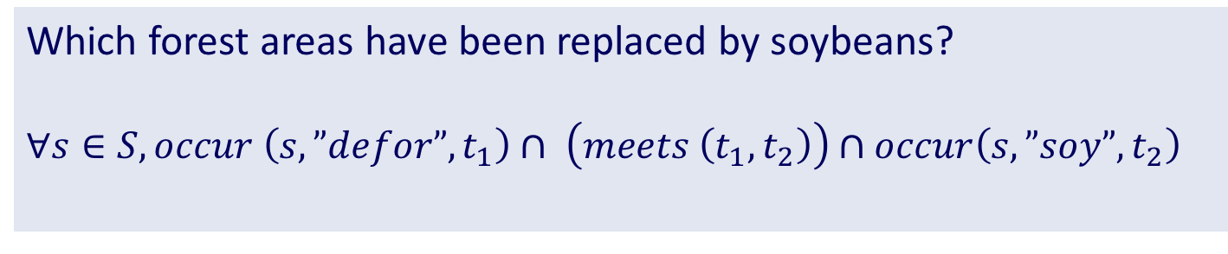
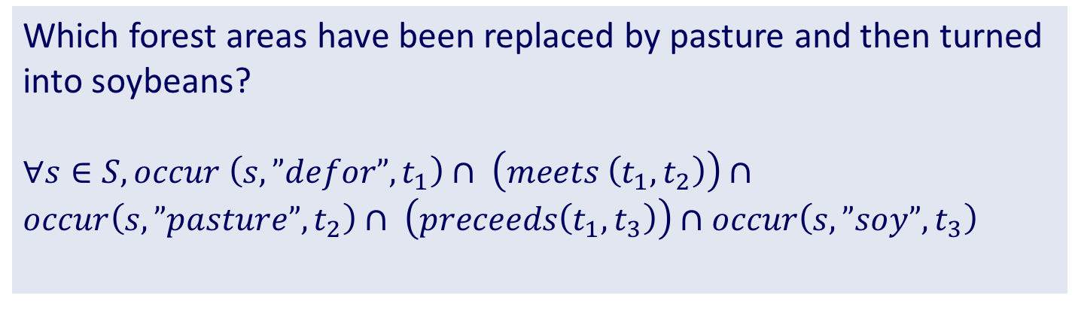
Deduction using spacetime temporal logic
Which forest areas have been replaced by soybeans?
$$∀s∈S, occur \left(s, ”defor”, t_{1}\right)∩ \left(meets \left(t_{1},t_{2}\right)\right)∩occur\left(s, ”soy”, t_{2}\right)$$
Which forest areas have been replaced by pasture and then turned into soybeans?
$∀s∈S, occur \left(s, ”defor”, t_{1}\right)∩ \left(meets \left(t_{1},t_{2}\right)\right)∩occur\left(s, ”pasture”, t_{2}\right)$ $∩ \left(preceeds\left(t_{1},t_{3}\right)\right)∩occur\left(s, ”soy”, t_{3}\right)$

Slide 41
Using events to understand land transitions

Slide 42
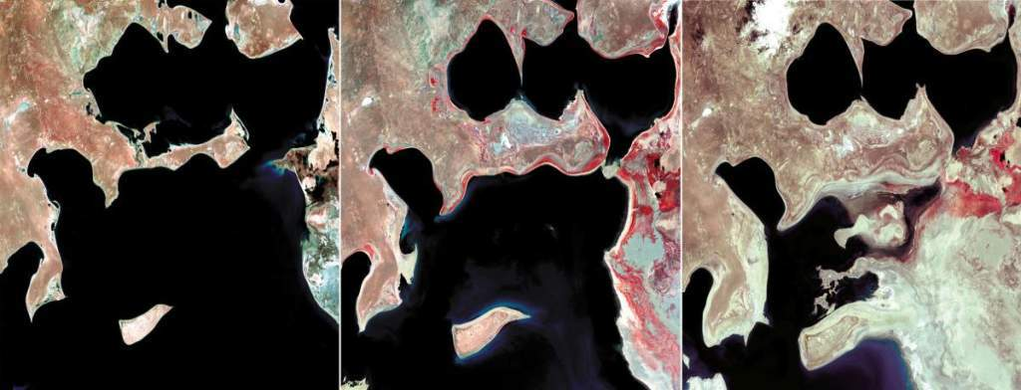
source: USGS
Are events categories?
identity : id · a = a
composition (?) : ∀a, ∀b, ∃c, c = a.b
associativity(?) : a · (b · c) = (a · b) · c

Slide 43
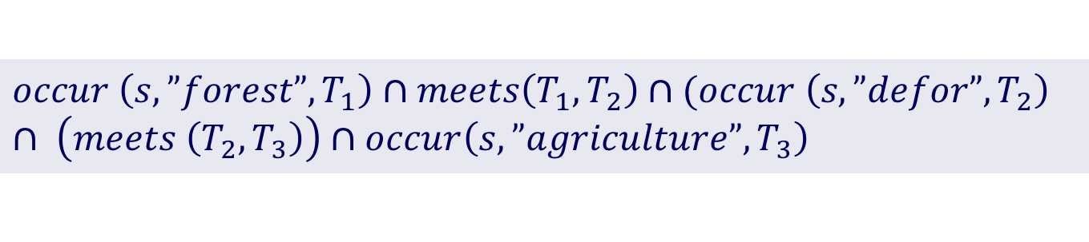
Land trajectories as event composition
Forest
Pasture
Agric
Área 1
Forest
Área 2
Forest
Agriculture
Área 3
Trajectory from forest to agriculture
$$occur \left(s,”forest”,T_{1}\right)∩meets\left(T_{1},T_{2}\right)∩(occur \left(s, ”defor”, T_{2}\right) ∩ \left(meets \left(T_{2},T_{3}\right)\right)∩occur\left(s, ”agriculture”, T_{3}\right)$$

Slide 44
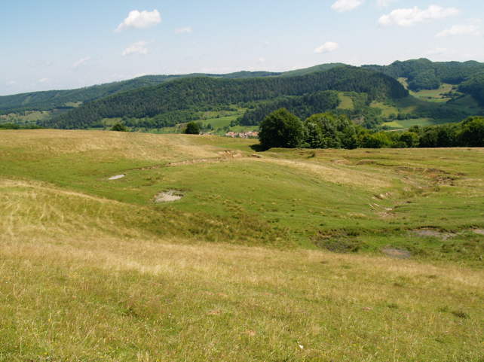
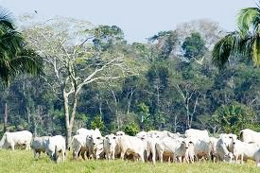
A view on land use and land cover
Space
Time
Continuants | Occurrents
Region | Cattle raising
water or lake?

Slide 45
Occurrent
Land Use
Sugarcane
Grain production
Cattle raising
Functioning
Functioning
Functioning
Biofuels and sugar
Cash crop
Food production

Slide 46
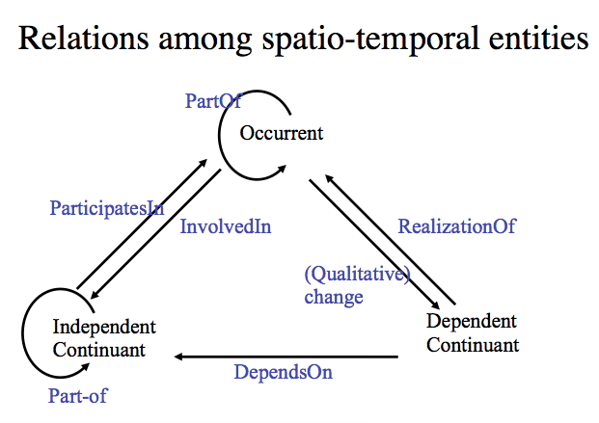
Land use?
Natural fire?
Climate change?
Land region
Land cover
source: Tom Bittner, Barry Smith (SUNY Buffalo)

Slide 47
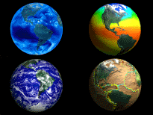
Conclusions
Managing change is a major challenge for the scientific community
Big data creates new challenges
Ontological thinking helps to understand big data
We need a mathematically and cognitively sound model of spatiotemporal events.

