Slide 1
Using big Earth observation data for better semantic description of land use change.
SAOA 2016, Buenos Aires
Gilberto Câmara, INPE
www.dpi.inpe.br/gilberto
www.geoinformatics.cc
Licence: Creative Commons ̶̶̶̶ By Attribution ̶̶̶̶ Non Commercial ̶̶̶̶ Share Alike
http://creativecommons.org/licenses/by-nc-sa/2.5/

Slide 2
What can Big Data learn from Ontology?
SAOA 2016, Buenos Aires
Gilberto Câmara, INPE
Licence: Creative Commons ̶̶̶̶ By Attribution ̶̶̶̶ Non Commercial ̶̶̶̶ Share Alike
http://creativecommons.org/licenses/by-nc-sa/2.5/

Slide 3
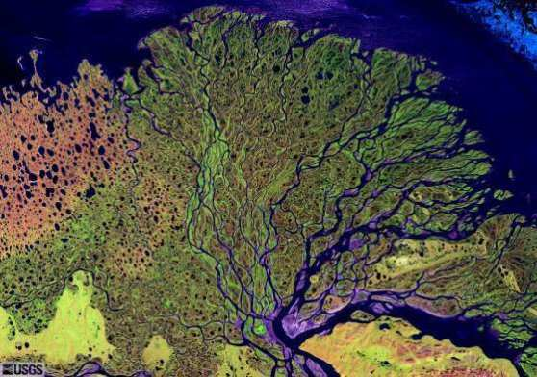
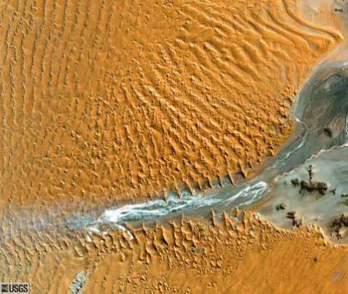
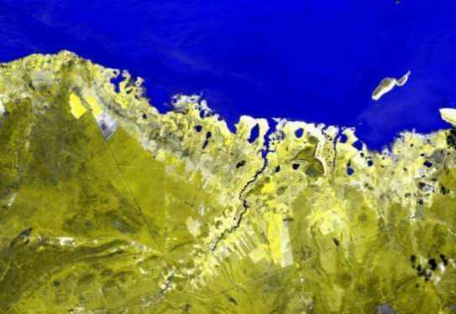
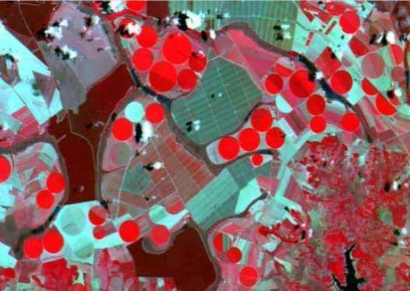
What are we looking for in big EO data?
“If you don't know where you are going,
you'll end up someplace else.” (Yogi Berra)

Slide 4
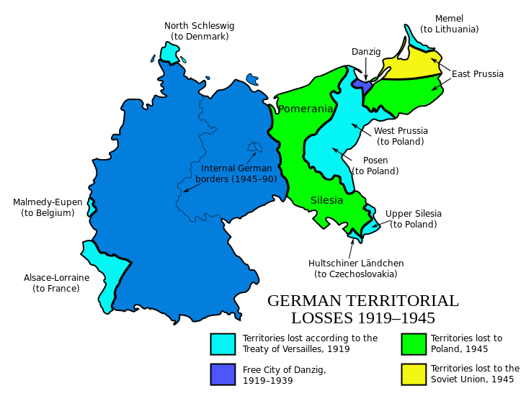
Social objects (a.k.a. fiat objects)

Slide 5
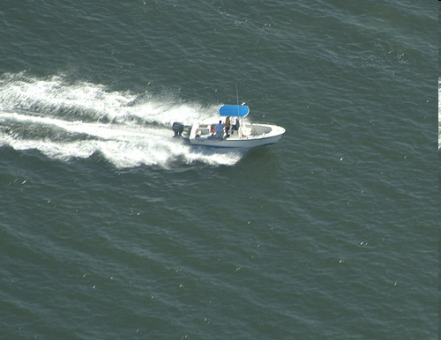
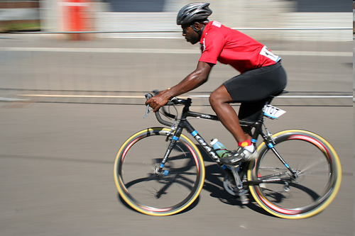

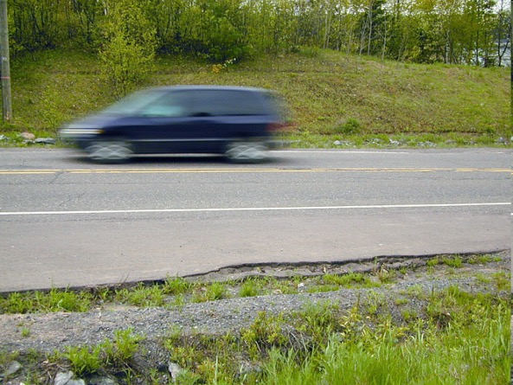
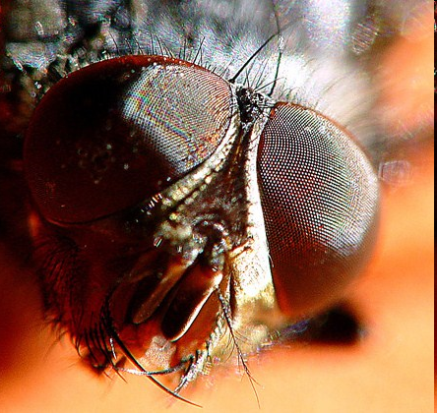

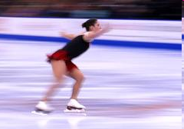
Moving objects (examples of bona fide objects)
Individual entities whose position and extent
are believed to exist

Slide 6
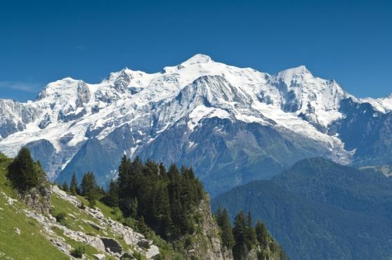
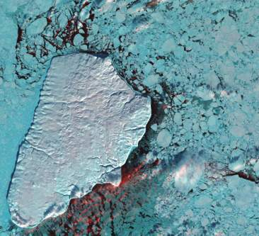
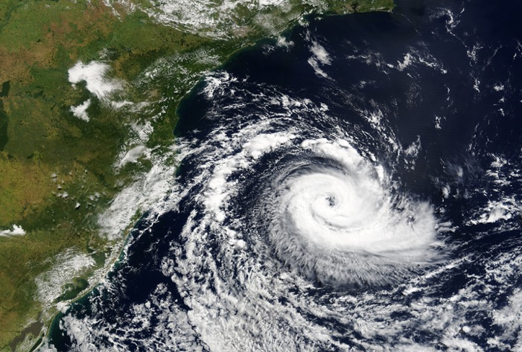
Natural objects?
Humans identify natural objects by convention
(salient features of continuous distributions)

Slide 7

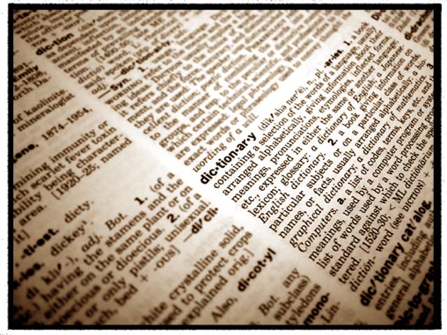
It all begins with observations…
What’s out there?
We use words in our language to describe the world

Slide 8
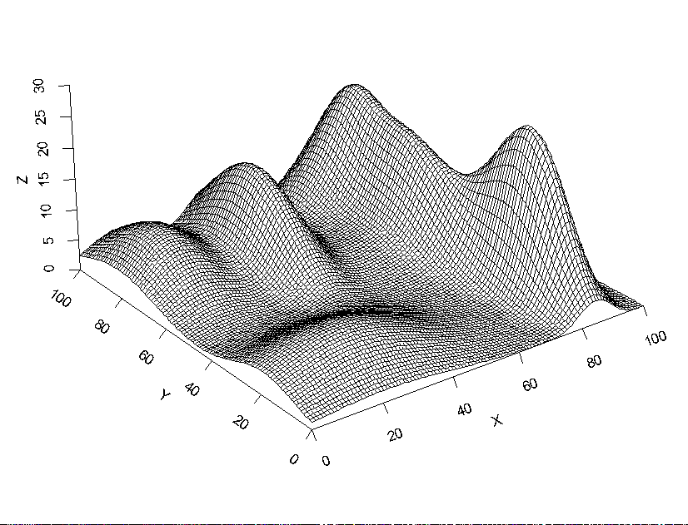
Natural world has continuous spatial variation
Temperature, Water ph, soil acidity...

Slide 9
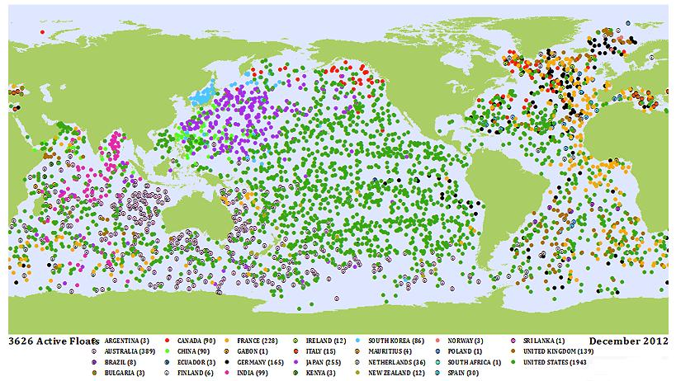
Geospatial ontology: observations as building blocks
measures of properties in space-time

Slide 10
From observations to continuous distributions (fields)

Slide 11
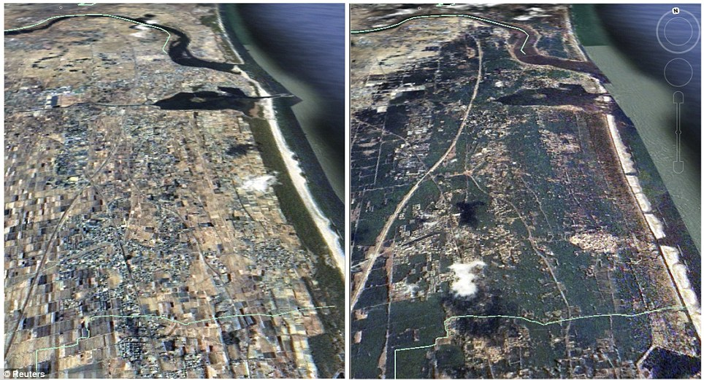
How can we describe change?
The 2011 Tohoku tsunami changed the coast of Japan

Slide 12
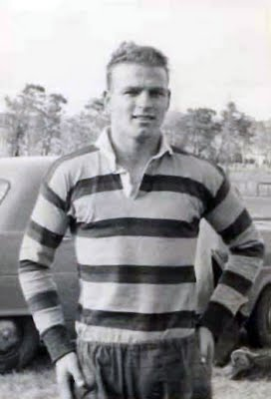
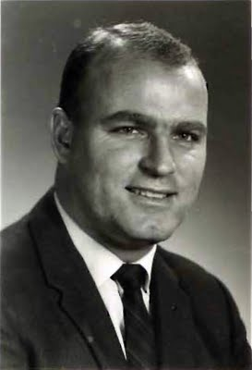
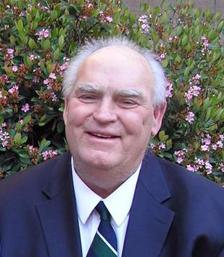
Temporal perception as event-ordering
The brain represents time by means of time: events are recorded as relevant personal experiences

Slide 13
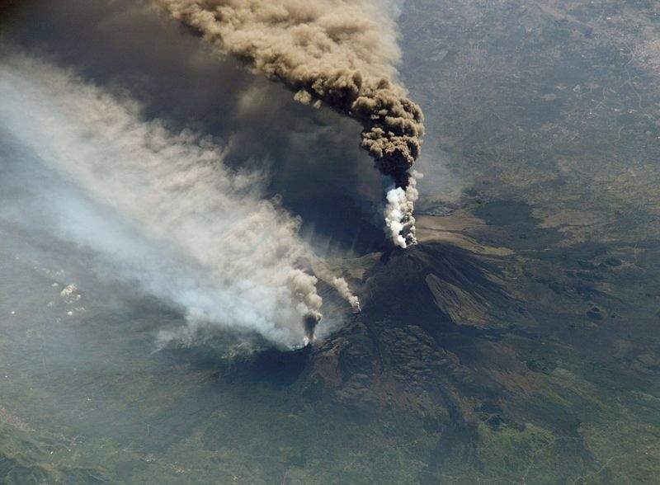
objects exist, events occur
Mount Etna is an object
Etna’s 2002 eruption was an event

Slide 14
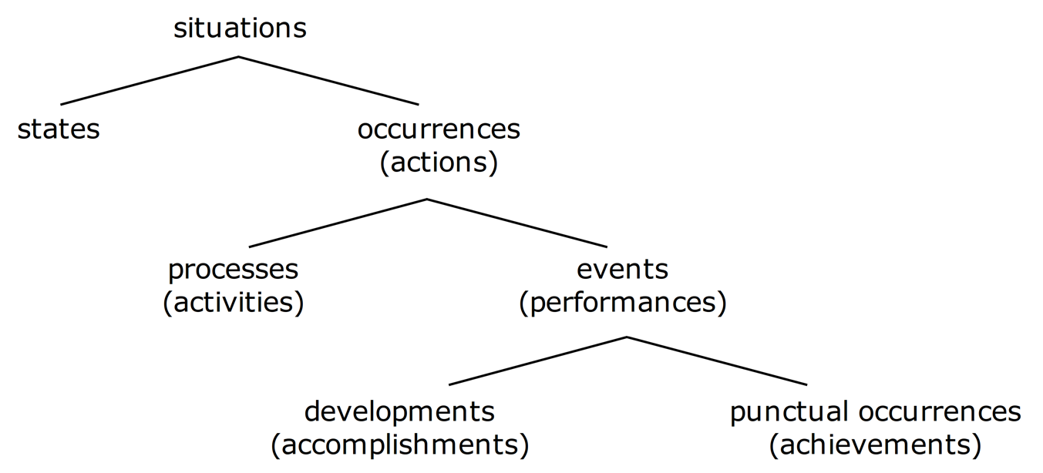
Events, processes and states (Mourelatos)
”I walked for 15 minutes” (accomplishment)
“I reached the Borges Centre” (achivement)

Slide 15
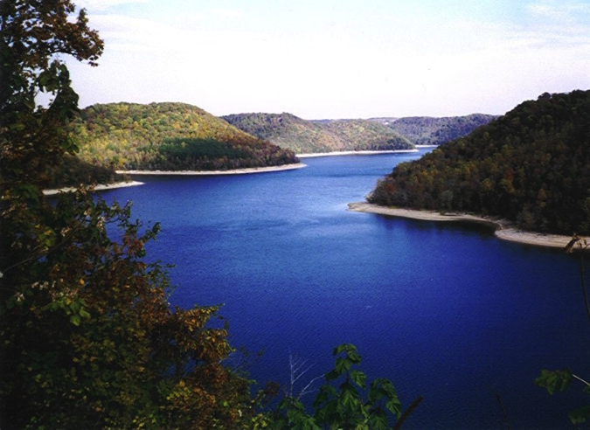
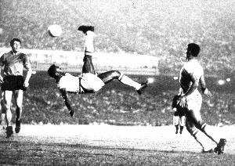
A view on processes and events
(Worboys & Galton)
Space
Time
Count
Objects | Events
Matter | Processes
Mass
football or game?
water or lake?

Slide 16
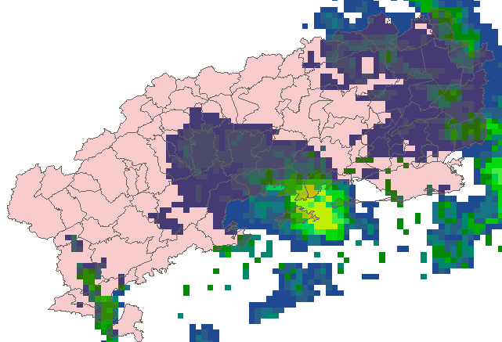
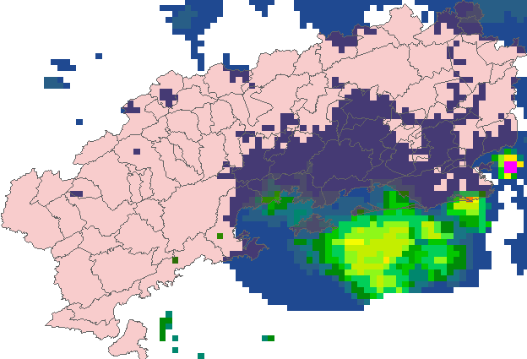
The event data type
An event is an individual episode with a beginning and end, which define its character as a whole.
An event does not exist by itself. Its occurrence is defined as a particular condition of one spatiotemporal type.
Notes:
INPE has a project called PROARCO responsible for monitoring fire spots in South America, In this application, each fire is presented by its location and the time instant when it was detected.
This picture is an example of the detected fires in a Brazilian state called Pará in august 2003.
The second demand is related to a project responsible for monitoring the Amazon deforestation called PRODES. In this application, each deforested area is represented by a polygon that limits the deforested region and the time when it was detected.

Slide 17
A view on geospatial ontology
Objects
External Reality
Observ.
Fields
Events

Slide 18
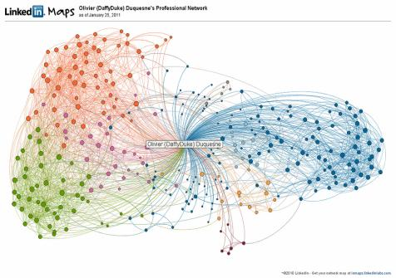
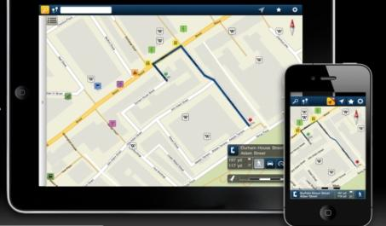
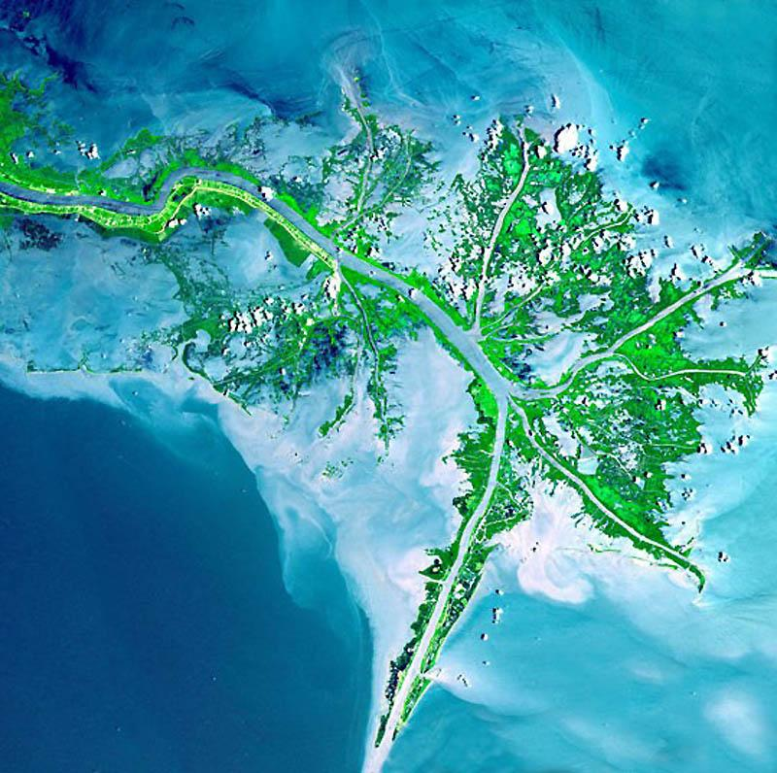
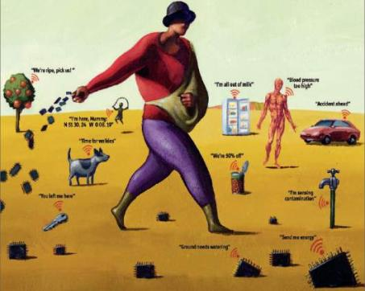
mobile devices
social networks
Mobile devices, crowdsourcing, massive Earth observation sets: new technologies, new challenges
sensors everywhere
ubiquitous imagery

Slide 19
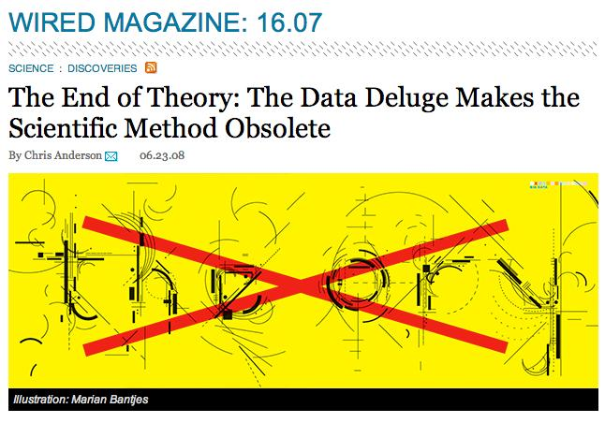
Is the scientific method obsolete?

Slide 20
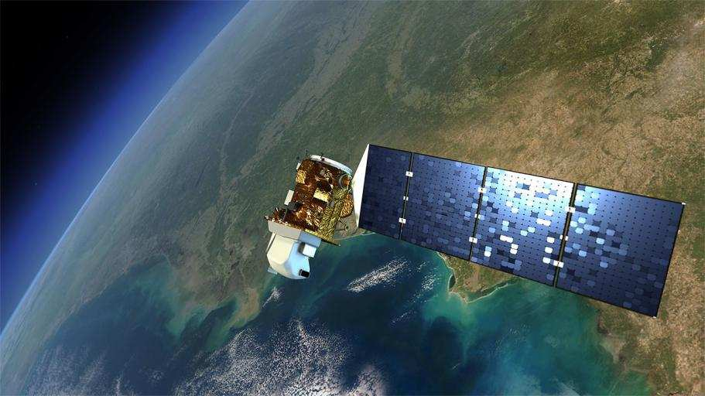
Earth Observation data is now free…and big
Image source: NASA
Sentinels: 3 Tb/day

Slide 21
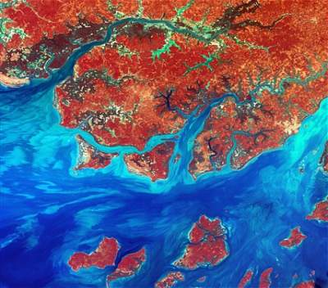
Data Access Hitting a Wall
How do you download a petabyte?
You don’t! Move the software to the archive

Slide 22
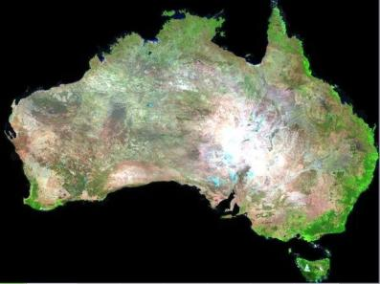


Big Earth Observation data
graphics: Geoscience Australia
Searching for changes instead of searching for objects

Slide 23

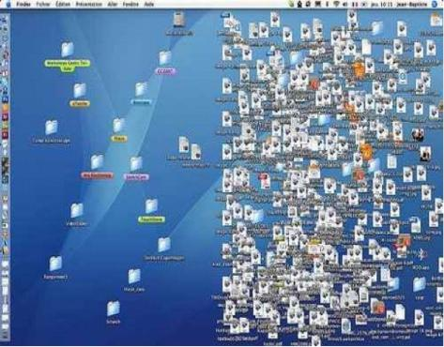
Big data = lots of files?
“…by the time a file system can deal with billions of files, it has become a database system” (Jim Gray)

Slide 24
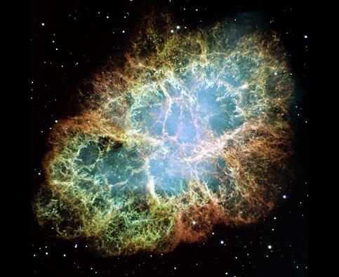
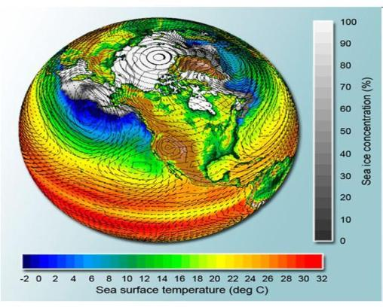
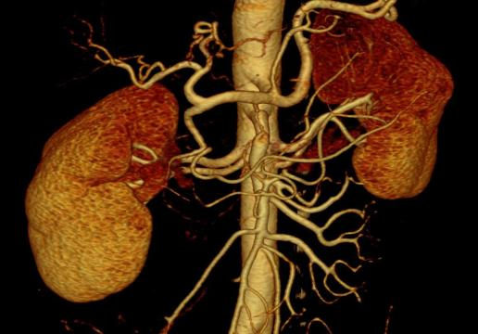
What do these data have in common?

Slide 25
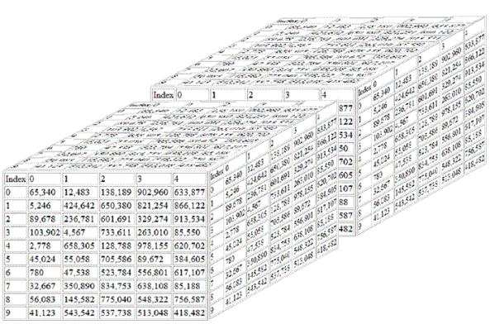
Scientific data: multidimensional arrays
y
t
X
g = f(<x,y,t> [a₁, ….a_{n}])

Slide 26
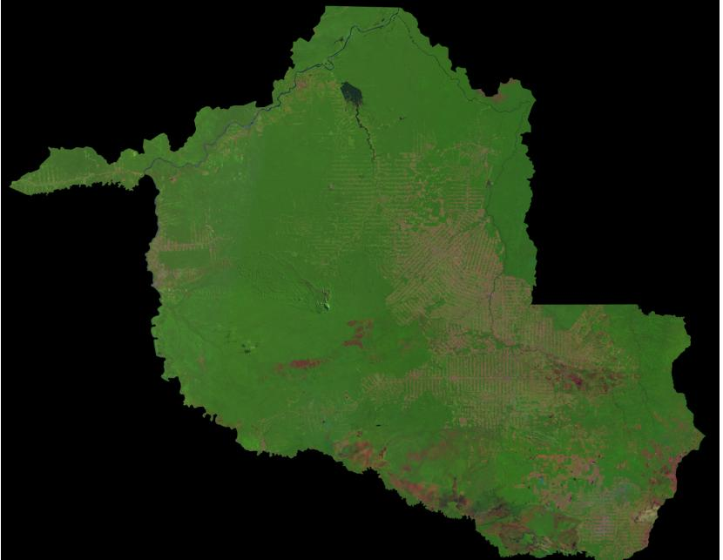
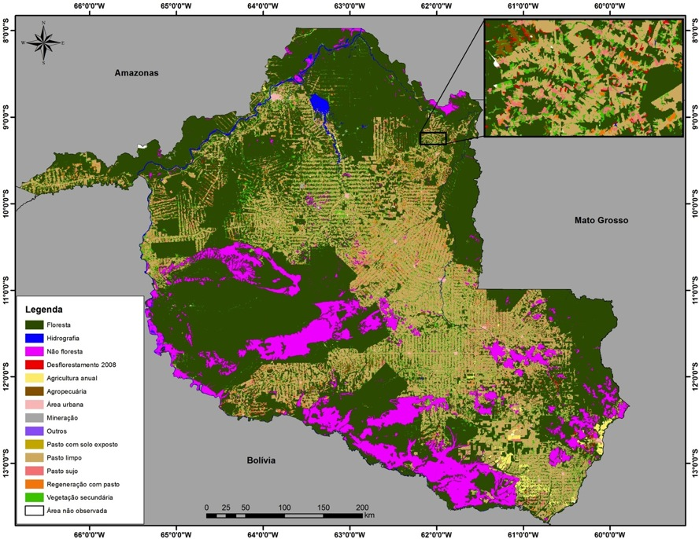
The quest for the perfect map
The world is divided in cells. Each cell has a single class.
There is a correct classification.
The more our classification approaches the ideal, the better.

Slide 27
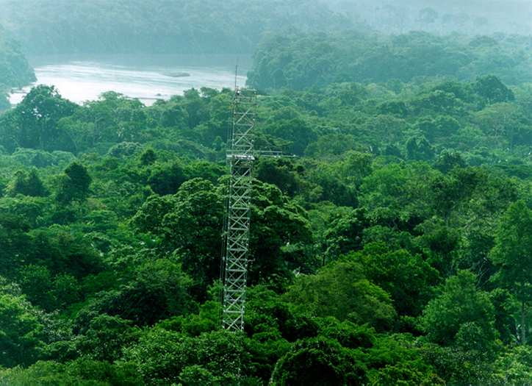
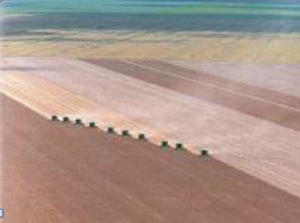
Land cover
  tropical forest
  wetlands
Land cover: “the observed biophysical cover on the Earth’s surface"
  Non-natural vegetation
  shrublands

Slide 28
Land cover
  non-managed forest
  pasture
Land use:“arrangements, activities and inputs people do in a certain land cover type to produce, change or maintain it”
  large-scale agriculture
  subsistence agriculture

Slide 29
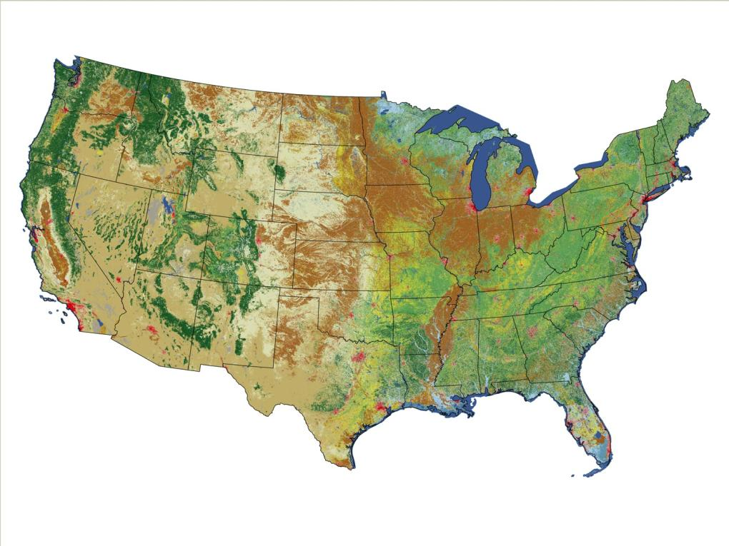
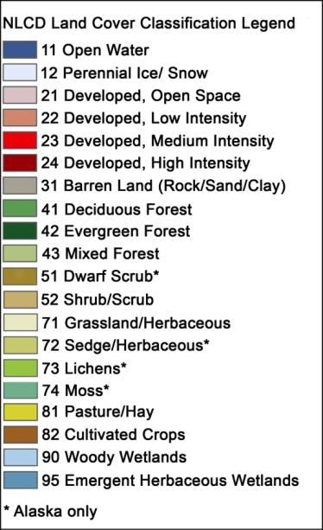
Classification systems are purpose-specific and mix land cover and land use classes
US National Land Cover 2006
source: USGS

Slide 30
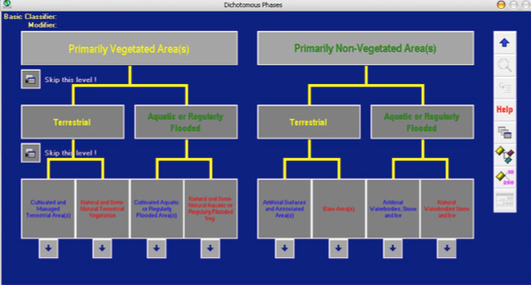
FAO’s Land Cover Classification System (LCCS)
LCCS: unambiguous definitions of each cover class
Application-specific: LCCS is a meta-ontology

Slide 31
FAO’s Land Cover Classification System (LCCS)
Land use in refugee camps in South Sudan (Hagenlocher et al., 2012)

Slide 32
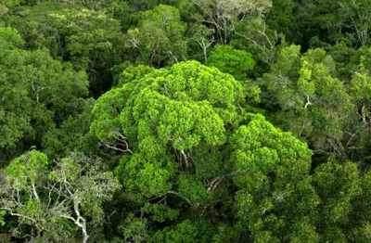
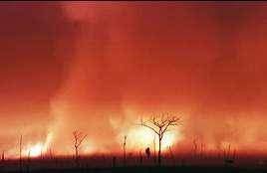
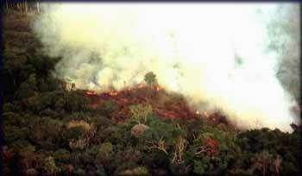
A scientific question linked to public policy
When is a forest a forest?

Slide 33
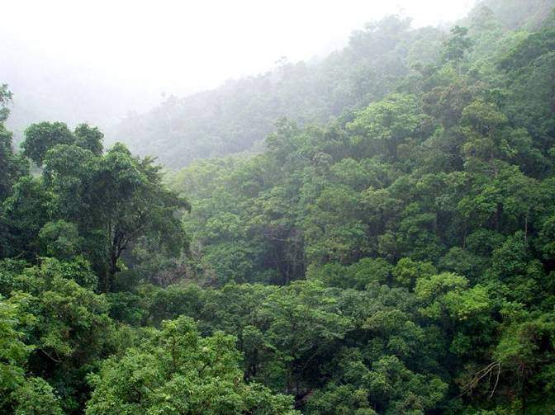
Tropical rainforest

Slide 34

Taiga (boreal forest)

Slide 35
Tropical dry forest (caatinga)

Slide 36
Planted forest of oil palms

Slide 37

Forest (FAO definition)
Land spanning more than 0.5 hectares with trees higher than 5 meters and a canopy cover of more than 10 percent, or trees able to reach these thresholds in situ.

Slide 38
Multiple definitions of forest
Comber (2006), Ahlqvist(2015)

Slide 39
When is a forest a forest?
Chadzon et al (2016)

Slide 40
Distinguishing forests by temporal evolution
Chadzon et al (2016)

Slide 41
Distinguishing forests by temporal evolution
Chadzon et al (2016)

Slide 42


Classification: continuants x occurents
Space first: classify
images separately
(object-centered view)
Time first: classify
time series
(event-centered view)

Slide 43

A continuant-based approach to big data
Hansen et al. (2013)
Find forest areas in images from 2000 and from 2010
Compare the results to account for forest loss
(650,000 LANDSAT images – 140 x 10⁹ pixels)

Slide 44

When the continuant view fails
Removal of natural forest
Cuts on planted forests

Slide 45

Land trajectories: an occurent perspective
Forest
Pasture
Agric
Área 1
Forest
Área 2
Forest
Agriculture
Área 3
“The transformations of land cover due to actions of land use”
graphics: Victor Maus (INPE, IFGI)

Slide 46




Land trajectories in forests
Exploração intensiva
Event 1
80%
Perda >50% do dossel
Event 2
50%
Perda >90% do dossel
Event 3
10%
Corte raso
Event 4
0%
Floresta
Floresta
Events of forest cover loss

Slide 47



Land trajectories: deforestation events
images: INPE
2010
2011

Slide 48



Land trajectories: forest degradation
EVI Time Series
2007
2009
2007
2009

Slide 49

Land trajectories: forest degradation
EVI Time Series
2007
2009
PRODES
2007
2008

Slide 50
Land trajectories: deforestation events
images: INPE
2010
2011

Slide 51

Double-cropping: soybeans + corn
Two samples per month (?)
graphics: LAF/INPE
source: INPE

Slide 52

Single-crop grain production: soybeans
One sample per month (?)
graphics: LAF/INPE
source: INPE

Slide 53

Time series mining: pattern matching
Finding subsequences in a time series
High computational complexity
Patterns are idealized, data is noisy
Esling & Agon (2012)

Slide 54
Finding events in remote sensing time series
Prototypical event signatures are matched against a long time series of remote sensing data

Slide 55
Time-weighted dynamic time warping (TWDTW) for remote sensing time series
TWDTW finds alignments of short templates in a long time series
considering the agricultural calendar

Slide 56
Land use patterns derive from phenological cycles
Temporal patterns of EVI modis 16 days
Arvor et al. (2011)

Slide 57
Mato Grosso – Amazonia biome (2001)
33 Million time series = 3 x 10⁹ pixels

Slide 58
Mato Grosso – Amazonia biome (2005)

Slide 59
Mato Grosso – Amazonia biome (2009)

Slide 60
Mato Grosso – Amazonia biome (2013)

Slide 61
Interval temporal logic (Allen)

Slide 62


Spacetime event logic (discrete partitions)
$$S = \{s1, s2,…, sn\}$$
Discrete space partitions
$T=\{t_{1}$, $t_{1}$, …, $t_{n}\}$
Discrete time intervals

Slide 63



Spacetime event logic (discrete partitions)
$$S = \{s1, s2,…, sn\}$$
Discrete space partitions
$T=\{t_{1}$, $t_{1}$, …, $t_{n}\}$
Discrete time intervals
P = {p₁, p₂,…, p_{n}}
Discrete properties
Allen’s interval logic

Slide 64

Spacetime event logic (discrete partitions)
$$S = \{s1, s2,…, sn\}$$
Discrete space partitions
$T=\{t_{1}$, $t_{1}$, …, $t_{n}\}$
Discrete time intervals
  $$holds \left(s, p,t\right)→Bool$$
  occurs $\left(s, p,t\right)→Bool$
P = {p₁, p₂,…, p_{n}}
Discrete properties
Allen’s interval logic

Slide 65


Spacetime event logic
What happens in a spatial partition in a minimal interval?
  $∀ s∈S,p∈P,$ $t∈T, holds \left(s, p,t\right)→Bool$
When does an event happen?
  $Given s∈S, p∈P,$ $T_{e}⊆T, { T}_{e}$ $=\{t_{i},t_{i+1},$…, $t_{i+m}\}$
  $$occurs \left(s, p,T_{e}\right) ≡ ∀t_{i}∈T_{e}, holds \left(s, p,t_{i}\right)$$
$$∩ ¬holds \left(s, p,t_{i−1}\right)∩¬holds \left(s, p,t_{i+m+1}\right)$$

Slide 66

Markets chain arrangements: are they working?
Forest
Defor
Soy
NO
Forest
Defor
Pasture
Soy

Slide 67
Contribution to public debate
Gibbs et al (Science, 2015)

Slide 68


Deduction using spacetime temporal logic
Which forest areas have been replaced by soybeans?
$$∀s∈S, occur \left(s, ”defor”, t_{1}\right)∩ \left(meets \left(t_{1},t_{2}\right)\right)∩occur\left(s, ”soy”, t_{2}\right)$$
Which forest areas have been replaced by pasture and then turned into soybeans?
$∀s∈S, occur \left(s, ”defor”, t_{1}\right)∩ \left(meets \left(t_{1},t_{2}\right)\right)∩occur\left(s, ”pasture”, t_{2}\right)$ $∩ \left(before\left(t_{2},t_{3}\right)\right)∩occur\left(s, ”soy”, t_{3}\right)$

Slide 69
Using events to understand land transitions

Slide 70

Land trajectories as event composition
Forest
Pasture
Agric
Área 1
Forest
Área 2
Forest
Agriculture
Área 3
Trajectory from forest to agriculture
$$occur \left(s,”forest”,T_{1}\right)∩meets\left(T_{1},T_{2}\right)∩(occur \left(s, ”defor”, T_{2}\right) ∩ \left(meets \left(T_{2},T_{3}\right)\right)∩occur\left(s, ”agriculture”, T_{3}\right)$$

Slide 71


A view on land use and land cover
Space
Time
Continuants | Occurrents
Region | Cattle raising
water or lake?

Slide 72
Occurrent
Land Use
Sugarcane
Grain production
Cattle raising
Functioning
Functioning
Functioning
Biofuels and sugar
Cash crop
Food production

Slide 73

Land use?
Natural fire?
Climate change?
Land region
Land cover
source: Tom Bittner, Barry Smith (SUNY Buffalo)

Slide 74

Conclusions
Managing change is a major challenge for the scientific community
Big data creates new challenges
Ontological thinking helps to understand big data
We need a mathematically and cognitively sound model of spatiotemporal events.

