Slide 1
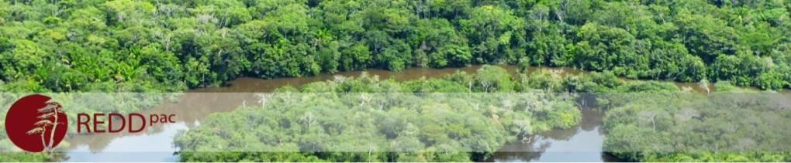

Assessing future impacts of land use policies in Brazil

Slide 2






REDD-PAC project team: Brazil study
Alexandre Ywata (IPEA)
Aline Soterroni (INPE)
Fernando Ramos (INPE)
Gilberto Câmara (INPE)
Pedro Andrade (INPE)
Ricardo Cartaxo (INPE)
Aline Mosnier (IIASA)
Petr Havlik (IIASA)
Florian Kraxner (IIASA)
Johannes Pirker (IIASA)
Michael Obersteiner (IIASA)
Geraldine Boqueho (IIASA)
Rebecca Mant (WCMC)
Valerie Kapos (WCMC)

Slide 3
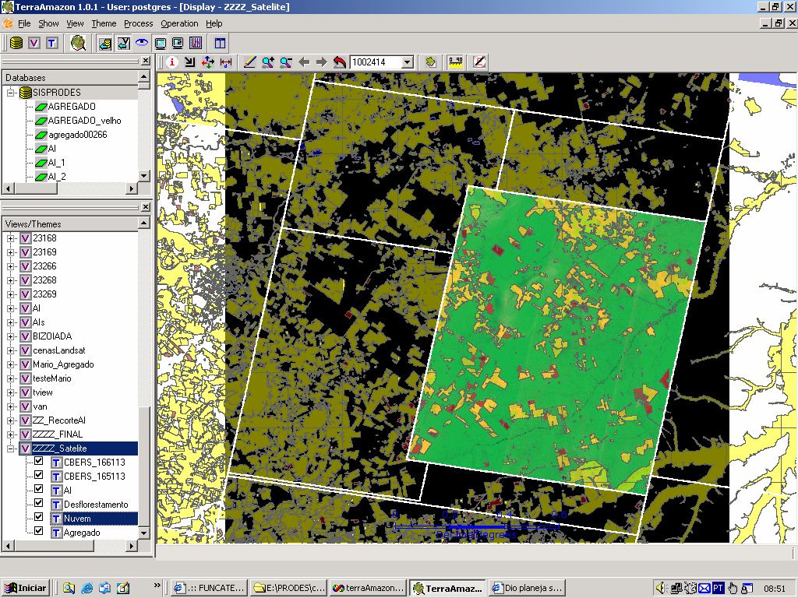
Transparency builds credibility and governance!
“Brazil’s monitoring system is the envy of the world..” (Science, 2007)

Slide 4
COP-15: Brazil pledges to reduce deforestation in Amazonia by 80%
What happens after 2020? What about the rest of Brazil?

Slide 5
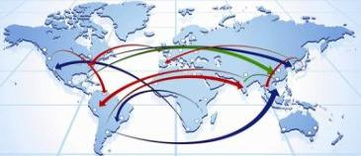




GLOBIOM: Global Biosphere Management Model
Partial equilibrium model: Agriculture, Forestry and Bioenergy sectors
Population - Economic Growth - Trade
Commodity
Prices and Quantities
DEMAND
MARKETS
Wood
Crops
Livestock
SUPPLY
Land Use
Forest Cropland Pasture Other
IIASA

Slide 6
GLOBIOM-Brazil validation and projections
Base
Year
Validation
Projections
2000 | 2010 | 2020 | 2030 | 2040 | 2050
Mature Forests
Cropland
Managed Forests
Pasture
LAND USE
Planted
Forest
Natural
land
Forest Regrowth

Slide 7
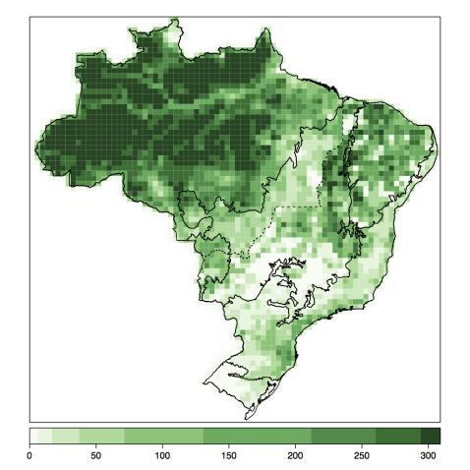
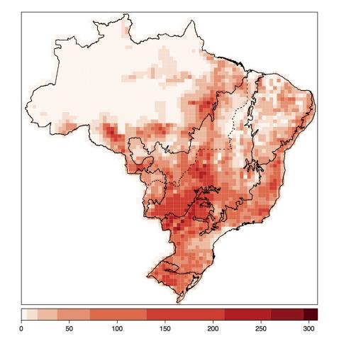
Base maps for GLOBIOM-Brazil
Forest 2000
Livestock 2000

Slide 8
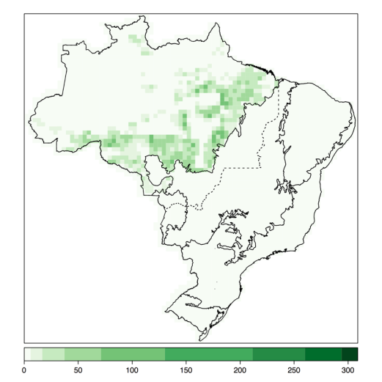
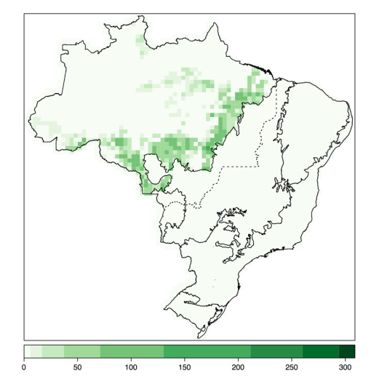
Validation: Accumulated Deforestation 2001-2010
PRODES/INPE (16.5 Mha)
GLOBIOM-Brazil (16.9 Mha)

Slide 9
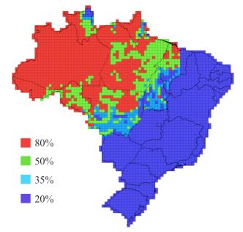
Brazil’s Forest Code: what is the effect of the rule of law?
Private farms have to preserve natural vegetation (20% - 80%)

Slide 10
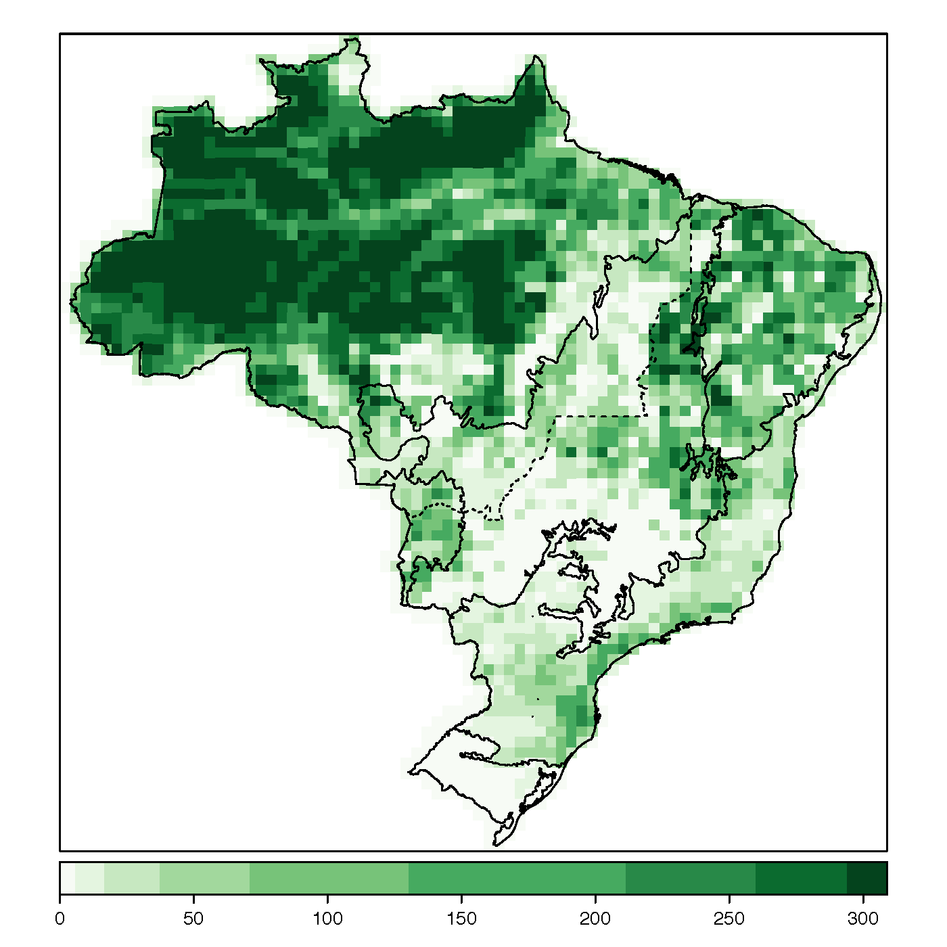
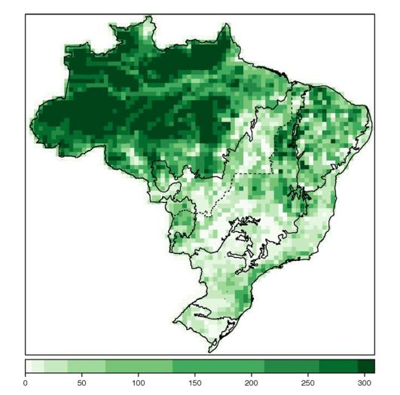
Projections: Forests 2030
Business as usual (400 Mha)
Forest Code (430 Mha)

Slide 11
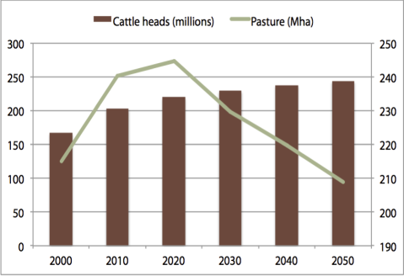
Crop production grows, grassland decreases
Croplands (Mha)
Cattle and pasture (heads and Mha)

Slide 12
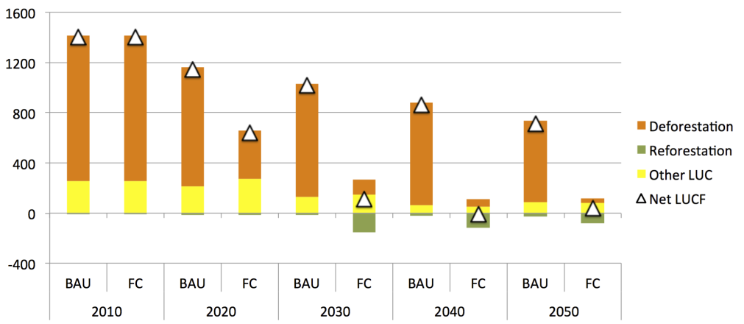
Brazil’s new Forest Code: zero net emissions from deforestation after 2030

Slide 13
Foundations of modern democracies
State (power by technical staff)
Science
Institutions
Rule of law
(limits power)
Society
(public accountability)
source: Fukuyama (2011)

Slide 14
Additional slides for debate

Slide 15
Possible trajectories of Brazilian GHG emissions?
?
Notes:
15

Slide 16
Brazil’s emissions profile is fast changing!

Slide 17
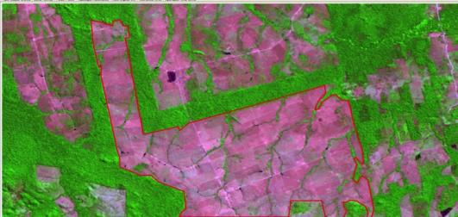
The importance of Brazil’s Forest Code
Monitoring + control +
land tenure +
transparency + verification +
market chain + incentives =

Slide 18
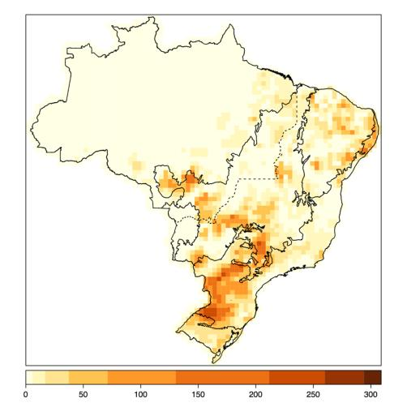
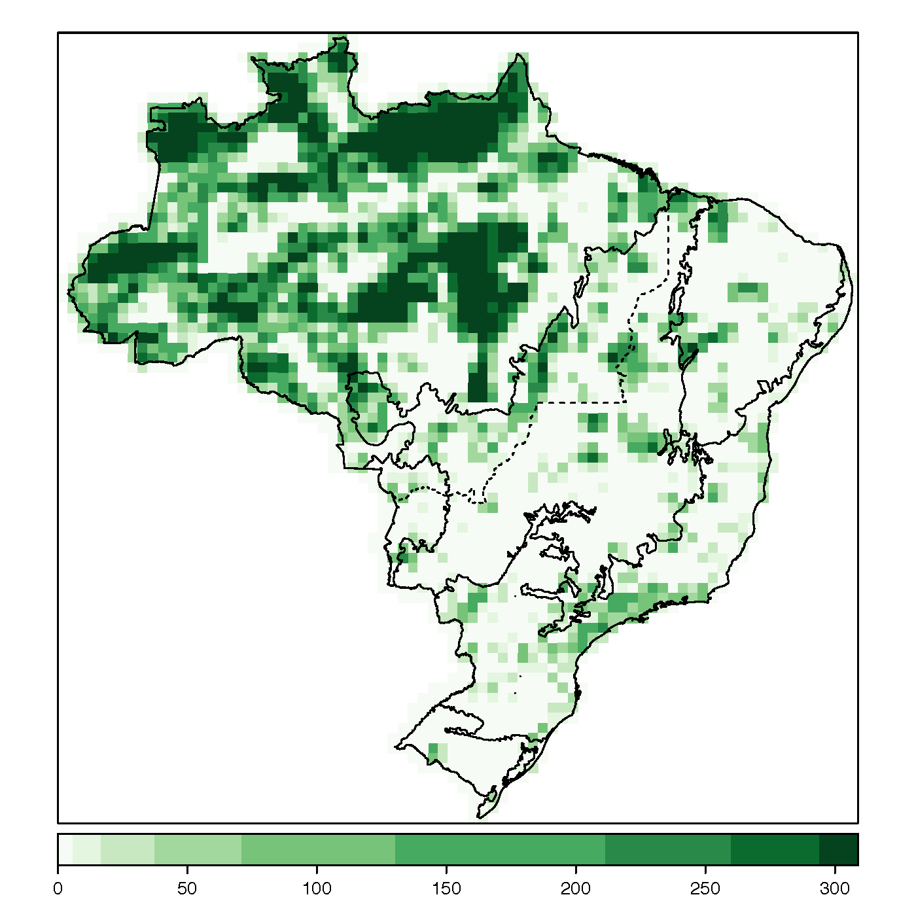
Base maps for GLOBIOM-Brazil
Croplands 2000
Protected areas 2000

Slide 19
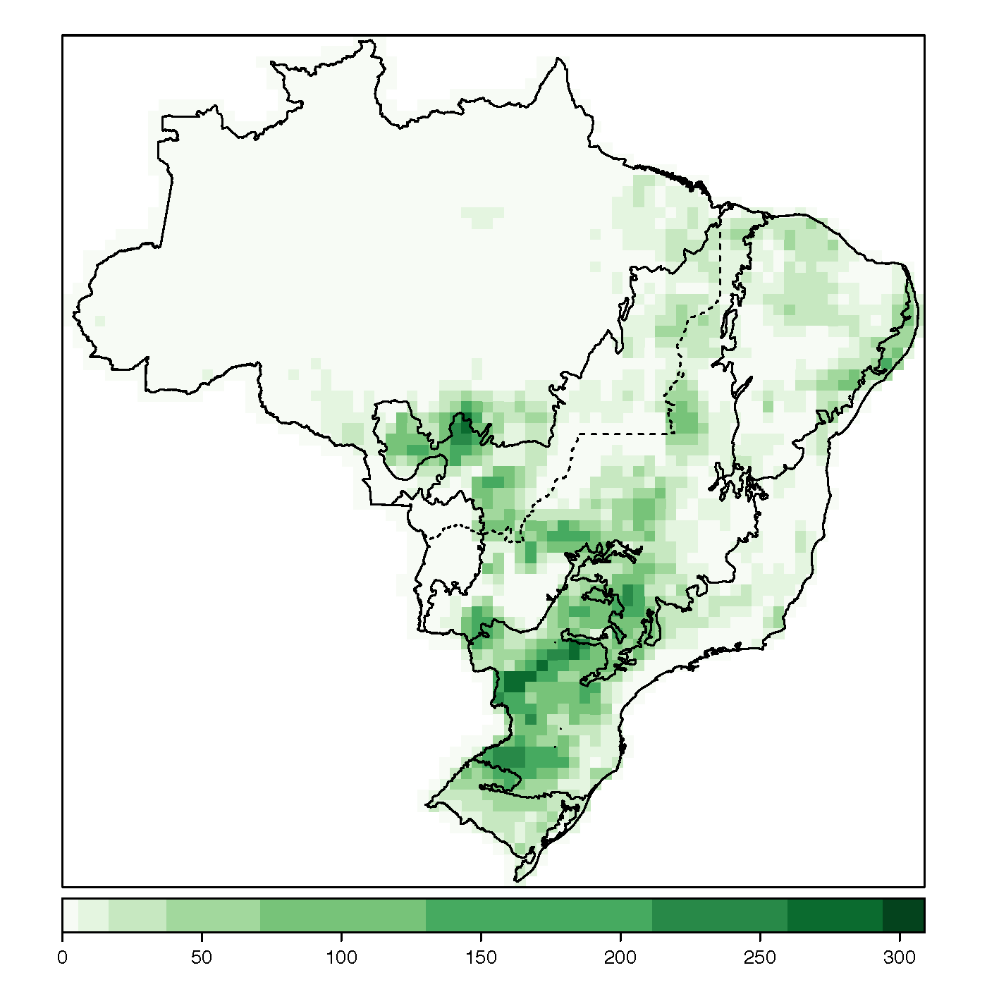

Validation: Croplands 2010
Census Bureau (57 Mha)
GLOBIOM-Brazil (61 Mha)

Slide 20
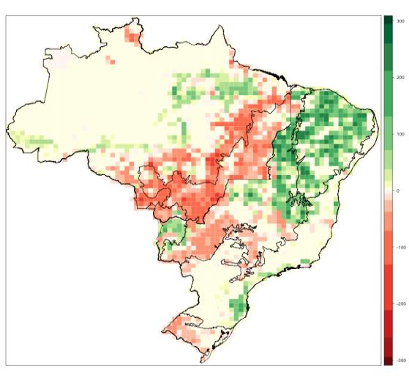
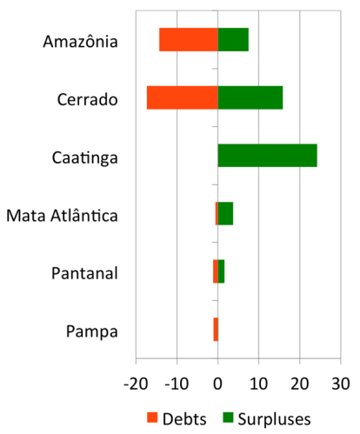
Environmental Debts and Surpluses (2010)
Debts
Surpluses

Slide 21
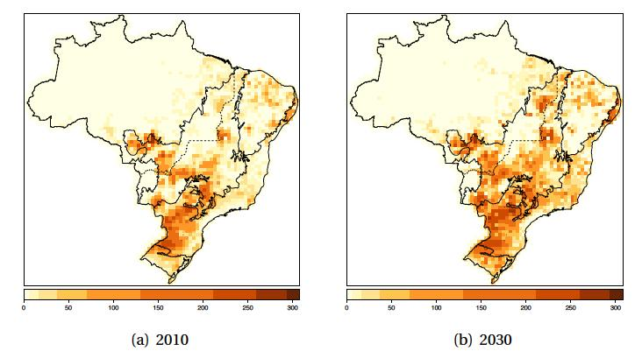
Cropland expansion: 2010 - 2030

Slide 22
Amazonia: the land of the cattle?
Pasture in Amazonia (Mha)
Cattle in Amazonia (Mtlus)

Slide 23
The importance of Brazil’s Forest Code
A high quality rural environmental cadaster
A monitoring system for the whole country
Avoiding illicit break-up of large farms.
Avoid leakages and enhance forest conservation.
Strong action to avoid illegal deforestation in Amazonis
Right incentives for efficient production must be in place

Slide 24
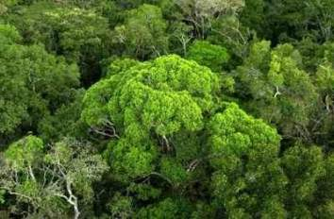
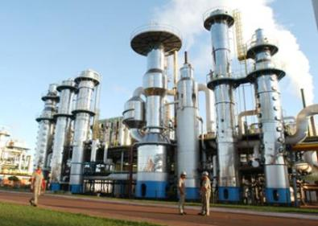
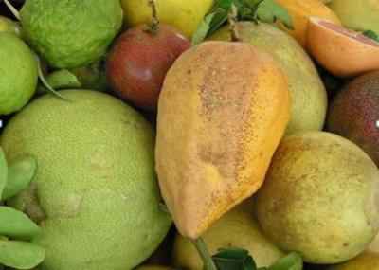
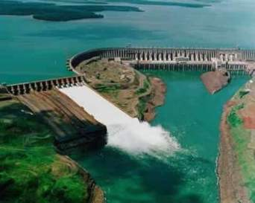
Brazil: a natural knowledge economy
Deforestation cut by 80% (2005-15)
Best technology in biofuels
World leader in tropical agriculture
46% of energy is renewable

