Slide 1






Projections of land change and GHG emissions from LULUCF in Brazil
Alexandre Ywata (IPEA)
Aline Soterroni (INPE)
Fernando Ramos (INPE)
Gilberto Câmara (INPE)
Pedro Andrade (INPE)
Ricardo Cartaxo (INPE)
Aline Mosnier (IIASA)
Florian Kraxner (IIASA)
Johannes Pirker (IIASA)
Michael Obersteiner (IIASA)
Rebecca Mant (WCMC)
Valerie Kapos (WCMC)

Slide 2



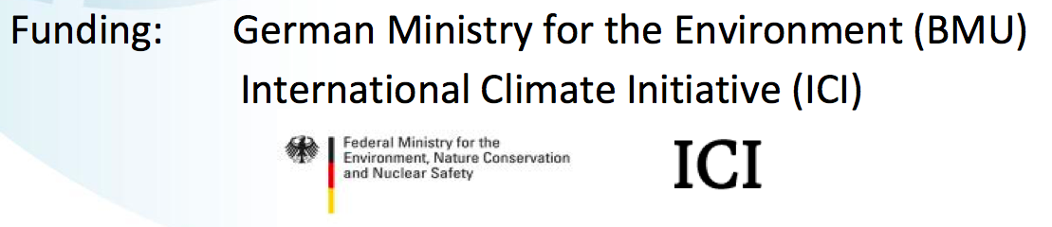
REDD+ Policy Assessment Center
www.red-pac.org.br
Partner
Institutions:
Duration: November 2011 – March 2016

Slide 3
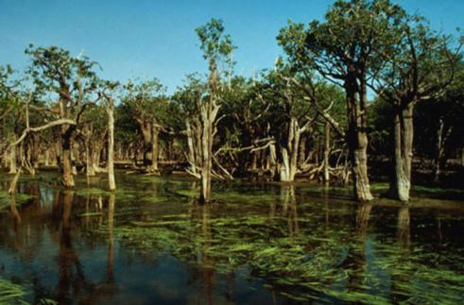
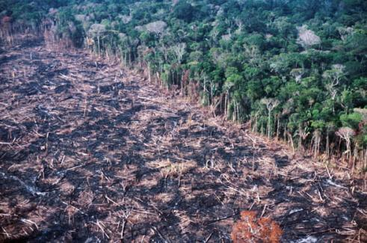
Land use change emissions in Brazil
LUC emissions decreased: 1.6 Mt CO₂eq (2005) to 500 MtCO₂eq (2020)
Can Brazil achieve further gains in LUC emissions for 2030?

Slide 4
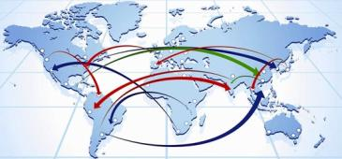




GLOBIOM: Global Biosphere Management Model
Partial equilibrium model: Agriculture, Forestry and Bioenergy sectors
Population & Economic Growth & Exogenous Demand Shocks
Commodity
Prices and Quantities
DEMAND
REGION
MARKETS
Wood
Crops
Livestock
Land Use
SUPPLY
SPATIAL RESOLUTION
Forest Cropland Pasture Other
Environmental effects
LAND
source: IIASA

Slide 5
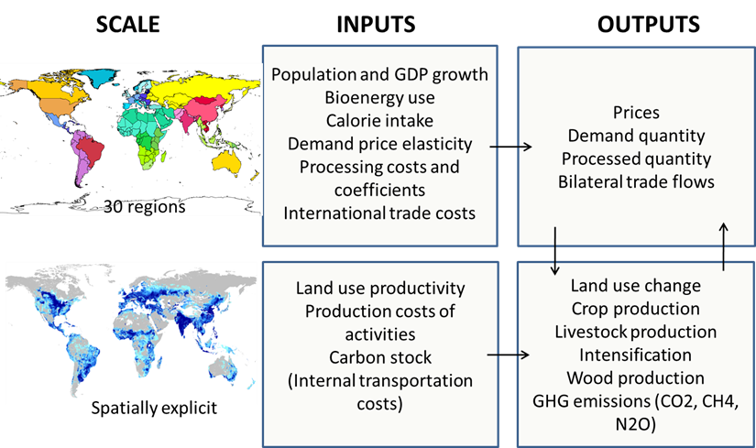
GLOBIOM: inputs and outputs
source: IIASA
Notes:
The model directly represents production from four major land cover types : cropland, managed forests, short rotation tree plantations and grassland
2 land ‘reserves’ = natural forests and natural land
Account for associated GHG emissions from land use change
Main outputs
land use (cropland, natural and managed forests, short rotation tree plantations, grassland and other natural land),
spatially explicit agricultural production (19 crops, 6 livestock products),
spatially explicit forest production,
food consumption and food prices,
bilateral trade flows
Biofuels
Feedstock: rapeseed, soybean, palm oil for biodiesel, sugarcane, wheat, corn for ethanol
Process data: from the literature (Haas et al., 2006; Hermann and Patel, 2007)
Use of biofuel by-products for animal feeding(Gallagher review)
For crops = expressed in primary equivalents => no explicit procesing for food products

Slide 6

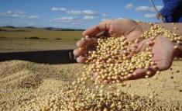
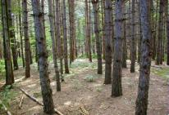

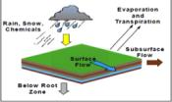
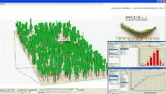
GLOBIOM components
Demand
Exogenous drivers
Population, economic growth
Wood products
Food
Bioenergy
PROCESS
OPTIMIZATION
53 regions
Supply
Raw wood
Crops
Partial equilibrium model
EPIC
G4M
RUMINANT
Biophysical models
source: IIASA
Notes:
Gathering available information in a consistent framework
Helps identifying information gap
Better understanding of the economic mechanisms
Analysis of local issues in a global context
Analysis of cross-sector interactions
Forward looking approach highlights the need for a long term strategy

Slide 7
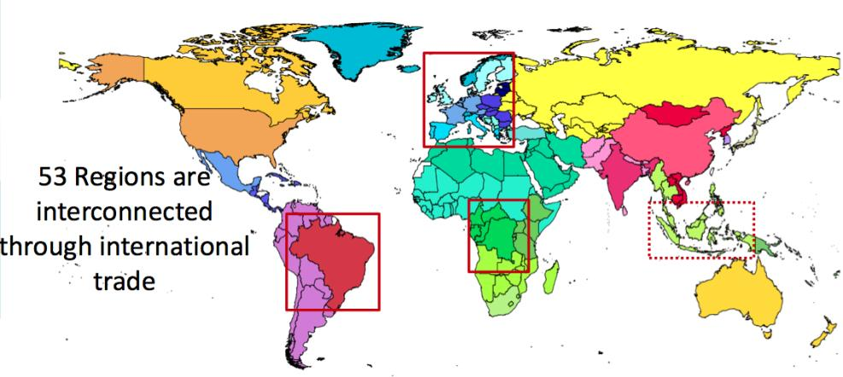
GLOBIOM – A global model with the possibility to zoom in one region
source: IIASA
30
Regional zooming allows detailed spatial representation of land (50x50km) and introduction of regional policies

Slide 8
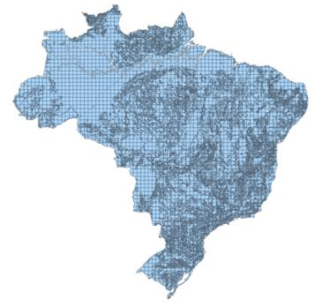
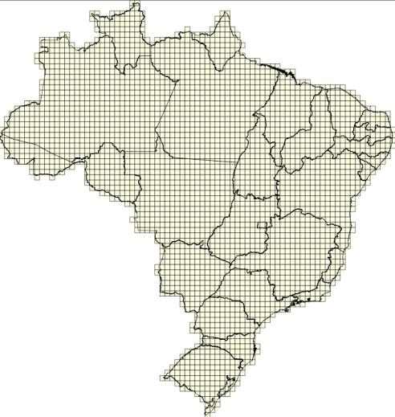

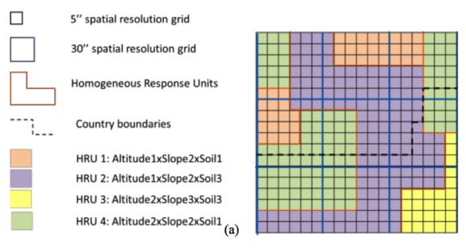
Spatial resolution in GLOBIOM
11,003 Simulation Units (SimUs)
HRUs (hom. response units)
3,001 Spatial units (ColRow)
50x50km
source: IIASA

Slide 9



Spatially explicit input data in GLOBIOM
CROPS
LIVESTOCK
FORESTRY
BIOENERGY
Wheat
Rice
Maize
Soybean
Barley
Sorghum
Millet
Cotton
Dry beans
Rapeseed
Groundnut
Sugarcane
Potatoes
Cassava
Sunflower
Chickpeas
Palm oil
Sweet potatoes
Cattle
Sheep Goat
Pig
Poultry
Beef
Lamb and Pork
Poultry and Eggs
Milk
Biomass for logs
Fuel wood
Other wood
Pulp wood
Logs
Ethanol
FAME
Methanol
Heat
Electricity
Biogas
source: IIASA

Slide 10
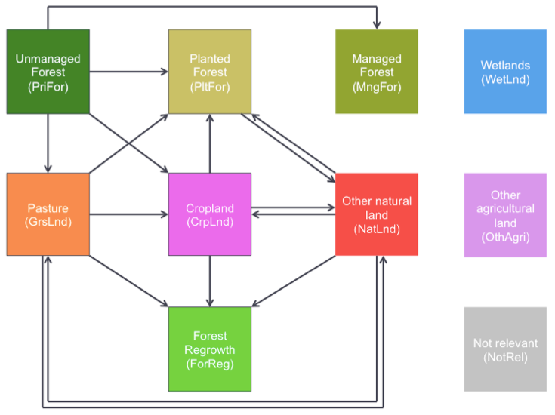
Land use transitions in GLOBIOM-Brazil

Slide 11











Land use and supply chain
LAND USE CHANGE
Natural
Forests
Wood
Managed
Forests
Saw and pulp mills
Bioenergy
Planted
Forests
Biorefinery
Cropland
Crops
Crop processing
Grassland
Livestock
Meat
Other Natural
Land
Forest
Regrowth
Notes:
The model directly represents production from four major land cover types : cropland, managed forests, short rotation tree plantations and grassland
2 land ‘reserves’ = natural forests and natural land
Account for associated GHG emissions from land use change
Main outputs
land use (cropland, natural and managed forests, short rotation tree plantations, grassland and other natural land),
spatially explicit agricultural production (19 crops, 6 livestock products),
spatially explicit forest production,
food consumption and food prices,
bilateral trade flows
Biofuels
Feedstock: rapeseed, soybean, palm oil for biodiesel, sugarcane, wheat, corn for ethanol
Process data: from the literature (Haas et al., 2006; Hermann and Patel, 2007)
Use of biofuel by-products for animal feeding(Gallagher review)
For crops = expressed in primary equivalents => no explicit procesing for food products

Slide 12
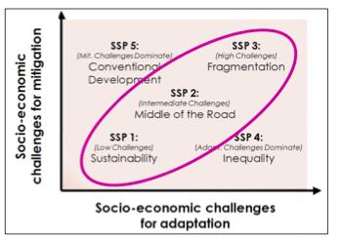
GLOBIOM projections use SSP scenarios
SSP3 - fragmented world. Unmitigated emissions are high, low adaptive capacity and large number of people vulnerable to climate change.
SSP1 - strong development goals, reduced fossil fuel dependency and rapid technological changes
SSP2 current trends with some effort to reach development goals and reduction in resource and energy intensity.
source: IPCC AR5 (2012)

Slide 13
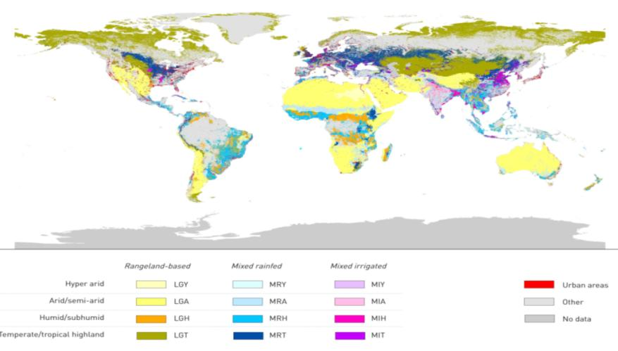
Data for GLOBIOM: Global Livestock
14 livestock production systems
(Buffalo, Cattle, Sheep, Goat, Pig, Poultry)
source: FAO/ILRI (2012)

Slide 14
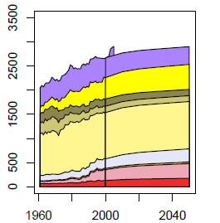
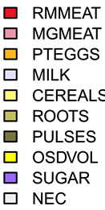
Projections for Brazil: Food Consumption
Food consumption per capita (kcal/day)
source: Alexandratos and Bruinsma (FAO) 2012

Slide 15
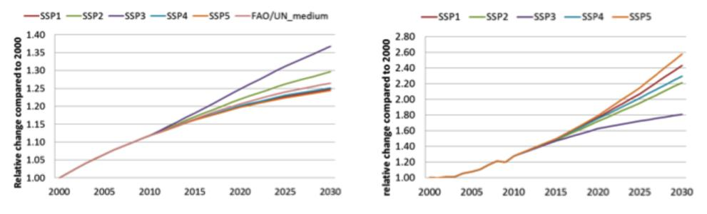
Brazil: Population and GDP Projections
Population growth
Brazil less than world average
GDP per capita
Brazil more than world average
source: IPCC AR5 (2012)

Slide 16
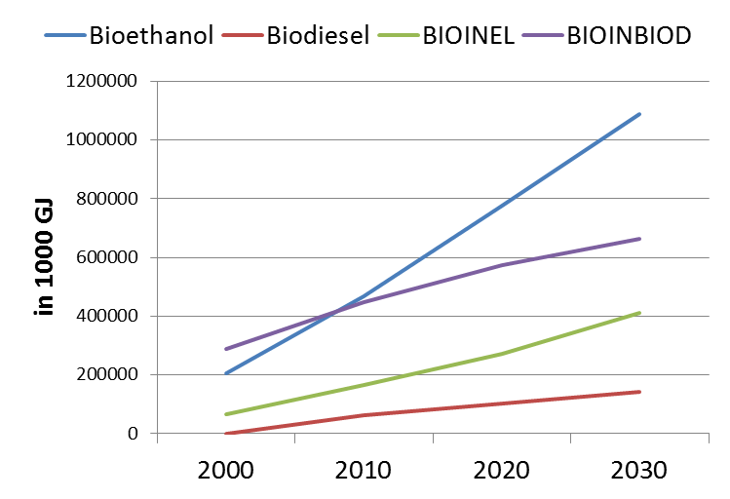
Brazil: Bionergy Projections to 2030
Heat and power generation (BIOINEL), Biomass consumption (BIOINBIOD), Bioethanol, Biodiesel
source: World Energy Outlook (2010)

Slide 17
GLOBIOM-Brazil validation and projections
Base
Year
Projections
Validation
2000 | 2010 | 2020 | 2030 | 2040 | 2050
LAND USE
Unmanaged Forests
Cropland
Land use changes are consistently transferred from one period to another
Managed Forests
Pasture
Planted
Forest
Other natural
land
Forest Regrowth

Slide 18
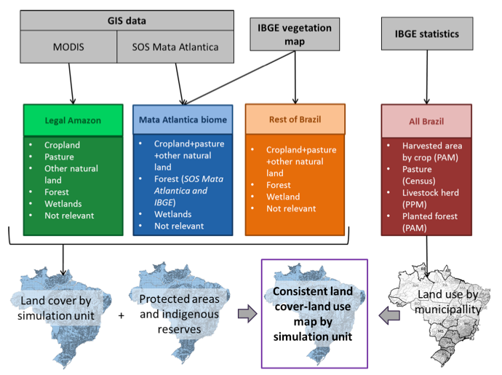
GLOBIOM- Brazil base data consistent land cover/land use map

Slide 19
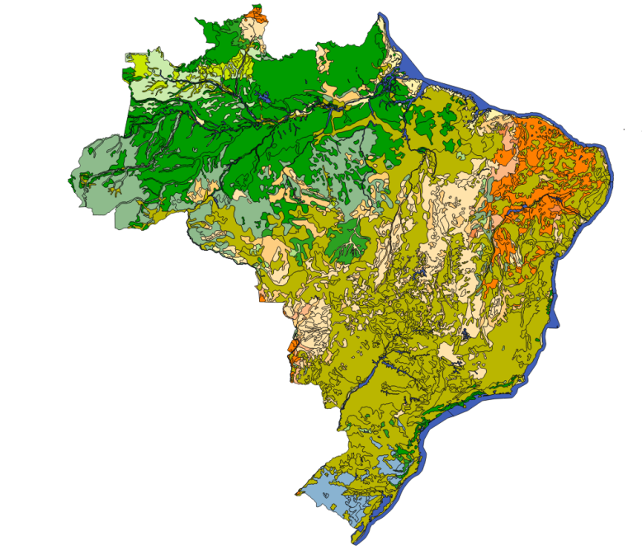
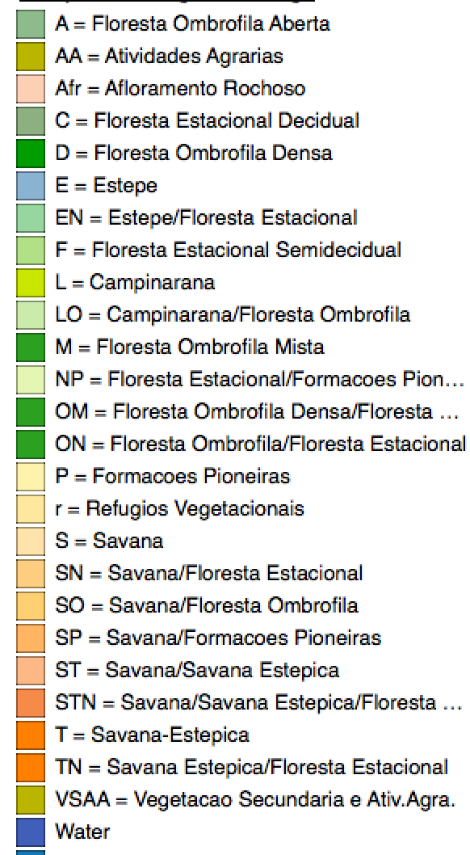
IBGE Vegetation Map
source: IBGE (2012)

Slide 20
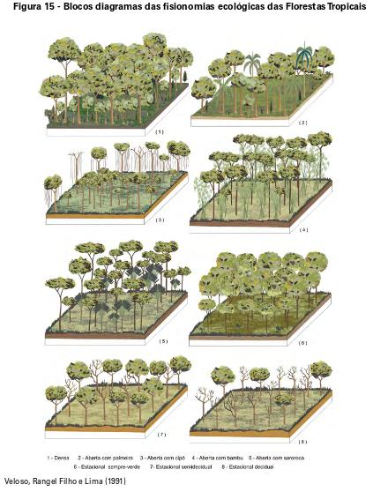
IBGE has defined different forest types in Brazil
Brazil’s FREL (forest reference emissions level) and GLOBIOM-Brazil use the same IBGE forest definion
source: IBGE (2012)

Slide 21
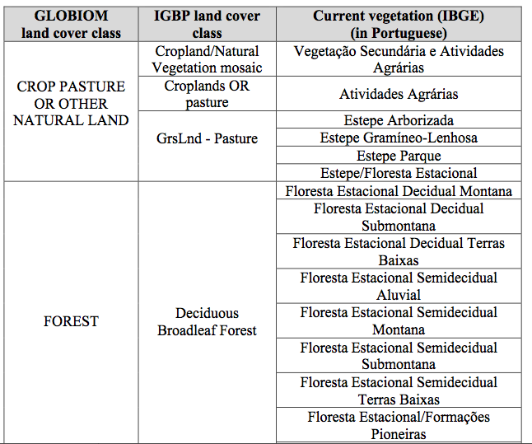
Correspondence between GLOBIOM, IGBP and IBGE land cover classes
…

Slide 22
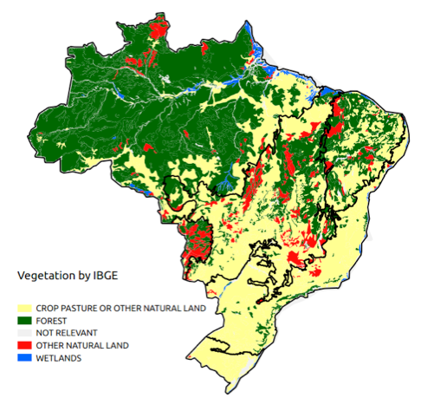
IBGE Vegetation Map reclassified into GLOBIOM classes

Slide 23
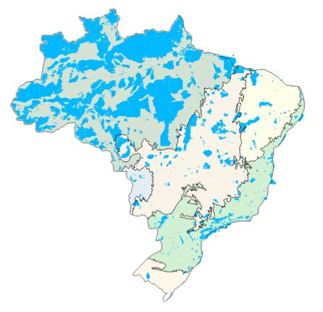
Protected Areas in GLOBIOM-Brazil
Federal, State and Municipal Conservation Units (full protection and sustainable use)
Indigenous lands
Model assumption: 100% protection in PA
source: MMA (2015)
Notes:
UCs federais de proteção integral
UCs federais de uso sustentável
UCs estaduais de proteção integral
UCs estaduais de uso sustentável
UCs municipais de proteção integral
UCs municipais de uso sustentável
Terras indígenas
Florestas Públicas

Slide 24
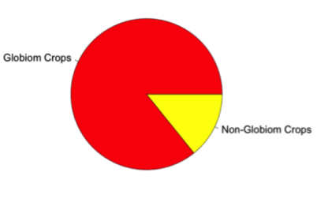
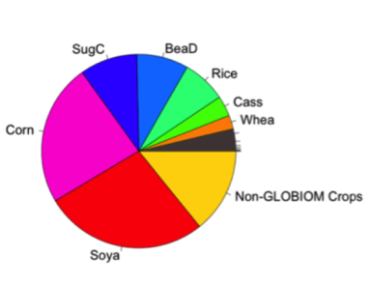
Cropland in GLOBIOM-Brazil: 18 crops
Pota: Potato
Rape: Rapeseed
Rice: Rice
Soya: Soybeans
Srgh: Sorghum
SugC: Sugar cane
Sunf: Sunflower
SwPo: Sweet potatoes
Whea: wheat
Barl: Barley
BeaD: Dry beans
Cass: Cassava
ChkP: Chickpea
Corn: Corn
Cott: Cotton
Gnut: Groundnuts
Mill: Millet
OPAL: Palm oil
IBGE Data | 2000
 | Mha | Share
GLOBIOM Crops | 43 | 86%
Non-GLOBIOM Crops | 7 | 14%
Total | 50 | 100%
source: IBGE PAM (2000)
Notes:
Introduction of CrpLnd from IBGE

Slide 25
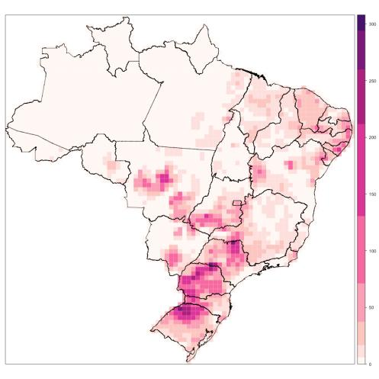
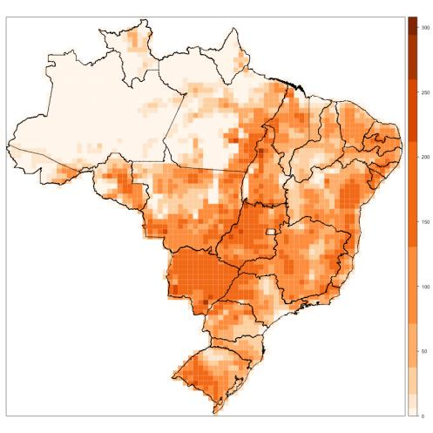
Cropland and Pasture in GLOBIOM-Brazil (2000)
Cropland 43 Mha
Pasture
215 Mha

Slide 26
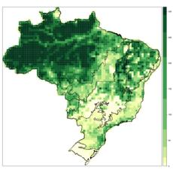
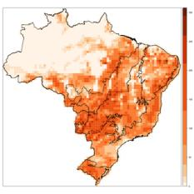
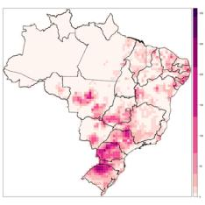
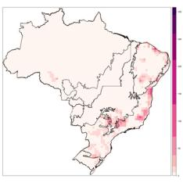
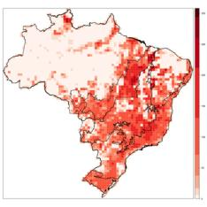
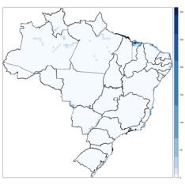
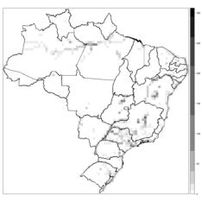
GLOBIOM-Brazil Land Cover Map for 2000
Forest Pasture Cropland Other agricultural land
Other natural land Wetland Not relevant
Consistent land cover-land map for whole Brazil

Slide 27
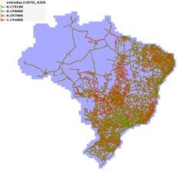
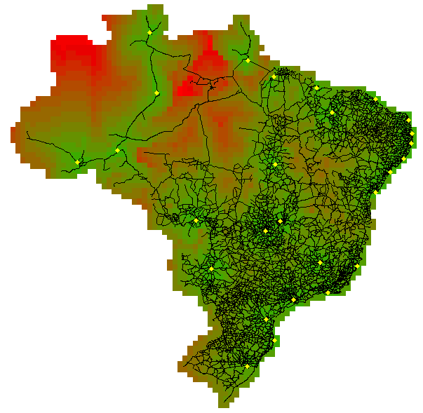
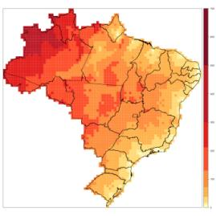
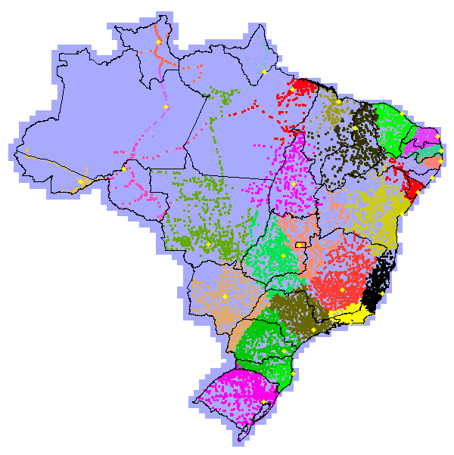
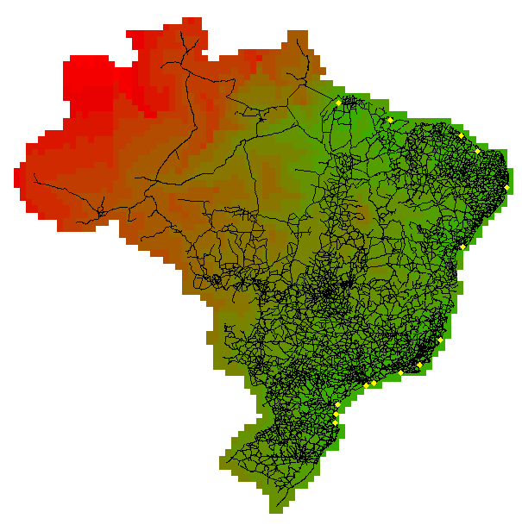
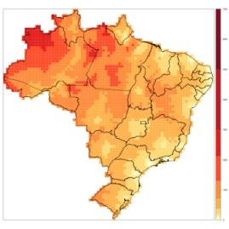
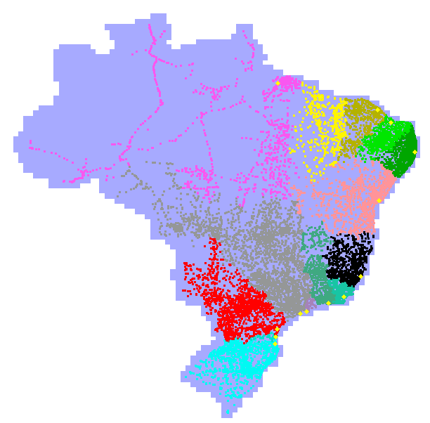
Transportation Costs (per product and destination)
Pulp Biomass
Costs to state
capitals
Roads
Nearest
state capital
Nearest
sea port
Costs to
sea port
Bovine Meat
Notes:
Data produced by IIASA with Aline and others. Its corresponds to the average cost to transport one ton of crop to the closest city above 50000 inhabitants.

Slide 28
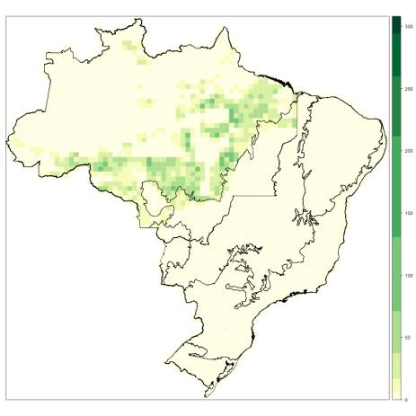
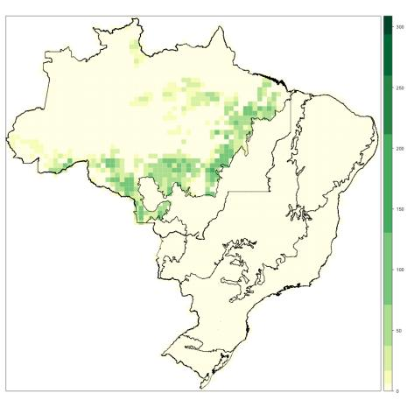
Validation: Accumulated Deforestation 2001-2010
PRODES/INPE
GLOBIOM-Brazil projection
16.53 Mha
16.93 Mha
model produces consistent estimate of deforestation (2000-2010)

Slide 29
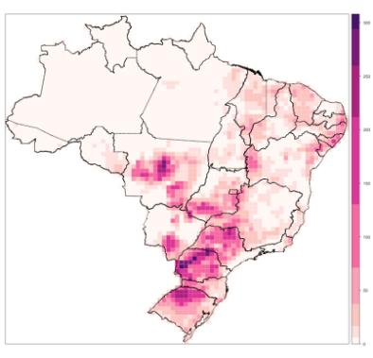
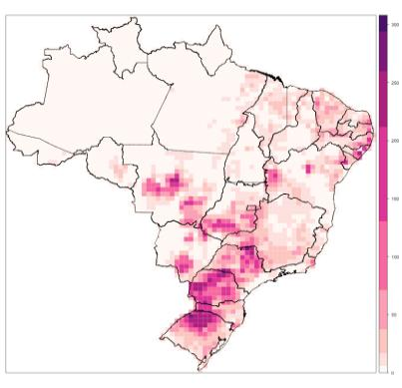
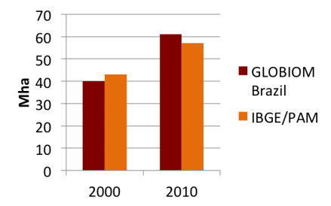
Validation: Crop Area in 2010
IBGE/PAM GLOBIOM-Brazil
Crop Area [Mha]
 | 2000 | 2010
IBGE/PAM | 43 | 57
GLOBIOM Brazil | 40 | 61

Slide 30

Validation: Crop area in 2010
IBGE/PAM x GLOBIOM-Brazil
Differences btw model and validation ± 10%
Notes:
5% changes in Crop area
-10 % changes in Crop production
2% difference in live numbers

Slide 31


Validation: Soybean area in 2010
IBGE/PAM
GLOBIOM-Brazil
23 Mha
25 Mha

Slide 32


Validation: Sugarcane area in 2010
IBGE/PAM
GLOBIOM-Brazil
9 Mha
8 Mha

Slide 33


Validation: Bovine Numbers in 2010
IBGE PPM GLOBIOM
142 Mtlu
143 Mtlu
One tropical livestock unit (tlu) is one cattle with a body weight of 250 kg

Slide 34

Validation: Bovine numbers in 2010
Notes:
Major differences in Amazon and Caatinga

Slide 35

Livestock numbers in 2010:
IBGE/PAM x GLOBIOM-Brazil

Slide 36



Brazil’s new Forest Code (FC)
  Legal Reserve (LR)
  Small farms amnesty (SFA)
  Environmental Reserve Quota (CRA)
LR
SFA
CRA
IPAM
Soares et al.

Slide 37
GLOBIOM-Brazil scenarios for LULUCF 2020-2030
BAU
BUSINESS AS USUAL
FC
COMMAND AND CONTROL
FC+
COMAND AND CONTROL
+ INCENTIVES
Extrapolation of 2000-2010 trends
No forest regrowth
Mata Atlântica Law enforced
Forest Code enforced
No illegal deforestation
Legal reserve recovery
Debt offset using quotas
Small farms amnesty
Mata Atlântica Law enforced
Forest Code rules +
Legal reserve recovery in small farms by forest regrowth

Slide 38


Environmental Debts and Surpluses (2010)
Debts
Surpluses
Potential surpluses from Amazonas, Amapá and Roraima were not considered

Slide 39

GLOBIOM-Brazil projections for forest cover
Small farms amnesty is 30 million ha
BAU results in 30 million ha additional deforestation

Slide 40

Brazil: forest cover in BAU scenario
BAU causes major losses in Cerrado and Caatinga biomes

Slide 41

Brazil: forest cover if Forest Code is enforced
Amazonia rain forest stabilizes in the long run towards 320 million ha

Slide 42




BAU
FC
388 Mha
419 Mha
Spatial Distribution of Total Forest
in 2050
FC without
SFA
FC without
CRA
451 Mha
422 Mha

Slide 43




BAU
FC
0 Mha
9 Mha
Projections of forest regrowth
in 2050
FC without
SFA
FC without
CRA
42 Mha
36 Mha

Slide 44


Forest Regrowth in 2030 per Biome
Forest Code
FC+ (Forest code + SF reforestation)
9.3Mha
30.8 Mha
6.8 Mha
15.9 Mha
0 Mha
4.1 Mha
1.5 Mha
4.5 Mha
0 Mha
5 Mha
1 Mha
1.5 Mha
Reduction in cropland area with FC+: 4%
Reduction in bovine numbers with FC+: 2.5%

Slide 45

Pristine forest projections
CRA has an important rôle in protecting pristine forests in Brazil
Impact of CRA is equivalent to 20 Mha of forest protection

Slide 46


GLOBIOM-Brazil projections for Forest Code scenario: pristine and regrown forest
Pristine forest in 2050 (410 Mha)
Forest regrowth in 2050 (9 Mha)

Slide 47


Projected expansion of planted forests in Brazil (Forest Code scenario)
2010
2050
16Mha
7.6 Mha
16 Mha

Slide 48


Projected expansion of croplands in Brazil (Forest Code scenario)
2010
2050
61 Mha
117 Mha
Major growth in MATOPIBA and potentially fertile regions of NE Brazil

Slide 49

Potential expansion of pasture in Brazil
GLOBIOM projects stabilization of pasture area around 240 million ha
No major conversion from pasture to croplands

Slide 50

Projection of Bovines in Brazil 2010-2050 (Mtlu)
GLOBIOM projects growth by moderate intensification
Density will grow from 0.5 tlu/ha in 2000 to 0.65 tlu/ha in 2050

Slide 51

Projection of other natural lands (non-productive areas) in Brazil 2010-2050
GLOBIOM projects major land conversion of areas in Cerrado, Caatinga and Mata Atlântica biomes (keeping Amazonia protected)

Slide 52





GLOBIOM-Brazil projections: 2020-2050
cropland
pasture
total forest
pristine forest

Slide 53


source: Liu et al., Nature Climate Change, 2015
Base data for CO₂ emissions from LUC in Brazil
Tropical forests
125 MgC/ha
Grasslands
Woody savannahs
5 MgC/ha
a
22 MgC/ha
Aboveground biomass carbon density by biome

Slide 54


Uncertainty in biomass maps for Brazil
Saatchi et al. (2011) biomass map in MgC/ha
Biomass densities in MgC/ha in Amazônia biome for different biomass maps

Slide 55

Forest regrowth schedule
Artwork credit: Gareth Railton
Decades | Amazônia and Mata Atlântica | Cerrado, Caatinga And Pantanal | Pampa
First | 40% | 70% | 100%
Second | 22% | 30% | -
Third | 16% | - | -
Fourth | 12% | - | -
Fifth | 10% | - | -

Slide 56
Emissions from Amazon deforestation
Source | Emissions [MtCO₂eq/yr] | Statistics
FREL (2014) | 872 | Mean (2001 - 2010)
Aguiar et al. (2012) | 831 | Mean (2000 - 2009)
GLOBIOM-Brazil | 858 | Median (2001 - 2010)
+ 88
- 24
GLOBIOM estimates are based on an ensemble of 24 cases, considering different biomass maps

Slide 57
Brazil’s Total LUC Emissions
Source | Emissions [MtCO₂eq/yr] | Statistics
MCTI Report | 1326 | Mean (2001 – 2010)
GLOBIOM-Brazil | 1301 | Median (2001 – 2010)
+ 417
- 302

Slide 58

Projected LUCF emissions in Brazil (MtCO₂eq/year)
BAU ➔ FC : -3.9 GtC
BAU ➔ FC+: -5.4 GtC
Brazil needs FC+ incentives to achieve zero net LUCF emissions by 2030

Slide 59


Projected LUCF emissions in Brazil (MtCO₂eq/year)
Amazônia
Cerrado
FC+ incentives are more relevant in Amazonia than in Cerrado Amazonia becomes a net sink with FC+

Slide 60
Emissions from LUC and Forestry sectors

Slide 61
Emissions from agriculture: 2010-2050

Slide 62
Projected impact of forest regrowth in LUC emissions in 2030 (with 100%CRA)
Forest Code
FC+ (Forest code +incentives)
-92 MtCO₂eq/yr
-505 MtCO₂eq/yr
-68 MtCO₂eq/yr
-291 MtCO₂eq/yr
-31 MtCO₂eq/yr
-47 MtCO₂eq/yr
Increase in C capture with FC+: 450%

Slide 63
GHG emissions Brazil for 2000-2030
2000 and 2010 emissions data: SEEG
Energy, Industry GHG emissions projection: 2.2% growth/year
LULUCF GHG emissions projections: GLOBIOM-Brazil
2020: 37% decrease from BAU set in COP-15
2020 onwards: decrease in LUCF offset by growth in Energy and Industry

Slide 64

Conclusions
GLOBIOM-Brazil model makes consistent projects for LUC in Brazil for 2020-2050: major advance in science-based guidance for land use policy
Brazil can balance production and protection if Forest Code is enforced (including CRAs)
Forest regrowth policies need to consider leakage resulting from uncontrolled incentives
REDD+ Policy Assessment Center

