Slide 1


TerraLib: Technology in Support of GIS Innovation

Slide 2
Authors and presenters
Presented by Gilberto Ribeiro at IFGI GI Forum 2013
Prepared by the TerraLib team
  Karine Ferreira
  Lubia Vinhas
  Antonio Miguel Monteiro
  Emiliano Castejon
  Gilberto Câmara
  Gilberto Ribeiro
  Pedro Ribeiro de Andrade
  Thales Körting

Slide 3
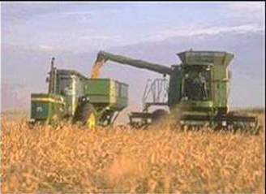
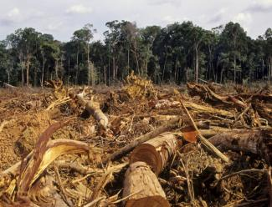

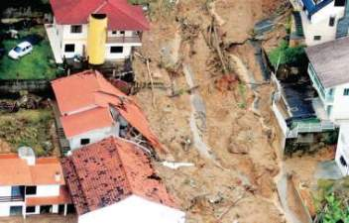
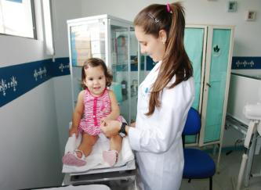
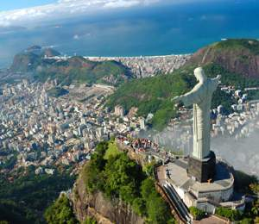
Biodiversity
Agriculture
Deforestation
Brazilian challenges where INPE’s geoinformatics technology is being applied
Urban planning in
megacities
Public health
Weather and natural disasters

Slide 4
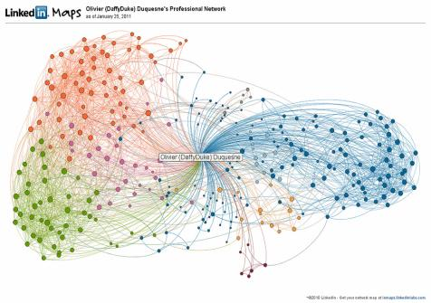
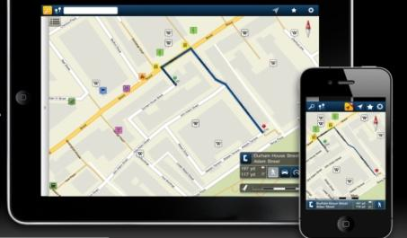
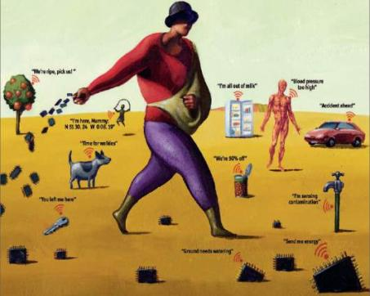
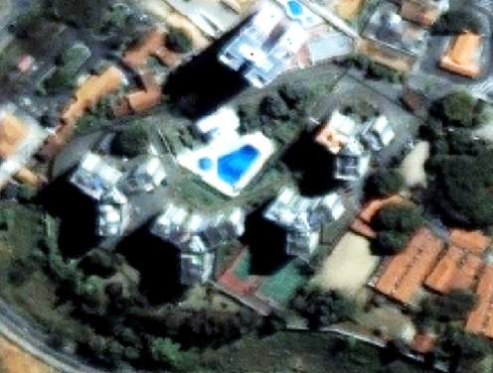
mobile devices
social network
Big data, mobile devices, crowdsourcing, massive Earth observation sets: new technologies bringing new problems
sensors everywhere
ubiquitous imagery

Slide 5
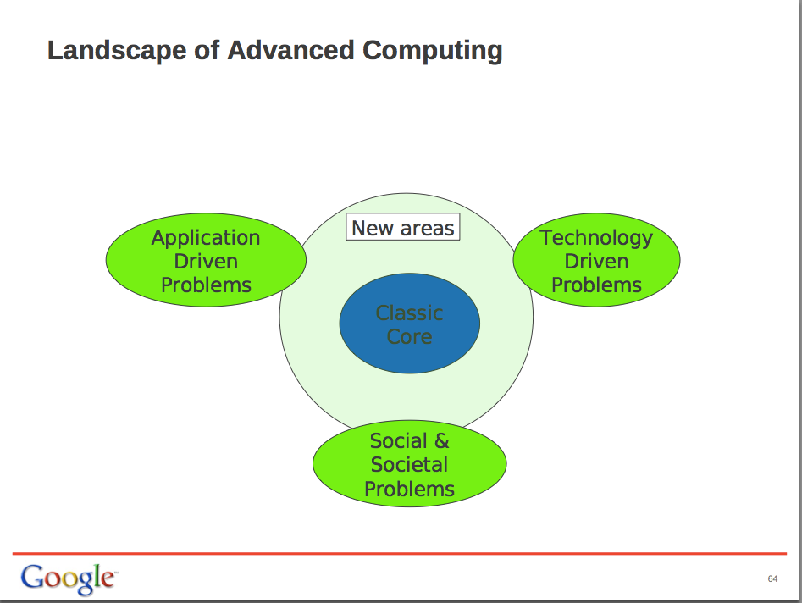
Stuart Feldman, VP Engineering, Google, Unicamp 2011

Slide 6

The rôle and duties of a software engineer
“The essence of a software entity is a construct of interlocking concepts: data sets, relationships among data items, algorithms, and invocations of functions. The hard part of building software is the specification, design, and testing of this conceptual construct, not the labor of representing it and testing the fidelity of the representation. Building software will always be hard.”
Fred Brooks, “No Silver Bullet: Essence and Accidents of Software Engineering”. IEEE Computer, 1987

Slide 7
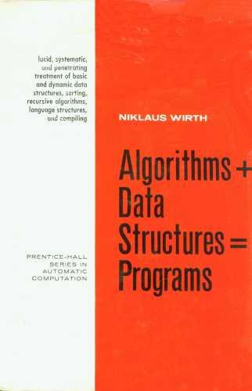
Challenges for GI software architects
Concepts +
Types +
Algorithms +
Data Structures +
Data Sources +
Custom programs =
Systems for solving
real-life problems
Classical view of software development
GI Engineering needs

Slide 8



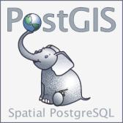




How to build systems that support GIS-21 needs with FOSS4G?
FOSS4G today: different concepts, different architects need higher-level abstractions

Slide 9

The TerraLib vision: FOSS4G for innovation
“Many developments (in industry and FOSS4G) have ignored scientific advances in GIScience. Thus, the geographical information community would benefit from the availability of a general, open source GIS library. This resource would make a positive impact by allowing researchers and solution developers access to wider range of tools than what is currently offered.”
Câmara, G. el al., “TerraLib: Technology in Support of GIS Innovation”. GeoInfo 2000

Slide 10
TerraLib: high-level GI abstractions on top of FOSS
DengueME
TerraAmazon
TerraMA²
TerraView
R
TerraME
GeoDMA
aRT
TerraHS
TerraOGC
TerraLib
LOD
Lua
GDAL
Boost
Twitter
PostGIS,
SciDB
...
TerraLib is a common interface to FOSS and data sources
Application development becomes easier

Slide 11
Milestones of TerraLib project
TerraLib 1.0
TerraLib 2.0
TerraLib 3.0
TerraLib 4.0
TerraLib
5.0
2002
2004
2006
2008
2010
2012
2014
TerraView
aRT
TerraHS
Terra
Amazon
TerraME
GeoDMA
TerraMA²
TerraLib evolves together with its tools
Each new tools brings new concepts to TerraLib

Slide 12
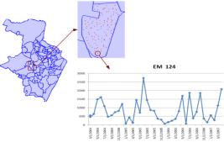
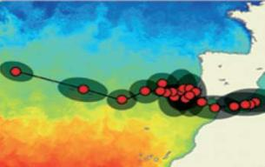
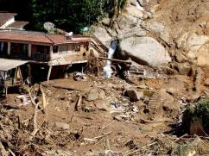
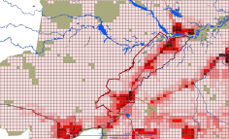
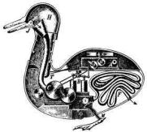
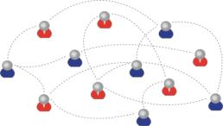
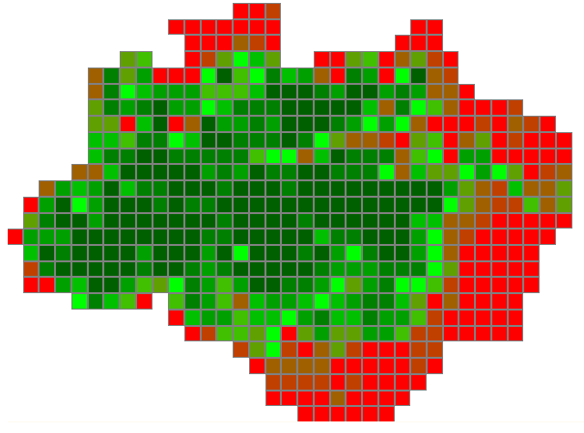
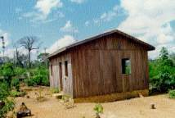
Types in TerraLib ecosystem: new tools, new types
Time Series
Trajectory
Event
2014
Cellular Space
Social Network
Agent
2010
Object
Geometry
2002
Coverage

Slide 13
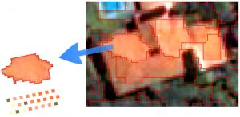
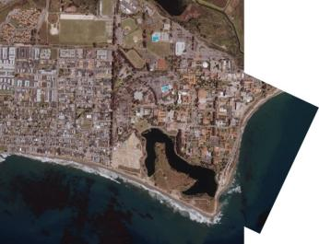
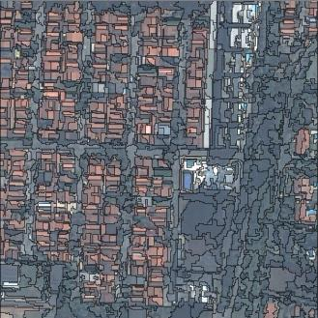
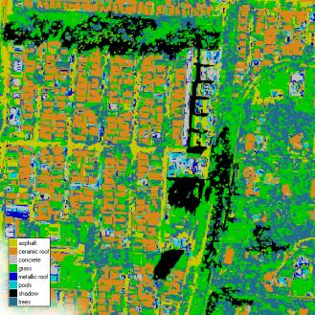
Image Processing Algorithms (100+)
Mosaic
Clipping
through
iterators
Segmentation
Classification

Slide 14
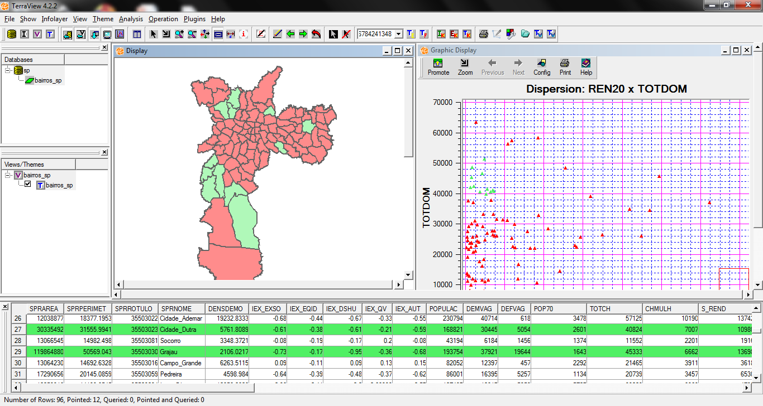
TerraView: visualization and exploratory data analysis
Brushing tool for exploration
Access to TerraLib tools via plugins
Notes:
TerraView is a small GIS developed on top of TerraLib.
It is basically a tool for spatial data visualization and exploratory analysis
This picture show one example of use of TerraView…
It give access to TerraLib via plugins

Slide 15
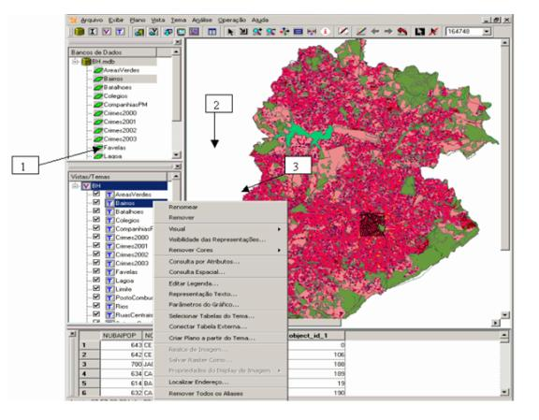
TerraView: extensibility with plugins
Plugins:
Data mining
Spatial segregation
Cell spaces
Network flows
Biodiversity(openModeller)
Clustering
Plugins allow external groups to cooperate in the TerraLib project
Notes:
Plugins is also a good way of external …
We have a lot of plugins, some of them are shown here:….
Alguns desses plugins foram feitos por nós e outros por alunos e colaboradores externos…

Slide 16
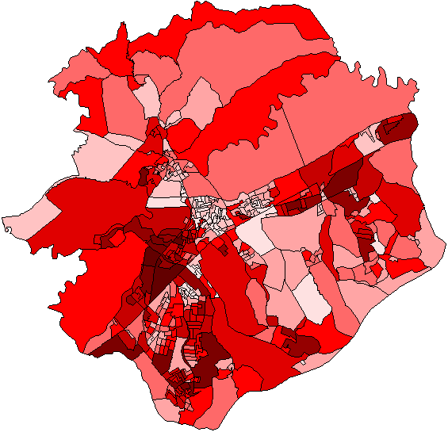
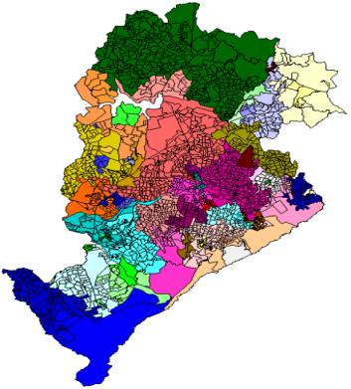
Innovative spatial analysis: available in TerraView using plugins
Spatial segregation indexes
Regionalization
F. Feitosa et al., “Global and local spatial indices of urban segregation”. IJGIS, 2007 (MsC).
R. Assunção et al. “Efficient regionalisation techniques for socio-economic geographical units using minimum spanning trees”. IJGIS, 2006 (PhD).
Notes:
These are two works on innovative spatial analysis, onde done by Feitosa wich developed a new spatial…
And the other
Done by assuncao e colab that developed regionalizatio techniques
Both works were developed using terralib and now they are available as plugins…

Slide 17
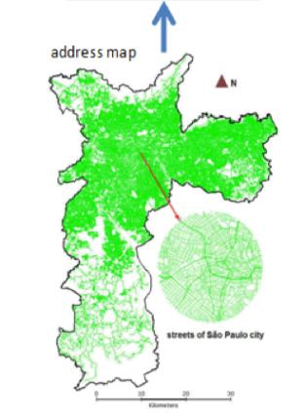
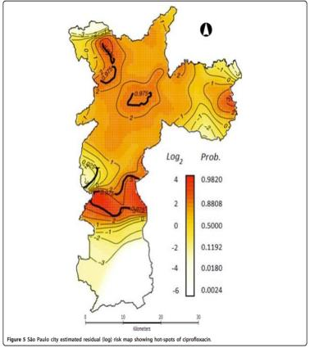
Applications in Health and Public Policies
Streets of Sao Paulo
Clusters of resistance to antibiotics
Spatial analysis
Address geocoding of resistance to antibiotics
Database of
antibiotic users
Kiffer, E., Camargo, E. et al., “A spatial approach for the epidemiology of antibiotic use and resistance in community-based studies: the emergence of urban clusters of Escherichia coli quinolone resistance in Sao Paulo”. IJ Health Geographics, 10, 2011.
Notes:
Another work using TerraView is the work from Carlos Kiffer which study the resistence of antobiotic in the population.
They used TerraView to spatialize their data according to Brazilian address model, then they performed some spatial analysis for creating a map with cluster of resistence to antibiotics….
O mais escuro é o mais resistente

Slide 18
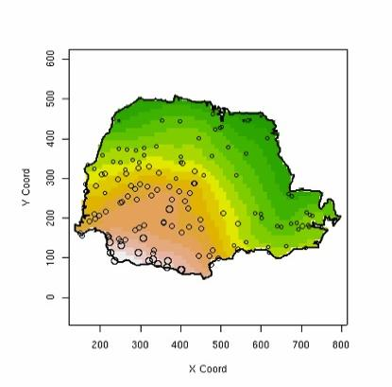
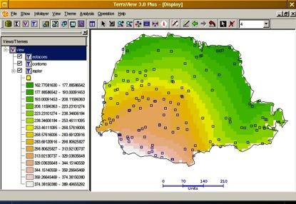



aRT: R-TerraLib programming interface
Accessing TerraLib databases using R-sp package standards
Database
P. Andrade et al., “A Process and Environment for Embedding The R Software into TerraLib.” GeoInfo 2005.
Notes:
ART is another tool developed in the TerraLib ecosystem that integrates TerraLib to R.
It allows the TerraView users to perform spatial analysis through R.
All the comunication between R and terrlib is done by the database.
A user working with a spatial database in TerraView can go to R access the same data and perform some spatial analysis an then come back to TerraView to display the result and further analysis.

Slide 19
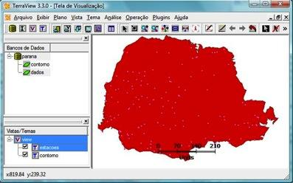
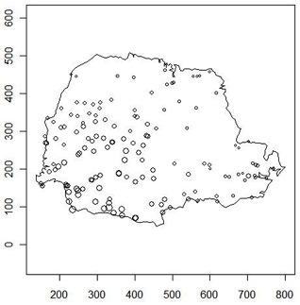
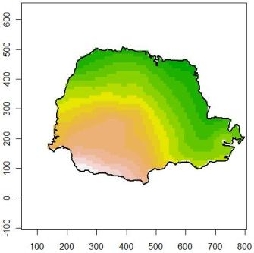
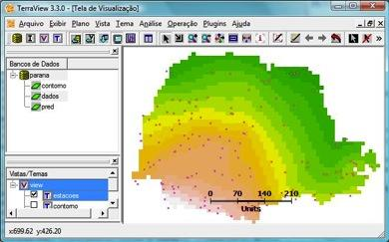
db = openDb(dbms="mysql", dbname = “parana”)
my_points = getPoints(db, “pointdata")
my_limits = getPolygons(db, “limits")
raster = kriging(my_points, my_limits)
createLayer(db, "lraster”, raster)
Notes:
These is an example that shows how a TerraView user can write an R script to perform a kriging.
In the first picture we have to datasets inside TerraView, one with point data and another one with the Parana State boundary.
So in R you can connect to the same database, access both layers and then call an R function that do kriging
All you need at the end is to save the data in database and then comeback to terraview to see the result and do something else.

Slide 20
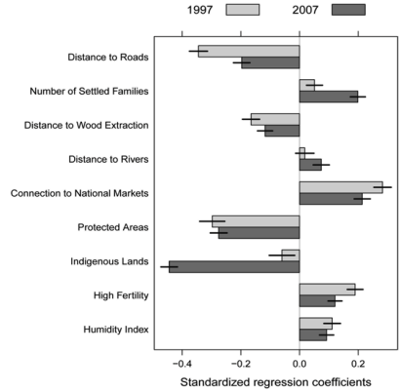
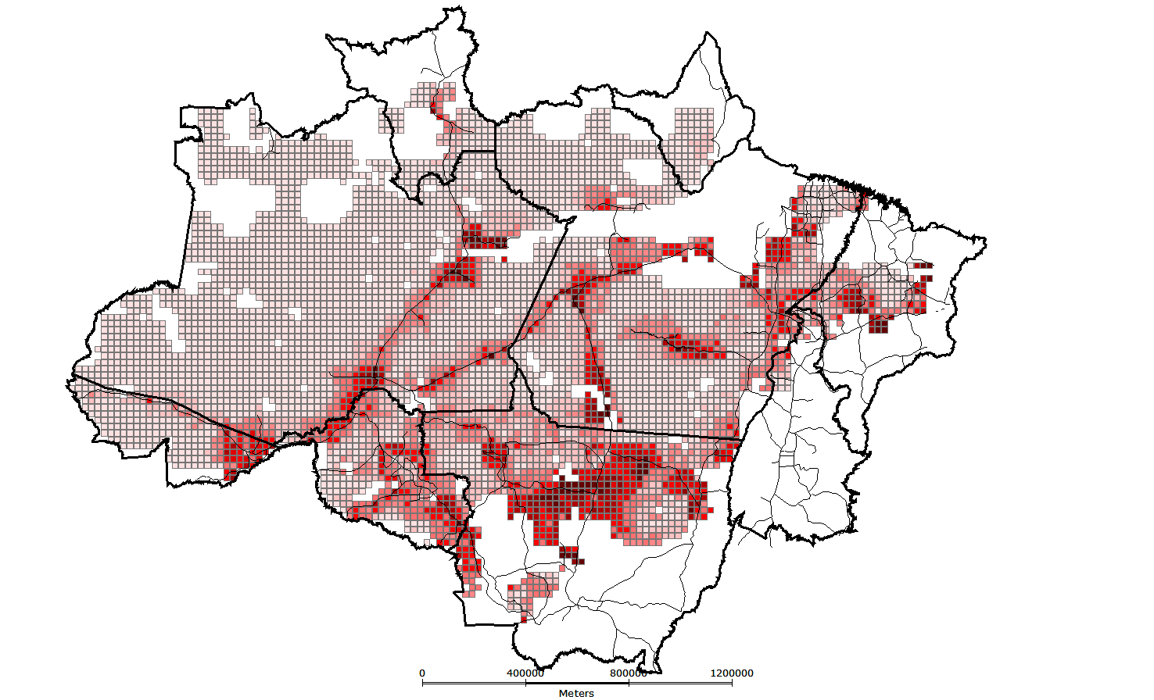
What are the drivers of deforestation in Amazonia?
aRT + deforestation maps + census data + R methods
A. Aguiar et al., “Spatial statistical analysis of land-use determinants in the Brazilian Amazon”. Ecological Modelling, 2007 (PhD).
G. Espíndola et al., “Agricultural land use dynamics in the Brazilian Amazon based on remote sensing and census data”, Applied Geography, 2012 (PhD).
Notes:
This tool was used in some works, we have here two examples onde from Aguiar and another from Giovana that used ART with deforestation dataset and census data to study the drivers of deforestation in Amazonia and they perform several ST to invesitigate the impact of different factors such as: ….
O impacto dessas variáveis no desmatamento!

Slide 21
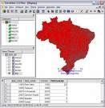
TerraHS: funcional programming for GI
GI Programs as
algebraic
specifications
TerraHS
Haskell
By separating speciﬁcation from implementation,
algebras help to develop reliable and expressive GIS applications
(Frank and Kuhn 1995)
TerraLib
TerraView
Data
base
S. Costa et al., “TerraHS: Integration of Functional Programming and Spatial Databases for GIS Application Development”. GeoInfo 2006.

Slide 22

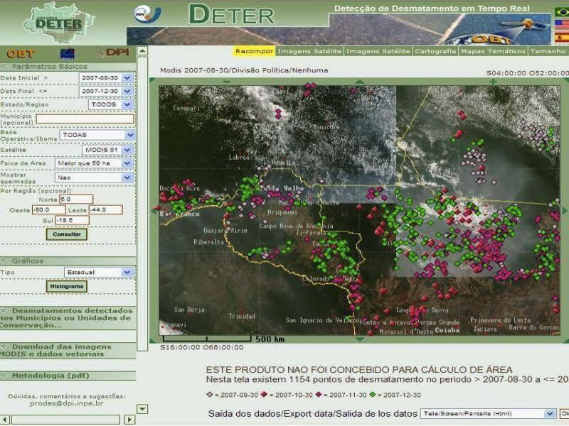
TerraAmazon: infrastructure for management of deforestation data
Fifteen years of remote sensing images,
deforestation polygons and forest fire occurrences
in a single information system

Slide 23
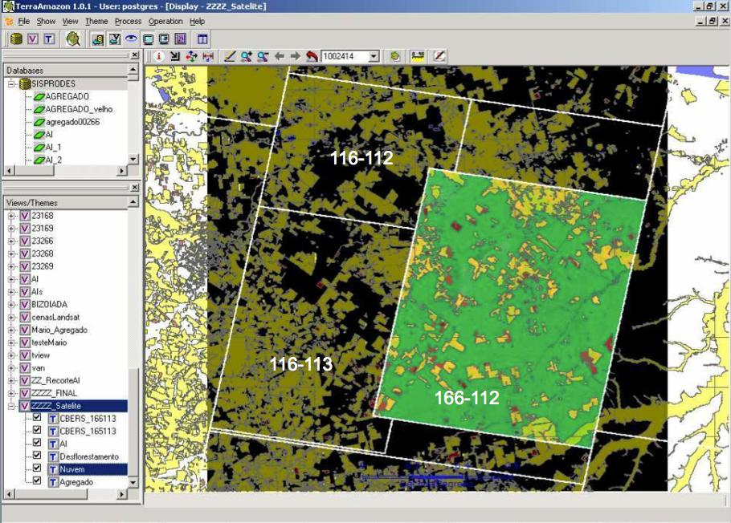
TerraAmazon data is freely available on the web
Data transparency helps society to put pressure on government
116-112
Deforestation in Brazilian Amazonia was reduced
from 27,000 km² in 2004 to 4,900 km² in 2012
116-113
166-112
Ribeiro V., Freitas U., Queiroz G., Petinatti M., Abreu E. , “The Amazon Deforestation Monitoring System”. OSGeo Journal 3(1), 2008.
Notes:
Cena de maior prioridade utilizou imagens CBRES na s tres principais areas: 166-112, 165-113 2 166-113. Sendo complementada por imagem TM

Slide 24
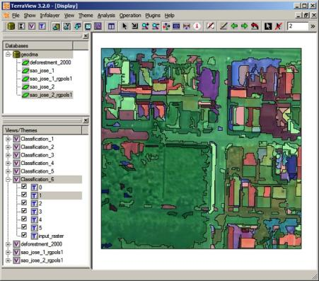
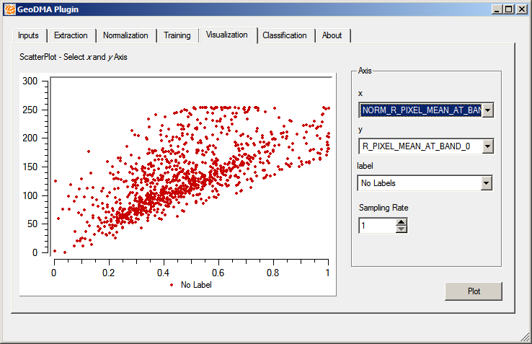
GeoDMA: Data mining using geospatial data
Classification and clustering of objects
extracted from remote sensing images
M. Silva et al., “Remote sensing image mining: detecting agents of land use change in tropical forest areas”. Int Journal Remote Sensing, 29 (16): 4803 – 4822, 2008.
T. Korting et al., “GeoDMA—Geographic Data Mining Analyst”. Computers & Geosciences, 57:133–145,2013.
Notes:
É uma ferramenta que usa técnicas de data mining para classificar e identificar padrões em imagens de sr.
Est;a dispon;ivel na forma de plugi do terraview
É fruto de uma tese de doutorado, o aluno agora faz parte do time de desenvolvimento da TL.

Slide 25
Occupation patterns in Amazonia
Different human actions, different patterns
Notes:
This tool has being used to identify patterns of occupation footprints in Amazonia.
This table shows all the patterns informed by an specialist in order to prepare a complete map with the occupation footprints.
In this column we have some image samples, in this columns we have the deforestation patterns as indicated by an specialist, its desciption and semantics
NOME-DO-PADRAO; DESCRICAO DO PADRAO

Slide 26
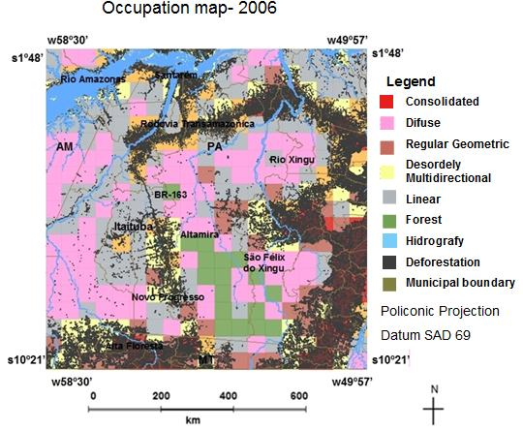
GeoDMA: Classification of patterns of deforestation
Map shows main patterns in a 50 km x 50 km cell
Notes:
Here we have the resulting map where each cell was given a deforestation pattern.
The final classification is done for cells…

Slide 27
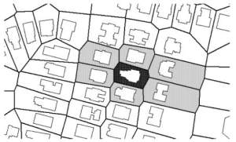
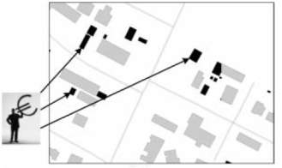
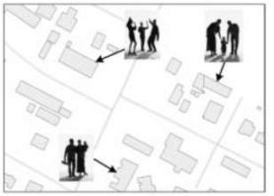
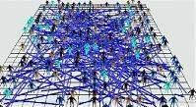
TerraME: nature-society modelling
Space Agent
Agent Space
Nature represented in cellular spaces, society represented as agents
T. Carneiro, P. Andrade, et al., “An extensible toolbox for modeling nature-society interactions”. Enviromental Modelling and Software, 2013 (Two PhDs).
Notes:
TerraME is…
It is capable of accessing data in a spatial database through terralib
It has

Slide 28
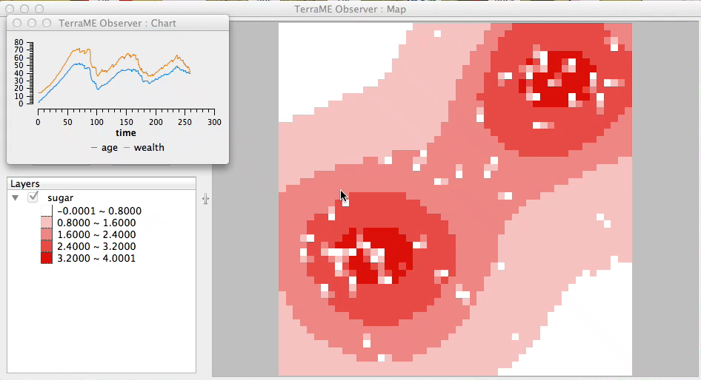
Nature-Society interaction models with TerraME
Sugarscape model – agents consuming renewable resources in a landscape (ants eating sugar)
Notes:
Simulando padrões de incêndios no Parque Nacional das Emas
Rodolfo Almeida, Elbert Macau, Fernando Ramos, Helena França, Tiago Carneiro
GeoInfo 2008
CARNEIRO, T. Nested-CA: a foundation for multiscale modeling of land use and land change. PhD Thesis in Computer Science.Sao Jose dos Campos: INPE.

Slide 29
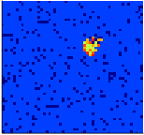



DengueME: spatial model of dengue
Humans
60 days
110 days
260 days
Notes:
Where we study the dengue epidemics in Brazil

Slide 30




TerraMA²: Natural Disasters Monitoring, Analysis and Alert
Geology, soils,
slopes, houses
Likely risk areas
Users
Weather
River flows
(real-time)
Data
integration
Alerts
Roads
traffic
(real-time)

Slide 31

TerraMA²: Natural Disasters Monitoring and Alert
System operational in real-life situations
Notes:
31

Slide 32
Terralib 5: the next generation
Modelling
Data discovery
Data access
Analysis
Data
source
Data
source
Data
source
Data
source
Distributed data sources, unified data access

Slide 33







Different data sources, same interface
Linked open data
Abstract description of geospatial data, flexible data containers
Notes:
This core is also responsible for all the data access
We have the concept of data source and data access drivers and this is the low level o TerraLib.
The next release will be able to interpret queries over two or more data sources

Slide 34

Transforming data into high-level abstractions
Notes:
Esta figura ilustra a visão geral da arquitetura da TerraLib 5.
parte central da arquitetura que é responsável pelo manipulação dos dados geo-espaciais

Slide 35


Space-time modelling in TerraLib
Time Series
how the number of mosquito eggs varies over time
Trajectory
Observations
how animals move over time
Coverage
how precipitation varies within the limits of Rio de Janeiro state
Raw Data
Spatiotemporal Data Types
K. Ferreira, G. Câmara, A.M. Monteiro, “An Algebra for spatiotemporal data: from observations to events”. Transactions in GIS, 2013. (PhD)
Notes:
Time series: fixed location, etc, etc...

Slide 36


From observations to events

Slide 37


Collaboration Network
Notes:
This project is very interesting because it opened the doors for a quite considerable amount of partnerships from Industry, academy, government and from the army

Slide 38






Core concepts of spatial information (Kuhn, IJGIS, 2012)
network
neighborhood
location
field
object
event
Notes:
Na TerraLib partimos do principio que existem core concepts compartilhados na area de geoinformatica e uma idéia interessante que vem crescendo em aceitacao na comunidade\

Slide 39
Core concepts of geospatial information on the age of big data: proposal for cooperation
Core
concepts
of GI
TerraHS
(prototype)
validate?
organize?
use?
Big data
(Science and
Society)
SciDB,
Twitter,
LOD
represent?

Slide 40

Spacetime: R package for spatiotemporal data
Space-time interpolations of wind
Pebesma E., “spacetime: Spatio-Temporal Data in R”. Journal of Statistical Software, 2012.

Slide 41

Proposed collaboration on R-Terralib integration
Data Analysis
Organizing
big data for
analysis with R
Data abstractions
(TerraLib)
Data discovery and access (Terralib)
Spatiotemporal
DB
Spatiotemporal
DB

Slide 42
..... Thank You !
Contact: Gilberto Ribeiro de Queiroz email : gribeiro@dpi.inpe.br phone: (+55)12 3208 - 6507
42
Notes:
I have to be honest and give much of the credits to Gilberto Camara that still being my advisor and friend!

Slide 43
Recent scientific advances in Geoinformatics: some examples
spacetime
trajectories
social
networks
data
mining
agent
mining
spatial
statistics

