Slide 1
Data-intensive Geoinformatics: a new research area at INPE?
Gilberto Câmara
October 2012
Licence: Creative Commons ̶̶̶̶ By Attribution ̶̶̶̶ Non Commercial ̶̶̶̶ Share Alike
http://creativecommons.org/licenses/by-nc-sa/2.5/

Slide 2










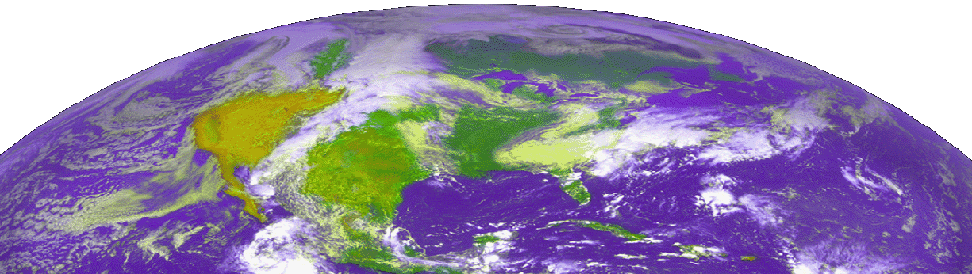


Welcome to the Age of Data-intensive Science!
image: GEO
Vantage Points
Capabilities
Far-Space
L1/HEO/GEO TDRSS & Commercial
Satellites
Permanent
LEO/MEO Commercial Satellites and Manned Spacecraft
Near-Space
Airborne
Aircraft/Balloon Event Tracking and Campaigns
Deployable
Terrestrial
Forecasts & Predictions
User
Community

Slide 3
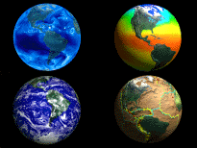
Data-intensive Geoinformatics = principles and applications of spatial information science to extract information from very large data sets
image: NASA

Slide 4




Slide 5
There is an urgent need for the international scientific community to develop the knowledge that can inform and shape effective responses to these threats in ways that foster global justice and facilitate progress toward sustainable development goals.

Slide 6
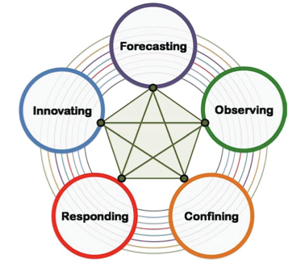
ICSU “Grand challenges”
Improve the usefulness of forecasts of future environmental conditions and their consequences for people.
Develop, enhance and integrate the observation systems needed to manage global and regional environmental change.
Determine what institutional, economic and behavioral changes can enable effective steps toward global sustainability.

Slide 7
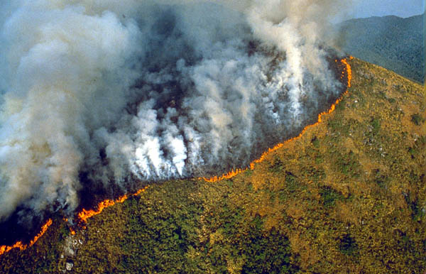

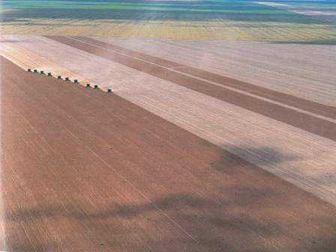
Land change is crucial for the world

Slide 8
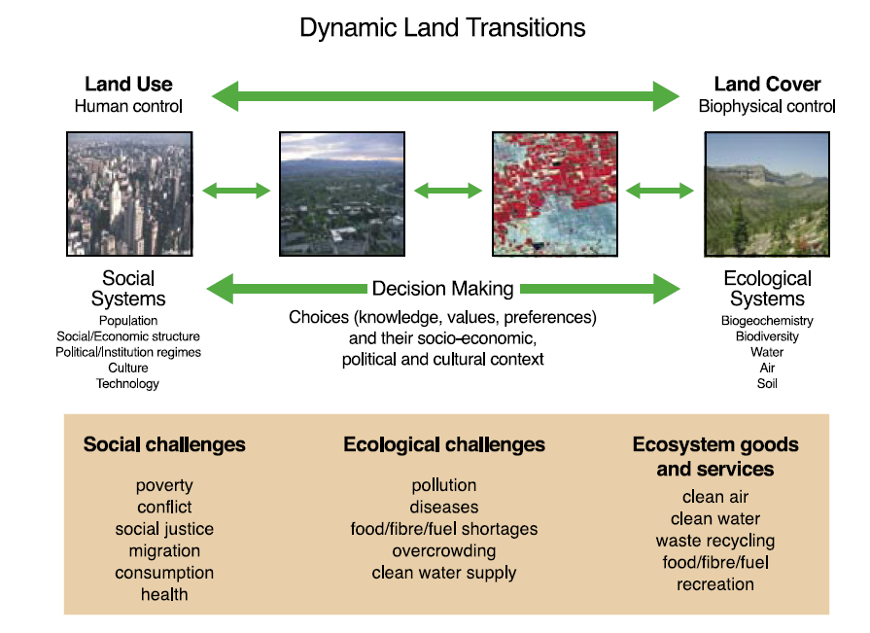
source: Global Land Project Science Plan (IGBP)

Slide 9
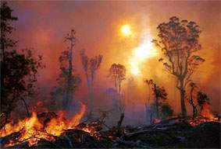
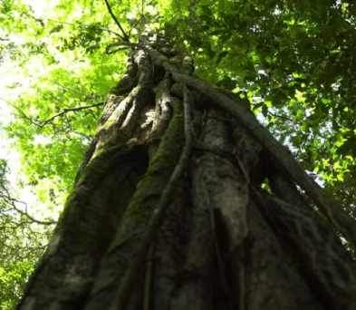
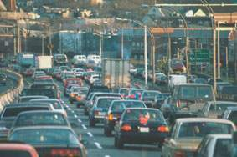
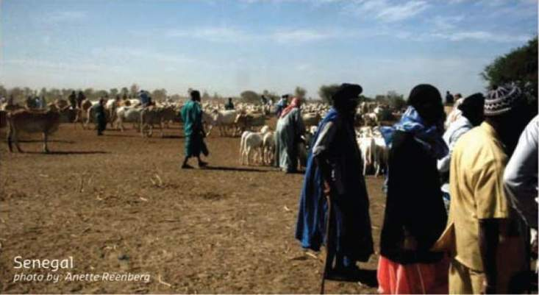
Global Change
Human actions and global change
photo: C. Nobre
Where are changes taking place?
How much change is happening?
Who is being impacted by the change?
What is causing change?
photo: A. Reenberg

Slide 10




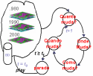
What do we (Geoinformatics scientists) know?
  Connect expertise from different fields
  Make the different conceptions explicit
If (... ? ) then ...
Desforestation?

Slide 11
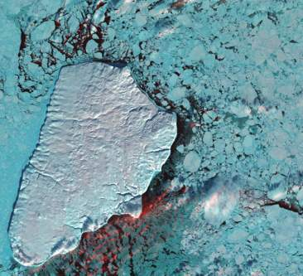
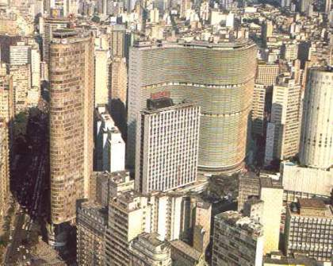
Geoinformatics enables crucial links between nature and society
Nature: Physical equations
describe processes
Society: Decisions on how to
use Earth´s resources
images: USGS, F. Ramos

Slide 12
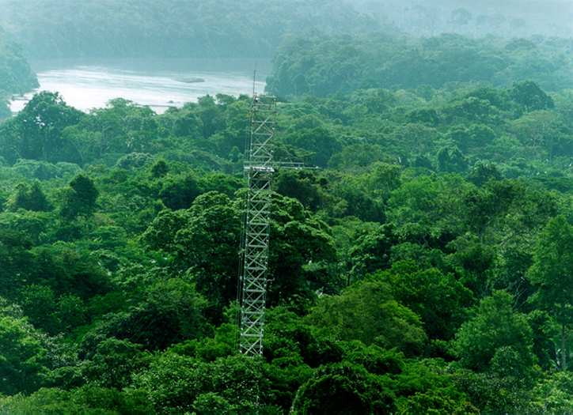
How does INPE´s R&D in Geoinformatics fits in the big picture?
LBA tower in Amazonia (image source: C.Nobre)

Slide 13
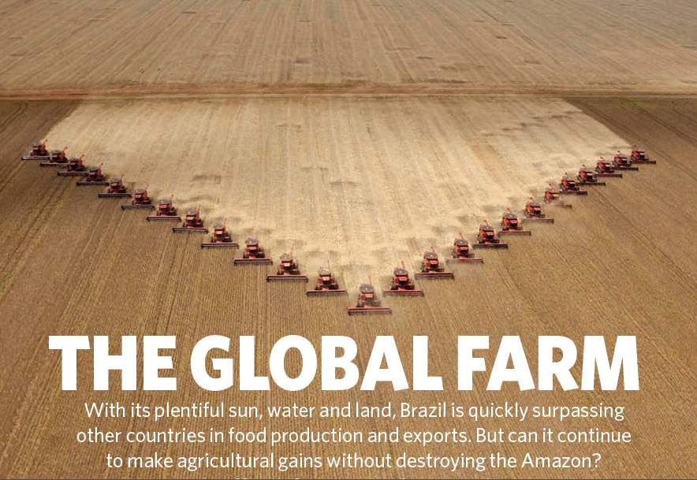
Nature, 29 July 2010

Slide 14
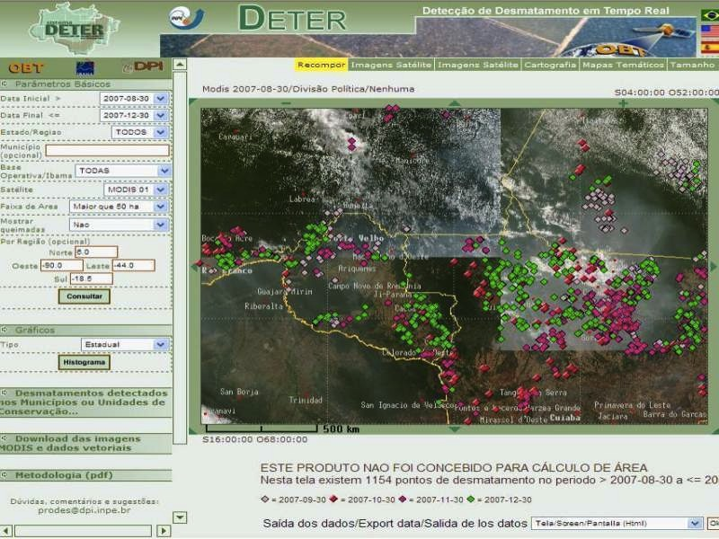

DETER: real-time deforestation monitoring
Daily warnings of newly deforested large areas

Slide 15
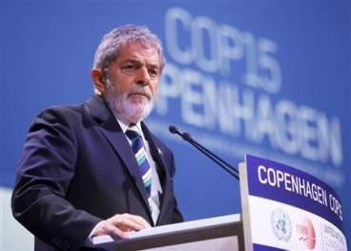
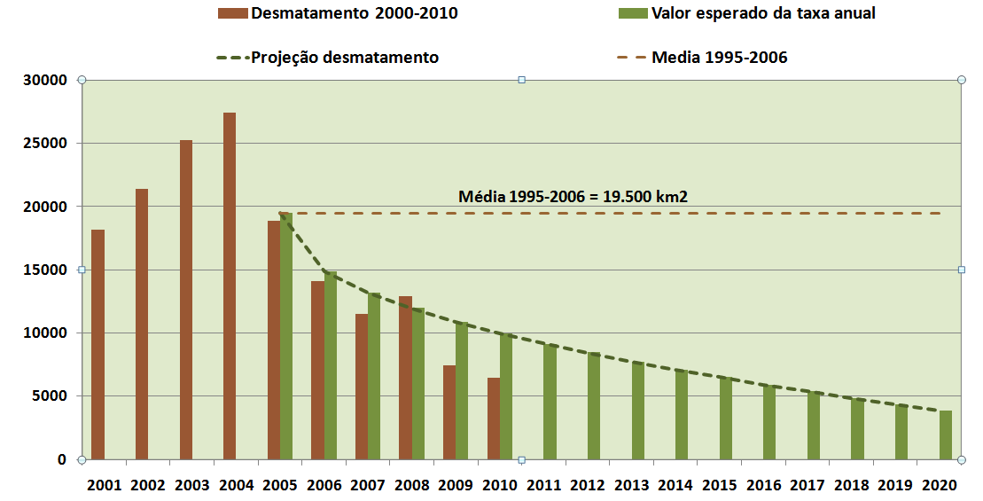
“By 2020, Brazil will reduce deforestation by 80% relative to 2005.” (pres. Lula in Copenhagen COP-15)

Slide 16
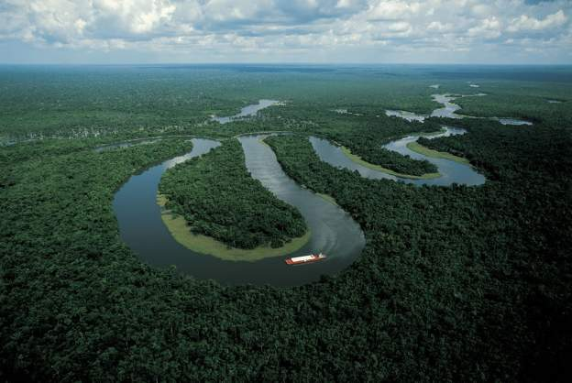
“Deforestation in Brazilian Amazonia is down by a whopping 78% from its recent high in 2004. If Brazil can maintain that progress — and Norway has put a US$1-billion reward on the table as encouragement — it would be the biggest environmental success in decades” (Nature, Rio + 20 editorial)

Slide 17
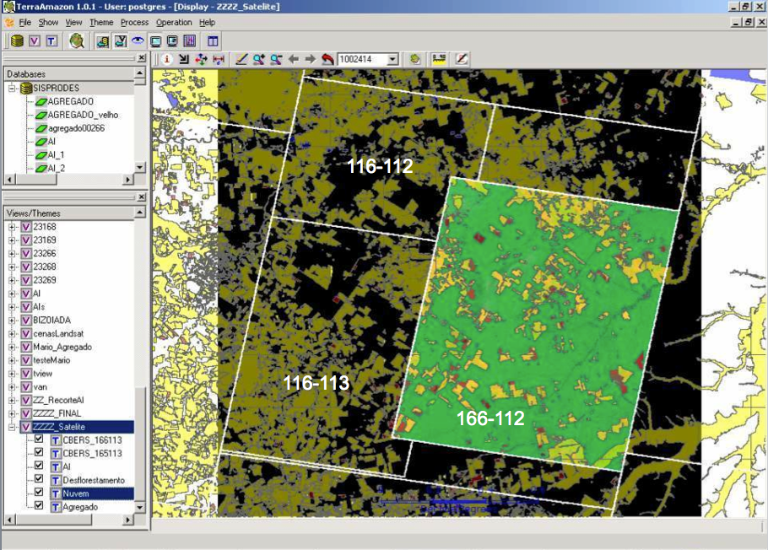
How much it takes to survey Amazonia?
116-112
30 Tb of data
500.000 lines of code
150 man-years of software dev
200 man-years of interpreters
116-113
166-112
Notes:
Cena de maior prioridade utilizou imagens CBRES na s tres principais areas: 166-112, 165-113 2 166-113. Sendo complementada por imagem TM

Slide 18
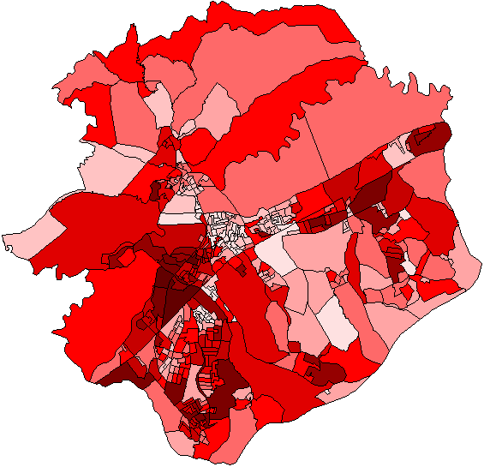
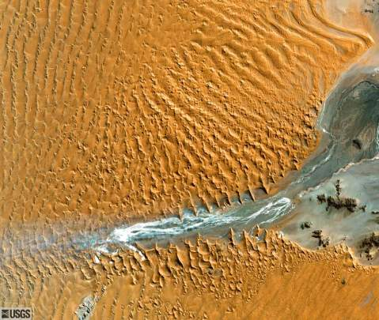

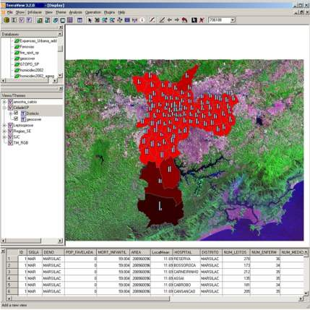
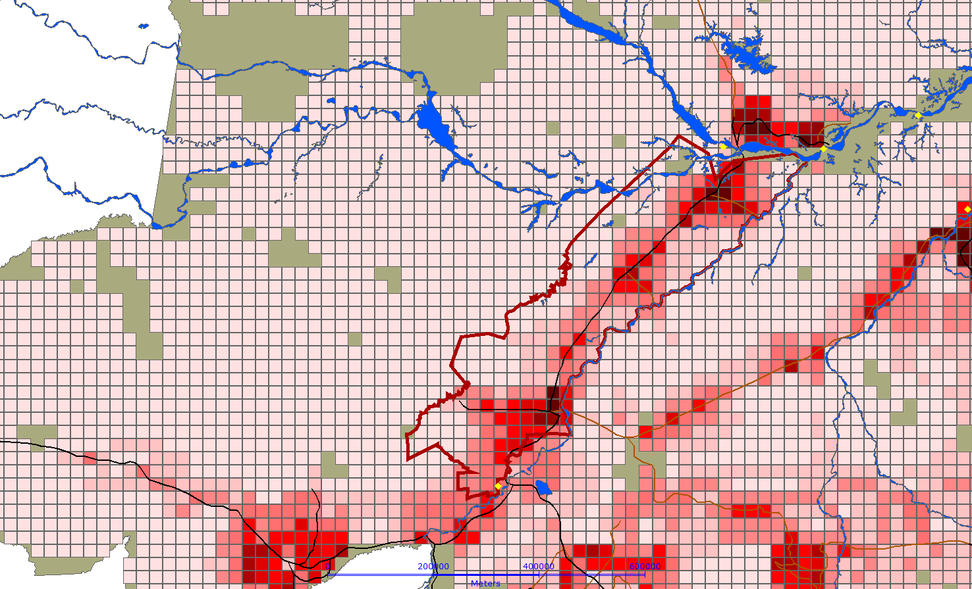
Spatial segregation indexes
Remote sensing image mining
INPE´s strong point: a combination of problem-driven GI research and engineering
GI software: SPRING and TerraView
Land change modelling

Slide 19

Geographical Information Engineering
Chemistry Chemical Eng.
Physics Electrical Eng.
Computer Science Computer Eng.
GI Science GI Engineering
GI Engineering: “The discipline of systematic construction of GIS and associated technology, drawing on scientific principles.”

Slide 20
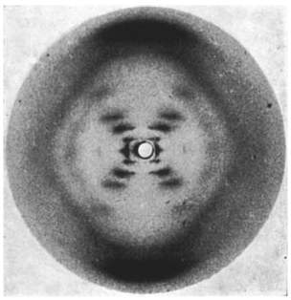
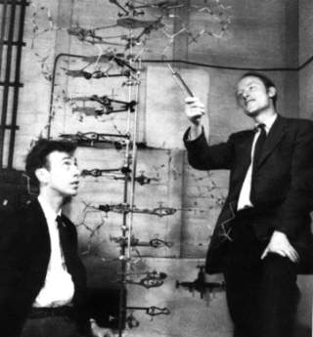
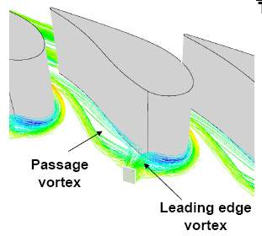

Scientists and Engineers
Photo 51(Franklin, 1952)
Scientists build in order to study
Engineers study in order to build

Slide 21
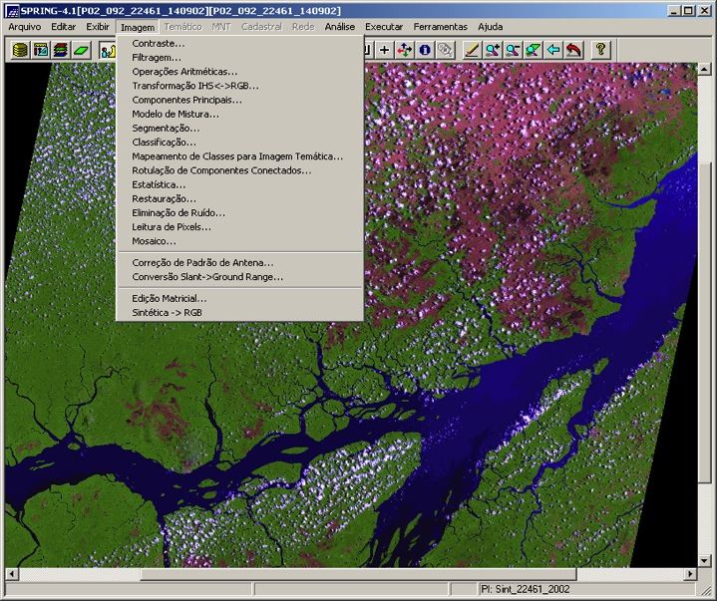
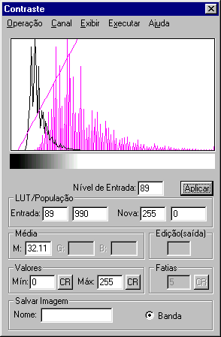
What have we achieved so far (1982-2012)?
Object-oriented desktop GIS (SPRING)
Spatial data analysis (many application areas)
Spatial databases (TerraLib)

Slide 22
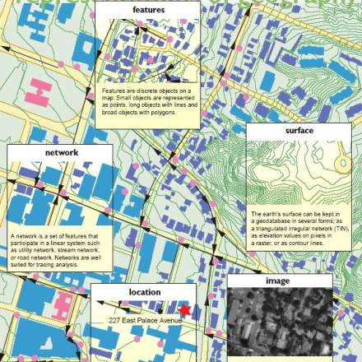
SPRING: Object-oriented modelling for GIS
SPRING´s object-oriented data model (1995)
ARCGIS´s object model (2002)
Spatial
database
contains
contains
Coverage
Geo-object
is-a
is-a
Geo-field
Cadastral
is-a
is-a
Categorical
Numerical
G. Câmara, R. Souza, U. Freitas, J. Garrido, F. Ii, “SPRING: integrating remote sensing and GIS with object-oriented data modelling. Computers and Graphics, 15(6):13-22, 1996.

Slide 23
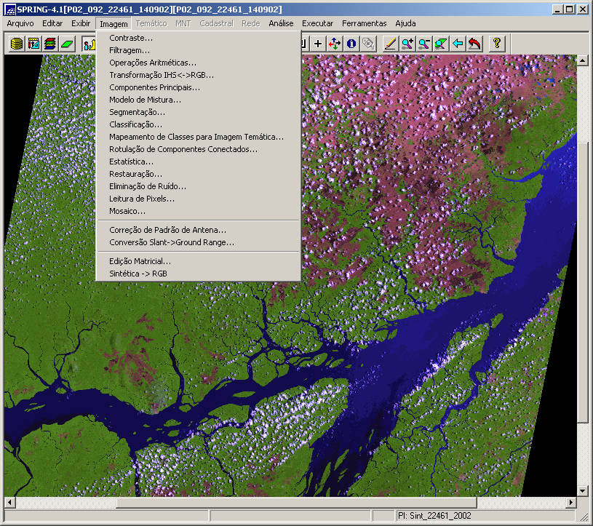
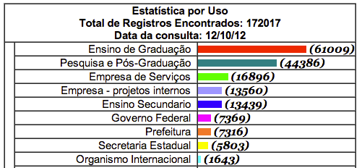
SPRING: still strong after all these years (170.000+ downloads)....

Slide 24
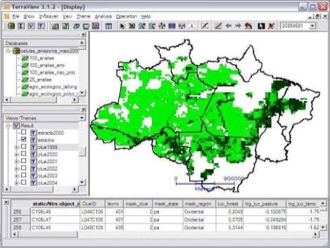
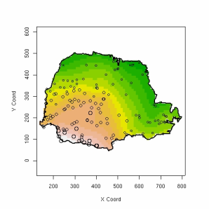
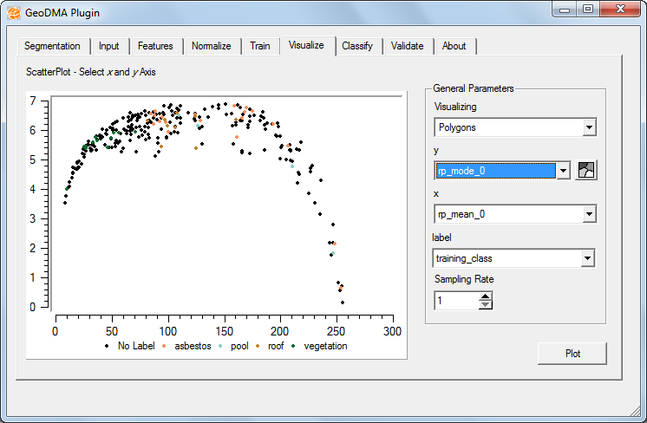
TerraLib: spatio-temporal database as a basis for innovation
TerraView
Modelling (TerraME)
Spatio-temporal
Database (TerraLib)
Statistics (aRT)
Data mining (GeoDMA)
G. Câmara, L. Vinhas et al. “TerraLib: An open-source GIS library for large-scale environmental and socio-economic applications”. In: B. Hall and M. Leahy (eds.), “Open Source Approaches to Spatial Data Handling”. Springer, 2008.

Slide 25
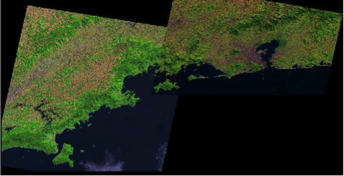
Raster data handling in Terralib
A generic API for multiresolution image handling
B_{j+N,i}
B_{j+2,i}
B_{j+1,i}
B_{j,i}
B_{j,i+1}
B_{j,i+M}
L. Vinhas et al., , “Image data handling in spatial databases”. GeoInfo 2003

Slide 26
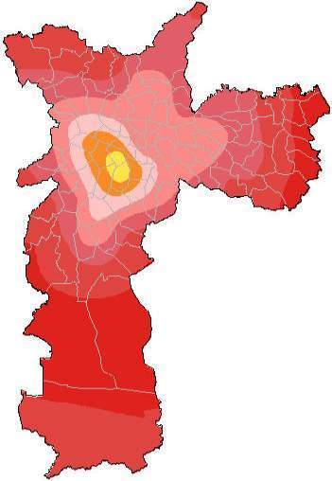
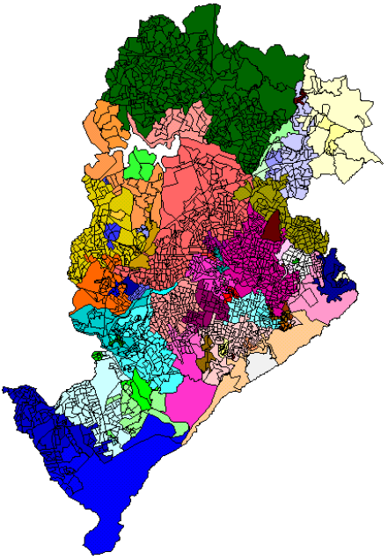
Spatial analysis in SPRING and TerraLib
Geostatistics in SPRING
Regionalization in TerraLib
E. Camargo et al. “Mapping homicide risk using binomial co-kriging and simulation: a case study for São Paulo”, Cadernos de Saúde Pública, 24(7):1493-1508, 2008.
R. Assunção et al. “Efficient regionalisation techniques for socio-economic geographical units using minimum spanning trees”, IJGIS, 20(7):797-812, 2006.

Slide 27
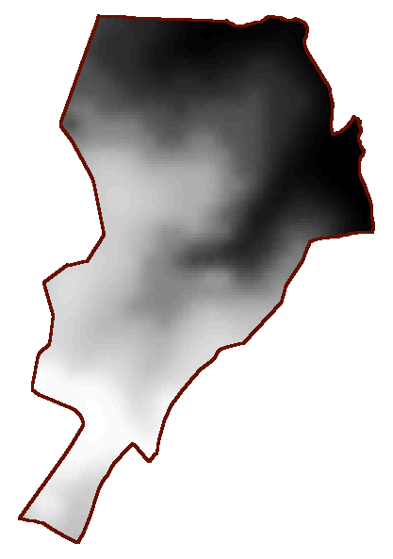
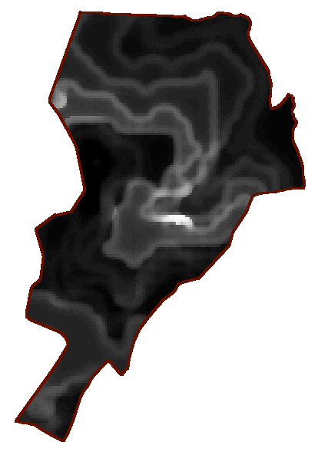

Spatial analysis: dealing with uncertainty
DTM estimation
Uncertainity estimate
894.0
100.3
695.6
5.05
C Felgueiras, “Environmental modelling with uncertainty estimation”, INPE Dr thesis, 1999.
S. Bonisch, L. Assad, G Camara, AV Monteiro, “Representing and propagating uncertainity in soil data”, Revista Brasileira de Ciencia dos Solos, 28(1): 1-32.

Slide 28
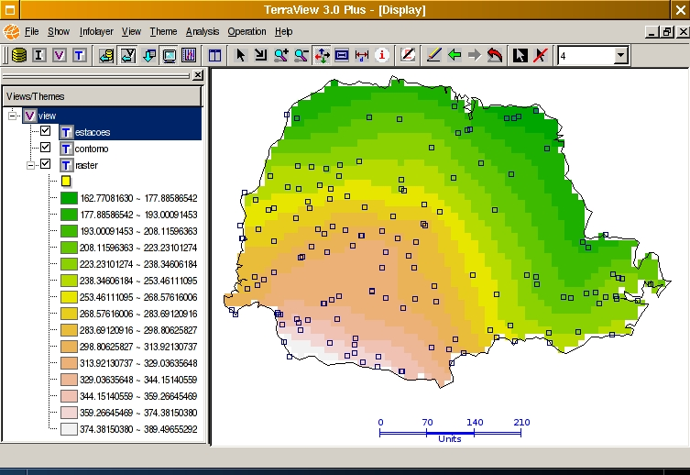
Spatial analysis in SPRING and TerraLib
Spatial segregation indexes
R-Terralib interface
F. Feitosa et al., “Global and local spatial indices of urban segregation”.
IJGIS, 21(3):299-323, 2007.
P. Andrade, P. Ribeiro, “A process and environment for embedding the R software into TerraLib”. GeoInfo 2005.

Slide 29

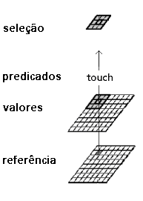
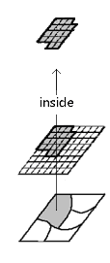
Generalized map algebra
Focal
Zonal
Directional
touch
inside
west, north, ...
J.P. Cordeiro, G. Câmara, F. Almeida, "Yet Another Map Algebra", Geoinformatica, 13(2): 183-202, 2009.
S. Costa, G. Câmara, D. Palomo, “TerraHS: Integration of Functional Programming and Spatial Databases for GIS Application Development”, GeoInfo 2006.

Slide 30
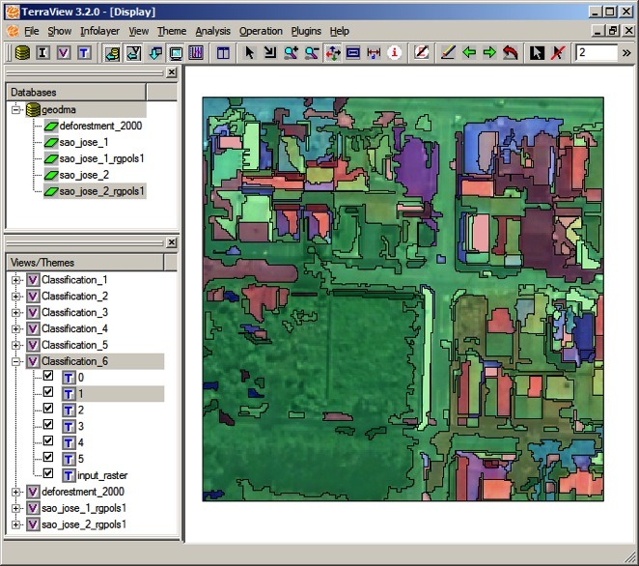
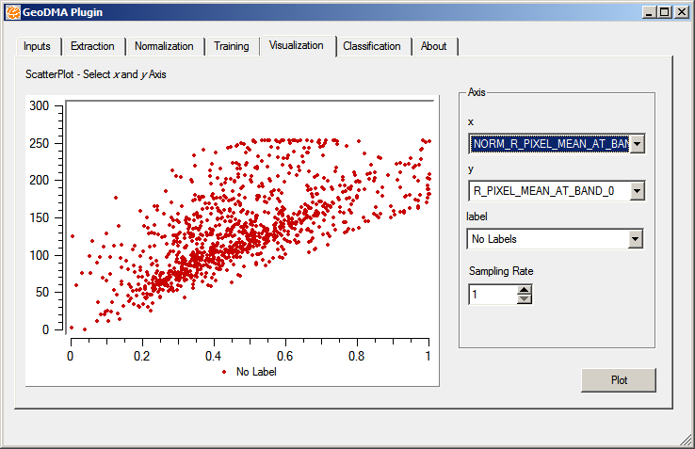
Data mining in images
M. Silva, G. Câmara, I. Escada, R. Souza, “Remote sensing image mining: detecting agents of land use change in tropical forest areas”. Int Journal Remote Sensing, 29 (16): 4803 – 4822, 2008.
T. Korting, L. Fonseca, G. Câmara, “Interpreting images with GeoDMA”. Geographic Object-Based Image Analysis 2010, Ghent, Belgium.

Slide 31
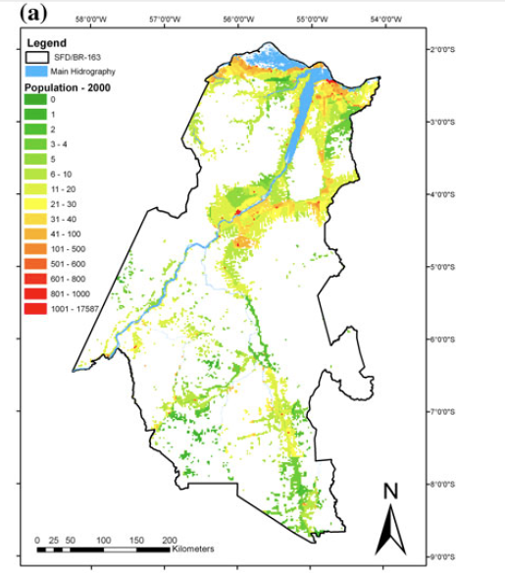
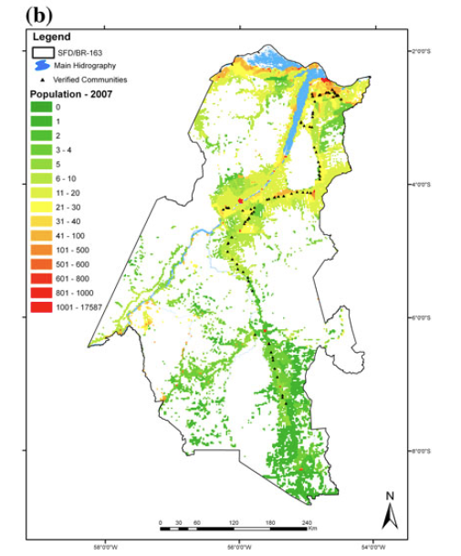
Linking remote sensing and census: population models
S. Amaral, A. Gavlak , I. Escada, A. Monteiro, “Using remote sensing and census tract data to improve representation of population spatial distribution: Case studies in the Brazilian Amazon”. Population and Environment, 34(1): 142-170, 2012.

Slide 32
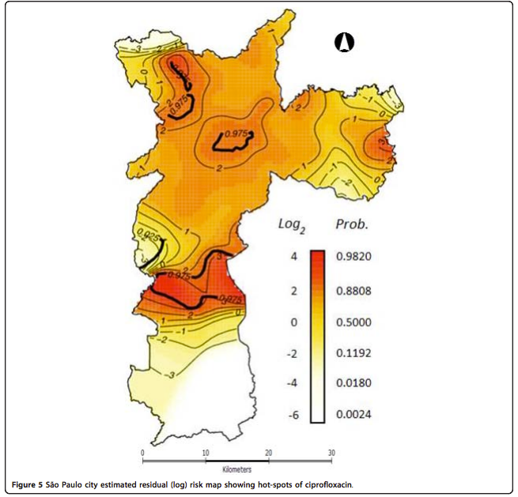
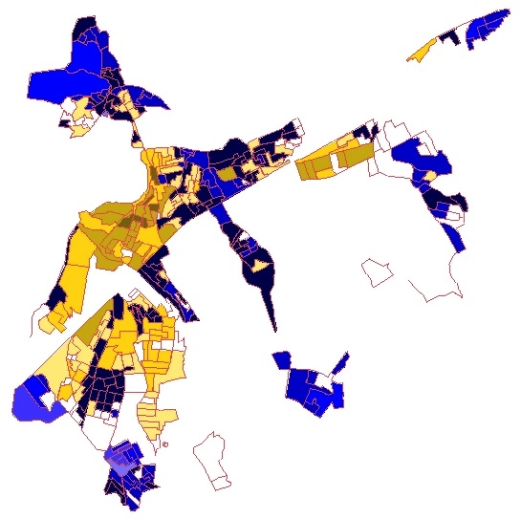
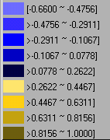
Applications in Health and Public Policies
EXCLUSÃO SOCIAL
(Passo Igual)
Kiffer, E., Camargo, E. et al., “A spatial approach for the epidemiology of antibiotic use and resistance in community-based studies: the emergence of urban clusters of Escherichia coli quinolone resistance in Sao Paulo”, IJ Health Geographics, 10, 2011.
Câmara, Monteiro, et al. “Mapping Social Exclusion/Inclusion in Developing Countries: Social Dynamics of São Paulo in the 90's.” In: D. Jonelle, M. Goodchild (eds.) "Spatially-Enabled Social Science: Examples in Best Practice”, 2004.

Slide 33


GIS for monitoring dengue in Recife
Regis, L. et al, “An entomological surveillance system based on open spatial information for participative dengue control”, Proceedings of the Brazilian Academy of Sciences, 81(4), 2009

Slide 34
TerraAmazon – open source software
for large-scale land change monitoring
116-112
116-113
166-112
Ribeiro V., Freitas U., Queiroz G., Petinatti M., Abreu E. , “The Amazon Deforestation Monitoring System”. OSGeo Journal 3(1), 2008.
Notes:
Cena de maior prioridade utilizou imagens CBRES na s tres principais areas: 166-112, 165-113 2 166-113. Sendo complementada por imagem TM

Slide 35

TerraMA² - Natural Disasters Monitoring and Alert System
Notes:
35

Slide 36




GIS-21: the next generation
mobile devices
augmented reality
Data-rich, mobile-enabled, internet-based
sensor networks
images: everywhere everyday

Slide 37



Earth observation satellites and geosensor webs provide key information about global change…
images: USGS, INPE
…but that information needs to be modelled and extracted

Slide 38




1975
1986
INPE´s proposed R&D agenda in Geoinformatics: modelling change using large geospatial data sets
1992
Notes:
Amazon basin - Rondonia, Brazil

Slide 39
What do we need to bring about?
New technologies for large-scale data handling
New ideas for semantic data description
New ways of representing spatiotemporal data
New techniques for extracting information
New methods for environmental modelling
images: USGS, INPE

Slide 40


“A few satellites can cover the entire globe, but there needs to be a system in place to ensure their images are readily available to everyone who needs them. Brazil has set an important precedent by making its Earth-observation data available, and the rest of the world should follow suit.”

Slide 41





Data is coming... are we ready?
2011
2012
2013
2014
2015
CBERS-3
Amazônia-1
CBERS-4
Landsat-8
Sentinel-2A
Sentinel-2B
ResourceSat-2
ResourceSat-3

Slide 42

Data Access Hitting a Wall
Current science practice based on data download
How do you download a petabyte?

Slide 43
Data Access Hitting a Wall
Current science practice based on data download
How do you download a petabyte?
You don’t! Move the software to the archive

Slide 44

Scientific Data Management in the Coming Decade (Jim Gray, 2005)
Next-generation science instruments and simulations will produce peta-scale datasets. Such peta-scale datasets will be housed by science centers that provide substantial storage and processing for scientists who access the data via smart notebooks. The procedural stream-of-bytes-file-centric approach to data analysis is both too cumbersome and too serial for such large datasets. Database systems will be judged by their support of common metadata standards and by their ability to manage and access peta-scale datasets.

Slide 45








Virtual Observatory
If data is online, internet is the world’s best telescope (Jim Gray)

Slide 46

Where is scientific database technology going?

Slide 47

From tables to arrays: the new generation of scientific DBMS
image
date
sensor
selection,
projection,
join
SELECT *
FROM images
WHERE date=“today”
relation
(table)
relational
algebra
SQL
language
SELECT Mean (A.B)
FROM Array A
Spatial queries,
Math operations
Scientific
data
Array
Algebra
AQL
language
Notes:
7

Slide 48
Stage 1 – Personal GIS (SPRING)
User interface
Database creation
Database access
Analysis
Local
database

Slide 49

Stage 2 – Corporate database (TerraLib 4.x)
User interface
Database access
Analysis
Corporate
database
Database creation

Slide 50
Stage 2 – Corporate database (TerraLib 4.x)
Good: long-term data preservation
data sharing inside the lab
reusable corporate software
Bad: substantial costs on data admin
little outside data sharing
User interface
Database access
Analysis
Corporate
database
Database creation

Slide 51

Stage 3 – Multidatabase access (Terralib 5+)
Modelling
Data discovery
Data access
Analysis
Data
source
Data
source
Data
source
Remote Analysis
Remote Analysis
Remote Analysis

Slide 52
Stage 3 – Multidatabase access (Terralib 5+)
Modelling
Good: long-term data preservation
shared costs on data admin
access to large external database
Bad: rewrite software for cloud processing
finding data is a major problem
Data discovery
Data access
Analysis
Data
source
Data
source
Data
source
Remote Analysis
Remote Analysis
Remote Analysis

Slide 53
What do we need to bring about?
New technologies for large-scale data handling
New ideas for semantic data description
New ways of representing spatiotemporal data
New techniques for extracting information
New methods for environmental modelling
images: USGS, INPE

Slide 54

Representing concepts is hard
What do we know we don’t know?
vulnerability? climate change? poverty?
image: WMO

Slide 55

We’re bad at representing meaning
What do we know we don’t know?
Representing concepts is hard
degradation
deforestation? degradation? disturbance?

Slide 56

Geosemantics: representing concepts is hard
vulnerability
degradation
image: Y.A. Bertrand

Slide 57


Geosemantics: representing concepts is hard
sustainability
resilience
image: Y.A. Bertrand
Human-environmental models need to describe complex concepts (and store their attributes in a database)

Slide 58

Representing change is very hard
What do we know we don’t know?
images: USGS

Slide 59

Describing events and processes is very hard
What do we know we don’t know?
When did the flood occur?

Slide 60

GEOSS
accesses
GEO Web Portal
searches
User
searches
GEOSS
registry
GEOSS
Clearinghouse
accesses
registers
Catalogues
Offerors
references
Notes:
This explains the relationship of registries and Clearinghouse. Numbers imply an order to the interactions.

Slide 61
GEOSS
accesses
GEO Web Portal
searches
User
searches
There is not a uniform, consistent way that data are registered, stored, and accessed in GEOSS (Evaluation Report, 2011)
GEOSS
registry
GEOSS
Clearinghouse
accesses
registers
Catalogues
Offerors
references
Notes:
This explains the relationship of registries and Clearinghouse. Numbers imply an order to the interactions.

Slide 62
Improving GEOSS with brokers
catalogue
GEOSS
catalogue
Broker
catalogue
catalogue
source: R.Shibasaki

Slide 63

Data discovery: the whole earth catalogue
?
answers
questions
What data exists about Quixeramobim?
When did this flood happen?
Where do I find data on forest degradation?

Slide 64
Semantic data discovery in Terralib 5+?
Modelling
Data discovery
Data access
Analysis
internet
Data
source
Data
source
Data
source
Remote Analysis
Remote Analysis
Remote Analysis

Slide 65

Linking INPE’s data to a semantic search engine
EuroGEOSS broker
Some experiments linking EuroGEOSS broker with INPE’s data base show potential (credits to Lubia Vinhas)… but there’s much to be done…

Slide 66
What do we need to bring about?
New technologies for large-scale data handling
New ideas for semantic data description
New ways of representing spatiotemporal data
New techniques for extracting information
New methods for environmental modelling
images: USGS, INPE

Slide 67

From observations to events
An observation is a measure of a value in a location in space and a position in time

Slide 68
Inherent structure of geoinformation (Sinton, 1978)
Fixing space, controlling time, and measuring value:
a time series.
Fixing value, controlling time, and measuring space: a trajectory.
Fixing time, controlling space, and measuring value: a coverage.

Slide 69

From observations to events
K. Ferreira, G. Câmara, A. Monteiro, R. Pereira, “An algebra for spatiotemporal data: from observations to events” (under review).

Slide 70

Time Series
Continuous variation of a property value over time
(water table depth sensors) in a fixed location

Slide 71


Moving objects have trajectories
trajectory : represents how locations or boundaries of an object evolve over time.

Slide 72
images: USGS
Coverage: variation of a property within a spatial extent at a time.
  Two-dimensional grids whose values change.
  Samples from fixed or moving geosensors.

Slide 73

Objects and events
images: Reuters
The coast of Japan is an object
The 2011 Tohoku tsunami was an event

Slide 74

objects exist, events occur
Mount Etna is an object
Etna’s 2002 eruption was an event

Slide 75

Object (GPS buoy) + event (tsunami)

Slide 76

Land cover objects
LAND COVER OBJECTS
Boundaries determined by agreement about land categories (geometry, topology and properties change)

Slide 77

Trajectories of change in land cover objects
Reconstructing the history of a landscape
J. Mota, G. Câmara et al, "Case-based reasoning for eliciting the evolution of geospatial objects”, COSIT 2009.

Slide 78


The event data type
An event is an individual episode with a beginning and end, which define its character as a whole.
An event does not exist by itself. Its occurrence is defined as a particular condition of one spatiotemporal type.
Notes:
INPE has a project called PROARCO responsible for monitoring fire spots in South America, In this application, each fire is presented by its location and the time instant when it was detected.
This picture is an example of the detected fires in a Brazilian state called Pará in august 2003.
The second demand is related to a project responsible for monitoring the Amazon deforestation called PRODES. In this application, each deforested area is represented by a polygon that limits the deforested region and the time when it was detected.

Slide 79


When did the large flood occur in Angra?
images: O Estado de São Paulo

Slide 80
When did the large flood occur in Angra? When precipitation was > 10mm/hour for 5 hours
Coverage set (15-min precipitation grid)
⬇
Event (precipitation > 10 mm/hour for 5 hrs)
Notes:
INPE has a project called PROARCO responsible for monitoring fire spots in South America, In this application, each fire is presented by its location and the time instant when it was detected.
This picture is an example of the detected fires in a Brazilian state called Pará in august 2003.
The second demand is related to a project responsible for monitoring the Amazon deforestation called PRODES. In this application, each deforested area is represented by a polygon that limits the deforested region and the time when it was detected.

Slide 81
What do we need to bring about?
New technologies for large-scale data handling
New ideas for semantic data description
New ways of representing spatiotemporal data
New techniques for extracting information
New methods for environmental modelling
images: USGS, INPE

Slide 82

Matching visual interpretation is very hard!
Ponto 115 e 117 (S 11,93º ; W 54,46º)(S 11,92º; W 54,41º)
images: INPE

Slide 83

Information extraction from image time series
“Remote sensing images provide data for describing landscape dynamics”
(Câmara et al., "What´s in An Image?“ COSIT 2001)
data source: B. Rudorff (LAF/INPE)

Slide 84

MODIS time series describe changes in land use
Land use change by sugarcane expansion
data source: B. Rudorff (LAF/INPE)

Slide 85
What do we need to bring about?
New technologies for large-scale data handling
New ideas for semantic data description
New ways of representing spatiotemporal data
New techniques for extracting information
New methods for environmental modelling

Slide 86

Slides from LANDSAT
images: USGS
Modelling Human-Environment Interactions
How do we decide on the use of natural resources?
What are the conditions favoring success in resource mgnt?
Can we anticipate changes resulting from human decisions?
Aral Sea
1973
1987
2000

Slide 87



TerraME: Computational environment for developing human-environment models
Cell Spaces
www.terrame.org
T. Carneiro, P. Andrade, G. Câmara, A. Monteiro, R. Pereira, “TerraME: an extensible toolbox for modeling nature-society interactions” (under review).
Notes:
Tiago Garcia de Senna Carneiro, “Nested-CA: A Foundation for Multiscale Modelling of Land Use and Land Cover Change”. PhD Thesis in Computer Science, INPE, 2006.

Slide 88




Modelling human-environment interactions
  What models are needed to describe human actions?

Slide 89




Clocks, clouds or ants?
Clouds: statistical distributions
Clocks: deterministic equations
Ants: emerging behaviour

Slide 90
Statistical-based land use models
Driving factors of land use/cover change QUANTITY (at time t)
Driving factors of land use/cover change LOCATION (at time t)
Feedback on spatial
drivers
Rate and magnitude of change
for each land use at time t
(DEMAND)
Cell suitability
for each land use at time t
(POTENTIAL)
Feedbacks
Bottom-up calculation
Top-down constraint
Allocation of change combining demand and cell potential at time t
(ALLOCATION)
Land use
at time t-1
Time Loop
Land use map at time t
sources: P. Verburg, A.P. Aguiar

Slide 91


Statistics: Assessment of land use drivers
Land use models are good at allocating change in space. Their problem is: how much change will happen?
A. Aguiar, G. Câmara, I. Escada, “Spatial statistical analysis of land-use determinants in the Brazilian Amazon”. Ecological Modelling, 209(1-2):169–188, 2007.
G. Espíndola, A. Aguiar, E. Pebesma, G. Câmara, L. Fonseca, “Agricultural land use dynamics in the Brazilian Amazon based on remote sensing and census data”, Applied Geography, 32(2):240-252, 2012.

Slide 92

GLOBIOM: a global model for projecting how much land change could occur
source: A. Mosnier (IIASA)

Slide 93

GLOBIOM: land use types and products
source: A. Mosnier (IIASA)

Slide 94



REDD-PAC: land use policy assessment
GLOBIOM, G4M, EPIC, TerraME
TerraLib
Land use data and drivers for Brazil
Model cluster - realistic assumptions
Globally consistent policy impact assessment
Information infrastructure

Slide 95


Complex adaptive systems: humans as ants
Systems composed of many interacting parts that evolve and adapt over time.
Organized behavior emerges from the simultaneous interactions of parts without any global plan.

Slide 96


Computing is also a natural science
Computing studies information flows in natural systems...
...and how to represent and work with information flows in artificial systems
Notes:
96

Slide 97
Agent-Based Modelling: Computing approaches to complex systems
Representations
Goal
Communication
Communication
Action
Perception
Environment
source: Nigel Gilbert

Slide 98




Modelling collective spatial actions
Space Agent
Agent Space
source: Benenson and Torrens, “Geographic Automata Systems”, IJGIS, 2005
(but many questions remain...)

Slide 99

Modelling collective spatial actions
S. Costa, A. Aguiar, G. Câmara, T. Carneiro, P. Andrade, R. Araújo, “Using institutional arrangements and hybrid automata for regional scale agent-based modelling of land change” (under review), 2012.

Slide 100
Conclusions
Data-intensive geoinformatics is a new research frontier that is fit for INPE’s group
We can develop new concepts and models to describe spatial change and help Brazil improve its environmental sustainability

